Slide 1


CAPS Survey Summary Form
& Online Financial plan
Notes:
Hello and welcome. Thank you for taking the time to attend this webinar today. I am glad you were able to make it.
We will be covering the CAPS SSF, which opens August 1st (that is in 2 weeks) and the Online Financial Plan which is due September 9th (in about 7 weeks).
I am the CAPS Information Services Coordinator, from the Center for Environmental and Regulatory Information Systems at Purdue University.

Slide 2

Communication
Your Team:
NOM
SSC PSS
SPHD SPRO
CAPSIS
National Operations Manager – NOM
State Plant Regulatory Officials – SPRO
State Plant Health Director – SPHD
State Survey Coordinator – SSC
Pest Survey Specialist – PSS
CAPS Information Services - CAPSIS
Notes:
The first thing I want to say is that communication is very important when you are planning your surveys.
You will likely be in contact with everyone on your team, including myself, if you need me.
Please talk openly to your team and reach out for any reason.

Slide 3
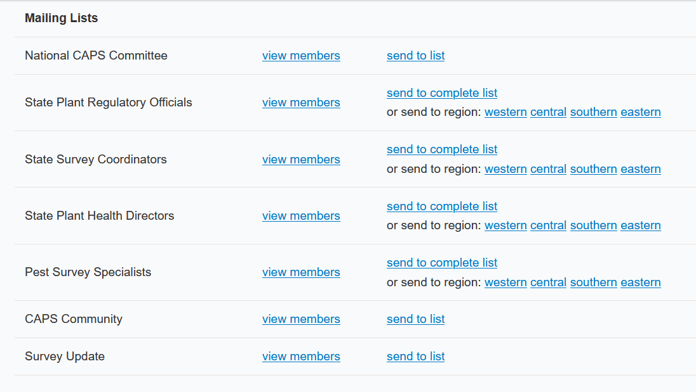
Communication
Phone Numbers and Emails Can Be Found in the Online Directories:
https://caps.ceris.purdue.edu/caps-directories
NOM
SSC PSS
SPHD SPRO
CAPSIS
Notes:
The fastest way I know, to find contact information for CAPS members, in any region or state, is to go to the directories on the CAPS site.
Here is the link, but it can also be located under the About Tab on the CAPS Resource and Collaboration website.
You will need to login to view the table at the bottom of the page.
There you can select which group you are interested in by clicking “view members”.

Slide 4
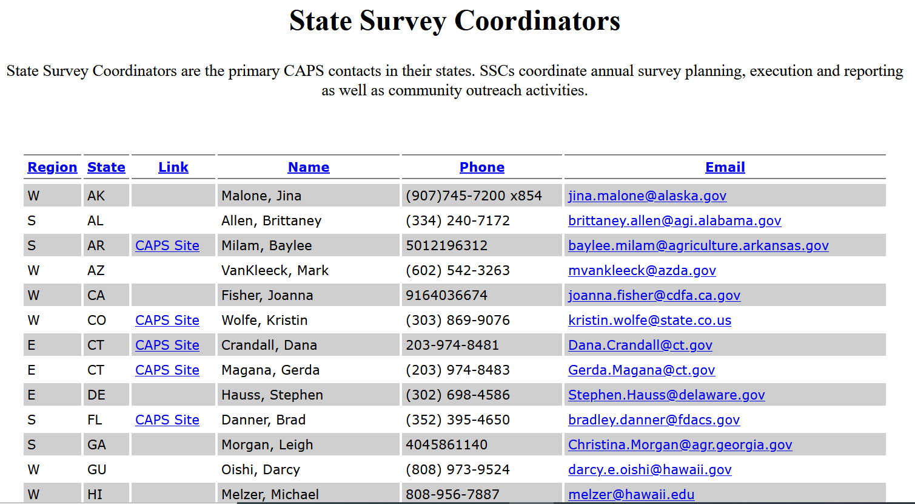
Communication
Phone Numbers and Emails Can Be Found in the Online Directories:
https://caps.ceris.purdue.edu/caps-directories
NOM
SSC PSS
SPHD SPRO
CAPSIS
Notes:
The list is sorted alphabetically by state.
So, for example, if you wanted to call or email the SSC in Guam, you would be able to find their information very quickly here.
Which reminds me, if you ever find that your information is out of date, please let me know how you would like it updated.

Slide 5
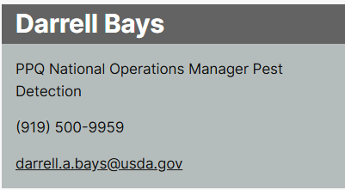
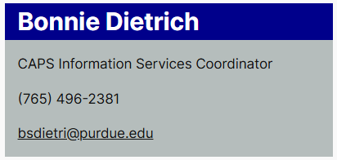
Communication
This is the contact information for the NOM and CAPSIS.
NOM
SSC PSS
SPHD SPRO
CAPSIS
Notes:
And here is the contact information for the NOM, Darrell, and the Coordinator at CAPSIS, and myself.
Two things to note here:
First, the email for CAPSIS is CAPSIS@purdue.edu, but you could also email NAPIS@purdue.edu, and you will reach James and me.
Second, I have different phone hours. That’s because we live in different times zones, much like all of you.

Slide 6

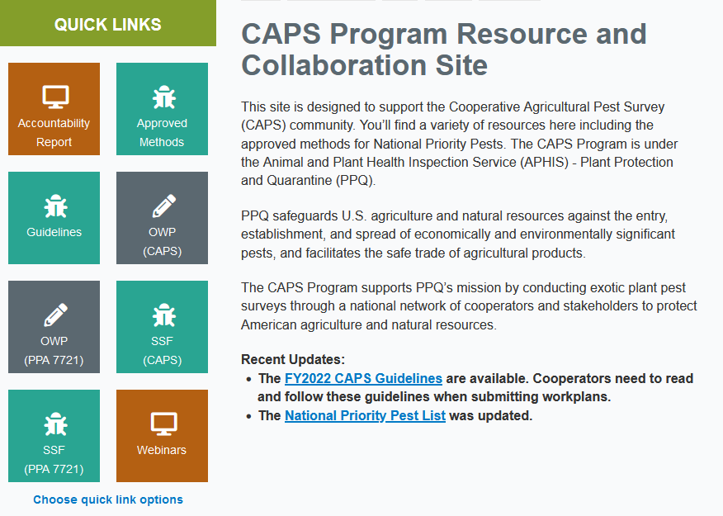

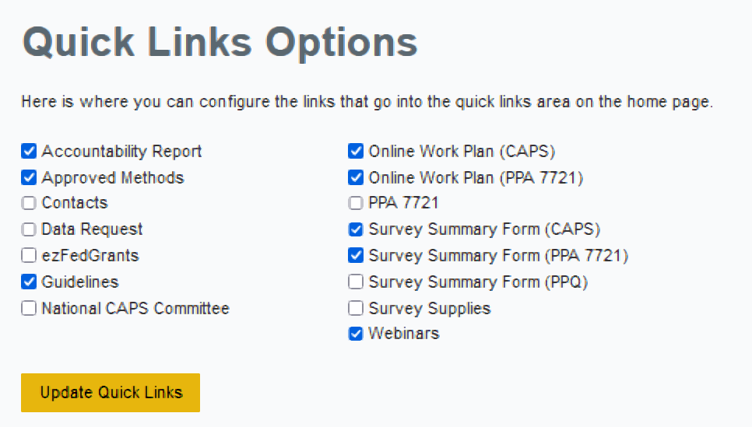
CAPS Program R&C Site
Notes:
The next thing I want to talk about is navigating the CAPS Program Resource and Collaboration Website.
I strongly encourage you, the next time you login, to find the “Choose Quick Links Options” area at the bottom of these colored squares and to click on it.
When you do that, this box will pop up allowing you to select the areas of the website you use most often.
Then, the links are added to your home screen and you will not need to remember how to get to them through the tabs at the top of the page.

Slide 7
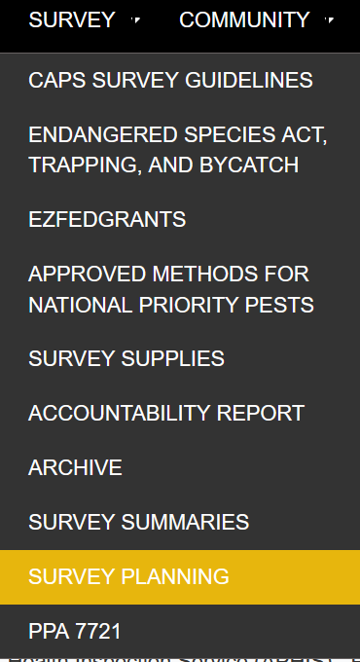
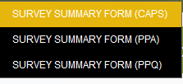
Location of Survey Summary Form & Online Financial plan on the CAPS Site
SURVEY
SURVEY PLANNING
SURVEY SUMMARY FORM (CAPS)
Notes:
But, I will show you how to get to the CAPS Survey Summary Form anyways.
There are five links at the top of the page here.
Find the one that says Survey, then find Survey Planning, and finally Survey Summary Form.

Slide 8
Work Plan Process for CAPS Surveys
  For Work Plans:
  The narrative portion will be done in a
    Microsoft Word Template, available for download on the CAPS R&C website.
  The financial portion for Combined Survey
    and Infrastructure will still be done in the
    Online Financial Plan Interface then exported to Word.
Notes:
And here is something important work plans:
The financial portion for Combined Survey
and Infrastructure will still be done in the
Online Financial Plan Interface then exported to Word.
Financial details of both the Infrastructure and Survey Work Plans must be entered into the online interface.

Slide 9
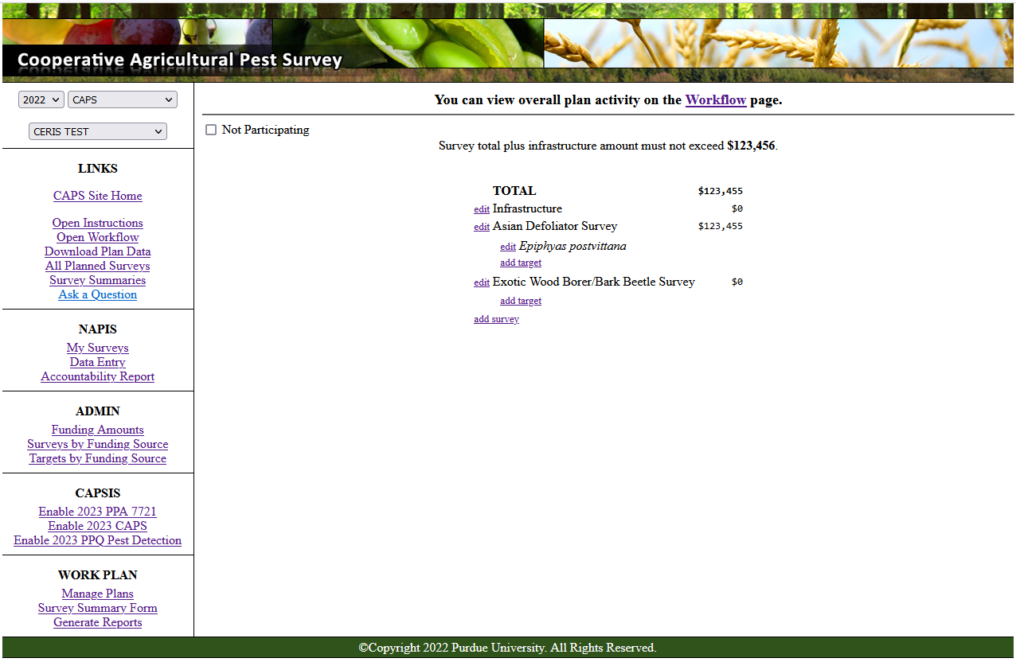

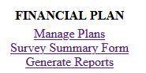
Survey Summary Form
Not Participating?
Check the box at the top of this section
Need Access or Help?
Contact CAPSIS: CAPSIS@purdue.edu
Notes:
This is what the Survey Summary Form page looks like.
SSCs will coordinate all survey entries into the SSF, including for non-traditional cooperators.
When you get here, the first step is to use the drop down menus in the top left field of your screen.
Use these to set the correct Year, Funding Source, and the correct State for the surveys you are entering.

Slide 10
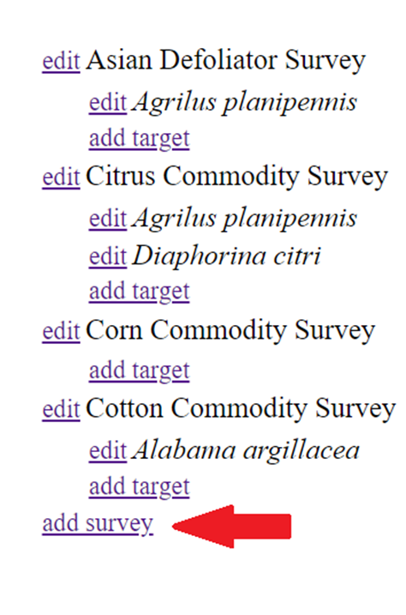
Survey Summary Form
Notes:
Once you have the correct year, funding source, and state selected, click on Add Survey and begin completing the necessary sections.
A quick note here:
As a survey is entered into the SSF, it unlocks the Financial Plan in the online work plan interface.

Slide 11
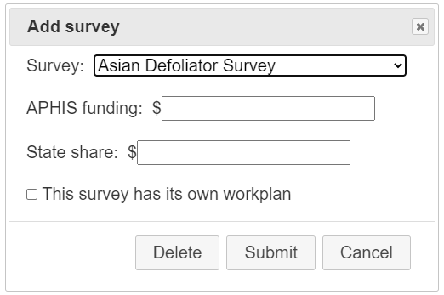
Survey Summary Form
Notes:
For the Survey Plan, the default in the SSF’s “Add Survey” section is the Combined Survey Work Plan.
Most states now use the Combined Survey Work Plan.
Fill out the SSF individually by each survey, regardless of whether you pursue a Combined Survey work plan or Individual Work Plans.

Slide 12
Survey Summary Form
Notes:
Some states may still need to submit more than one survey work plan because there are multiple cooperators needing separate work plans/agreements.
For states that have previously needed individual work plans, your interface is set up with Individual Work Plan as an option.
You will see this box that you need to check.
If you didn’t need an Individual Work Plan in the past, but need one now, contact your ADODR and NOM.

Slide 13
Survey Summary Form
Notes:
To access the Online Interface, for the Financial Plan portion, go to the lower left-hand corner of the Survey Planning page, and click on “Manage Plans”:
You can do this any time after the SSF has been started, as in after one Survey Name has been selected, even if you have not filled out your other survey details yet.

Slide 14
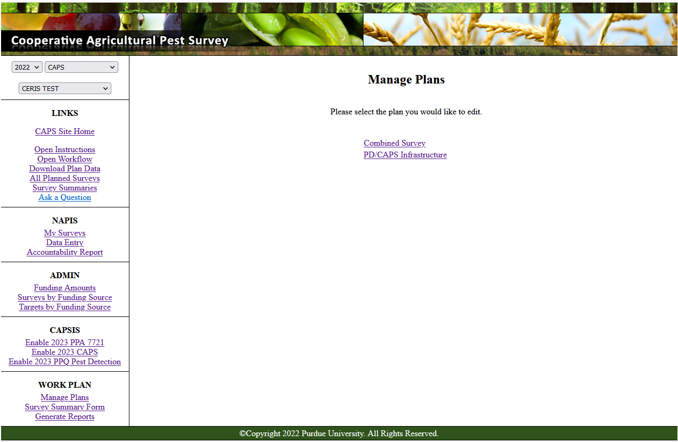
Online Financial plan
Choose which Work Plan you would like to edit.
Combined Survey
Infrastructure
Notes:
This is the next step to get to your Online Financial Plan.
Choose which Work Plan you would like to edit.
Your Combined Survey Workplan
Or your Infrastructure Work Plan

Slide 15
Online Financial plan
There will be an Infrastructure link available if your state receives an Infrastructure agreement.
If your state does not receive an Infrastructure agreement, there should not be an Infrastructure link in the online interface.
Notes:
There will be an Infrastructure link available if your state receives an Infrastructure agreement.
If your state does not receive an Infrastructure agreement, there should not be an Infrastructure link in the online interface.

Slide 16
Online Financial plan
The SSF does not need to be started to work on the Infrastructure Financial Plan.
The Infrastructure Financial Plan in the online interface can be completed before, after, or at the same time as the Survey Work Plan.
Notes:
The SSF does not need to be started to work on the Infrastructure Financial Plan.
The Infrastructure Financial Plan in the online interface can be completed before, after, or at the same time as the Survey Work Plan.

Slide 17
Online Financial plan
  For Combined Survey Work Plans
  The Financial Plan does not need to be broken down by survey. It is combined.
  For Individual Survey Work Plans
  Each work plan needs its own Financial Plan.
  Each work plan will result in a separate agreement.
Notes:
For Combined Survey Work Plan
The Financial Plan does not need to be broken down by survey. It is combined.
For Individual Survey Work Plan
Each work plan needs its own Financial Plan.
Each work plan will result in a separate agreement.

Slide 18
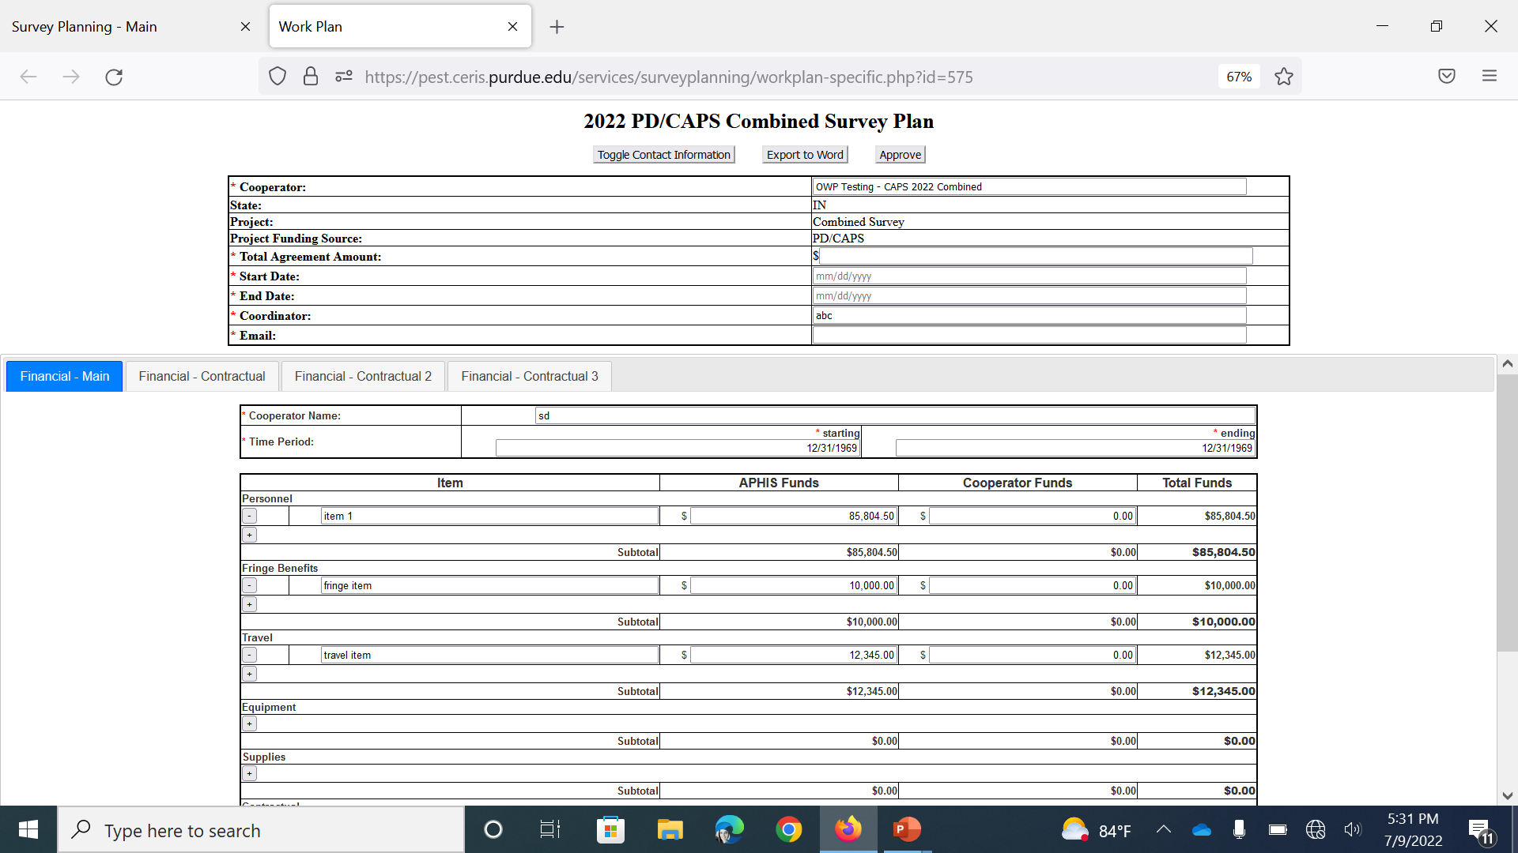
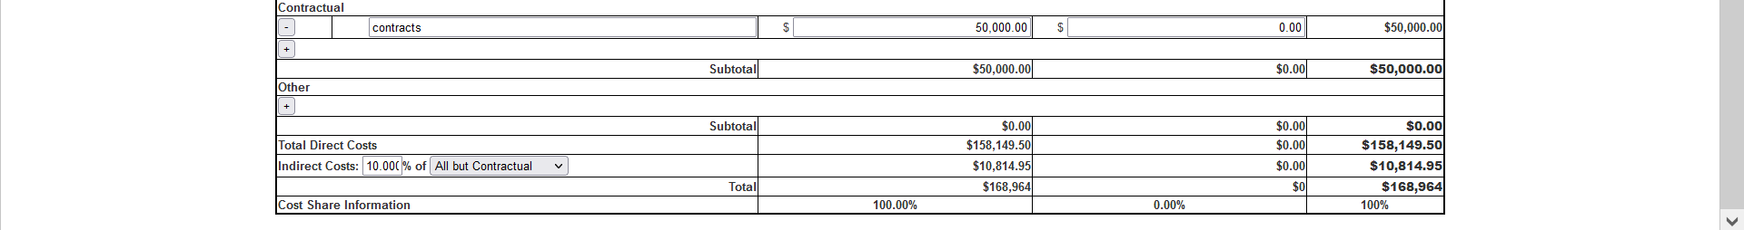
Online Financial plan
Notes:
Auto-fill will pre-fill the State; Cooperator ; Coordinator, etc.
Fill in the remaining fields: Total Agreement Amount; Start/End Date; and Your Email.
Then Use the Toggle function to Collapse the Contact Information

Slide 19
Online Financial plan
Notes:
This is what it looks like once the toggle button is pushed. You basically have more viewing space on the page because that contact section disappears… UP.
The next thing you want to do is to select which Financial Plan you are entering and start filling it in.
Your work will be saved every minute.

Slide 20
Calculation Removed from Indirect Rate Row
  The calculation feature has been removed from the Indirect Rate row in the online interface.
  This was the section that was causing the most errors.
  The calculations have been left in the other sections.
Notes:
For the Financial Plan, the calculation feature has been removed from the Indirect Rate row in the online interface.
This was the section that was causing the most errors.
The calculations have been left in the other sections and will add to the total.

Slide 21
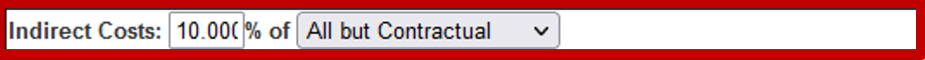
Online Financial plan
Notes:
For the Indirect Costs:
Type in your percentage rate.
Choose what the Indirect Cost Rate is applied to from the dropdown menu.
Enter the dollar amount
The amount will not be auto calculated in this row, but it will be used to calculate the Overall Total

Slide 22
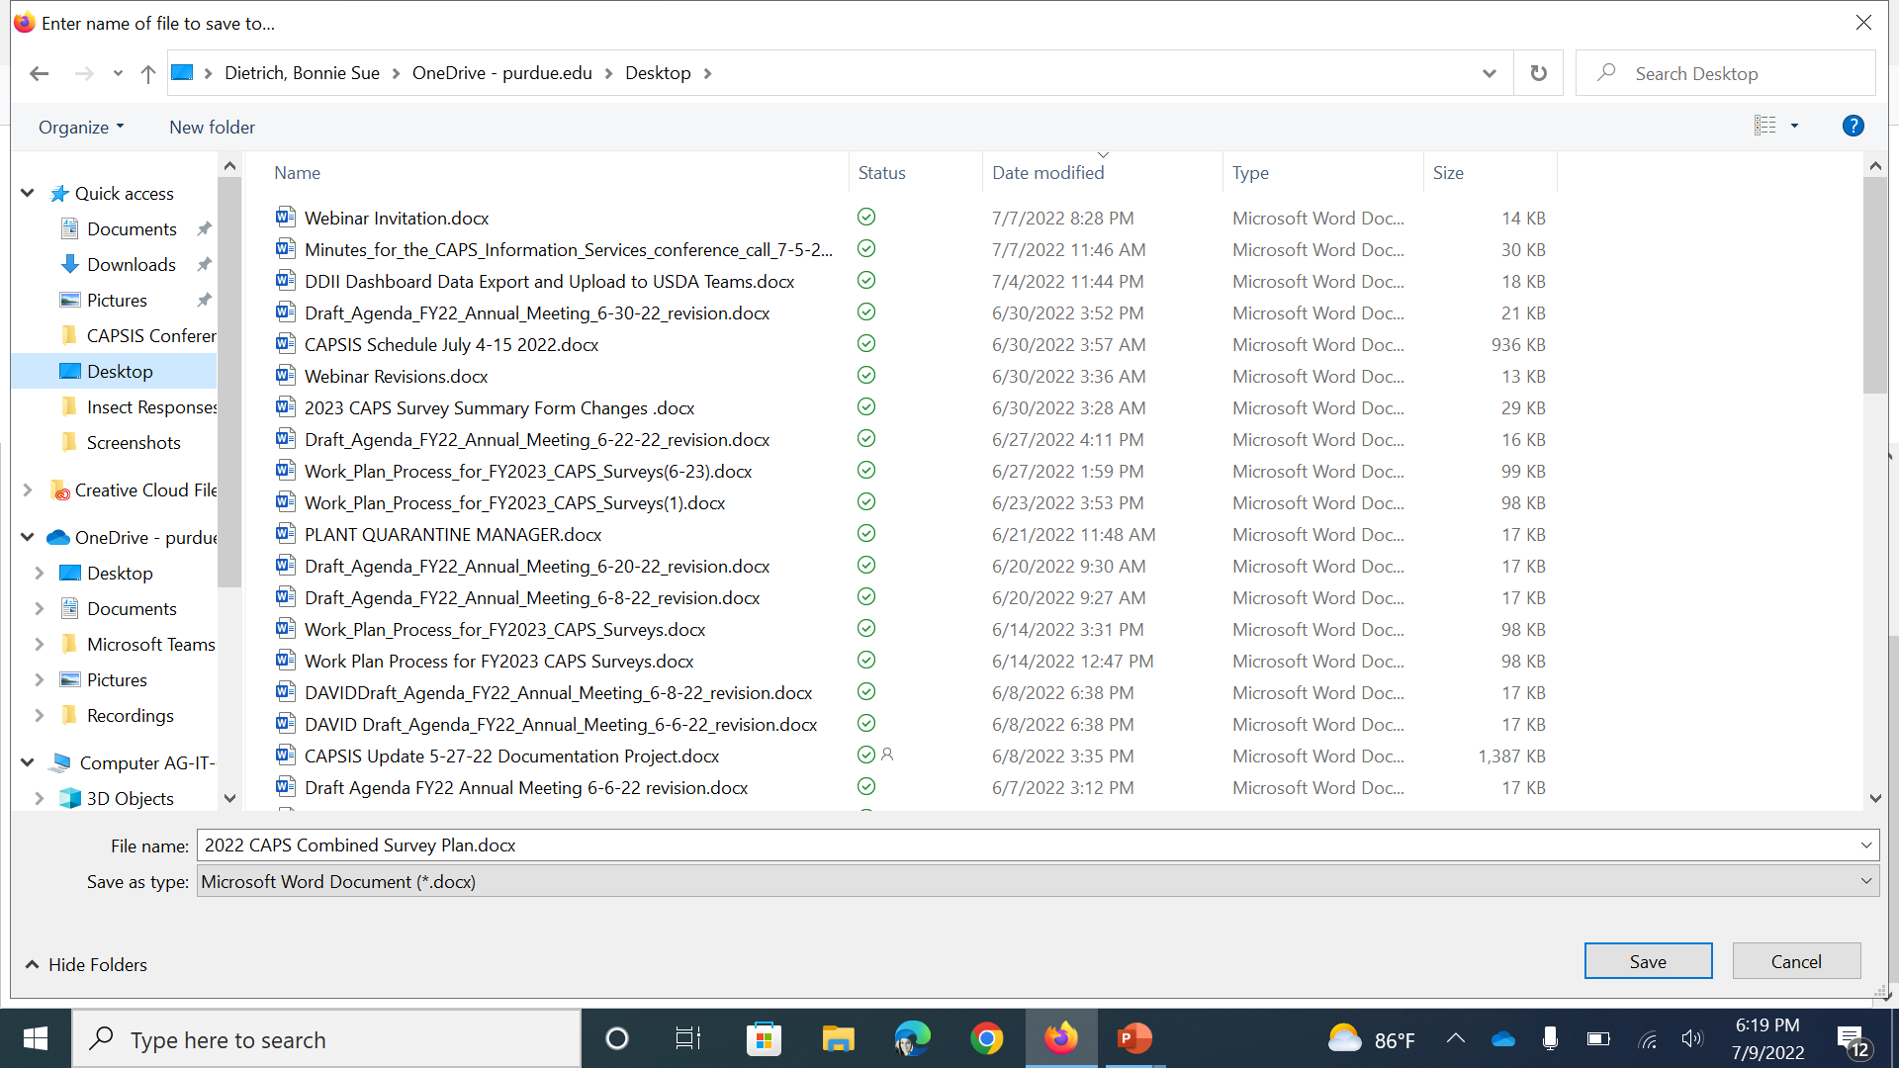
Online Financial plan
Notes:
When you are finished entering your financial data, and you click on the Export to Word button, you’ll be able to name and save it on your computer.
The Export to Word button is here, at the top of the page.

Slide 23
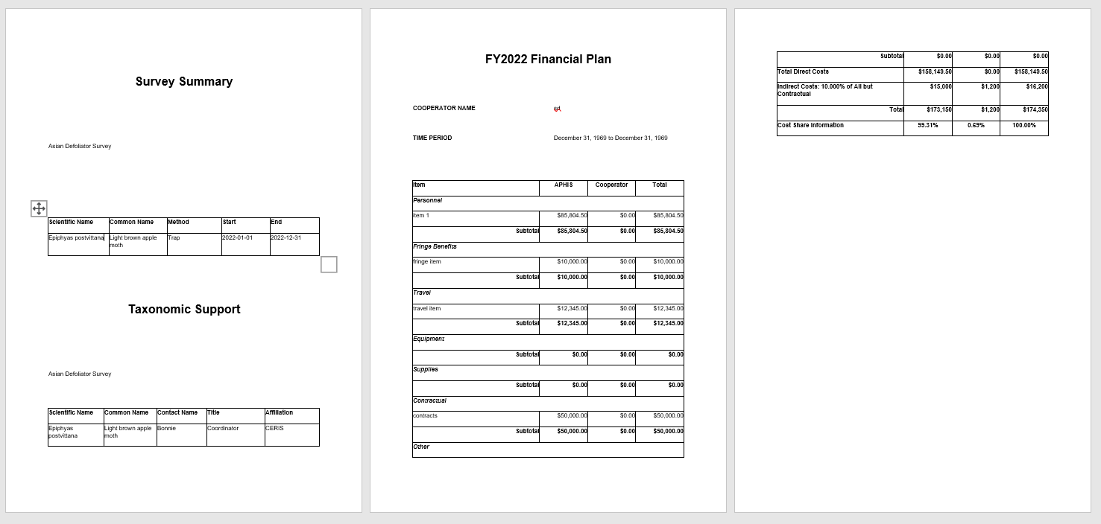
Financial Section (word EXPORT)
Notes:
It will look something like this.

Slide 24

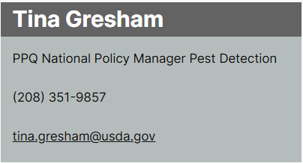
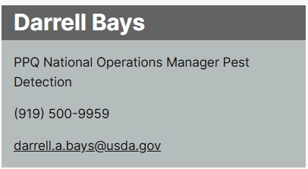
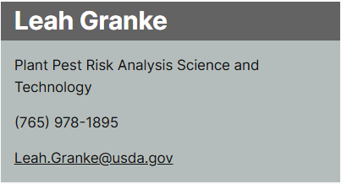
Thank You
Bonnie Dietrich
Pest Detection CFWG
CAPS Information Services Coordinator
(765) 496-2381
12pm-9pm ET (6am-3pm Hawaii Time)
CAPSIS@purdue.edu
NAPIS@purdue.edu
bsdietri@purdue.edu

