Slide 1
CPHST Support: Bringing Pests, Surveys, Plants, and Science Together
Melinda Sullivan Lisa Jackson
CPHST Fort Collins CPHST Raleigh
melinda.j.sullivan@aphis.usda.gov lisa.d.jackson@aphis.usda.gov

Slide 2
Topics
Pest List Review
Pest List Working Group
Asian Defoliator/Palm Surveys
Notes:
Today, we will be covering three topics that CPHST has been working on.

Slide 3
Pest List Review
Notes:
First, I would like to talk about the Pest List Review.

Slide 4
Pest List Review
History
Effort initiated in June 2011
Addressed concerns raised by CAPS community and CPHST
Purpose: To review the process behind the AHP pest list.
Notes:
The Pest List Review Group was initiated in June 2011.
The group was formed to address concerns raised by the CAPS community and CPHST, including:
-Comments received during the breakout session at the 2010 National CAPS Meeting and
-Questions raised by CPHST and other subject matter experts along the way.
Purpose: To review the process behind the AHP pest list.

Slide 5
Pest List Review
History
Core Team
Matt Royer, John Bowers, Kristian Rondeau, Brian Kopper, Rick Zink, Melinda Sullivan, Lisa Jackson
Other individuals on adhoc basis
CPHST Otis lab (insect survey methods)
CPHST Beltsville lab (pathogen diagnostics)
CPHST PERAL lab (pathway analysis)
NIS and Identification experts (insect ID methods and capacity)
Notes:
The Core Team is made up of:
Matt Royer, John Bowers, Kristian Rondeau, Brian Kopper, Rick Zink, Melinda Sullivan, and me
Other individuals, including identification and survey experts, will be called upon on an adhoc basis, including
Scientists and analysts from the:
CPHST Otis lab (insect survey methods)
CPHST Beltsville lab (pathogen diagnostics)
CPHST PERAL lab (pathway analysis), and
NIS and Identification experts (insect ID methods and capacity)

Slide 6
Pest List Review
Five Overarching Questions
How do pests get on the list?
How are pests removed from the list?
How are pests managed on the list?
What is the archival process?
How do we deal with other lists (e.g., Commodities and Additional Pests of Concern)?
Notes:
The group has identified 5 overarching questions:
How do pests get on the list?
How are pests removed from the list?
How are pests managed on the list?
What is the archival process?
How do we deal with other lists (e.g., Commodities and Additional Pests of Concern)?

Slide 7
Pest List Review
#1 How do pests get on the list?
Big Issues not being addressed in AHP
Pathway
Lack of Survey and ID/ Diagnostic methods
Use a Pre-assessment process for all new CAPS suggestions
Evaluate the pest’s pathway, pest status, etc.
Conservative approach
Notes:
So far, we have worked on the first question, how do pests get on the list.
There were two big issues that were not being addressed in the current AHP model that have been
brought up many times by many different people:
-Pathway: how to include it in the model? In the AHP model itself, pathway could not be included as one of the criteria. It broke one of the rules of the model (double-counting criteria).
-The other issue is the Lack of Survey and ID/ Diagnostic methods. Should pests be on the list if we do not have sufficient methods?
To address the pathway concern and other issues, we decided to go through a pre-assessment process for all new CAPS suggestions. This process will occur before any pests are run through the model.
-This will allow us to evaluate the pest’s pathway, pest status, etc.
-We decided to take a conservative approach. We didn’t want the Pre-assessment to be so restrictive that it
Would exclude too many pests. However, we want to use it as a transparent process to kick out pests that are not appropriate for CAPS.

Slide 8
Pest List Review
Post-assessment process for pests that make it to AHP list
Are there effective survey and diagnostic methods?
Exclude many pests that don’t have methods.
Pests would go to a research and development list.
These pests would not be listed on the final AHP list.
Notes:
In addition, we are adding a Post-assessment process for pests that make it through the Pre-assessment process, are run through the model, AND rank above a cut off point (for example, 50 pests).
We would then determine if there are effective survey and diagnostic methods AND sufficient capacity to perform IDs and diagnostics.
This would exclude many pests that don’t have methods
These pests would then move to a research and development list.
These pests would not be listed on the final AHP list until there are methods available.

Slide 9
Pests are suggested by CAPS community.
Completed pre-assessment form is archived. Pest may be re-submitted in the future if more information becomes available.
Pests are run through Pre-assessment Form.
Pest is not a candidate for AHP.
Lower-ranking pests (below a certain pre-determined number) are not added to the final AHP list.
Pest is a candidate for AHP. Pest is run through AHP model.
High-ranking pests (above a certain pre-determined number) are run through the Post-assessment Form.
Pests that do not pass the Post-assessment are put on a research list for methods development/ improvement or ID capacity improvement.
Pests are run through Post-assessment Form (evaluate Survey and ID methods/ capacity).
Pests that make it through the Post-assessment will be on the final pest list.
Notes:
So this is what our proposed new process would look like. We are still in the beginning stages.
We have only completed a few Pre-assessments so far, so we have yet to run one pest through the
Entire process.
(Orange)
(Red) If the pest does not make it through the Pre-assessment, it is not run through the AHP model.
(Blue) If the pest does pass the Pre-assessment, it is run through the model.
(Purple) Lower-ranking pests (likely below our current cut-off of rank #50) are not added to the final AHP list.
We are still considering what to do with these pests.
(Yellow)

Slide 10
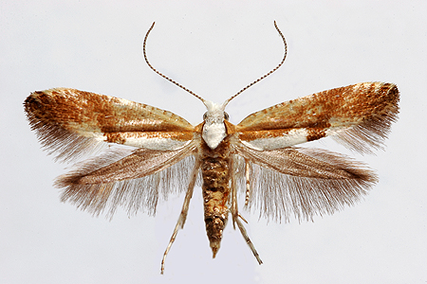
Pest List Review
Pre-Assessment
Consulted the New Pest Advisory Group (NPAG)
Also use a pre-assessment process
Decided on questions most important to CAPS
Developed a pre-assessment questionnaire
Notes:
To develop the Pre-assessment, we first consulted the New Pest Advisory Group.
They use a pre-assessment process to determine if they will write an NPAG report.
Adapted some of their questions to be more relevant for CAPS.
Developed a pre-assessment questionnaire
Here is an example of a completed Pre-assessment for the cherry blossom moth.
Show cherry moth example – share file
This was a pretty straightforward pest to assess. It was obvious that it is a pest and
That there is a pathway.

Slide 11
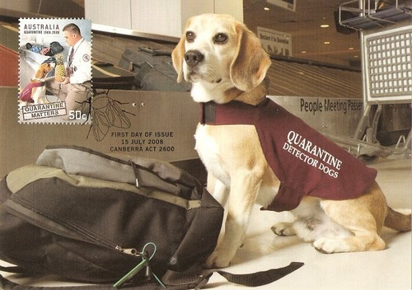
Pest List Review
Pre-Assessment
To date have run 3 insects and 2 pathogens
Takes 6 to 8 hours to evaluate one pest
Pathogens are having some issues with pathway/smuggling question
Notes:
To date, we have been focusing on the Pre-assessment.
To evaluate the tool, we have run 3 insects and 2 pathogens
Takes 6 to 8 hours to evaluate one pest
Pathogens are having some issues with pathway/smuggling question.
And if you would like to learn more about that aspect, Melinda can address it in the discussion after the PowerPoint.

Slide 12
Pest List Review
Post-Assessment
Work in progress
Will consider survey effectiveness/methods availability
Will consider diagnostic methods available
Will kick out pests without adequate methods
Move to a research/development list
Can be reconsidered when/if methods available
Notes:
The Post-assessment is still a work in progress.
We have a draft of the insect post-assessment, but we have not tried it yet.
The Post-assessment:
Will consider survey effectiveness and methods availability
Will consider the availability of ID or diagnostic methods and capacity
Will kick out pests without adequate methods
These pests will move to a research/development list
The pests can be reconsidered when/if methods available

Slide 13
Pest List Review
Timeline
Decided to update the AHP list every two years:
Year 1: AHP Process
Year 2: Develop support products for new pests
Notes:
We decided to update the AHP list every two years:
Year 1: Complete the AHP Process, from pest suggestions to the final list
Year 2: Develop support products for new pests
Right now, we create a list in Jan, release the list in April, and then CPHST plays catch up
trying to support the pests before the actual surveys begin.
This new approach would be proactive instead of reactive. It would allow over a full additional year
for CPHST, John Crowe, the domestic identifiers, and other key players to develop the necessary tools and
infrastructure to support these new pests.
When the pest is finally offered as a survey target, the proper support will be ready.

Slide 14
Time Line for Year 1: AHP Process
Pest Suggestions and Pre-assessments
January – July 1 | New pest suggestions sent to Melinda and Lisa throughout year until July 1. Melinda and Lisa perform Pre-assessments on these pests as they come in.
June 1 – July 1 | Call for pest suggestions to CAPS community.
August 1 | All Pre-assessments are completed.
Notes:
This represents a breakdown of the activities in the first year, the complete AHP Process.

Slide 15
Time Line for Year 1: AHP Process
AHP Process
August 1 – September 1 | Biological assessments are completed.
September 1 – October 1 | Economic assessments are completed.
November 1 | Pests are run through AHP model. Ranked list completed by Nov. 1.

Slide 16
Time Line for Year 1: AHP Process
Post-assessments and Final List
November 1 – January 1 | Post-assessments are completed for all high-ranking pests (i.e., with ranks >50). Pests that do not pass the Post-assessment are placed on a research list. Some lower-ranking pests are run through the Post-assessments to create a final list of 50. (For example, if 5 pests did not make it through the Post-assessment, then pests ranked 51-55 would be run through the Post-assessment.)
January 20 | Final, ranked list ready for the NCC meeting.
Notes:
T

Slide 17
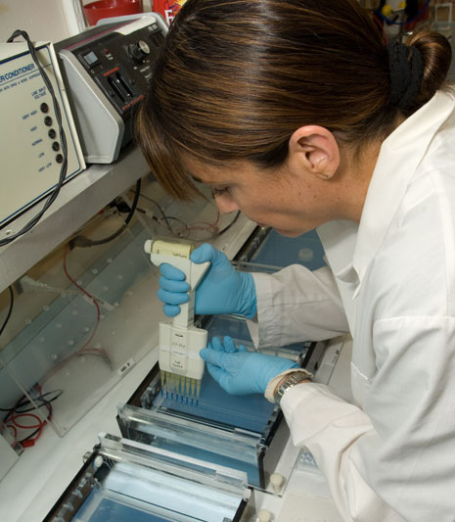
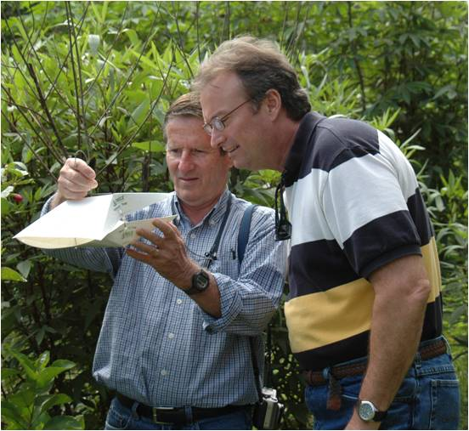
Pest List Review
Year 2: Support for Pests
Develop approved methods
Develop screening aids and diagnostic methods
Ensure taxonomic capacity and expertise are available
Allow time for trap and lure procurement
Develop datasheets and NAPPFAST maps
Notes:
Year 2 would be devoted to developing support tools and infrastructure for the pests.
This would include:
Developing approved methods
Developing screening aids and diagnostic methods
Ensuring taxonomic capacity and expertise is available
Allowing time for trap and lure procurement
Developing datasheets and NAPPFAST maps

Slide 18
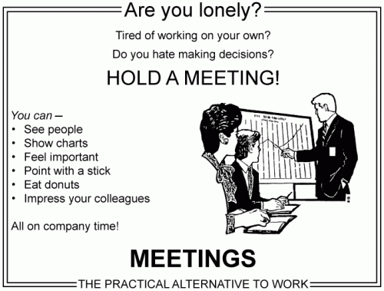
Discussion/ Questions
Notes:
And now we would like to open up the topic for discussion.

Slide 19
Pest List Working Group

