Slide 1
UPDATE: Asian Defoliator Pathway-Based Survey & Palm Commodity-Based Survey

Slide 2
Asian Defoliator Pathway Survey
New Survey for 2013
Scientific Name | Common Name
Dendrolimus pini | Pine-tree Lappet
Dendrolimus punctatus | Masson Pine Moth
Dendrolimus sibiricus | Siberian Silk Moth
Lymantria albescens | Okinawa Gypsy Moth
Lymantria dispar asiatica | Asian Gypsy Moth
Lymantria dispar japonica | Japanese Gypsy Moth
Lymantria mathura | Rosy Moth
Lymantria monacha | Nun Moth
Lymantria postalba | White-winged Gypsy Moth
Lymantria umbrosa | Hokkaido Gypsy Moth

Slide 3
Palm Commodity-Based Survey
New Survey for 2013 or 2014
Potential Pests | From AHP, APC, and J3s
Bursaphelenchus cocophilus (red ring nematode) | Paysandisia archon (a palm borer)
Candidatus Phytoplasma palmae (lethal yellowing/Texas Phoenix palm decline) | Planococcus minor (Passionvine mealybug)
Coconut cadang cadang viroid (CCVd) | Raoiella indica (Red palm mite)
Darna pallivitta (nettle caterpillar) | Rhabdoscelus obscurus (New Guinea sugarcane weevil)
Haplaxius (formerly Myndus) crudus (American palm cixiid | Rhynchophorus ferrugineus (red palm weevil)
Metamasius hemipterus (silky can weevil) | Rhynchophorus palmarum (giant/South American palm weevil)
Oryctes rhinoceros (coconut rhinoceros beetle) | Tetranychus roseus (a spider mite)
Issues:
Geographic distribution of pests: Pacific region (Hawaii/Guam) vs. Carribbean (Puerto Rico, U.S. Virgin Islands) vs. Continental United States
Diagnostic and/or Survey Issues: pathogens/nematode
One pest – little to no information available

Slide 4
Web-Based Delivery of All Documents
Current Plan:
Develop an introductory document for each survey with specific survey instructions/considerations
Post individual pest fact/datasheets
Post as a link off of CAPS Resource & Collaboration Website
Printable

Slide 5
Web-Based Delivery of All Documents
Current Plan Continued:
Currently writing all datasheets normally
Identifiers and others weigh in
Using Fact Sheet Fusion program to create an Access database with all data/fact sheets
Easily updatable – update database once, automatically updates all datasheets
Many options – filtering capacity, image galleries, glossaries, etc.

Slide 6
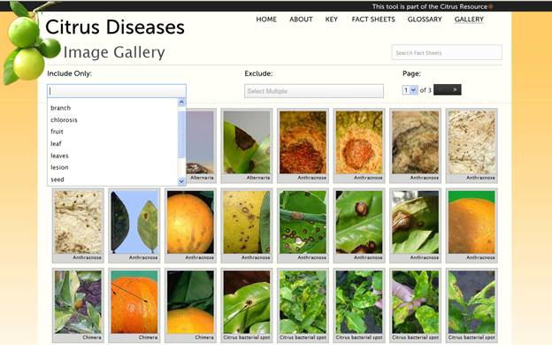
Example of an Image Gallery

Slide 8
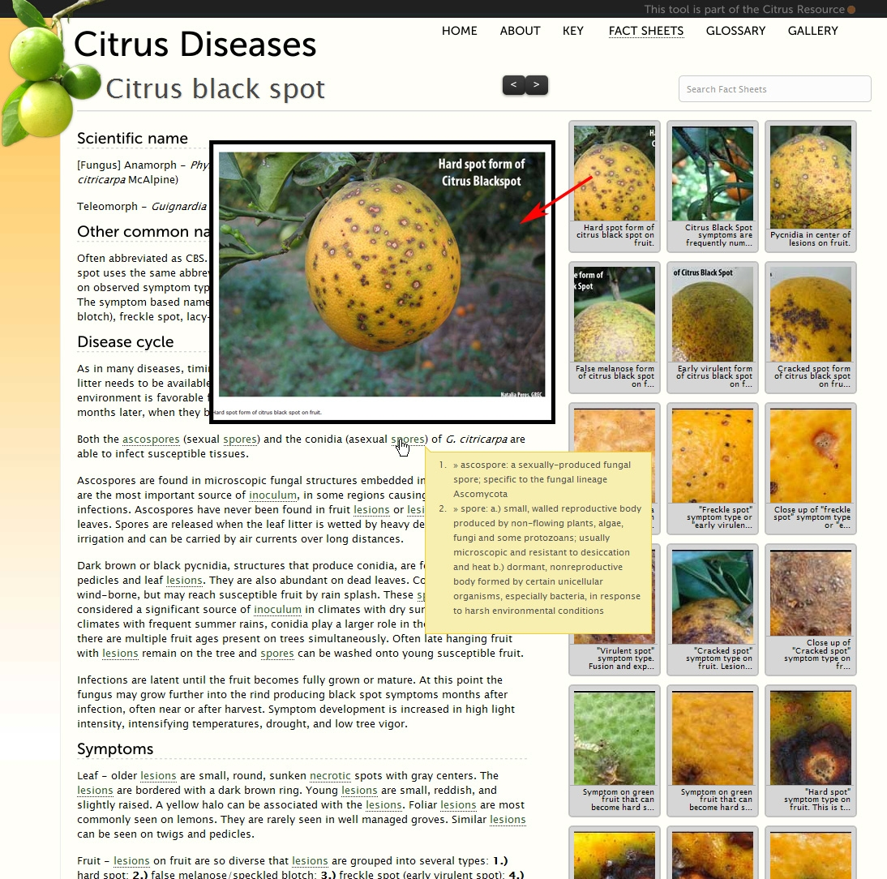

Slide 9
Web-Based Delivery of All Documents
Issues:
Asian Defoliator:
Lisa is working with the PPQ Asian Gypsy Moth program to develop the introductory document
Will be a pathway-based survey, so it will be different than other manuals completed so far.
Palm:
Pest List Finalization – need to work out survey/ID issues for pathogen/nematode
Lack of info. on some pests (spider mite)–Remove?
Geographic distribution – needs a filtering feature
Images:
Captioning – if too long – image doesn’t display correctly
Quality of images – 300 dpi or above isn’t always available

Slide 10
Web-Based Delivery of All Documents
Issues:
Fact Sheet Fusion can automatically develop the datasheets, but not very attractive
Requires a web-designer/programmer to work on appearance and functionality
Work in conjunction with Identification Technology Program (Terrence Walters)
Losing web-designer in February
Announcement of position – last week
Qualified Applicant – Looking for programmer vs. web designer now

Slide 11
Tentative Time-Line
Action | Time Frame
Datasheet Headings to ITP | Week of Jan. 23rd
Content entered into Fact Sheet Fusion as finalized | Now through August
Template Decided (what do we want the datasheets to look like –image display, caption issues, etc.) | End of February
Web designer/programmer works on formatting | March/April
Two example datasheets to NCC for comment | April
Finalized pest lists to John for inclusion in national guidelines | Before April 1st (Asian Defoliator for sure; palm possibly)
Develop Introduction documents and finalize all datasheets | April through August 1st
All Documents Delivered | August 1st

