Slide 1
Developing a new pest prioritization model
Alison Neeley and Trang Vo
Plant Epidemiology & Risk Analysis Laboratory

Slide 2
Analytical Hierarchy Process (AHP)
At the time of its adoption the AHP was one of the few available published techniques for pest prioritization
Notes:
Has been used for many years for prioritizing CAPS target pests
MCDM = Multicriteria decision methods
The methodology of the AHP is similar to that used in common sense decision making. Consequently, this methodology is quite easy for most decision makers to understand.

Slide 3

Advantages of the AHP
Useful decision tool for complex problems
Methodology is relatively simple
Both qualitative and quantitative information can be compared
Process is intuitive and easy for most decision-makers to understand
Notes:
Has been used for many years for prioritizing CAPS target pests
MCDM = Multicriteria decision methods
The methodology of the AHP is similar to that used in common sense decision making. Consequently, this methodology is quite easy for most decision makers to understand.

Slide 4

Disadvantages of the AHP
Labor intensive
Highly subjective
  Results can be inconsistent
  Subject to a high degree of expert bias
Criteria must be independent
Not integrated with other PPQ risk assessment methods
Difficult to validate
Notes:
Subject to rank reversal
If the performance of the alternatives with respect to the criteria can be quantitatively measured and the values of these performances can be represented by a linear value function, then the mAHP (S1.14) is clearly superior to the AHP in that: (i) pairwise comparisons need not be used in the determination of the ; and (ii) the results produced by the mAHP are not subject to rank reversal.
In my opinion the biggest disadvantage of using the analytic hierarchy process is that the number of comparison tables can become very large if you use a lot of comparison attributes. This can lead to a tendency to exclude valid comparison attributes in order to keep the number of calculations manageable.

Slide 5
Is there a better model to prioritize pests?
A pest prioritization process that would improve on the existing AHP process should be:
  Data driven
  Objective
  Rapid
  Use proven pest prioritization techniques
  Use relevant PPQ data and methods
Notes:
Such a process would allow for:
would allow a larger pest universe to be ranked
could be used to develop lists for specific types of pest surveys
The new technique, once refined and tested, would ultimately provide better allocation of scarce resources for managing high priority plant pests.

Slide 6
Developing an alternative to AHP for prioritizing pests

Slide 7
Our goal...
Develop an accurate & quick pest prioritization process that is:
Consistent between analysts/experts
Comparable between pest types
Based on potential economic & environmental impacts and likelihood of introduction
  Address issues of dependency
Tested and validated for use in the entire United States
Consistent with PPA authority and international standards
Notes:
Improve consistency:
Between analysts/experts
Between pest types (e.g. insects vs. pathogens vs. mollusks)

Slide 8
Our model…
Adapting PPQ’s Weed Risk Assessment Process
  Very successful tool for evaluating the “invasive” potential of plants
  Widely evaluated, tested, and validated
  Adopted by other stakeholders
WRA
Guidelines

Slide 9
Methods – Developing a Model
Starting by developing list of yes/no and multiple choice questions
Questions deal with various elements of risk including:
  Host range/status
  Plant part affected/symptoms on plant
  Life history of the pest
  Means of dispersal
  Current geographic distribution of the pest
  Ease of Identification & Detection
  Climatic/environmental constraints
  Prevention/control strategies
Also developing interpretative guidelines for answering questions consistently
Notes:
Rather than reinventing the wheel, we decided to start with The Australian WRA since it has been relatively successful and widely tested. We sorted its questions into four risk elements. We also added, deleted, and modified questions based on the results from other studies of the Australian WRA and other WRA systems. We used similar scoring.
For our predictive model, we decided to only use the likelihood of establishment and spread, and the consequences. Many other WRA systems, including the Australian WRA include a few questions about the climatic and geographic suitability of the PRA area for the species being assessed. After all, the PRA should consider if the plant can’t survive at all in the PRA area. However, because the United States is climatically very diverse, we decide to not include this element of risk in the predictive model. We didn’t want to bias the model against any particular part of the United States. We also designed an entry potential risk element, but we haven’t validated this yet. We expect that for most plants we assess, we will not need to assess this because they will be intentionally introduced. I won’t talk about this risk element again.

Slide 10
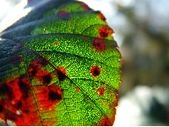
Sample Questions
Is the organism a known pest in its area of current distribution?
Are any closely related species known pests?
Has the pest established in new areas outside its original area of distribution?
Is reproduction: (a) continuous; no overwintering period; (b) overwintering/ dormancy period
Notes:
Here are some sample questions from our 2 predictive risk elements

Slide 11
Sample Questions: Hosts
 | on host? (y/n/c ) | Host status to pest | Plant part(s) impacted | in/on/with/ other | Type of damage | Degree of damage
COMMERCIAL CROPS
alfalfa seed
almonds
pome fruit (apples, pear, quince, etc.)
asparagus
barley
beans
blackberries and raspberries
blueberries
Brassica (cabbage, cauliflower, cabbage)
cantaloupe, honeydew, watermelon
carrots
cranberries
celery
citrus

Slide 12
Sample Questions: Geo Potential
Cold Hardiness Zones | Köppen-Geiger Climate Classes | 10-inch Precipitation Bands
Zone 1 (below -50F or below -45.6C) | Tropical rainforest | 0-10 inches (0-25 cm)
Zone 2 (-50 to -40F, or -45.6 to -40.0C) | Tropical savanna | 10-20 inches (25-51 cm)
Zone 3 (-40 to -30F, or -40.0 to -34.4C) | Steppe | 20-30 inches (51-76 cm)
Zone 4 (-30 to -20F, or -34.4 to -28.9C) | Desert | 30-40 inches (76-102 cm)
Zone 5 (-20 to -10F, or -28.9 to -23.3C) | Mediterranean | 40-50 inches (102-127 cm)
Zone 6 (-10F to 0F, or -23.3 to -17.8C) | Humid subtropical | 50-60 inches (127-152 cm)
Zone 7 (0 to 10F, or -17.8 to -12.2C) | Marine west coast | 60-70 inches (152-178 cm)
Zone 8 (10 to 20F, or -12.2 to -6.7C) | Humid cont warm summers | 70-80 inches (178-203 cm)
Zone 9 (20 to 30F, or -6.7 to -1.1C) | Humid cont cool summers | 80-90 inches (203-229 cm)
Zone 10 (30 to 40F, or -1.1 to 4.4C) | Subarctic | 90-100 inches (229-254 cm)
Zone 11 (40 to 50F, or 4.4 to 10C) | Tundra | 100+ inches (254+ cm)
Zone 12 (50 to 60F, or 10 to 15.6C) | Icecap
Zone 13 (above 60F, or above
Notes:
Here are some sample questions from our 2 predictive risk elements

Slide 13

Methods: Species Selection
We will start by identifying pests that have been introduced and currently established in the United States
  Developmental & training datasets (N=40-50 each—maybe more)
PERAL economics team will evaluate each
pest in terms of observed impacts
  Agricultural
  Environmental
  Social
Pests will be grouped into three categories: major pest, minor pest, and non-pest

Slide 14
Methods: Assessments
Using the model, our team (consisting of PERAL entomologists, plant pathologists, and botanists) will assess each pest on the “developmental” list
Sources of information
  Pest behavior & Impacts – outside the U.S.
  Basic biological traits (e.g. dispersal) – anywhere
Plan is to meet weekly to review each assessment and to check for inter-assessor consistency
Notes:
So, let’s get back to our validation work. Here is our methodology.
Identify 204 known major, minor, and non-invaders (68 each).
Subject them to both assessment systems & review. Each assessment is reviewed by someone else.
Rely on information on invasive behavior from outside of the U.S. (e.g., impact), but use basic biological information from anywhere (e.g., dispersal). This approach is consistent with that by Doria Gordon when she tested the Australian system in Florida.
Using a set of interpretative guidelines to help us with question approach and interpretation. These guidelines were created by a group of weed scientists at the 2nd International Weed Risk Assessment workshop. We refined some of these interpretative guidelines during our work and have created additional guidelines for our other questions.
At the end, we will develop cutoff scores that will help policy makers make regulatory decisions about which species should be imported and which should be banned from entry. We are working with a statistician to make sure we use the right analyses for our validation.
Use interpretative guidelines
Discuss question approach & interpretation
Check question validity & behavior.
Create cutoff scores

Slide 15
Methods: Refining the Model
Using the developmental dataset we will…
Assess the explanatory power of every question by comparing results of the assessment to actual observed impact
Weight predictive questions more
Eliminate questions with no predictive power
Goal: Maximize risk score separation
  ANOVA

Slide 16
Invasiveness elsewhere (X²=83.0***)
Self-compatible (X²=5.3)
34 34 34
29 23 27
F
E
F
Yes
D
E
B
C
A
No
B
E
Geophyte (X²=0.1)
Forms seed banks (X²=8.3**)
34 34 34
30 21 6
Yes
Yes
No
No
?
Notes:
Explain colors
I don’t have time to show you the results from all of the questions, but I will share with you results from a few. By far, the most predictive question we had, that is to say, the question with the largest chi-square value was the questions about a species invasive status elsewhere in the world. In this graph, you can see our 3 apriori categories. You can also see that virtually all of the major-invaders were invasive elsewhere in the world. In contrast, only 1 non-invader was invasive elsewhere. Shown in dark green are all of the species that have been introduced elsewhere in the world, 75 years or more, and have not shown any evidence of naturalizing or escaping cultivation. Almost all of these species are non-invaders. Because this question was the most predictive, we weighted it more than the others.
Next is the question about whether the species has been intentionally introduced elsewhere outside of its range. Here we see that non-invaders had a greater proportion of yes’s than the other the other categories. BTW, so you know, answers shown in red are answers that contribute to invasiveness whereas green ones do not. Results from this question were opposite of what we expected, so this question, which is significant, actually hurt our attempt to predict invasive species. We removed this question from our model.
We also removed the question about being a geophyte, because it did not contribute anything to our predictive model. Not only was this question not significant, there wasn’t even a clear trend in one direction or another.
Finally, this next case is a good example of the types of patterns we saw in some of the questions. We had a very significant chi-square value for this question, but when you examine the results, you much of that signficance is due to a non-random distribution of species that answered unknown for this question. As you see, a much greater proportion of non-invaders answered unknown, than minors, than majors. This should not be surprising as a there will be much more literature available about major invaders than other categories. So, we species answering unknown, from this chi-square analysis. That Chi-square value that you see here, and that for all of the examples I show, you are based on datasets where we have removed the unknowns. In this case, this question is still predictive. That is, a greater proportion of species that form seeds banks are major invaders.

Slide 17
Methods: Refining the Model
With the developmental dataset…
Logistic regression
  Type of statistical analysis that uses continuous and discrete variables to predict the probability of occurrence of a discrete event
    Probability of being a Major Pest
    Probability of being a Minor Pest
    Probability of being a Non-pest

Slide 18


The Logistic Regression Model
(PPQ Week Risk Assessment)
For any given plant, all three probabilities were determined
P(Non-I) + P(Min-I) + P(Maj-I) = 1

Slide 19
The Logistic Regression Model (PPQ Weed Risk Assessment)
(0.2356*ES – 0.6019*Imp)

Slide 20
Methods: Validating the Model
Using the training dataset we will…
Assess the ability of the weighted model to identify major, minor, and non-pests

Slide 21
Weed Risk Assessment Results

Slide 22
Weed Risk Assessment Results
High Risk
Low Risk

Slide 23
Model Output

Slide 24
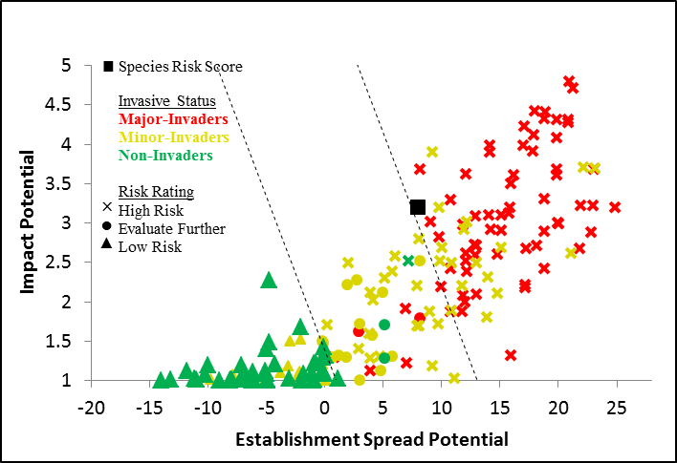
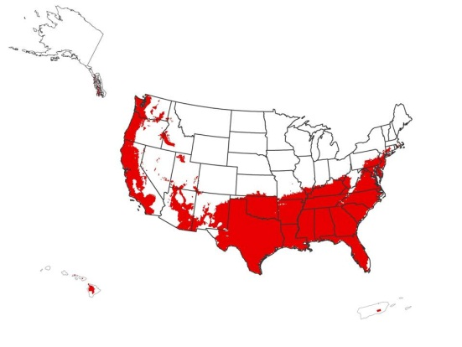
Model Output
Risk potential
Description of Uncertainty
Geographic potential

Slide 25
1) Risk Potential
Risk Score that can be used to rank pests
  Impact potential
  Likelihood of introduction
NOTE: sub-lists can be developed for different geographic regions and hosts
Risk Score
Non-Invader Minor Major
Notes:
Impact potential (likelihood of being a major pest)
Establishment and spread potential
Calculate risk scores for Establishment/Spread & Impact
Higher values indicate greater capacity
Calculate P(Major), P(Minor), & P(Non-Invader) with logistic-regression model
Invasiveness broadly defined to incorporate concepts of escape, naturalization, spread, and impact
All 3 probabilities sum to 1

Slide 26
Weed Risk Assessment Results
High Risk
Low Risk

Slide 27
2) Description of Uncertainty
Summarize & describe uncertainty for each risk element
  How confident are we in our results?
  Would additional/ better information be likely to change our results?

Slide 28
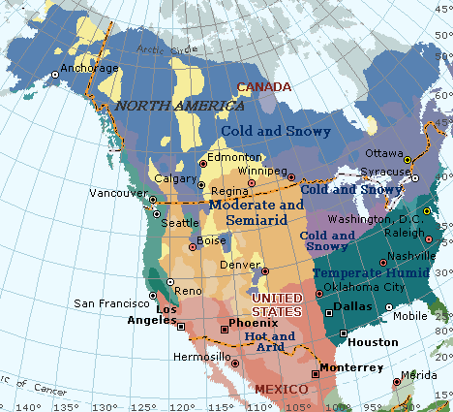
3) Geographic potential
Geo potential evaluated separately
Simple analysis that matches on and overlays
    Cold hardiness zones
    Annual precipitation
    Climate classes

Slide 29
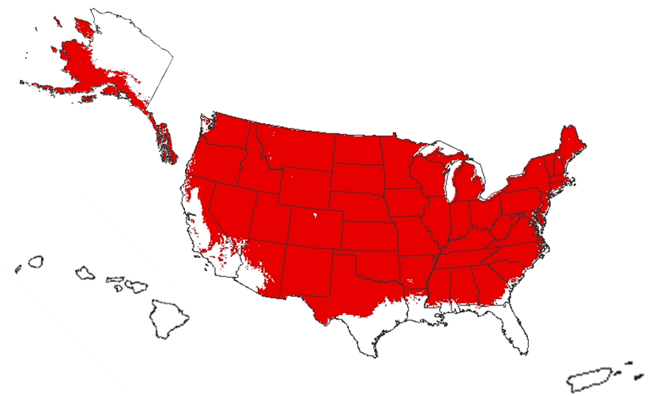
Representing areas where all three climatic variables are suitable for its survival

Slide 30
Tentative Timeline
2013
February: Finish developing model (i.e. draft questions) for insects and pathogens
March-April: Assess pests on “developmental” list
May-July: Refine model and develop weightings
August: Report on progress to NCC/ Present draft model
September- : Start validation process
2014
Start developing model for other pest groups (e.g. mollusks, plants)
Improve the model by collaborating with entomologists, plant epidemiologists, ecologists, statisticians and other specialists.

Slide 31
Questions??

