Slide 1
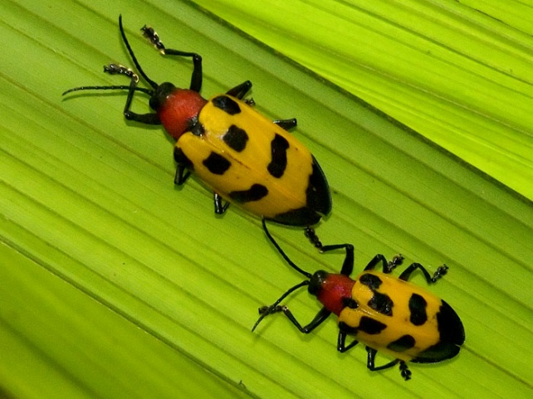
Cooperative Agriculture Pest Survey (CAPS)
John H. Bowers, Ph.D.
National Survey Coordinator
Emergency & Domestic Programs
USDA APHIS PPQ
Riverdale, MD

Slide 2
Pest Detection / CAPS Pest & Survey Measures
CAPS Measure | 2010 Results | 2011 Results | 2012 Results | 2013 Results
CAPS Participation
Total number of states/territories | 53 | 54 | 53 | 52
Including these territories | PR, VI, GU | PR, VI, GU, CNMI | PR, VI, AS, GU | PR, VI, GU
Number of states/territories with Infrastructure | 53 | 51 | 52 | 51
States w/o Infrastructure | - | AZ, NM, CNMI | AZ | AZ
Number of states/territories with Surveys | 51 | 51 | 51 | 51
States w/o Survey | IA, NM | MO, AZ, NM | AZ, NM | AZ

Slide 3
Pest Detection / CAPS Pest & Survey Measures
CAPS Measure | 2010 Results | 2011 Results | 2012 Results | 2013 Results
CAPS Priority Pest List
Percent of target pests on the CAPS Priority Pest List for which surveys were conducted * | 88.5% | 86.1% | 79.0% | 78.6%
Total number of Priority Pests | 122 | 122 | 124 | 117
Priority Pests targeted for survey | 108 | 105 | 98 | 92
Priority Pests not targeted | 14 | 17 | 26 | 25
~130 pests have Approved Survey Methods.
This includes all Priority Pests, as well as a few others because of the immediate need.

Slide 4
Pest Detection / CAPS Pest & Survey Measures
CAPS Measure | 2010 Results | 2011 Results | 2012 Results | 2013 Results
CAPS Surveys
Number of bundled surveys * | 154 | 130 | 133 | 119
Number of unique exotic pests for which national surveys are conducted * | 287 | 295 | 264 | 231
Average Number of pests per state | 16.5 | 17.0 | 15.6 | 16.3
Average number of pests per bundled survey * | 6.0 | 6.7 | 6.1 | 7.1
Average number of surveys per state * | 3.0 | 2.5 | 2.6 | 2.3
Average cost per individual survey * | $19,233 | $18,666 | $19,926 | $23,410

Slide 5
Number of States and Territories Conducting
Commodity- or Taxon-based Surveys
Survey | 2010 | 2011 | 2012
Citrus | 2 | 2 | 1
Corn | - | 5 | 7
Nematodes | 11 | 9 | 6
Grape | 11 | 6 | 2 |  | CAPS
Oak | 8 | 7 | 3 |  | Priority
Pine | 6 | 4 | 4 |  | Surveys
Small Grains | 6 | 7 | 7
Soybean | 9 | 6 | 5
Stone Fruit | - | - | 5
Woodborers & Bark Beetle | 18 | 15 | 18
Apple | 2 | - | 1
Banana | - | 2 | 1
Cotton | 1 | 3 | 3
Defoliating Moth | 3 | 4 | 2
Fruit Tree | 2 | 1 | 7 |  | State
Nursery | 16 | 21 | 9 |  | Bundled
Palm | - | 2 | 1 |  | Surveys
Rice | 2 | 1 | 2
Snail | 3 | 2 | 2
Vegetable / Tomato | - | 2 | 4
General / Forest Pests / Ornamental Crops | - | 5 | 5

Slide 6
Priority Surveys | # States |  | State Surveys | # States
Corn Commodity Survey | 7 |  | Mollusk Survey | 2
Cotton Commodity Survey | 4 |  | Citrus Commodity Survey | 1
Cyst Nematode Survey | 7 |  | Field Crops Pest Survey | 1
Exotic Woodborer/Bark Beetle | 16 |  | Forest Pest Survey | 11
Oak Commodity Survey | 6 |  | Fruit Crops Pest Survey | 1
Pine Commodity Survey | 7 |  | Greenhouse Crops Pest Survey | 1
Small Grains Commodity Survey | 10 |  | Legume Survey | 2
Soybean Commodity Survey | 6 |  | Mixed Commodity Survey | 2
Grape Commodity Survey | FB |  | Nursery & Retail Plants Pest | 19
Stone Fruit Commodity Survey | FB |  | Palm Pest Survey | 2
Asian Defoliating Moth Survey | FB |  | Rice Pest Survey | 3
Solanaceous / Tomato | FB |  | Root Crop Survey | 1
 |  |  | Tree Fruit Pest Survey | 4
CAPS 2013 Surveys |  |  | Vegetable Crops Pest Survey | 4

Slide 7
Pest Detection / CAPS Pest & Survey Measures
CAPS Measure | 2010 Results | 2011 Results | 2012 Results | 2013 Results
New to the United States
Percent of significant pest introductions that were detected before they had a chance to spread from the original point of colonization and cause severe economical and/or environmental damage * | 88.9% | 83.3% | 90% | TBD
New or re-introduced into the United States | 28 | 25 | 21
Percent listed as reportable/actionable | 96.4 % (27) | 100% | 100%
Number on Priority Pest List | 0 | 3 | 0

Slide 8
NAPIS Data | 2011 Results | 2012 Results
NAPIS Records | 122,707 | 87,781
Total number of Priority Pests | 122 | 124
Priority Pests targeted for survey (J-3) | 105 (86.1%) | 98 (79.0%)
Unique pests targeted for survey (J-3) | 295 | 264
Unique pests with data entered | 747 | 456
Pests with only positive records | 235 | 149
Pests with only negative records | 401 | 216
Pests with positive / negative records | 111 | 91
Priority Pests with negative records | 95 | 87
Priority Pests with positive records | 25 | 0
Priority Pests with both positive and negative records | 16 | 8

Slide 9

CAPS Resource and Collaboration Site
caps.ceris.purdue.edu

