Slide 1
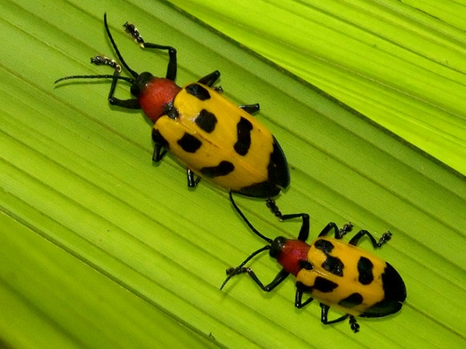
Cooperative Agriculture Pest Survey (CAPS)
John H. Bowers, Ph.D.
National Survey Coordinator
Emergency & Domestic Programs
USDA APHIS PPQ
Riverdale, MD

Slide 2
2013 Guidelines – Changes Going Forward
Funding Guidance
Plan with 2012 budget, but be ready to change
Tier 2 Infrastructure Eliminated
Cannot exceed 2012 amount
Travel Restrictions – CAPS activities only
Out-of state – capped at $5,000
In-state
Travel to conduct surveys survey work plan
Other travel to support CAPS only

Slide 3
2013 Guidelines – Changes Going Forward
Infrastructure Reporting
New reporting template – Appendix P-1
CAPS and Farm Bill Surveys
Grape, Stone Fruit, and other specialty crops
Not funded through CAPS Farm Bill
Discretionary Surveys Eliminated
Pests of state concern bundled w/ Priority Pests
Eliminates the need for 75/25 funding split
Infrastructure and Survey

Slide 4
2013 Guidelines – Changes Going Forward
Appendix J-3 – CAPS Survey Form
Completed online on CAPS R&C site
Must be complete when work plans are submitted
AHP Prioritized Pest List
Update every 2 years only
2013 same as 2012 (Planococcus minor removed)
Effort underway to update the process and model
Pest List Changes
Appendix M-2

Slide 5
2013 Guidelines – Changes Going Forward
NAPIS and IPHIS
High level requirements submitted to IPHIS team
Pilot testing of certain IPHIS functionality
CO, ID, ME
October 1 decision deadline

Slide 6
CAPS Resource and Collaboration Site
caps.ceris.purdue.edu

