Slide 1
PPQ Reorganization
Three core functional areas to
Provide risk-based solutions

Slide 3
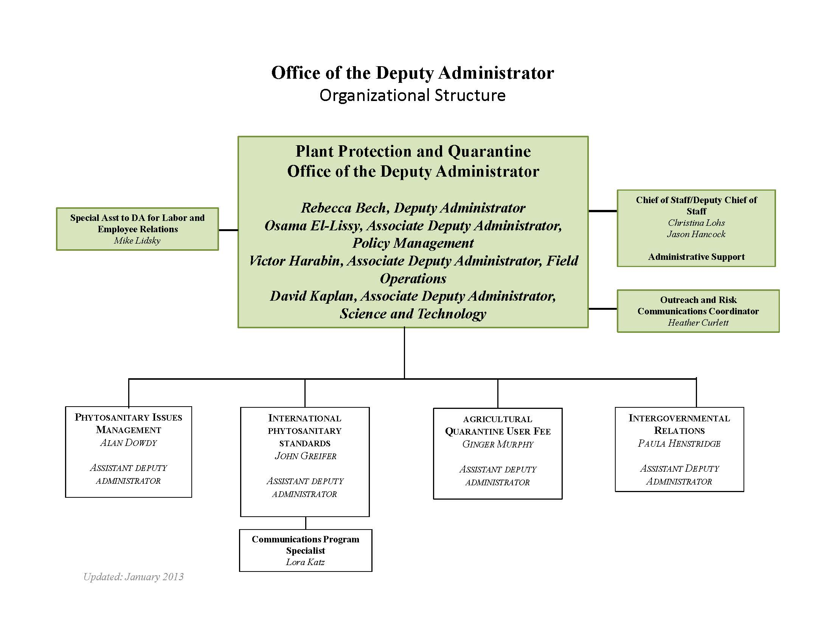

Slide 4
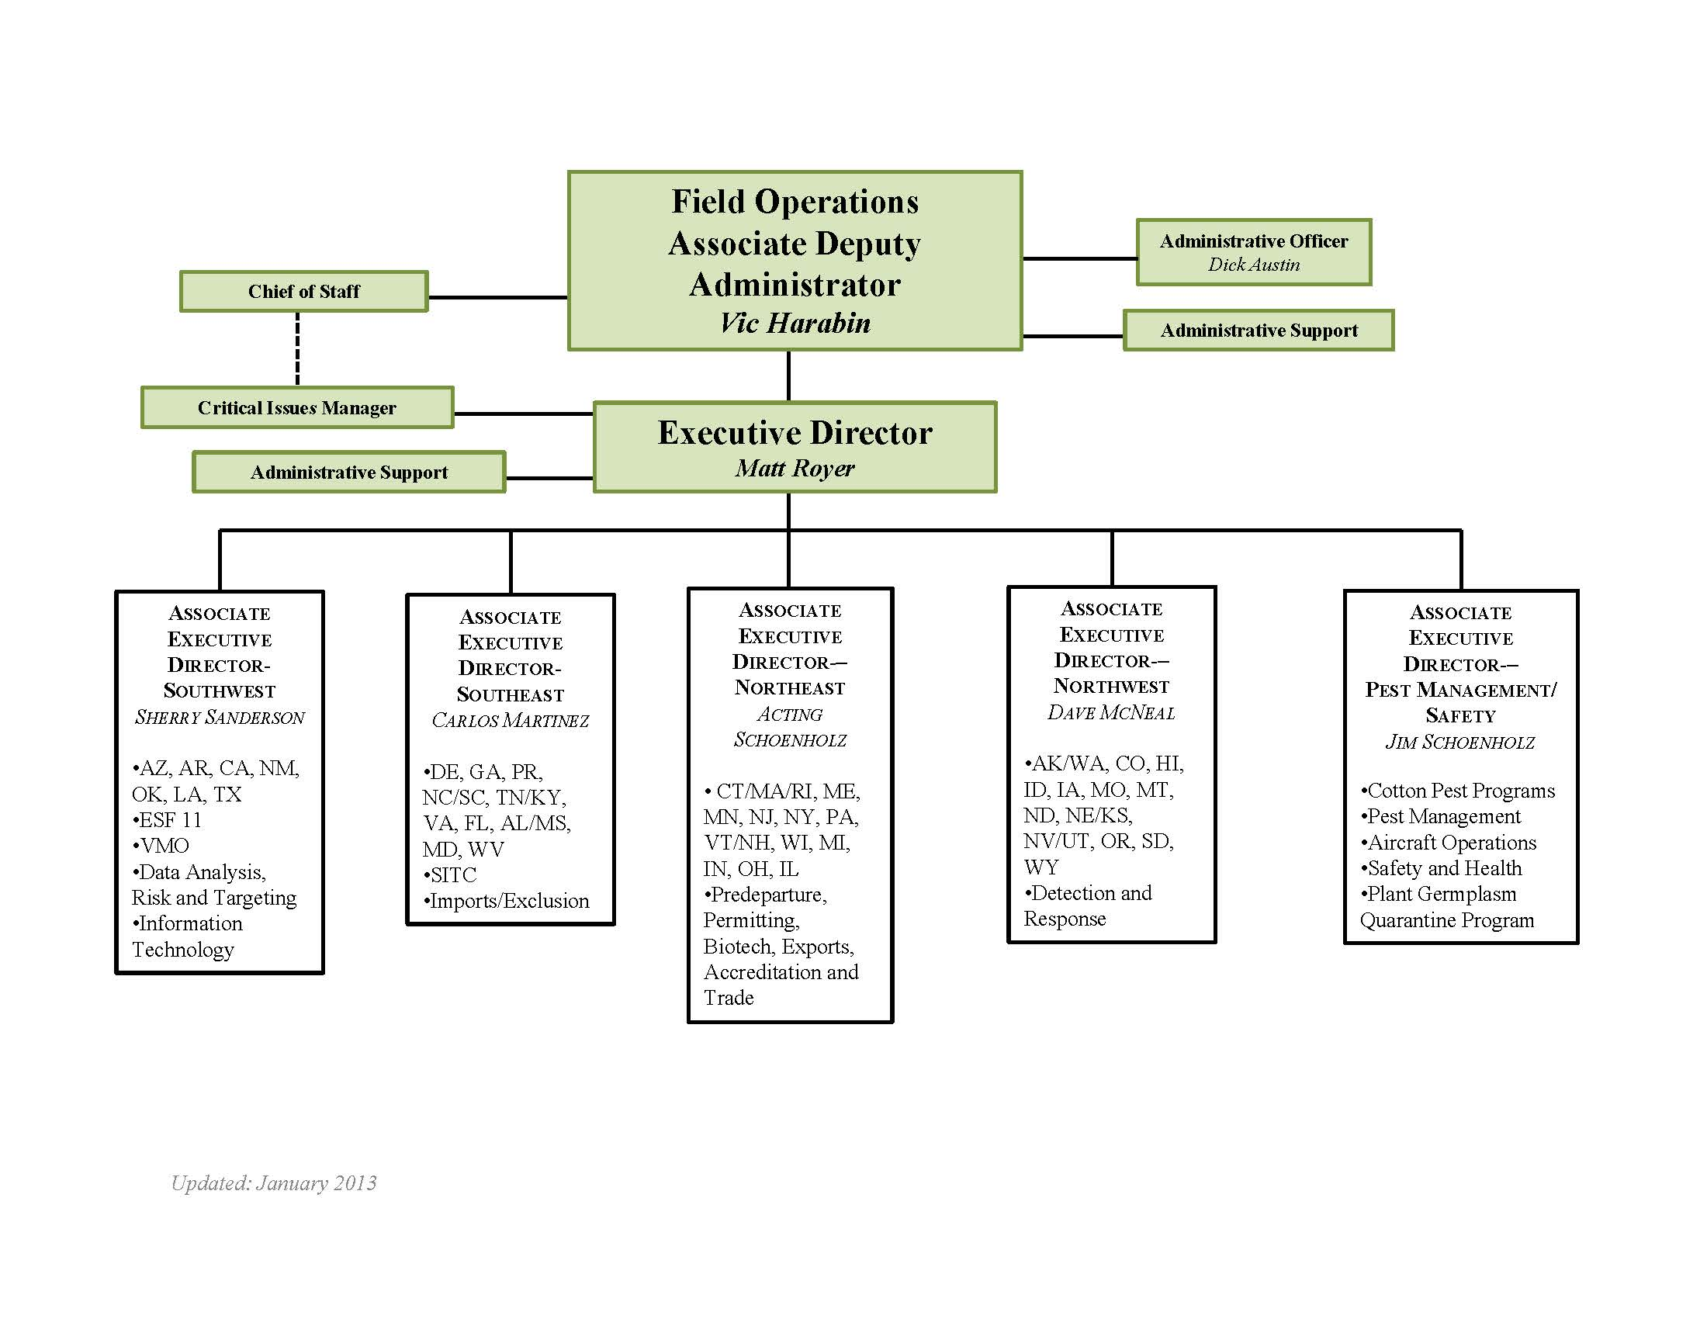

Slide 5
National Clean Plant
Network Program
Coordinator
Mr. Erich Rudyj
Science and Technology
Associate Deputy Administrator
Riverdale, MD
Dr. David T. Kaplan
Critical Issues Manager- Recruit
Administrative & Tech Services
Administrative Officer
Mr. Jay Drake
Executive Director
Raleigh, NC
Dr. Philip Berger
Program Analyst- Jennifer Nicholson
Staff Assistant- Davis Abner
Associate Director
Dr. Ron Sequeira
Associate Director
Dr. Michael K. Hennessey
Associate Director
Dr. Charla Hollingsworth
Associate Director
Dr. Russ Bulluck
CPHST Plant Epidemiology
and Risk Analysis Lab
Raleigh, NC
Laboratory Director
Mr. Robert Griffin
CPHST AQI Lab
Miami, FL & Raleigh, NC
Lab Director
Dr. Woody Bailey
Raleigh Coordinator
Mr. Scott Wood
CPHST Mission Lab
Edinburg, TX
Laboratory Director
Dr. Matt Ciomperlik
CPHST Fort Collins Lab
Fort Collins, CO
Laboratory Director
Dr. Richard Zink
CPHST Beltsville Lab
Beltsville, MD
Laboratory Director
Dr. Mark Nakhla
CPHST Phoenix Lab
Phoenix, AZ
Laboratory Director
Dr. Richard Zink
Biloxi Station
Biloxi, MS
Coordinator
Ms. Anne-Marie Callcott
Nat. Plant Prot. Lab
Accreditation Program
Coordinator
Dr. Pat Shiel
CPHST Otis Lab
Buzzards Bay, MA
Laboratory Director
Mr. Vic Mastro
Biological Control Program
Coordinator
Dr. Kenneth Bloem
Fruit Fly Program
Coordinator
Mr. Pat Gomes
California Station
Salinas, CA
Coordinator
Dr. Greg Simmons
National Scientific
Technologies Program
Coordinator
Dr. Laurene Levy
January 9, 2013

Slide 6
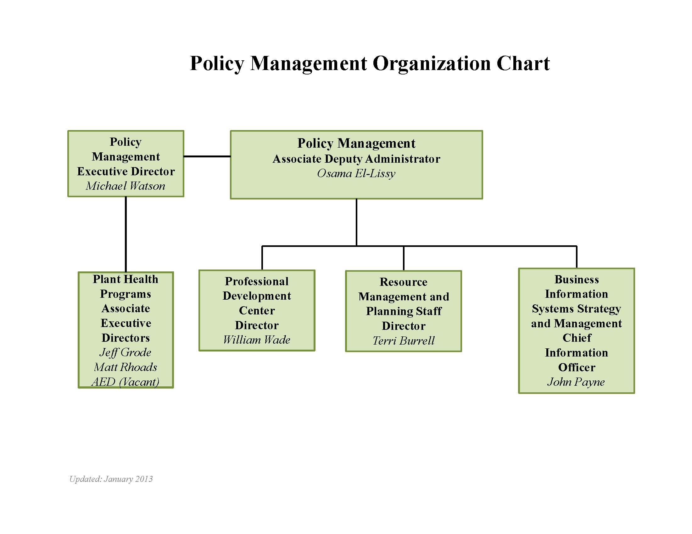

Slide 7
