Slide 1
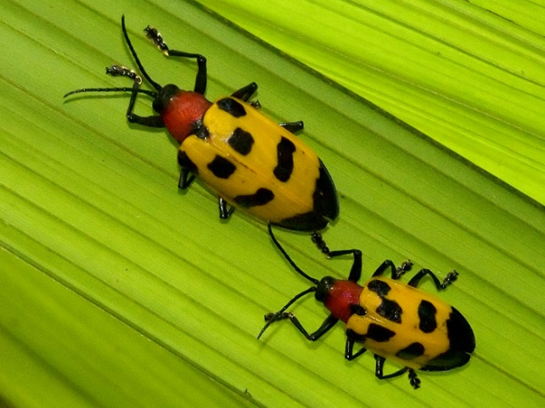
Pest Detection & Cooperative Agricultural Pest Survey (CAPS)

Slide 2
Pest Detection / CAPS Pest & Survey Measures
CAPS Measure | 2011 Results | 2012 Results | 2013 Results | 2014 Results
CAPS Participation
Total number of states/territories | 54 | 53 | 52 | 52
Including these territories | PR, VI, GU, CNMI | PR, VI, AS, GU | PR, VI, GU | PR, VI, GU
Number of states/territories with Infrastructure | 51 | 52 | 51 | 52
States w/o Infrastructure | AZ, NM, CNMI | AZ | AZ | AZ
Number of states/territories with Surveys | 51 | 51 | 51 | 52
States w/o Survey | MO, AZ, NM | AZ, NM | AZ | AZ

Slide 3
Pest Detection / CAPS Pest & Survey Measures
CAPS Measure | 2011 Results | 2012 Results | 2013 Results | 2014 Results
CAPS Surveys
Number of bundled surveys * | 130 | 133 | 119 | 116
Number of unique exotic pests for which national surveys are conducted * | 295 | 266 | 229 | 220
Average Number of pests per state | 17.0 | 15.6 | 16.3 | 16.3
Average number of pests per bundled survey * | 6.7 | 6.1 | 7.1 | 7.3
Average number of surveys per state * | 2.5 | 2.6 | 2.3 | 2.2
Average cost per individual survey * | $18,666 | $19,926 | $23,410 | $21,620
 Pre-Sequestration; CR

Slide 4
Pest Detection / CAPS Pest & Survey Measures
CAPS Measure | 2011 Results | 2012 Results | 2013 Results | 2014 Results
CAPS Priority Pest List
Percent of target pests on the CAPS Priority Pest List for which surveys were conducted * | 86.1% | 80.3% | 80.5% | 72.4%
Total number of Priority Pests | 122 | 127 | 118 | 145
Priority Pests targeted for survey | 105 | 102 | 95 | 105
Priority Pests not targeted | 17 | 25 | 23 | 40

Slide 5
Priority Surveys | 2013 | 2014 |  | State Surveys | 2013 | 2014
Corn Commodity Survey | 7 | 7 |  | Citrus Commodity Survey | 1 | 1
Cotton Commodity Survey | 4 | 4 |  | Field Crops Pest Survey | 1 | 4
Cyst Nematode Survey | 7 | 3 |  | Forest Pest Survey | 11 | 10
EWB/BB | 16 | 19 |  | Fruit Crops Pest Survey | 1 | 2
Mollusk | 0 | 4 |  | Greenhouse Crops Pest | 1 | 1
Oak Commodity Survey | 6 | 4 |  | Legume Survey | 2 | 1
Pine Commodity Survey | 7 | 5 |  | Mixed Commodity Survey | 2 | 3
Small Grains Commodity | 10 | 7 |  | Mollusk Survey | 2 | 0
Soybean Commodity Survey | 6 | 9 |  | Nursery & Retail Plants Pest | 19 | 19
Asian Defoliators | FB |  |  | Palm Pest Survey | 2 | 1
Grape Commodity Survey | FB |  |  | Rice Pest Survey | 3 | 4
Palm Commodity Survey | FB |  |  | Root Crop Survey | 1 | 0
Solanaceous Crops Survey | FB |  |  | Tree Fruit Pest Survey | 4 | 4
Stone Fruit Commodity | FB |  |  | Vegetable Crops Pest | 4 | 2

Slide 6
2013 CAPS – PPQ – Farm Bill Surveys
2013 Measures | CAPS | PPQ | Farm Bill
States and Territories | 52 | 45 | 46
Number of bundled surveys * | 119 | 132 | 151
Number of unique exotic pests for which national surveys are conducted * | 229 | 103 | 172
Average Number of pests per state | 16.3 | 9.6 | 25.2*
Average number of pests per bundled survey * | 7.1 | 3.3 | 7.7*
Average number of surveys per state * | 2.3 | 2.9 | 3.3
CAPS & PPQ: Pest Detection funding
Farm Bill: Goal 1 Survey

Slide 7
2013 CAPS – PPQ – Farm Bill Surveys
2013 Measures | CAPS | CAPS w/o FB Surveys | PPQ | Farm Bill
Number of 2013 Priority Pests | 118 | 109 | 118 | 118
Percent of target pests on the CAPS Priority Pest List for which surveys were conducted * | 79.7% | 85.3% | 41.5% | 59.3%
Priority Pests targeted for survey | 95 | 93 | 49 | 70
Priority Pests not targeted | 23 | 16 | 69 | 48
Additional pests targeted for survey | 134 | 136 | 55 | 103
Unique pests targeted for survey | 229 | 229 | 104 | 173

Slide 8
2013 CAPS – PPQ – Farm Bill Surveys
2013 Measures | CAPS | CAPS w/o FB Surveys | CAPS & PPQ | CAPS & PPQ & FB
Number of 2013 Priority Pests | 118 | 109 | 118 | 118
Percent of target pests on the CAPS Priority Pest List for which surveys were conducted * | 79.7% | 85.3% | 82.2% | 87.3%
Priority Pests targeted for survey | 95 | 93 | 97 | 103
Priority Pests not targeted | 23 | 16 | 21 | 15
Additional pests targeted for survey | 134 | 136 | 169 | 231
Unique pests targeted for survey | 229 | 229 | 266 | 334

Slide 9
Pest Detection / CAPS Pest & Survey Measures
CAPS Measure | 2011 Results | 2012 Results | 2013 Results | 2014 Results
New to the United States
Percent of significant pest introductions that were detected before they had a chance to spread from the original point of colonization and cause severe economical and/or environmental damage * | 83.3% | 90% | 88% | TBD
New or re-introduced into the United States | 25 | 21 | 17
Percent listed as reportable/actionable | 100% | 100% | 100%
Number on Priority Pest List | 2 | 0 | 1☺
2013: 20 confirmed; 3 not plant pests; 2 widespread at time of detection
☺ Trichoferus campestris – Velvet Longhorned Beetle

Slide 10
NAPIS Data | 2011 Results | 2012 Results | 2013 Results
NAPIS Records | 139,539 | 134,759 | 60,411
Total number of Priority Pests | 122 | 127 | 118
Priority Pests targeted for survey (J-3) | 105 (86.1%) | 102 (80.3%) | 95 (80.5%)
Unique pests targeted for survey (J-3) | 295 | 266 | 229
Unique pests with data in NAPIS | 790 | 802 | 384
Priority Pests with data in NAPIS | 92 | 99 | 95
Priority Pests with no data in NAPIS | 30 | 28 | 23
Not Priority Pests with data in NAPIS | 698 | 703 | 289
Priority Pests with positive records | 17 | 9 | 7

Slide 11
2011 Priority Pests with Positive Data in NAPIS (CY2011)
Agrilus planipennis | Lymantria dispar
Anoplophora glabripennis | Orthotomicus erosus
Candidatus Liberibacter asiaticus | Pityophthorus juglandis
Cernuella virgata | Planococcus minor
Epiphyas postvittana | Scirtothrips dorsalis
Hylurgops palliatus | Sirex noctilio
Lissachatina fulica | Tomicus piniperda
Lobesia botrana | Xyleborus glabratus
 | * New U. S. record

Slide 12
2012 Priority Pests with Positive Data in NAPIS (CY2012)
Agrilus planipennis | Sirex noctilio
Chrysodeixis chalcites | Tomicus piniperda
Epiphyas postvittana | Veronicella cubensis
Lymantria dispar asiatica | Xyleborus glabratus
Pityophthorus juglandis
 | * None were new U. S. records

Slide 13
2013 Priority Pests with Positive Data in NAPIS (CY2013)
Agrilus planipennis
Bactrocera zonata
Cernuella virgata
Lymantria dispar asiatica
Tomicus piniperda
Trichoferus campestris*
Veronicella cubensis
 | * New U. S. record

Slide 14
CAPS Resource and Collaboration Site
caps.ceris.purdue.edu

