Slide 1
Manual Format

Slide 2
Manual Format
In the past, each manual was offered as one large PDF file.
Two separate documents were available:
Reference – All pest datasheets in one file
Guidelines – Contained survey planning information
Issues:
Documents large – took too long to download and pull out pieces relevant to each state-specific survey
Guidelines document too complicated – state budgets/resources often do not allow statistically significant levels of survey
Updating documents was difficult/time-consuming for CPHST support staff

Slide 3
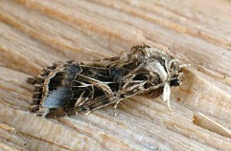
Manual Format
We are now offering each manual as a standalone Introduction and linking to individual pest datasheets.
Introduction: General survey information – will replace Guidelines document
The new format will allow us to make one datasheet for each pest and link it where appropriate and update one datasheet.
Spodoptera littoralis – 6 different manuals and on AHP listing

Slide 4
Manual Format
To date, we have offered Asian Defoliator, Exotic Wood Boring/Bark Beetle, and Palm in this new format.
Solanaceous hosts (tomato, potato, eggplant, pepper, tobacco) manual will be in this format.
All of the older manuals will be updated and offered in this format.
Will work on the older manuals in order of use/popularity of survey.
Starting with grape and stone fruit

Slide 5
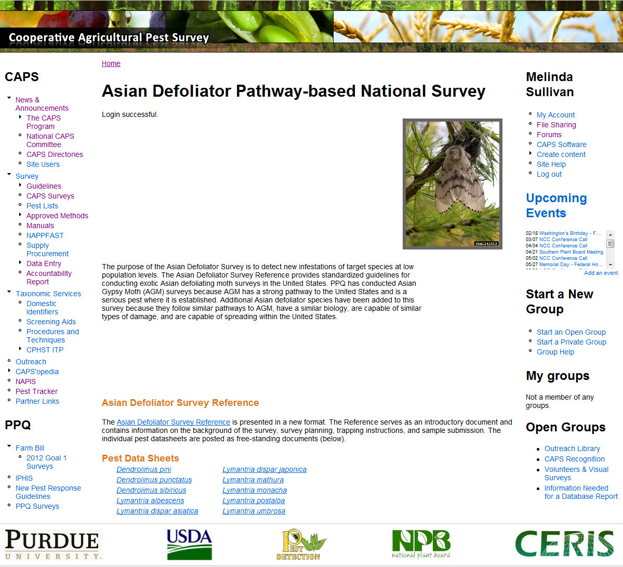

Slide 6
Manual Updates

Slide 7
Listing of Available Manuals
Commodity-Based
Taxon-Based
Corn
Cotton
Grape – FB
Oak
Palm – FB
Pine
Small Grains (wheat, oats, rye, barley)
Soybean
Stone Fruit – FB (peaches, plums, nectarines, cherries)
Exotic Wood Borer/Bark Beetle
Asian-Defoliator – FB
Notes:
Before I get started on the manual updates, I wanted to refresh your memories of the manuals that we have that are currently available. We currently have nine commodity-based manuals and two taxon-based manual available to support these CAPS or now Farm Bill surveys.

Slide 8
New Surveys for 2014
Palm
Scientific Name | Common Name
Bursaphelenchus cocophilus | Red ring nematode
Candidatus Phytoplasma palmae (16SrIV) | Lethal yellowing and related strains
Coconut cadang cadang viroid | Coconut cadang cadang viroid (CCCVd)
Darna pallivitta | Nettle caterpillar
Haplaxius crudus | American palm cixiid
Metamasius hemipterus | West Indian cane weevil
Oryctes rhinoceros | Coconut rhinoceros beetle
Paysandisia archon | Palm borer
Raoiella indica | Red palm mite
Rhabdoscelus obscurus | New Guinea sugarcane weevil
Rhynchophorus ferrugineus | Red palm weevil
Rhynchophorus palmarum | South American palm weevil
Notes:
For 2014, we offered a new survey. Several of these pests are exotic to the United States, but others are known to occur in one portion of the continental U.S. or territories but are exotic to other areas. Currently, there are a total of 11 pests in this survey (1 nematode, 1 phytoplasma, 1 viroid, 2 moths, 1 leaf/plant hopper, 1 mite, and 4 weevils).

Slide 9
New Surveys for 2014
Solanaceous Hosts
Scientific Name | Common Name
Autographa gamma | Silver Y moth
Candidatus Phytoplasma australiense 16SrXII-B | Australian grapevine yellows
Chrysodeixis chalcites | Golden twin spot moth
Diabrotica speciosa | Cucurbit beetle
Globodera pallida | Pale cyst nematode
Globodera rostochiensis | Golden nematode
Helicoverpa armigera | Old World bollworm
Meloidogyne fallax | False Columbia root-knot nematode
Meloidogyne minor | A root-knot nematode
Neoleucinodes elegantalis | Tomato fruit borer
Ralstonia solanacearum race 3 biovar 2 | Bacterial wilt; Southern bacterial wilt
Spodoptera littoralis | Egyptian cottonworm
Spodoptera litura | Cotton cutworm
Synchytrium endobioticum | Potato wart
Tecia solanivora | Guatemalan potato moth
Thaumatotibia leucotreta | False codling moth
Tuta absoluta | Tomato Leaf Miner
Notes:
For 2014, we offered a new survey. Close to delivery. Delayed slightly due to holiday, reviews, and Farm Bill commitments.

Slide 10
New Surveys Anticipated for 2015
Cyst Nematode taxon-based manual
All datasheets are completed – rough draft form
Will be posted in next few weeks
Working on Introduction (survey guidance)
Shooting for an April delivery
Mollusk taxon-based manual
Datasheets and Introduction are in progress

Slide 11
Manual/Datasheet Revisions
Changes to datasheets and manuals occur on a yearly basis
If substantial changes are made, a new version is created.
New method
Pest addition/removal
Changes are listed in the draft log at the beginning of each manual
CAPS Approved methods and forum notices (CR&C site).
Starting to apply pre- and post-assessment filters to commodity manuals as well

Slide 12
Changes to Manuals for 2014
2014 Asian Defoliator
Added: Casuarina tussock moth (Lymantria xylina) – CPHST Otis suggestion
2014 Exotic Woodborer/Bark Beetle
Removed: Red haired pine bark beetle (Hylurgus ligniperda) (deregulated)
Changed common name of Trichoferus campestris from Chinese longhorned beetle to velvet longhorned beetle – CPHST Otis suggestion
Added Black fir sawyer (Monochamus urussovii) datasheet (new 2014 AHP pests) – Listed under ‘Datasheets for Pests for Reference Only (no negative data reporting)’
2014 Grape
Added Honeydew moth (Cryptoblabes gnidiella), Flavescence dorée phytoplasma (Ca. Phytoplasma vitis), rotbrenner (Pseudopezicula tracheiphila) (new 2014 AHP pests)
Added updated pest datasheet for Australian grapevine yellows (Ca. Phytoplasma australiense)

Slide 13
Changes to Manuals for 2014
2014 Pine
Added Pine sawfly (Diprion pini) datasheet. An attractant is now available.
Added Pine witches’ broom (Ca. Phytoplasma pini) (2014 AHP Pest).
2014 Soybean
Updated Golden twin spot moth (Chrysodeixis chalcites) and Giant African snail (Lissachatina fulica) datasheets, updated the host range and distribution sections for many pests.
2014 Stone Fruit
Added Monilinia fructigena (Brown rot) (2014 AHP pest)
Updated Monilia polystroma (Asiatic brown rot) and Ca. Phytoplasma mali datasheet (apple proliferation) -find in Canada was not apple proliferation.
Deleted pest datasheet for Australian grapevine yellows (Ca. Phytoplasma australiense) – recent evidence shows find in peach was a misidentification

Slide 14
Changes to Manuals for 2014
Phytoplasmas
Phytoplasma identification is difficult, involves phloem extractions and nested PCR.
Very prone to contamination.
Confirmation of species, group, subgroup and the interpretation of results is difficult
Agreements are in place to provide phytoplasma screening services
Clemson, Texas A&M, plant pathology domestic identifiers (Craig Webb and Grace O’Keefe)
All have had training from Phytoplasma expert Dr. Robert Davis (ARS) and CPHST Beltsville lab in methods to use.
A real-time (qPCR) method for screening should be ready to roll-out to NPDN labs – currently testing with real-world samples.
Agreements are also in place for confirmations to species, group, subgroup level in cooperation with CPHST Beltsville
Dr. Robert Davis (ARS) (all non-palm samples)
Nigel Harrison (University of Florida) (palm samples)

Slide 15
What Do We Develop Next?
Do we need more commodity or taxon-based manuals?
Have we hit the major commodities?
We can look at the survey summary forms to see if there are surveys that we could develop manuals for.
The good thing about developing manuals is that surveys are more standardized, approved methods are developed, traps & lures are more standardized.
Orchard surveys (apple, pear) are popular.

Slide 16
Questions

