Slide 1
Developing a new pest prioritization model
Alison Neeley
Plant Epidemiology & Risk Analysis Laboratory

Slide 2
Analytical Hierarchy Process (AHP)
At the time of its adoption the AHP was one of the few available published techniques for prioritization
Notes:
Has been used for many years for prioritizing CAPS target pests
MCDM = Multicriteria decision methods
The methodology of the AHP is similar to that used in common sense decision making. Consequently, this methodology is quite easy for most decision makers to understand.

Slide 3

Advantages of the AHP
Useful decision tool for complex problems
Methodology is relatively simple
Both qualitative and quantitative information can be compared
Process is intuitive and easy for most decision-makers to understand
Notes:
Has been used for many years for prioritizing CAPS target pests
MCDM = Multicriteria decision methods
The methodology of the AHP is similar to that used in common sense decision making. Consequently, this methodology is quite easy for most decision makers to understand.

Slide 4

Disadvantages of the AHP
Highly subjective
  Results can be inconsistent
  Subject to a high degree of expert bias
Criteria must be independent
Not integrated with other PPQ risk assessment methods
Difficult to validate
Labor intensive
Notes:
Subject to rank reversal
If the performance of the alternatives with respect to the criteria can be quantitatively measured and the values of these performances can be represented by a linear value function, then the mAHP (S1.14) is clearly superior to the AHP in that: (i) pairwise comparisons need not be used in the determination of the ; and (ii) the results produced by the mAHP are not subject to rank reversal.
In my opinion the biggest disadvantage of using the analytic hierarchy process is that the number of comparison tables can become very large if you use a lot of comparison attributes. This can lead to a tendency to exclude valid comparison attributes in order to keep the number of calculations manageable.

Slide 5
Disadvantages of the AHP for CAPS
Results often seemed to depend on analyst/expert
Comparison between pest groups suspect
Consequences of introduction (economic/ environmental impacts) are a function of the biology of a pest, not an independent criteria
No way to look at regional differences for pest risk
Analysis based on scientific criteria was not separated from criteria based on policy
Difficult to validate
Notes:
Subject to rank reversal
If the performance of the alternatives with respect to the criteria can be quantitatively measured and the values of these performances can be represented by a linear value function, then the mAHP (S1.14) is clearly superior to the AHP in that: (i) pairwise comparisons need not be used in the determination of the ; and (ii) the results produced by the mAHP are not subject to rank reversal.
In my opinion the biggest disadvantage of using the analytic hierarchy process is that the number of comparison tables can become very large if you use a lot of comparison attributes. This can lead to a tendency to exclude valid comparison attributes in order to keep the number of calculations manageable.

Slide 6
Is there a better model to prioritize pests?
A pest prioritization process that would improve on the existing AHP process should be:
  Data driven
  Objective
  Rapid
  Use proven pest prioritization techniques
  Use relevant PPQ data and methods
* PPQ’s Weed Risk Assessment Model
Notes:
Such a process would allow for:
would allow a larger pest universe to be ranked
could be used to develop lists for specific types of pest surveys
The new technique, once refined and tested, would ultimately provide better allocation of scarce resources for managing high priority plant pests.

Slide 7
PPQ’s Weed Risk Assessment Process
Very successful tool for evaluating the “invasive” potential of plants
Widely evaluated, tested, and validated
Adopted by other stakeholders
WRA
Guidelines

Slide 8
New Pest Prioritization Model
Goal: Develop an accurate & quick pest prioritization process that:
  Relates analysis of pest biology to potential economic and environmental consequences
  Minimizes expert bias
  Appropriate for different pest types
  Can be tested and validated
  Separates analysis based on scientific information from that based on policy

Slide 9
Pest Ranking Model (CAPS)
Total Score
Impact Potential of Pest
Value at Risk
Entry Potential of Pest
Geographic Potential
Host Range (Value of hosts)
Predictive model
(Physical loss)
Spread
Damage potential
Mitigating factors
Likelihood of entry

Slide 10
Predictive Model for Impact Potential
Currently 2 models: arthropods and pathogens
Developed a set of questions we think will be predictive of impact
  Establishment & spread potential
  Damage Potential
  Mitigating Factors
Developed Guidance for answering questions consistently

Slide 11
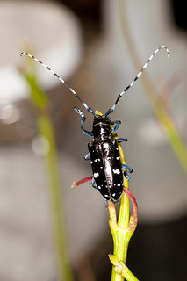
Arthropod Model
Model Template
Guidance Document
Notes:
Here are some sample questions from our 2 predictive risk elements

Slide 12

Developing Predictive Model for Impact Potential
Identified about 100 non-native pests that have become established in the United States
PERAL economics team is evaluating each
pest in terms of observed impacts
Pests grouped into three categories:
  major/high impact pest
  minor pest
  non-pest

Slide 13
Arthropod Model
List of Pests
Notes:
Here are some sample questions from our 2 predictive risk elements

Slide 14
Developing Predictive Model for Impact Potential
Currently analyzing these trial pests as if they are not present in the United States to determine which questions are best at predicting impact
Team meets weekly to review each assessment and to check for inter-assessor consistency

Slide 15
Arthropod Model
Completed Assessment
Notes:
Here are some sample questions from our 2 predictive risk elements

Slide 16
Developing Predictive Model for Impact Potential: Scoring System
Using dataset we will…
Assess the explanatory power of every question by comparing results of each assessment to actual observed impact
  Eliminate questions with no predictive power
Develop Scoring System
  Weight predictive questions more
  Idea is to maximize risk score separation
    ANOVA

Slide 17
Invasiveness elsewhere (X²=83.0***)
Self-compatible (X²=5.3)
34 34 34
29 23 27
F
E
F
Yes
D
E
B
C
A
No
B
E
Geophyte (X²=0.1)
Forms seed banks (X²=8.3**)
34 34 34
30 21 6
Yes
Yes
No
No
?
Notes:
Explain colors
I don’t have time to show you the results from all of the questions, but I will share with you results from a few. By far, the most predictive question we had, that is to say, the question with the largest chi-square value was the questions about a species invasive status elsewhere in the world. In this graph, you can see our 3 apriori categories. You can also see that virtually all of the major-invaders were invasive elsewhere in the world. In contrast, only 1 non-invader was invasive elsewhere. Shown in dark green are all of the species that have been introduced elsewhere in the world, 75 years or more, and have not shown any evidence of naturalizing or escaping cultivation. Almost all of these species are non-invaders. Because this question was the most predictive, we weighted it more than the others.
Next is the question about whether the species has been intentionally introduced elsewhere outside of its range. Here we see that non-invaders had a greater proportion of yes’s than the other the other categories. BTW, so you know, answers shown in red are answers that contribute to invasiveness whereas green ones do not. Results from this question were opposite of what we expected, so this question, which is significant, actually hurt our attempt to predict invasive species. We removed this question from our model.
We also removed the question about being a geophyte, because it did not contribute anything to our predictive model. Not only was this question not significant, there wasn’t even a clear trend in one direction or another.
Finally, this next case is a good example of the types of patterns we saw in some of the questions. We had a very significant chi-square value for this question, but when you examine the results, you much of that signficance is due to a non-random distribution of species that answered unknown for this question. As you see, a much greater proportion of non-invaders answered unknown, than minors, than majors. This should not be surprising as a there will be much more literature available about major invaders than other categories. So, we species answering unknown, from this chi-square analysis. That Chi-square value that you see here, and that for all of the examples I show, you are based on datasets where we have removed the unknowns. In this case, this question is still predictive. That is, a greater proportion of species that form seeds banks are major invaders.

Slide 18
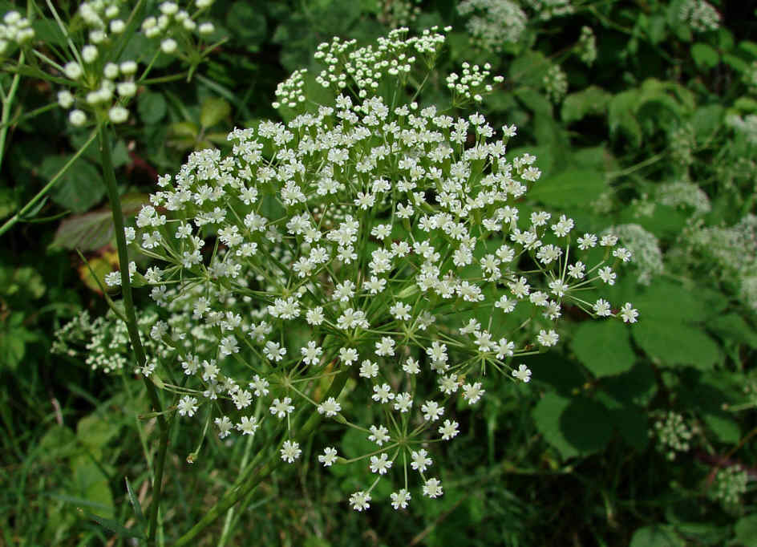
EXAMPLE
Weed Risk Assessment : Falcaria vulgaris

Slide 19
Developing Predictive Model for Impact Potential: Scoring System
Logistic regression
  Type of statistical analysis that uses continuous and discrete variables to predict the probability of occurrence of a discrete event
    Probability of being a Major Pest
    Probability of being a Minor Pest
    Probability of being a Non-pest
Different pest groups can be ranked together (even though they have different criteria) based on their likelihood of being a Major/High impact pest

Slide 20
The Logistic Regression Model (PPQ Weed Risk Assessment)
(0.2356*ES – 0.6019*Imp)

Slide 21
Description of Uncertainty
Summarize & describe uncertainty for each risk element
  How confident are we in our results?
  Would additional/ better information be likely to change our results?

Slide 22
Validating the Model
Using a separate dataset we will…
Assess the ability of the weighted model to identify major, minor, and non-pests
  Identify an additional 100 or so non-native arthropods, currently established in the United States
  Assess as if they are not in the United States using weighted model
  Determine how well weighted model predicts actual, observed impact

Slide 23
2013 Accomplishments
Identified 100 arthropods to analyze for developing the model
Finalized the set of initial questions for arthropod model
Developed detail guidance for answering model questions in order to ensure consistency in answering questions

Slide 24
2013 Accomplishments
Analyzed & reviewed just over 50 arthropods
Developed work plan and position descriptions for research assistant (biological science technician equivalent) and statistician (research associate)
Hired research assistant to begin organizing pest reports and data
Advertised for statistician and selected candidates (interviews will begin as soon as NC State approves choices)

Slide 25
Immediate Next Steps
Finish analyzing arthropods
Statistical analysis of arthropod dataset and development of weighting/scoring system
Finalize the set of initial questions for Plant Pathology model
Finish guidance for answering each of the questions
Finalize list of plant pathogens pests to analyze

Slide 26
2014 Target Dates
Task | Target Completion Date
Finish Plant Pathogen model questions and guidance | March 2014
Complete analysis of arthropods | March 2014
Statistical analysis of arthropods | May 2014
Complete preliminary arthropod model | June 2014
Complete analysis of plant pathogens | August 2014
Pilot test model with arthropods on current AHP list | August 2014
Run new arthropods through model | September 2014
Statistical analysis of plant pathogens | September 2014
Complete preliminary arthropod model | October 2014
Pilot test plant pathogen model | November 2014
Run new path pathogens through model | December 2014

Slide 27
Long-term Plan
Next year (2015):
Validate arthropod and plant pathogen models
Develop model for nematodes
Develop model for mollusks
Develop web-based system for using model

Slide 28
Pest Prioritization Modeling Team
PERAL
  Economists: Alison Neeley, Trang Vo
  Entomologists: Jim Smith, Leslie Newton, Glenn Fowler, Heather Moylett, Cynthia Landry
  Plant Pathologists: Heather Hartzog, Larry Brown, John Rogers
CPHST CAPS Core Team
  Lisa Jackson, Melinda Sullivan, Daniel Mackesy, Talitha Molet
Others
  Andrea Lemay, PPD interns, CIPM

Slide 29
Questions??

