Slide 1
NAPIS 3.0
Just do it or stop thinking.
Notes:
LOG IN AS ANNIE
Have napis-test open and logged in as Annie
Philosophical musings
Screenshot tour of NAPIS 3
Live demo
Testing plan
Discussion
SLOW DOWN
Some of you are probably wondering, why is NAPIS coming out with a new version. ISIS and IPHIS have been on the horizon. This was the case in 2006 when I joined the NAPIS team. The answer to the ‘why a new version’ question is ‘if we don’t, we will have to stop thinking. (next slide)

Slide 2
Why Convert?
History
Technology
User Experience
Notes:
SLOW DOWN
Let me tell you what we’ve been thinking about. We call the new NAPIS that I’m showing you today, NAPIS 3.0
(Bubble forward)
For historical context:
NAPIS 1 was the original telnet version that was used from 1985 to about 2000.
NAPIS 2 is the web based version that was first available in 1998 through the current NAPIS web application that was introduced in 2004.
NAPIS 1 and 2 have used a proprietary database and software
the license is costly and
programmers familiar with the system are hard to come by.
(Bubble forward) SLOW DOWN
Since 2006 we’ve built new functionality using open source environmet.
We refresh the survey data to the new platform early each morning to support
Pest Tracker and
CAPS tools like
The Accountability Report,
Approved Methods and the
Survey Summary work flow.
Once daily data updates constrain the function of new applications and
keeping everything in sync between the two environments is resource draining monkey work.
This conversion brings the NAPIS and CAPS applications together on one platform.
(Bubble forward) SLOW DOWN
We’ve been thinking about usability improvements.
Generating reports is a multi page process in NAPIS 2. We wanted to minimize the number of page loads and improve response time.
The SAS mapping technology used by NAPIS 2 is cumbersome, we’ve been using ARC GIS maps in Pest Tracker. Using ARC GIS maps in NAPIS 3.0 gives you more features and consolidates our toolset.
The conversion is an opportunity to build flexibility into the data set so that new elements can be added.
We’ve been thinking a lot about data entry. The steepest learning curve with NAPIS is data entry. We’ve coded validation rules into the single record entry and added a template feature that I’ll demonstrate later.
(Bubble forward) SLOW DOWN
So we got up wrote the conversion into our cooperative agreement for 2013. Kathy Handy visited us about this time last year and made 1 firm ‘suggestion’, that NAPIS 3.0 remain familiar to users. This became a guiding principle of the conversion.
(Bubble forward)
We’ve been working on the conversion for over a year now. Internal testing has taken us about as far as we can go. Now we need your input.

Slide 3
Log in
Notes:
Use CAPS R&C credentials to log in. SLOW DOWN

Slide 4
Home Page
Notes:
SLOW DOWN
The home page displays your user profile and you can click through to the CAPS site (for the time being you’ll need to log in there as well) and update profile information.
NAPIS 3.0 has a horizontal tool bar with the same basic menu items at NAPIS 2.0, but grouped a bit differently.
Data Entry
Reports
Survey Maps
Dictionaries and Support
(next slide)

Slide 5
Reports
Notes:
SLOW DOWN
We’ll look at the data entry menu, live, later.
So lets take a screen-shot tour of the remaining menu items.
The custom reports that were available in NAPIS 2.0 are available in NAPIS 3.0.
Custom reports are simply ad-hoc reports with certain filter values pre-determined.
(next slide)

Slide 6
Ad Hoc Reports
Notes:
SLOW DOWN
The first reports page defines the set of records that you would like return from the database.
This page should be familiar to folks that use NAPIS 2.0 reports.
The primary difference is the multiple value selection mechanism.
When you type a search string of three characters or more and click select or press enter, you will (next slide)

Slide 7
Multiple Selection Mechanism
Notes:
… be presented with a list of all survey targets that have the search string in the scientific or common name. Choose the organism or organisms that you would like to see in the report and confirm your selection. (new slide) SLOW DOWN

Slide 8
Output Format
Notes:
When you have selected all desired filters, proceed to the output page. SLOW DOWN

Slide 9
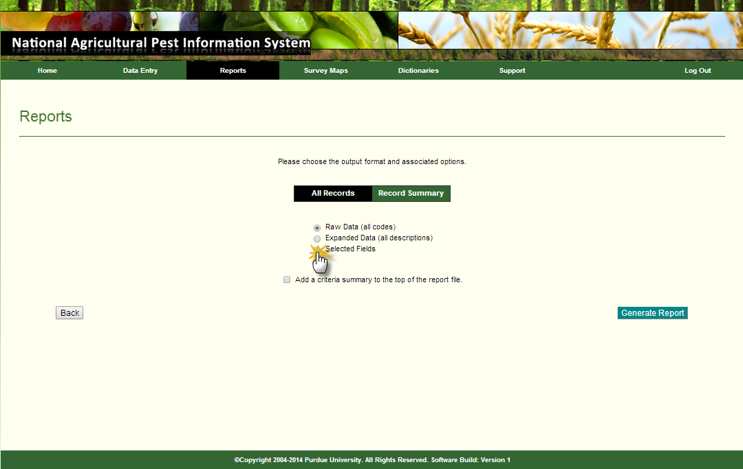
Record Level Reports
Notes:
You may choose raw data (all codes) or expanded data (all descriptions) output formats. Choosing either of these options will immediately download a file containing the data. SLOW DOWN
Choosing the selected fields options (next slide)

Slide 10
Selected Fields Report
Notes:
Allows you to choose the columns that you want in the file.
There are value added variations of observation Date; Year or Year-Month,
Or State or State County,
And you can choose Code or Description or both Code and Description.
Clicking ‘Generate Report’ downloads a file.
While the ‘All Records’ options are useful in some situations the record summary report option is a good way to get started with analysis of a data set that you are not familiar with. (next slide)

Slide 11
Summary Reports
Notes:
A record summary report helps you wrap your mind around the data.
This form gives you the same functionality as you had in NAPIS 2.0.
Questions about reports?
SLOW DOWN
Moving to maps.
(next slide)

Slide 12
Map Making
Notes:
Selecting criteria for survey data maps in NAPIS 3 uses a form similar to NAPIS 2.
You select the observation date range, the survey target pest, the map geography, and whether the map should show negative data only for surveys in the most recent three years.
NAPIS 3 uses ARC GIS mapping.
When you display the map the server will evaluate all of the data you selected and produce (Next Slide)
SLOW DOWN

Slide 13
Map Print View
Notes:
A map. This uses ARC GIS mapping software that is used to make the Pest Tracker maps. The map features are the same as well, zoom, pan, identify counties, hide labels and print view. This is the print view of the map.

Slide 14
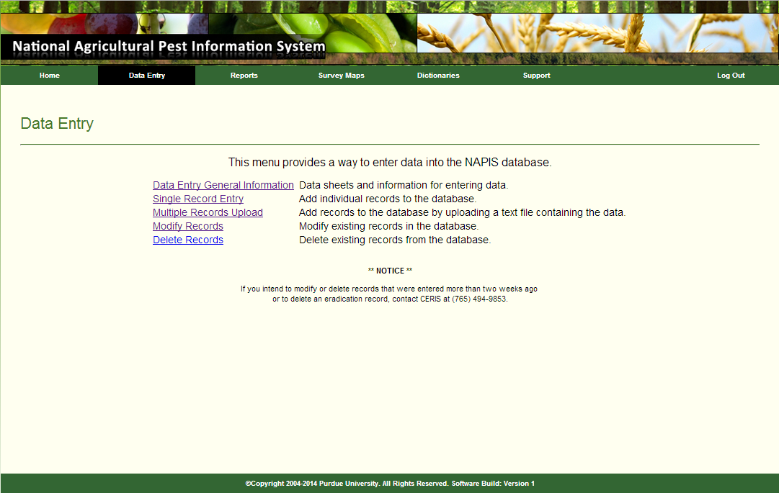
Data Entry
Notes:
In the remaining time we can look at data entry. The data entry forms, adhere to Kathy’s guidance, retaining familiarity with NAPIS 2. (next slide)

Slide 15
Multiple Record Upload
Notes:
The Multiple record upload page is almost identical to the current NAPIS with one big difference…
Only .xls or .xlsx files an be loaded.
The first row column heads identify the data and must be match the column head definitions.
Data validations in 3 just as it does in 2.
General templates can be downloaded from the links.
These templates contain the three new fields.
With the addition of the required funding data the single record entry has been

Slide 16
New Data Elements
Funding Year
Funding Source
Survey Name
Collected in the Survey Summary Form
Use Single Record Entry to create a template

Slide 17
Single Record
Notes:
Smart form
Template production
Go to live

Slide 18
Testing
NCC open testing.
napis-test.ceris.purdue.edu.
Send feedback to napis@purdue.edu
User acceptance testing in February
Open testing in March
Implementation April 1

Slide 19
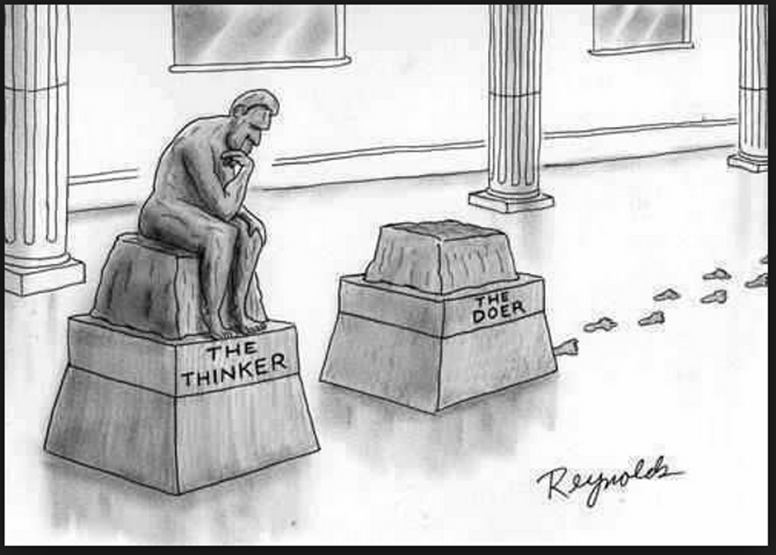
Just do it or stop thinking.
Programmers
James Kruse
David McClure
Testers
Kathy Handy
Cindy Music
Eileen Luke
Joe Hegarty
Notes:
Putting NAPIS 3.0 into production gives us a bit more thinking time. You are invited to share your thoughts with us.
NAPIS 3.1
1. A mechanism to toggle between your user information and a ‘task list’. Eg.
CAPS data due 3/31/2014
Corn Commodity Survey
EWB/BB Survey
Survey Summary due 8/26/2014
2. Data entry aids
3. My reports/maps
4. Single login event for both CAPS and NAPIS

