Slide 1
Geospatial Support for the CAPS Program the next chapter
Lisa Kennaway & Gericke Cook
USDA APHIS PPQ Science &Technology
Applied Geospatial Technology Program
February 4, 2015

Slide 2
Presentation Outline
Overview of past mapping support
Ideas for future mapping support
Test case #1 – Old World Bollworm
Test case #2 – False Codling Moth
Other items for discussion

Slide 3
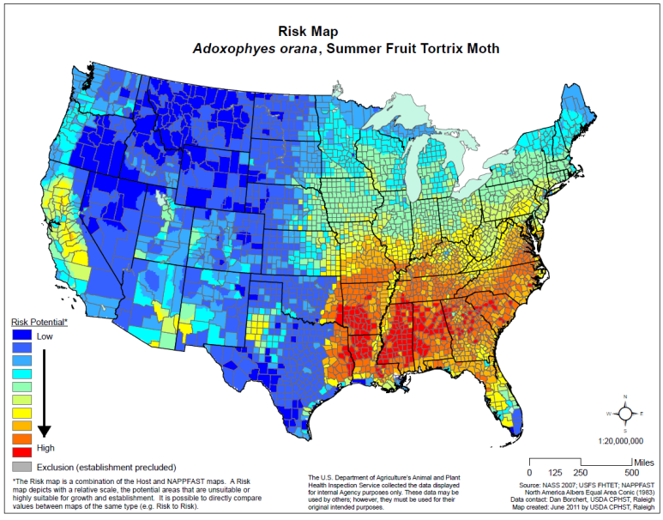
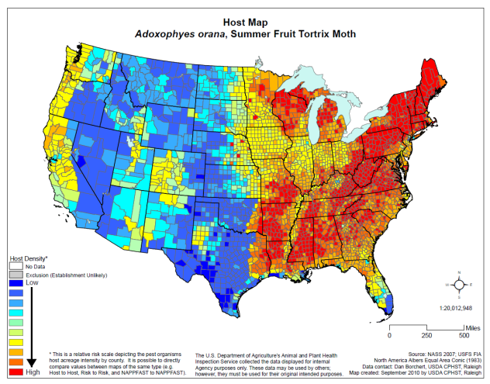
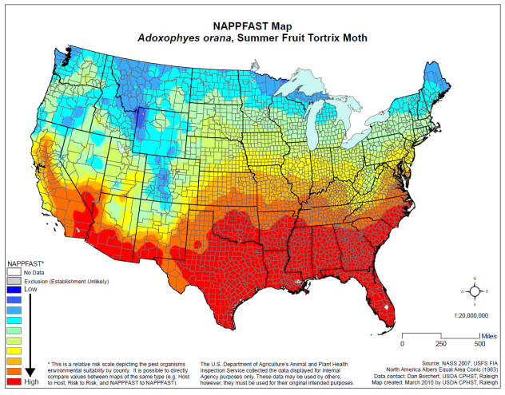
Past Geospatial Support
Identify areas at highest risk for plant pest introduction and/or establishment
Host and biology data and risk maps
Trade issues

Slide 4
Future Mapping Support
Build upon what was working
Work closely with CAPS team to identify appropriate input data, accepted assumptions, and visualization goals.
Implement standard procedures
Map look and feel
Map/document tracking
Required review
Archiving
Store and access everything in-house
Be dynamic and transparent
Document, document, document!

Slide 5
CAPS Geospatial Support Workflow
Need Identified
CAPS
Map/Analysis Requested
CAPS
Data Compiled/Draft Analysis Complete
GIS
Biology, Climate, & Cartographic Review
CAPS
GIS
SME
Final Product Delivered
GIS
Product Archived
GIS

Slide 6
Past Data Sources Future Data Sources
Climate
NAPPFAST
Host
NASS 2007
USFS (FIA, FHTET)
Distribution
Global Biodiversity Info Facility
Literature
Climate
BioSIM 10
USPest
SAFARIS
Others as appropriate
Host
NASS 2007
USFS (FIA, FHTET)
Others as appropriate
Distribution
Global Biodiversity Info Facility
Literature
PPQ
Others as appropriate

Slide 7
Proposed Approach
Develop a catalog of agricultural and forest data and maps
Keep the data/maps separate to allow dynamic access
For a pest of concern, select appropriate hosts from catalog
Use individual hosts maps
Use normalized combined host density maps
Develop a catalog of pest climatic thresholds maps
Multiple lifestage model
Accumulates degree days subject to upper and lower threshold limits
Tracks lifestage and number of generations over time
Evaluate needs to combine host and biology into one map either cartographically or analytically

Slide 8
Old World Bollworm
Test Case #1

Slide 9
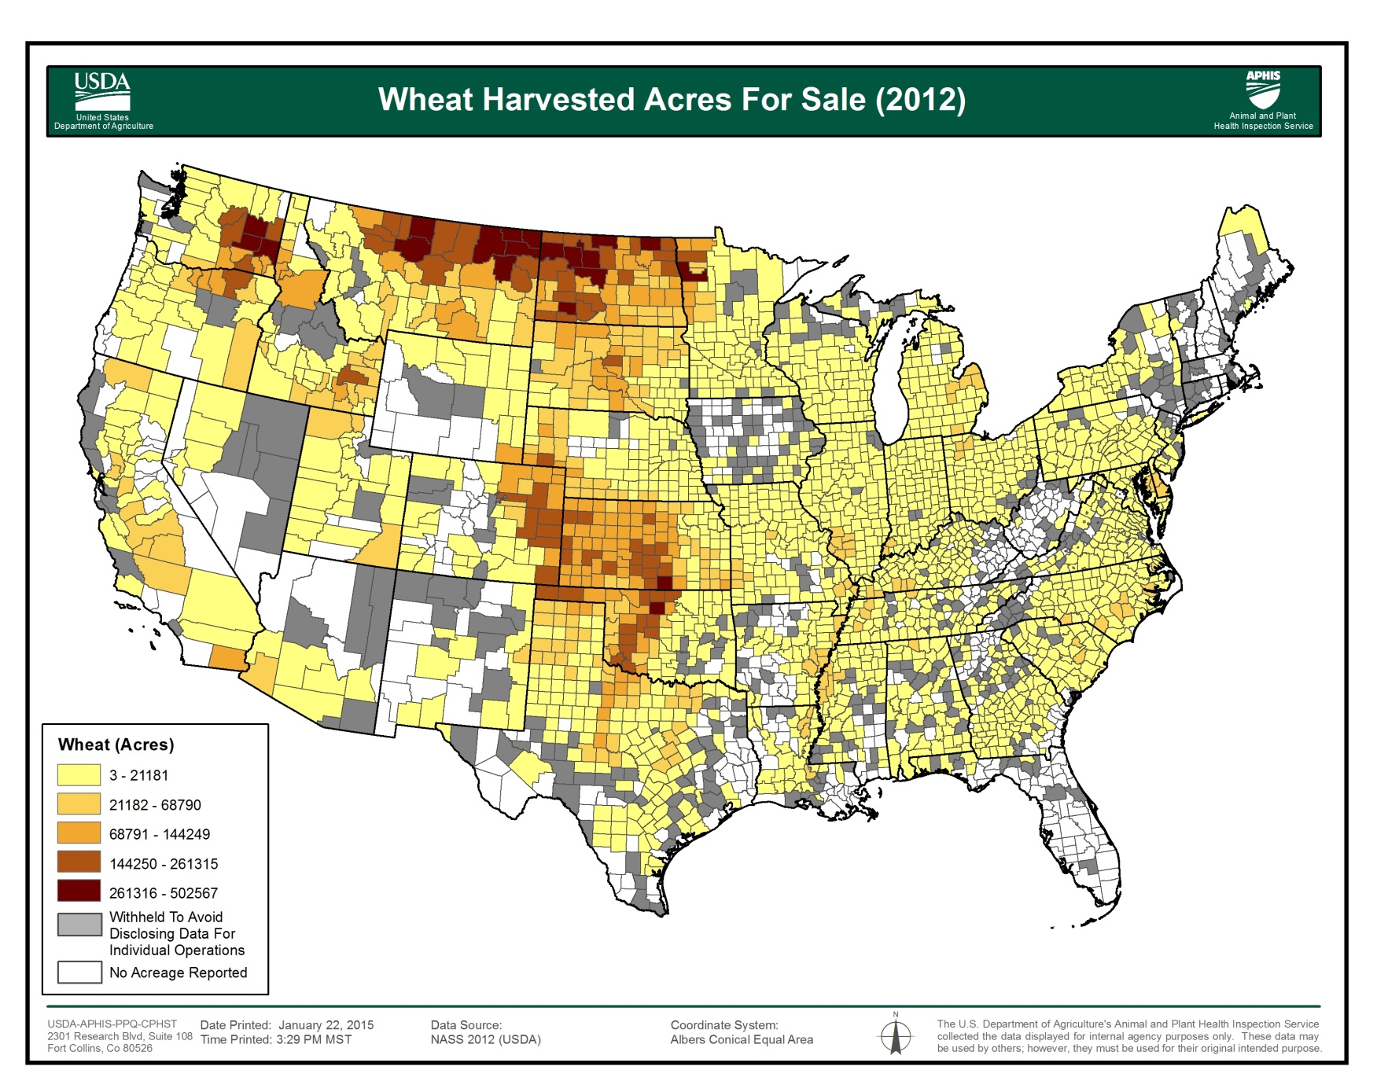
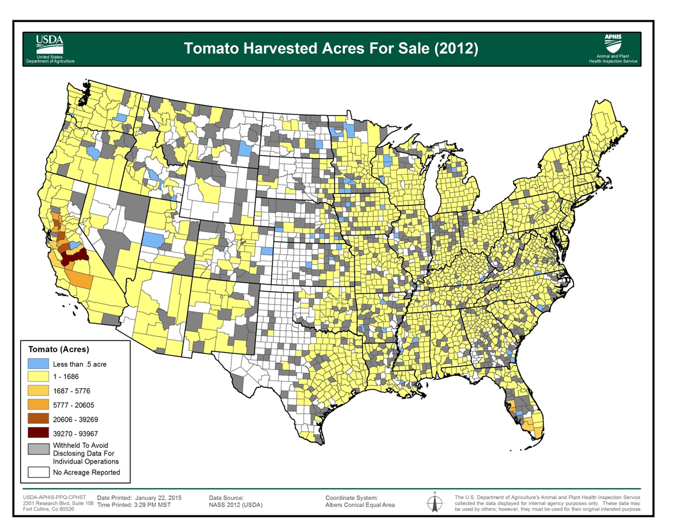
Thoughts on new color schema and potential impacts of NASS withheld data?
Old World BollWorm - Host
Step 1 – Compile individual host data layers

Slide 10
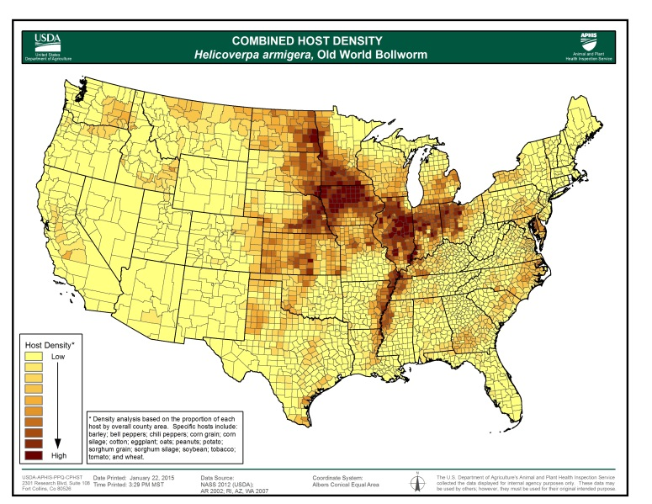
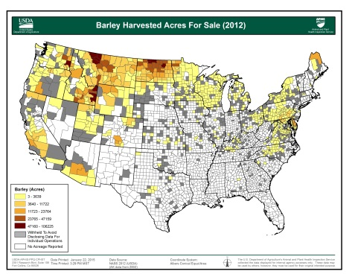
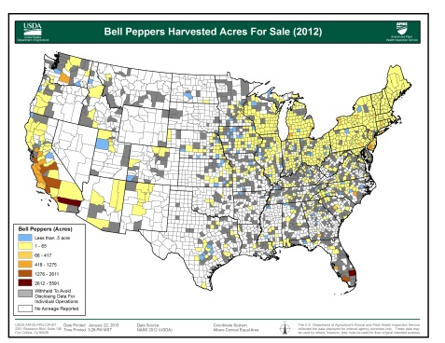
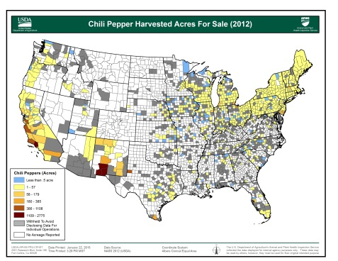
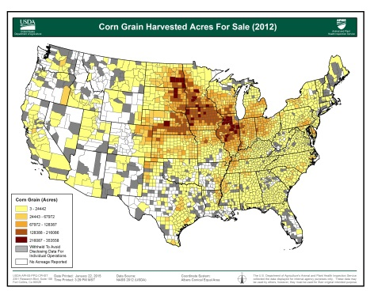
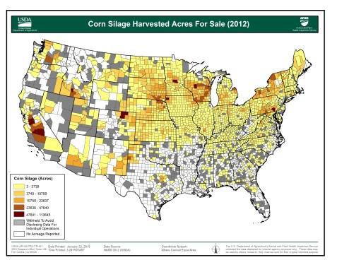
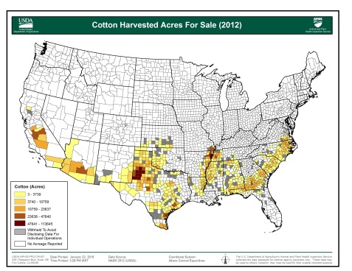
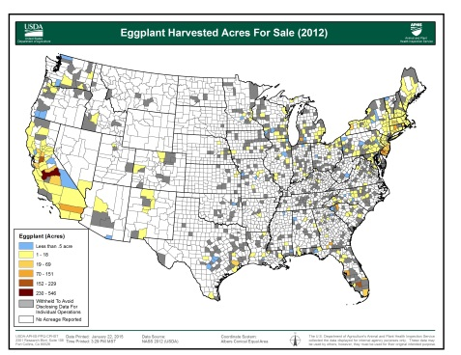
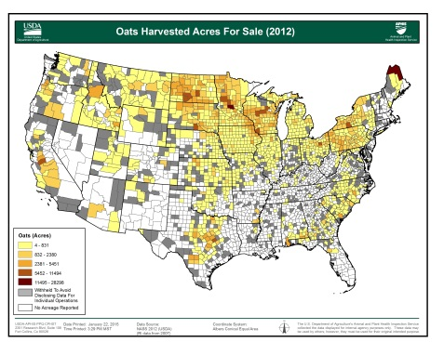
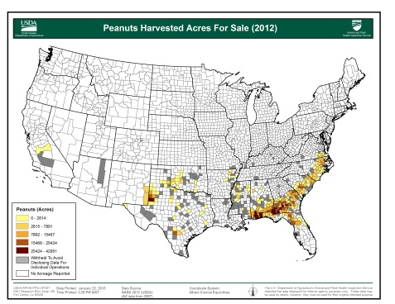
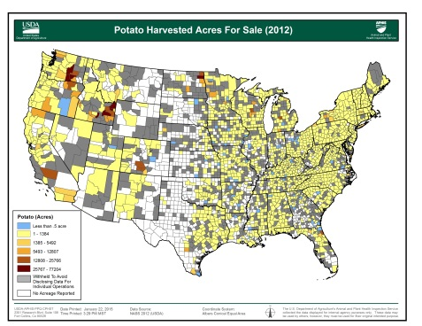
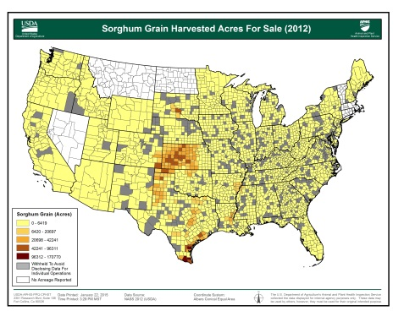
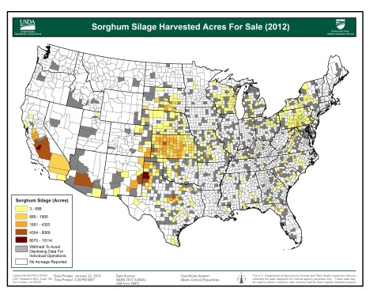
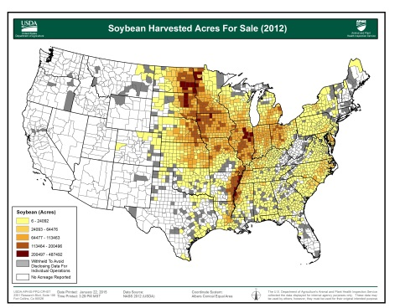
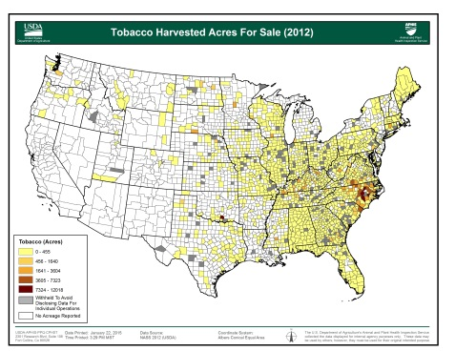
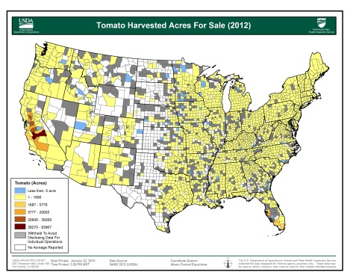
Old World BollWorm - Host
Step 2 – Combine host data layers
Normalize harvested acres by county area

Slide 11
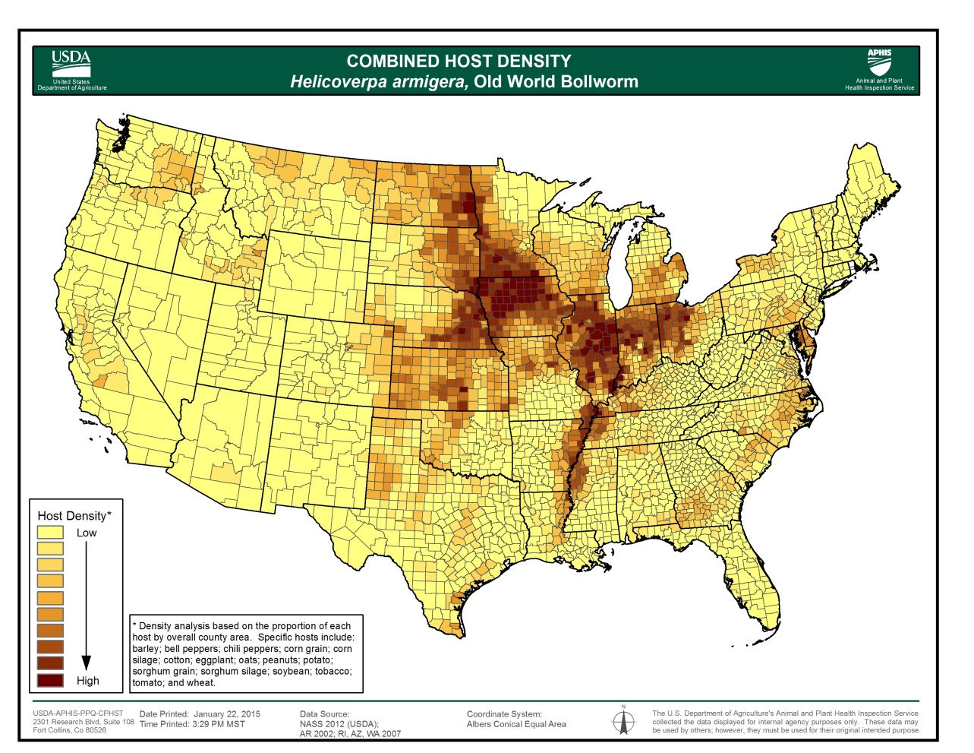
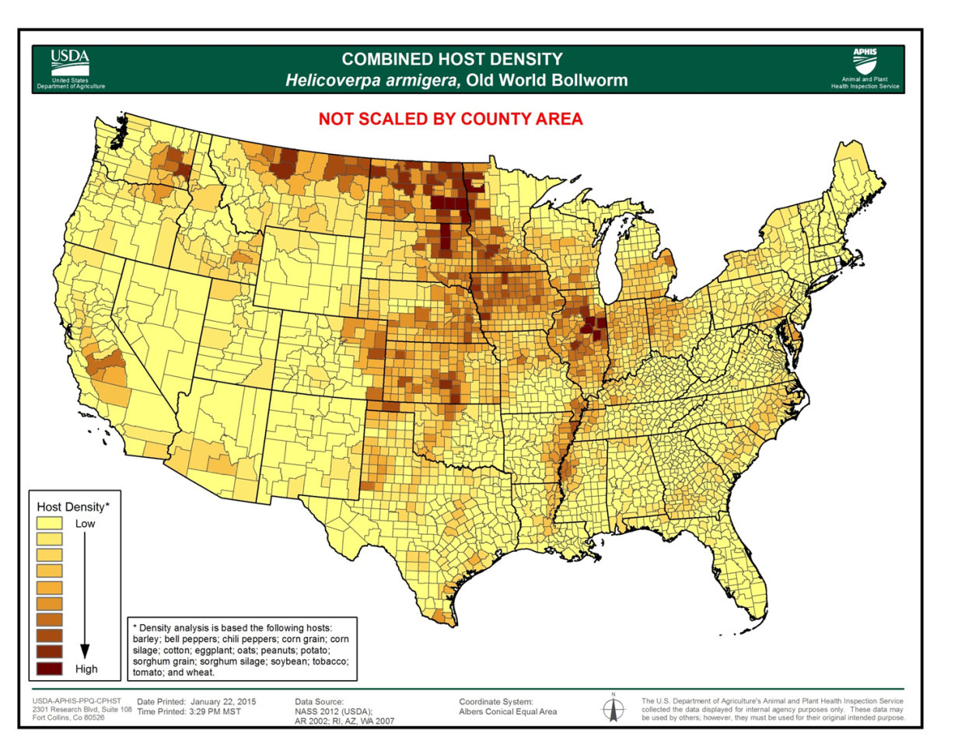
Thoughts on normalizing host area by county area?

Slide 12
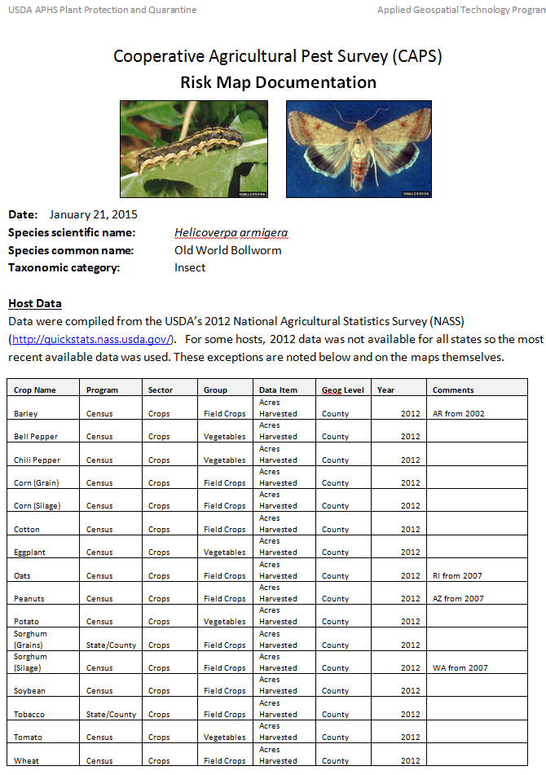
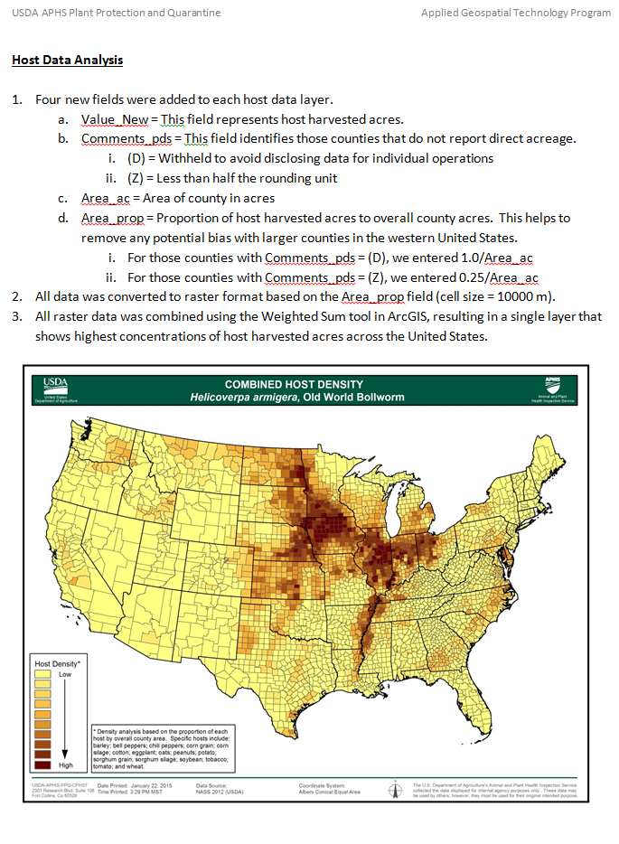
Old World BollWorm
Step 3 – Develop climate thresholds data/analysis (PENDING)
Step 4 – Combine host and climate data, analytically or cartographically (PENDING)
Step 5 - Create map documentation

Slide 13
Old World BollWorm - Host
Can this information be used to support efficient survey funding?
Step 6 – Incorporate into CAPS datasheets and other program support tools/documents.
States who planned to survey for H. armigera as mentioned in the j3s:
2010: CAPS: CO, DE, IN, KY, ME, ND, OH, SD, TN, UT, WI
2011: CAPS: CO, FL(2), ID, IN, KY(2), MA, ND, OH, SC, TX(2), UT, WI
2012: CAPS: CO, FL(2), IN, KY(2), ME, MN, ND, OH, RI, SD, TX, UT, WY FB: FL, UT
2013: CAPS: AR, CO(2), FL(3), IA, IN(3), KY(3), ME, MN, MT, ND, NY, OH(2), OR, RI, TN(2), TX, UT, WY FB: FL, GA, MD(2), TN, UT PPQ: AL, GA(3), LA, MI, MS, NC, TN(2), WV
2014: CAPS: AR, CO(2), FL(3), IN(3), KS, KY(3), ME, MI, MN, ND, NM, OH(2), SC, SD(2), TN(2), TX, UT(2), WV, WY FB: FL, GA, MD(2), MN, NC, OR, UT(2) PPQ: AL, GA, LA, MS, NC, PR, TN, WV

Slide 14
False Codling Moth
Test Case #2

Slide 15
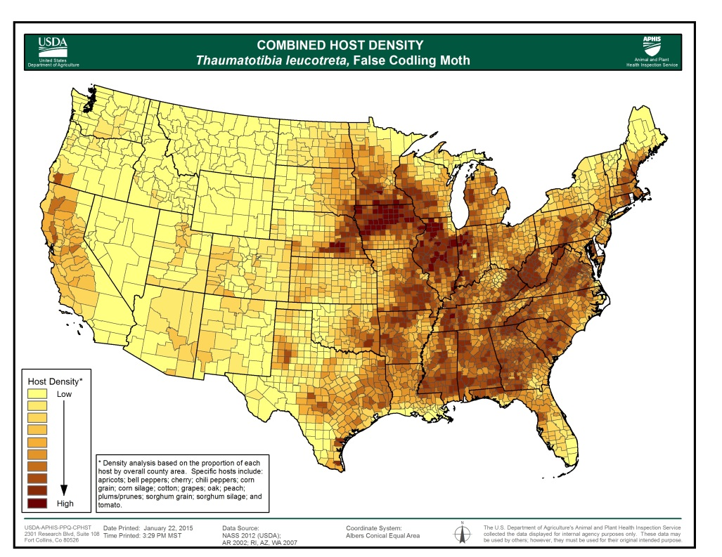
False Codling Moth - Host
Step 1 - Compile individual host data layers
Step 2 – Combine host data layers
Normalize harvested acres by county area
Normalize presence only forest data to proportion per county
Weight forest host lower to de-emphasize its overall contribution

Slide 16
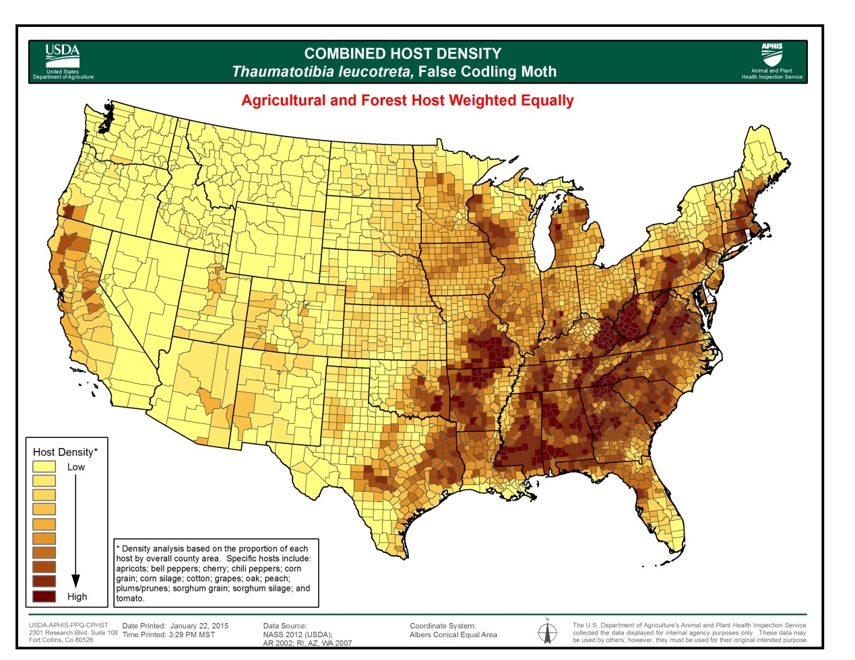
Thoughts on weighting the forest layer(s) less so that the agricultural hosts are not underrepresented? Maybe this is pest dependent?

Slide 17
False Codling Moth - Climate
Degree Day Calculation: Prior Method
Inputs
Daily Calculations
Output
Accumulated DD
Base Temp = 12˚C
Upper Threshold = 40˚C
DD threshold = 450
Exclusion = -3 $\text{˚}$C
day 2
day 3
day 1
$$DD=\sum_{1}^{365}{dd}$$
<12 $\text{˚}$C
12 < T_{avg} < 40
>= 40 $\text{˚}\text{C}$
$$\left\{\begin{aligned}dd=0 \\ dd= Tavg −12\text{˚}C \\ dd= 40\text{˚}C −12\text{˚}C\end{aligned}\right.$$
Number Generations
$≅$ DD/450
Average Daily Temperature
day 2
day 3
Exclusion
day 1
$$if \sum{E ≥5}$$
$$\text{E}\text{ =}\text{Tavg} ≤−3℃ \left\{\begin{aligned}1 \\ 0\end{aligned}\right.$$

Slide 18
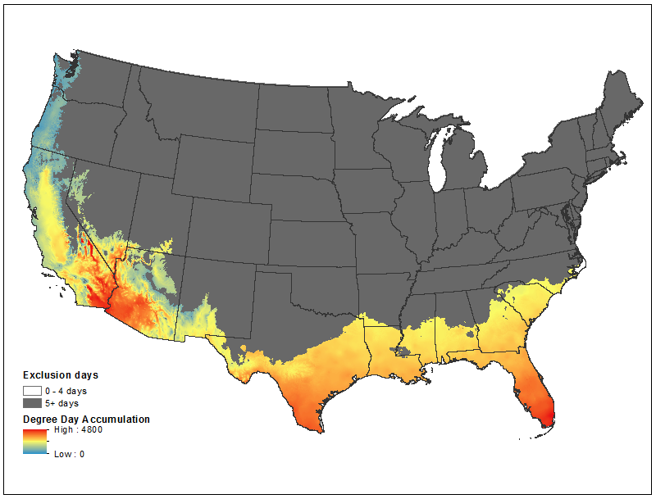
False Codling Moth - Climate
Degree Day Map With Exclusion

Slide 19
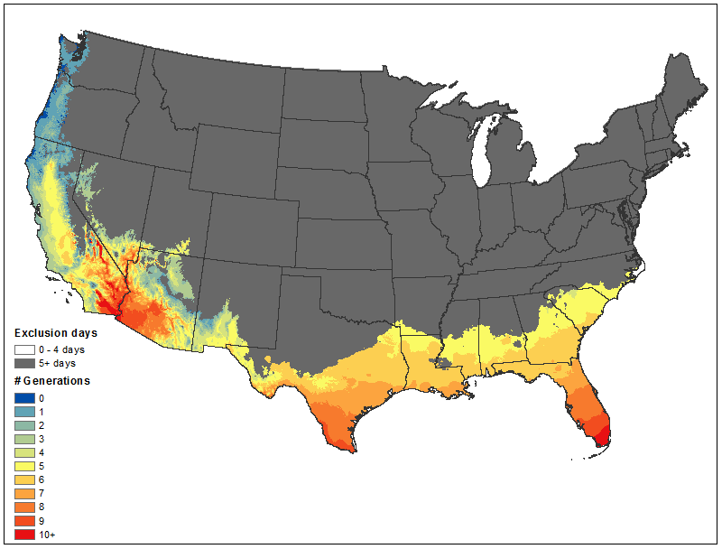
Generations map with exclusion
False Codling Moth - Climate
Degree Day Map With Exclusion

Slide 20
False Codling Moth - Climate
(Implied) Model Assumptions
Single base temperature threshold and critical temperature for larval period describes entire lifecycle.
Upper temperatures not usually described as lethal exclusion surfaces, just a maximum temperature for DD calculation.
Degree day accumulation and exclusion calculations are independent, (i.e. an exclusion occurring in January doesn’t prevent degree day accumulation for that generation).
Generations in multivoltine pests are independent.

Slide 21
False Codling Moth - Climate
Exploring New Methods
Multiple Lifestage Model – base temperatures, DD thresholds, and critical exclusion temperatures for each lifestage
If upper temperature is given, determine if temperature is described as lethal (i.e. another type of exclusion)
Calculate exclusion simultaneously with degee day accumulation.
Make next generation accumulation dependent if prior generation succeeded (no oviposition without adults)

Slide 22
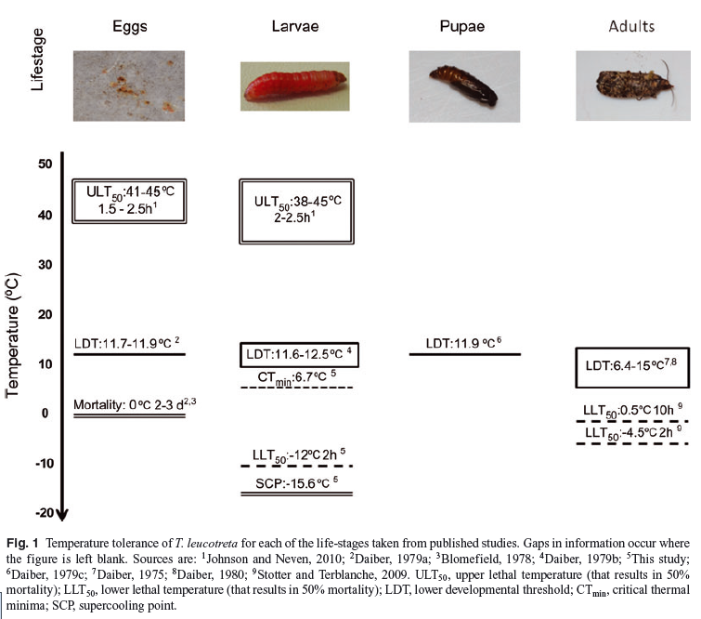
False Codling Moth - Climate
Multiple Lifestage Model
Temperature Range for DD Accumulation
Source: Boardman, Grout, and Terblanche (2012) “False Codling Moth Thaumatotibia leucotreta
(Lepidoptera, Torticidae) larvae are chill-susceptible. Insect Science 19: 315-328.

Slide 23
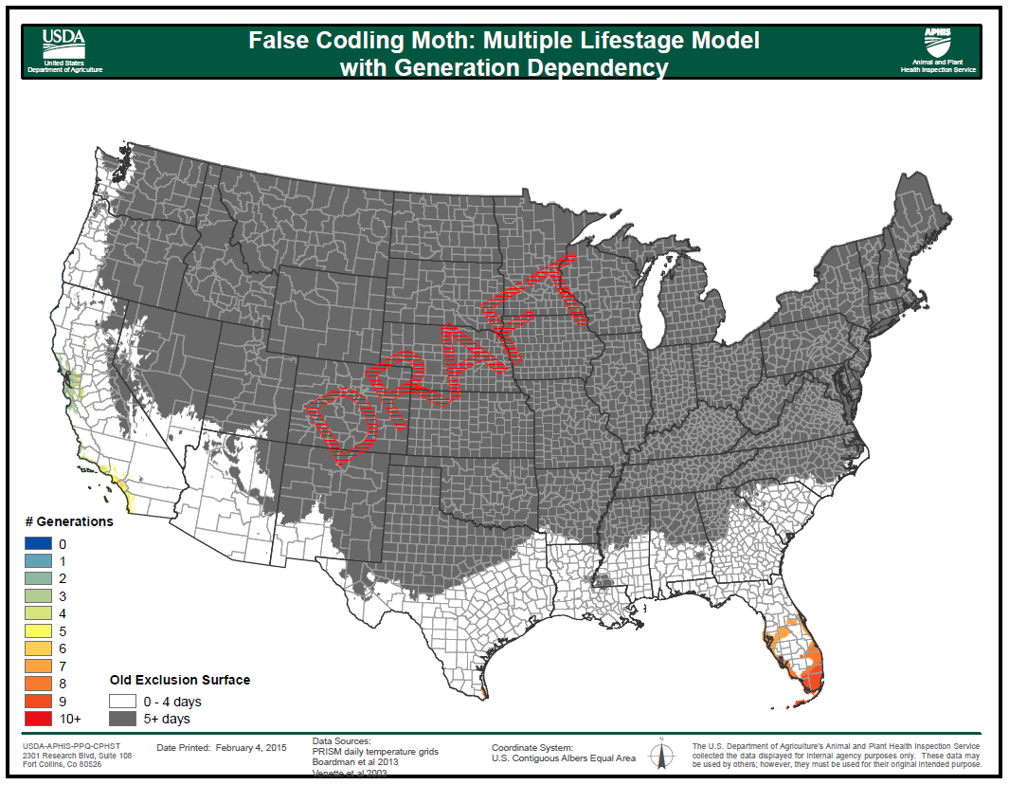
False Codling Moth - Climate
DRAFT MAP: Multiple Lifestage Model with Generation Dependency
Notes:
Incredible reduction in area. I looked at Tmax exclusion surfaces and this result appears to be driven by generation dependency.

Slide 24
False Codling Moth – Host & Climate
Step 3 – Combine host and climate, analytically or cartographically
Step 4 - Create map documentation.
Step 5 – Incorporate into CAPS datasheets and other program support tools/documents.
Can this information be used to support efficient survey funding?
States who planned to survey for T. leucotreta as mentioned in the j3s
2010: CAPS: CO, ID, IL, KY, MD, MO, MT, NC, OK, VT
2011: CAPS: IL, KS, KY(3), MD, MT, NY, OH, OK, SC, SD, TX(2), UT, VT, WV
2012: CAPS: CO, FL, ID, IL, KS, KY(3), MI, NY, OH(2), OK, RI(2), SC, SD, TX(2), WV FB: CA, CO, GA(2), MT, NC, OR, SC, UT, WV(2)
2013: CAPS: AR, CO, FL, KS, KY(2), ME, MI, NC, OH(2), RI, TX(3), WV FB: CA, CO, GA, KY, MD(2), MI, OR, RI, SC, UT, WV(2) PPQ: AL, GA(4), LA, MS, TN
2014: CAPS: AR, CO, FL, GA, KY(2), ME, MI, NC, NH, NM, OH, OK, TX(2), WY FB: CA, CO(2), GA(2), KY, MD(3), NH, NY, OR(2), UT, WV(2) PPQ: AL, GA(4), MS(2), OK(3), TN, WV

Slide 25
One More Discussion Item
Geospatial Support for CAPS Program

Slide 26
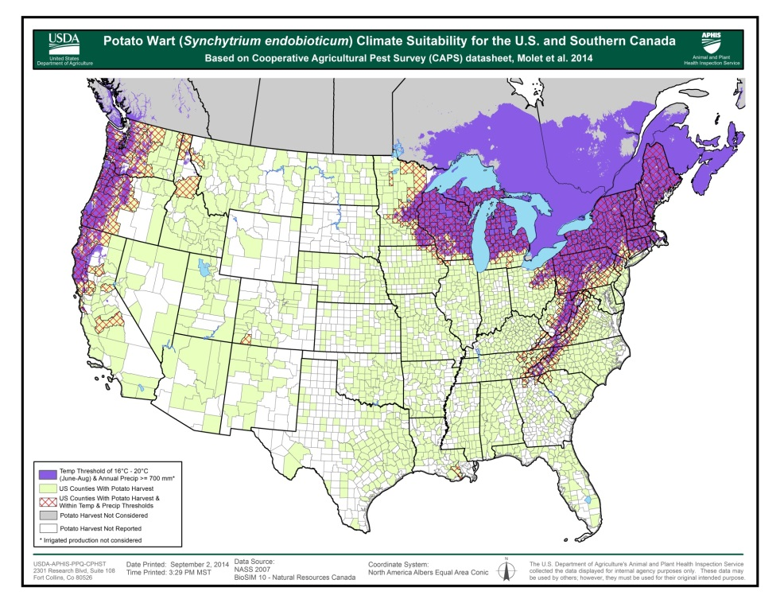
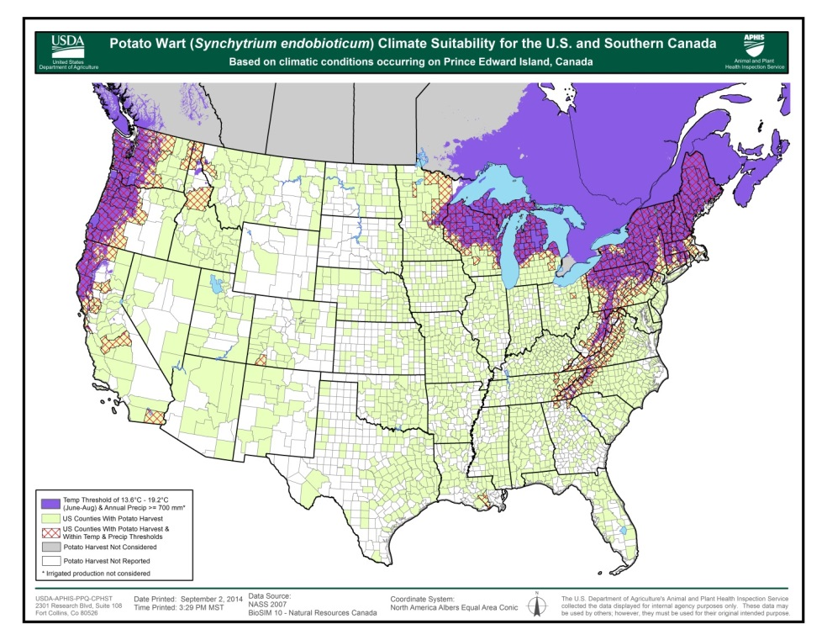
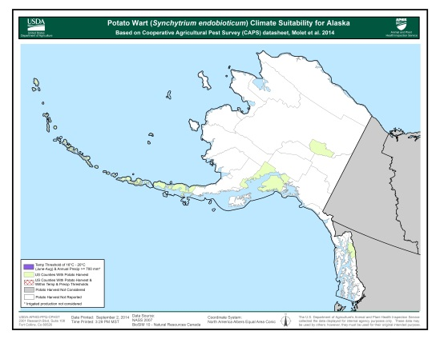
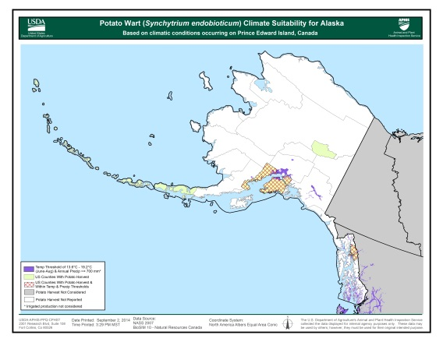
Does the analysis rely on literature reference or real day observation?
Potato wart example
Acres at risk = 205,794,048
Acres at risk = 174,064,128

Slide 27
Thank you!
Lisa Kennaway Gericke Cook
Lisa.f.kennaway@aphis.usda.gov Gericke.l.cook@aphis.usda.gov
970-490-4463 970-490-4489

