Slide 1

Developing a new model for ranking CAPS pests
Animal & Plant Health Inspection Service
Alison Neeley
Center for Plant Health Science & Technology

Slide 2
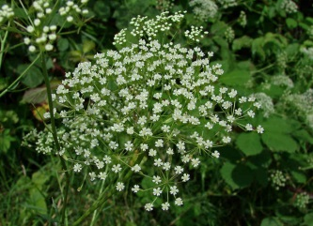
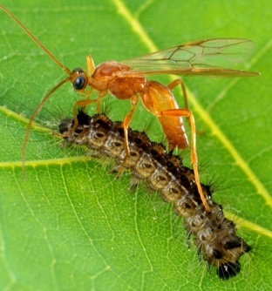
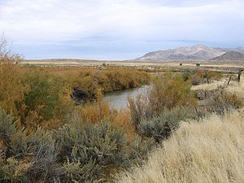
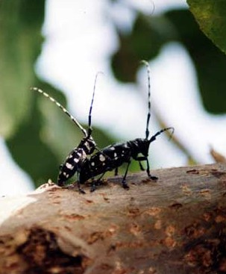
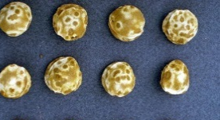
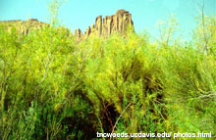
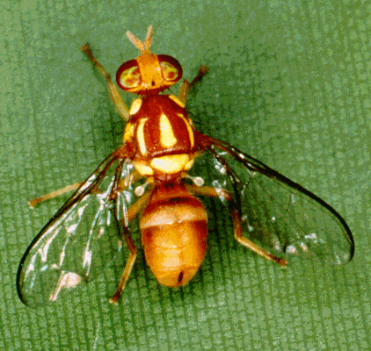
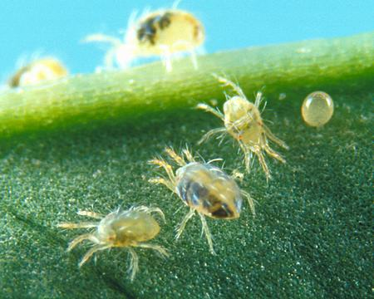
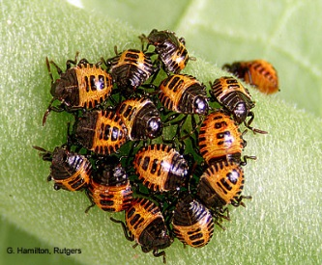
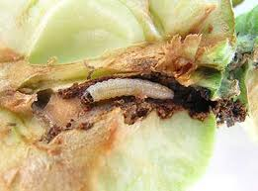
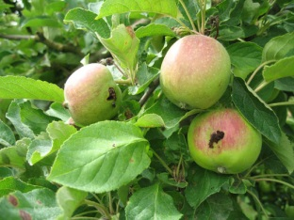
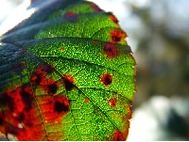
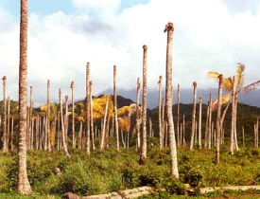
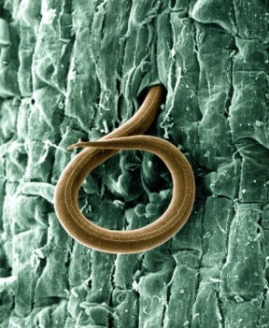
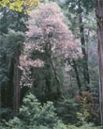
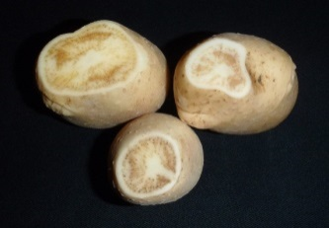
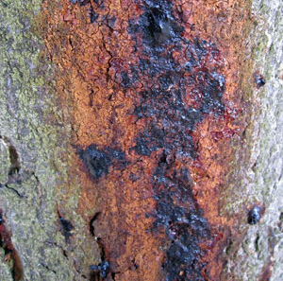
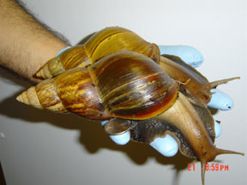
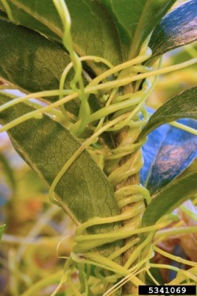
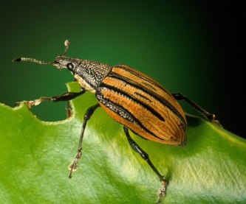
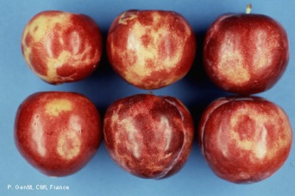
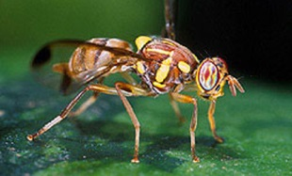
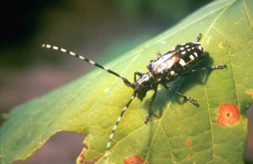
Why have a model for ranking pests?
Notes:
Arthropods: 36 (current list) + 19 (new suggestions) = 55 total
Plant pathogens/nematodes: 19/20 (current list) + 20 (new suggestions) = 39/40 (depending if we run Xanthomonas oryzae at the species or pathovar level).

Slide 3
How should pests be ranked?
Likelihood that they will be introduced into the United States & then spread
Likelihood that they will cause serious impacts upon introduction & spread
Political and human value-based considerations

Slide 4
Background: “AHP” model (2003)
Criteria:
  Entry potential
  Establishment potential
  Post-establishment proliferation and spread
  Economic impact
  Non-economic impact
Weightings:
  Derived through pair-wise comparisons of criteria and sub-criteria made by decision-makers

Slide 5
Problems with 2003 model
Highly subjective
  The pest’s reproductive potential is:
    Extremely high
    High
    Moderate
    Low
    Very low
May be too “Arthropod-centric”
Criteria not independent (violates a key assumption of the AHP)

Slide 6
Background: “AHP” model (2008)
Criteria:
  Economic Impact
  Environmental Impact
  Survey & Identification Feasibility
Weightings:
  Derived through pair-wise comparisons of criteria and sub-criteria made by decision-makers

Slide 7
Problems with 2008 model
Philosophical improvement over the original; however:
In practice, still highly subjective
  Very difficult to predict how a pest will behave in a novel environment → even though criteria themselves were objective, analysts’ answers were not necessarily consistent
  Trade impacts & public costs are highly political
Criteria still not completely independent

Slide 8
What is wrong with the old models for ranking pests?
Highly subjective – assessment results highly dependent on analyst
Questionable applicability for pest types – comparison between pest groups suspect
Shortcomings associated with applying AHP to this purpose:
  Requires independent criteria
  Weightings of criteria determined by experts rather than data & evidence
  Can’t be validated

Slide 9
What is wrong with the old models for ranking pests?
  Uncertainty cannot be handled explicitly
Not transparent – policy not separated from science & unclear which is driving pest ranking
Inflexible – no way compare risk by region or host

Slide 10
New Model for ranking
CAPS Pests
Total Score
Pest Impact (Damage) Potential
Policy Considerations
Pest
Establishment
Potential

Slide 11
Why is the new model better?
Objective – evidence-driven
Valid for all pest types
Transparent – separates analysis based on scientific information from that based on policy
Flexible – can be used to look at risk by region and host
Uncertainty separated from risk score
Defendable
  Uses methods that can be tested & statistically validated
  Based on other proven PPQ risk assessment methods
Notes:
Be evidence-driven
Use scientifically-valid methods that can be tested and validated
Evaluate pests across pest types using a common metric
Make it clear what part of the ranking is based on science and what part is based on policy

Slide 12
PPQ’s Weed Risk Assessment Process
Very successful tool for evaluating the “invasive” potential of plants
Widely evaluated, tested, and validated
Adopted by other stakeholders
WRA
Guidelines

Slide 13
Predictive Model for Impact Potential
We developed a set of yes/no and multiple choice questions (criteria) we thought might be predictive of impact
We tested how well each question predicts actual impact; removed non-predictive questions
We are in the process of weighting each question by its predictive power
Currently we have developed 2 separate models:
arthropods and pathogens (mollusk model to follow)

Slide 14

Development process: Arthropods
Identified over 100 non-native arthropods that have become established in the United States
PERAL economics team evaluated each
pest in terms of its observed impacts in the US
PERAL analysts analyzed each of those trial pests as if they were not present in the United States
NCSU statistician compared results to
observed impacts
Notes:
Pests were grouped into three categories:
major/high impact pest
minor pest
non-pest

Slide 15
How did we select the final questions?
“Feature Selection”
Data Mining – to determine which questions were “informative” (predictive)
  Information theory (Entropy based techniques: R)
  Maximized mutual information scores
  Contingency table analysis (JMP 11)

Slide 16
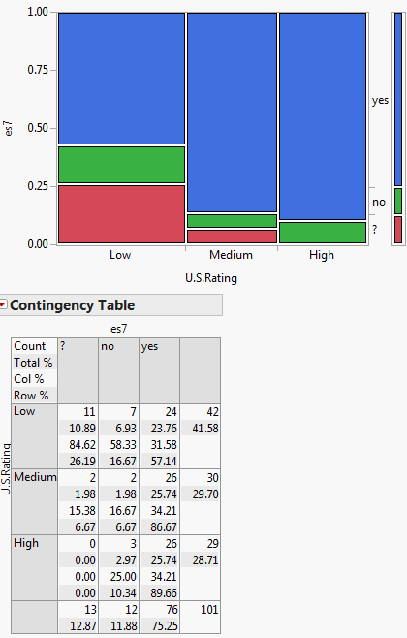
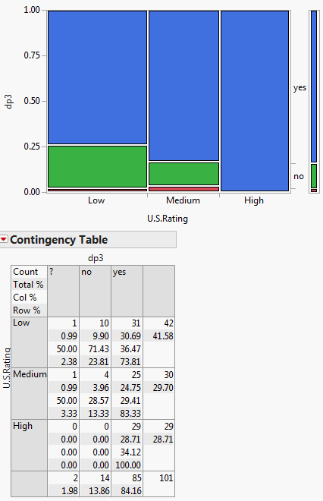
Methods – feature selection
Informative:

Slide 17
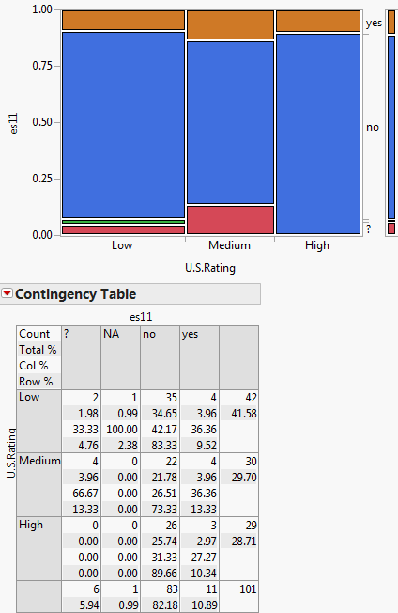
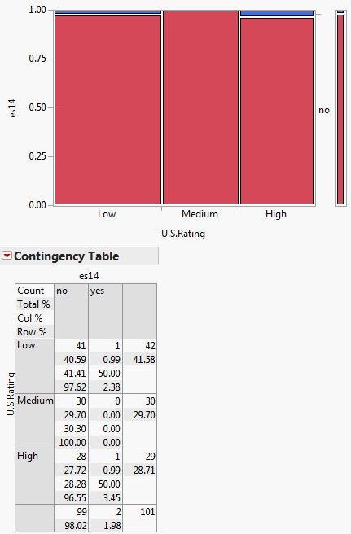
Methods – feature selection
Non - Informative:

Slide 18
How did we select the final questions?
“Feature Selection”
Eliminated about 60 non-informative variables (questions)
About 19 predictive variables

Slide 19
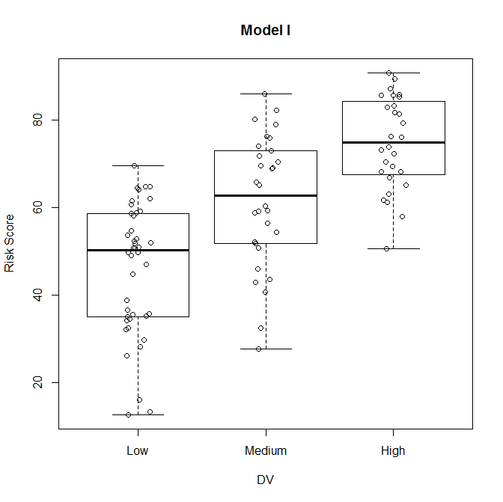
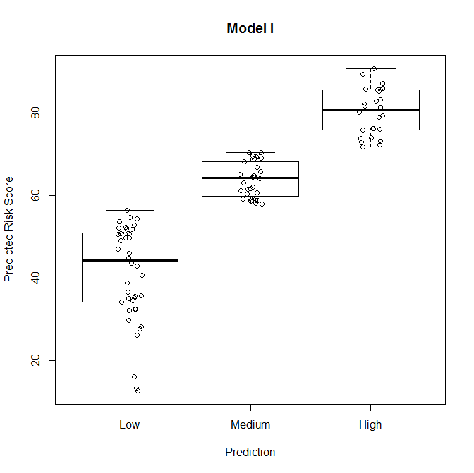
Feature selection and weights
Ordinal Logistic Regression
Mutual Information Scores (bits)
Mutual information percentage (%) = Entropy weights
Principal eigenvectors (%)
  Saaty’s principal eigenvectors feature weights

Slide 20
2015 Timeline
Task | Target Completion Date
Complete analysis of plant pathogens (test list) | February 2015
Test model with arthropods on current AHP list and run new arthropods through model | March-May 2015
Statistical analysis of plant pathogens | March-May 2015
Complete analysis of impact potential of arthropods | June 2015
Test plant pathogen model on current AHP list and run new pathogens through model | June-July 2015
Complete analysis of impact potential of pathogens | August 2015
Begin development of mollusk model | August 2015
Begin validation of plant pathology and entomology models | Summer

Slide 21
Future Goals:
FY 2016
Finish initial mollusk model (end of calendar year 2015)
Finish validation of arthropod and plant pathogen models (end of calendar year 2015)
Likelihood of introduction model
Incorporation of policy considerations (AHP)
Risk by region/ host

Slide 22
Pest Prioritization Modeling Team
CPHST – PERAL & NCSU Cooperators
  Team Lead: Alison Neeley
  Economists: Lynn Garrett, Trang Vo, Alan Burnie
  Entomologists: Leslie Newton, Glenn Fowler, Heather Moylett, Cynthia Landry, Ignacio Baez, Jim Smith
  Plant Pathologists: John Rogers, Lisa Kohl, Betsy Randall-Schadel, Jarrod Morrice, Heather Hartzog, Amanda Kaye, Walter Gutierrez
  Statistician: ByeongJoon Kim
CPHST CAPS Core Team
  Lisa Jackson, Melinda Sullivan, Daniel Mackesy, Talitha Molet
Others
  Andrea Lemay, PPD interns, CIPM Cooperators

Slide 23
Questions??

