Slide 1
CPHST Support: Bringing Pests, Surveys, Plants, and Science Together
Melinda Sullivan Lisa Jackson
melinda.j.sullivan@aphis.usda.gov lisa.d.jackson@aphis.usda.gov
Daniel Mackesy Talitha Molet
daniel.z.mackesy@aphis.usda.gov talitha.p.molet@aphis.usda.gov

Slide 2
Manual Updates

Slide 3
Topics
Format
New Surveys/Manuals for 2016
Proposed New Process for Manuals
Possible New Manuals
Manual Changes

Slide 4
Format
Notes:
This may be review for many of you, but we wanted to go over this briefly for the new people on the committee and the Farm Bill team is also present.

Slide 5
Manual Format
In the past, each manual was offered as one large PDF file.
Two separate documents were available:
Reference – All pest datasheets in one file
Guidelines – Contained survey planning information
Issues:
Documents large – took too long to download and pull out pieces relevant to each state-specific survey
Guidelines document too complicated – state budgets/ resources often do not allow statistically significant levels of survey
Updating documents was difficult/ time-consuming for CPHST support staff

Slide 6
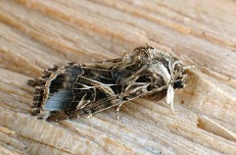
Manual Format
We are now offering each manual as a standalone Introduction and providing links to individual pest datasheets.
Introduction: General survey information – will replace Guidelines document
The new format allows CPHST to make one datasheet for each pest, link it where appropriate, and eliminate the need for duplicate updates.
Spodoptera littoralis – 6 different manuals and on AHP listing

Slide 7
Manual Format
The current manuals in the new format include: Asian Defoliator, Cyst Nematode, Exotic Wood Boring/ Bark Beetle, Grape, Mollusk, Palm, and Solanaceous Hosts.
New manuals are produced using the new format.
All of the older manuals will be updated and offered in this format.
Will work on the older manuals in order of use/ popularity of survey.
Aiming to complete at least one manual update (with complete datasheet revision) each year.
CPHST CAPS support recently finished putting Grape into the new format. Stone Fruit will be the next manual updated.

Slide 8
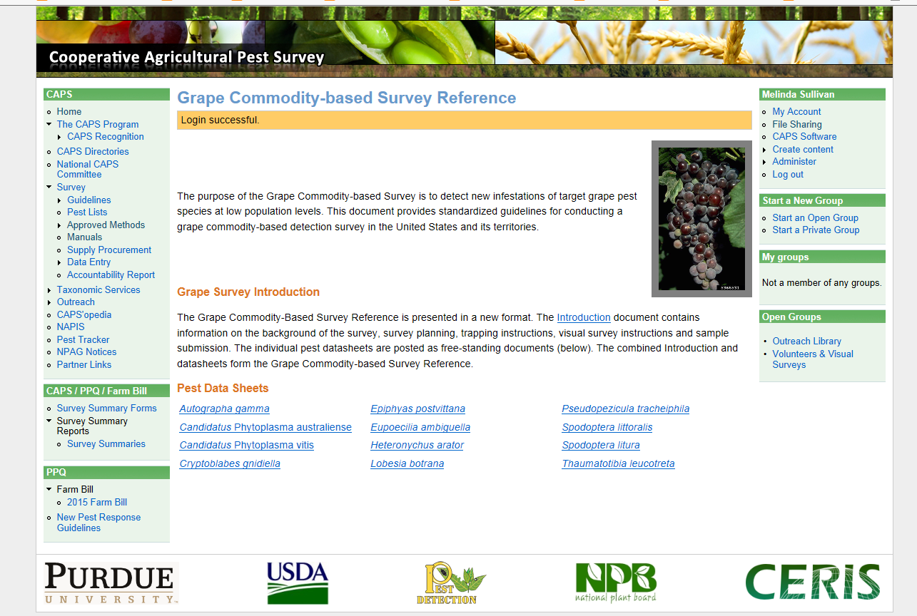
Notes:
Manuals available on CAPS Resource and Collaboration site under manuals. Example of grape page with Introduction and individual pest datasheets.

Slide 9
Listing of Currently Available Manuals
Commodity-Based
Taxon-Based
Corn – CAPS
Cotton – CAPS
Grape – FB
Oak – CAPS
Palm – FB
Pine – CAPS
Small Grains (wheat, oats, rye, barley) – CAPS
Soybean – CAPS
Solanaceous Hosts – FB
(eggplant, tomato, potato, pepper,
tobacco)
Stone Fruit – FB (peach, plum, nectarine, cherry)
Asian-Defoliator – FB
Cyst Nematode – FB/CAPS
Exotic Wood Borer/Bark Beetle – FB/CAPS
Mollusk – FB/CAPS
Notes:
Before I get started on the manual updates, I wanted to refresh your memories of the manuals that we have that are currently available. We currently have ten commodity-based manuals and four taxon-based manual available to support these CAPS or now Farm Bill Goal 1 surveys. The ones in teal font are available in the new manual format. We have also indicated the source of funding that typically funds the survey for pests in each manual.

Slide 10
New Surveys/ Manuals 2016

Slide 11
Tropical Pests
Intended to provide American Samoa, Guam, Hawaii, Puerto Rico, & U.S. Virgin Islands with their own pest list due to their unique climate and crop species.
Criteria (because ranking model not available):
Had to have at least 2 regions interested in conducting a survey for the pest (polled the states/territories via PSSs)
Region 1: Puerto Rico/U.S. Virgin Islands
Region 2: Hawaii
Region 3: American Samoa
Region 4: Guam
Not widely distributed already
Pass pre-assessment (pathway present into at least Hawaii or Puerto Rico; harder to assess for other areas)
Pass post-assessment (survey and identification methods available)
Notes:
The only new survey to be offered in 2016 will be for Tropical Pests. This survey is intended to provide Am. Samoa, Guam, Hawaii, Puerto Rico, and the U.S. Virgin Islands with their own pest list due to their unique climate and crop species. We had originally planned to run each suggested pest through our whole pest process (pre-assessment, ranking model, and post assessment), but the ranking model wasn’t yet available. It is being updated/revised. A presentation on this topic by Alison Neeley will follow later today.
So each pest had to pass through several criteria to make the final pest list.
The 1st criteria is that there had to be at least 2 Regions interested in conducting the survey. We divided these states/territories into 4 regions based on their proximity to each other and to the other areas. The pest couldn’t be widely distributed already in the area. It had to pass our pre-assessment and have a demonstrated pathway into Hawaii or Puerto Rico using AQAS or FAVIR data, and it had to pass our post-assessment that looks at availability of survey and identification methods.

Slide 12
Tropical Pest Suggestions
13 Arthropods
Scientific Name | Common Name | Type of Pest | Source
Aspidiotus rigidus | Armored scale | Scale insect | PestLens
Conogethes punctiferalis | Castor capsule borer | Moth | Additional Pests of Concern
Ecdytolopha aurantiana (Gymnandrosoma aurantianum) | Macadamia nutborer, citrus fruit borer | Moth | Additional Pests of Concern
Heilipus lauri | Avocado seed weevil | Weevil | OPIS B, of interest to PPQ trade director
Homalodisca vitripennis | Glassy winged sharpshooter | Planthopper/Leafhopper | Submitted by Guam
Hypocryphalus mangiferae | Mango bark beetle | Beetle | PestLens
Palmicultor lumpurensis | Bamboo mealybug | Mealybug | Submitted by Guam
Paratachardina pseudolobata | Lobate lac scale | Scale insect | Submitted by Guam
Scirtothrips dorsalis | Chilli thrips | Thrips | Submitted by Guam
Stenoma catenifer | Avocado seed moth | Moth | Additional Pests of Concern
Sternochetus mangiferae | Mango seed weevil | Weevil | Additional Pests of Concern
Tetranychus kanzawai | Kanzawa spider mite | Mite | Submitted by Guam
Xyleborus glabratus* | Redbay ambrosia beetle | Beetle | Submitted by Puerto Rico/USVI
* Already a prioritized pest (EWB/BB manual)
Notes:
We had 13 arthropods suggestions from a range of sources (PestLens, our former Additional Pests of Concern listing, OPIS lists, trade directors, or submitted by states/ territories).

Slide 13
Tropical Pest Suggestions
13 Plant Pathogens
Scientific Name | Common Name | Type of Pest | Source
Babuvirus Banana bunchy top virus | Banana bunchy top virus | Virus | Additional Pests of Concern
Badnavirus Banana streak virus | Banana streak virus | Virus | Submitted by Am. Samoa
Badnavirus Taro bacilliform virus | Taro bacilliform virus | Virus | Additional Pests of Concern
Ceratocystis manginecans | Mango sudden fungus decline | Fungus | PestLens
Fusarium oxysporum f. sp. cubense TR4 | Panama Disease Tropical race 4: | Fungus | Submitted by Puerto Rico State Survey Coordinator
Neofusicoccum mangiferae | Fruit rot of mango | Fungus | PestLens
Nucleorhabdovirus Colocasia bobone disease virus | Colocasia bobone disease | Fungus | Submitted by Am. Samoa; Additional Pests of Concern
Nucleorhabdovirus Taro vein chlorosis virus | Taro vein chlorosis | Virus | Submitted by Am. Samoa; recent find in Hawaii (NPAG)
Potyvirus Blackeye cowpea mosaic virus - a distinct strain of Bean common mosaic virus | Blackeye cowpea mosaic/bean common mosaic, cowpea strain | Virus | Submitted by Am. Samoa
Potyvirus Zucchini yellow mosaic virus | Zucchini yellow mosaic | Virus | Submitted by Am. Samoa
Raffaelea lauricola | Laurel wilt | Fungus | Submitted by Puerto Rico/USVI
Tospovirus Capsicum chlorosis virus | Capsicum chlorosis virus | Virus | Submitted by Am. Samoa
Xanthomonas campestris pv. musacearum | Banana Xanthomonas Wilt | Bacterium | Additional Pests of Concern
Notes:
We also had 13 plant pathogen suggestions from a range of sources (PestLens, our former Additional Pests of Concern listing, NPAG, or submitted by states/ territories).

Slide 14
Tropical Pest Suggestions
Criteria | # of Arthropods failed | # of Plant Pathogens failed
Pest already on CAPS Priority list | 1 | -
Minimum # of regions | 1 | 2
Distribution | 2 | 2
Pre-assessment (Pathway) | 2 | 4
Pre-assessment (Non-reportable) | 2 | -
Post-assessment | 1 | 3
Total Failed | 9 | 11
# Left | 4 | 2
Notes:
This table shows the number of suggested pests that failed our process at the various stages. As you an see, we are only left with six pests at this time when we started with 6.

Slide 15
Current Tropical Pest List
Scientific Name | Common Name
Aspidiotus rigidus | none, an armored scale
Ceratocystis manginecans* | Mango sudden fungus decline
Conogethes punctiferalis | Castor capsule borer
Fusarium oxysporum f. sp. cubense TR4 | Panama Disease Tropical race 4
Gymnandrosoma aurantianum | Macadamia nutborer
Paratachardina pseudolobata | Lobate lac scale
* Vector discussion
Notes:
Here are the remaining pests. Two of these pests are pending until we hear back from the appropriate identifiers but they have tentatively passed. Also note the mango sudden decline fungus, that we discussed in relation to vectored pathogens.

Slide 16
New Surveys Anticipated for 2016
Tropical Pest Manual
Working on finalizing the pest list for the manual
May need to solicit a few more new pests
Once the list is finalized, work will begin on the datasheets and Introduction
We will make datasheets available as completed but all will be completed no later than August 2015.

Slide 17
Proposed New Process for Manuals

Slide 18
Proposed Process for New Manuals
In the future, manual suggestions will require a ‘champion’ to sponsor it.
The champion will be required to submit an initial pest list (at least 6 exotic species) for consideration.
At least 4 or 5 states will need to sign up/ express interest for the new survey before development occurs.

Slide 19
“Champion” Responsibilities
Reach out to other states for their interest in survey (via PSSs, SSCs, SPHDs, SPROs)
Provide CPHST with a list of states who would be interested in participating.
Reach out to university extension for exotic pests of concern (6 pests per manual is the minimum to constitute a new manual).
Reach out to industry for exotic pests of concern?
Is this feasible? Who should do this (PPQ or champion)?
Could add a few pests of limited distribution or pests limited to one region of the country but not other areas important to the commodity.

Slide 20
Possible New Manuals

Slide 21
New Surveys Anticipated for 2017
1. Apple and Pear Commodity Manual
Beginning to work on the Pest list
Want to get manual champions involved
One from east (Rachel Braud -WV) & want a champion from the west
Have a pest list related to trade with the European Union to start with.
31 pests in total (19 of which are not on our prioritized pest list or already present)
Industry input?
Datasheets and Introduction to come after pest list finalized
Working on this manual while updating Stone Fruit manual (overlap of pests with apple/pear; pests can go into manual where make the most impact).
Notes:
Proposing one new survey/manual and one complete manual update per year as a maximum.

Slide 22
Other Suggested Surveys
Berries/Small Fruit
Saul Vaiciunas is the current champion
Has sent us 3 or 4 possible pests that we are evaluating
Likely 2018 at earliest
Dry bean/ pea/ pulse crops
Ian Foley (MT) is willing to champion per Helmuth
Vegetable seed
Nancy Osterbaur (OR) and Helmuth Rogg are willing to champion per Helmuth
Want to focus on viruses – concern is ID methods

Slide 23
Manual Changes

Slide 24
Manual/Datasheet Revisions
Changes to datasheets and manuals occur on a yearly basis.
If substantial changes are made, a new version is created.
New survey or ID method
Pest addition/ removal
Changes are listed in the draft log at the beginning of each manual.
Datasheet changes are also at the end of the specific datasheet.
CAPS Approved methods and forum email notices (CR&C site).
Starting to apply pre- and post-assessment filters to commodity manuals as well.

Slide 25
Changes to Manuals for 2015/2016
2015 Grape
Removed*: Adoxophyes orana (summer fruit tortrix moth) (minor host for this moth; not likely to be detected in grape).
Removed*: Diabrotica speciosa (cucurbit beetle) (minor host for this beetle; not likely to be detected in grape).
* Note: Pests are available in other manuals and can be bundled.
Updated all datasheets and put into new format (standalone datasheets and introduction document).
2016 Grape
Adding: Lycorma delicatula (spotted lanternfly) – Several states are interested in this pest after PA find.
Adding: Brevipalpus chilensis (Chilean false red mite) – PPQ P&M/ PDMT request; survey needed; fumigation costs for this pest in grape.
Notes:
Note: The pests removed are from these manuals are available for survey in other manuals where we would be more likely to find them. In addition, these pests can still be bundled into other surveys as well.

Slide 26
Changes to Manuals for 2015/2016
2016 Soybean
Removing: Adoxophyes orana (summer fruit tortrix moth) (minor host for this moth; not likely to be detected in soybean).
Removing: Heteronychus arator (black maize beetle) (minor host for this beetle; not likely to be detected in soybean)
2016 Oak
Removing: Ephiphyas postvittana (light brown apple moth/LBAM) (minor host for this moth; not likely to be detected in oak)

Slide 27
Changes to Manuals for 2015/2016
2016 Small Grains
Removing: Lobesia botrana (European grapevine moth) – Barley likely not a host
Removing: Peronosclerospora philippensis (Philippine downy mildew) – Oats only minor host; not likely to be detected in oats.
Removing: Spodoptera litura (cotton cutworm) – Wheat only minor host; not likely to be detected in oats.
Removing: Heteronychus arator (black maize beetle) (minor host for this beetle; not likely to be detected in small grains)

Slide 28
Potential Changes to Manuals for 2015/2016
Two new pathogens
Candidatus Phytoplasma solani (bois noir; stolbur phytoplasma)
Very broad host range; rapidly spreading across Europe
Likely will add this pest to grape, Solanaceous hosts, corn, and stone fruit
Phytophtora kernoviae (No common name)
Very similar to P. ramorum (similar host range plus beech)
May add to oak manual

Slide 29
Discussion
CPHST can only maintain manuals and pest lists at current levels (10 manuals; ~145 pests in total) with current staffing
Is there agreement with the “champion” idea?
Puts some responsibility on the manual suggestor/ champion vs. just CPHST.
Can we have too manual manuals? Are we spreading our resources too thin; only certain amount of funding available?
How to prioritize new manual suggestions?

Slide 30
One Option: Manual Rotation
CPHST plans to clean up existing/older manuals as we update them; remove pests that are not being surveyed for or are only minor hosts of a given host.
Manual rotation may be an option (sometime in the future).
Manuals available for survey could be rotated (available some years; not available other years)
CAPS and Farm Bill need to implement to be effective
How do we do this and still meet the needs of the field?
Rotate by popularity of survey. Less popular not available first.
Rotate yearly (may not work as some states do the same survey across multiple years/ split state into smaller units, survey for a subset of pests of interest across years, etc.)
Survey available for 2-3 years and then rotated (not available) for several years.

Slide 31
Questions

