Slide 1
CAPS Services Update

Slide 2
Did, Doing, Will Do
Notes:
When I updated the NCC on our activities last year I ended with this image - We had been thinking about moving NAPIS to a relational data base and were close to implementing on the new platform.

Slide 3
CAPS Services Systems
Approved Methods
Survey Summary
Survey Database NAPIS 3.0
Accountability Report
Pest Tracker
Notes:
In the NAPIS 2.0 environment there was a lot of time consuming work to keep the CAPS suite of services working together. With NAPIS now on a common platform with CAPS applications, we are refining the connections between the applications. Adding elements to improve the mechanisms.

Slide 4
NAPIS 3.0 Feedback
NAPIS 3.0 had an uneventful first day. Twenty three end users logged in, to create 25 maps and download thirty five reports. Two records were entered, and one user that had not yet participated in the demonstration tested data and produced a clean file.
SSC Comment – ‘I really like this version of NAPIS much better than the last. In my limited experience, it has proven to be much more user friendly and easier to navigate. ‘
What is your impression?
Notes:
NAPIS 3.0 went into production almost 11 months ago on April 1st.
End users can function without training – shows interfaces are designed for cognitive accessibility.
We’ve heard positive comments from users.

Slide 5
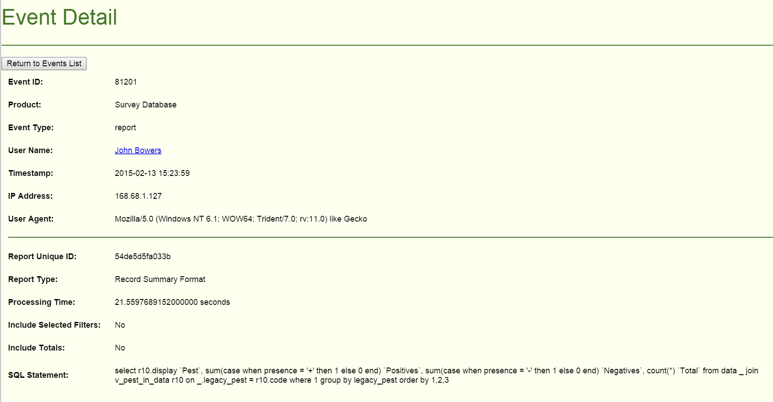
Event Logging
Real time access to user interactions with the application
Notes:
Event logging is a powerful hidden feature in NAPIS 3.0
User Support – Browser errors, report and map questions.

Slide 6
By the numbers
NAPIS 3.0 event log provides metrics about usage.
Guide when to make changes, who to consult on upgrades…
Notes:
We never had easy access to NAPIS application event details. Now we can make data driven decisions.

Slide 7
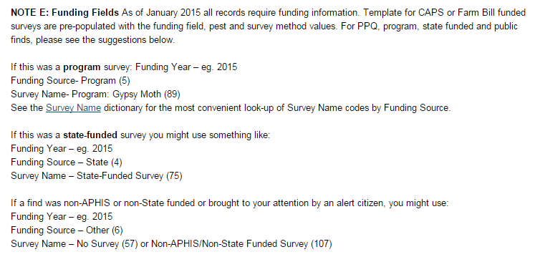
New Data Elements
Technically - very easy
In practice - requires extra support
‘My Surveys’
July - 2014 CAPS funded surveys,
September - 2014 Farm Bill funded surveys.,
January – filters to download any CAPS or Farm Bill funded survey
Error message with resource link.
Funding Year, Funding Source, and Survey Name are required. Note E has more information.
Survey funding fields required for 2015
Funding year
Funding source
Survey name
Trapping fields proposed
Trap
Lure
Notes:
In NAPIS 3.0 it is easy to add new data elements – from the technical side.
We have responded to lots of user support contacts for the funding fields.
Lessons learned
– give back what we have from survey summary – ‘My Surveys’.
Provide information for self service.

Slide 8
Pest Dictionary –Synonyms Project
December 2014
Code | Common Name | Genus | Species | Subspecies | ? Justified?
FDACCOZ | Ash Dieback | Chalara (Hymenoscyphus) | Fraxinea (pseudoalbidus) |  | Yes
Presented in new format
Code | Type | Common Name | Genus | Species | Subspecies | ? Justified?
FDACCOZ | Primary | Ash Dieback | Chalara | fraxinea |  | Yes
FDACCOZ | Synonym | Ash Dieback | Hymenoscyphus | pseudoalbidus |  | Yes
2011 International Code of Nomenclature new naming convention for algae, fungi, and plants.
Farm Bill suggestion funded upgrade to NPDN dictionary, shared with NAPIS,
New format with ICN primary name
Code | Type | Common Name | Genus | Species | Subspecies | ? Justified?
FDACCOZ | Primary | Ash Dieback | Hymenoscyphus | fraxineus |  | Yes
FDACCOZ | Synonym | Ash Dieback | Chalara | fraxinea |  | Yes
FDACCOZ | Synonym | Ash Dieback | Hymenoscyphus | pseudoalbidus |  | Yes
Notes:
Scientific names in parentheses under the old dictionary are on their own row in the new dictionary and are tagged as synonyms.

Slide 9
Synonym Search and Display
Search for ‘Chalara’
Notes:
For report and map pest filters, searching on either the primary name of the synonym will return possible pest references.

Slide 10
Survey Method Crosswalk
NAPIS Survey Methods – Method Centric
The survey method defines valid data values for elements target pest, host, pest life stage and descriptor units.
Not used to validate incoming data.
Describes sampling method, when to survey, sample selection, sample procedure, reporting units and method origin.
No review process.
CAPS Approved Methods – Pest Centric
Multiple method options may be defined for a target pest.
Multiple lure options may be defined for a method option.
Used to validate incoming data.
Links to references for survey procedures not defined and validated.
Frequent review by CPHST, versions establish the approved methodology for a given time period.
Notes:
Survey planning uses CAM for

Slide 11
Survey Method Reconciliation Early Design
Procedure | Required Data Elements | Units (validate)
Trap | Trap (from table),& Lure (from table) & Crop Situation CAM Version or ? | Pest(s) in trap(s)
Sample - Soil | Crop Situation Diagnostic Lab Confirmation Method CAM Version or ? | Lb/Kg
Sample - Plant Material | Site & Crop Situation Diagnostic Lab Confirmation Method CAM Version or ? | Leaves/Stems/Roots
Sample - Sweep | Site & Crop Situation Diagnostic Lab Confirmation Method CAM Version or ? | Pests(s) in sweeps
Visual | Site & Crop Situation CAM Version or ? | Plants/Trees Fields/Acres/Properties
This design adds Trap and Lure as data elements required for trapping surveys and replaces legacy NAPIS survey methods.
CAM version for priority pests.
Or
??? for survey targets without a CAM.
Notes:
This is a concept that has taken form from discussions with Melinda and Lisa, analysis of data…
How many non-priority pests use trapping- , sample- , visual- ?

Slide 12
Proposed New Data Elements: Trap & Lure
Next steps:
Use case analysis
CAPS / CPHST review
NCC review
End User input session/training
Apply lessons learned from adding funding fields:
Include trap, lure and CAM version values in ‘My Surveys’ templates.
Link data validation error messages to documentation.

Slide 13
CAPS Site
2014 Did:
Active forum replaced by surveyupdate@purdue.edu mail list.
Behind the scenes, the survey summary data was rebuilt.
Survey summary query was created using the new data structure.
2015 Doing:
Rebuild CAPS Accountability Report to include survey name.
Survey Summary update form and work flow.
Migration to Drupal 7 will be largely invisible to end users.
One benefit will be a single sign-on for CAPS and NAPIS.

Slide 14
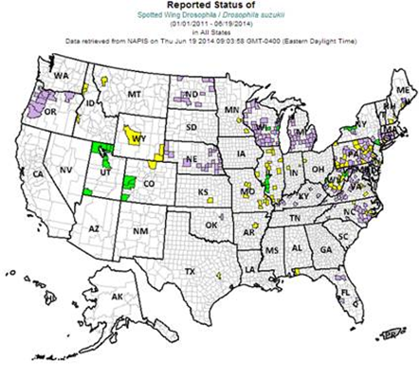
Mapping
Original proposal, to ‘roll forward’ established records.
Analysis showed this would more than double the number of records in the database with a big hit on NAPIS map generation time.
Modified proposal: Create process to display Pest Tracker map status as if established finds were rolled forward. Any period mapped after a pest is recorded as established will be colored purple.
Kathy worked with states to resolve objections and a project to update Boll Weevil maps.
Identified and resolved misleading display of eradication records when creating NAPIS maps with ‘3 years negative data’ filter chosen.
Project to represent persistent presence in counties where pests are established on Pest Tracker maps.
Do we need a mechanism for users to choose to create NAPIS maps using Pest Tracker process?

Slide 15
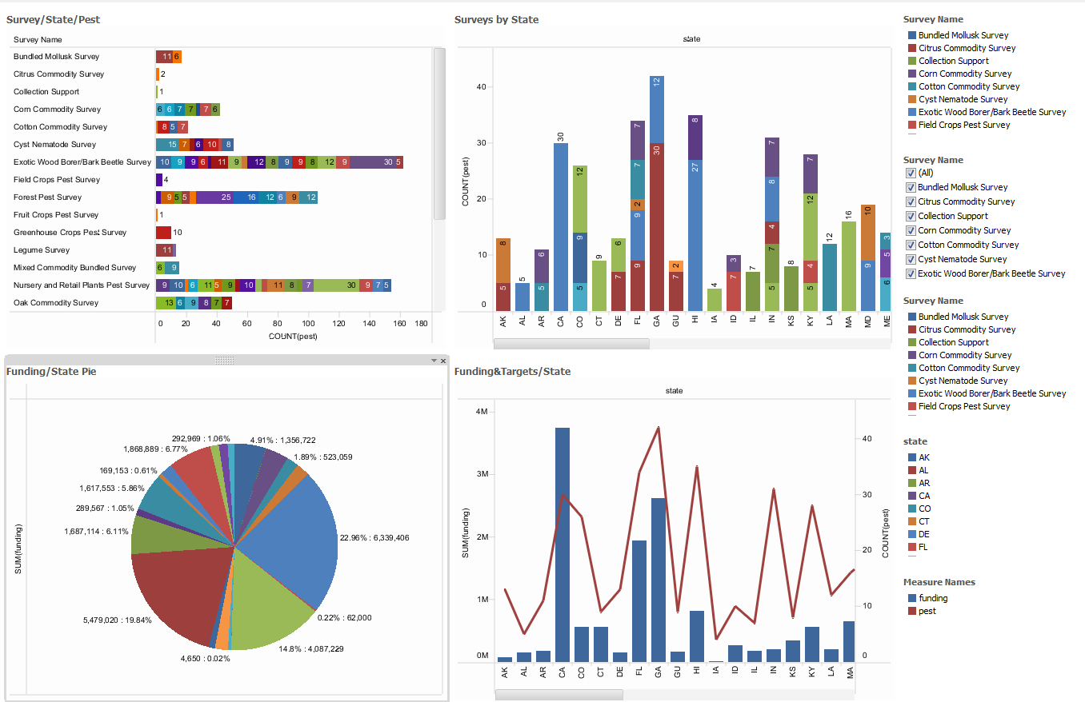
Data Visualization
Seeing meaning in data
Dashboards for instant access
Notes:
Thinking

