Slide 1
CAPS Services Update
2016 NCC meeting

Slide 2
CAPS Services Updates
Survey Summaries – Process Enhancement
Survey Method Reconciliation – Phase I, Trap and Lure
Data Validation
Performance Measures – How are we doing?
Odds and Ends –
Bios
Accomplishment Report
Notes:
CAPS Update

Slide 3
CAPS Services
2012
2010
AMPS 2011
2014
2010 Accountability Report
2011 Approved Methods for Pest Surveillance
2012 Survey Summary
2014 NAPIS 3.0
Notes:
Administration of the CAPS program has improved since 2008.
2008? NCC meeting. No accountability or Survey Summary
Applications and features developed organically and are tailored to the program.
2010 through 2013 the Accountability Report matched targets from the J3s with NAPIS data.

Slide 4
Survey Summaries
Do you remember J3s?
2012 Farm Bill form was the first Survey Summary in spring of 2012
CAPS form in August
PPQ form in November 2012
2014 Add Funding Fields to NAPIS data
Create ‘My Survey’ templates from Survey Summary data
2015 Consolidate Survey Summary Data
Collect funding information with data
Collect Host with Survey Summary
2016 SSF Change Request Form
Add Trap and Lure
Merge Survey Summary forms
Notes:
J3 - In the spring we would collate the survey targets on the 50+ spreadsheets, translating listed survey targets to pest codes – weeks of resource.

Slide 5
CAPS Development 2016
Extend Accountability Report to leverage funding fields.
Implement a Survey Summary request form.
Change request; add, modify or delete survey summary data.
Trap and Lure request for non-AMPS survey targets – 2016 Farm Bill Goal 1 Survey Summary.
Develop Survey Summary Form to collect all survey plans – August 2016 for CAPS 2017 surveys.
NCC vision a survey funding model that better meets program and state needs?
CAPS Services design the SSF with flexibility to work from here to there.
Notes:
2015 was the first year to collect funding data so the Accountability Report was not

Slide 6
Survey through the Years
Procedure | Inactive | Active
Sample | 32 | 36
Trap | 108 | 1
Visual | 168 | 24
Notes:
Characteristics of NAPIS data have changed since the early 20 hundreds.
The volume of yearly records has increased
predominantly Visual, Trap and Sample procedures.
Around 2007 focus of survey toward regulatory, early detection
Input from NCC.
AMPS
What about non-AMPS
Phasing out NAPIS Methods in recent years.
SMR

Slide 7
Recording Survey Method
Trapping Surveys January 2016.
Sample Surveys
Visual Surveys
In Process
Input Please

Slide 8
Survey Method Reconciliation Phase I: Trapping Surveys
‘3001’
My Surveys
Validation
Notes:
All trapping surveys come in with Survey Method Code ‘3001’.
There are templates for all funded surveys that are pre-populated for 3 funding fields/pest code/survey method/trap/lure/descriptor units.
Pest, trap and lure data are validated.

Slide 9
Visual & Sample Methods
A sparse survey method
A robust survey method
Survey Method: | 236 - Count; Leaves
Procedure: | Count
When to Survey: | For leafhoopers look in May - June (1st generation) and August (2nd generation). Start early season when leaves are expanded and blossum buds are visable in the crowns for strawberry plants. This could be as early as April. Continue monitoring through harvest (usually July).
Sample Selection: | For 1st generation nymphs, examine weekly the underside of new leaves leaves next to two year wood. Action threshold is average 1/2 nymph per leaf. For 2nd generation of nymphs, examine weekly the underside of cluster side-shoot and terminal leaves. Action threshold is average 1 nymph per leaf. To sample for two spotted spider mite, walk diagonally across the field, randomly picking one mature, fully expanded leaflet from every other row until 60 leaves are collected. Examine the leaves. If 25% are infested with mites (this corresponds to about 5 mites/leaflet), a miticide is recommended. This is a conservative action threshold.
Sample Procedure: | Examine plant parts as appropriate for the generation of leafhopper being surveyed for. Examine the strawberry plant leaves for the presence/absence of two spotted spide mite infestations.
Reporting Units: | Record number of nymph(s) per leaf for leafhoppers on apple. Record the percent of strawberry leaflets infested with mites.
Method Origin: | Pest Management Scouting Manual for Tree Fruit in Western New York, by Douglas Bruno and Michael Scharz, Cornell Univ., Coop. Ext. Strawberry Scouting Procedures A Guide to Sampling for Common Pests in New York State, by J. Kovach, W. Wilcox, A. Agnello, and M. Pritts, NY State Integrated Pest Management Program, N. 203, 1990, Cornell Cooperative Ext.
Survey Method: | 57 - Bucket;30-35stems;Assessment;Nc Man
Procedure: | Count
When to Survey: | Sampling begins the week the degree day accumulation reaches 190 degree days (usually at the begining of May in most areas).
Sample Selection:
Sample Procedure:
Reporting Units:
Method Origin:
Used to report 160 different pests including aphids, weevils, cutworms, borers, beetles, leafspots, weeds, bugs, leafminers, parasites, grasshoppers…
Used to report:
3 beetles
5 diseases
6 leafhoppers
7 mites
Notes:
From inception in 1985 NAPIS has maintained survey methods, sometimes detailed, sometimes minimal.

Slide 10
Data validation
Host Code – required for diseases. Hosts are mostly species level and some habitats. Question from a users recording a pathway survey of community gardens; can negative disease data be recorded with family level hosts?
Total Units Checked. AZ would like to report services. Use new Descriptor Units – currently all trapping surveys report ‘pest(s) in trap(s)’. Downside, lose some information re. survey density.
Validation – Observation Year & Funding Year

Slide 11
Metrics
What does CAPS/Pest Detection do that merits the expenditure of tax dollars?
Legacy Reports
Performance Measures
Record Counts
First Ins
Trap Counts
Maps
John’s Charts and Graphs
Pest Detection Metrics
Notes:
What does CAPS do that merits the expenditure of tax dollars? Providing data to respond to that question has motivated development of

Slide 12
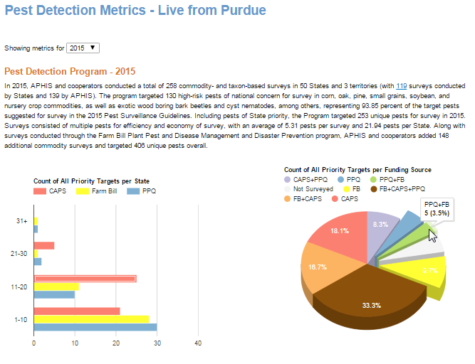
Interactive metrics tell a story.
What is the message?
Choose a meaningful measure of central tendency.
Accentuates CAPS funding
And provide the data to back it up.
Notes:
Added the graphs at the bottom of the narrative in the 11th hour to illustrate the features we can deliver. You need to craft the message and we can work with you to develop visualizations to communicate the message.

Slide 13
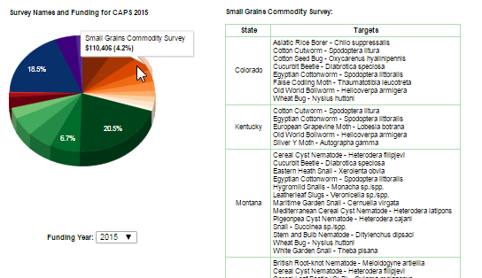
Interactive Metrics Features
Select a subset of data – in this case by year.
Use of color to communicate information.
Drill down to detail

Slide 14
Leveraging Content
Biography Format
Accomplishment Report
State centric
Dynamically generated framework
Title
Summary data
Survey Sections
Target image and survey map
Survey plan for coming year

