Slide 1
Pest Risk Mapping Catalogue
Decision making tools
Host distribution (agricultural & forest)
Individual host and pest-specific analyses
Predictive weather forecasting for survey planning
Climate suitability maps (spatial risk)
Timing of pest events (temporal risk)
Stage/generation maps (phenology progression)
Led out of the CPHST Fort Collins Lab
Cooperating with OSU (Dr. Len Coop)
Climate products
Cooperating with NCSU (SAFARIS)
Hosting entire catalogue for archive and customer access
Notes:
The weather forecasting tools apply to predicting how pest species are predicted to change across space and time months in advance. These forecasting tools will allow managers to plan survey operations months in advance. Climate suitability – are this season’s weather patterns expected to show spatial shifts in distribution suitable for the pest to establish? Pest events – are this season’s weather patterns expected to show early or late pest emergence compared to the norm? Pest event maps show the calendar date of when to deploy or remove traps for that pest. Stage/generation maps show the progression of the pest’s development through multiple lifestages and generations. It is useful as an overview phenology map.
Climate products update daily as new weather info is captured and the forecasts approach reality.

Slide 2
Deliverable Status – Year 1 Pest List
Latin Name | Common Name | Host Map | Climate Suitability | Pest Event Maps
Dendolimus pini | Pine Tree Lappet, Pine Lappet, Pine Moth | Complete | August 2016 | August 2016
Epiphyas postvittana | Light Brown Apple Moth (LBAM) | March 2016 | April (prototype) | February (prototype)
Helicoverpa armigera | Old World Bollworm | Complete | April (prototype) | February (prototype)
Monochamus alternatus | Japanese Pine Sawyer | March 2016 | April (prototype) | February (prototype)
Platypus quercivorus | Oak Ambrosia Beetle | March 2016 | August 2016 | August 2016
Thaumatotibia leucotreta | False Coddling Moth | Complete | In development | Prototype complete

Slide 3
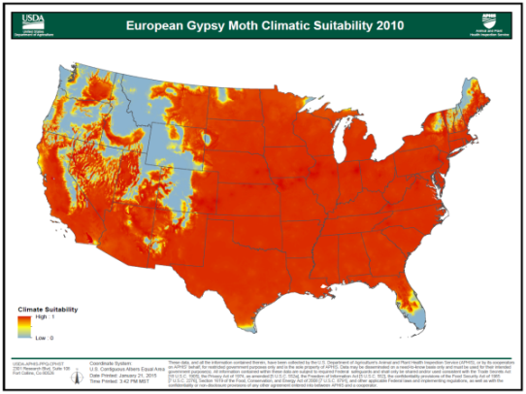
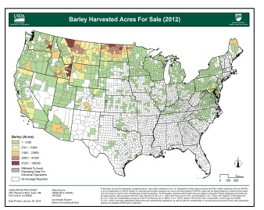
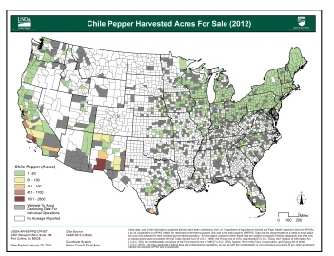
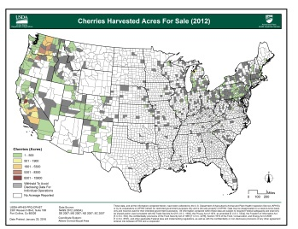
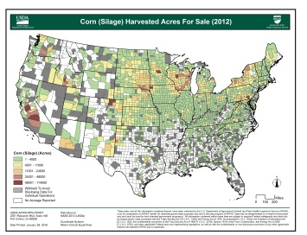
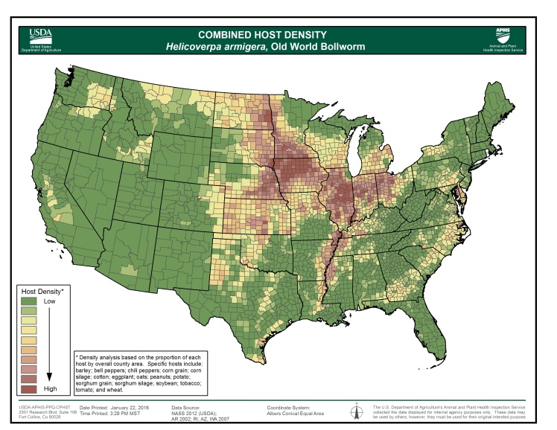
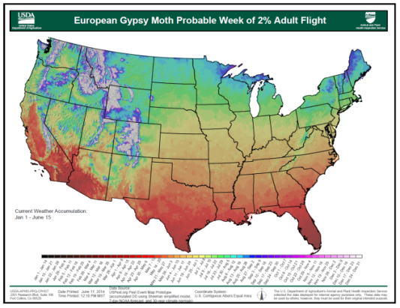
Product Examples
Host Catalogue
Climate Catalogue
Individual Host (Ag & Forest)
Climate Suitability
Updated Daily until Forecasts
Approach Final Accumulation
Pest Specific Combined Host
Pest Event Maps

