Slide 1
Purdue University CAPS Services Update
CAPS Services – Providing continuous maintenance, process improvements, and a high level of customer support
Presented to the NCC Committee, February 2017 - Cindy Music and David McClure

Slide 2
Survey Summary Form - Purpose
To assemble the surveys to be conducted by each state according to funding sources of Farm Bill, CAPS and PPQ.

Slide 3
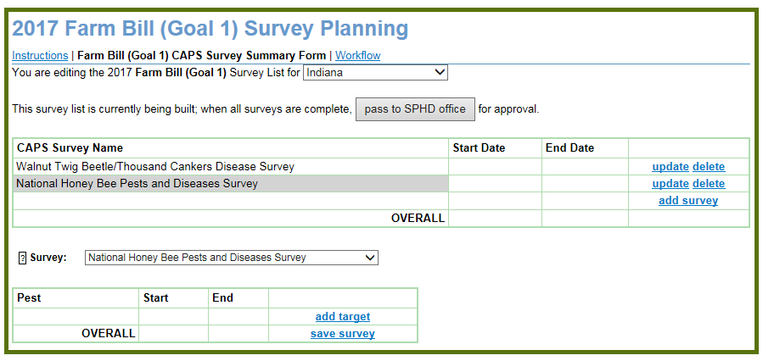
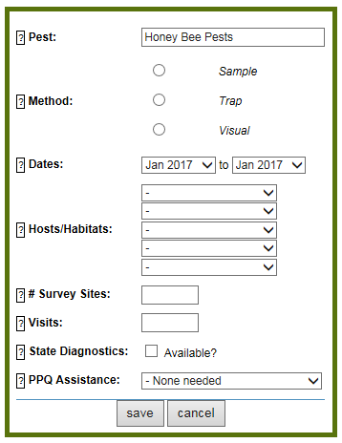
Survey Summary Form – Fields

Slide 4
Work Flow Process
SSC enters information
SPHD
Program Manager
SSF Approved
SSC
SPHD
Program Manager
SSC emails Change Request
Program
Manager
Modifications made, parties informed
Administrative review

Slide 5
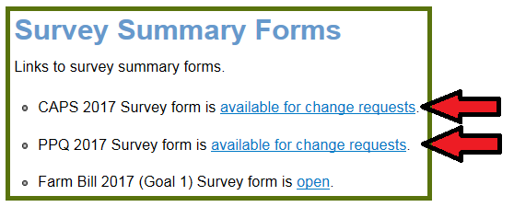
Change Request Process

Slide 6
Change Request - Example

Slide 7
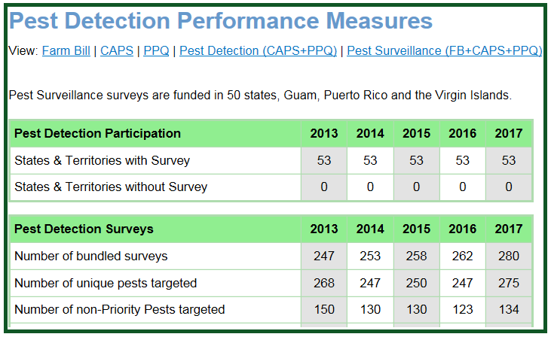
Survey Summary Form – supporting the following
Survey Summaries/All Planned Surveys
Survey Supplies
My Surveys
Diagnostic Resource Planning
Metrics
Performance Measures
Targets by Funding Source
Survey Funding

Slide 8
Survey Summary Form – results of survey data collection
Data Notifications
Accountability Report
State Summary Reports

Slide 9
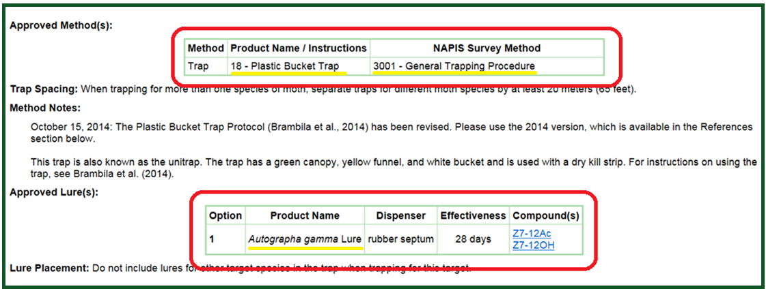
Survey Methods Reconciliation – Trap and Lure

Slide 10
Survey Methods Reconciliation – Sample Surveys
Survey methods 3011-3014

Slide 11
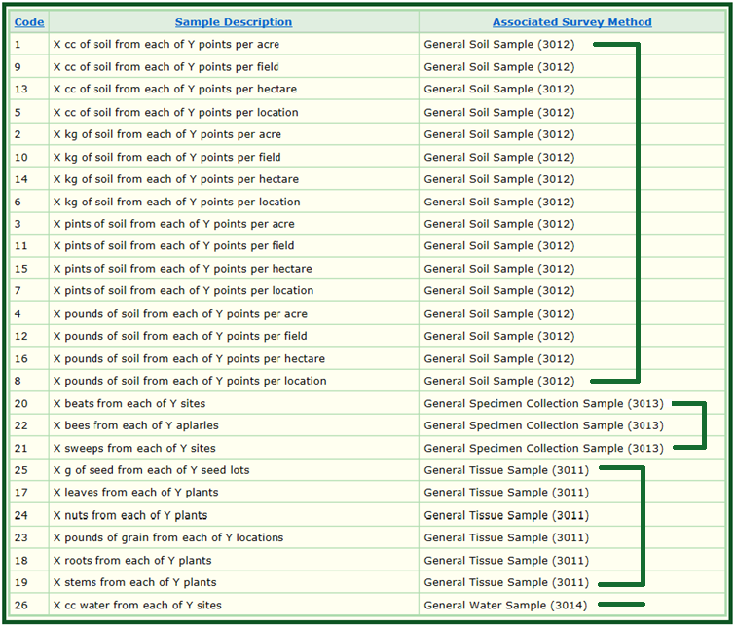
Sample Descriptors

Slide 12
Spreadsheet/Template - Karnal bunt

Slide 13
Accountability Reports – CAPS, Farm Bill
A Reporting Tool

Slide 14
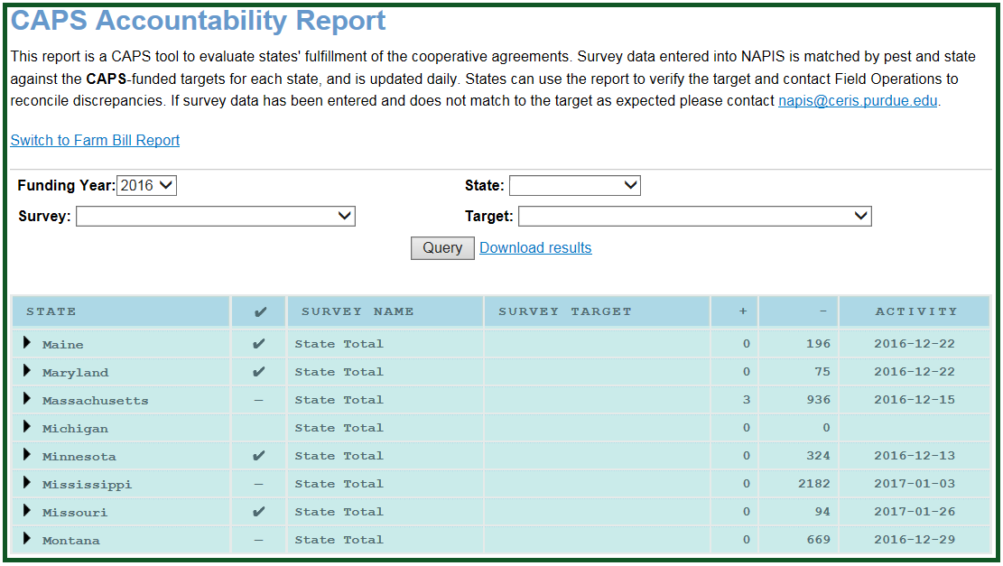

Slide 15
Other
Survey Methods Reconciliation – Visual Surveys
Pest Tracker
Data entry
SSF
Publications
Infrastructure
NAPIS Database summary, 2016:
New in U.S. = 6, New in State = 79, New in County = 645
Total records processed in 2016 = 277,588
Pest Codes: assigned = 893, modified = 19324, deleted = 6
Host Codes: assigned = 91, modified = 381, deleted = 1
Misc.

Slide 16
Thank You
CAPS Services
Striving to provide continuous maintenance, operate well, and provide a high level of customer support

