Slide 1
Center for Plant Health Science & Technology (CPHST) CAPS Support Team
Pest Detection Management Team S&T:
Richard Zink
Two CPHST scientists
Vacant (vice-Lisa Jackson (entomologist))
Vacant (vice-Melinda Sullivan (plant pathologist))
Two CPHST technicians
Heather Moylett (arthropods, mollusks)
Daniel Mackesy (plant pathogens, weeds, nematodes)

Slide 2
CPHST CAPS Support Team
Work with other scientists at CPHST labs to provide support:
Plant Epidemiology and Risk Analysis Laboratory (PERAL) Raleigh, NC – Pest prioritization
Beltsville, MD Laboratory – Plant pathogen molecular diagnostics; confirmations
Otis, MA Laboratory – Trap and lures, insect survey protocols
Ft. Collins, CO Laboratory – Applied geospatial products, digital identification tools
Mission, TX laboratory – warehouse for trap/lures; insect molecular confirmations

Slide 3
Main Responsibilities
Provide support for the field/ CAPS community
Develop and maintain the CAPS Priority Pest Lists
Develop pest datasheets and survey manuals
Develop approved survey and diagnostic/ identification methods
Other duties:
Serve on Farm Bill review teams (Goal 1S, 3)
Serve on committees and working groups
Cooperative agreement ADODRs

Slide 4
Pest Prioritization Process
Pre-assessment
Prioritization Model (OPEP)
Post-assessment
Final List

Slide 5
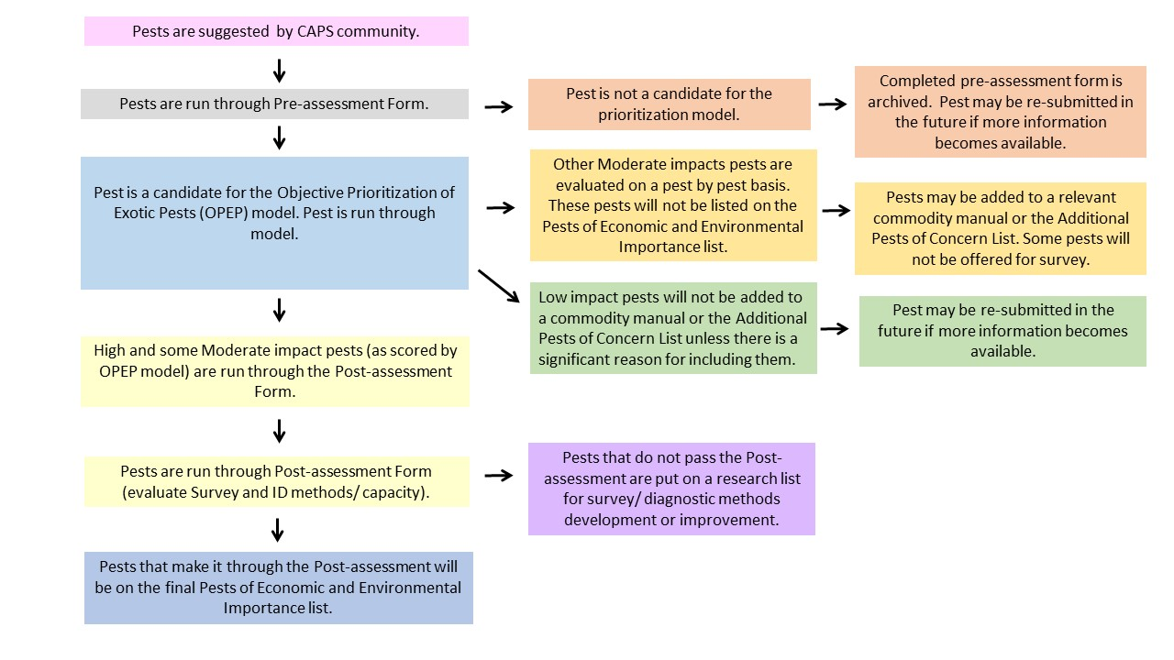
Pest Prioritization Process
New flowchart

Slide 6
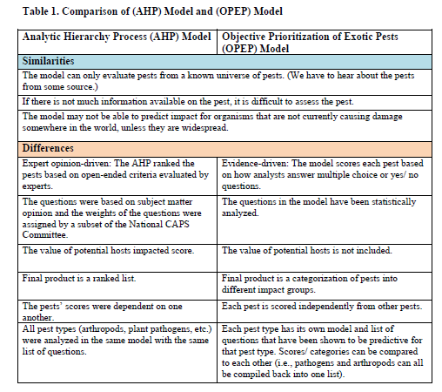
Pest Prioritization Process

Slide 7
Pest Prioritization Process
Pre-assessment Questionnaire
Is it a plant pest as defined by the IPPC?
Does the pest cause measurable damage on any plant listed in the CAPS Host Matrix or interfere with trade for any of these hosts? Describe damage or trade issues.
Is citrus the only important host for this pest? (If yes, refer to CPHST citrus team.)
Is the pest exotic to the United States? (If the distribution of the pest is limited in the United States, it may be added to an appropriate commodity manual.)
Is it listed in the AQAS database as non-reportable at the species level? Yes = Fail
Is there a demonstrated pathway of introduction, not including smuggling?
Is the deliberate smuggling of this pest or any host of this pest likely to occur? For example, is there non-traditional trade of this pest (e.g., for religious purposes, in the pet trade industry, etc.).

Slide 8
Pest Prioritization Process
Post-assessment Questionnaire
Evaluates:
Survey method
Identification/ diagnostic method
Capacity/ expertise to perform ID/ diagnostics
Exclude pests that don’t have effective methods.
These pests would not be listed on the final prioritized pest list.
Pests would go to a research and development list.
Farm Bill Goal 3 has asked us for recommendations for priorities each year

Slide 9
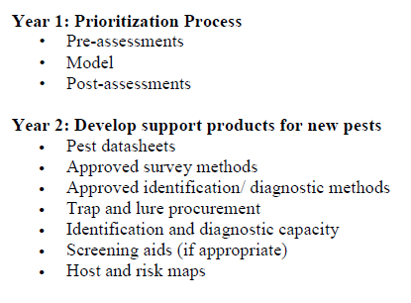
General Timeline for Prioritized Pest List Development

Slide 10
Outcome for New Model

Slide 11
Outcome for New Model
Pests fall into three categories:
Category 1 (Top 45 pests, High and some Moderate pests)
Pests have a greater than 20% probability of being a high impact pest.
If the pest passes the Post-assessment, they will be listed on the Pests of Economic and Environmental Importance List.
Pests will also be added to relevant commodity manuals.
If pests fail the Post-assessment, they will be placed on a priority list for research.

Slide 12
Outcome for New Model
Category 2 (Middle 15 pests, Moderate pests)
Pests are most likely to have a moderate impact.
Pests have a 10 to 20% probability of being a high
impact pest.
These pests will not be part of the Pests of Economic
and Environmental Importance List.
Pests that are recommended for survey and pass the Post-assessment will be added to commodity or posted as free-standing datasheets.
If fail the Post-assessment, they may or may not be listed as priorities for research.

Slide 13
Outcome for New Model
Category 3 (Bottom 31 pests, Low impact pests)
Pests are most likely to have a low impact.
Pests have a less than 10% probability of being a high impact pest.
These pests will not be included on the Pests of Economic and Environmental Importance List.
New pests assessed will not be included in a commodity manual or posted as free-standing datasheets.
Existing pests present in a commodity-manual will likely be removed from manuals over time.

Slide 14
OPEP Updates 2017

Slide 15
OPEP Update 2017
Multiple initiatives within the model
New features of model
Projects that use OPEP to support CAPS

Slide 16
Validation of the model
Arthropod Model Validation
Validation of the model is underway and should be finished by end of Feb.
PERAL analyzed 77 pests during validation and are in the process of retesting questions from development.
Once validation is complete, PERAL will start using the validated model to evaluate new pest suggestions and also older commodity pests.
The revised model will not be used for CAPS until 2019 (no new list for 2018).
Changes to the pests’ ranking are expected to be minor.
Plant Pathogen Model Validation
Validation is underway and the timeline for completion is FY2017.
60 – 75 pathogens will be analyzed for validation of the model.
PERAL has finished 20 pests so far and reviews are underway.

Slide 17
Use of model
Evaluate New Pest Suggestions
PERAL will continue to support this effort.
After the arthropod model has been validated, PERAL will begin assessing new pest suggestions that have made it through the pre-assessment.
In the future, all new pests for commodity manuals will also be evaluated with the OPEP model by PERAL.
Evaluate Commodity Pests
We have a Farm Bill project that is starting up that will run all of the current commodity pests through the model.
This will help us remove any pests that are of low impact.
This will also standardize our Prioritized Pest Lists: all pests will have eventually been run through the OPEP model.

Slide 18
New features of model
Mollusk Model
PERAL is putting together a scoping document and an application for funding from CPHST.
PPQ Policy Management requested this work, to assist PPQ in determining high impact mollusk pests.
We have 9 completed assessments and are planning for 25 to 34 total mollusks for development.
Likelihood of Introduction/Establishment
PERAL reviewed theoretical models for entry and establishment and identified primary drivers for arthropods (e.g. environmental suitability, population dynamics, management, and ecological communities). PERAL will extend the process to pathogens.
PERAL is developing potential analysis questions to address each driver and are identifying sources for answering these questions.

Slide 19
Manual Updates

Slide 20
Manual Updates
Deliver calendar year 2016
Revise Pine manual and datasheets (near completion)
Revised Oak manual and datasheets (near completion)
Develop pest list for Sorghum bundled survey (draft, needs S&T review, then roll out)
Datasheets for new pests (3 still pending) *The arthropod team was hit with 3 NPAG pests that required datasheet revision/development in April/May.

Slide 21
Manual Updates
April 2017 (for 2018 Survey Season)
Revise Corn manual and datasheets (fall 2017).
We will not be able to work on Apple/Pear.
Would like to propose breaking down manuals as main priority in addition to completing all new 2017 datasheets.
Only add new OPEP pests for hot/political pests. (Rest will wait until 2019 Survey Season, plan to revise every 2 years) (there have been no requests)
Remove pests that were low risk/undetermined.

Slide 22
Manual Updates
April 2018 (for 2019 Survey Season)
• New Ec and Env. List (2 years’ worth of OPEP pests, culminate for this season).
PERAL will run pests through model; unclear if S&T will have resources available to create datasheets, develop approved methods, etc. in time for April 2018.
Likely, no new manual for 2018.
In the queue are:
1) Add Sorghum to Corn and update the pests for Corn.
2) Apple/Pear: have preliminary pest list.

Slide 23
Manual Updates
April 2018 (for 2019 Survey Season)
• “Clean up” the commodity lists:
As we revise each manual, apply post-assessments to pests that never received it. Remove from list if necessary.
Run commodity pests through OPEP. Remove low-ranking pests.
High-ranking pests without good survey/diagnostic methods move to research list.
Add Oak and Pine pests to EWB/BB list and vice versa.

