Slide 1
Center for Plant Health Science & Technology (CPHST) CAPS Support
Rick Zink
Richard.T.Zink@aphis.usda.gov
Heather Moylett
Heather.Moylett@aphis.usda.gov
Daniel Mackesy
Daniel.Z.Mackesy@aphis.usda.gov
Annual NCC Meeting February 7-8, 2018 Newnan, GA

Slide 2
CPHST CAPS Support Team
Pest Detection Management Team S&T:
Richard Zink
Two CPHST scientists
Vacant (vice-Lisa Jackson (entomologist))
Vacant (vice-Melinda Sullivan (plant pathologist))
Two CPHST technicians
Heather Moylett (arthropods)
Daniel Mackesy (plant pathogens, weeds, nematodes, mollusks)

Slide 3
CPHST CAPS Support Team
Work with other scientists at CPHST labs to provide support:
Plant Epidemiology and Risk Analysis Laboratory (PERAL) Raleigh, NC – Pest prioritization
Beltsville, MD Laboratory – Plant pathogen molecular diagnostics; confirmations
Otis, MA Laboratory – Trap and lures, insect survey protocols
Ft. Collins, CO Laboratory – Applied geospatial products, digital identification tools
Mission, TX laboratory – warehouse for trap/lures; insect molecular confirmations

Slide 4
CPHST CAPS Support Team
Main Responsibilities
Provide support for the field/ CAPS community
Develop and maintain the CAPS Priority Pest Lists
Develop pest datasheets and survey manuals
Develop approved survey and diagnostic/ identification methods
Other duties:
Serve on Farm Bill review teams (Goal 1S, 3)
Serve on committees and working groups
Cooperative agreement ADODRs

Slide 5
Objective Prioritization of Exotic Pests (OPEP)
Heather Moylett
Heather.Moylett@aphis.usda.gov
Daniel Mackesy
Daniel.Z.Mackesy@aphis.usda.gov
Annual NCC Meeting February 7-8, 2018 Newnan, GA

Slide 6
Pest Assessment and Prioritization Process
This process ensures that pests included in the Priority Pest List are appropriate survey targets with effective and practical survey and identification methods.
Pre-assessment
OPEP Model
Post-assessment
Priority Pest List
Notes:
Presented by Dan Mackesy
And to give you an overview of the pest prioritization process, when we get pest suggestions:
First, we conduct a pre-assessment to determine if the pest is a good candidate for CAPS.
If it passes the pre-assessment, the potential impact of the pest is evaluated using the Objective Prioritization of Exotic Pests (OPEP) model.
The pests that rank as high impact and some pests that rank as moderate impact are then run through a post-assessment.
The post-assessment is used to determine if there are adequate survey and identification or diagnostic methods available.
Those that pass the post-assessment are added to the CAPS prioritized pest list and are considered ready for the field.

Slide 7
Pest Assessment and Prioritization Process
Pre-assessment
OPEP Model
Post-assessment
Priority Pest List
Slide deck and recorded webinar available on CAPS R&C site: https://caps.ceris.purdue.edu/webinars

Slide 8
Pest Assessment and Prioritization Process
Pre-assessment Questionnaire
The Pre-assessment questionnaire is used to assess potential new CAPS pests before the pests are run through OPEP model. The Pre-assessment determines if:
The pest causes measurable damage.
The pest is established in the United States.
The pest is reportable by PPQ.
A pathway of introduction exists for the pest.
Notes:
Presented by Dan Mackesy
As you remember, the pre-assessment first determines if the species is
Is it a plant pest as defined by the IPPC?
Does the pest cause measurable damage on any plant of value or interfere with trade?
Is citrus the only important host for this pest? (If yes, refer to CPHST citrus team.)
Is the pest exotic to the United States?
Is it listed in the AQAS database as non-reportable at the species level? Yes = Fail
Is there a demonstrated pathway of introduction, not including smuggling ?
Is the deliberate smuggling of this pest or any host of this pest likely to occur?

Slide 9
Pre-assessment questionnaire
Pest is not a candidate for Prioritized Pest List.
Completed pre-assessment form is archived. Pest may be re-submitted in the future if more information becomes available.
Pests are run through Pre-assessment Form.
FAIL
PASS
Pest is a candidate for the Objective Prioritization of Exotic Pests (OPEP) model. Pest is run through model.
Notes:
Presented by Dan Mackesy
Pests which pass the Pre-assessment are run through the OPEP model.
Pests which fail the pre-assessment are archived and may be re-evaluated if new information becomes available.

Slide 10
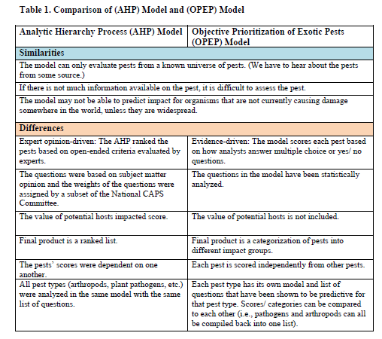
Objective Prioritization of Exotic Pests (OPEP)
Notes:
Move to the end of ppt?

Slide 11
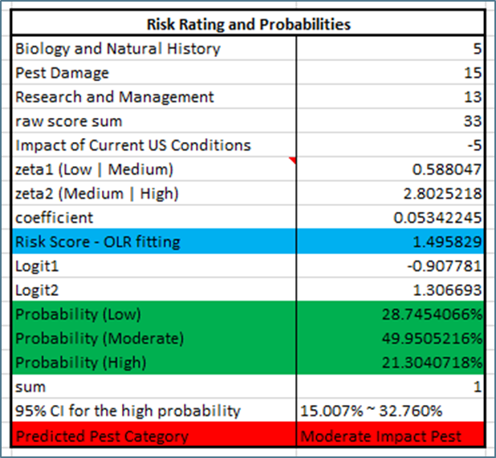
OPEP Results: Outcome for CAPS
Category 1 (High Impact Pest)
Significant likelihood to have a high impact in the U.S.
Greater than 20% probability of being a high impact pest.
Post-assessment candidate.
Category 2 (Moderate Impact Pest)
Most likely have a medium impact in the U.S.
10 to 20% probability of being a high impact pest.
Evaluated on a case by case basis.
Category 3 (Low Impact/Undetermined)
Have a low impact in the U.S or not enough info to evaluate.
Less than 10% probability of being a high impact pest.
Not evaluated further unless significant reason.
Notes:
Presented by Heather Moylett
Category 1 (High and some Moderate pests; Pests in Risk Groups A, B, C, and D)
• Pests have a significant likelihood to have a high impact in the United States. Pests have a greater than 20% probability of being a high impact pest.
• If the pests pass the Post-assessment (which evaluates the survey and identification/ diagnostic method), they will be listed on the Pests of Economic and Environmental Importance List. Pests will also be added to relevant commodity manuals.
• Pests on the Pests of Economic and Environmental Importance List are Priority Pests.
• If pests fail the Post-assessment, they will be placed on a priority list for research.
Category 2 (Other Moderate pests; Pests in Risk Groups E, F, and G)
• Pests are most likely to have a medium impact in the United States. Pests have a 10 to 20% probability of being a high impact pest.
• These pests will not be part of the Pests of Economic and Environmental Importance List.
• Pests will be evaluated on a case-by-case basis to determine if surveys are warranted. Pests that are recommended for survey and pass the Post-assessment (which evaluates the survey and identification/ diagnostic method) will be added to commodity manuals or posted as free-standing datasheets.
• If the pest is added to a commodity manual, it will be considered a Priority Pest. If the pest does not fit into an existing commodity manual, it will be added to the Additional Pests of Concern List and will not be considered a Priority Pest.
• If pests are recommended for survey but fail the Post-assessment they may or may not be listed as priorities for research.
Category 3 (Low impact or Undetermined pests; Pests in Risk Groups H, I, and J)
• Pests have a less than 10% probability of being a high impact pest.
• Low impact pests: pests are most likely to have a low impact in the United States. Undetermined pests: there is not enough information available to evaluate likely impacts.
• These pests will not be included on the Pests of Economic and Environmental Importance List.
• New pests assessed will not be included in a commodity manual or posted as free-standing datasheets unless there is a significant reason (political/ trade implications, human health impacts, etc.) for including them.
• Existing pests present in a commodity manual will likely be removed from manuals over time. These pests will still be available for bundling into other surveys.

Slide 12
Objective Prioritization of Exotic Pests (OPEP)
Moderate impact pests (Category 2) evaluated on a pest by pest basis. If recommended for CAPS the pest will go through the Post-assessment questionnaire
Pest is a candidate for the Objective Prioritization of Exotic Pests (OPEP) model. Pest is run through model
Low impact pests (Category 3) are not added to the final Priority Pest List unless there is a significant reason
High impact pests (Category 1) are run through the Post-assessment questionnaire (evaluate Survey and ID methods/ capacity)
Notes:
Presented by Heather Moylett

Slide 13
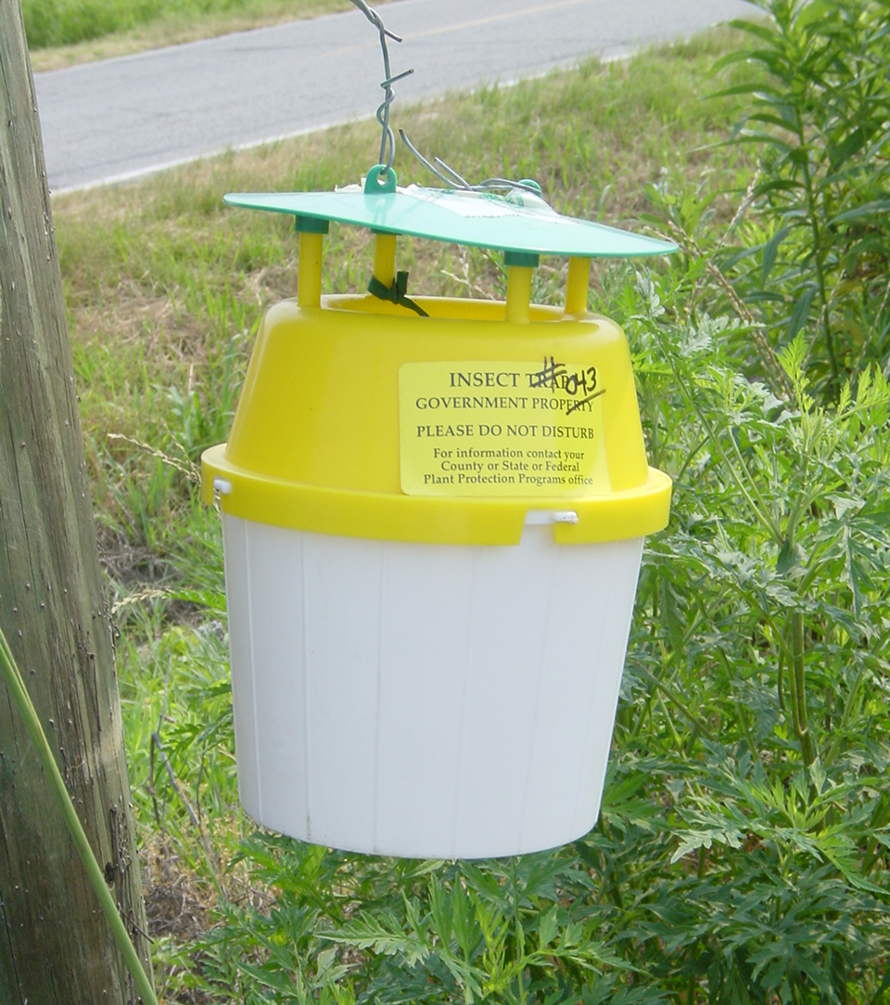
Pest Assessment and Prioritization Process
Post-assessment Questionnaire
Evaluates:
Survey method
Identification/diagnostic method
Capacity/expertise to perform ID/diagnostics
Exclude pests that don’t have effective methods.
These pests would not be listed on the final prioritized pest list.
Pests would go to a research and development list.
Notes:
Presented by Heather Moylett
The post-assessment evaluates the:
Ease of detection for this pest: (specific pheromone, generic sticky trap, visual)
Ease of identification:
Are there validated- diagnostic methods?
Does it require extensive sample preparation?
Is the target easily confused with many native/endemic pests?
and if there is sufficient capacity and available expertise to identify the pest should a large scale survey be conducted

Slide 14
Post-assessment questionnaire
High impact pests, and some moderate, are run through the Post-assessment Questionnaire. Evaluate Survey and ID methods/ capacity
Pests that fail the Post-assessment are put on a research list for survey or ID methods development/ improvement.
FAIL
PASS
Pests that make it through the Post-assessment will be on the Priority Pest List.
Notes:
Presented by Heather Moylett
Pests that pass the post-assessment are added to the CAPS priority pest list.
Pests that fail the post-assessment are added to a research list for methods development.

Slide 15
CAPS Pest List
Survey Manuals
Economic and Environmental Importance
Additional Pests of Concern
Notes:
Presented by Heather Moylett
The Priority Pest List includes the target pests in the CAPS Program. As of 2017, there are 153 pests on the CAPS list. This number is subject to change each year as CAPS adds new pests or removes existing pests. Pests are removed based on changes in US distribution, regulatory status, or changes to impact.
The pests listed are included in one or more of the following categories: Additional Pests of Concern, Survey Manuals, and Economic and Environmental Impact.

Slide 16
Economic and Environmental Importance
List of pests ranked as high impact by OPEP.
Additional Pests of Concern
Moderate impact pests that do not fit into an existing survey manual. Datasheets are freestanding.
Survey Manuals
Provide guidelines for early detection surveys.
Organized by Taxonomy or Commodity.
Priority Pests: High impact pests and moderate impact pests when appropriate.
These pests are also included in relevant survey manuals.
Priority Pests
Not Priority Pests
Low impact pests with significant reason.
Notes:
Presented by Heather Moylett
Survey Manuals:
All CAPS surveys use a bundled survey approach, and survey manuals provide guidelines for conducting these surveys. In bundled surveys, groups of exotic pests are surveyed for concurrently. The purpose of this commodity-based (pests with the same host plant), taxon-based (similar pest taxa; e.g., cyst nematodes, bark beetles), and pathway-based (pests that follow the same pathway; e.g., Asian defoliators) bundling is to increase efficiency and cost-effectiveness of surveys.
Economic and Environmental Impact:
Pests on the Economic and Environmental Impact list (currently ~55 pests) are predicted to have significant economic or environmental impact if they become established in the U.S.
Additional Pests of Concern:
Pests on the Additional Pests of Concern list are moderate pests recommended to CAPS that do not fit into a survey manual or low impact pests that are retained for significant reasons (political, trade, etc.). Pests on the APC List will have a free-standing datasheet accessible from the Approved Methods page and will not be considered a Priority Pest.
Ex. Mamestra brassicae

Slide 17
CAPS Timeline
General Timeline for Prioritized Pest List Development
Year 1: Prioritization Process
Pre-assessments
OPEP Model
Post-assessments
Year 2: Develop support products for new pests
Pest datasheets
Approved survey methods
Approved identification/diagnostic methods
Trap and lure procurement
Identification and diagnostic capacity
Screening aids (if appropriate)
Host and Risk maps
Notes:
Presented by Heather Moylett
A new pest list is developed every two years. The process involves both the prioritization process to create a pest list and also development of the support tools that make the pest list “field-ready.” In this way, when the pest list is made available to the CAPS community, the datasheets, approved methods, and necessary infrastructure (traps and lures, diagnostics, screening aids, etc.) are in place so that surveys can take place. This slide represents our two-year timeline.

Slide 18
OPEP Updates 2018
CAPS Pest Assessment and Prioritization Processes

Slide 19
Objective Prioritization of Exotic Pests (OPEP)
Phase I:
Arthropod & pathogen models developed and validated.
Phase II:
To be completed FY 2018
Phase III:
To be completed FY 2019
Impact Potential
Likelihood of Introduction
Add to survey program?
Survey Feasibility & Cost Effectiveness
Policy considerations*
(Decision Lens/AHP)
Notes:
Models in development

Slide 20
Phase I: Impact Potential
Arthropod Model
Validation of the model is complete.
PERAL analyzed and 73 arthropods during validation and retested questions that were found not to be predictive.
The validated model will be used for CAPS 2019.
74 new arthropods have been assessed for CAPS/NPAG using the validated model.
Plant Pathogen Model
Validation of the model is complete.
PERAL analyzed an additional 50 pathogens during validation.
52 new pathogens have been assessed for CAPS/NPAG.
Notes:
Analyzed 100 arthropods and 83 pathogens during development.

Slide 21
Phase I: Impact Potential
Mollusk Model
PPQ Policy Management requested this work, to assist PPQ in determining high impact mollusk pests.
PERAL submitted a Farm Bill proposal for FY18 funding.
We have 9 completed assessments and are planning for 25 to 34 total mollusks for development.

Slide 22
Phase II: Likelihood of Introduction/Establishment
PERAL has developed a theoretical model for entry and establishment and identified primary drivers for arthropods and pathogens (e.g. environmental suitability, population dynamics, management, and ecological communities).
PERAL is in the process of making the theoretical model operational, developing potential analysis questions to address each driver and identifying sources for answering these questions.

Slide 23
Phase II: Likelihood of Introduction/Establishment
To be completed FY2018
Further refine prioritized list by the likelihood of introduction
High impact pests
High likelihood of introduction
High priority pests

Slide 24
Phase III: Survey Feasibility & Cost Effectiveness
Develop a method for comparing the cost of the survey to the expected losses
Determine which pest surveys will give us the greatest value for our dollar
Eliminate surveys where the cost of survey is greater than the potential damage
To be completed FY2019

Slide 25
Objective Prioritization of Exotic Pests (OPEP)
Phase I:
Arthropod & pathogen models developed and validated.
Phase II:
To be completed FY 2018
Phase III:
To be completed FY 2019
Impact Potential
Likelihood of Introduction
Add to survey program?
Survey Feasibility & Cost Effectiveness
Policy considerations*
(Decision Lens/AHP)
Notes:
Reminder of whole picture

Slide 26
CAPS Use of Model
Evaluate New Pest Suggestions
PERAL is using validated arthropod and pathogen models to assess new pests that have passed pre-assessment.
In the future, all new pests for commodity manuals will also be evaluated with the OPEP model by PERAL.
CAPS submitted 28 new pests. 19 completed.
CAPS Category | Arthropods | Pathogens
Category 1 | 4 | 2
Category 2 | 2 | 2
Category 3 | 1 (low) 1 (undetermined) | 6 (low) 1 (undetermined)

Slide 27
CAPS Use of Model
Evaluate New Pest Suggestions
Category 1
Cydalima perspectalis
Nilaparvata lugens
Ostrinia furnacalis
Puccinia graminis f. sp. Tritici (Ug99)
Trichoferus campestris
Xylella fastidiosa ssp. pauca
Notes:
List category 1 pests?

Slide 28
CAPS use of model
Evaluate Commodity Pests
We have a Farm Bill project that started Sept 2017.
This will help us remove any pests that are of low impact.
This will also standardize our Prioritized Pest Lists and remove low impact pests.
CAPS submitted 32 commodity pests. Pending assessment.
16 arthropods
16 pathogens

Slide 29
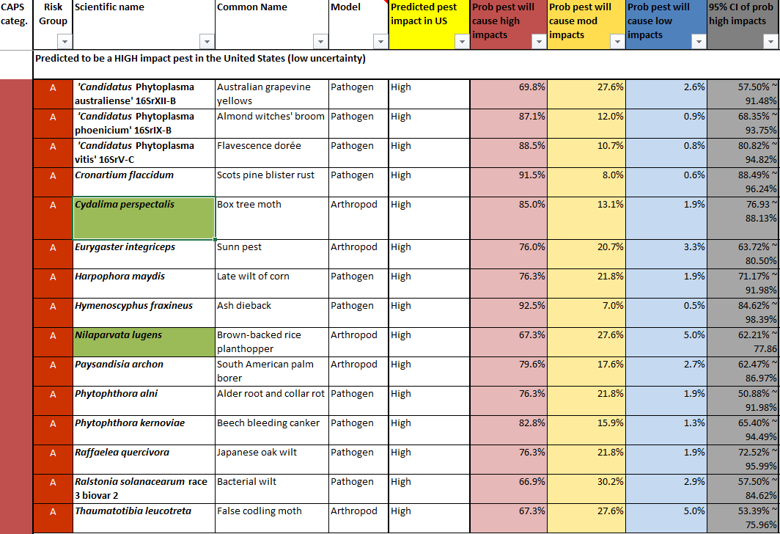
CAPS use of model
CAPS will receive updates from PERAL on a quarterly basis.
OPEP excel file CAPS R&C site will be updated

Slide 30
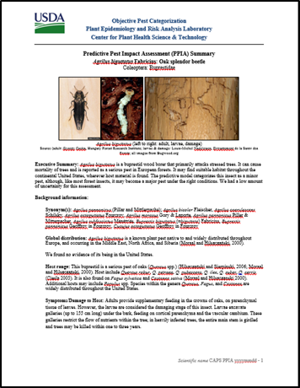
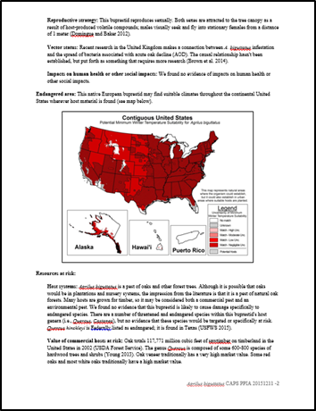
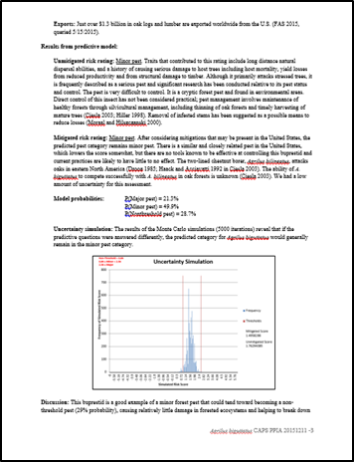
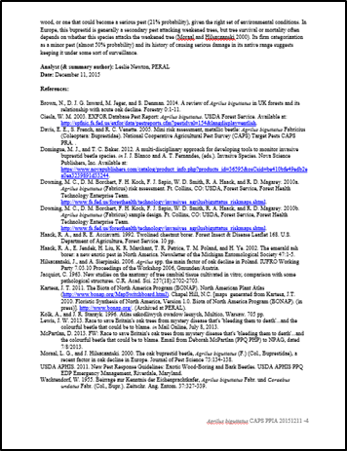
OPEP Impact Assessment Summaries
A summary document encapsulates the assessment with background information, results from the predictive model, endangered area, references, and an appendix with predictive questions & answers
Notes:
Presented by Leslie Newton

Slide 31
OPEP Impact Assessment Summaries
2017 NCC Action Item
Update:
Summaries available through PestLens – login required.
Links to OPEP summaries will be posted on the CAPS R&C site.
Brief guidance doc on PestLens and where to find summaries will be provided.
(https://pestlens.info/)
Notes:
Presented by Leslie Newton

Slide 32
Additional slides

Slide 33
Pests are suggested by CAPS community and other sources.
Pests that fail the Pre-Assessment are not candidates for the Prioritized Pest List
Completed pre-assessment form is archived. Pest may be re-submitted in the future if more information becomes available.
Pests are run through Pre-assessment questionnaire.
Moderate impact pests evaluated on a pest by pest basis. If recommended for CAPS the pest will be run through the Post-assessment questionnaire .
Pest is a candidate for the Objective Prioritization of Exotic Pests (OPEP) model. Pest is run through model.
Low impact pests are not added to the final CAPS Pest List unless there is a significant reason.
High impact pests are run through the Post-assessment questionnaire (evaluate Survey and ID methods/ capacity).
Pests that fail the Post-assessment are put on a research list for survey or ID methods development/ improvement.
Pests that make it through the Post-assessment will be on the CAPS Pest List.
Notes:
Presented by Dan Mackesy
This is the Pest Assessment and Prioritization Process in greater detail.
A pest is suggested to the CAPS program by the CAPS community or other sources, like the New Pest Advisory Group (CPHST PERAL).
The pest is run through the CAPS Pre-Assessment questionnaire.
If the pest fails the CAPS Pre-Assessment, it is archived and may be resubmitted to CAPS in the future as new information becomes available.
If the pest passes CAPS Pre-Assessment, it is passed to the Objective Prioritization of Exotic Pests (OPEP) team for evaluation.
Pest is evaluated using OPEP model
Pests found to be low impact are archived and do not advance to the CAPS Post-Assessment unless significant reason exists (political/trade implications).
Moderate impact pests are evaluated on a pest by pest basis
High impact and some moderate impact pests advance to the CAPS Post-Assessment
Pest is run through the CAPS Post-Assessment questionnaire to evaluate detection and identification methods available.
If high impact pest fails the CAPS Post-Assessment, it is placed on a research list for survey and ID methods development/improvement
Moderate impact pests that fail post-assessment may or may not be listed as priorities for research.
Pests that pass the CAPS Post-Assessment are added to the CAPS Prioritized Pest List and approved methods for survey and identification are posted to the CAPS Resource and Collaboration Site: http://caps.ceris.purdue.edu/home.

