Slide 1
Approved Methods for Pest Surveillance
Heather Moylett
Heather.Moylett@aphis.usda.gov
Daniel Mackesy
Daniel.Z.Mackesy@aphis.usda.gov
Annual NCC Meeting February 7-8, 2018 Newnan, GA

Slide 2
Changes for 2018
Fluon-coated cross vane panel traps
Required for Callidiellum villosulum (brown fir longhorned beetle) and Trichoferus campestris (velvet longhorned beetle)
Will extend requirement to all EWB/BB survey targets in 2019
Pre-treated cross vane panel traps
Not in stock yet, will be ordered once budget is passed
Until available, refer to Guidance for applying fluoropolymers to panel traps doc on CAPS R&C site
Callidiellum Lure
Available soon
Effective for Callidiellum villosulum (target pest) and C. rufipenne (Japanese cedar longhorned beetle)
Two components: 3-hydroxy-2-hexanone (aka, 6-ketone or ketol) + pyrrole (newly described compound)
Cross Vane Panel Trap, Black* - treated with fluoropolymer

Slide 3
Changes for 2018
Trichoferus campestris (VLB)
Black Light Traps and Visual Survey are no longer approved methods.
Approved method for negative data:
Ethanol
Cross Vane Panel Trap, Black* - treated with fluoropolymer
Trichoferone lure – one more year of trials, may be ready for 2019
Agrilus planipennis (EAB)
New approved method added: 3Z-Lactone Lure + Z-3-hexenol Lure and green prism trap.
3Z-Lactone Lure and green prism trap are not offered through IPHIS.
Primary and preferred method: Z-3-hexenol lure (used alone) with purple prism trap.
Notes:
.

Slide 4
Changes for 2018
Annual ryegrass toxicity
There are real-time PCR assays available to detect Rathayibacter toxicus in plants and nematodes.
The assays have been validated by Beltsville, and a draft of the work instructions is complete. The approved methods will be updated in the 2019 Guidelines.
Veronicellidae (Leatherleaf slugs)
If planning to survey for any of the six target genera, be sure to include all six in your work plan, survey summary form, and in your final data reporting.
Notes:
.

Slide 5
Changes for 2019
Annual ryegrass toxicity
There are real-time PCR assays available to detect Rathayibacter toxicus in plants and nematodes.
The assays have been validated by Beltsville, and a draft of the work instructions is complete. The approved methods will be updated in the 2019 Guidelines.
Notes:
.

Slide 6
Changes for 2019
Chrysodeixis chalcites (golden twin spot moth)
Glue in wing traps damaging to specimens
Traps approved for 2018:
wing trap kit, paper or plastic
plastic bucket trap
Trap approved for 2019:
plastic bucket trap
Mesh screens for bucket traps available through IPHIS soon.
Notes:
The glue used in wing trap kits has been found to damage samples, making screening and identification difficult and time consuming. Studies support the use of plastic bucket traps for C. chalcites early detection survey.
Sweep net sampling has been added as an approved method for Chrysodeixis chalcites (golden twin spot moth). This method is approved for negative data reporting from Michigan, only. Michigan is employing sweep net sampling to target the larval life stage to determine if adult detections represent a breeding population or fly-overs from an adjacent population present in Canada. Wing trap kits (paper or plastic) and the plastic bucket trap remain the only approved traps for all other states.

Slide 7
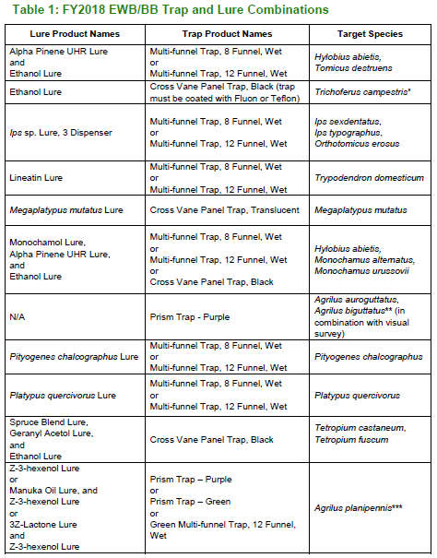
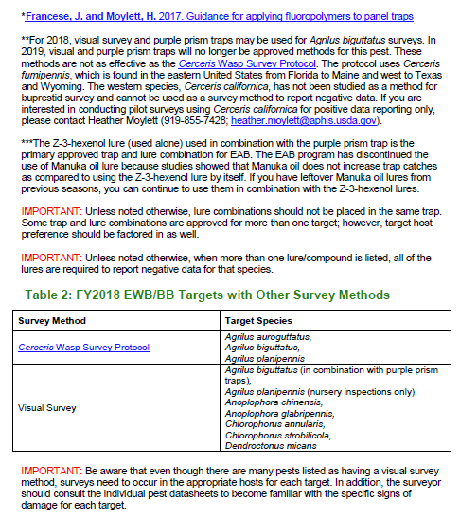
Resources
FY2018 EWB/BB Trap and Lure Combo table
http://download.ceris.purdue.edu/file/3479
Notes:
This document includes a table for trap and lure combinations as well as a table that lists the targets for visual and Cerceris wasp survey. Updates include removing pests that are no longer CAPS targets, adding new lure and trap combinations, and providing links to resources (e.g., Cerceris wasp protocol). The tables are meant to act as a reference when purchasing survey supplies or planning surveys.

Slide 8
Resources
FY2018 EWB/BB Trap and Lure Combo table
Species removed:
New trap and lure combinations have been added for Trichoferus campestris and Agrilus planipennis.
Links to the Cerceris Wasp Survey Protocol and Guidance for applying fluoropolymers to panel traps have been added.
Monochamus saltuarius | Tomicus piniperda
Monochamus sutor | Xyleborus glabratus
Scolytus intricatus | Xyleborus spp.
Tomicus minor | Xylotrechus spp.
Notes:
This document includes a table for trap and lure combinations as well as a table that lists the targets for visual and Cerceris wasp survey. Updates include removing pests that are no longer CAPS targets, adding new lure and trap combinations, and providing links to resources (e.g., Cerceris wasp protocol). It will be available before Sept 30th and we will send an announcement. The tables are meant to act as a reference when purchasing survey supplies or planning surveys.

Slide 9
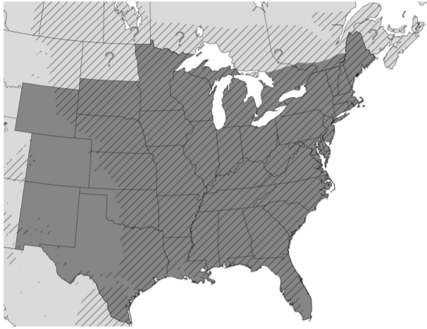
Resources
Cerceris Wasp Survey Protocol
Existing protocol uses Cerceris fumipennis
Distribution of C. fumipennis
Known distribution shaded in,
Question marks indicate where expected but not recorded,
hatching indicates distribution of six Fraxinus species found in eastern N.A.
(Careless et al., 2014)
Notes:
C. Fumipennis - which is found in the eastern United States from Florida to Maine and west to Texas and Wyoming. Not recorded in North Dakota or Montana and west.
Careless, P., S. A. Marshall, and B. D. Gill. 2014. The use of Cerceris fumipennis (Hymenoptera: Crabronidae) for surveying and monitoring emerald ash borer (Coleoptera: Buprestidae) infestations in eastern North America. Can. Entomol. 146:90-105. Last accessed January 29, 2018 from https://www.cambridge.org/core/journals/canadian-entomologist/article/use-of-cerceris-fumipennis-hymenoptera-crabronidae-for-surveying-and-monitoring-emerald-ash-borer-coleoptera-buprestidae-infestations-in-eastern-north-america/22361B8C4664201C9F9A90E3ACDED53C

Slide 10
Resources
Cerceris Wasp Survey Protocol using C. californica
Western species, Cerceris californica
Requires further study. Not approved survey method for reporting negative data.
Western states interested in conducting pilot surveys using Cerceris californica for positive data reporting only, please contact Heather Moylett (919-855-7428; heather.moylett@aphis.usda.gov).
Notes:
C. Fumipennis - which is found in the eastern United States from Florida to Maine and west to Texas and Wyoming.

Slide 11
Changes to AMPS on CAPS R&C website

Slide 12
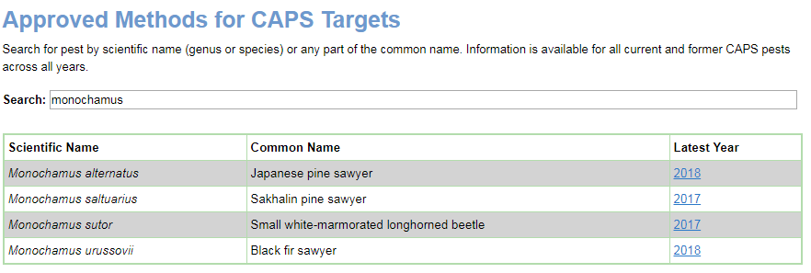
New search tool

Slide 13
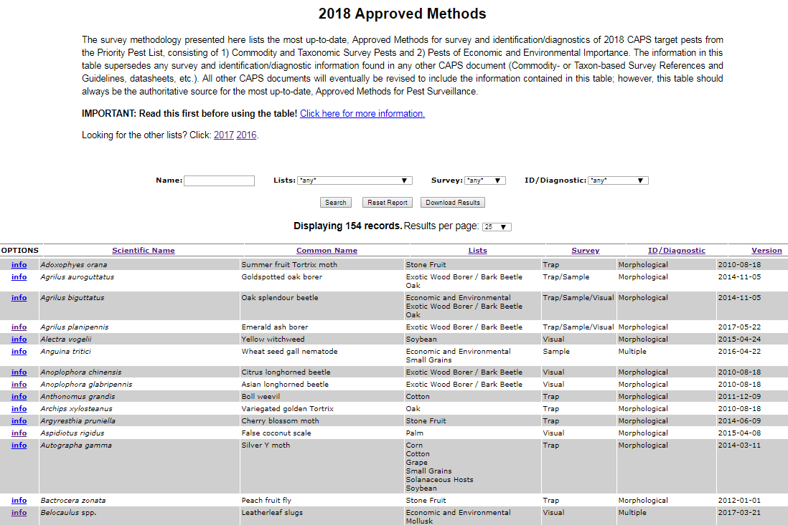
AMPS Table
How are you using the AMPS table?

Slide 14
AMPS Table Changes: Information
“Survey” - split into two columns
“Survey Method” – list trap type, visual, or sample type
“Lure” – list all lure combos effective for target
“ID/Diagnostic” – indicate level of difficulty
Develop ranking criteria based on available resources, methods, and easily confused species
“Version” – remove or show year only?
Notes:
Trap and lure combinations - especially lures that attract multiple targets
if you are surveying for X, be sure to survey for Y, too
For example:
Dendrolimus pini and Dendrolimus sibiricus
The "Dendrolimus pini - Dendrolimus sibiricus Lure," is effective for both Dendrolimus pini and D. sibiricus. If Dendrolimus pini is listed as a survey target in your work plan, then Dendrolimus sibiricus must also be listed in the work plan. If Dendrolimus sibiricus is listed as a survey target in your work plan, please add Dendrolimus pini.
This guidance has been added to the AMPS pages for Dendrolimus pini and Dendrolimus sibiricus.
Tetropium fuscum and Tetropium castaneum
The approved lure combination 1) Spruce Blend Lure, 2) Geranyl Acetol Lure, and 3) Ethanol Lure, are effective for both Tetropium fuscum and Tetropium canstaneum. If Tetropium fuscum is listed as a survey target in your work plan, then Tetropium castaneum must also be listed in the work plan. If Tetropium castaneum is listed, please add Tetropium fuscum.
This guidance has been added to the AMPS pages for Tetropium fuscum and Tetropium canstaneum.

Slide 15
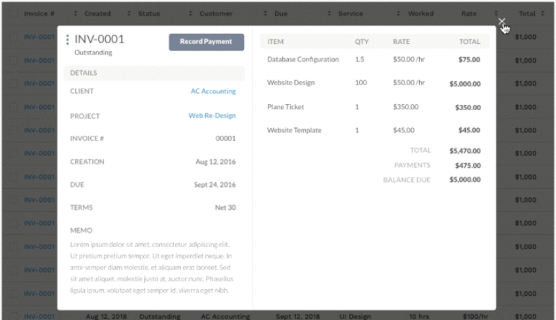
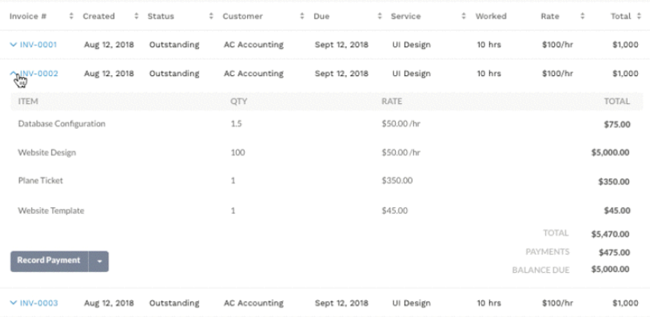
AMPS Table Changes: Format/Usability
Add filters for:
“Survey Method” and “Lure”: ensure all targets for lure are accounted for and included in work plans/SSF
“ID/Diagnostic difficulty”
Reduce clutter using expandable rows or modals
Notes:
Trap and lure combinations - especially lures that attract multiple targets

Slide 16
CAPS Survey Manual Introductions
Daniel Mackesy
Daniel.Z.Mackesy@aphis.usda.gov
Heather Moylett
Heather.Moylett@aphis.usda.gov
Annual NCC Meeting February 7-8, 2018 Newnan, GA

Slide 17
Topics
Review of the current CAPS Survey Manual Introduction format.
Proposed change to online format of Manual Introductions.
Free-standing guidance documents.
Notes:
Review of current manual intros.
Potential changes in format and presentation of information.

Slide 18
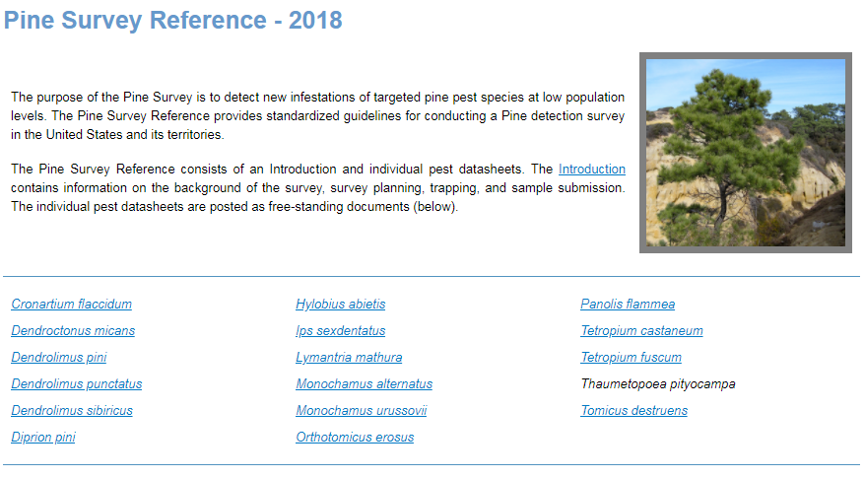
Current Manual Intro Format
Prior to 2012, survey manuals were large pdfs with the introduction and the pest datasheets all in one.
In 2012, datasheets were separated from the manual introductions.
Notes:
Prior to 2012, manuals were one large PDF file. They were difficult to maintain.

Slide 19
Current Manual Intro Format
Similar challenges with Manual Introductions
Difficult to maintain and keep current:
15 CAPS survey manuals
Duplication of information across manual intros
Manual Introductions are long (30-40 pages each) making information harder to find quickly
Some information provided in introductions also found in pest datasheets.
Notes:
A lot of information, such as trap descriptions, survey planning, and sample submission are the same regardless of the survey. With 15 manuals, keeping them updated takes a significant amount of time. We do not want to preclude information in the datasheets.

Slide 20
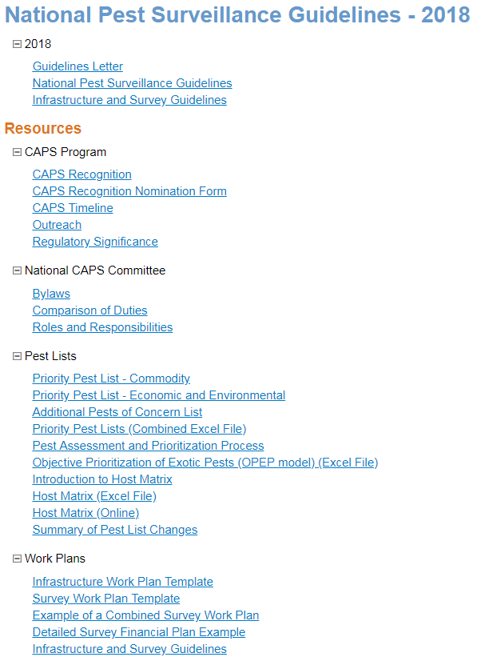
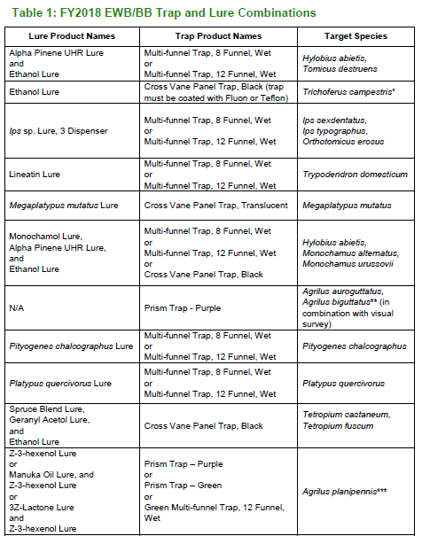
Redundancy Issues
Approved Methods Tables needed for each survey?
Some info in documents provided in Guidelines Resources.
Ordering info = Survey Supply
Notes:
There is a lot of redundancy in the manual introductions.

Slide 21
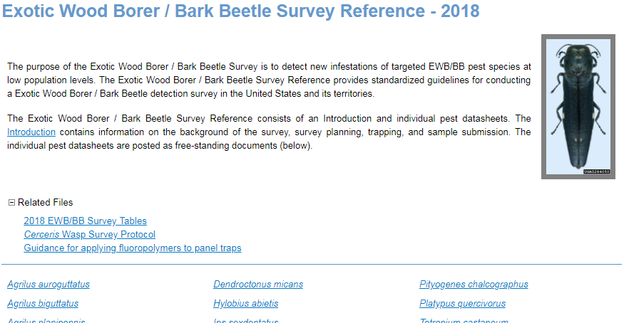
Proposal
In 2018, breakdown information sections and appendices into free-standing guidance documents.
Curate list of links for each manual page on the CAPS R&C site

Slide 22
Proposal: Benefits
Easier to update = Current information and improved consistency across manuals.
Information needed is easier to find – is this true?
Expedite building needed or new manual intros.

Slide 23
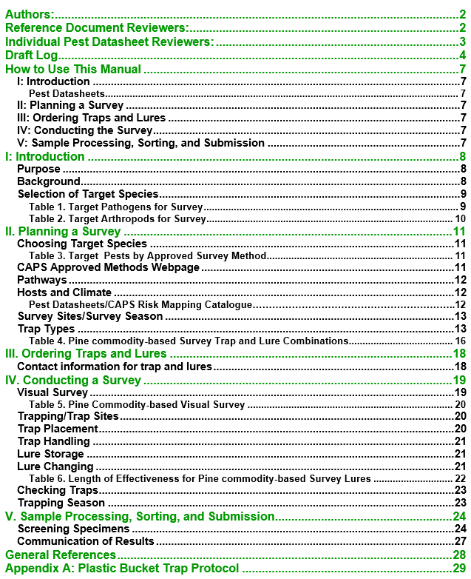
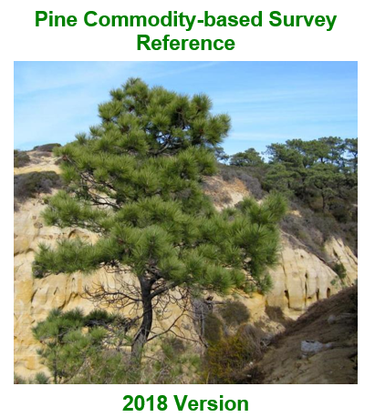
Current Manual Intro Format
Notes:
Heather takes it from here. Here is an example of the 2018 pine manual introduction.

Slide 24
Survey Manual Introduction
I: Introduction
Describes the purpose of the Commodity-based Survey Reference. This section also lists the pest species targeted in the respective survey.
II: Planning a Survey
Contains survey planning information, including: Choosing target species, CAPS-approved survey and ID methods, and general information on survey sites, survey season, and the approved traps.
III: Ordering Traps and Lures
Provides general ordering information.
IV: Conducting the Survey
Provides specific information on conducting visual and/or trap & lure surveys for target pests.
V: Sample Processing, Sorting, and Submission
Provides information on submitting samples for identification.
Appendices: Provide additional relevant information for particular surveys and submission form 391.
Notes:
There are five main sections in each manual introduction as well as appendices.
.

Slide 25
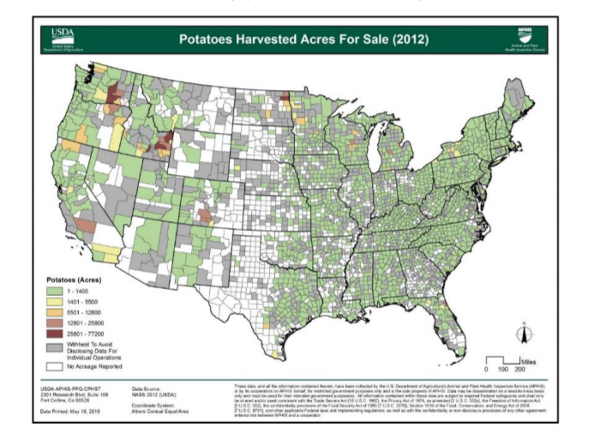
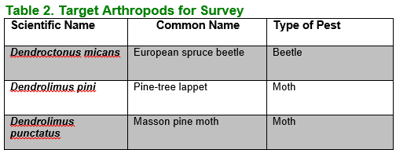
I: Introduction
Purpose
Background
Commodities: Info and US distribution maps
Target species
Notes:
The first section of describes the purpose of the Commodity-based Survey Reference. This section also lists the pest species targeted in the respective survey. Pest lists are also available on the approved methods page.

Slide 26
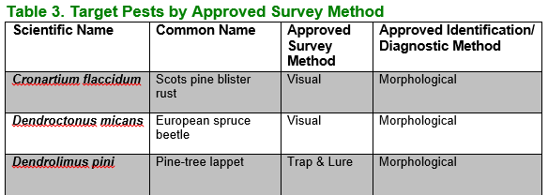
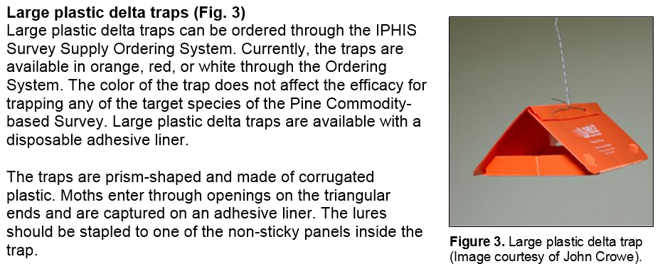
II: Planning a Survey
Target Pests by Approved Survey Method
Reviews:
Pathways
Survey methods
Trapping density and season
Notes:
Here is a sample of information from Section II. This section reviews pests for survey, trap types, and trap and lure combinations. It also lists target pests again.

Slide 27
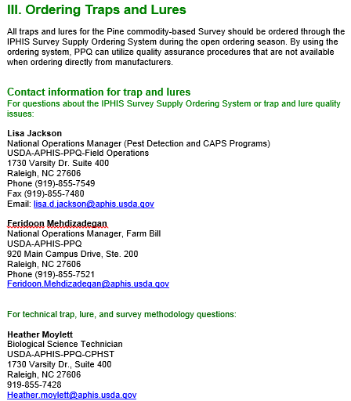
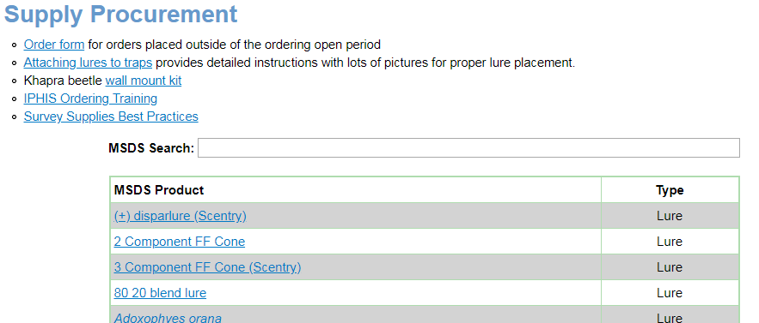
III: Ordering Traps and Lures
Move this information to Survey Procurement page?
Notes:
Section 3 is brief and can be absorbed into other documents.

Slide 28
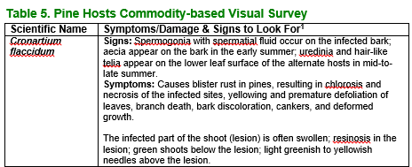
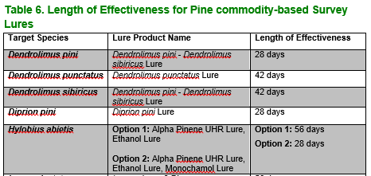
IV: Conducting a Survey
Provides visual survey instructions.
Specific pest symptoms
Provides trap and lure information.
Trap Sites, Placement, Servicing
Lure Handling, Storage, Changing
Notes:
Provides general information on conducting a visual survey and a trap & lure survey. It provides specific information about visual symptoms of target pests. This is redundant and can be found in pest datasheets. Trap and lure information is also largely redundant.

Slide 29
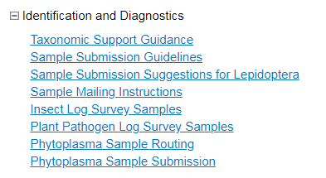
V: Sample Processing, Sorting, and Submission
Provides information on sample screening and submission for arthropods and pathogens.
Provides contact information for identifiers.
Information is the same across manuals
Notes:
Section V: Information is the same across manuals.

Slide 30
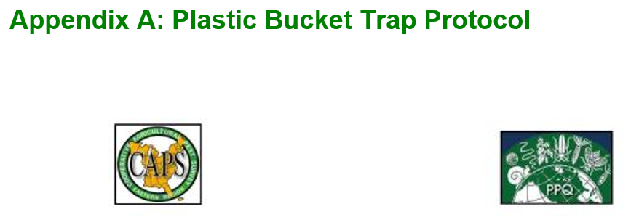
Appendices
Provide additional information such as trapping protocols and PPQ form 391.
Notes:
Appendices provide additional information that is relevant to the respective survey. A copy of PPQ form 391 is also included.

Slide 31
Free-standing Documents: Survey/Sampling Method
Soil Sample protocol
Visual Survey protocols
Mollusk Visual Survey protocols
Sweep Netting protocols
Notes:
**check survey supply page

Slide 32
Free-standing Documents: Survey/Sampling Method
Trap and Lure guidance
Ordering – Survey Supply
Trap types and care
Plastic bucket trap protocol
Assembly Instructions for Cross-vane panel traps
Trap supply checklist for placing and checking
Lure storage, handling, and changing
Cross-contamination guidance
Appendix: Survey Trap Card
Notes:
**check survey supply page

Slide 33
Free-standing Documents
Sample Processing, Sorting, and Submission
Molecular guidance
Submitting Bark Beetle Specimens
PPQ Form 391/IBP Records
Where to put these?
Determination of Risk Assignment for Businesses
Hot Zone Trapping Program
Firewood Dealers, Sawmills, Logging, and Pallets

