Slide 1
2019 Pest List, Survey Manual, and Host Matrix Updates
Daniel Mackesy Heather Moylett daniel.z.mackesy@aphis.usda.gov heather.moylett@aphis.usda.gov

Slide 2
Topics
Pest List Updates
Survey Manual Updates
Host Matrix Updates
Notes:
Topics
Manual Changes
Upcoming/ Possible New Manuals

Slide 3
Pest List Updates
Due to a yearlong staffing shortage, no new pests will be added to the 2019 CAPS list.
Pest lists were thoroughly reviewed for accuracy, and CAPS pests were also reviewed for possible removal.
Notes:
Instead of adding pests this year, the focus shifted to accuracy of survey lists. In addition, the CAPS list was reviewed, and some pests are candidates for removal in 2019.

Slide 4
Pest List Updates
Pests with name changes in 2019
Pest | Common Name | New Name | Pest Lists
Tospovirus Groundnut bud necrosis virus | Groundnut bud necrosis virus (GBNV) | Orthotospovirus Groundnut bud necrosis virus | Economic and Environmental Solanaceous
Notes:
These two pests have new scientific names effective survey year 2019: Citrus fruit borer and GBNV

Slide 5
Pest List Updates
Candidates for removal from CAPS list
Pest | Common Name | Pest Lists | Reason for removal | OPEP status
Chlorophorus strobilicola | Slender-banded pinecone longhorn beetle | EWBB/BB | Pine is only known host, direct evidence is weak. No trap/lure available. | Pending
Eutetranychus orientalis | Citrus brown mite | cotton, soybean | Citrus is only major host with direct evidence. No direct evidence for cotton or soybean. | Pending
Onopordum acaulon | Horse thistle | economic and environmental | Rarely surveyed for. | N/A
Unaspis yanonensis | Arrowhead scale | additional pests | Citrus is only host with direct evidence. Not surveyed for since 2015 | Complete (Mod impact)
Notes:
The following pests are candidates for removal:

Slide 6
Pest List Updates
Proposed changes to CAPS pest lists
Pest | Common Name | Proposed changes | Reason for change
Alectra vogelii | Yellow witchweed | Remove from Soybean list | Soybean is a secondary host. Cowpea is the main host.
Autographa gamma | Silver Y moth | Remove from corn, grape, soybean, wheat | No direct evidence
Cernuella virgata | Maritime garden snail | Add to mollusk | Inadvertently omitted
Heteronychus arator | Black maize beetle | Remove from grape | Grape appears to be a minor host. Very little direct evidence.
Lymantria mathura | Rosy moth | Remove from pine and oak list | Experimental evidence only
Spodoptera littoralis | Egyptian cottonworm | Remove from grape, small grains | No direct evidence
Spodoptera litura | Cotton cutworm | Remove from corn, grape | No direct evidence
Thaumatotibia leucotreta | False codling moth | Remove from grape, oak | No direct evidence
Notes:
The following pests are candidates for removal:

Slide 7
Pest List Updates
Beyond 2018, the pest lists will likely change as more CAPS pests receive an OPEP evaluation.
OPEP evaluations for 32 CAPS pest are pending.
47 additional CAPS arthropods and pathogens will need OPEP evaluations in the future.
Notes:
The pest lists may look different after OPEP evaluations are completed for each current CAPS pest.

Slide 8
2019 Manual Updates

Slide 9
Manual Updates
Deliver calendar year 2018 (Contingent on staffing levels)
Publish datasheets for remaining new 2018 pests (drafts completed)
Revise Pine manual and datasheets (manual intro revised, datasheets near completion)
Revise Oak manual and datasheets (in progress)

Slide 10
Manual Updates
Calendar year 2018 (proposed)
“Clean up” the commodity lists
As we revise each manual, apply post-assessments to pests that never received it. Remove from list if necessary.
Run commodity pests through OPEP. Remove low-ranking pests. High-ranking pests without good survey/diagnostic methods move to research list.
Notes:
This year, we will focus on cleaning up the commodity lists. As we revise each manual, OPEP evaluations and post-assessments will be done on pests.

Slide 11
Manual Updates
No new manual for 2019 survey season. New manuals are on hold indefinitely.
In the manual queue:
1) Add Sorghum to Corn and update the pests for Corn.
2) Apple/Pear: We have preliminary pest list.
Notes:
Manuals are on hold indefinitely due to staffing issues. Eventually, we plan to add sorghum pests to the corn survey and add an apple/pear manual.

Slide 12
2019 Host Matrix Changes

Slide 13
Host Matrix
A tool for identifying:
CAPS pests which are threats to a given host.
Important hosts of pests on the CAPS list.
Potential survey targets.
Notes:
The host matrix is a tool for identifying pests which are a threat to a given host, and a tool for identifying survey targets.

Slide 14
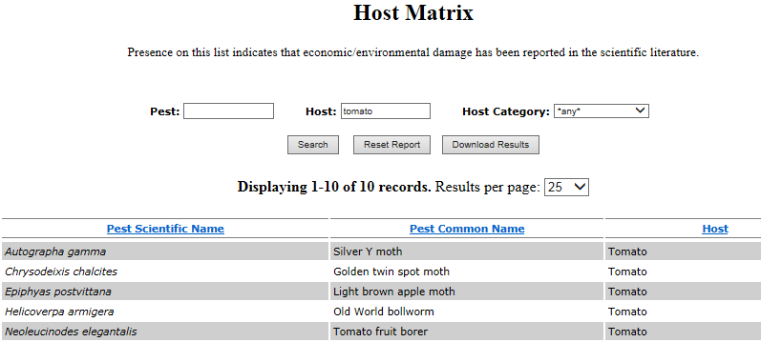
Host Matrix
Available in spreadsheet form and as a search tool on the CAPS website.
Notes:
The Host matrix is available as an excel file and as a search tool on the CAPS website. The excel file can be downloaded. Here is an example of both.

Slide 15
Changes to 2019 matrix
One new host added: Sugarbeets.
Literature reviews and host evaluations were performed on numerous polyphagous CAPS pests, and hosts without direct evidence of damage were removed.
Notes:
One new host will be added. Sugarbeets. Please review the matrix and make suggestions for additional hosts that are added.

Slide 16
Not included in Host Matrix
Pests of stored products (Khapra Beetle).
Mollusks
Weeds
Secondary hosts of pests
Notes:
Pests which are not host-specific are not included in the 2018 matrix and are best surveyed for along potential pathways of introduction. Weeds are also not included (Parasitic plants such as witchweed are included). In the interest of creating a simpler and more efficient tool, secondary hosts were not included.

Slide 17
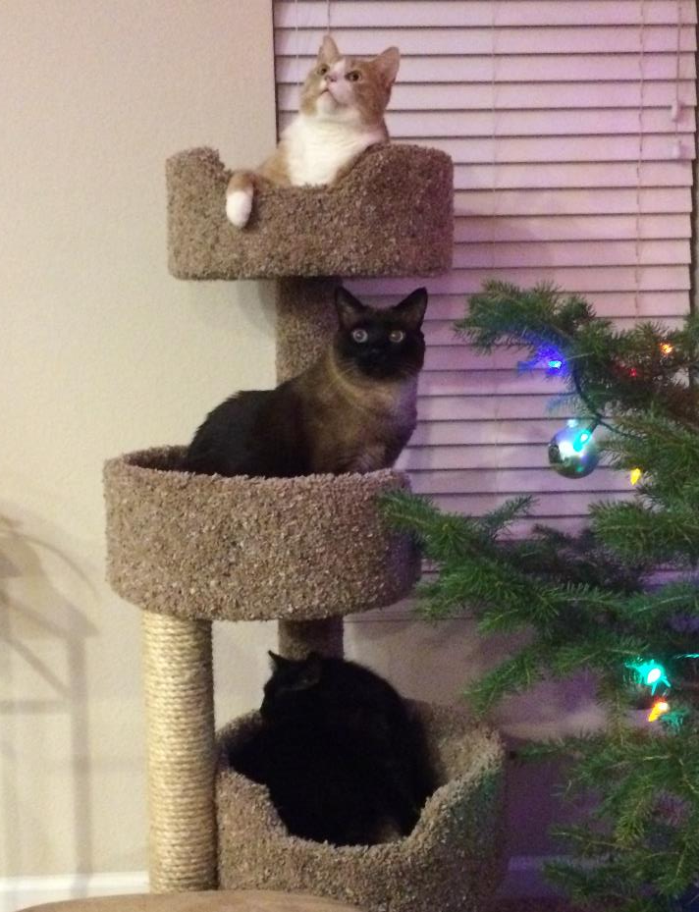
Questions ???

