Slide 1
CAPS Survey Manual Introductions
Daniel Mackesy
Daniel.Z.Mackesy@aphis.usda.gov
Heather Moylett
Heather.Moylett@aphis.usda.gov
Annual NCC Meeting February 7-8, 2018 Newnan, GA

Slide 2
Topics
CAPS Survey Manual updates
Review of the current CAPS Survey Manual Introduction format.
Proposed change to online format of Manual Introductions.
Free-standing guidance documents.
Notes:
Review of current manual intros.
Potential changes in format and presentation of information.

Slide 3
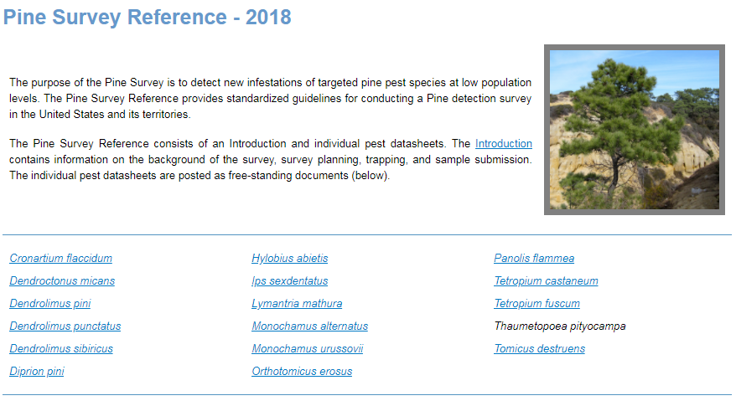
Current Manual Intro Format
Prior to 2012, survey manuals were large pdfs with the introduction and the pest datasheets all in one.
In 2012, datasheets were separated from the manual introductions.
Notes:
Prior to 2012, manuals were one large PDF file. They were difficult to maintain.

Slide 4
Current Manual Intro Format
Similar challenges with Manual Introductions
Difficult to maintain and keep current:
15 CAPS survey manuals
Duplication of information across manual intros
Manual Introductions are long (30-40 pages each) making information harder to find quickly
Some information provided in introductions also found in pest datasheets.
Notes:
A lot of information, such as trap descriptions, survey planning, and sample submission are the same regardless of the survey. With 15 manuals, keeping them updated takes a significant amount of time. We do not want to preclude information in the datasheets.

Slide 5
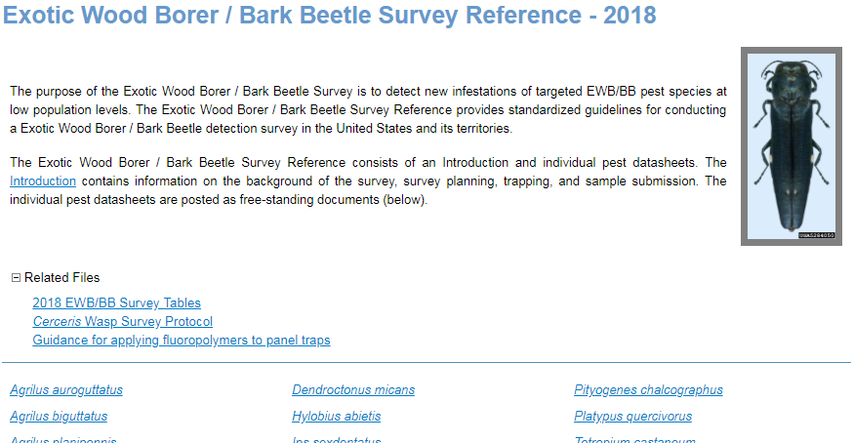
Proposal
In 2018, breakdown information sections and appendices into free-standing guidance documents.
Curate list of links for each manual page on the CAPS R&C site

Slide 6
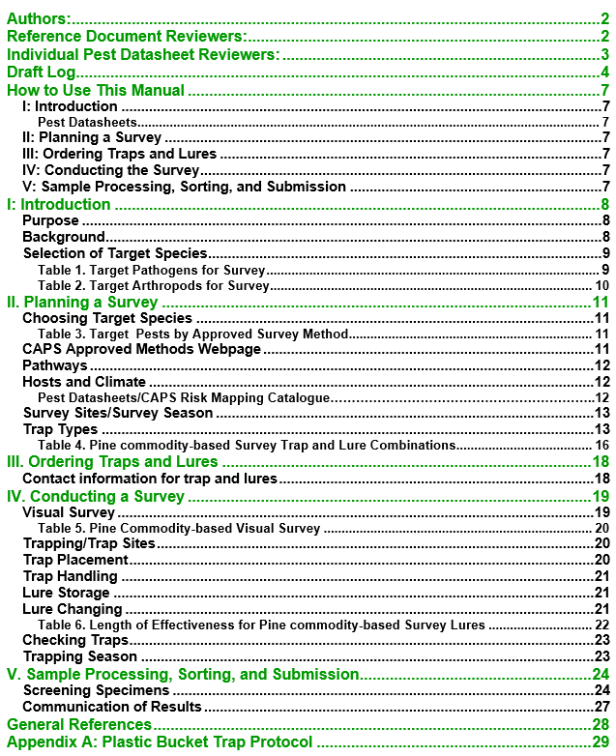
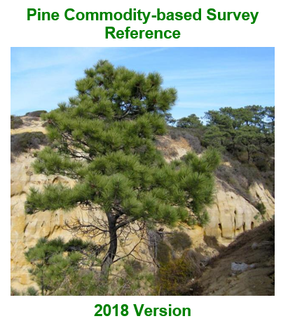
Current Manual Intro Format
Notes:
Heather takes it from here. Here is an example of the 2018 pine manual introduction.

Slide 7
Survey Manual Introduction
I: Introduction
Describes the purpose of the Commodity-based Survey Reference. This section also lists the pest species targeted in the respective survey.
II: Planning a Survey
Contains survey planning information, including: Choosing target species, CAPS-approved survey and ID methods, and general information on survey sites, survey season, and the approved traps.
III: Ordering Traps and Lures
Provides general ordering information.
IV: Conducting the Survey
Provides specific information on conducting visual and/or trap & lure surveys for target pests.
V: Sample Processing, Sorting, and Submission
Provides information on submitting samples for identification.
Appendices: Provide additional relevant information for particular surveys and submission form 391.
Notes:
There are five main sections in each manual introduction as well as appendices.
.

Slide 8
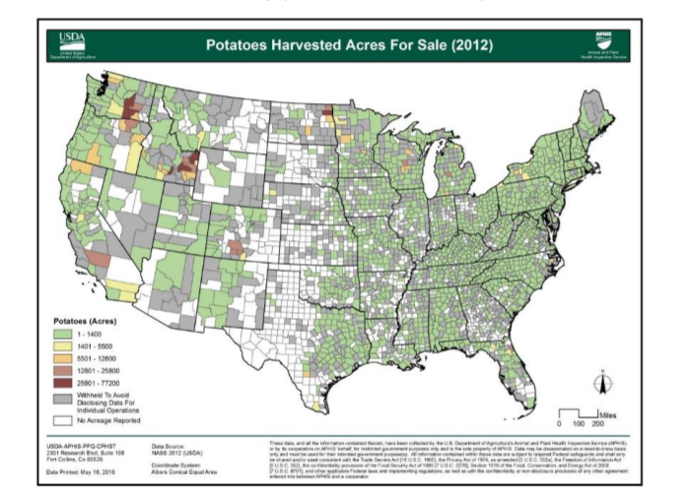
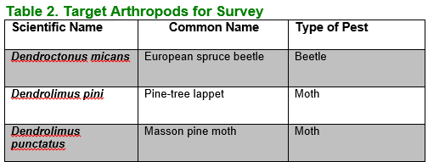
Introduction
Purpose
Background
Commodities: Info and US distribution maps
Target species
Notes:
The first section of describes the purpose of the Commodity-based Survey Reference. This section also lists the pest species targeted in the respective survey. Pest lists are also available on the approved methods page.

Slide 9
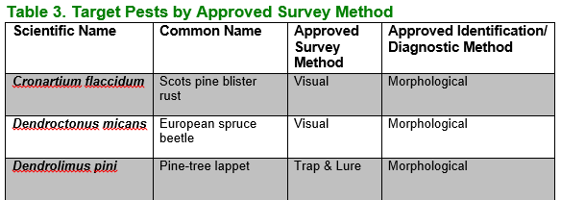
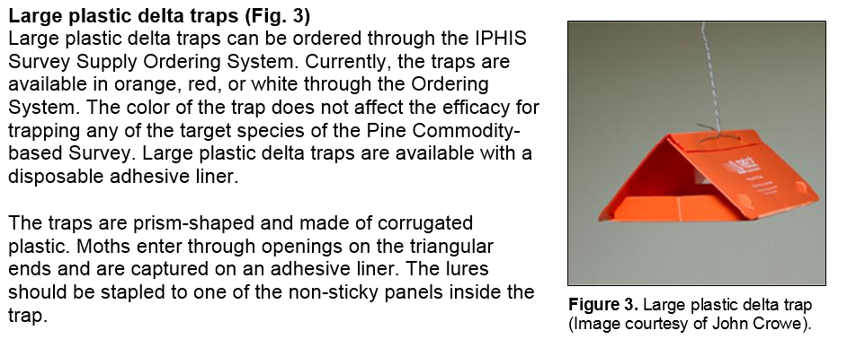
Planning a Survey
Target Pests by Approved Survey Method
Reviews:
Pathways
Survey methods
Trapping density and season
Notes:
Here is a sample of information from Section II. This section reviews pests for survey, trap types, and trap and lure combinations. It also lists target pests again.

Slide 10
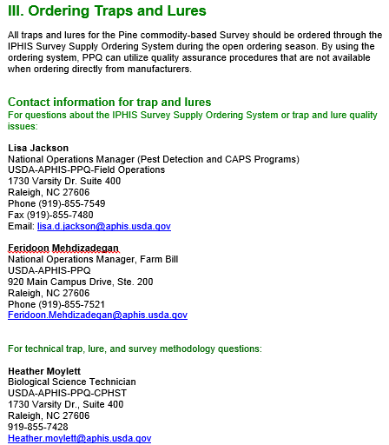
Ordering Traps and Lures
This section is brief, only has contact information. Can be consolidated into other documents.
Notes:
Section 3 is brief and can be absorbed into other documents.

Slide 11
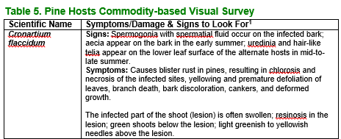
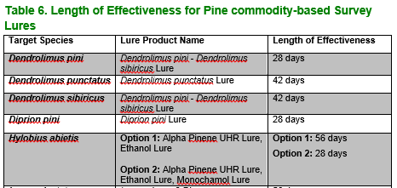
Conducting a Survey
Provides visual survey instructions.
Specific pest symptoms
Provides trap and lure information.
Trap Sites, Placement, Servicing
Lure Handling, Storage, Changing
Notes:
Provides general information on conducting a visual survey and a trap & lure survey. It provides specific information about visual symptoms of target pests. This is redundant and can be found in pest datasheets. Trap and lure information is also largely redundant.

Slide 12
Sample Processing, Sorting, and Submission
Provides information on sample screening and submission for arthropods and pathogens.
Provides contact information for identifiers.
Information is the same across manuals.
Notes:
Section V: Information is the same across manuals.

Slide 13
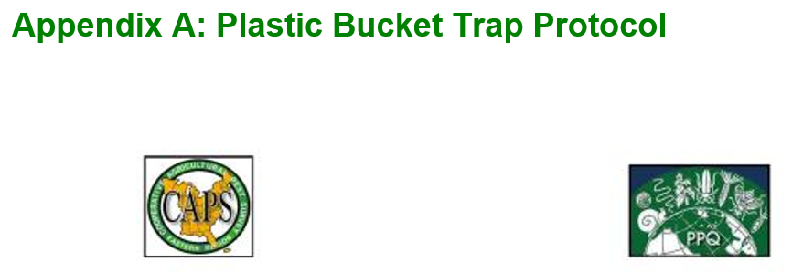
Appendices
Provide additional information such as trapping protocols and PPQ form 391.
Notes:
Appendices provide additional information that is relevant to the respective survey. A copy of PPQ form 391 is also included.

Slide 14
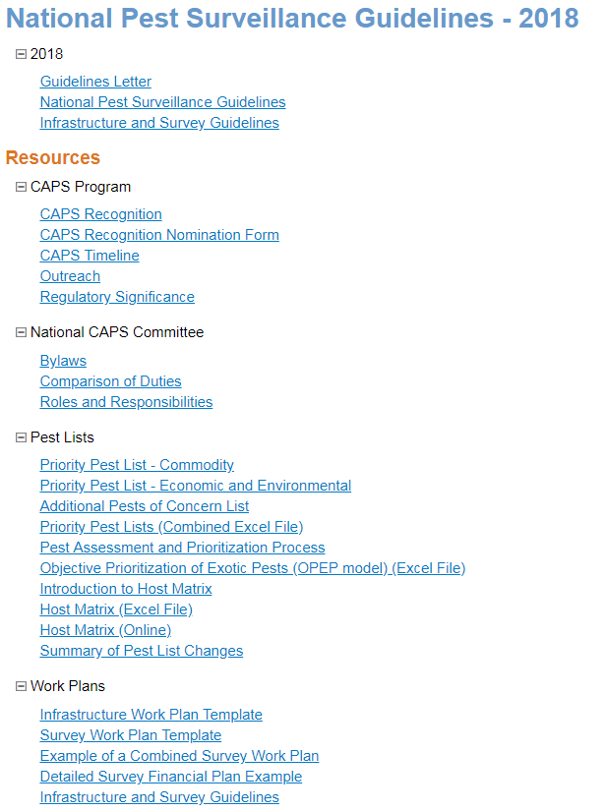
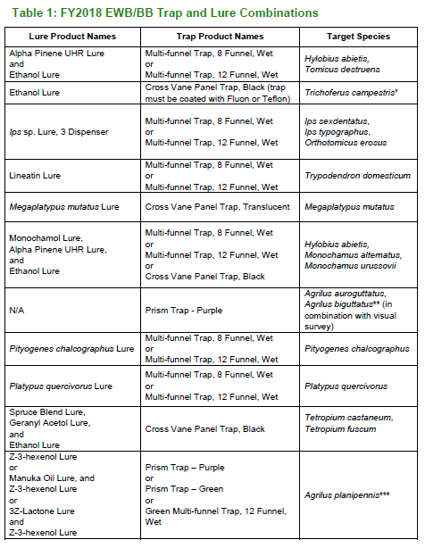
Redundancy Issues
Approved Methods Tables needed for each survey?
Some info in documents provided in Guidelines Resources.
Ordering info = Survey Supply
Notes:
There is a lot of redundancy in the manual introductions.

Slide 15
Free-standing Documents: Survey/Sampling Method
Soil Sample protocol
Visual Survey protocols
Mollusk Visual Survey protocols
Sweep Netting protocols
Notes:
**check survey supply page

Slide 16
Free-standing Documents: Survey/Sampling Method
Trap and Lure guidance
Ordering – Survey Supply
Trap types and care
Plastic bucket trap protocol
Assembly Instructions for Cross-vane panel traps
Trap supply checklist for placing and checking
Lure storage, handling, and changing
Cross-contamination guidance
Appendix: Survey Trap Card
Notes:
**check survey supply page

Slide 17
Free-standing Documents
Sample Processing, Sorting, and Submission
Molecular guidance
Submitting Bark Beetle Specimens
PPQ Form 391/IBP Records
Where to put these?
Determination of Risk Assignment for Businesses
Hot Zone Trapping Program
Firewood Dealers, Sawmills, Logging, and Pallets

Slide 18
New Format: Benefits
Easier to update = Current information and improved consistency across manuals.
Information needed is easier to find – is this true?
Expedite building needed or new manual intros.

