Slide 1
Purdue University CAPS Information Services Update
CAPS Services – Providing continuous maintenance, process improvements, and a high level of customer support
Presented to the NCC Committee, February 2018
- Cindy Music and David McClure
Notes:
Thank you for inviting CERIS to attend and the opportunity to present our enhancements, accomplishments and support provided by CAPS information services.

Slide 2
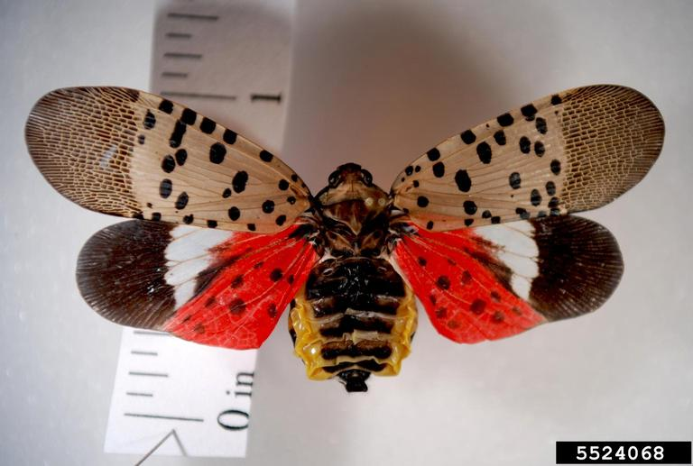
NAPIS - discussion item
Live records versus dead records
When does a dead insect indicate interception and when should it go into the database?
Notes:
Today we will be requesting quite a bit of discussion and input.
First up:
When is a dead insect appropriate to enter into NAPIS?
What parameters are used?
Background:
Dead Spotted lantern flies were found in NY and DE. These finds were obvious, non-environmental situations.
- How and if should they be entered into the NAPIS database?
- Possible repercussions: maps, reports

Slide 3
NAPIS - discussion item
Interceptions versus environmental detections
If, when and how should an interception record be entered into the NAPIS database?
“I”
Notes:
If interceptions are wanted in the NAPIS database, what should the parameters be?
Discussion on “I” attribute
(not to be published in Pest Tracker or data notifications?)
is this desired?
will it be used?
how should it be used?

Slide 4
NAPIS - discussion item Descriptive and quantification fields of data entry
Currently:
Proposed:
Definitions:
Total Units Checked | The number of units (as defined in Descriptor Units) that were checked.
Positive Units | The number of units (as defined in Descriptor Units) that were positive for the pest.
Quantification | Raw count, percentage or average pest organisms observed. Interpreted with Descriptor Units.
Descriptor Units | Defines Quantification, Total Units Checked, and Positive Units.
Notes:
Currently, the logic of the data entry sequence goes from an “end” point to a “beginning” point:
1. Quantification – number of pests observed, total
2. Descriptor units – how the pests are observed, i.e. pests in traps
3. Total units checked – number of units, as described in descriptor units, checked
4. Positive units – number of units that were positive for pests
The actual process is more accurately and logically described as the number of positive pests, how the survey was done (i.e., pests in traps), how many units are checked and the number of units actually observed with pests.
It is proposed that the sequence of data entry be changed to how many units are checked, the number of units actually observed with pests (positive), the number of positive pests, and how the survey was done (i.e., pests in traps).
The proposed order would be:
1. Total units checked – number of units, as described in descriptor units, checked
2. Positive units – number of units that were positive for pests
3. Quantification – number of pests observed, total
4. Descriptor units – how the pests are observed, i.e. pests in traps
NOTE – templates currently being used would not have to be changed.

Slide 5
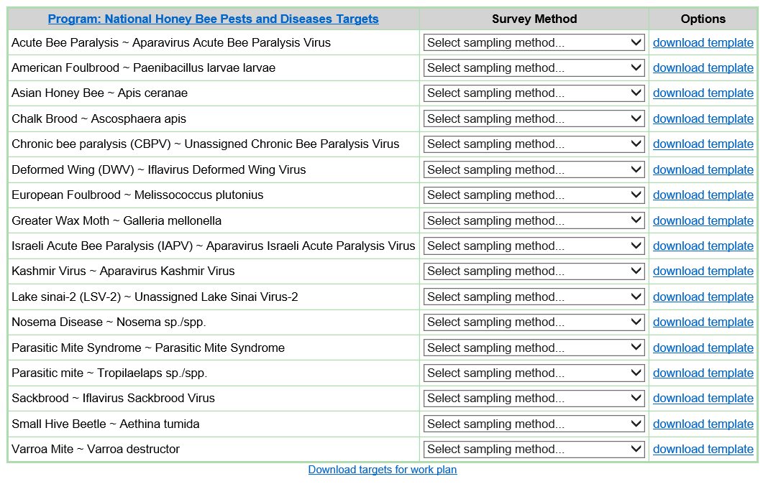
NAPIS - discussion item
My Surveys - template downloads
Current: individual template by targeted pest
Proposed: template by survey, individualized to state’s SSF
Notes:
Discussion point:
Should there be a template that is survey conclusive versus individual pest templates?
- individualized to the state?

Slide 6
CAPS Resource & Collaboration
Re-imaganing
Purdue Marketing Team
Input from users
Reviewers needed
Notes:
Purdue Marketing Team –
While the CAPS R&C site has a lot of useful information, it needs a new look, better organization, etc.
As a result, the CERIS staff met with a Purdue University marketing team where we described the website, its use and gave more detail about the role and efforts envisioned from the Purdue Marketing Department.
Additional information and metrics were provided following the meeting.
In summary, the Purdue Marketing Team will provide consultation in assessing and making recommendations from a marketing perspective about the CAPS R&C site. CERIS staff will manage the software development and are looking forward to providing a better more innovative website.
Need input from users….
So far we have Chris Pierce as a reviewer, need more reviewers

Slide 7
Survey Summary Form
Combined SSF
Farm Bill 2018
opens with announcement of spending plan.
Survey names are pre-populated in a drop down
Same change request process
Goal is to merge for 2019 Survey Summary Forms
All plans and all years for each funding source to be available
Change Request Process
Submit change request will look the same
Automatic
Volunteers for to review?
Notes:
Combined SSF:
A. Farm Bill 2018
1. opens based on a certain schedule – when the FY18 Farm Bill Spending Plan has been announced
2. Survey names are pre-populated to choose from in a drop down
3. The change request process, remains the same - to be used for modifications after submission. While the 2018 Farm Bill SSF is still open, contact field operations to re- enable write access. When the 2018 Farm Bill is closed, use the change request form.
B. Another factors in putting the merged SSF into production includes the development of the 2019 Approved Methods. The SSF is at the “center” and affects many products, i.e., my summaries, accountability report, etc.
C. The goal for 2019 SSF development is to be ready for the opening of the 2019 CAPS SSF and then the 2019 PPQ SSF.
D. New interface will include:
all plans and all years for each funding source available.
Data since 2012.
Automatic change request process. For modifications after submission - submit the change as normal. This will trigger a workflow process for approval, with notifications at each step. This will be open for modifications towards any plan

Slide 8
Survey Summary Form - discussion item
State View of PPQ Survey Summary Form
Notes:
State View of PPQ Survey Summary Forms
include the state for informative purposes, transparency?
Per inclusion in email chain?
discussion and input

Slide 9
CAPS and Farm Bill
Accountability Report
A Reporting Tool
Notes:
The CAPS community is using the accountability reports as a reporting tool.
- We have been contacted by users wanting to know when there is an issue with the state’s data is not showing up on the accountability report.
- Often, a modification to the data records is the explanation, i.e., a funding source, funding year, etc.
Please use this tool and check often!

Slide 10
Survey Methods Reconciliation - update
Trap – 2016, from 32 to 1 survey method
Sample – 2017, from 22 to 5 survey methods
Visual – 2018?, 13 to ?
Notes:
Trap and Sample survey method reconciliations have been done.
We are still in the process of finishing up the visual survey method reconciliation.

Slide 11
Survey Methods Reconciliation - Visual
Current Sample Descriptions for Visual survey methods:
Notes:
The visual survey reconciliation will be set up similar to the sample survey method - with sample descriptions.

Slide 12
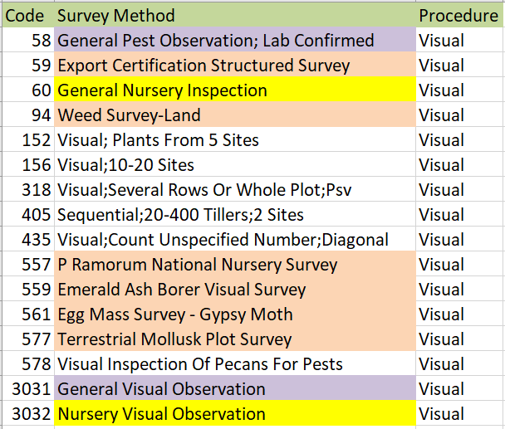
Survey Methods Reconciliation - Visual
Current visual survey methods:
Notes:
To complete the Visual survey reconciliation, assistance is needed on how to deal with these surveys.
Which to include?
yellow – Nursery visual – is this needed? would a crop situation or site/crop code work? How is this currently done? Have numbers for past few years.
purple – do we need more sample descriptions when replacing 00058, General pest observation; lab confirmed?
peach – program surveys to 3031? Sample descriptions?
What additional sample descriptions will be needed?
Pass out a list and ask to check those used, not used, include, suggestions, etc.

Slide 13
Other items
NAPIS Database summary, 2017 (2016) as of 1/26/2018
New in US = 8 (10)
New in State = 29 (60)
New in County = 233 (490)
Unique record factors and duplications
Accomplishment report
Notes:
NAPIS database numbers
B. Reminder of which data factors make a Unique record: Observation number, Observation year, Pest, State/County
C. Accomplishment report – currently available to SSC and SPRO, open up to SPHD and PSS?

Slide 14
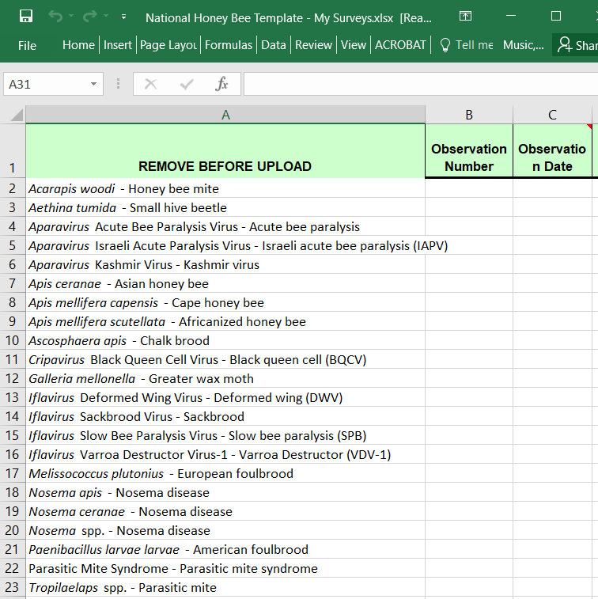
Other items - continued
NHB
Template update: pests, first column
Notes:
NHB
1. The template is being updated. Hoping to have it available for Farm Bill.
2. updates per NHB w/ Heather and Robyn Rose: working on guidance for NHBS data and data entry, aligning the dataset sent from the lab with NAPIS, improving how changes and information are communicated to SSCs.
3. NAPIS:
a. Dataset provided to SSC includes excess data - the diagnostic lab may develop a simplified dataset with the SSCs/PSS still receiving the comprehensive dataset.
b. Target pests auto-populated through the NHB template in the SSF may not match the targets listed in the datasets which gives an incomplete Accountability Report - The NHBS will provide an updated target list to Purdue
c. The diagnostics lab is to be informed that all targets tested should remain on the list with negative and positive results reported
d. Other changes to target list in SSF should be addressed using the change request form.
3. A request made by Robyn Rose, NPM for the NHBS, along with consultation of John Bowers, it was concluded, that NHB pests entered for the first time into NAPIS need no longer be reported in the NAPIS data notification.
4. CAPSIS is now providing an additional function within the NHB template for the user. There is a star on the header of the first column – the database will “ignore” the “starred” column and it no longer will have to be removed by the user. Removing the first column, as done in the past, will not be an issue.

Slide 15
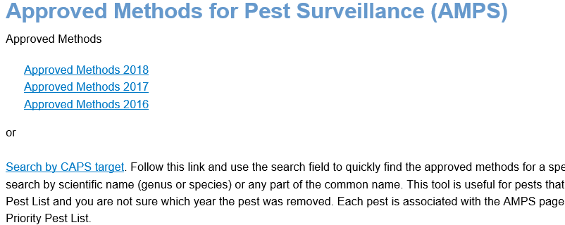
Other items - continued
AMPS – intermediate page with choice of AMPS page or key word search for targets; screening aids
Notes:
NAPIS 3.0 and CAPS R&C updates
AMPS – intermediate page with choice of AMPS page or key word search for targets

Slide 16
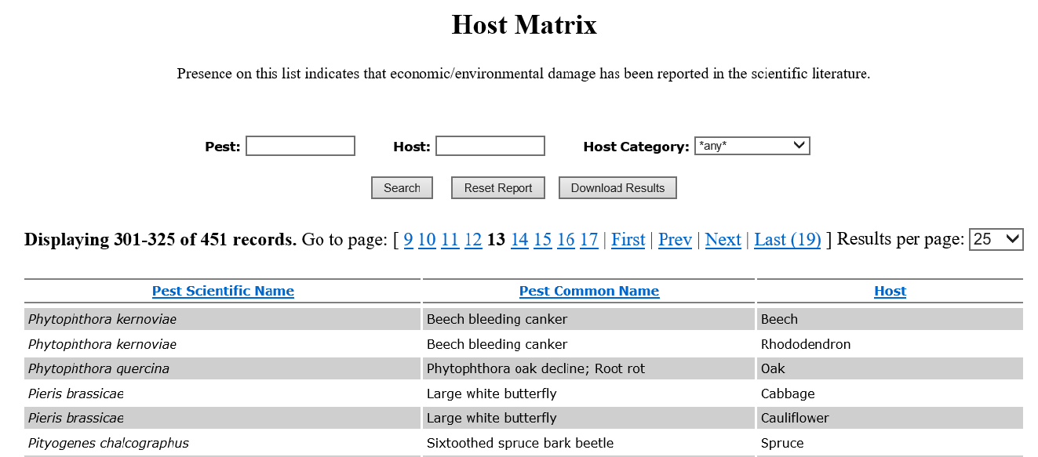
Other items - continued
Host Matrix
Notes:
Host Matrix

Slide 17
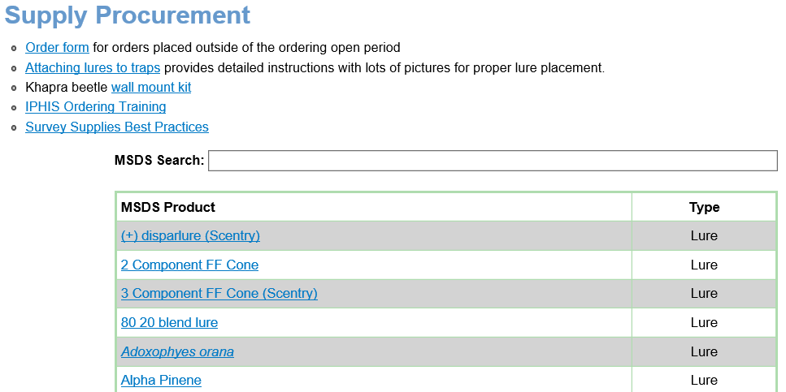
Other items - continued
Supply Procurement – MSDS keyword search
Notes:
Supply Procurement – MSDS keyword search

Slide 18
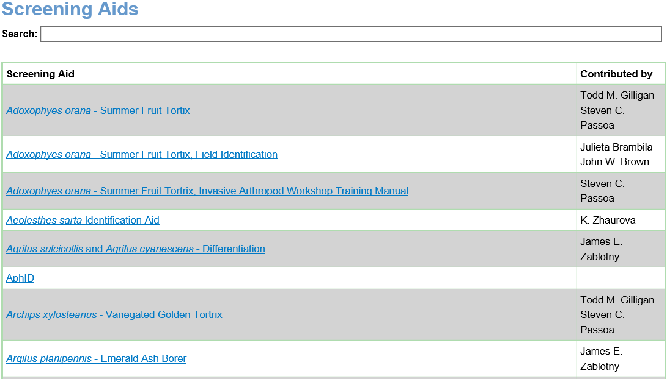
Other items - continued
Screening Aids - key word search
Notes:
Screening Aids - key word search

Slide 19
CAPS Information Services
Thank You
Providing continuous maintenance, process improvements, and a high level of customer support

