Slide 1
Application Management
GM 302
Version 1.0

Slide 2
Agenda
Course Introduction
Module 1 – Searching for Funding Opportunities
Module 2 – Creating and Submitting Applications
Module 3 – Application Review and Approval
Course Summary

Slide 3
Introduction
Name
Role
Training Purpose

Slide 4
Agenda
Course Introduction
Module 1 – Searching for Funding Opportunities
Module 2 – Creating and Submitting Applications
Module 3 – Application Review and Approval
Course Summary

Slide 5
Objectives
After completing this module, you will be able to:
Describe how to search for a funding opportunity in ezFedGrants
Explain the functionality, goals and benefits of ezFedGrants

Slide 6
Searching for Funding Opportunities
Begin by accessing the ezFedGrants home screen.

Slide 7
Searching for Funding Opportunities
Select My Applications and then Create Application from the drop-down menu.

Slide 8
Searching for Funding Opportunities
Enter any search criteria into the appropriate field. The system does allow for the use of a wildcards (e.g. an asterisk or *) to help make searching easier.

Slide 9
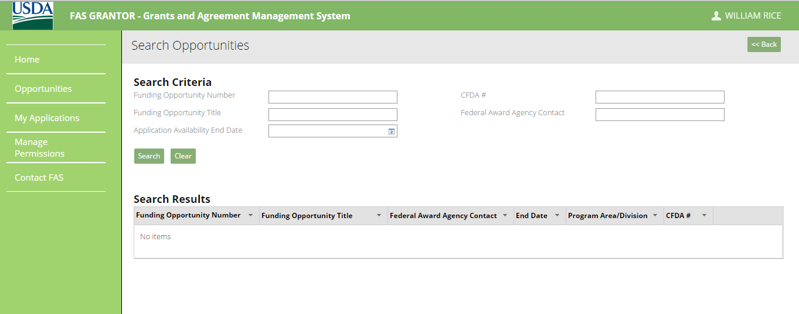
Searching for Funding Opportunities
After entering your criteria, click the Search button to perform the search.

Slide 10
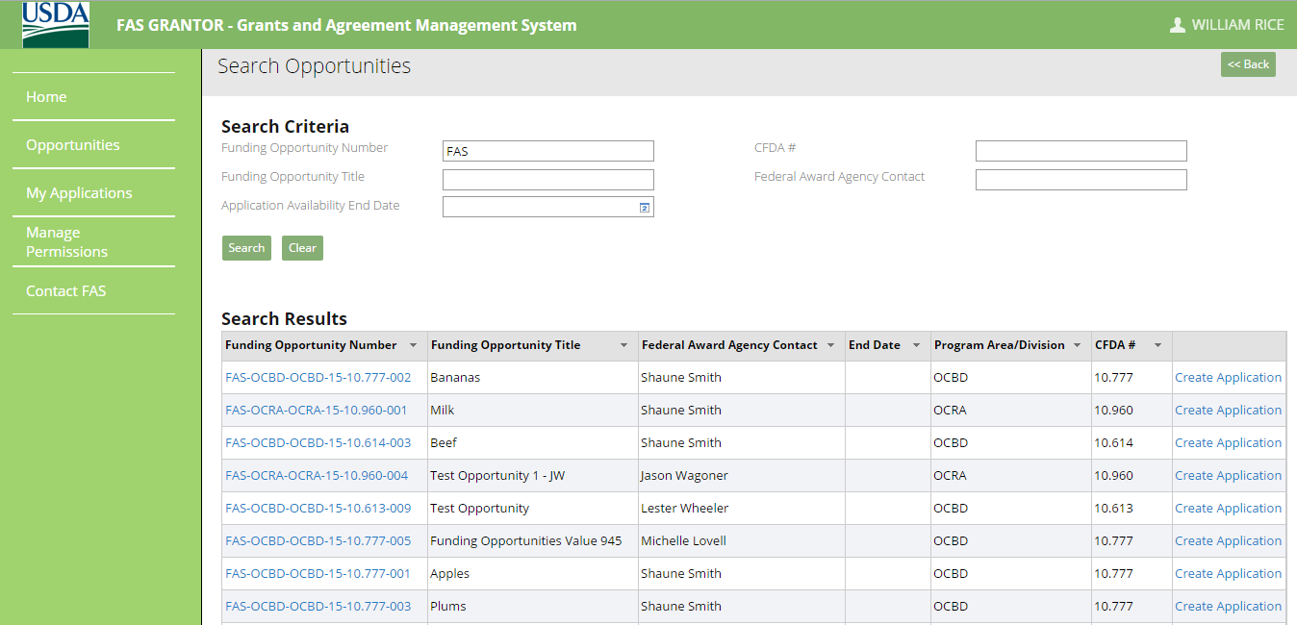
Searching for Funding Opportunities
Search results will appear below. You can filter or sort search results by clicking the arrow on the column headers.

Slide 11
Module Summary
In this module, you have learned to:
Describe the ezFedGrants opportunity search process

Slide 12
Agenda
Course Introduction
Module 1 – Searching for Funding Opportunities
Module 2 – Creating and Submitting Applications
Module 3 – Application Review and Approval
Course Summary

Slide 13
Objectives
After completing this module, you will be able to:
Explain how to create an application in ezFedGrants
Describe the application submittal process in ezFedGrants

Slide 14
Creating and Submitting Applications
Select a Funding Opportunity from the search results by clicking on Create Application from one of the results.

Slide 15
Creating and Submitting Applications
The SF-424 should appear. You can use the navigation circles to move from screen to screen, or hit Next at the top of the screen.

Slide 16
Creating and Submitting Applications
Choose the option for the type of application that you are creating in section 1.

Slide 17
Creating and Submitting Applications
Gray fields indicate auto-populated fields, or fields where the information is yet to be determined. Enter pertinent information into the white action fields.

Slide 18
Creating and Submitting Applications
Scroll down and fill out the contact information section. Fields marked with a red asterisk (*) are required fields.

Slide 19
Creating and Submitting Applications
Click Next to move to the next step.

Slide 20
Creating and Submitting Applications
Complete the SF-424A form. Your information can be saved at any time by clicking the Save button on the top right of the screen. To move to the next form, click the Next button on the top right of the screen.

Slide 21
Creating and Submitting Applications
Complete the Partners section. The required fields, The Primary Administrative Contact and The Primary Program POC, are marked with a red asterisk.

Slide 22
Creating and Submitting Applications
Complete the Additional Details section. Required fields are marked with a red asterisk. Your information can be saved at any time by clicking the Save button on the top right of the screen. To move to the next form, click the Next button on the top right of the screen.

Slide 23
Creating and Submitting Applications
Complete the Attachments section by scrolling to the bottom of the page and clicking on the red Attach button to the right of the required attachment. To add any other type of Attachments, click on the Click Here to Attach Additional Files link on the bottom of the page. You will be prompted to add a File Title for these non-required attachments.

Slide 24
Creating and Submitting Applications
The required attachments for an application will depend on the Instrument Type, Recipient Type, and radio button selections in the Additional Details section of the Application. A check mark will appear next to items that have been successfully attached.
After the all of the forms are completed, the application is now marked as Draft Pending Signature. Now the process advances to Signatory Official Review.

Slide 25
Module Summary
In this module, you have learned to:
Create an application in ezFedGrants

Slide 26
Agenda
Course Introduction
Module 1 – Searching for Funding Opportunities
Module 2 – Creating and Submitting Applications
Module 3 – Application Review and Approval
Course Summary

Slide 27
Objectives
After completing this module, you will be able to:
Understand how to submit an application for review and approval.

Slide 28
Reviewing Applications
Click on the Actionable Items tab.

Slide 29
Reviewing Applications
The actionable items are then displayed in a pop-up. Click on the Transaction ID for the item you wish to review.

Slide 30
Reviewing Applications
Review the application. You have the option to Sign and Submit, Return, or Withdraw.

Slide 31
Reviewing Applications
If the Application requires edits, click on the Return button. You must include the reason(s) why the Application was returned in the Return Comments section. Click the Submit button.

Slide 32
Reviewing Applications
A confirmation page and an email will be generated indicating that the Application has been Returned

Slide 33
Reviewing Applications
To withdraw the Application, click on the Withdraw option. Once this is done, you must provide reasons for withdrawing the Application in the Withdraw Comments section. Once that field is entered, click the Submit button.

Slide 34
Reviewing Applications
A confirmation page indicating that the Application has been withdrawn will be generated.

Slide 35
Reviewing Applications
If you want to submit the Application, you must click the Sign and Submit option from the dropdown menu. You are then brought to the Sign and Submit screen.

Slide 36
Reviewing Applications
Before you can sign and submit the Application, you must click on the Legal Notice tab to review the Terms and Conditions of the Opportunity. Once this tab is clicked, the Terms and Conditions page is generated.

Slide 37
Reviewing Applications
After reading the Terms and Conditions, if you accept them, you must check the I agree with the listed Terms and Conditions box and then click the OK button below. If you do not accept the Terms and Conditions, the Application cannot be submitted and the you can click on the Cancel button below to return to the draft Application.

Slide 38
Reviewing Applications
Once you accept the Terms and Conditions, you are taken to the Sign and Submit screen with the Complete Signature button now active. To submit the Application, click the Complete Signature button.

Slide 39
Reviewing Applications
Once the application is successfully submitted, a confirmation page will generate.

Slide 40
Reviewing Applications
If an application is marked as Returned by the Signatory Official, the Grant Processor and/or the Grant Administrative Official will receive a new Actionable Item in their workflow.

Slide 41
Reviewing Applications
Once you click on the Actionable Items tab, a pop-up generates that allows you to view (after clicking on the active link under the Transaction ID column) and take proper action on the Application.

Slide 42
Reviewing Applications
You are brought to the Application screen which now includes a section outlining the comments entered by the Signatory Official outlining what edits need to be made to the Application for proper submission. The name of the Signatory Official who made the comments and the date and time of the Application’s return for edits are also included on the page

Slide 43
Reviewing Applications
If you elect to make the required edits, proceed to the Add Attachments section of the Application and click on the Submit button to resubmit the Application to the Signatory Official. If you elect not to make the required edits, the Application will ultimately not be signed and submitted by the Signatory Official.

Slide 44
Module Summary
In this module, you have learned to:
Review and submit and application for approval.

Slide 45
Additional Resources
Job Aids located at: https://www.nfc.usda.gov/FSS/ClientServices/ezFedGrants/index.php
FAQ
Agency Representative

Slide 46
Conclusion
You have completed GM 101 – Introduction to ezFedGrants. Thank you for your time.

Slide 47
Questions?

