Slide 1
Submitting Claims and Reports
GM 301
Version 1.0

Slide 2
Agenda
Course Introduction
Module 1 – Creating and Submitting Claims
Module 2 – Submitting Reports
Course Summary

Slide 3

Introduction
Name
Role
Training Purpose

Slide 4

Course Objectives
After completing this course, you will be able to:
  Summarize the ezFedGrants claims creation and submission process
  Describe the process for submitting and approving reports in ezFedGrants
  Understand additional training offerings and how to access training materials
  Navigate to and within ezFedGrants system

Slide 5
Agenda
Course Introduction
Module 1 – Creating and Submitting Claims
Module 2 – Submitting Reports
Course Summary

Slide 6
Objectives
After completing this module, you will be able to:
  Describe the ezFedGrants claims creation process
  Describe the ezFedGrants claims submission process
  Explain the functionality, goals and benefits of ezFedGrants

Slide 7
Creating and Submitting Claims
What’s Needed?
You must have access to the ezFedGrants External Portal with a user role and permissions to create and/or certify (digitally sign) claims.
The agreement you are making a claim against must be in Active status.
In order to submit a new claim to your USDA agency, any previously created claims from your organization must have been fully submitted [digitally signed and submitted by the certifying official(s)] to your USDA agency or cancelled.
Any overdue performance and/or financial progress reports must be submitted to your USDA agency before a claim can be submitted.
For agreements allowing advance payments, your first advance payment request for that agreement is submitted as a normal claim. However, all subsequent advance payment requests for that agreement require a justification narrative for the previous advance payment. New advance payment requests cannot be processed by your USDA agency until the justification narrative has been provided for the prior advance payment.

Slide 8
Creating and Submitting Claims
Helpful Hints
On certain screens you may need to scroll to view additional data fields.
Certain screenshots may display only a portion of the screen. Note that when working within a system, only the center body of the screen will change. The navigation options along the left side of the screen and the header bar across the top of the screen will remain the same.
When actually submitting a claim, it is recommended to fully review the claim forms, including fields not covered in this job aid, and contact your agency representative if you have any questions.
Note: Data used in this procedure is a representative sample for the purpose of training. Actual data in the system may vary based on agency and scenario.

Slide 9
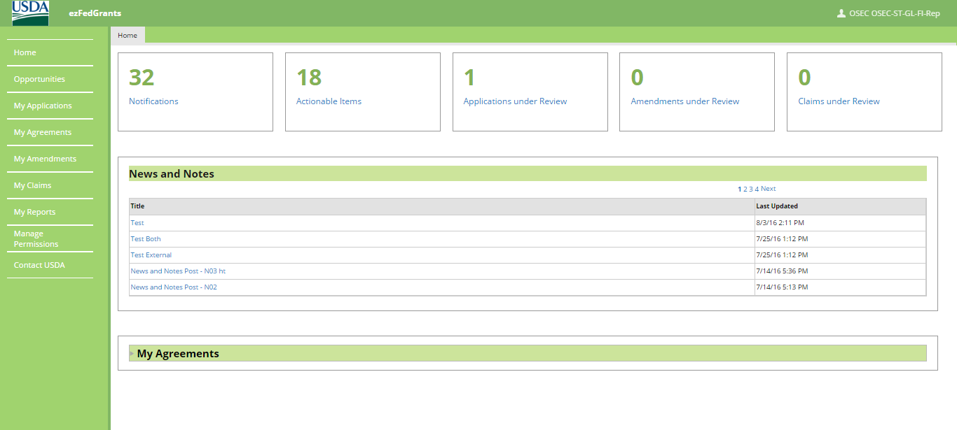
Creating and Submitting Claims
Start the procedure by accessing the ezFedGrants External Portal Home screen.

Slide 10
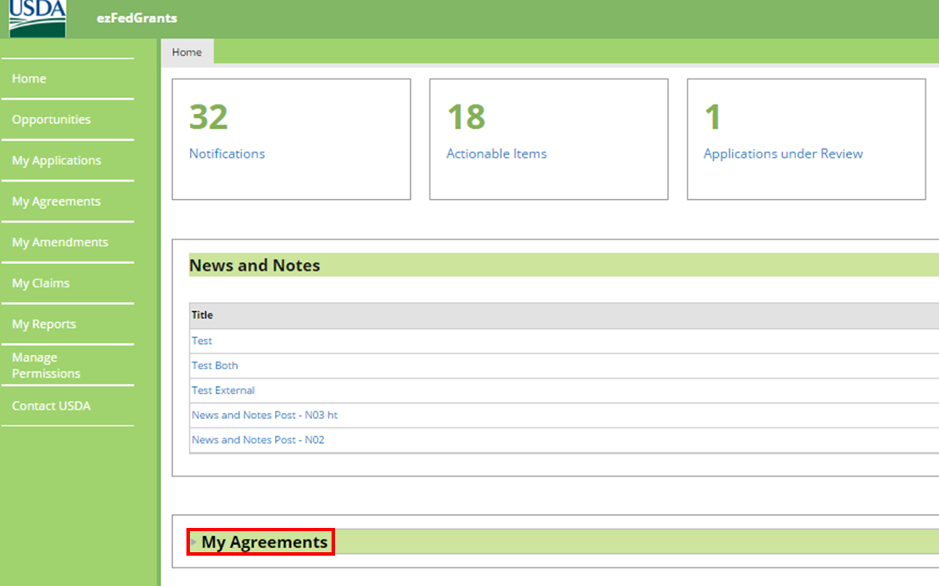
Creating and Submitting Claims
On the ezFedGrants External Portal Home screen, click the My Agreements button to reveal a list of your current agreements.

Slide 11
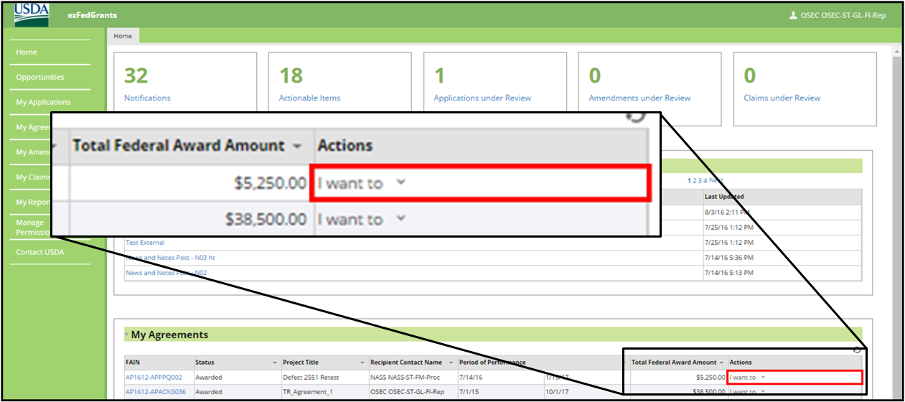
Creating and Submitting Claims
Within the My Agreements table, locate the agreement against which you would like to make a claim and click the I want to field in the Actions column.

Slide 12
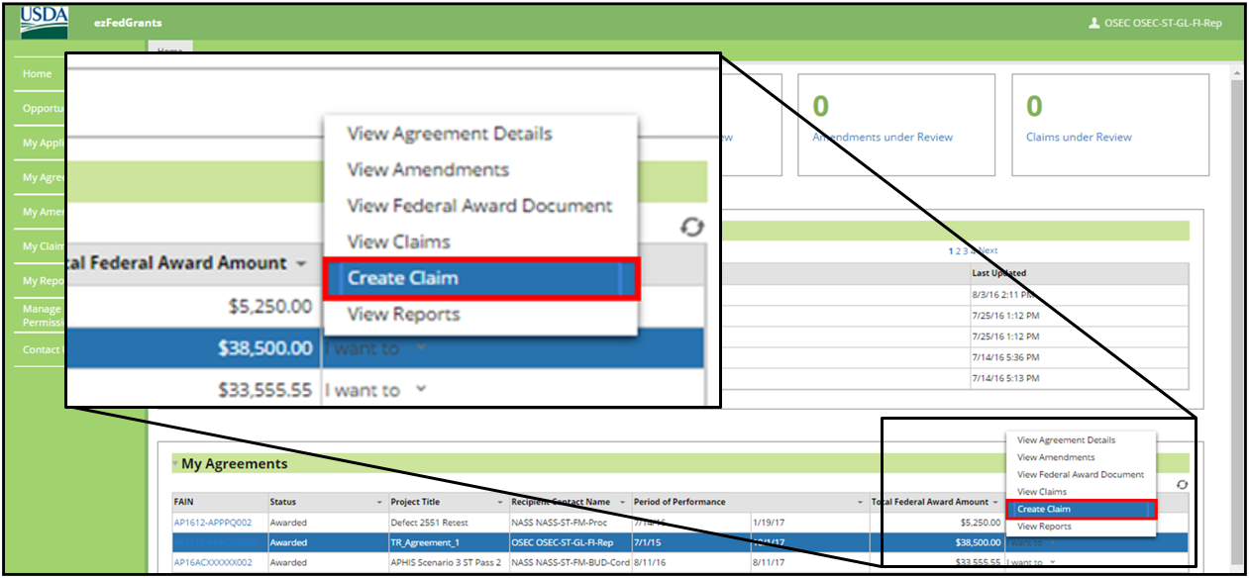
Creating and Submitting Claims
In the I want to dropdown menu, click the Create Claim option to begin the claims creation process.

Slide 13
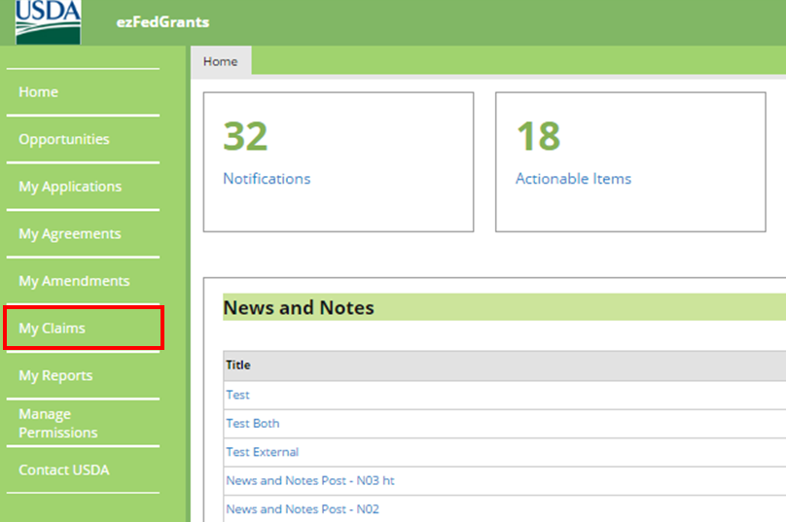
Creating and Submitting Claims
If the agreement you wish to create a claim against does not appear in your My Agreements table, click the My Claims tile in the left-hand navigational menu.

Slide 14
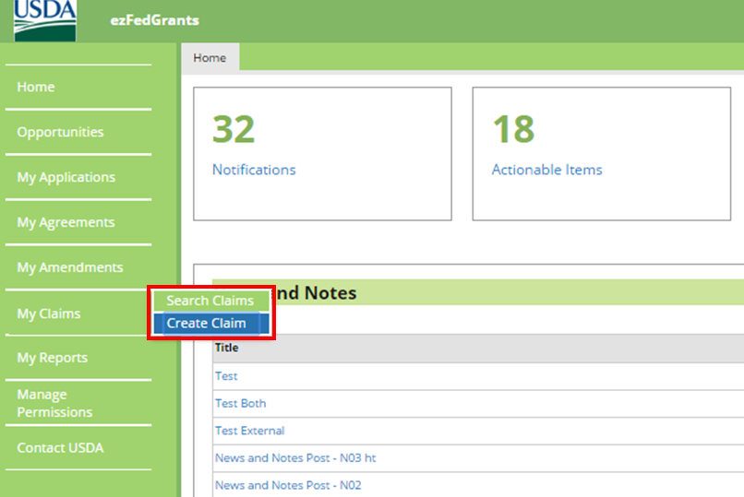
Creating and Submitting Claims
Click the Create Claim option from the My Claims dropdown menu.

Slide 15
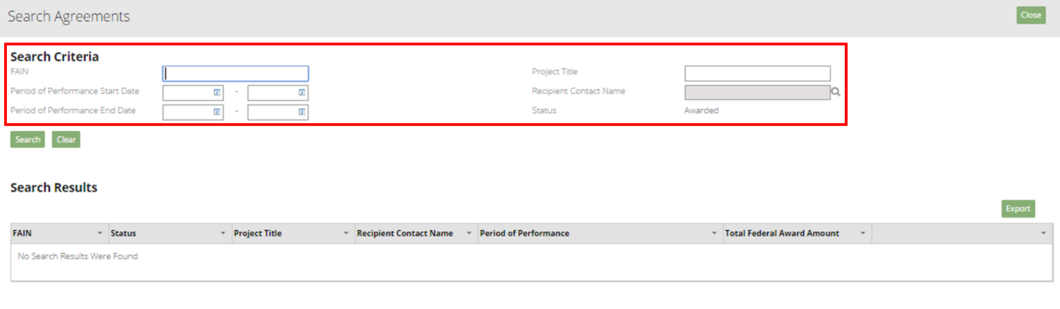
Creating and Submitting Claims
The Search Agreements screen will open. From here you may search for the agreement you would like to make a claim against. To begin, enter information about the relevant agreement in the available Search Criteria fields.

Slide 16
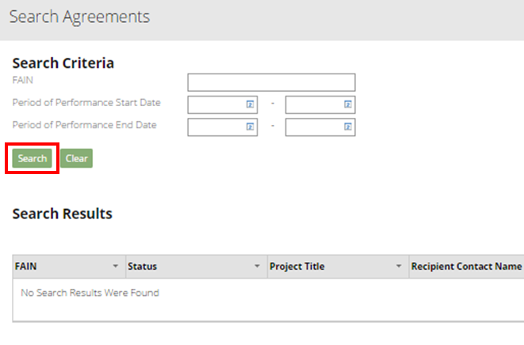
Creating and Submitting Claims
Once you have completed all applicable search criteria fields, click the Search button.

Slide 17
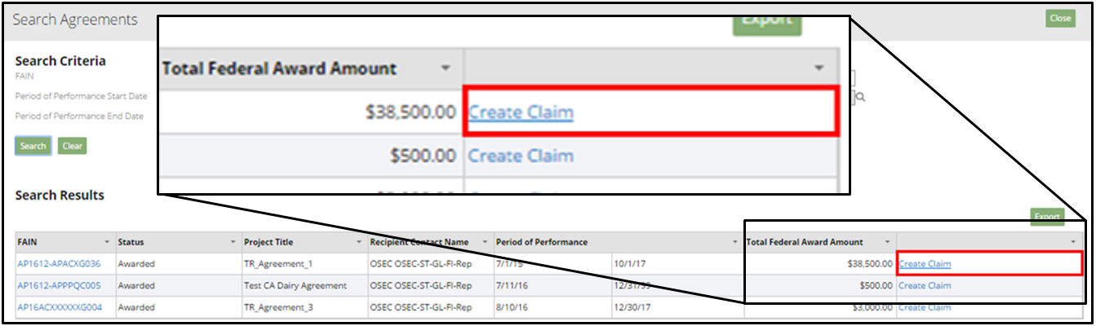
Creating and Submitting Claims
Locate the relevant agreement in the Search Results table and click the Create Claim link to initiate the claim creation process.

Slide 18
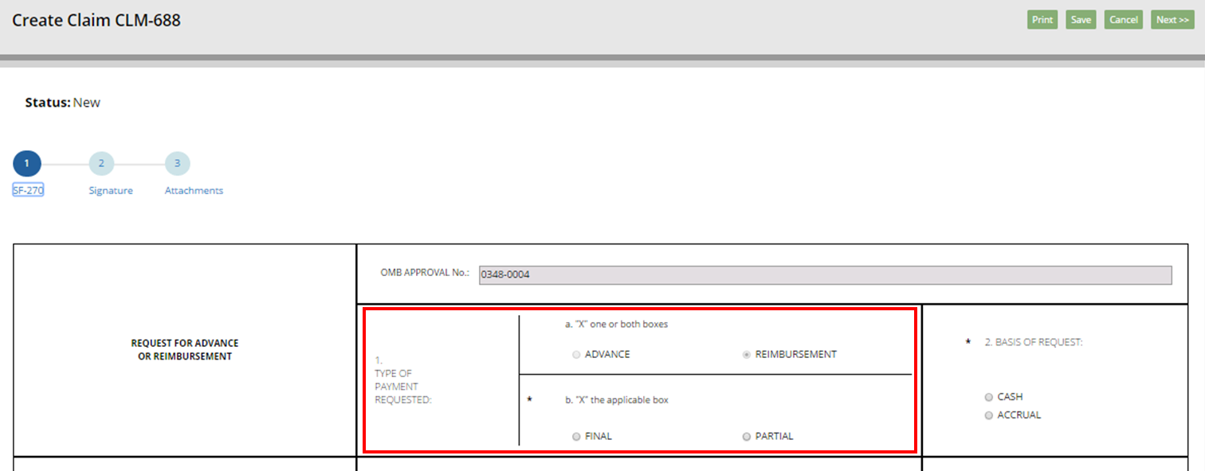
Creating and Submitting Claims
Once the Create Claim screen opens, the SF-270 will appear, prepopulated with information from the initial agreement.
Complete section 1. TYPE OF PAYMENT REQUESTED of the SF-270. In box a. select the REIMBURSEMENT radio button. In box b. select either the FINAL or PARTIAL radio button, depending on your claim.

Slide 19
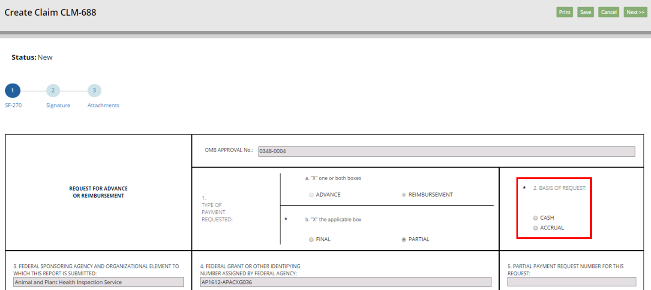
Creating and Submitting Claims
In section 2. BASIS OF REQUEST of the SF-270, indicate whether the request is cash or accrual by selecting the radio button to the left of the CASH or ACCRUAL option.

Slide 20
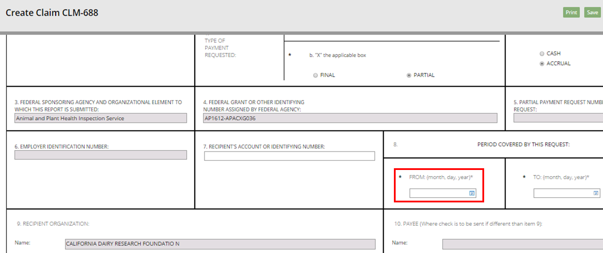
Creating and Submitting Claims
Scroll down the Create Claim screen to section 8. PERIOD COVERED BY THIS REQUEST of the SF-270, and click the icon in the FROM (month, day, year) field.

Slide 21
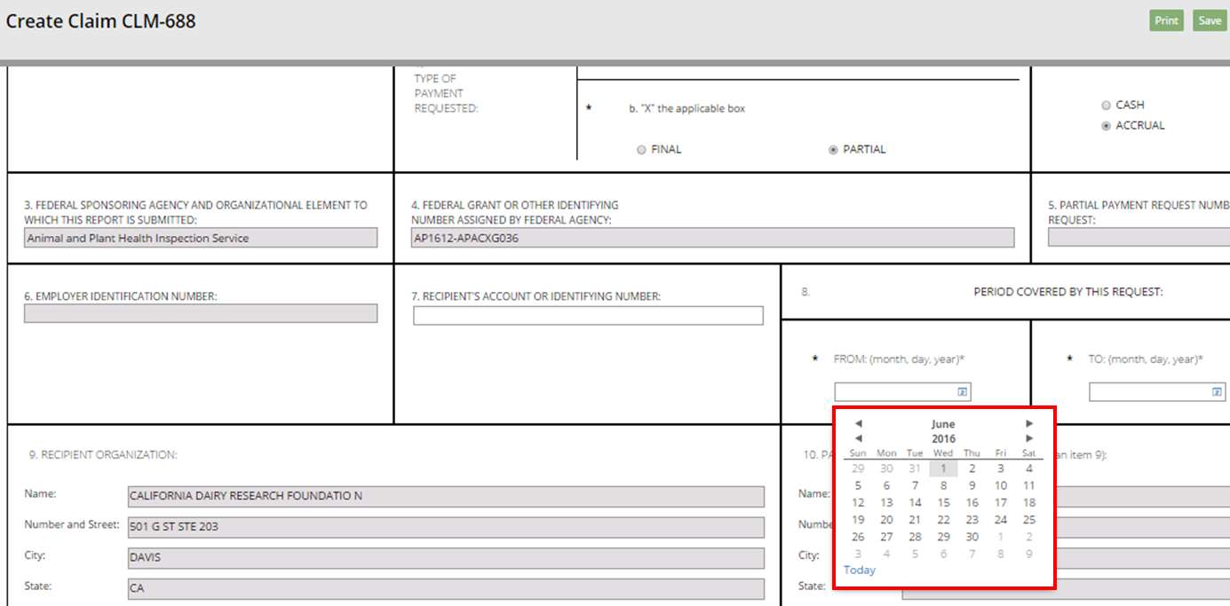
Creating and Submitting Claims
Click the start date of the claim period in the FROM (month, day, year) dropdown calendar.

Slide 22
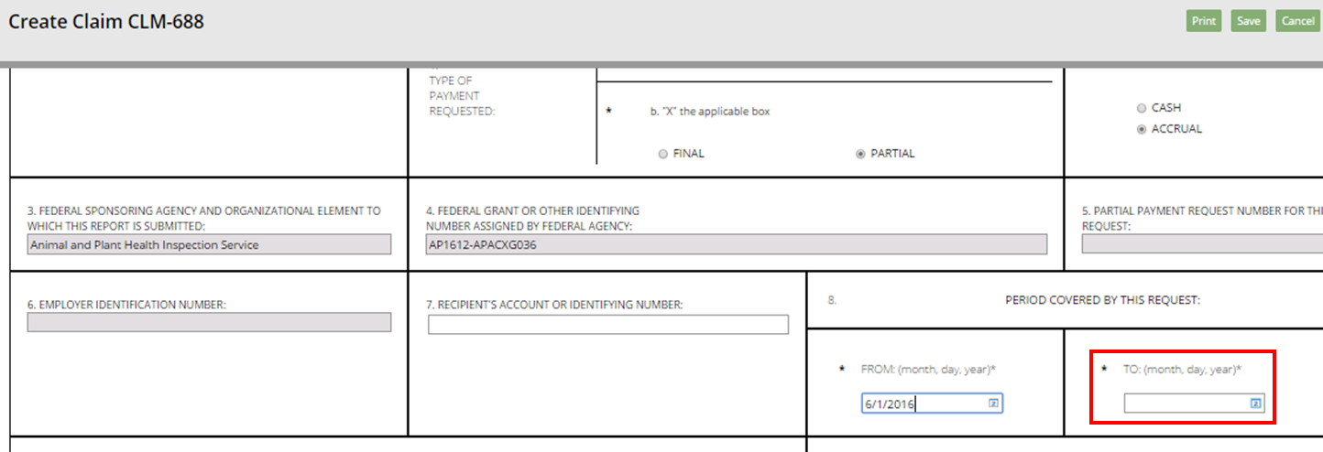
Creating and Submitting Claims
Click the icon in the TO (month, day, year) field in section 8. PERIOD COVERED BY THIS REQUEST of the SF-270.

Slide 23
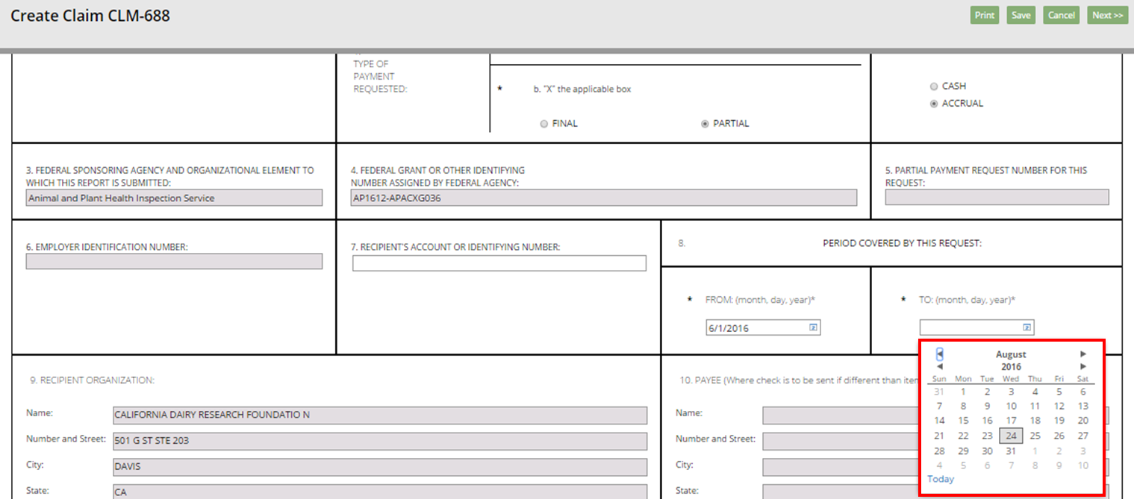
Creating and Submitting Claims
Click the end date of the claim period in the TO (month, day, year) dropdown calendar.

Slide 24
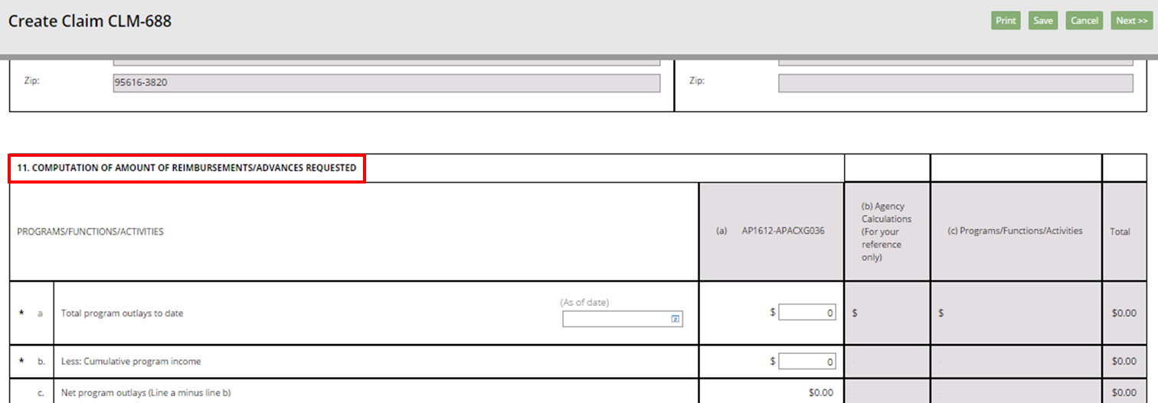
Creating and Submitting Claims
Scroll down the Create Claim screen to section 11. COMPUTATION OF AMOUNT OF REIMBURSEMENTS/ADVANCES REQUESTED of the SF-270 to begin entering the dollar values for the claim.

Slide 25
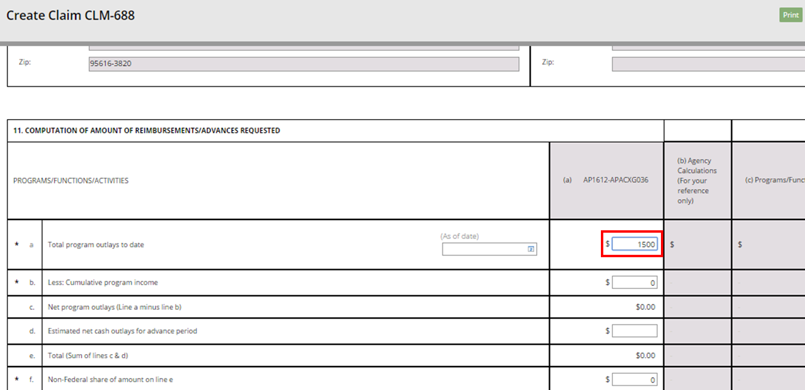
Creating and Submitting Claims
In section 11., click on the dollar value field in column (a) of row a. Total program outlays to date and enter the relevant dollar amount.

Slide 26
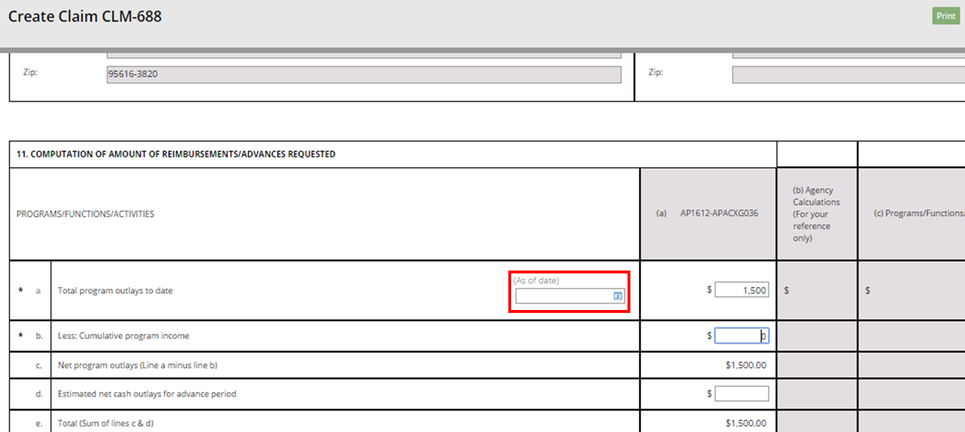
Creating and Submitting Claims
In section 11, click on the icon in the (As of date) field in row a. Total program outlays to date.

Slide 27
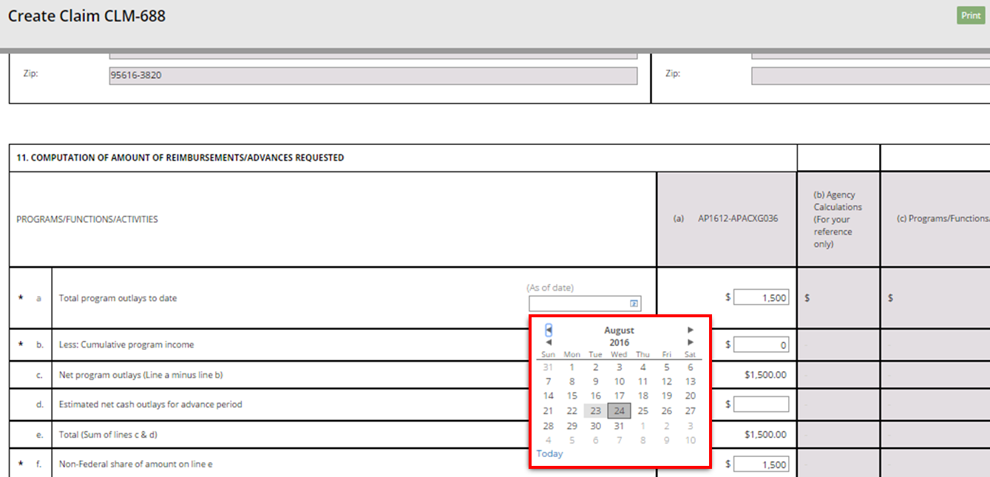
Creating and Submitting Claims
Click the current date, or the date applicable for the claim, in the (As of date) dropdown calendar.

Slide 28
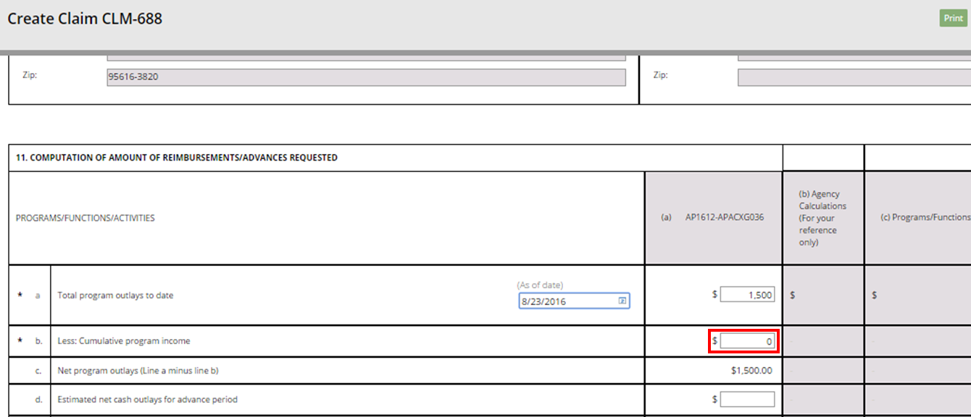
Creating and Submitting Claims
In section 11., click the dollar value field in column (a) of row b. Less: Cumulative program income and enter the cumulative program income.

Slide 29
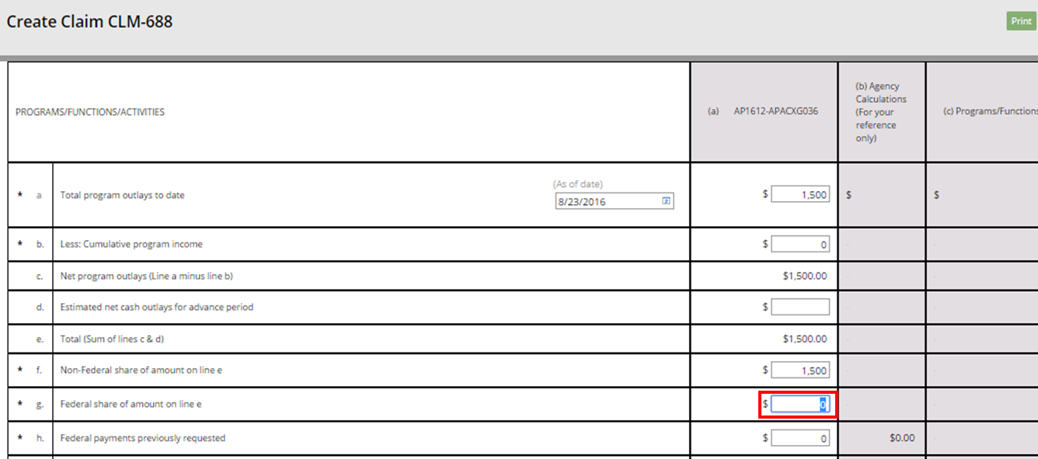
Creating and Submitting Claims
In section 11., click the dollar value field in column (a) of row g. Federal share of amount on line e and enter the relevant dollar value.

Slide 30
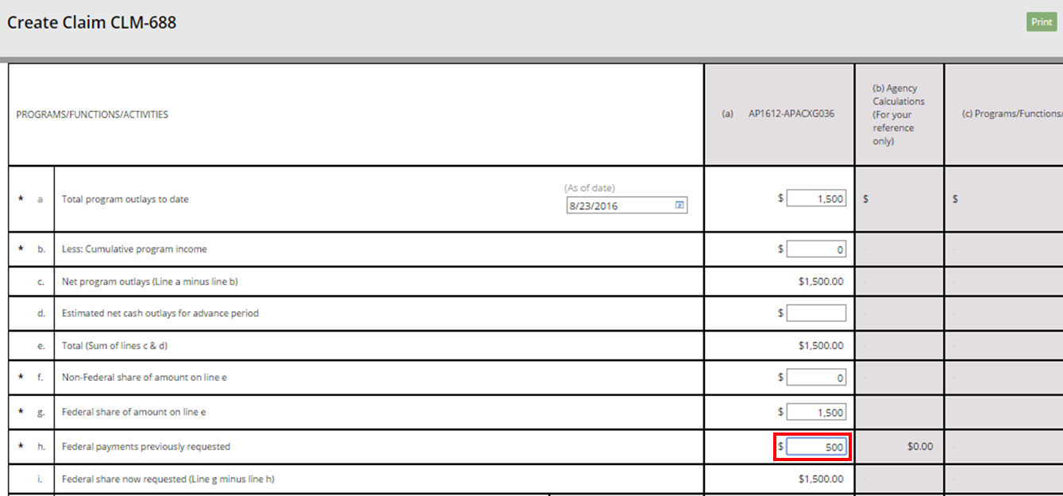
Creating and Submitting Claims
In section 11., click the dollar value field in column (a) of row h. Federal payments previously requested and enter the amount of federal payments previously requested.

Slide 31
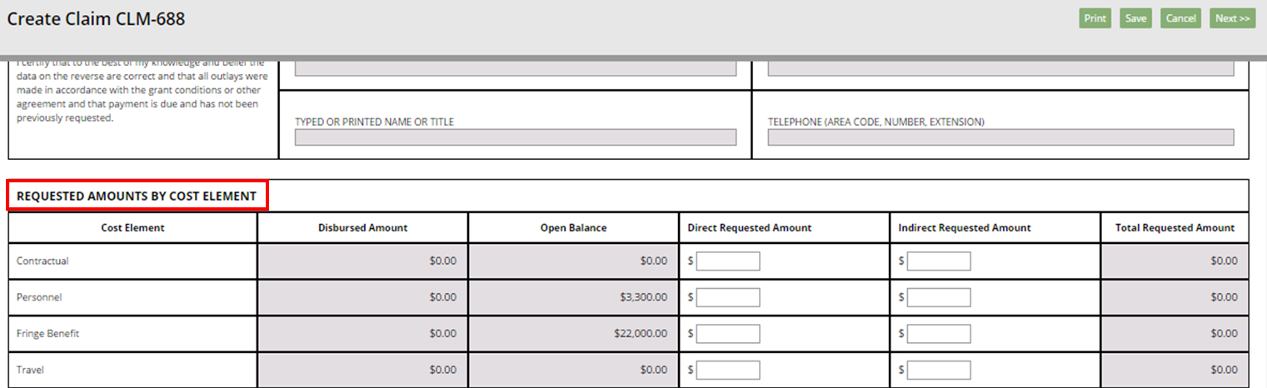
Creating and Submitting Claims
Scroll down the Create Claim screen to the REQUESTED AMOUNTS BY COST ELEMENT section of the SF-270.

Slide 32
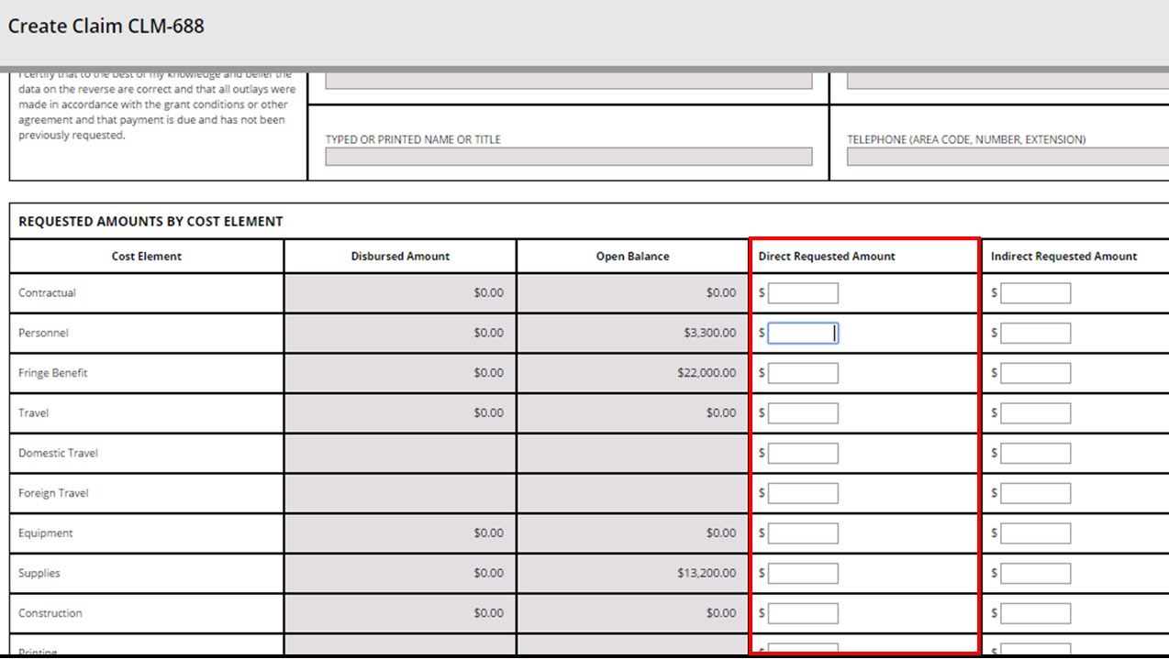
Creating and Submitting Claims
Click in the dollar value fields in the Direct Requested Amount column and enter the relevant dollar amounts for each Cost Element category applicable for this claim.

Slide 33
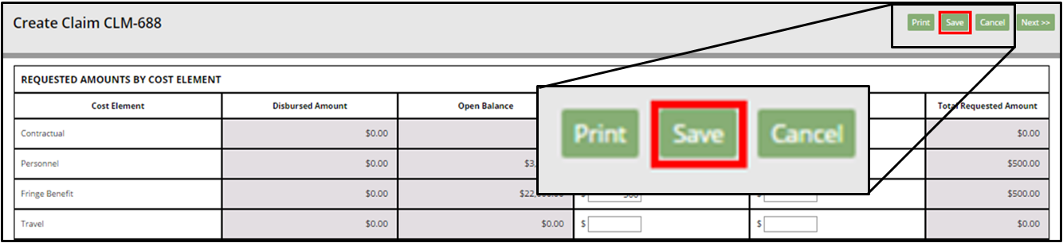
Creating and Submitting Claims
Once you have entered all of the relevant dollar amounts, click the Save button at the top of the screen.

Slide 34
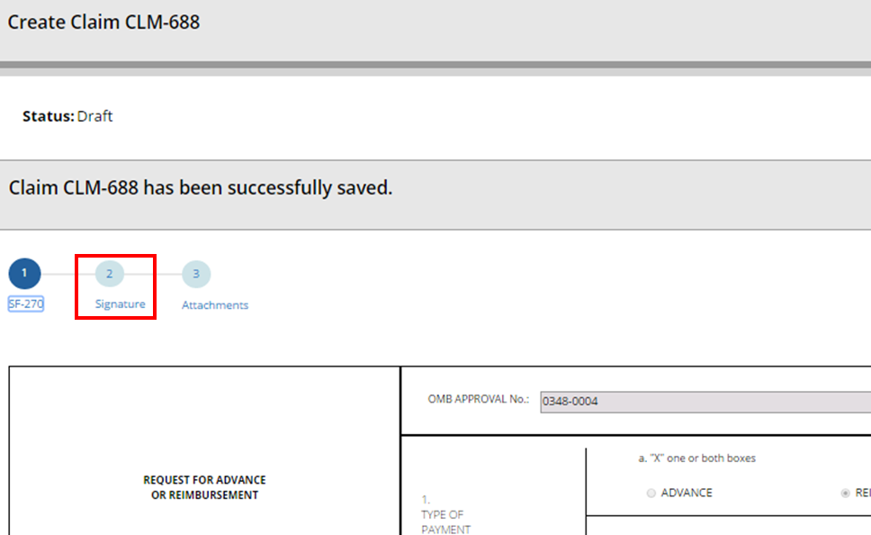
Creating and Submitting Claims
Scroll to the top of the Create Claim screen and click the 2 icon to move to the second phase of claim creation. You can also move to the next stage by clicking the “Next >>” button in the top right corner of the screen.

Slide 35
Creating and Submitting Claims
Adding a Signature
The second stage of claim creation is the signature stage. You must select a primary certifying official for this claim. Depending on your agency or organization, a secondary certifying official may or may not be required. Click in the Primary Certifying Official field.
The Certifying Official assignment is not the same as the Signatory Official user role for your organization. Certifying Official is a temporarily assigned role linked to one specific business object (such as a claim), whereas the Signatory Official role is a permanent user role. Any user can be a Certifying Official, regardless of her/his permanent role.
Note: To go back to the SF-270, click the 1 icon, or the << Previous button, at the top of the screen.

Slide 36
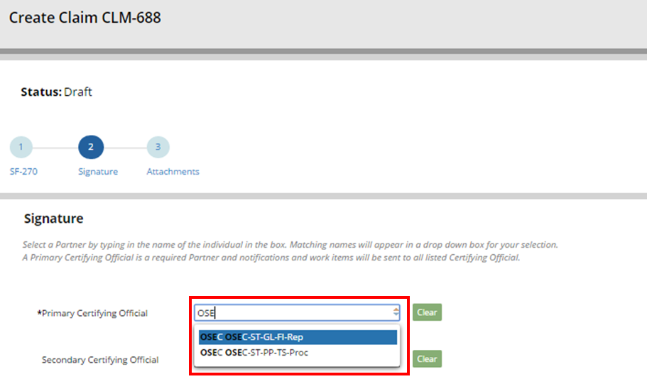
Creating and Submitting Claims
Begin typing the username of the individual you would like to assign as the primary certifying official in the Primary Certifying Official field. The system will generate a dropdown menu of suggested usernames as you type. When you see the relevant username, click the username in the dropdown menu.

Slide 37
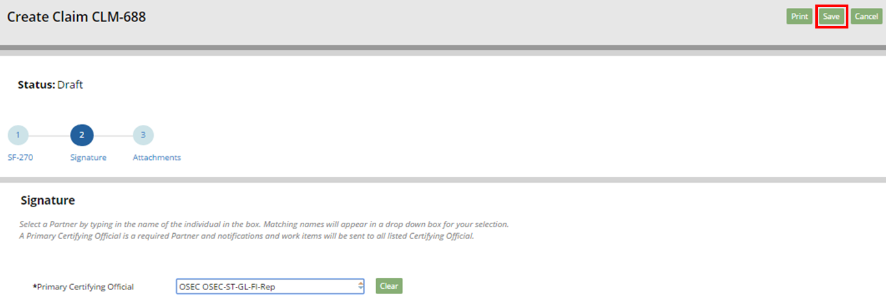
Creating and Submitting Claims
Once you have added one or both of the certifying officials (depending on your organization or award requirements), click the Save button.

Slide 38
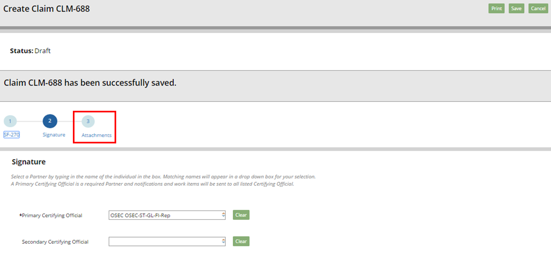
Creating and Submitting Claims
If your claim has successfully saved, the system will generate a confirmation message at the top of the Create Claim screen. Click the 3 button to continue to stage three of the claim creation process. You can also advance to the next stage of claim creation by clicking the “Next >>” button in the top right corner of the screen.

Slide 39
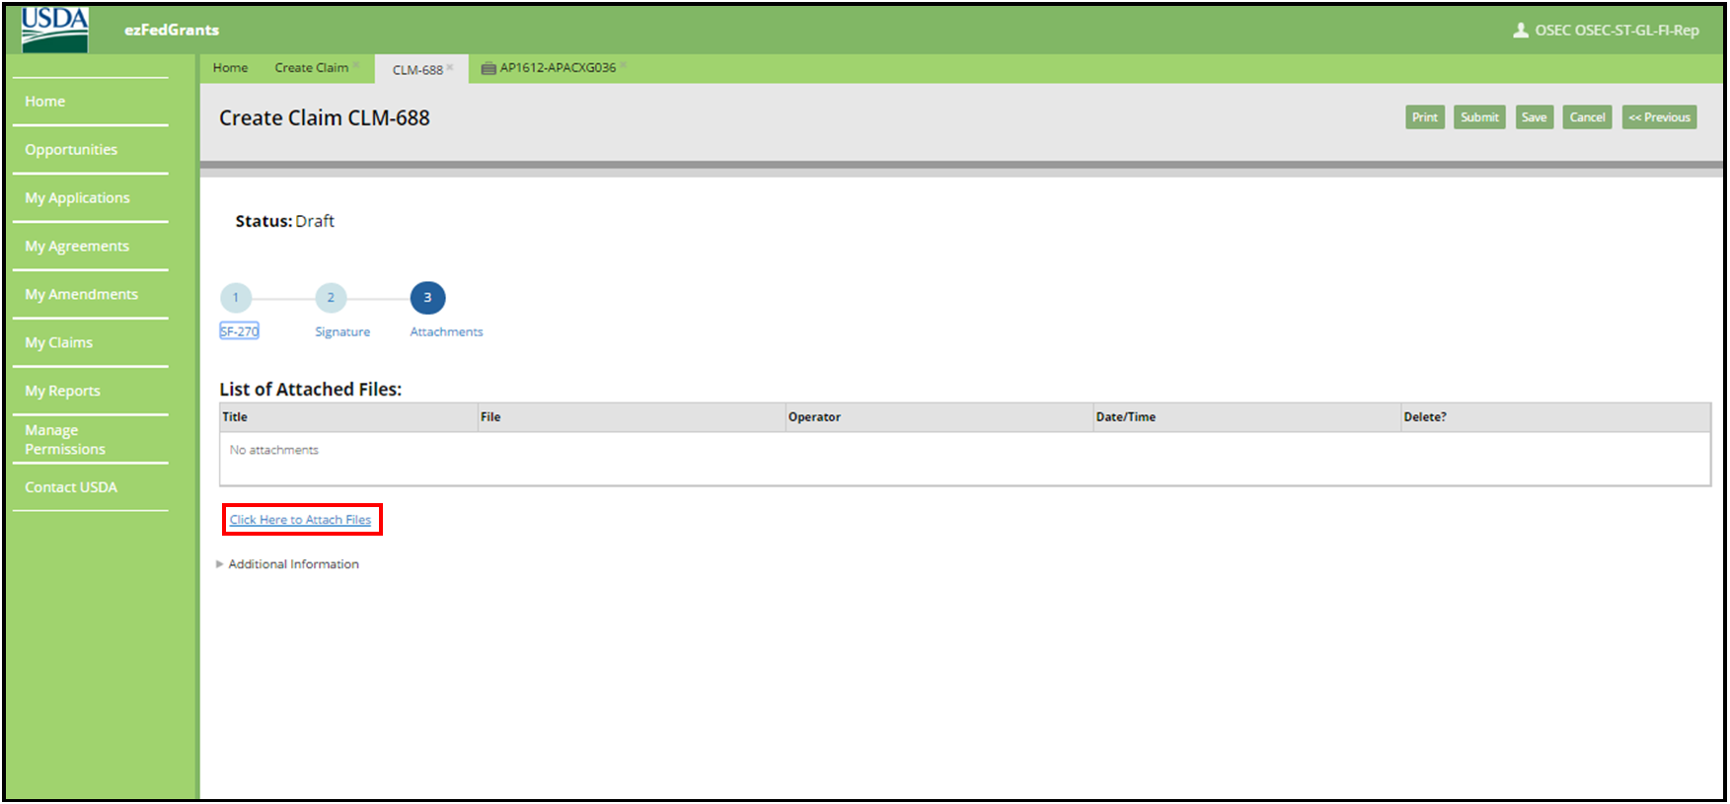
Creating and Submitting Claims
Adding Attachments
Stage three, the final stage of claim creation, is the attachments stage. Attachments are not required in order to submit a claim, but your organization or awarding agency may require attachments with your claims.
Note: To return to either of the previous stages of claim creation (SF-270 or Signature), click the numbered icons or the << Previous button at the top of the screen.

Slide 40
Creating and Submitting Claims
To add an attachment, click the Click Here to Attach Files link under the List of Attached Files table. This will open the Add Attachment popup window.

Slide 41
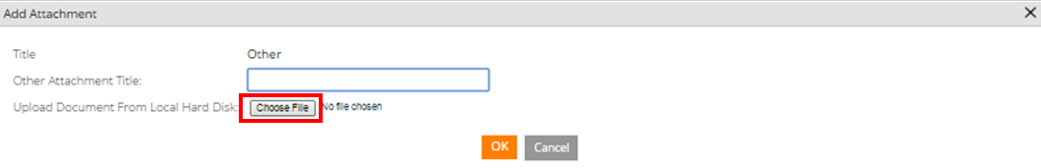
Creating and Submitting Claims
In the Add Attachment popup window, click the Choose File button to locate and select the desired attachment file on your computer.

Slide 42

Creating and Submitting Claims
Click in the Other Attachment Title field and type a title for your attachment.

Slide 43
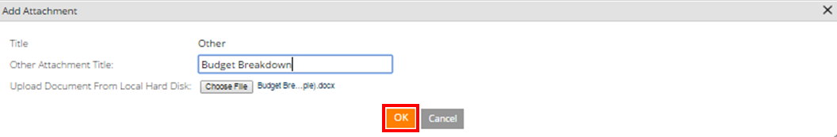
Creating and Submitting Claims
Click the OK button to attach your file and close the Add Attachment popup window. To exit the Add Attachment popup window without attaching a document, click the Cancel button at the bottom of the popup window, or the X button in the top right corner of the popup window

Slide 44
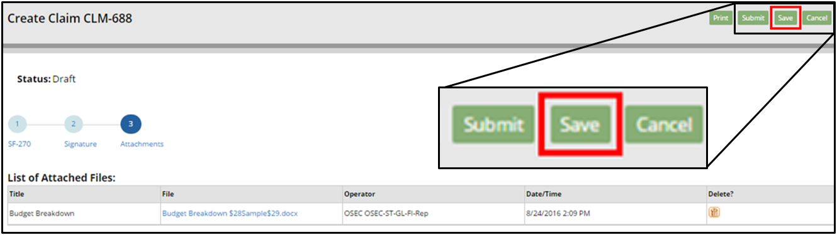
Creating and Submitting Claims
Once you have attached all necessary files, click the Save button.

Slide 45
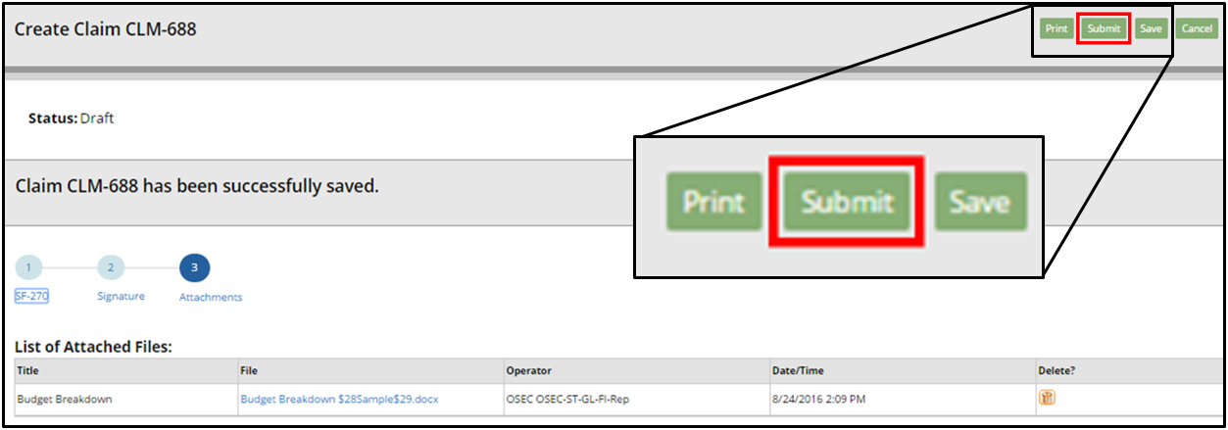
Creating and Submitting Claims
Once you are ready to submit the claim for review by the Certifying Official, click the Submit button.

Slide 46
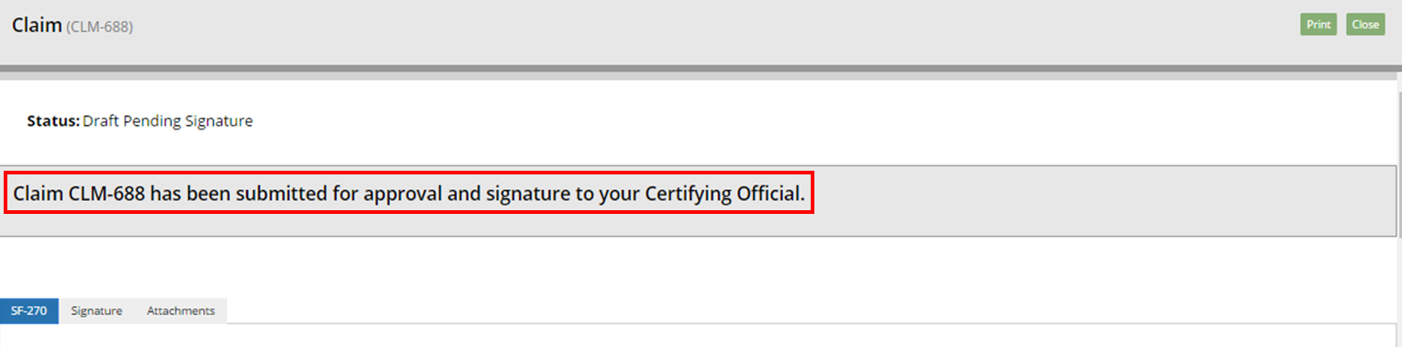
Creating and Submitting Claims
If your claim has submitted successfully, the system will display a submission confirmation message. The individuals you assigned as certifying officials will then receive work items and notifications altering them to the new claim.

Slide 47
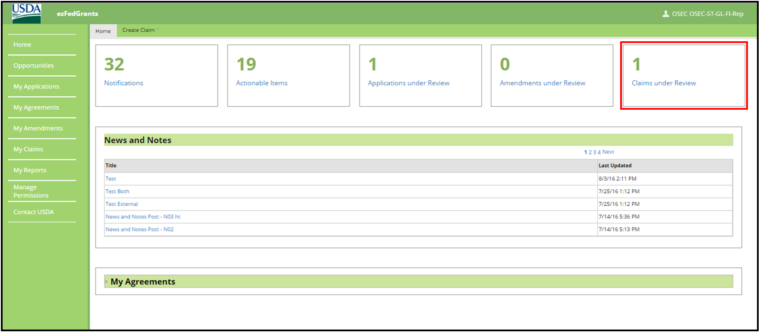
Creating and Submitting Claims
You can view your claims pending review by certifying officials by clicking the Claims under Review tile on the ezFedGrants External Portal Home screen.

Slide 48
Creating and Submitting Claims
Certifying Claims
Once the claim is submitted it must be certified by the designated certifying official.

Slide 49
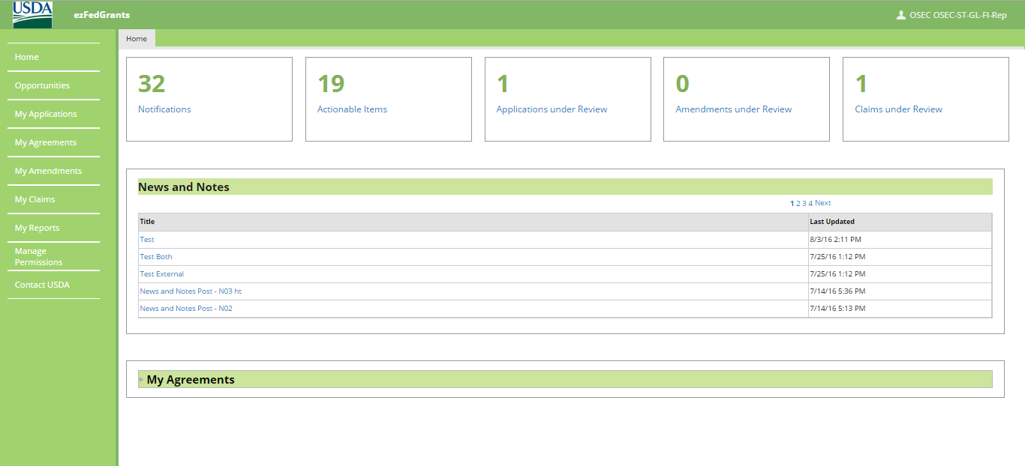
Creating and Submitting Claims
Begin by accessing the ezFedGrants External Portal Home screen.

Slide 50
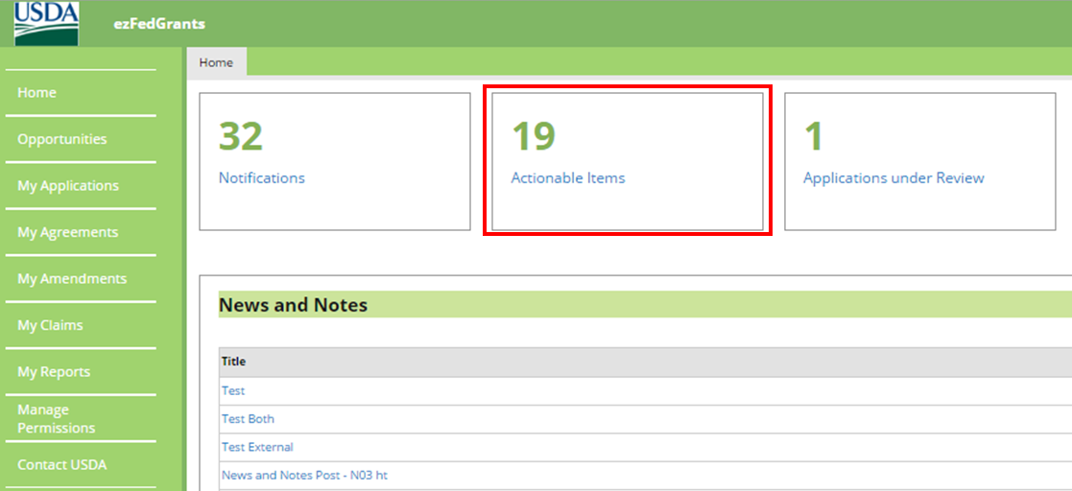
Creating and Submitting Claims
Click the Actionable Items tile to open the Actionable Items for Past 90 Days popup window.

Slide 51
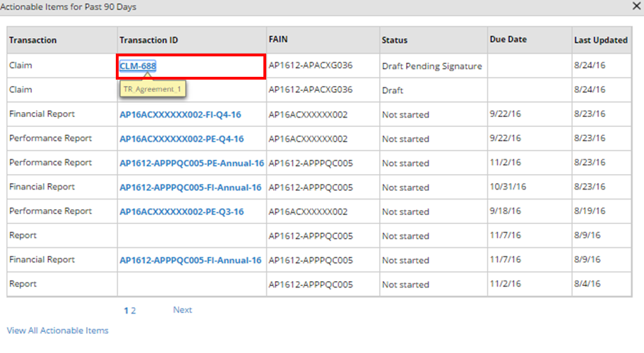
Creating and Submitting Claims
In the Actionable Items for Past 90 Days popup window, click the Transaction ID link of the claim you wish to take action on in the Transaction ID column. This will open the Claim screen. Click the View All Actionable Items link to view all work items, including those sent to you more than 90 days ago.

Slide 52
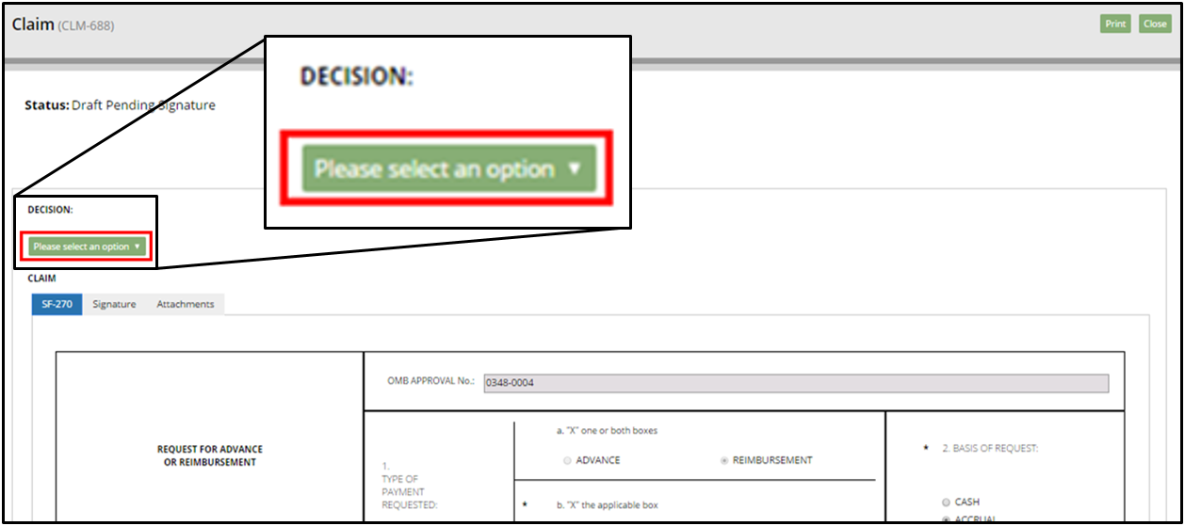
Creating and Submitting Claims
On the Claim screen, review the claim using the SF-270, Signature, and Attachments tabs, and then click the Please select an option field in the Decision section.

Slide 53
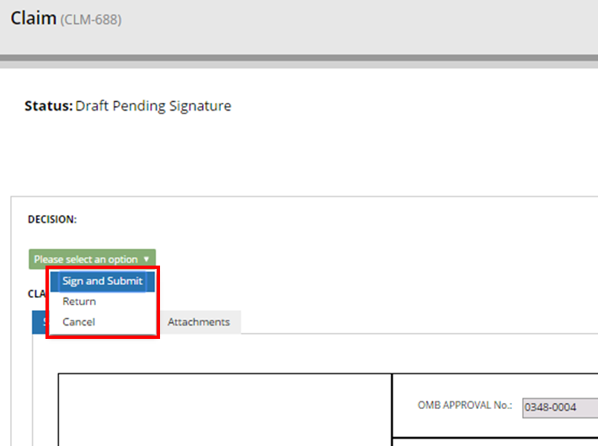
Creating and Submitting Claims
If the claim appears complete, correct, and ready to submit, click the Sign and Submit option on the Please select an option dropdown menu to proceed with digitally signing the claim and submitting it to the awarding agency. The Return option will return the claim to the claim creator for editing. The Cancel option will cancel and void the claim.

Slide 54
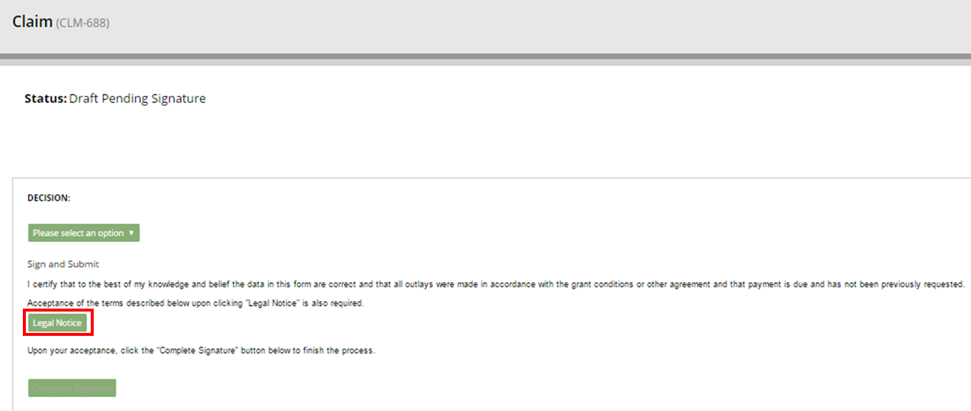
Creating and Submitting Claims
Once you select the Sign and Submit option, you must review and agree to the legal notice/terms and conditions before submitting the claim to your agency. To review and accept the terms and conditions, click the Legal Notice button. This will open the Legal Notice popup window.

Slide 55
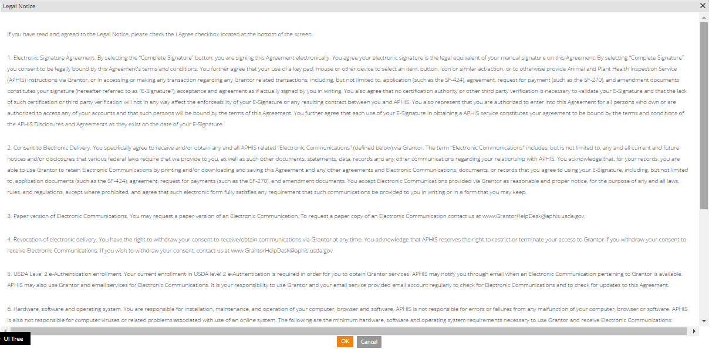
Creating and Submitting Claims
Scroll along the Legal Notice popup window to review the terms and conditions.

Slide 56
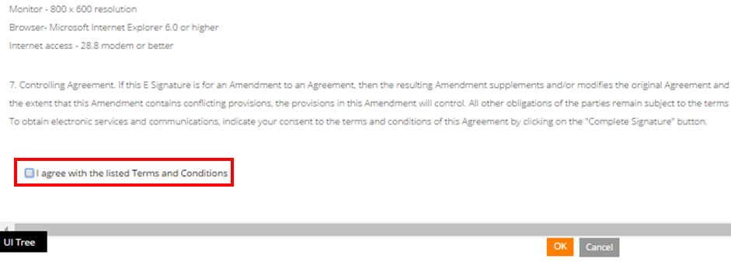
Creating and Submitting Claims
Once you have reviewed the legal notice, scroll to the bottom of the Legal Notice popup window and click the checkbox to the left of the I agree with the listed Terms and Conditions statement.

Slide 57
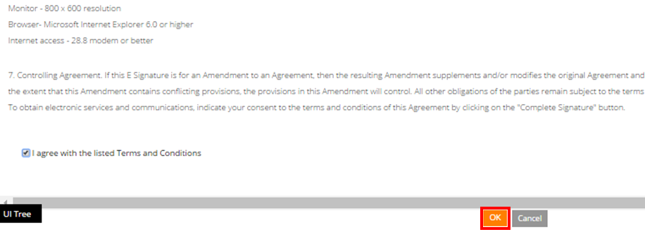
Creating and Submitting Claims
Click the OK button to submit your acceptance of the legal notice and proceed with claim submission. This will close the Legal Notice popup window.

Slide 58
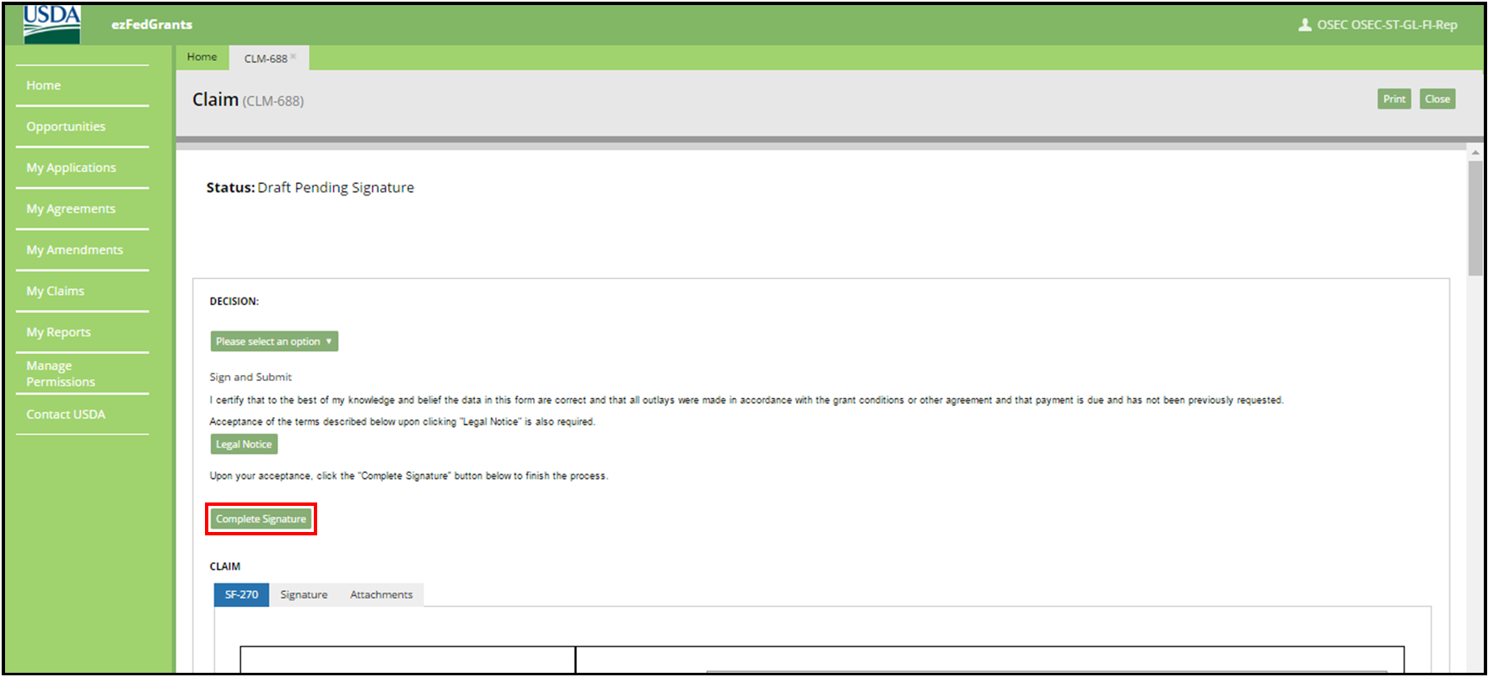
Creating and Submitting Claims
Once you click the OK button, you will be returned to the Claim screen. Click the Complete Signature button to finalize your digital signature and submit the claim to your agency. If submission is successful, the system should display a confirmation message. Otherwise, you can confirm the successful submission by checking that the claim no longer appears on your worklist/actionable items list.

Slide 59

Module Summary
In this module, you have learned to:
  Describe the ezFedGrants claims creation process
  Describe the ezFedGrants claims submission process
  Explain the functionality, goals and benefits of ezFedGrants

Slide 60
Agenda
Course Introduction
Module 1 – Creating and Submitting Claims
Module 2 – Submitting Reports
Course Summary

Slide 61
Objectives
After completing this module, you will be able to:
  Describe the process for submitting reports in ezFedGrants

Slide 62
Submitting Reports
What’s Needed?
The agreement must be in active status.
No previous reports can be in the workflow. All previously created reports must be submitted or cancelled in order to fill out and submit a new report.
The user must be provisioned with the correct roles (either Grants Processor or Grants Administrative Officer)

Slide 63
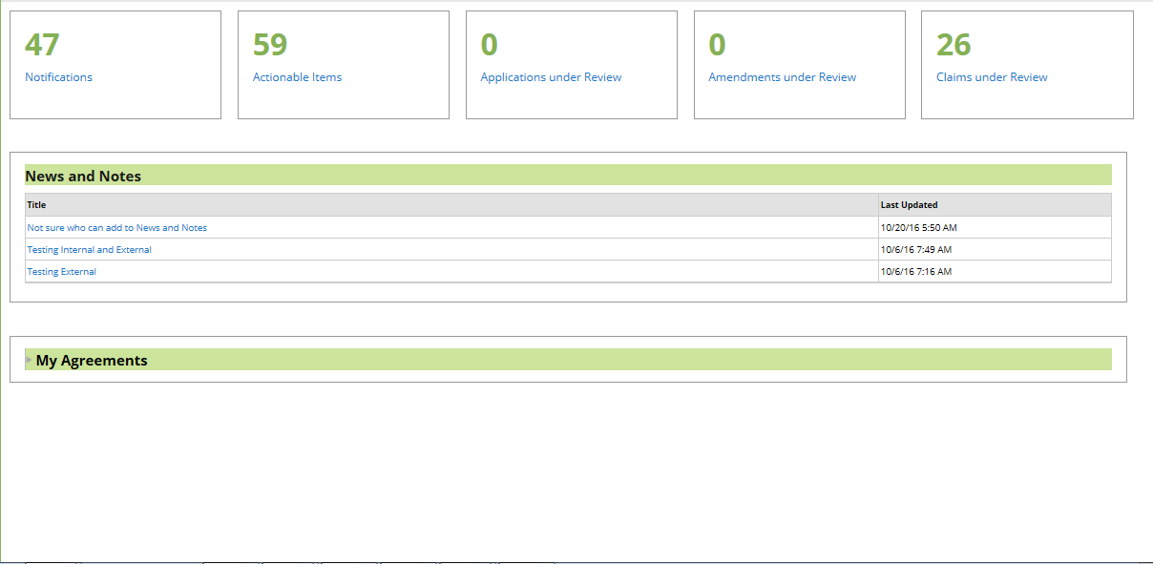
Submitting Reports
Start the transaction by accessing the ezFedGrants External Portal homepage and clicking on the Actionable Items tile

Slide 64
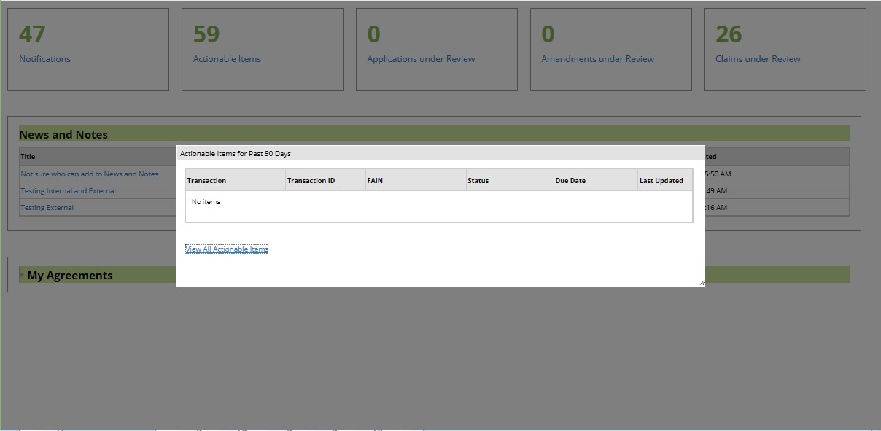
Submitting Reports
Reports generated within the past 90 days will display on the pop-up. To select one of these reports, click the link under the Transaction ID column. To view all reports, click the View All Actionable Items link.

Slide 65
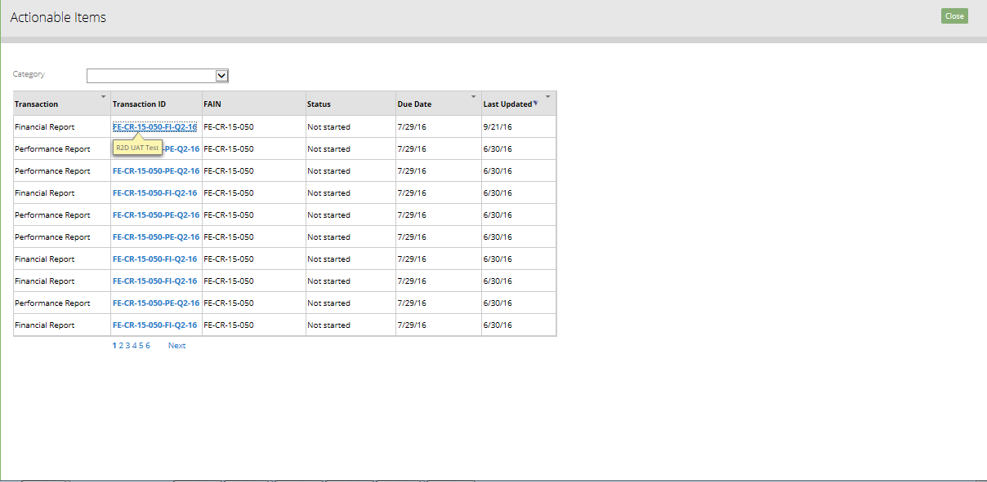
Submitting Reports
Identify the report you wish to submit and click on the link under the Transaction ID column.
The report type for each report is specified under the Transaction column.

Slide 66
Submitting Reports
Report IDs
You can also identify the report type and other information about the report from the Transaction ID.
For example, FE-CR-15-050-Q2-16 indicates:
  FE - Agency/Dept.
  CR - Agreement Type
  15 - Fiscal Year of Agreement
  050 - Sequential Number
  Q2 - Quarter for Report
  16 - Fiscal Year for Report

Slide 67
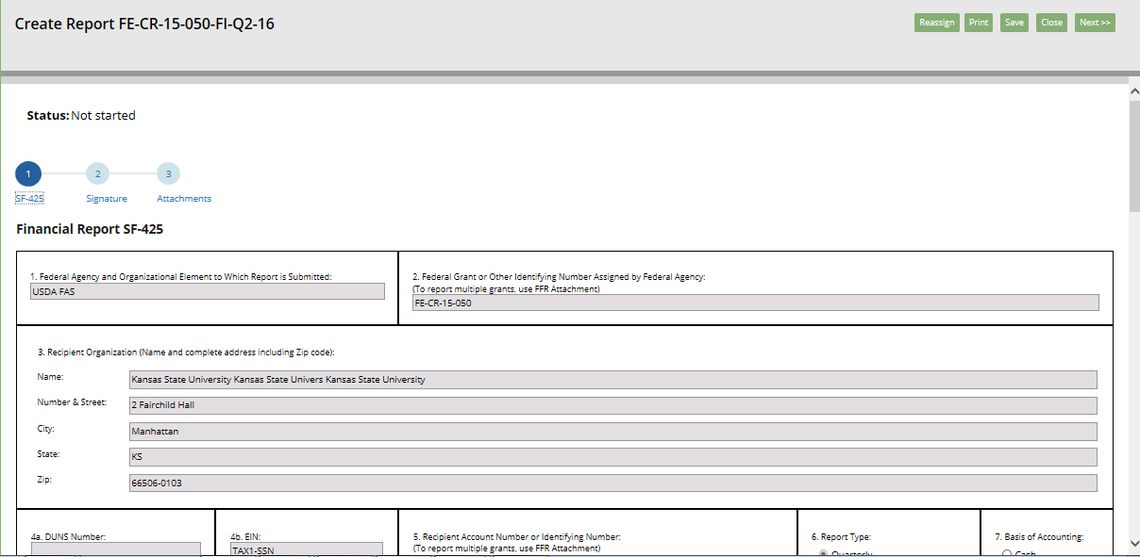
Submitting Reports
Start on the first tab of the report creation process. The first tab is the standard form. This is a financial report so it is the SF-425 form. In order to navigate to other portions of the report creation process, click on the other tabs (e.g. 2, 3)

Slide 68

Submitting Reports
In the Transactions section, click in the field "a. Cash Receipts" and fill out the amount of "Cash Receipts" for this reporting period.

Slide 69

Submitting Reports
In the Transactions section, click in the field "b. Cash Disbursements" and fill out the amount of "Cash Disbursements" for this reporting period. The field "c. Cash on Hand (line a minus b)" will auto-calculate based on what you type into fields a. and b.

Slide 70

Submitting Reports
Click in the field "e. Federal share of expenditures" and type the Federal share of expenditures for this reporting period.

Slide 71

Submitting Reports
Click in the field "f. Federal share of unliquidated obligations" and fill in the Federal share of unliquidated obligations for this reporting period.

Slide 72

Submitting Reports
Click the Save button often to save your changes to the report

Slide 73

Submitting Reports
Click the next tab in order to move to the Signature page

Slide 74

Submitting Reports
Click in the Primary Certifying Official field and type in a Certifying Official for this report. The Certifying Official can be anyone within ezFedGrants system from your organization, including yourself.

Slide 75

Submitting Reports
As you type, options of organization users will display for selection.

Slide 76

Submitting Reports
To move to the final step, click tab "3. Attachments"

Slide 77

Submitting Reports
To attach a file, click the "Click Here to Attach Files" link

Slide 78

Submitting Reports
Click in the "Other Attachment Title" field and type an attachment title into the "Other Attachment Title" field.

Slide 79

Submitting Reports
Click the Browse button and select the file you want to attach

Slide 80

Submitting Reports
Once the file attaches, click the OK button

Slide 81

Submitting Reports
Once you have completed filling out all the necessary information for the report, click the Submit button

Slide 82

Submitting Reports
After the report is submitted, a work item will be sent to the Certifying Official(s) and the status of the report will change to "Draft Pending Signature"

Slide 83

Submitting Reports
Once the Certifying Official accesses the report through their Actionable Items tile, they will be able to review the report and select a decision from the Decision Dropdown Menu

Slide 84

Submitting Reports
Click on the Decision Dropdown Menu. In order to submit the report to the agency or department, Click the "Sign and Submit" option. To return the report to its creator for edits, click the "Return" option.

Slide 85

Submitting Reports
After selecting to sign and submit the report, you will have to review the legal notice section. In order to do this, click the Legal Notice button

Slide 86

Submitting Reports
After reviewing the legal notice and if you agree with the listed terms and conditions, click in the I agree with the listed Terms and Conditions checkbox, then click the OK button.

Slide 87

Submitting Reports
Click the Complete Signature button

Slide 88

Submitting Reports
After successfully signing and submitting the report, you will be taken to a confirmation page and the status of the report will change to "Submitted"

Slide 89

Submitting Reports
The process for completing and submitting a performance report is almost identical. In this case, the form you will be required to complete is the SF-PPR

Slide 90

Submitting Reports
Scroll down the SF-PPR form and click in the field "10. Performance Narrative (attach performance narrative as instructed by the awarding Federal Agency):"

Slide 91

Submitting Reports
After completing the SF-PPR, the Signature page, and attaching any necessary documents, click the Submit button

Slide 92

Submitting Reports
After clicking the Submit button, you will be taken to a confirmation page

Slide 93
Module Summary
In this module, you have learned to:
  Describe the process for submitting reports in ezFedGrants

Slide 94
Agenda
Course Introduction
Module 1 – Creating and Submitting Claims
Module 2 – Submitting Reports
Course Summary

Slide 95

Additional Resources
Job Aids located at: https://www.nfc.usda.gov/FSS/ClientServices/ezFedGrants/index.php
FAQ
Agency Representative

Slide 96

Conclusion
You have completed GM 101 – Introduction to ezFedGrants. Thank you for your time.

Slide 97

Questions?

