Slide 1
Purdue University CAPS Information Services Update
CAPS Information Services – Providing continuous maintenance, process improvements, and a high level of customer support
NCC Meeting, March 2019
Cindy Music, David McClure

Slide 2
CAPS
Why a new site?
Quick Links
Log in
Notes:
Go to CAPS – New and Improved
Why a new site?
Software update
Purdue Marketing and Media department aided in new look and improved organization
Quick Links
Defaults to 6 boxes
Log in to update to individualize
No maximum, minimum is one
Others to include?
Logging in
Allows
Viewing of Accountability report, SSF, Notify
Changing of quick links
Not logged in – public site

Slide 3
Online Work Plans
Interface mock-up
Goal - product the users will like
SSF functionality
Save as you go
Produce pdf
Ability to generate reports, metrics, etc.
Notes:
Online Work Plans - Mock-up of interface – refer to hand out
Goal – product that the users will like
Not good if the online version takes more time
Using a year of work plans to test interface, provides a foundation for populating dropdowns, etc.
Opportunity to combine work plan and SSF into one interface
Will produce a pdf for ezFedGrants
Will require a good deal of software development, extensive testing (student) and user feedback

Slide 4
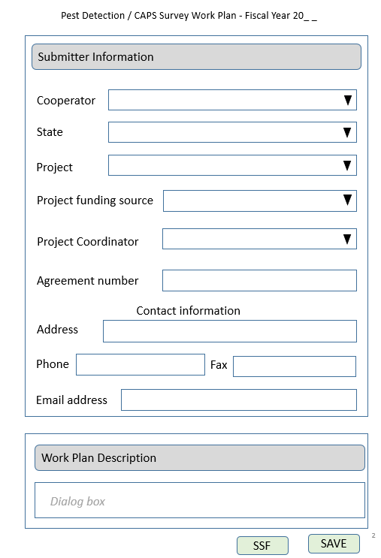
Online
Work Plans
- mock up
Notes:
Online Work Plans - Mock-up of interface – refer to hand out
Goal – product that the users will like
Not good if the online version takes more time
Using a year of work plans to test interface, provides a foundation for populating dropdowns, etc.
Opportunity to combine work plan and SSF into one interface
Will produce a pdf for ezFedGrants
Will require a good deal of software development, extensive testing (student) and user feedback

Slide 5
NAPIS Data Entry/SSC Entry
Distinguishing entities within a state
Providing appropriate reports, separations, etc.
SSC data entry?
Notes:
NAPIS Data Entry/SSC Entry
Discussion points:
How to distinguish entities within a state
Tribal Council, WI
GA – Forestry Commission
2. Needs to be handled by a software side also
Provide appropriate reports, separations, etc
Currently “data source” is used – continue?
3. SSC to do data entry for various entities?

Slide 6
SSF Review
SSF Farm Bill entry – Questions?
Change Request
Notes:
SSF – review
SSF Farm bill entry
Change request process
Accountability report is not available when a change request is in process.

Slide 7
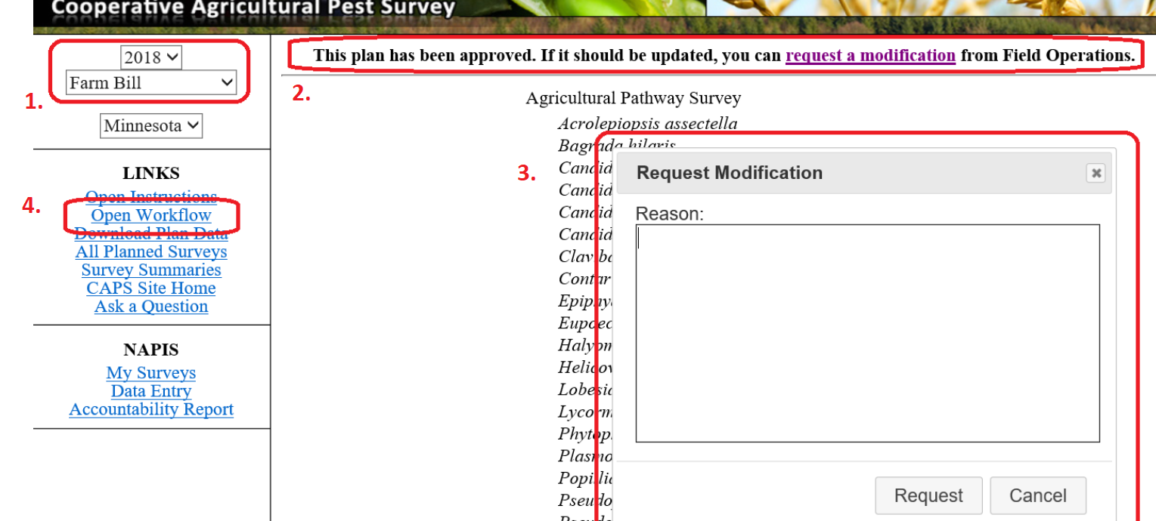
Change
Request
Set appropriate funding year, source.
Click on request modification link.
Make a detailed request, click request.
Check status in Workflow.
Check for status emails.
When approval is given, make edits and save.
Notes:
Process:
Set appropriate funding year, source.
Click on request modification link.
Make a detailed request, click request.
Check status in Workflow.
Check for status emails.
When approval is given, make edits and save.
ck for status emails.
When approval is given, make edits and save.

Slide 8
Data Report Request Form
Designed to minimize access requests
Vetted
Notes:
Data Report Request Form
Bring up CAPS site
Result of requests for access to database
Vetted by Lisa and John, Created by CAPSIS
Form was created for those who do not have access
Reminder - Core four has ability to create reports
For any training, please email clmusic@purdue.edu

Slide 9
Fair and Appropriate Use Statement
The NAPIS database and its associated reports and maps
is a state system and the states ‘own’ the data.
The use and sharing of information is understood to be
within the CAPS Community
Among the states there is an implied trust.
The Fair Use statement is to provide guidelines and
awareness.
Notes:
Fair and Appropriate Use Statement
Protections for
Purdue intellectual property
Publication of data
(Result of a state pulling their data, info, etc. and handing it over to a data collection source.)
When and where? – to be determined
come up every time the site is opened?
– NAPIS site only
Reminder that this also occurs with generation of maps
John and Lisa’s involvement – knowledge of what is happening versus permission

Slide 10
Proposed Fair and Appropriate
Use Statement
Permission to access data in the National Agricultural
Pest Information System (NAPIS) does not confer rights
to share, present, or publish any raw, processed or summary data outside of your own individual use.
Specific permission is required for each disclosure
event whether digital or analog, oral or written
and can be granted only by the PPQ National
Policy Manager or the PPQ National
Operations Manager.

Slide 11
Questions?
Additional comments?

Slide 12
Thank You
Providing continuous maintenance,
process improvements, and a high level of customer support

