Slide 1
S&T CAPS Support and S&T Realignment
Animal & Plant Health Inspection Service

Slide 2
Scientific & Technical Support for CAPS
Priority Pest List – evaluate potential pests (OPEP); develop list; prepare and present relevant analyses
Approved Methods for Pest Survey (AMPS) – develop practical science-based survey methods
Datasheets – provide pest info and survey guidance to support survey
Risk maps – develop climate suitability and phenology maps to support surveys
Coordinate research needs and provide ad hoc science support (e.g., pollinator bycatch, Fluon application guidance)
Notes:
S&T provides scientific and technical support for the CAPS program.

Slide 3
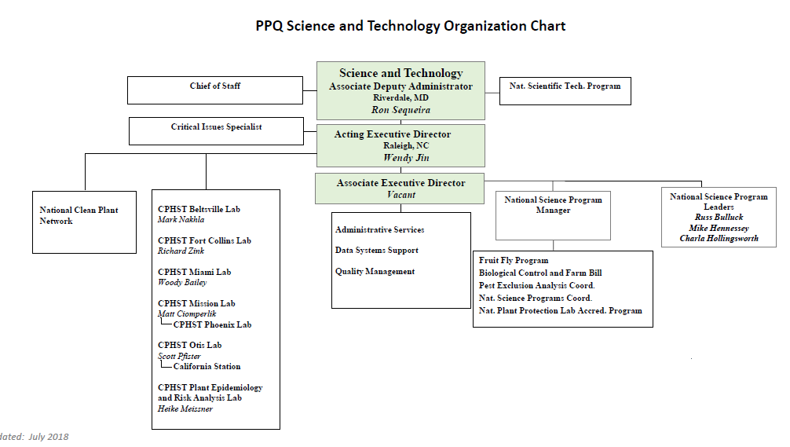
Notes:
Laboratories
CPHST Miami Lab, Miami, FL
Develops improved inspection methods and phytosanitary treatment technologies.
Evaluates commodity treatment efficacy and technology and certifies and audits treatment facilities.
Provides analytical chemistry support.
CPHST Beltsville Lab, Beltsville, MD
Develops, validates, and deploys new molecular diagnostics methods for high consequence plant pathogens.
CPHST Fort Collins Lab, Fort Collins, CO
Develops pest identification tools and technologies.
Develops pest survey protocols and guidelines.
Assesses waste disposal and decontamination methods.
CPHST Mission Lab, Edinburg TX
Develops molecular diagnostics for arthropods and gastropods.
Provides support for Mexican fruit fly sterile insect technique eradication program.
Supports research on integrated pest management and biological control.
CPHST Otis Lab, Buzzards Bay, MA
Develops phytosanitary treatments for commodities.
Develops and evaluates pest surveillance and management methods.
Develops and deploys biological control programs for insect pests.
Plant Epidemiology and Risk Analysis Laboratory, Raleigh, NC
Analyzes the pest risks associated with import and export of plant products in order to facilitate safe trade.
Identifies and assesses new pest threats.
CPHST Phoenix Lab, Phoenix, AZ
Develops and implements management methods for pink bollworm and rangeland pests such as grasshoppers and Mormon cricket.
CPHST Biloxi Station, Biloxi, Mississippi
Develops methods and tools for the survey, detection, regulation, and control of the imported fire ant to support the Federal Imported Fire Ant Quarantine.
Oversees routine sample analysis for detecting the presence of pesticide residues and toxic substances to support APHIS programs.
CPHST California Station, Salinas, CA
Develops pest management and commodity treatment methods for light brown apple moth, European grapevine moth, and Asian citrus psyllid.
Programs
Biological Control Program
Develops new biological control programs and technologies to control plant pests and weeds.
Fruit Fly Program
Develops methods to support exotic fruit fly exclusion and detection.
National Plant Protection Laboratory Accreditation Program
Evaluates laboratories outside of PPQ to ensure their capability to make accurate diagnostic determinations for regulatory purposes.
National Scientific Technologies Program
Assesses and transfers detection, identification, diagnostic, and exclusion tools and technologies to support PPQ programs

Slide 4
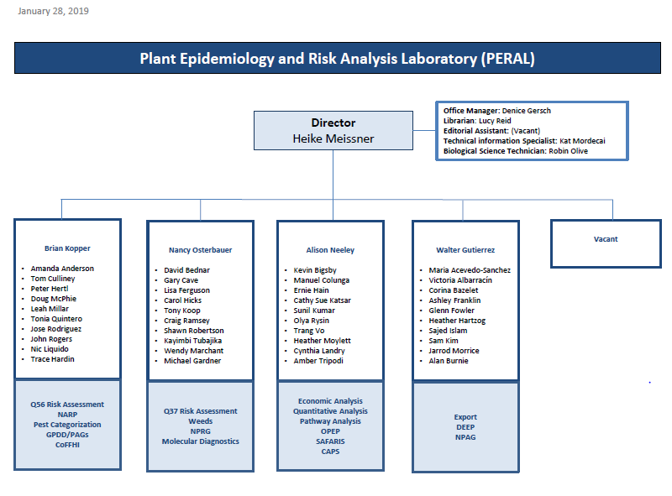

Slide 5
History of S&T CAPS Support
Prior to 2018 the S&T Ft. Collins lab coordinated S&T CAPS support
In 2016 several key vacancies occurred and with Federal hiring limitations the positions remained vacant straining resources
March 2018 S&T CAPS support moved to PERAL
April 2018 the decision was made to change S&T representation on the NCC and PDMT to PERAL

Slide 6
S&T CAPS Support
S&T support for CAPS remains a shared activity across S&T and includes PERAL, Otis and Beltsville labs
In conjunction with the PDMT we revised the S&T workflow to increase efficiency and maximize resources between PERAL, OTIS, Beltsville
We also revised the internal process S&T uses to determine if pests are appropriate for the priority pest list.

Slide 7
The Objective Prioritization of Exotic Pests (OPEP): A new system for prioritizing pests
Animal & Plant Health Inspection Service
Plant Epidemiology & Risk Analysis Laboratory
Center for Plant Health Science & Technology

Slide 8
What is OPEP?
Framework for prioritizing a set of pests based on:
Evaluation of risk
Impact potential (Direct impacts to any host)
Likelihood of introduction (entry + establishment)
Survey Feasibility
Cost Effectiveness
Other policy considerations
For CAPS
Notes:
Direct impacts- physical losses;
Near-term (expected losses in a 5-10 year time horizon)

Slide 9
Risk Assessment and Uncertainty
When conducting risk assessment, we separate evidence from uncertainty in order to ensure that risk is not artificially elevated by uncertainty.
In the past many pests were “guilty by association”
There is a cost to being precautionary
Notes:
In terms of pest risk assessment, this means we must extrapolate from the current situation of the pest to a new situation in the PRA area.
Pests “guilty by association”

Slide 10
Notes:
“When everyone’s super, no one will be”
By focusing on those organisms that have a high likelihood of being high impact pests, we free up our resources for those things that will surprise us.

Slide 11
The absence of information is sometimes evidence.
For example, the lack of information about economic impacts of a pest is often evidence that there are no significant impacts (or they would have been noticed and reported); this is particularly true when a pest is widespread and has been introduced into novel areas.
Notes:
Uncertainty forces decision-makers to judge how probable it is that risks will be overestimated or underestimated for every member of the exposed population, whereas variability forces them to cope with the certainty that different individuals will be subjected to risks both above and below any reference point one chooses.”
See Thompson, 2011 (http://www.ce.ncsu.edu/risk/pdf/thompson.pdf)
National Research Council, 1996

Slide 12
Things to remember about risk analysis:
Risk assessment is not a crystal ball: We can’t predict everything
We have to evaluate pests and make predictions and decisions with incomplete information (we “do the best we can with what we’ve got”)
There is always a chance that our prediction may be wrong
Our estimates of risk may change as we get more information
Rare events can and do occur
There will always be pests that surprise us (that we didn’t even know we should worry about)
There are pests we can be fairly certain about
We prioritize pests based on our best evaluation of each pest’s risk (predicted impact and likelihood of establishment)
Notes:
We have to make decisions and prioritize resources under uncertainty
We must often adopt an attitude of “do-the-best-you-can-with-what-you’ve-got”

Slide 13
Things to remember about prioritization
We should generally not spend limited resources on low risk pests (even though there is always a chance that these pests might establish and cause higher impacts than we originally predicted)
There are times we may not want to spend limited resources on high risk pests (e.g. if there is nothing we can do, or cost of “doing something” is more than the impact the pest will cause)
Notes:
There is also a chance that “high risk” pests will either never establish or upon establishment impacts are less than we predicted

Slide 14
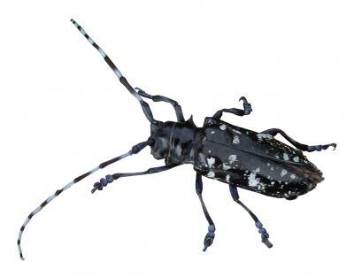
By focusing on those organisms that we determine have a high probability of causing serious impacts, and likely to establish, we can free up resources that can then be spent on those pests that will inevitably surprise us.
Notes:
Uncertainty forces decision-makers to judge how probable it is that risks will be overestimated or underestimated for every member of the exposed population, whereas variability forces them to cope with the certainty that different individuals will be subjected to risks both above and below any reference point one chooses.”
Opportunity cost of being precautionary
See Thompson, 2011 (http://www.ce.ncsu.edu/risk/pdf/thompson.pdf)
National Research Council, 1996

Slide 15
Things to remember about prioritization
We should generally not spend limited resources on low risk pests (even though there is always a chance that these pests might establish and cause higher impacts than we originally predicted)
There are times we may not want to spend limited resources on high risk pests (e.g. if there is nothing we can do, or cost of “doing something” is more than the impact the pest will cause)
Notes:
There is also a chance that “high risk” pests will either never establish or upon establishment impacts are less than we predicted

Slide 16
OPEP Framework
Survey Feasibility
Assessment
Pest Risk
Impact Potential
Likelihood of Introduction
Policy Considerations
Phase I
Phase II
Cost Effectiveness
Add to survey program
Phase III
Other Policy Considerations*

Slide 17
Why OPEP?
Objective – evidence-driven, not opinion-driven
Valid & comparable across pest types
Transparent – separates analysis based on scientific information from that based on policy
Separates pest risk from policy considerations
Flexible – can be used to look at risk by region and host
Defendable
Uses methods that can be tested & statistically validated
Based on other proven PPQ risk assessment methods
Notes:
Be evidence-driven
Use scientifically-valid methods that can be tested and validated
Evaluate pests across pest types using a common metric
Make it clear what part of the ranking is based on science and what part is based on policy

Slide 18
Impact Potential

Slide 19
Predicted Impact Model Development: (based on previous U.S. invasions)
Analyst
Reviewer
Analyst
Consistency Review
Behavior outside U.S.
?
Answer 1
Answer 2
Answer 3
Answer …
=
U.S. Impact
?
High Impact
Moderate Imp.
Low Impact
Economics
Team
Notes:
Created a training dataset for each pest group (arthropods, pathogens, and mollusks). Training data were used to develop the models and included exotic pests that have already become established in the United States. Literature reviews focused on information outside the United States for the model development.
Identify variables that can be used to evaluate the entry, establishment, spread and damage potential of an exotic plant pest.
Based on pest assessments of the training data, variables will be identified that are most significant to the model. Subsequently, a suitable model is identified.
Develop a scoring system based on the how predictive each variable is; the most predictive variables receive the greatest weighting.
Validate the model using a second data set.

Slide 20
Model Results
Best predictor of pest behavior in the United States is behavior outside the U.S. and the level of control/ research on the organism, when the pest has been introduced into novel areas
Specific biological characteristics are not as important in predicting impact
Notes:
Number of hosts (host range) was not found to be related to impact
Ability to survive harsh conditions was not found to be related to impact for pathogens

Slide 21
Model Results (cont.)
If a pest has not been introduced into a novel area, the model should generally not be used to make a prediction (unless it is clearly a pest in its native range)
Notes:
Number of hosts (host range) was not found to be related to impact
Ability to survive harsh conditions was not found to be related to impact for pathogens

Slide 22
By focusing on those organisms that we determine have a high probability of causing serious impacts, and likely to establish, we can free up resources that can then be spent on those pests that will inevitably surprise us.
Notes:
Why I advocate that some level of general surveillance – especially for early detection of damage – is so important.

Slide 23
Impact Potential Model
Pests are scored based on how predictive each question is; the most predictive questions have the greatest weight.
Model also considers production practices and availability of tools in the United States that would likely be effective at mitigating the pest

Slide 24
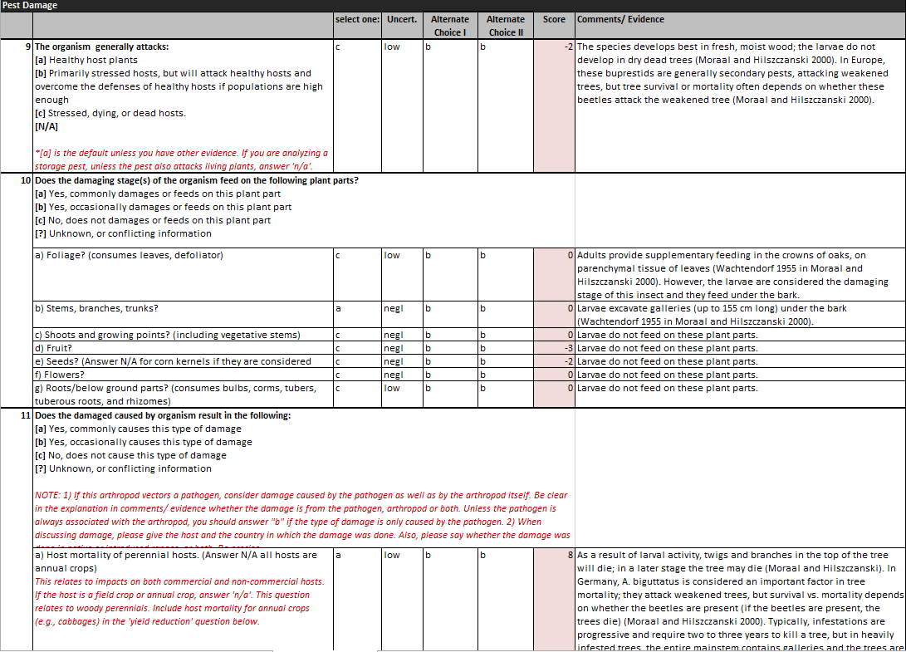

Slide 25
Evaluation of exotic pests for CAPS Pest Prioritization
Each pest on the proposed list was assessed using one of the models and was given a “risk score”
Based on that score we determined:
Probability of being a high impact pest
Probability of being a moderate impact pest
Probability of being a low impact pest
Notes:
One part of the questionnaire (40 lines) I don’t expect you to read it– just to give you a sense

Slide 26
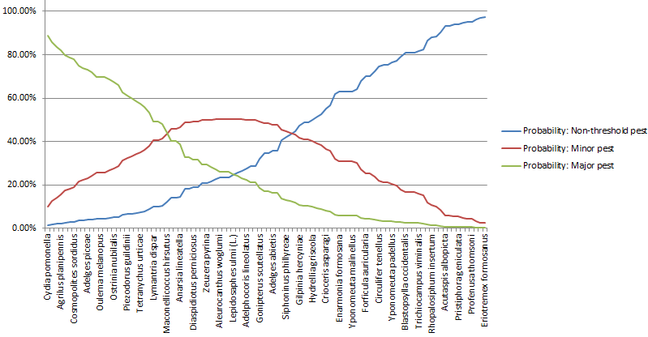
Ordinal logistic regression to determine impact likelihoods
High impact
Moderate
Low impact
Risk Score

Slide 27
CAPS Pest Prioritization
Pests are prioritized based on likelihood of being a high impact pest
NOTE: Model is NOT used for pests where there little to no documented evidence of damage by the pest AND the pest has not been introduced outside of its native range.

Slide 28
Status of Impact Model:
Arthropod Model
94 arthropods have been assessed
Plant Pathogen Model
67 pathogens have been assessed
Ongoing work
30 assessments through cooperative agreement with CIPM,
12 assessments managed through PERAL
5 “existing pests” remaining (excluding mollusks)
Mollusk model development

Slide 29
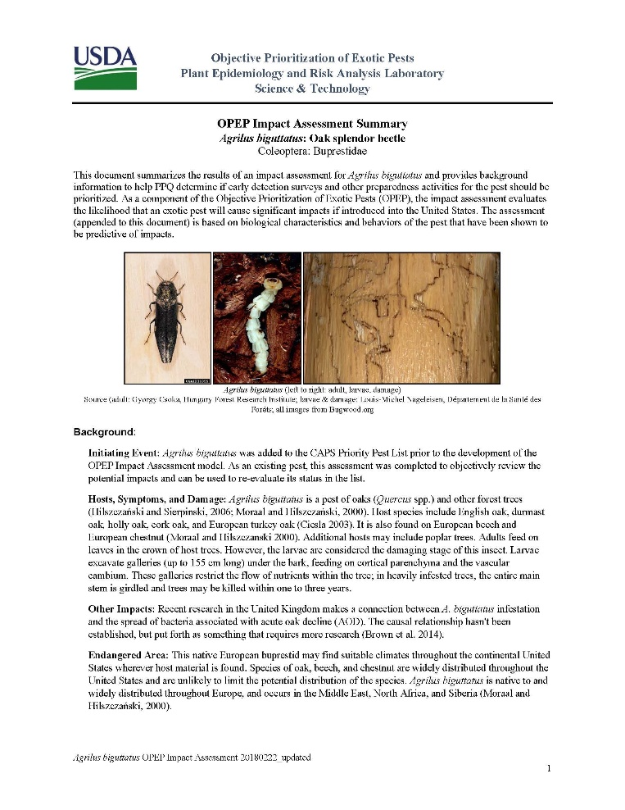
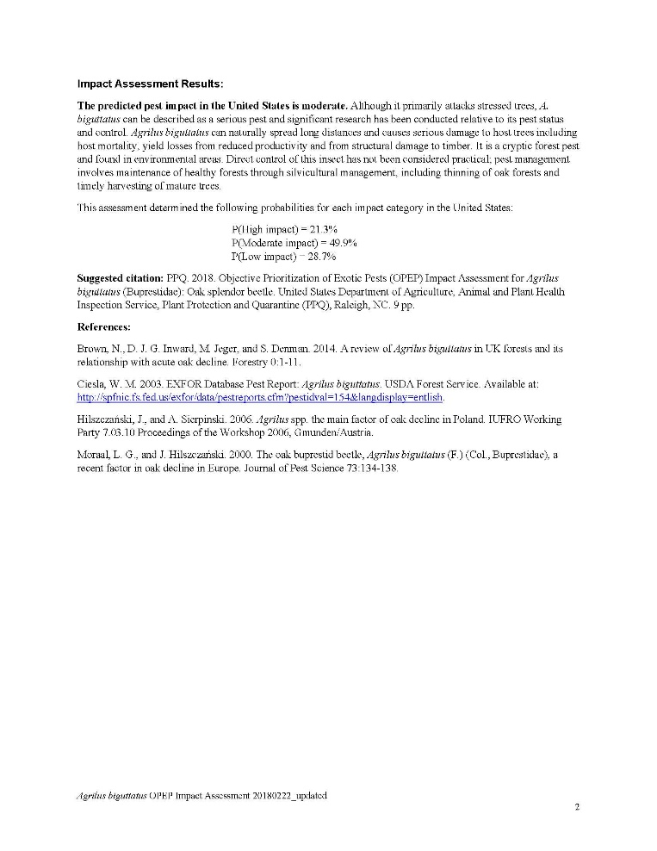
Notes:
The result of these stakeholder meetings, discussion, and iterations of the template along with considerations of the recent writing initiatives has been the development of a new template that is both easier and more straightforward to put together by the analyst and also more directed at the needs of the customer. We provide a brief overview of the background information just focusing on what the pest is known to do on what host plants, and where in the United States it is likely to be able to establish. Then we provide the results, focusing on the likely impact the pest would have if introduced into the US, and considering the current production practices that could affect the ability of the pest to cause damage as well as other biological traits that may affect the final result or should be considered by our stakeholders. Sam Kim took a look at the updated template, and also agreed that the information is sufficient and there aren’t any aspects of the old template that were critical to that work that would need to be added back in.

Slide 30
Likelihood of Introduction

Slide 31
Phase II: Likelihood of Introduction/Establishment
Further refine prioritized list by the likelihood of introduction
PERAL has developed a theoretical model for entry and establishment and identified primary drivers for arthropods and pathogens (e.g. environmental suitability, population dynamics, management, and ecological communities).
The model and associated guidance are currently being tested.
This model should also be ready for use by the end of FY19.

Slide 32
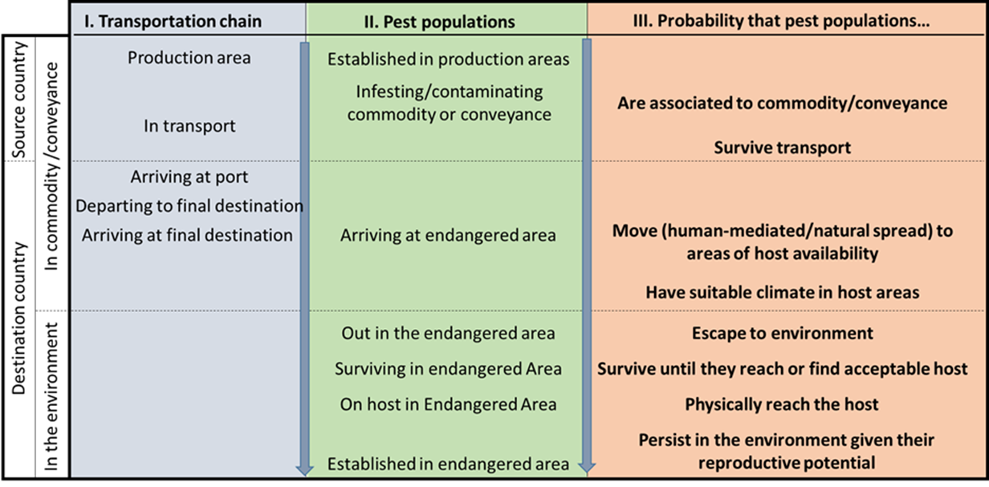
Phase II: Likelihood of Introduction/Establishment
Notes:
The LOI model [focusing on boxes I and II] takes into consideration conditions and establishment of the pest in the source country, the pathway or pathways themselves, and the conditions that would affect the likelihood of establishment in the United States. The analyst uses a rating system from 1 (negligible probability) to 5 (nearly certain probability) to estimate probabilities that the pest population will have the biological attributes to complete the factors considered in box III (association with the commodity or conveyance, ability to survive transport, the likelihood to be moved to an endangered area, escape to the environment, survive and then physically find a suitable host, and reproduce or persist in the environment. These probabilities are then combined into an overall Low, Moderate, or High likelihood of introduction [NOTE THAT I NEED TO TALK WITH MANUEL ABOUT THIS – There are some questions about whether these results are combined into an overall rating or considered separately. I’d like to have confirmation on this before the presentation]

Slide 33
Survey & Identification Feasibility Assessment
AKA: CAPS “Post-Assessment”

Slide 34
Cost Effectiveness

Slide 35
Phase III: Survey Feasibility & Cost Effectiveness
Developing a tool for comparing the cost of the survey to the expected losses
Determine which pest surveys (or group of surveys) will give us the greatest value for our dollar
Eliminate surveys where the cost of survey is greater than the potential damage
Notes:
Self-explanatory

Slide 36
Other Policy Considerations

Slide 37
Possible policy considerations for CAPS
Potential geographic distribution
e.g. number of potential states impacted?
Hosts
Number of hosts?
Amount of production?
Number of producers?
Importance of host
Total value at risk? Export importance? Most profitable?
Specific hosts? (e.g. tree fruit?, environmentally important? all specialty?)
Organization of industry?
Export importance of pest
Non-plant impacts (e.g. human health)
Other things to consider?

Slide 38
PestLens Demo
www.pestlens.info
Notes:
Heike can you navigate to the live system and demonstrate how to find information?
OPEP summary documents currently “encapsulates the assessment with background information, results from the predictive model, endangered area, references, and an appendix with predictive questions & answers”
I am in the process of revising these documents to more closely match CAPS needs (endangered area, hosts, final rating/uncertainty). If the situation allows, it could be helpful to get feedback from the CAPS community regarding the information they find most helpful in the Summary documents.

Slide 39
Questions??

Slide 40
S&T CAPS Support
Heather Moylett
Heather.Moylett@aphis.usda.gov
S&TCAPS@aphis.usda.gov
Annual NCC Meeting March 20-21, 2019 Portland, OR
Notes:
New email reminder

Slide 41
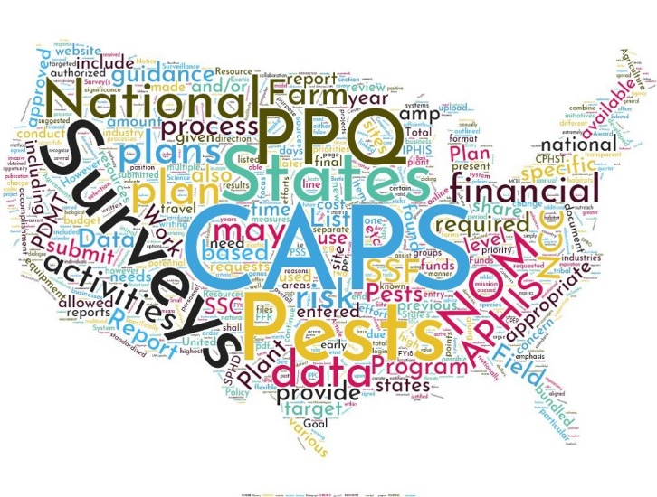
2020 Pest List

Slide 42
Removed: Impact, US Dist, or Regulatory Status
Target | Common Name | Manual | Justification | Bundling?
Archips xylosteanus | Variegated golden tortrix | Oak | Cat 3 | Yes
Argyresthia pruniella | Cherry blossom moth | Stone fruit | Cat 3 | Yes
Chlorophorus strobilicola | Slender-banded pine cone longhorn beetle | EWB/BB | Cat 3 | No, ineffective survey method (visual)
Enarmonia formosana | Cherry bark tortrix | Stone fruit | US dist (WA/OR) | Yes
Eutetranychus orientalis | Citrus brown mite | cotton soybean | Cat 3 | No, ineffective survey method (visual)
Heterodera latipons | Mediterranean cereal cyst nematode | cyst nematode small grains | Cat 3 | Yes
Heterodera sacchari | Sugar cane cyst nematode | cyst nematode | Cat 3 | Yes

Slide 43
Removed: Impact, US Dist, or Regulatory Status
Target | Common Name | Manual | Justification | Bundling?
Meloidogyne minor | Root-knot nematode | solanaceous | Cat 3 | Yes
Orthotomicus erosus | Mediterraneran pine engraver | EWB/BB pine | Cat 3 Deregulated | Yes
Paratachardina pseudolobata | Lobate lac scale | Tropical | US Dist (FL, HI, PR) Regulated in Guam and PT | No, ineffective survey method (visual)
Phytomyza gymnostoma | Allium leafminer | APC | Deregulated except CA | No, ineffective survey method (visual)
Phytophthora quercina | Oak decline | oak | Cat 3 | Yes
Tortrix viridana | Green oak tortrix | oak | Cat 3 | Yes

Slide 44
Removed – Research
Target | Common Name | Manual | Justification | Bundling?
Monilinia fructigena | brown rot; apple brown rot | stone fruit | Tentative. Molecular diagnostics tool needed. Beltsville developing/validating tool. If ready for use by 2020, will not remove. | No
Monilinia polystroma | Asiatic brown rot | stone fruit | Tentative. Molecular diagnostics tool needed. Beltsville developing/validating tool. If ready for use by 2020, may still remove - Cat 3 pest. | No
Rathayibacter toxicus | Annual ryegrass toxicity | APC | Molecular diagnostic tool needed. Cat 3 pest, but will be returned to APC list because it is a select agent. | No
Sclerophthora rayssiae var. zeae | Brown stripe downy mildew | corn | Molecular diagnostic tool needed. Cat 3 pest, but will be returned to list because it is a select agent. | No
Notes:
Monilinia - State survey: 2018 - ME, MT, PA, UT, WA
Rathayibacter toxicus - B'ville: CAPS FY18 project (LAMP). Stefano Costanzo. $44,137 State survey: 2018 - HI, PA;
Sclerophthora rayssiae var. zea - B'ville: working on it but hampered by lack of samples and reference material State survey: 2018 - FL, IN, KS, MN, MS, ND, PA; 2019 - FL, ID, IN, MN, MS, ND, OR, PA
Paysandisia archon – morphologically distinct. Allow visual survey in nursery only?

Slide 45
Remove? – Discuss
Target | Common Name | Manual | Justification | Bundling?
Agrilus auroguttatus | Goldspotted oak borer | EWB/BB Oak | Described from AZ, considered native to U.S. | Yes
Agrilus planipennis | EAB | EWB/BB | In many states, slated for deregulation. | Yes
Anoplophora chinensis | citrus longhorned beetle | EWB/BB | Ineffective survey method (visual). Add to research list. Will return to priority list once tools are available (Cat 1) | In nursery settings only?
Paysandisia archon | Palm borer | Palm EEI | Ineffective survey method (visual). Add to research list. Will return to priority list once tools are available (Cat 1) | In nursery settings only?

Slide 46
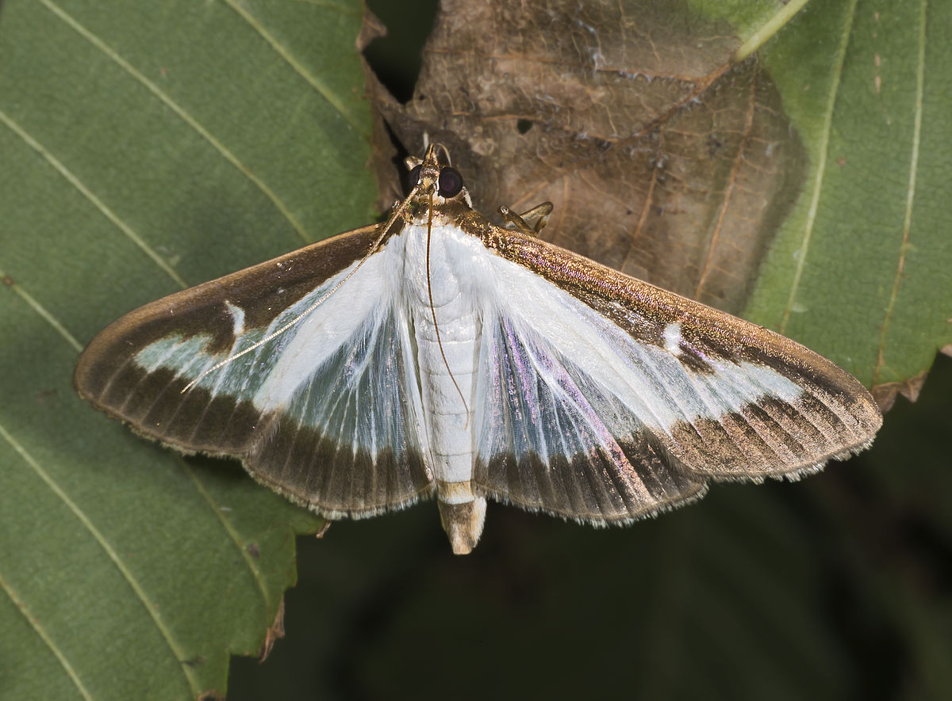
Added
Cydalima perspectalis (box tree moth)
Approved survey method
Trap: tricolor plastic bucket trap
Lure: Z11-16:Ald and E11-16:Ald (mixture of 5:1)
Photo credit: Didier Descouens, 2013 (CC BY-SA 3.0)

Slide 47
Bundling Criteria
Pest is removed:
Lacks effective survey or ID methods →
Federally deregulated or present in U.S.
Effective survey and ID →
Lacking effective survey or ID →
NO
YES
NO
Notes:
Work with Lisa on this.
Do we want to include Program pest bundling reminder here?

Slide 48
Bundling Criteria: Take-Away
No effective survey or identification method?
Bundling
Notes:
No effective survey or identification method = No bundling

Slide 49
Weeds
Horse thistle WRA assigned March 2019.

Slide 50
Apple/Pear Manual
Pest list in development
Pest Categorization
22 candidates identified as appropriate for OPEP
OPEP Impact Assessment
In progress
Survey/ID Feasibility Assessment
Pending

Slide 51
Approved Methods for Pest Surveillance
2019 & 2020

Slide 52
Fluon-coated traps
In stock: Fluon-coated cross vane panel & multi-funnel traps
Trap Product Names will not change in the IPHIS Survey Supply Ordering System
Cross Vane Panel Trap, Black
Black Multi-funnel Trap, 8 Funnel, Wet
Black Multi-funnel Trap, 12 Funnel, Wet
Inventory is limited – not possible to replace all traps yet.

Slide 53
Fluon-coated traps
Fluon-coated cross vane panel traps
2019 orders will receive fluon-coated cross vane panel traps
Required for Callidiellum villosulum (brown fir longhorned beetle) and Trichoferus campestris (velvet longhorned beetle).
May order new traps if surveying for these targets
Other targets, continue to use the traps you have if in good condition.
Fluon-coated multi-funnel traps
Deplete untreated stock first. 2019 orders will likely receive uncoated multi-funnel traps.
Not required for any CAPS pests at this time. Continue to use the traps you have if in good condition.

Slide 54
Callidiellum villosulum (brown fir longhorned beetle)
Callidiellum Lure available for 2019
Approved survey method:
Lure: Callidiellum Lure
Trap: Cross Vane Panel Trap, Black*
Effective for Callidiellum villosulum (target pest) and C. rufipenne (Japanese cedar longhorned beetle)
*treated with fluoropolymer

Slide 55
Trichoferus campestris (velvet longhorned beetle)
Trichoferone lure will be available for 2019
Approved survey method:
2019
Lure: Ethanol or Trichoferone
Cross Vane Panel Trap, Black*
2020
Lure: Trichoferone
Cross Vane Panel Trap, Black*
*treated with fluoropolymer
On the shelf
this
week!
Notes:
.

Slide 56
Chilo partellus (spotted stem borer)
New trap approved – effective 2019
Large Plastic Delta Trap
Approved survey method:
Lure: Chilo partellus Lure
Trap:
Wing Trap Kit, Paper or Plastic
Large Plastic Delta Trap, Orange, Red, or White
Delta trap color or wing trap material (paper or plastic) is up to the State and does not affect trap efficacy for this species.
Notes:
Delta is a standard tortricid trap and approved for Chilo suppressalis
Wing allows for multiple plume orientation where delta is two sided, but delta improves specimen quality for identification. Scant literature, but delta is supported as an appropriate trap.

Slide 57
Epiphyas postvittana (LBAM)
Light Brown Apple Moth (LBAM) Program approved change in lure formulation for Epiphyas postvittana Lure
Previous lure was two-component pheromone blend.
Recent research shows four-component lure is more sensitive and may detect new LBAM populations at lower numbers.
CA and New Zealand trials: 2 – 5 x higher catch over two component.
FY19 and on, all Epiphyas postvittana Lure ordered will contain the four-component pheromone blend.

Slide 58
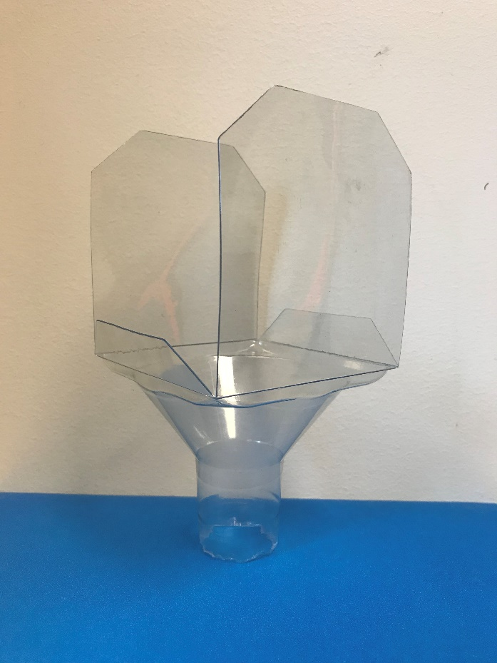
Plastic funnel insert
Dendrolimus pini (pine-tree lappet) and D. sibiricus (Siberian silk moth)
Modified milk carton trap + plastic funnel insert
Funnels are reusable
Available
to
order now!
Notes:
.

Slide 59
Research & Methods Development
Update & Needs

Slide 60
New Screening Aids (7)
Screening Aid | Associated Taxon | Common Name
Aeolesthes sarta | Aeolesthes sarta* | City longhorn beetle
Agrilus spp. | Agrilus auroguttatus | Goldspotted oak borer
 | Agrilus biguttatus | Oak splendor beetle
 | Agrilus planipennis | Emerald ash borer
Chlorophorus spp. | Chlorophorus annularis* | Bamboo borer
 | Chlorophorus strobilicola | Pinecone longhorn beetle
Neoleucinodes spp. | Neoleucinodes elegantalis | Tomato fruit borer
Oryctes spp. | Oryctes rhinoceros | Coconut rhinoceros beetles
Tetropium spp. | Tetropium castaneum | Black spruce longhorn beetle
 | Tetropium fuscum | Brown spruce longhorn beetle
Trichoferus campestris | Trichoferus campestris | Velvet longhorn beetle
*not a CAPS target

Slide 61
Lure cross-contamination
Storage practices after opening manufacturer packaging.
Do you store target specific components in sealed containers/bags? Are they separated by target or are different components comingled?
What types of containers do you use for storage (e.g., mylar bag, sandwich bag, glass jar, plastic container, etc.)?
How are lure components stored short-term (during the survey season (days to weeks)) versus long-term (between the survey season (months, years))?
General observations – are there storage practices they have questions/concerns about?
Notes:
Brian Sullivan – Southern Research Station in Pineville, LA
Unexpected trapping results – collecting southern pine beetle in sirex traps
Sirex lure – a/b- pinene
Found sirex lure releasing frontalin at the prescribed rate
Take away: cross-contamination can occur at low temps and we should use mylar bags to store lures and heat-sealed mylar for long-term storage (alternative option: mason jars).

Slide 62
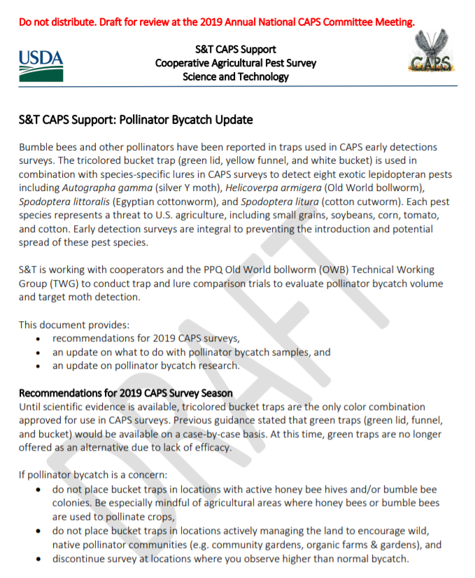
Pollinator Bycatch Update
S&T CAPS Support: Pollinator Bycatch Update
Draft for NCC review in booklet

Slide 63
Pollinator Bycatch Update
Recommendations for 2019
Until scientific evidence is available, the tricolor bucket trap is the only color combination approved.
Green traps are no longer offered on case-by-case basis.
If concerned about bycatch:
Avoid areas with active honey bee hives/bumble bee colonies.
Avoid areas actively managing for land to encourage native pollinator communities (e.g. community garden, organic production)
Be mindful of seasonal peaks in pollinator activity (e.g. crop flowering)
Discontinue survey if you observe higher than normal bycatch

Slide 64
Pollinator Bycatch Update
Pollinator Bycatch Samples
In 2019, no longer necessary to collect new samples or provide bycatch data to CAPS.
Research group will use a more targeted approach and may reach out to specific states for bycatch samples and data.
If you do observe higher than normal bycatch (in your experience) notify CAPS and provide
Date
Crop/survey
Trap/lure
Target species
Description of bycatch (#s; honey bee, bumble bee, other bee)

Slide 65
Pollinator Bycatch Update
Pollinator Bycatch Research
Three projects are funded through the FY2019 PPA (Plant Protection Act) Section 7721 Program (formerly Farm Bill).
Collaborative effort between PPQ, ARS, state cooperators, and university researchers to investigate the:
effect of lure and/or trap color on pollinator bycatch volume,
effect of trap color and design on early detection of target species, and
potential impact of bycatch to local bumble bee populations and communities, as well as pollination services within different cropping systems.
Trap comparison includes tricolor, all-green, and green and white bucket traps.
Notes:
0406
Year 1: Collect data to understand and mitigate risk that may be associated with bycatch.
Year 2: Collect a second year of data, and use both years to develop a model that predicts impact of bycatch on multiple cropping systems.
Main Objectives :
document regional differences in bumble bee bycatch in different crops: tri-color bucket trap + OWB lure set by CAPS/FB coops in PNW, W, SW, Great Lakes, SE, and Mid-Atlantic. Will focus on bycatch in veg survey but may request bycatch from other commodity groups.
determine if the bycatch community in traps differs from the resident community in the landscape: use community data collected in 0340
measure the impact of bycatch on bumble bee colony growth and development
0340
Survey bumble bee communities by net collecting bees in standardized survey. This community data will be compared to the trapped bumble bee data collected in 0406.
0632
Testing tricolor and all-green buckets and wing traps with hot melt/traditional liners. Will use lures for OWB, Autographa gamma, and Spodoptera. Trap in WA and UT
0494
Identify and enumerate bees collected on sticky traps. A database will be developed that incorporates lure type, trap type, locality and collection data.

Slide 66
Pollinator Bycatch Update
Pollinator Bycatch Research
Following a second year of research, the research group will develop a guidance document that will
Describe scope of bumble bee bycatch in traps deployed in CAPS surveys
Provide guidance to surveyors on reducing impacts of trapping practices on pollinators and pollination services.
Notes:
Consortium
Deliverable: Use data from the four projects to develop a guidance document that will help survey personnel understand the scope of bumble bee bycatch and provide guidance for surveyors, thereby improving these surveys and reducing impacts of trapping practices on pollinators and pollination services moving forward.

Slide 67
CAPS Datasheet Stakeholder Survey

Slide 68
Datasheet Stakeholder Survey
Purpose: Evaluate how pest-specific info is delivered to the field. Identify opportunities for improvement.
How are datasheets used by the field?
Is information presented intuitively?
Are there information gaps? Do you have to check other sources?
Is there too much information or a better resource for the same information?
Will distribute early April 2019.
Notes:
Use
Are there sections you regularly use? Sections you never use?
Do you repackage info into field guides for staff? Which sections do you use?
Info helpful in survey planning? Resource for State CAPS Committee
Intuitive
For example, Pest Description v. approved identification/diagnostics
Maps – other sources for this that are more current compared to static maps in datasheets
Hosts – how do you use the host section?
Tell the story of the pest

