Slide 1
NAPIS Data entry
– If, Then
Cindy Music
CAPS Information Services (CAPSIS)
Purdue University, December 4, 2019
Notes:
Good Afternoon,
I am an Associate NAPIS Analyst for CAPS Information Services, or CAPSIS for short. We are located at Purdue University in central Indiana.
Today we are reviewing data entry in the NAPIS database, what thedata entry process entails and how it is connected within the CAPS world.
I’m using an If, Then subtitle to reinforce the idea that there is a lot of interconnectivity going on and not just a record going in!

Slide 2
If a workplan,
then a Survey Summary Form (SSF)
If a SSF, then an Accountability Report
If an Accountability Report checked
then next year’s workplan.
If a SSF then,
a My Survey
If data entry,
then an Accountability
Report checked
If a My Survey,
then a survey
If a data record,
then a SSF validation
If validation,
then data entry
If a survey,
then a data record
Notes:
Currently a state will begin with the workplan. The workplan provides the survey targets to be used to create a Survey Summary Form or SSF.
When the SSF has been created and approved, then an Accountability Report is generated with the SSF information.
The My Survey is also generated at this time, again using SSF information.
The My Survey interface can now be used to create a template for surveying
With the template as a guide, surveying can be done and a data record can be assembled.
Once the data record has been assembled and validated to the SSF, it can be uploaded.
Once a validated data record is uploaded there will be a check on the accountability report!
And so on to the next year!

Slide 3
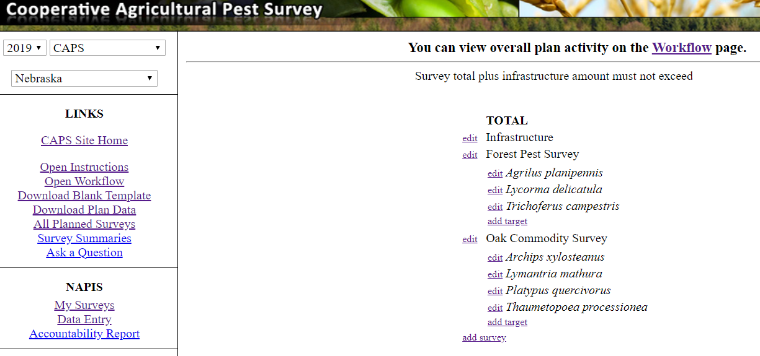
Survey summary form (SSF)
Notes:
Please note
- the funding year
- the funding source
- the survey name
- the targeted pest
What you do not see, but is there beneath the targeted pest is
- host
- survey plans – method, timing, numbers, visits, etc.
- contact/diagnostic information

Slide 4
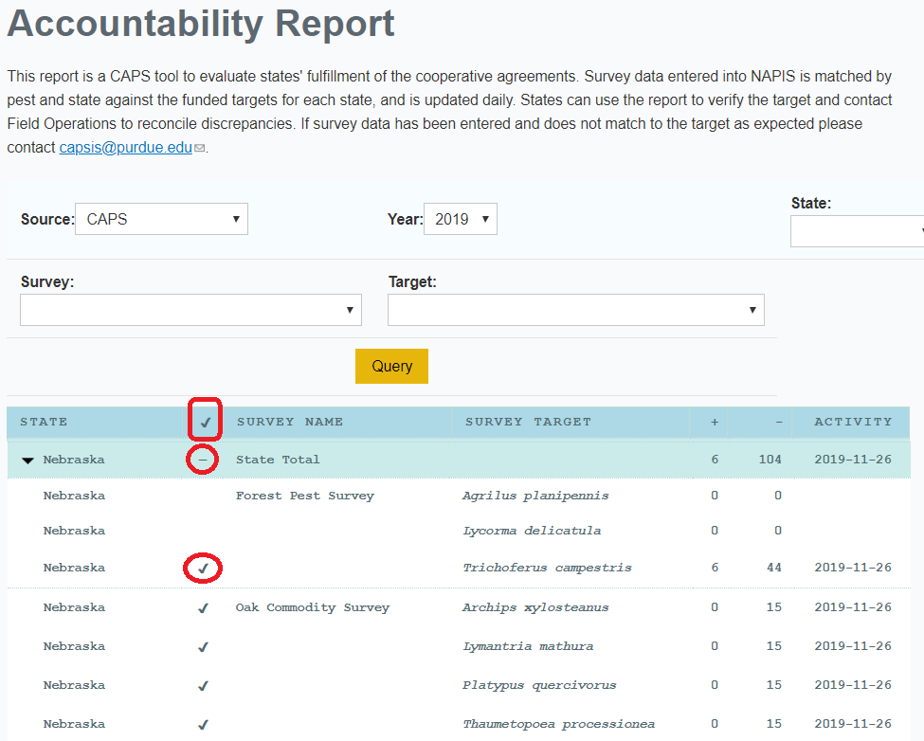
Accountability
Report
Notes:
Note that a check at the targeted pest level signifies that records have been entered for the targeted pest for this particular funding year, source and survey.
At the state level
- a dash signifies that the state has begun entering targeted pest records for the particular funding year and funding source.
- a check signifies that the state has entered at least one record for the targeted pest for the particular survey, funding year and funding source.

Slide 5
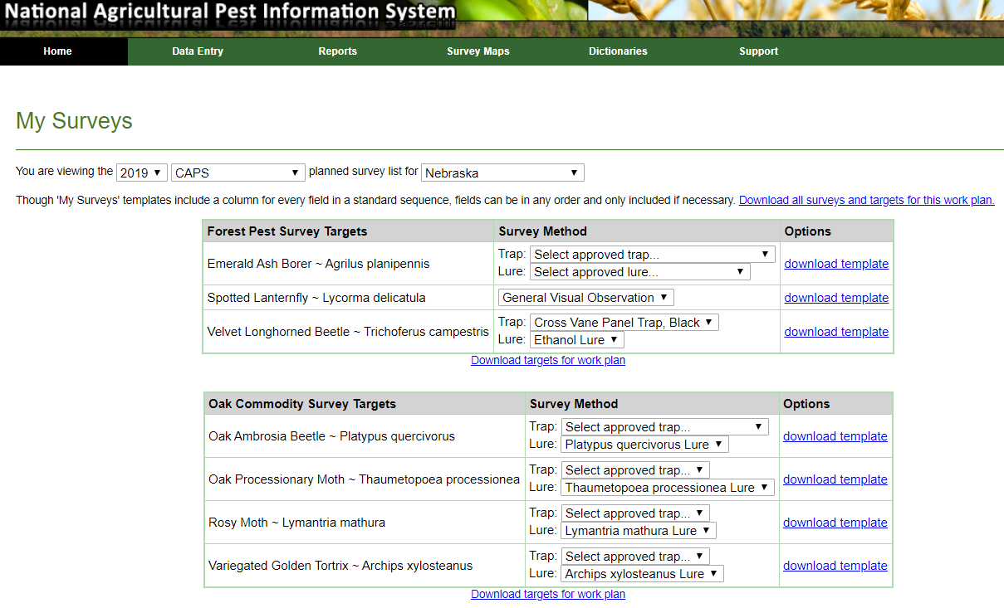
My survey
Notes:
Please note the funding year, funding source, state – for those with multiple states – survey names and targeted pests
- all pulled from the SSF
Specific survey methods are pulled from the Approved Method sheets created by the Science and Technology CAPS support group, when the targeted pest is a priority pest.

Slide 6
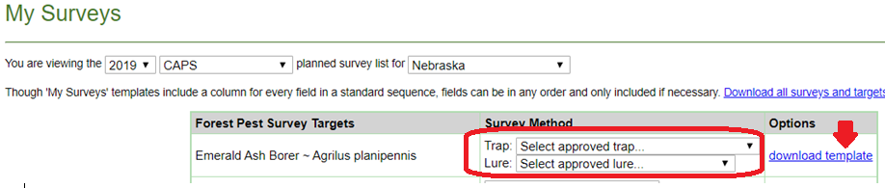
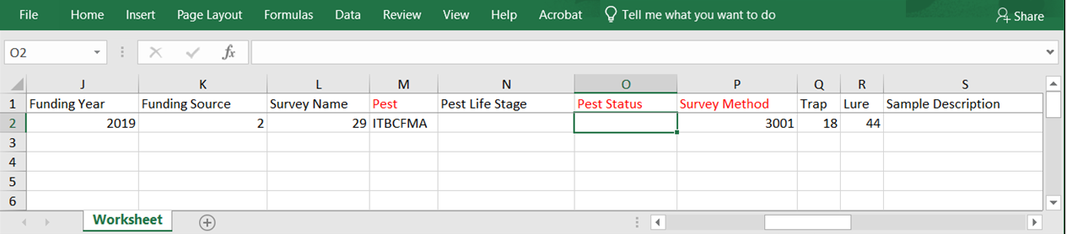
My Survey
- template
Notes:
A template to be used for surveying can be generated from the my survey tables.
The template will provide
- the fields needed to create a data record
- and auto-populates the fields from the my survey information.

Slide 7
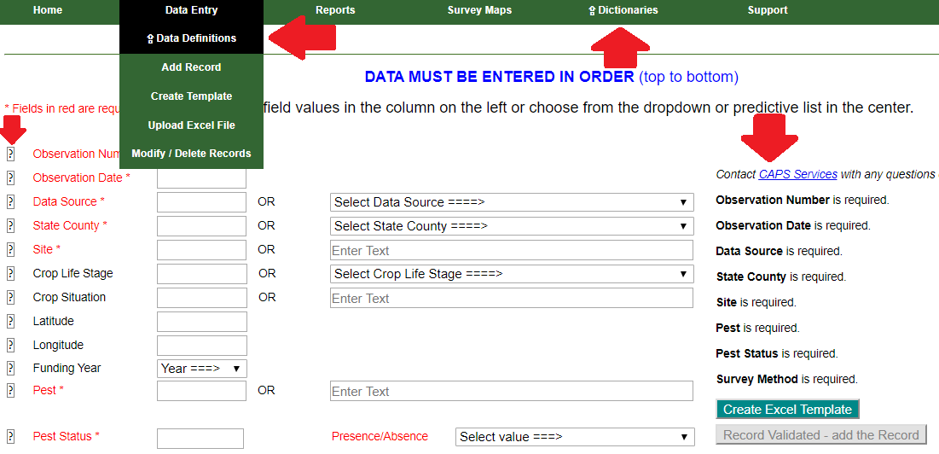
Data Entry – helpful hints
Notes:
Before starting the data record review, here are some helpful tips
- The data definition page will define all the fields of a data record
- the question mark inside a box will provide the definition specific to that particular field.
- an up arrow signifies that the proffered page will open in a new tab.
- a record must be entered in order from top to bottom of the interface
- columns
- definition
- name of field
- box for free typing, or code for field
- box with a drop down or enter text to provide a dropdown, will also fill in code box to the left
- requirements or trouble shooting column with create an excel template button.

Slide 8
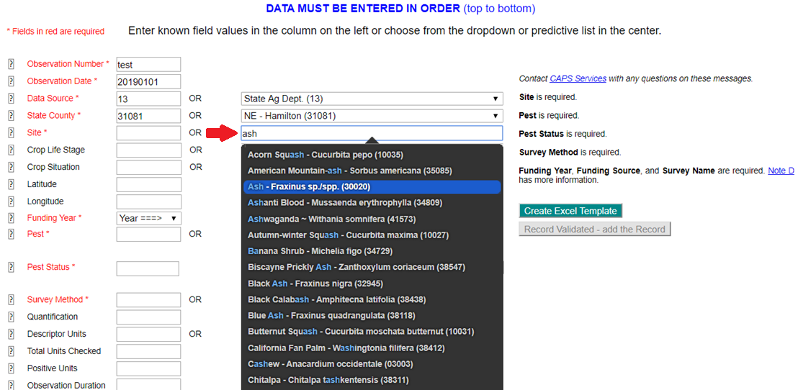
Data entry
Notes:
Note
- red fields are required
- when there is a enter text box – type, when finished, pause and do not move the cursor/mouse as it may take a second to pull the information up.
- notice the changes in the far right column….

Slide 9
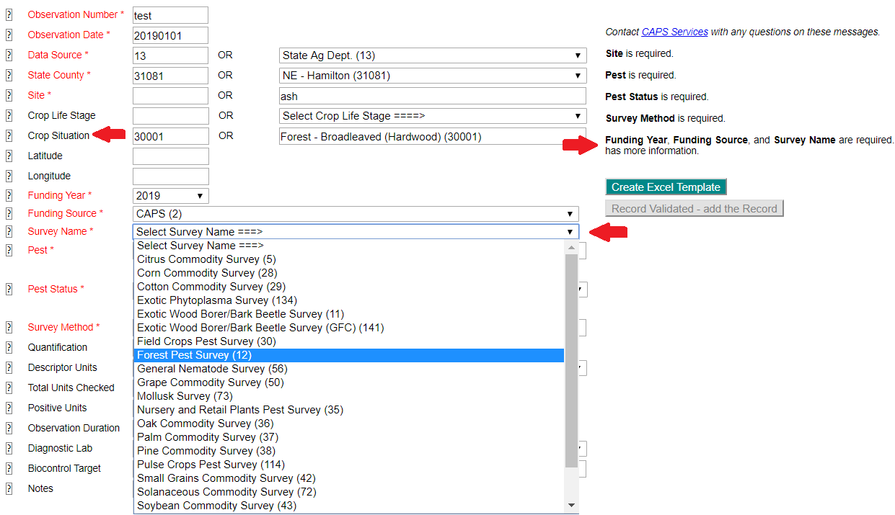
Data entry, cont.
Notes:
Please note that if a site is unknown (99999), then the crop situation must be entered.
I, personally would recommend that, if possible, this is always done in an effort of error prevention.
There are four areas on this interface that will open additional dropdowns when information is entered.
The first is the funding year. This will open the funding source, which opens the survey name.
Again, take a look at the far right column….

Slide 10
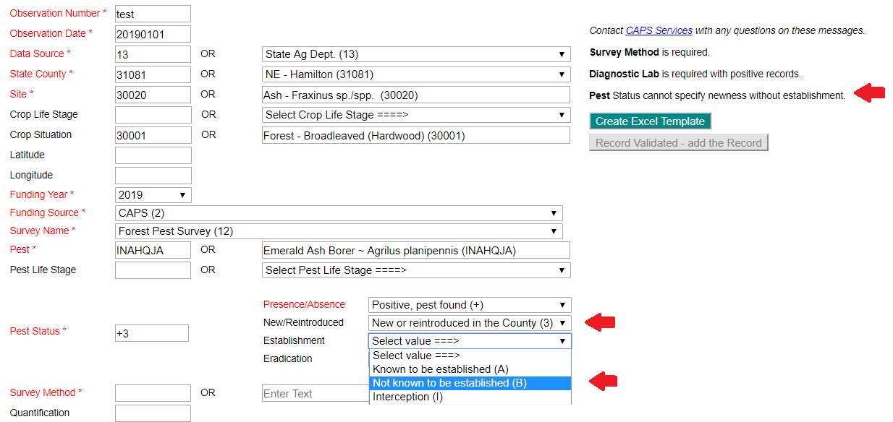
Data entry, cont.
Notes:
Here we are going to show a positive trap survey record as that requires additional information.
If a record has not previously been entered into the NAPIS database at the US, State, or county level, it will be flagged when a data notification email is generated to the CAPSIS staff. Which means, the person who entered the record that has been flagged will get an email from me….
If a record is a new in at any level, establishment must be chosen.

Slide 11
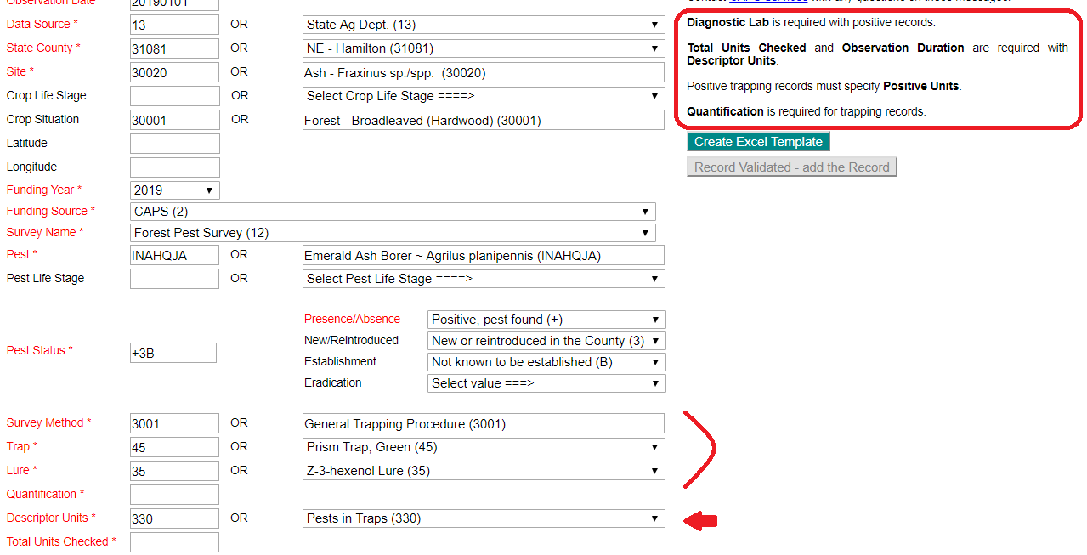
Data entry, cont.
Notes:
Notice that with a specific survey method entered, more fields have opened.
A trap record requires that the descriptor unit be pests in traps, so that auto-populates when the trapping survey method is chosen.

Slide 12
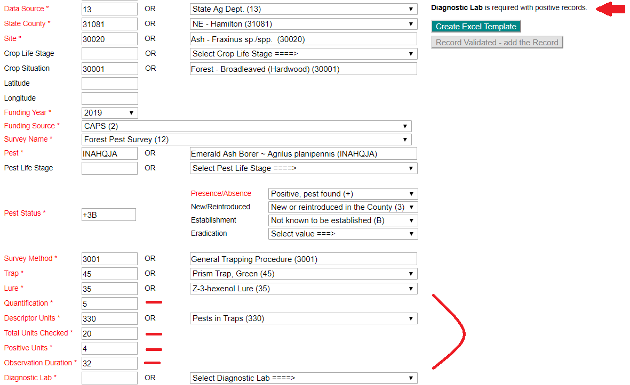
Data entry, cont.
Notes:
Quantitative value is the actual number of pests found…how many beetles?
Total units are the number of traps being used in this record that were checked…how many traps did you look at for this record?
Positive units is the number of traps that you looked at that had the targeted pests in them…how many traps actually had the pests?
Observation duration is the number of days from the start of the survey until you found the pest in the trap…if the trap was placed on March first and a pest was found on April first, then the observation duration would be 32
If the record is negative, then the observation duration is the number of days the trap was actually up.
Note the right column

Slide 13
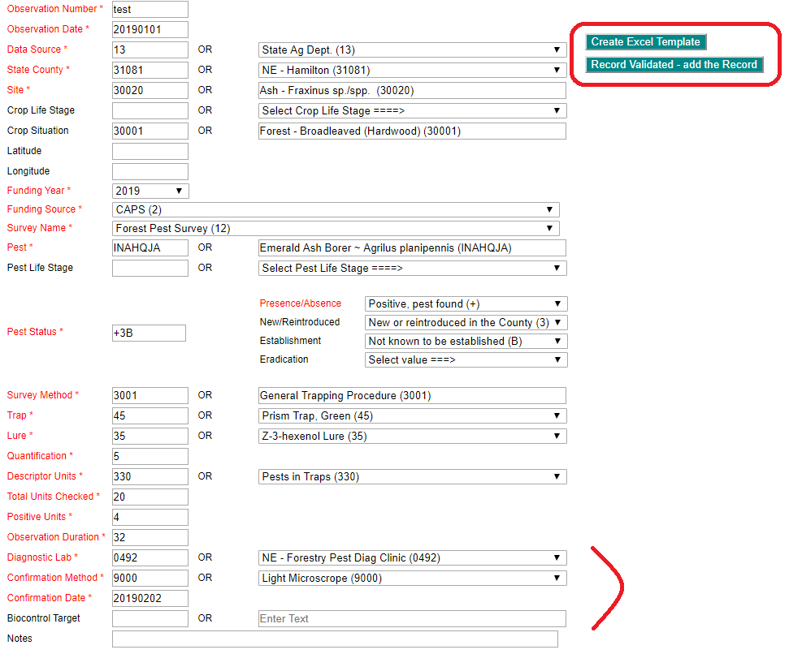
Data entry, cont.
Notes:
Once the diagnostic lab is entered, the confirmation method and confirmation date boxes open up.
Make sure the confirmation date is after the observation date.
Once these are filled in, the right column no longer has any comments.
At this time a template can be created for testing.
If you are a data entry personnel and only entering one record, it could be added at this time.
If you are not data entry personnel, the add record button will remain gray.

Slide 14
Create Excel Template
Notes:
The fields from the interface are filled in and ready for testing.
At this point and further, the excel file can have records added, but as usual, be cautious with any copying and pasting endeavor.
The NAPIS database will upload an excel template containing multiple records.
The NAPIS database will also upload an excel template containing multiple pests.

Slide 15
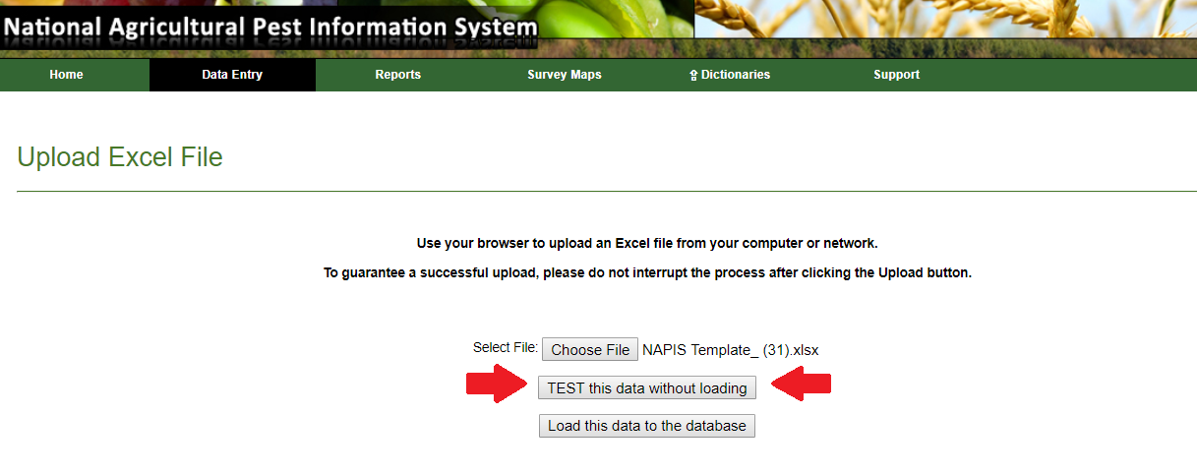
Upload an excel file
Notes:
Choose the file to be tested
Test the data – if a user has read only access to the NAPIS website he or she can test the records for data upload, but will not be able to upload the records.
This is how a user can prepare a file for the data entry personnel.

Slide 16
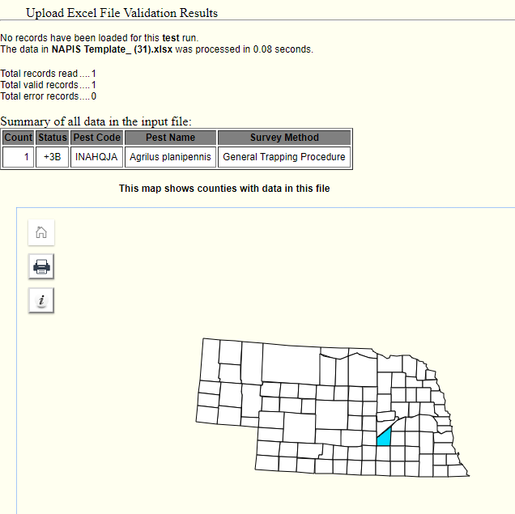
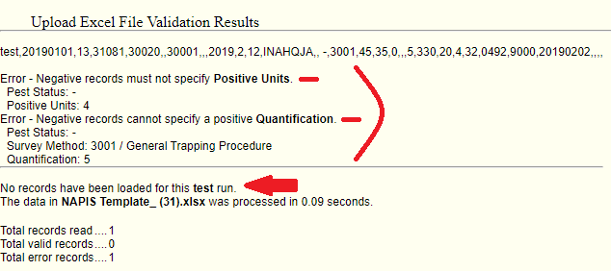
Valid/invalid data entry
Notes:
When testing the file, it will either be valid or invalid
If valid, the table with the noted information will show, along with a state map displaying the pertinent counties.
If invalid, there will be descriptive error messages. These messages are provided in an effort to assist the modifications needed to upload the data.
I made the positive pest status negative without changing anything else to provide this particular invalid message.

Slide 17
Review and questions
Notes:
Any questions or clarifications needed?
The CAPSIS team’s contact information is on the CAPS website under contact us, on the NAPIS site under support and on the Pest Tracker site under contact us.

