Slide 1

S&T CAPS Support
stcaps@usda.gov
Annual NCC Meeting January 29-30, 2020 Chicago, IL

Slide 2
The Objective Prioritization of Exotic Pests (OPEP):
A system for prioritizing pests
Plant Epidemiology & Risk Analysis Laboratory
Science & Technology
Plant Protection & Quarantine
Animal & Plant Health Inspection Service

Slide 3
Impact Potential Model
A series of multiple choice or yes/no questions to evaluate the potential impacts that could occur if introduced.
Pests are scored based on how predictive each question is; the most predictive questions have the greatest weight.
Model also considers production practices and availability of tools in the United States that would likely be effective at mitigating the pest

Slide 4
Impact Assessment Model Results
Specific biological characteristics are not as important in predicting impact
Best predictor of pest behavior in the United States is behavior elsewhere in the world and the level of control and research, when the pest has been introduced into novel areas
Model can predict potential impacts of pests that have:
  Been introduced into areas outside of their native range
  OR, cause significant impacts within their native range
Model is not appropriate for pests that have already been introduced into the United States
Notes:
With regard to the Impact Assessment portion
Number of hosts (host range) was not found to be related to impact
Ability to survive harsh conditions was not found to be related to impact for pathogens

Slide 5
Evaluation of exotic pests for CAPS Pest Prioritization
Each pest on the proposed list was assessed using one of the models and was given a “risk score”
Based on that score we determined:
  Probability of being a high impact pest
  Probability of being a moderate impact pest
  Probability of being a low impact pest

Slide 6

Impact Potential Model
Arthropod Model
Pathogen Model
Mollusk Model
(still in development)
Observed Impacts
  Used for comparison
  Focuses on agricultural impacts
What about environmental and forest pests?

Slide 7
Impact Potential Model Status
Impact Assessments for nearly all existing pests on the CAPS list have been completed.
Completed a revision of the Summary documents.
Likelihood of Introduction and Impact Assessment model for mollusks are nearly complete

Slide 8
Phase II: Likelihood of Introduction
Introduction (of a pest): The entry of a pest resulting in its establishment
Further refine prioritized list by the likelihood of introduction
Pests with predicted High or Moderate impacts are considered further
High impact pest with reduced likelihood of introduction should be considered to be prioritized lower than pests with a high likelihood of introduction

Slide 9
Phase II: Likelihood of Introduction
Evaluated several iterations and approaches for analyzing LOI
The best predictor for determining LOI is reviewing information on pest movement elsewhere in the world.
With regard to pest prioritization, we conclude that the risk posed by a pest to U.S. agriculture or natural resources is:
            Elevated
            Not Affected
            Reduced

Slide 10
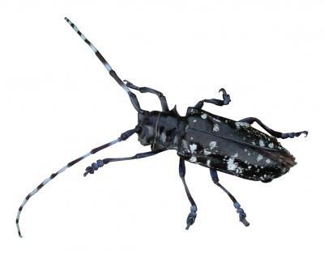
We can most effectively allocate resources by focusing on those organisms that have a high probability of causing serious impacts, and are likely to establish.
Notes:
Why I advocate that some level of general surveillance – especially for early detection of damage – is so important.

Slide 11
OPEP Framework
Survey Feasibility
Assessment
Pest Risk
Impact Potential
Likelihood of Introduction
Policy Considerations
Phase I
Phase II
Cost Effectiveness
Add to survey program
Phase III
Other Policy Considerations*

Slide 12
OPEP Impact Assessments Results Excel File
http://caps.ceris.purdue.edu/pest-surveillance-guidelines/2020
http://caps.ceris.purdue.edu/pest-surveillance-guidelines/objective-prioritization-exotic-pests/2020

Slide 13
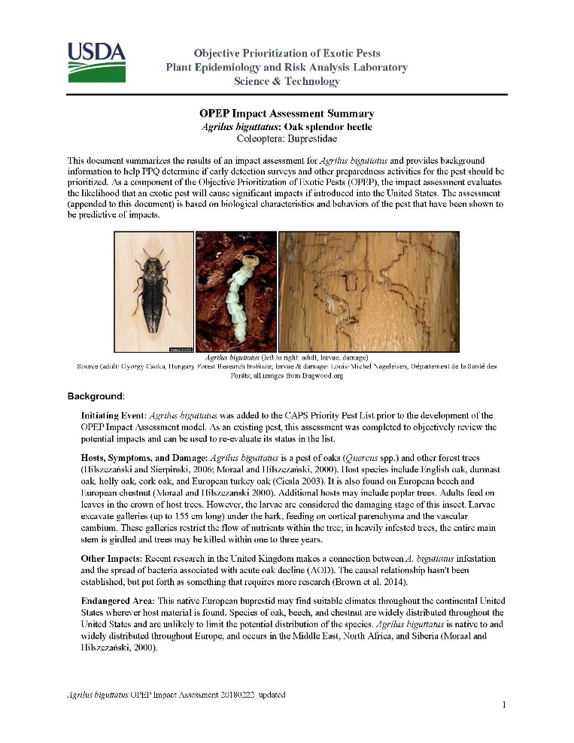
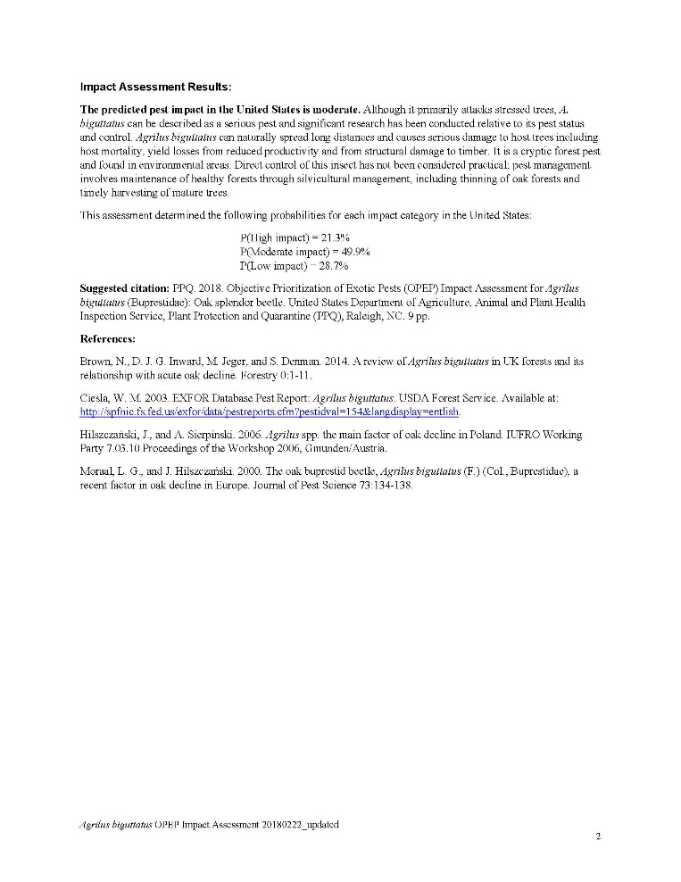

Slide 14
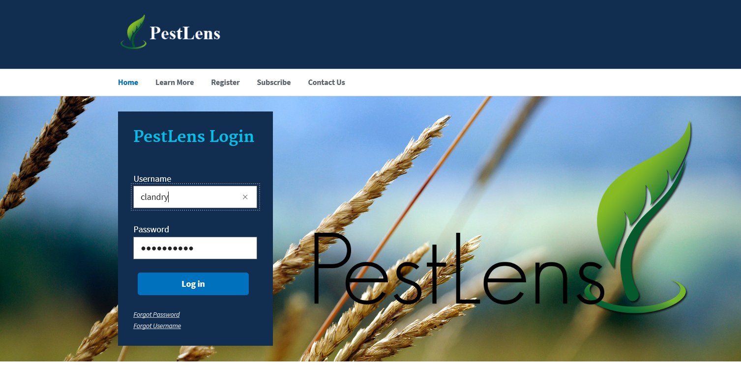
https://pestlens.info/
User guide available upon request

Slide 15
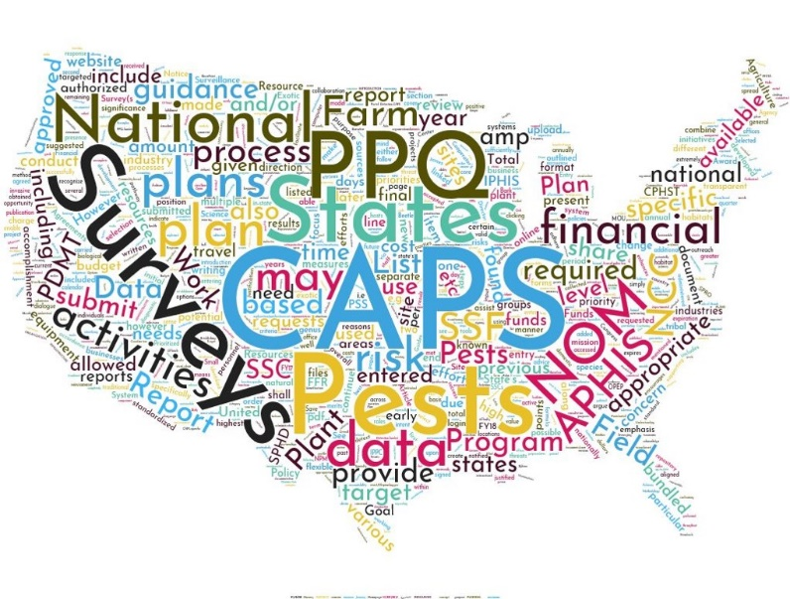
CAPS Priority Pest List

Slide 16
Currently…
CAPS Priority Pest List is grouped:
Economic and Environmental Importance (EEI) – Cat 1 pests
Commodity and Taxonomic Manuals
Additional Pests of Concern (APC) – Cat 3 pests w/ significant reason
Cat 1: Pests have a significant likelihood to have a high impact in the U.S.
Cat 2: Pests are most likely to have a medium impact in the U.S. Pests have a 10-20% probability of being a high impact pest.
Cat 3: Pests most likely to have low impact. Pests have less than 10% probability of being a high impact pest.

Slide 17
In 2021…
No longer need EEI list
  OPEP Impact Assessments completed for all existing CAPS pests
APC list = bundling
Keeping commodity and taxonomic manuals
Removing Category 2 pests, w/ some exceptions (e.g., forest pests)

Slide 18
Summary of Priority Pest List Changes
Removed based on predicted impact
Target | Justification | Allow bundling?
Anguina tritici, wheat seed gall nematode | OPEP: predicted moderate impact | Yes
Aspidiotus rigidus, false coconut scale | OPEP: predicted moderate impact | Yes
Callidiellum villosulum, brown fir longhorned beetle | OPEP: undetermined. Not established outside of native range. | Yes
Chilo partellus, spotted stem borer | OPEP: predicted moderate impact | Yes
Ditylenchus angustus, rice stem nematode | OPEP: predicted moderate impact | Yes
Erwinia pyrifoliae, Asian pear blight | OPEP: predicted moderate impact | Yes, pending diagnostic method
Heterodera cajani, pigeonpea cyst nematode | OPEP: predicted moderate impact | Yes
Leucoptera malifoliella, pear leaf blister moth | OPEP: predicted low impact | Yes
Mamestra brassicae, cabbage moth | OPEP: predicted moderate impact | Yes

Slide 19
Summary of Priority Pest List Changes
Removed based on predicted impact
Target | Justification | Allow bundling?
Meloidogyne fallax, false Columbia root-knot nematode | OPEP: predicted moderate impact | Yes
Monilinia fructigena, brown rot | OPEP: predicted moderate impact | Yes, depending on status of diagnostics
Monochamus alternatus, Japanese pine sawyer | OPEP: predicted moderate impact | Yes
Neofusicoccum mangiferae, mango fruit rot | OPEP: predicted low impact | Yes
Nepovirus Tomato Black Ring Virus, TBRV | OPEP: predicted moderate impact | Yes
Phytophthora austrocedrae, cypress mortality | OPEP: predicted moderate impact | Yes
Pieris brassicae, large white butterfly | OPEP: predicted moderate impact | Yes, no lure bc butterfly
Pityogenes chalcographus, sixtoothed spruce bark beetle | OPEP: predicted low impact | Yes
Spodoptera littoralis, Egyptian cottonworm | OPEP: predicted moderate impact | Yes
Tomicus destruens, Mediterranean pine shoot beetle | OPEP: predicted low impact | Yes

Slide 20
Summary of Priority Pest List Changes
Removed based on U.S. dist, research, outside of CAPS scope
Target | Justification | Allow bundling?
Agrilus planipennis, emerald ash borer | US dist: 35 states. Dereg - responding to comments | Yes
Haplaxius crudus, American palm cixiid | US dist: FL, PR, TX. Not a quarantine pest. | Yes
Anoplophora chinensis, citrus longhorned beetle | Lacks effective survey method - visual. Is on research needs/Goal 3 list. | No, ineffective survey method (visual)
Bactrocera zonata, peach fruit fly | Included in Fruit Fly Program | Yes

Slide 21
Summary of Priority Pest List Changes
Remove? Discuss
Target | Justification | Allow bundling?
Gymnandrosoma aurantianum, citrus fruit borer | added in 2015, one survey in 2017 | Yes
Hemileia vastatrix, coffee leaf rust | added in 2015, last surveys in 2016 | Yes

Slide 22
Summary of Priority Pest List Changes
Adding
Magnaporthe oryzae Triticum pathotype (MoT) (wheat blast)
Survey: tissue sample – collect seed sample coupled with visual survey of the seed heads, leaves, and stems
  resistant variety: collect random sample, sample collection guidance in progress
  Susceptible vs. resistant varieties – is this knowable?
Diagnostic: molecular
  Screening: conventional PCR to species
  Confirmation: cPCR + real-time PCR to pathotype

Slide 23
Pest submissions stcaps@usda.gov
Tropical pests
Hemp pests
Other pest concerns?
Improve pest submission process?
Notes:
Have a side group meeting for tropical pests
Can we improve/increase pest submission?
When are you thinking about pest concerns? State CAPS meetings? Send call for submissions at this time

Slide 24
Survey Manuals

Slide 25
Apple/Pear Pests
Pest Categorization
22 candidates identified as appropriate for OPEP
OPEP Impact Assessment
3 candidates identified as Category 1
Survey/ID Feasibility Assessment
In progress
Notes:
Phlyctinus callosus garden weevil
Cacopsylla pyri European pear sucker
Carposina sasakii peach fruit moth

Slide 26
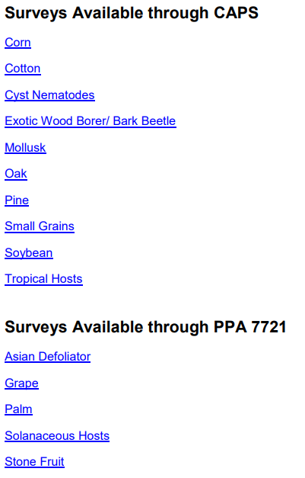
Survey Manuals
Priority Pest List is grouped into 15 commodity and taxonomic manuals
Manual intros include protocols and information to guide survey

Slide 27
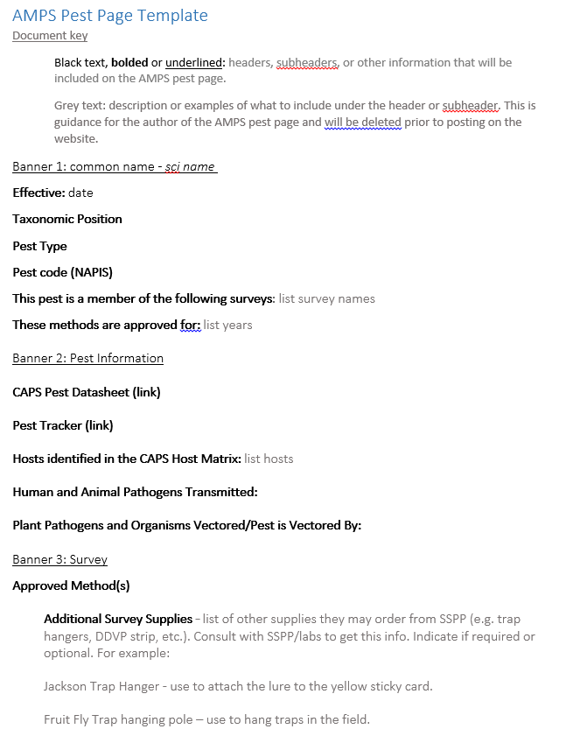
Instead of manual intros….
Standalone documents, like:
  Data entry guidance
  General survey protocol (soil sampling, Cerceris, etc.)
  Trap protocols/videos
  Lure handling
Improved AMPS pest pages:
  Expanded to include pest specific guidance
  Link standalone documents
Notes:
In 2018 we talked about breaking manual intros down into stand alone component parts, but retaining the manuals. Today we are proposing a new structure. The plan is to have general protocols/guides (for example: soil sampling, sweep netting, visual survey) and then complement those with specific guidance for each pest. For example, if the approved method for a pest is visual survey, we’d link to the visual survey guide for the best practices and then provide additional guidance for completing a visual survey for that pest.

Slide 28
Instead of grouping by commodity or taxonomic manuals…
Create a tool that makes it easy to
  Group priority pests by host/habitat (pathway)
  Find information needed to prioritize and select targets
  Modify state target list each year and incorporate it into the SSF and online work plan
Notes:
Basically taking what you are already doing but putting everything in one place

Slide 29
Survey Builder
Survey Builder
Purpose | Survey Builder > Survey Summary Form > Online Work Plan
 | Helps the user select appropriate survey targets for their state from the priority pest list. | Build survey plan w/ budget Submit for SPHD/FO review & approval

Slide 30
Survey Builder the idea
Priority Pest List
Survey Name: Stone Fruit Commodity Survey
Host/Habitat: Peach
AMPS, other criteria
Output: customized peach pest list transferable to SSF
Notes:
The first year – optional tool using information that we already have in place

Slide 31
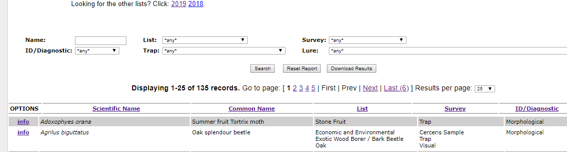
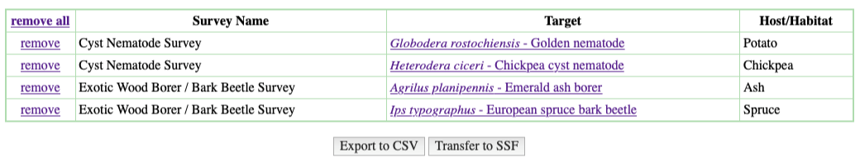
Prototype 1: Survey Builder + Approved Methods table
Survey Name:
Host(s):
Climate suitability:
Survey Method:
ID/Diagnostic Method:
Trap:
Lure:
Pest Name:
Add to Cart
Select
Survey Name
Survey Method
ID/Diagnostics
Agrilus biguttatus
Cart
Notes:
SSF button enabled with login credentials – keep cart to help coops prepare for state CAPS meetings

Slide 32
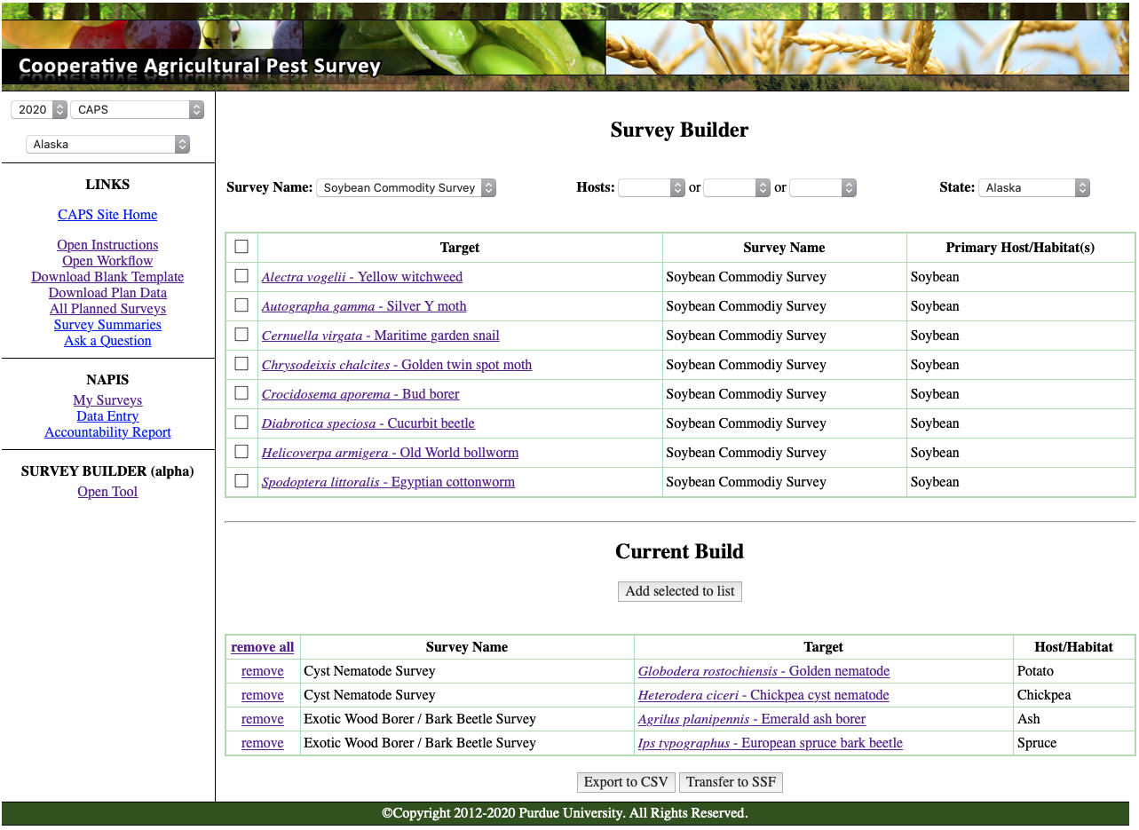
Prototype 2: Survey Builder within Survey Planning
Notes:
Not accessible to non-traditional Goal 1 s coops

Slide 33
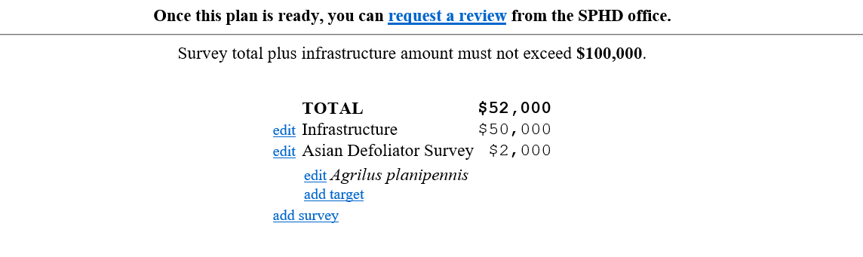
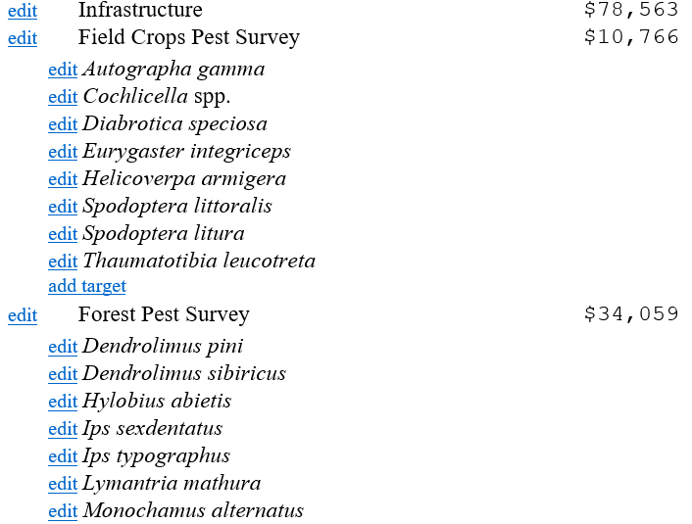
Survey Summary Form
$0
Notes:
Still have full edit control of this work space

Slide 34
Approved Methods for Pest Surveillance
2020 & 2021

Slide 35
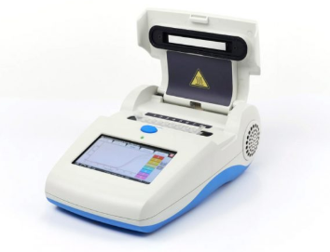
Hymenoscyphus fraxineus (ash dieback)
*2021*
Key Diagnostics: Molecular
  Screening: Loop-mediated isothermal amplification (LAMP)
  Confirmation: real-time PCR and conventional PCR

Slide 36
Peronosclerospora philippinensis (Philippine downy mildew)
*2021*
Key Diagnostics: Molecular
  Screening: LAMP
  Confirmation: multiplex conventional PCR

Slide 37
Crocidosema aporema (bud borer)
Current AMPS:
  Black light trap or Visual
Improved survey method available
  Trap: large plastic delta (any color)
  Lure: (7Z,9Z)-dodeca-7,9-dien-1-ol and (7Z,9Z)- dodeca-7,9-dienyl acetate
Introduce for 2021?
compounds require custom synthesis ($$$)
limited storage time (possibly <2yrs)
Only one state surveying 2017-2020 – visual
Would more states survey with lure?
Notes:
Removing black light trap

Slide 38
Plant pathogen support
CAPS Pathologist
Validation requirements for methods
Reviewing commercial kits for screening
Level | Purpose
1 | Urgent usage
2 – single lab validation | Specialist use
3 – independent lab validation | Confirmation
4 – collaborative study | Screening

Slide 39
PPQ pathogen screening support
PPQ has limited capacity to screen pathogen samples.
PPQ Pathogen Diagnostic Resources
FO – Domestic Identifier – Pathogens = domestic pest-specific program support
NIS – PPQ National Mycology Specialists = primarily confirmation, can support some screening
S&T Beltsville Lab = confirmation
Do not send unprocessed or bulk samples to PPQ for pathogen screening.

Slide 40
PPQ pathogen screening support for 2020
NIS – PPQ National Mycology Specialists can screen samples for:
  Cronartium flaccidum, Scots pine blister rust
  Hemileia vastatrix, coffee leaf rust
  Pseudopezicula tracheiphila, rotbrenner
  Synchytrium endobioticum, potato wart
  Ceratocystis manginecans, mango sudden decline**
  Raffaelea quercivora, Japanese oak wilt**
To request support, contact the PPQ National Mycology Specialists (PPQNISNTMycology@usda.gov)
**Contact NIS for guidance on how to sample and isolate these fungi
Notes:
**If you have non-PPQ taxonomic assistance in place for Ceratocystis manginecans and Raffaelea quercivora surveys, it is still important to contact the PPQ National Mycology Specialists prior to the start of the survey season. Both require isolation prior to screening, and NIS can provide guidance on how to sample and isolate these fungi in addition to discussing the laboratory requirements for successful isolation.

Slide 41
PPQ pathogen screening support for 2020
FO – Domestic Identifier – Pathogens can screen samples for:
  Globodera pallida, Pale cyst nematode
  Globodera rostochiensis, Golden nematode
  Potyvirus Plum Pox Virus, Plum pox virus (PPV)
To request support, contact Craig Webb, PPQ Domestic Identifier for plant pathogens (craig.a.webb@usda.gov).

Slide 42
PPQ pathogen screening support for 2020
S&T Beltsville Lab:
  Only send samples for confirmatory diagnostics.
  Do not send samples for screening. Select agents are the only exception.
Prior to sending samples, contact the S&T Beltsville lab and copy Steve Bullington, PPQ Domestic Diagnostics Coordinator. They will provide you with the necessary forms and sample submission instructions.

Slide 43
Research &
Methods Development

Slide 44
Lymantria trap comparison
A: No.
The paper delta is the better trap for all Lymantria targets, except L. mathura.
Q: Can we use milk carton traps instead of:
  Paper delta for
    L. dispar japonica (Japanese gypsy moth)
    L. monacha (nun moth)
  Paper wing trap for
  L. mathura (rosy moth)
Study in Japan compared large paper delta, paper wing, and milk carton traps and found:

Slide 45
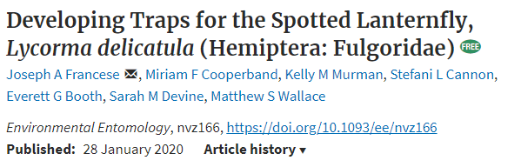
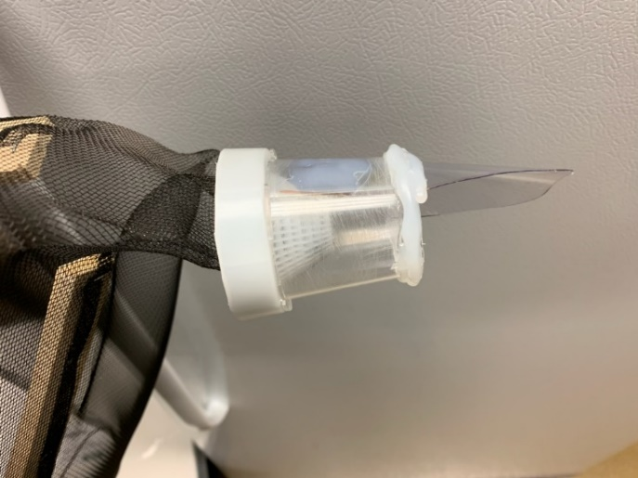
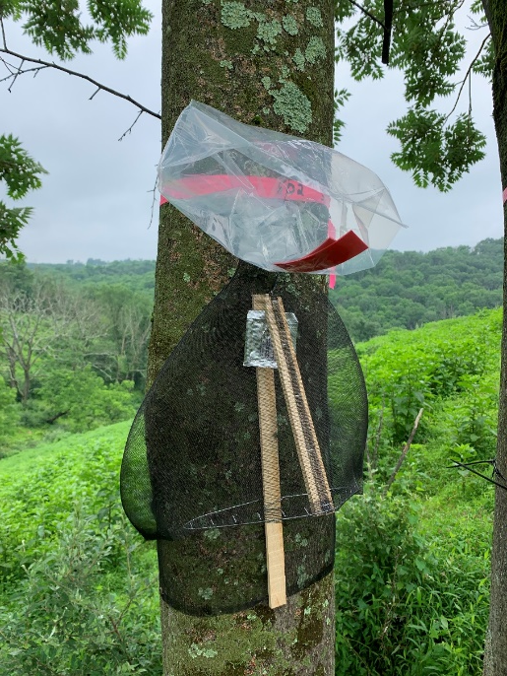
SLF trap & lure
Circle trunk trap w/ bag
Placed at edge of wood lots
Lure still in testing
Visual survey remains the approved survey method.

