Slide 1
CAPS – Online Workplan
CAPS Information Services – Providing continuous maintenance, process improvements, and a high level of customer support
NCC Meeting
January 2020
Cindy Music
Notes:
a. Online workplan is at the beta stage and we are currently doing in-house testing

Slide 2
CAPS – Online Workplan
Proposed location on CAPS Resource and Collaboration Site, Survey Planning page.
Notes:
Note that the access to the online work plan will be on the survey planning page. Left menu
Also note that the funding year, funding source and state designation will determine the work plan that is linked.

Slide 3
Online Workplan - Survey
Notes:
Toggle contact information – will collapse this box
Note validate button
This will check for obvious errors – requirements not filled in.
Note export to Word button
Note export to PDF button

Slide 4
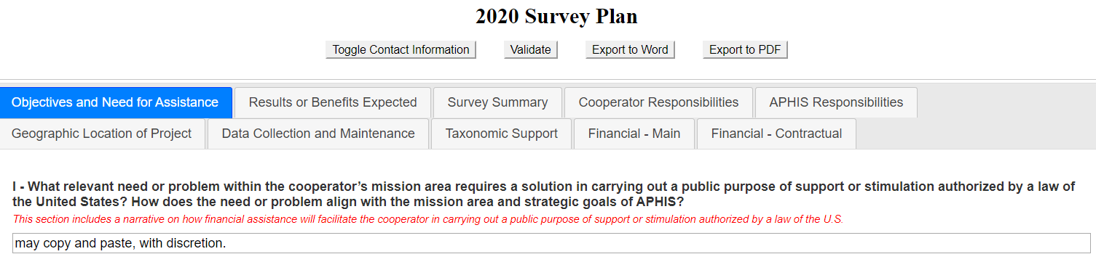
Online Workplan - Survey
Notes:
A. Text may be copied and pasted, using discretion.

Slide 5
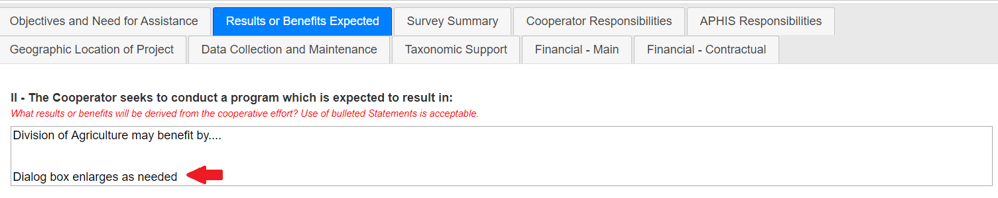
Online Workplan - Survey
Notes:
A. Dialog boxes will enlarge as needed. No limit.

Slide 6
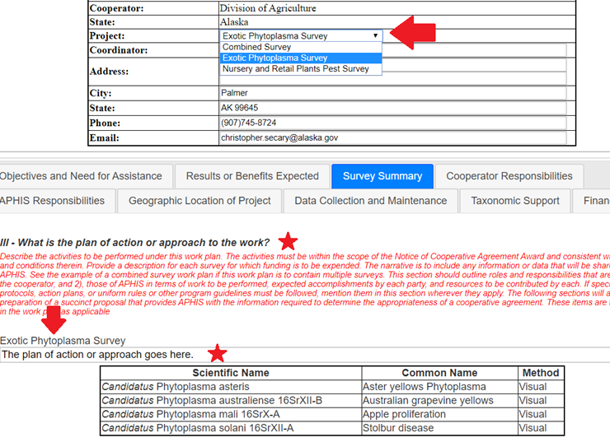
Online Workplan - Survey
Notes:
Cooperator information
State/cooperator – auto fill per choice on survey planning page
Project – portion of the Survey Summary Form
SSF too long
Address, phone, email – dialog boxes
Match up project to title below.
Note dialog box

Slide 7
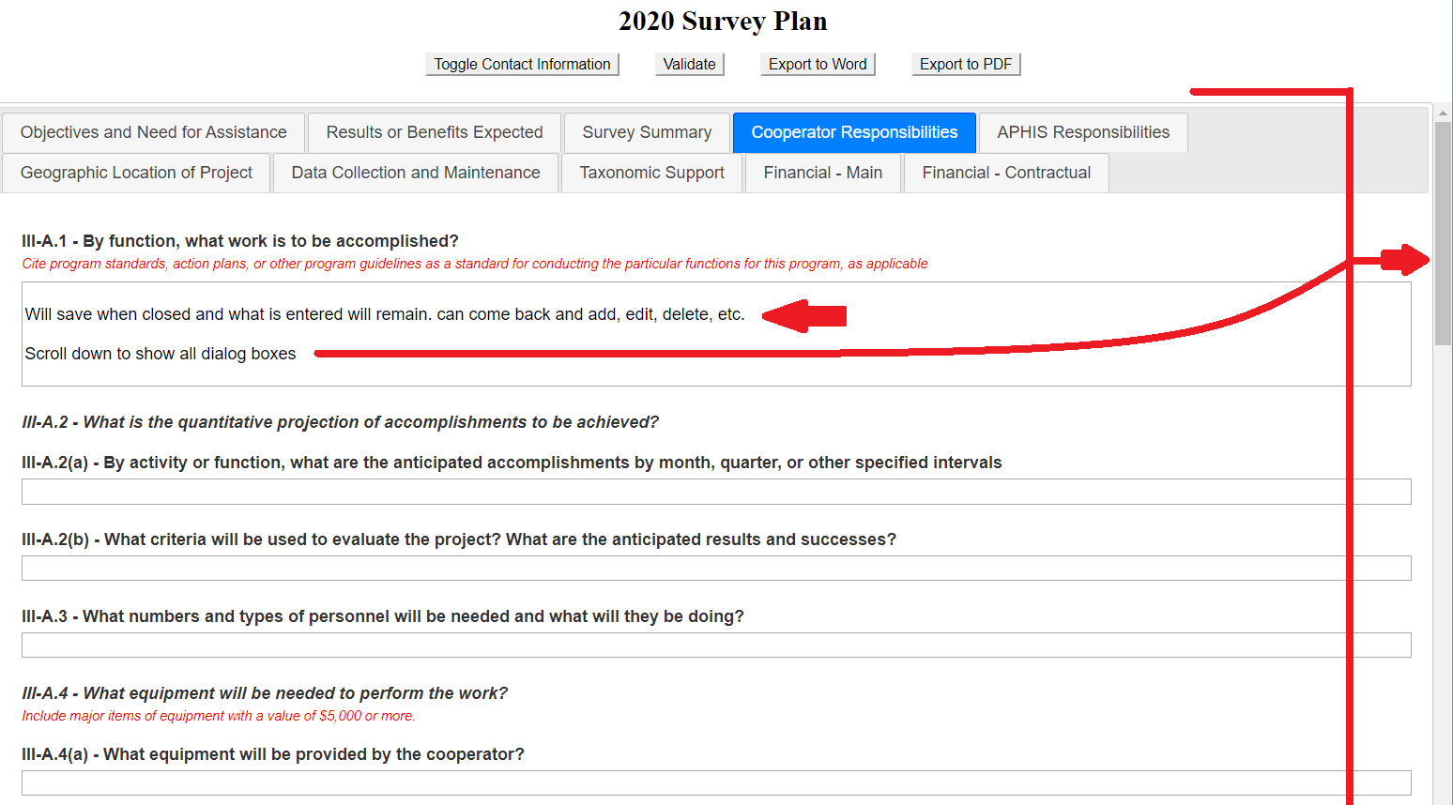
Online Workplan - Survey
Notes:
Saving functions
Auto save with exit
Can return, and edit, delete, add, etc.
Scroll bar moves body of workplan, but not top area with buttons/contact information

Slide 8
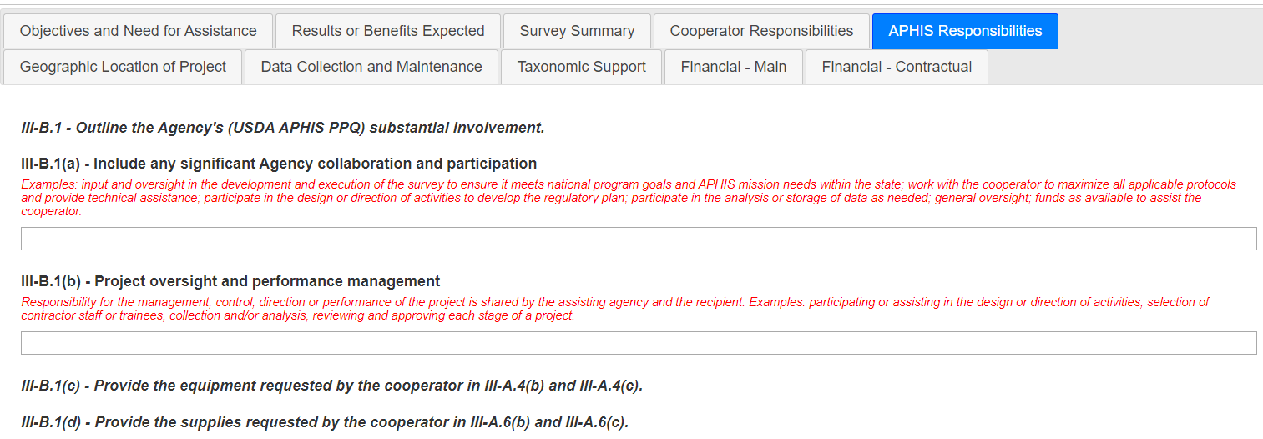
Online Workplan - Survey

Slide 9
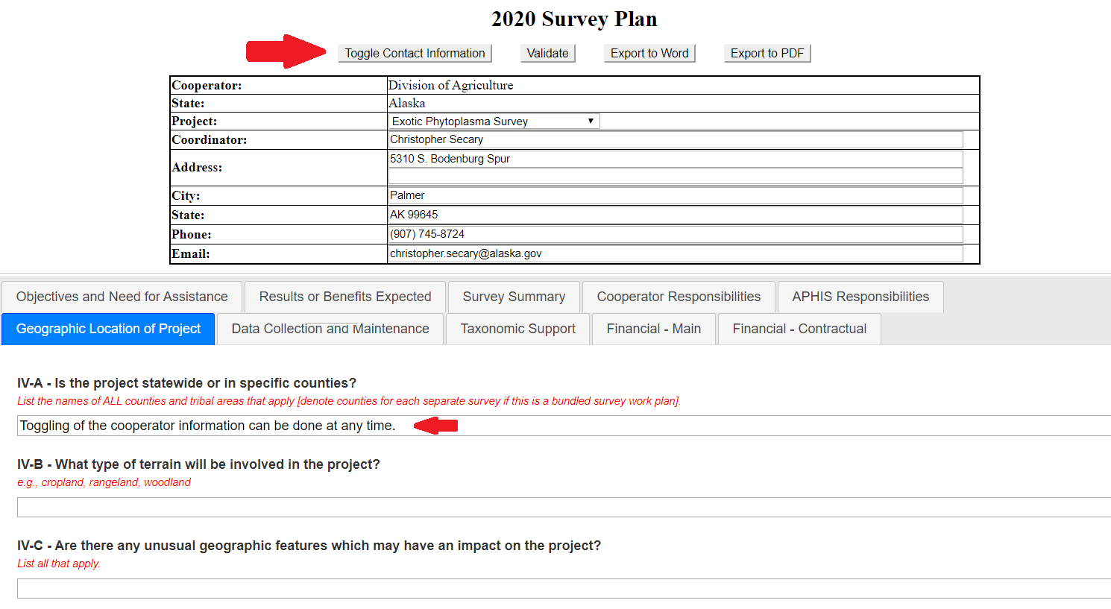
Online Workplan - Survey
Notes:
Can toggle contact information at any point of interface.

Slide 10
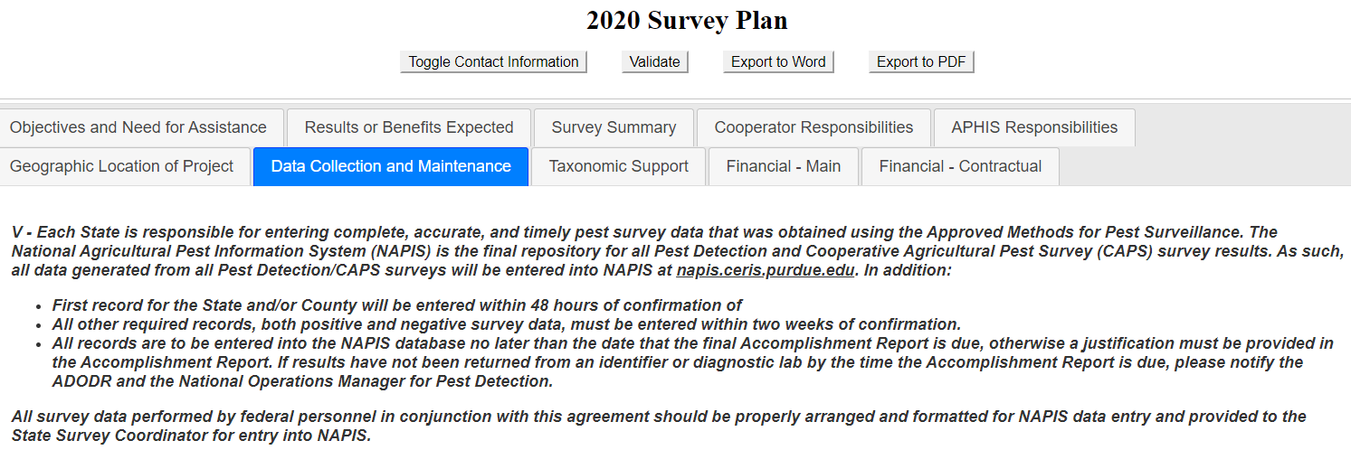
Online Workplan - Survey

Slide 11
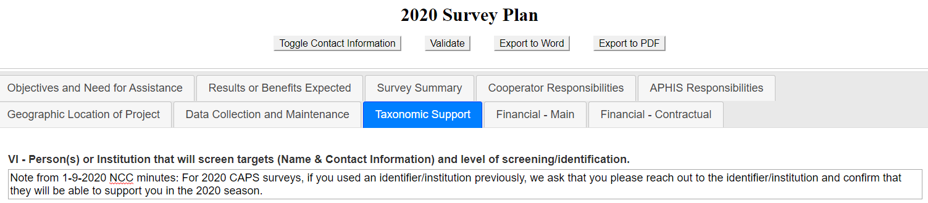
Online Workplan - Survey

Slide 12
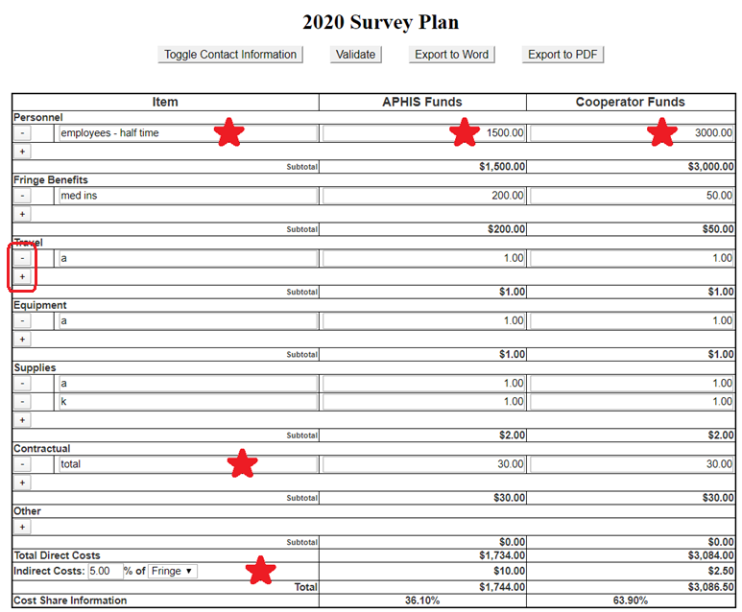
Online Workplan – Survey, Financial - Main
Notes:
Must click on “+” to add item and funds in the dialog boxes.
“-” will delete
Totals at bottom
Indirect costs % can be changed
% choice of direct or fringe

Slide 13
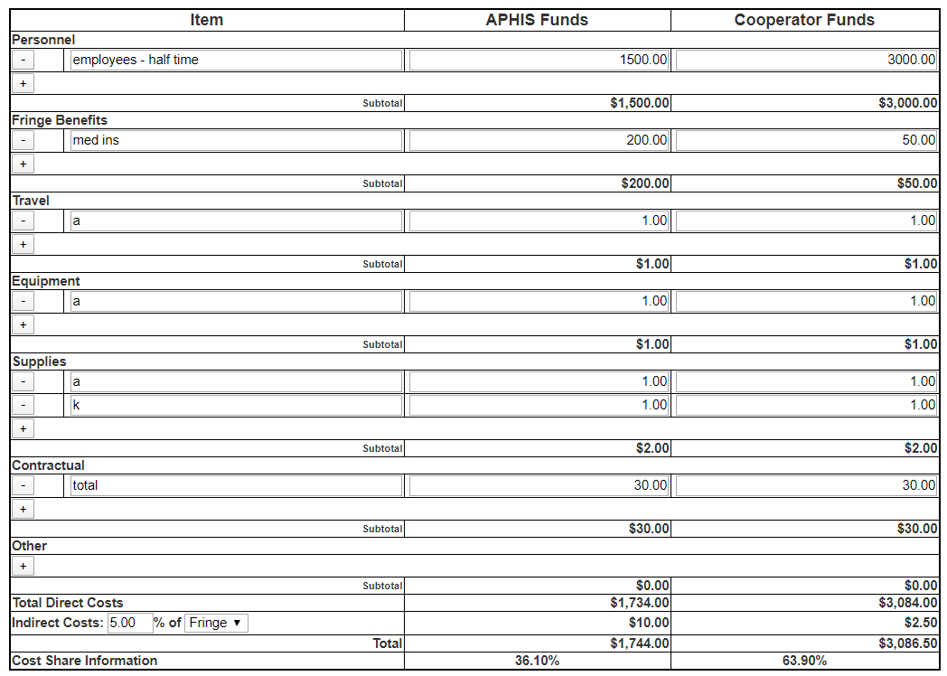
Online Workplan – Survey, Financial - Contractual
Notes:
a. Contractual calculator will add into the main calendar.

Slide 14
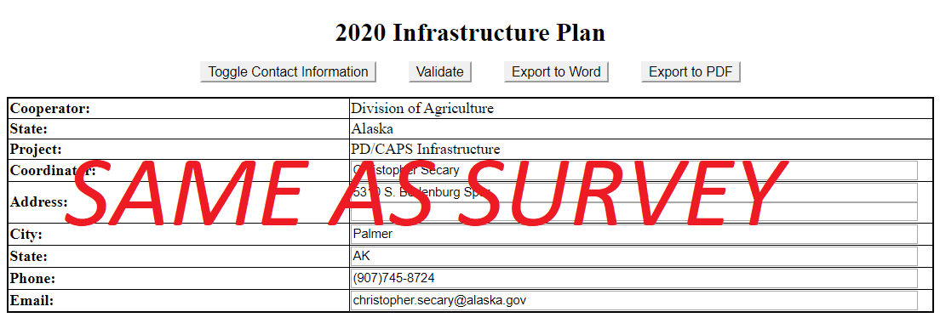
Online Workplan - Infrastructure
Notes:
a. The infrastructure work plan has the same functionality as the Survey work plan

Slide 15
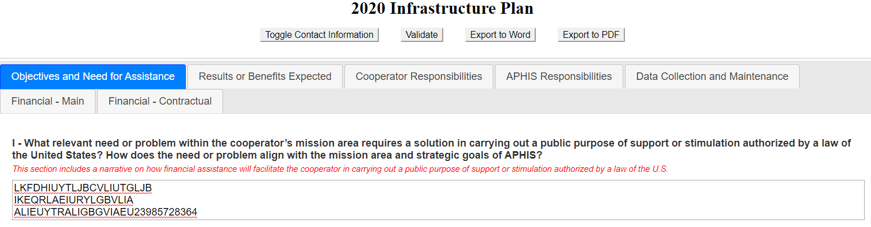
Online Workplan - Infrastructure

Slide 16
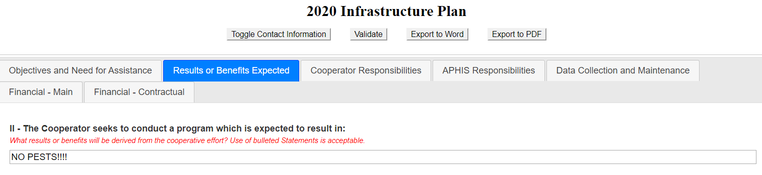
Online Workplan - Infrastructure

Slide 17
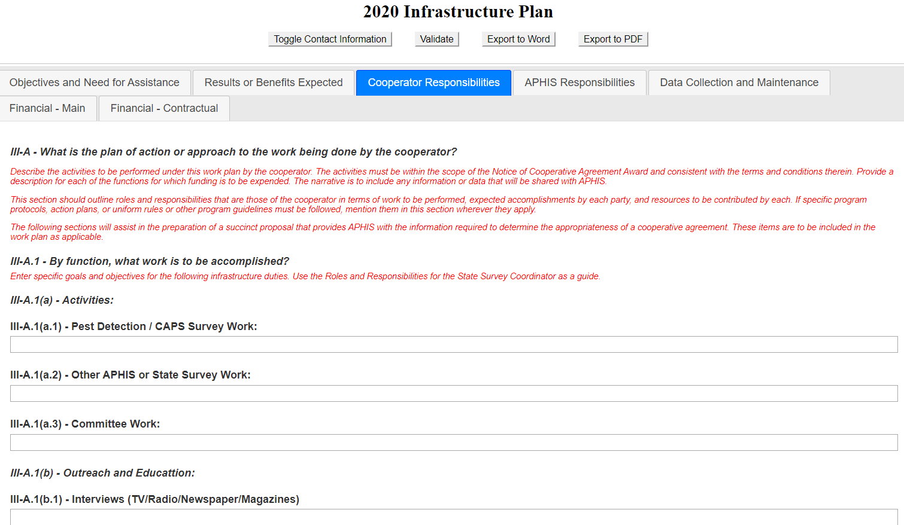
Online Workplan - Infrastructure

Slide 18
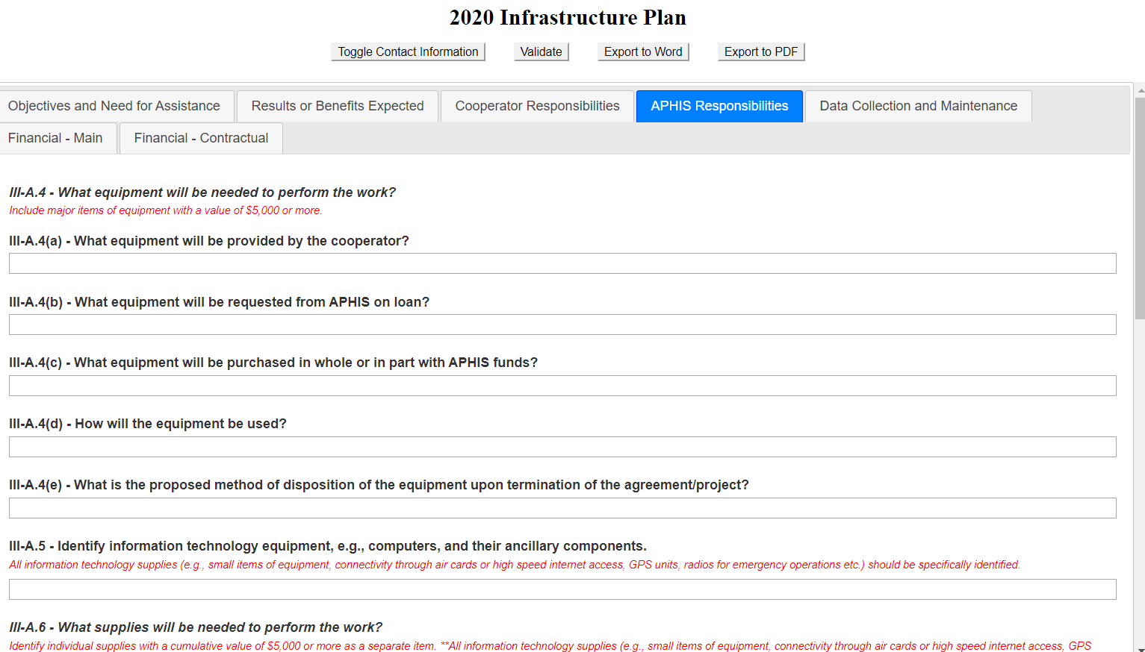
Online Workplan - Infrastructure

Slide 19
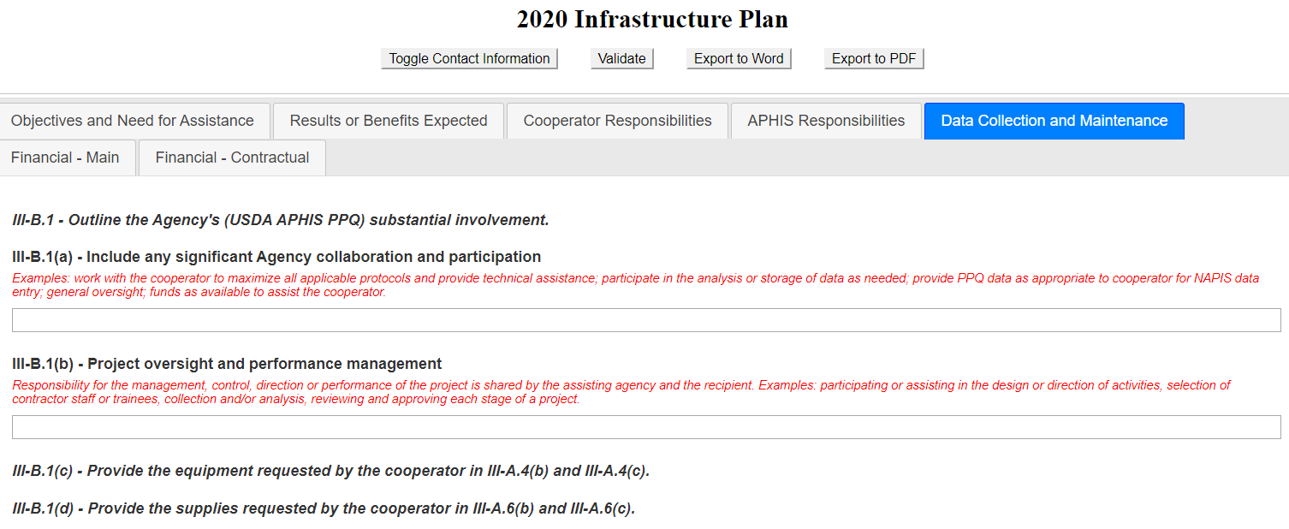
Online Workplan - Infrastructure

Slide 20
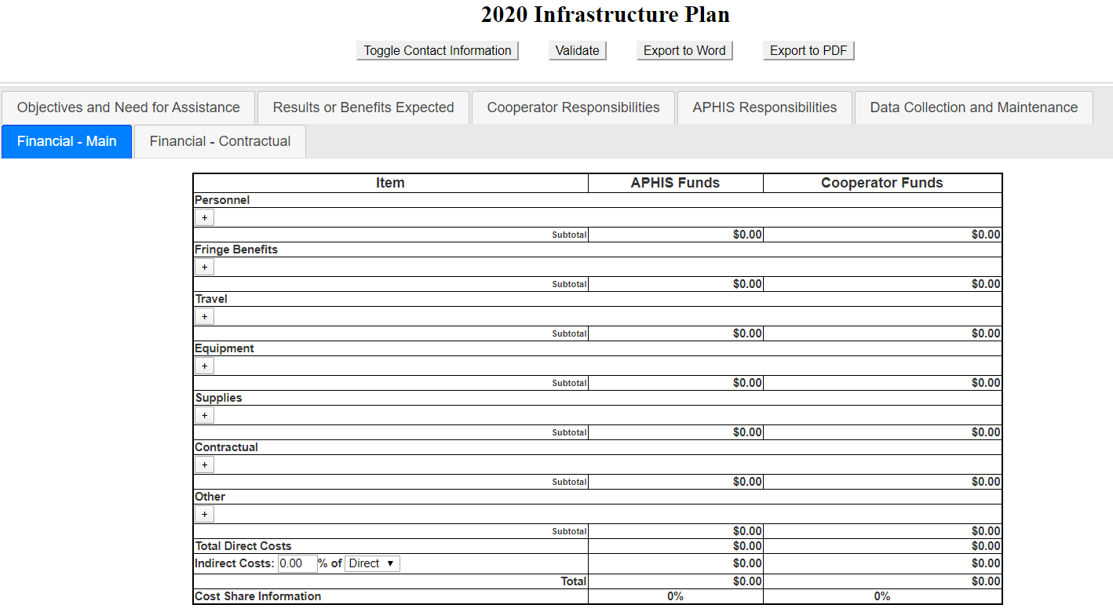

Online Workplan - Infrastructure
Notes:
a. Again, same functionality as survey work plan

Slide 21
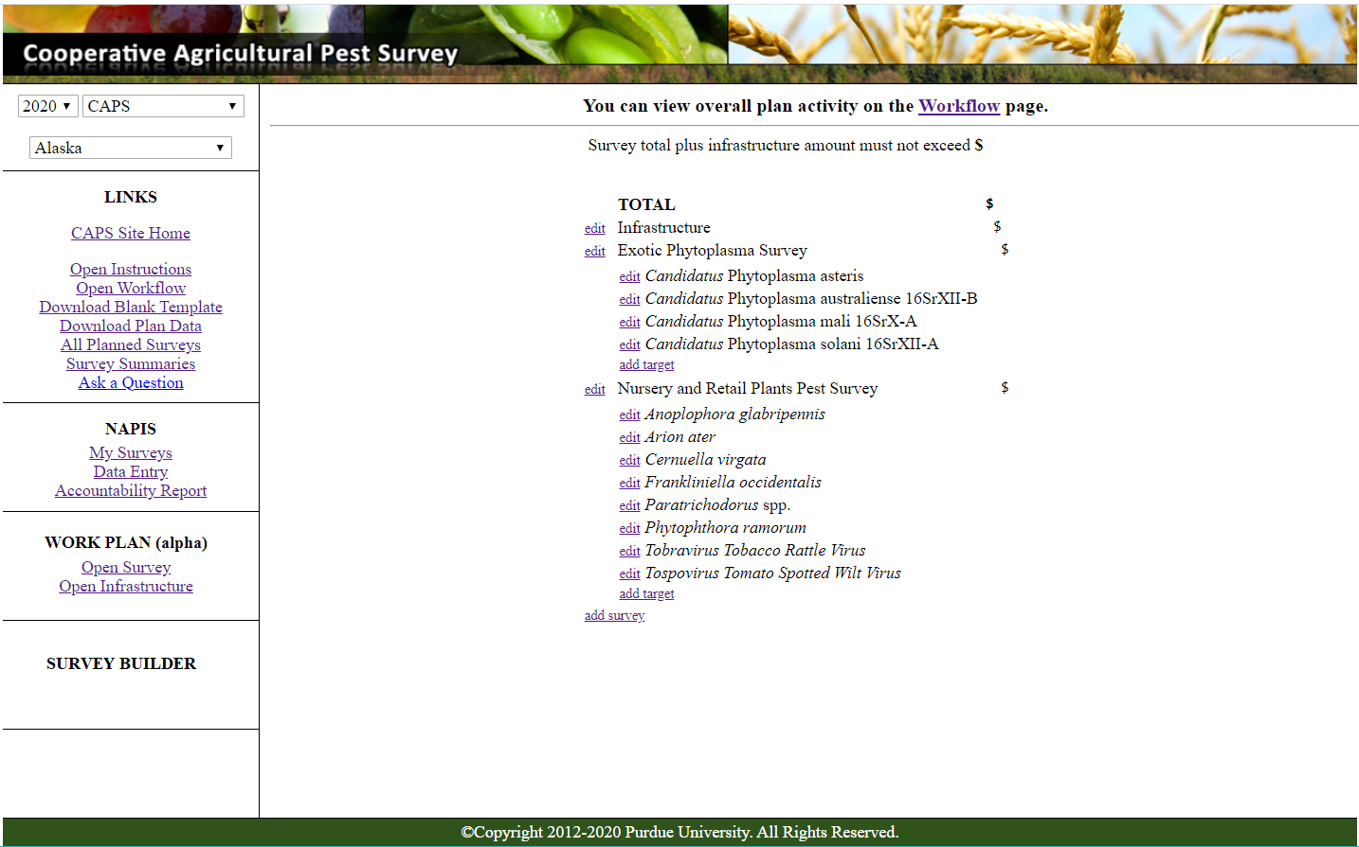
Survey Planning Page
Notes:
Discussion?

