Slide 1

Online Work Plan & SSF
– 2021 PPA 7721
Cindy Music
CAPSIS
Purdue University
February 3, 2021
Notes:
Thank you for attending this webinar about the online workplan.
As of January 20th the online workplan for 2021 PPA 7721 is up and running!!

Slide 2

Communication!!!
CAPS
Non-Traditional Cooperators
Notes:
As with all things, communication is important.
CAPS Users– reviews, edits, etc
Non – traditional cooperators will need to create a user name to be able to use the online workplan – SPHD should email Cindy Music, clmusic@purdue.edu with name and email
NOMs – assistance, information, etc
NOMs have put together a process document that goes through the complete process. “Work Plan Process for Goal 1 Surveys” located on the 2021 PPA 7721 page in CAPS R & C
CAPSIS – assistance, information, etc.

Slide 3
Survey Summary Form
Survey Name generates
online workplan
SSC enters Survey Summary Form information
Targeted Pests
autofill Taxonomic Tab
& pest portion of
Survey Summary Tab
Notes:
1. The actual starting point for the online workplan is the survey summary form.
2. The SSF is still required to be completed, submitted and approved. This will need to be done before the final online workplan can be downloaded for submission.
3. Only the SSC can fill in the SSF.
4. The user will need to add a survey name to the SSF for a workplan to be available and open. Targeted pests need to be added to the SSF for the SSF information to show up within the online workplan.
5. Please be aware that there are two surveys which will not be on the online workplan: NHB and P. ramorum. These will use the program specific work and financial plan templates.
6. As the SSF is filled out with targeted pests, the appropriate sections of the online workplan will auto-populate.
7. So, yes the SSF and the Online Workplan can be filled in at the same time, as long as the appropriate survey names have been created.

Slide 4
Online workplan
Positives:
  One time SSF
  Archives
  Copy and paste
Notes:
There is a one time SSF entry – the Taxonomic section and targeted pest portion of Survey Summary section are auto-populated with the information from the SSF.
After approval from the NOMs, the online workplans can no longer be edited, but are still available digitally.
Digital availability allows
Ease of viewing on the part of the users and NOMs
Copying and pasting - into next year’s online workplan, as appropriate.
Report information

Slide 5
Contact information
  Auto-fill of state, project/survey name
  Cooperator, Coordinator, etc.
  Toggle function
Notes:
1. The first portion of the online workplan is the contact interface.
2. The state and project (survey name) is auto filled.
3. The remaining information will need to be filled in.
1. This information can be copied and pasted.
4. Non-traditional cooperators will need to create a CAPSIS user name.
How to do this:
1. This is done by having the SPHD communicate with the SSC to obtain the names and emails of non-traditional cooperators
2. This list of names and email addresses is then sent to Cindy Music at CAPSIS clmusic@purdue.edu
5. The contact information can be toggled so that it does not fill the screen.
6. All SSCs have access to their respective state’s SSF and OWP

Slide 6
online workplan- overview
Workplan template used
Eight tabbed sections
Red dialog
Dialog boxes
Financial
Notes:
The original workplan template was used for the creation of the online workplan.
Each section of the workplan is tabbed within the online workplan. There are eight tabbed sections that make up the work plan portion. Six of these have dialog boxes with the remaining two requiring review.
Please note that red printed area are instructional.
Dialog boxes - increase with typing, can paste copied information
Saving function occurs when the user goes to a different tab or “clicks” outside of the dialog box
There is one main financial plan and three contractual financial plans

Slide 7
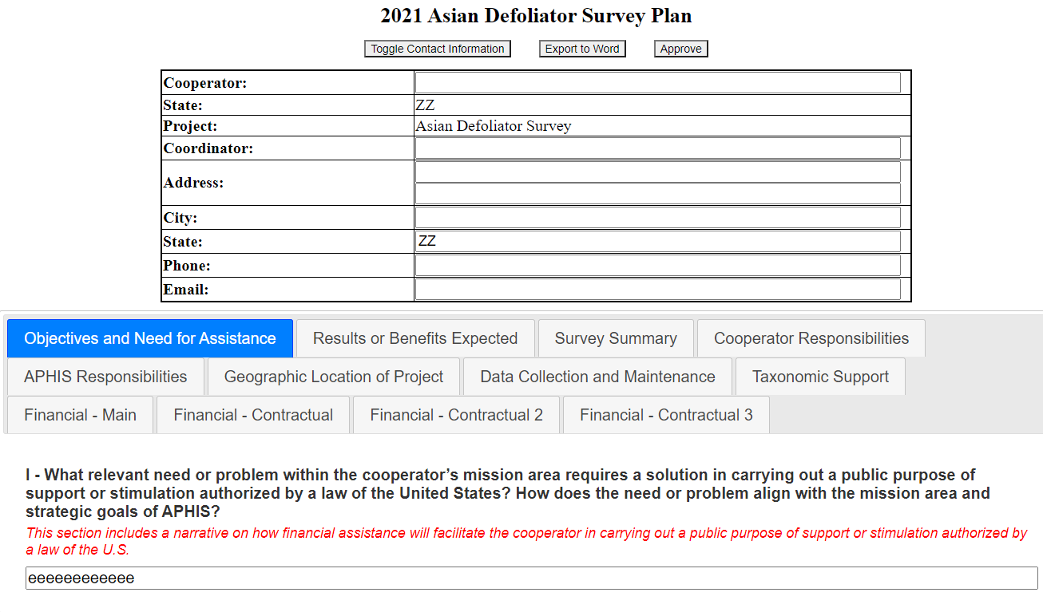
online workplan
Notes:
Financial plans will only print out with the word export if there is information entered within a financial plan.
Contractual financial plans
Up to three can be used
Financial plan helpful hints
Toggle
Hit the + to add a line
Have added more than 30 lines within a dialog box
Clicking outside of the entry box enters information
As appropriate, enter indirect costs – percentage, dropdown choice.

Slide 8
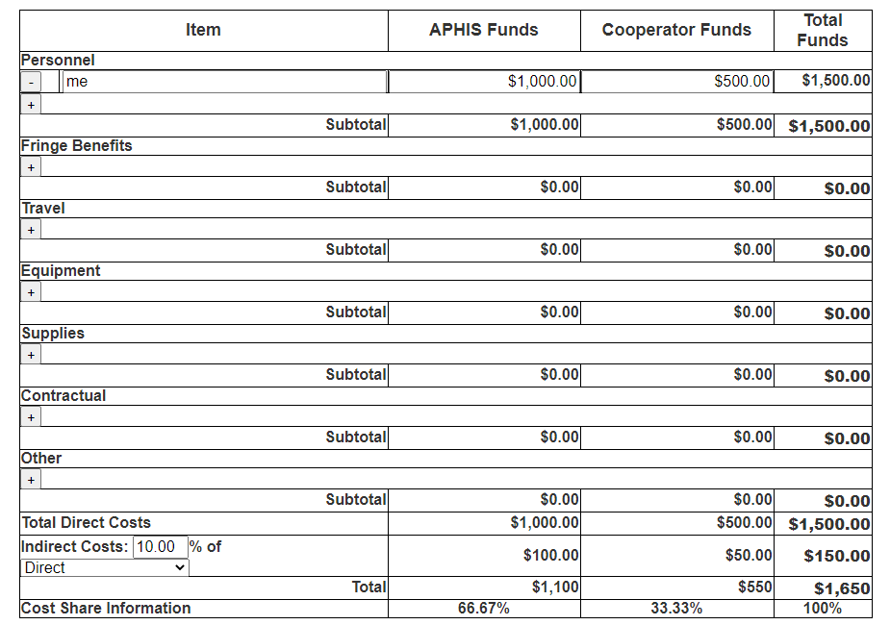
online workplan - financial
Helpful
Hints
Notes:
Financial plans will only print out with the word.doc export if there is information entered.
Contractual financial plans
Up to three can be used
Financial plan helpful hints
Toggle
Hit the + to add a line
Have added more than 30 line to a topic
Clicking outside of the entry box saves information
As appropriate, enter indirect costs – percentage, dropdown choice.
The cooperators name and the actual dates for the PPA time period will export on to the financial pages when the word doc is exported.

Slide 9
online workplan
- exporting
Export a word document
Review and edit
Final document
Follow guidelines in Work Plan Process for Goal 1 Surveys for submission
Notes:
A button to export a word doc is available at the top.
Initially this is for review and edit purposes
Once the online workplan is reviewed, edited and polished. It should be exported to a word doc. Within this word doc is the option to create a pdf with the option to request signatures.
Notice the exported word doc does have a signature page between the work plan and the financial plan.

Slide 10
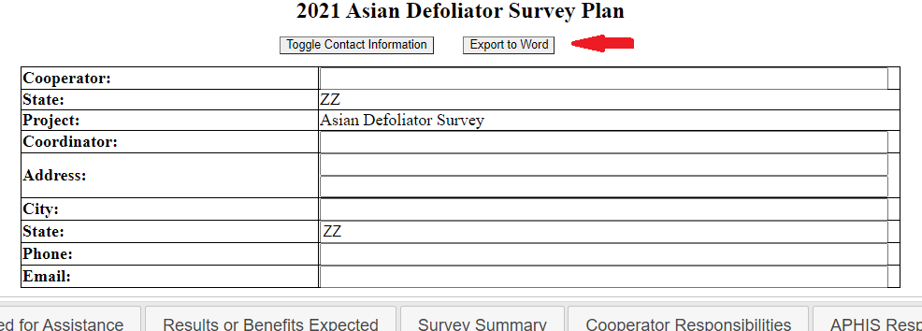
online workplan
- exporting
Export a word doc
Notes:
A button to export a word doc is available at the top.
Initially this is for review and edit purposes

Slide 11
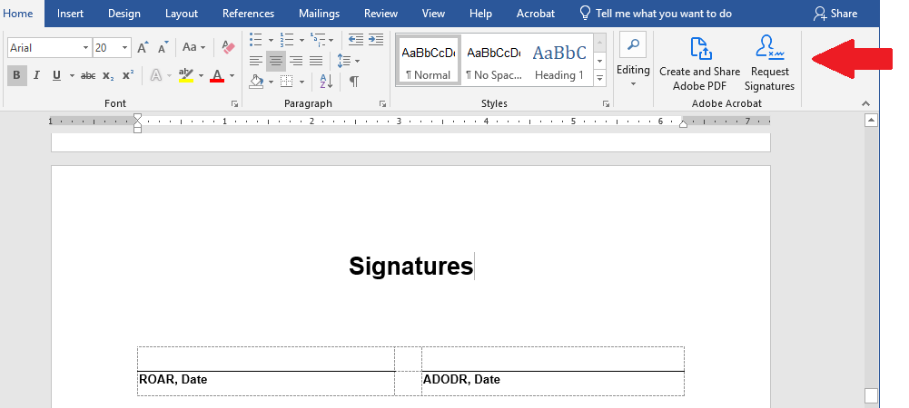
online workplan
- exporting
Final document
Notes:
Once the online workplan is reviewed, edited and polished. It should be exported to a final word doc. Within this word doc is the option to create a pdf with the option to request signatures.
Notice the exported word doc does have a signature page between the work plan and the financial plan.

Slide 12
Questions?
Work Plan Process for Goal 1 Surveys
  CAPS Resource and Collaboration, 2021 PPA 7721 page
clmusic@purdue.edu

