Slide 1
Endangered Species Act and the CAPS Program
Tracy Willard
Policy and Program Development
Environmental and Risk Analysis Services

Slide 2
ESA Overview
Endangered Species Act of 1973
16 U.S.C. Section 1531
Goal – to recover T&E species and the ecosystems on which they depend
Green Pitcher Plant

Slide 3
Endangered Species Act
Administered by U.S. Fish and Wildlife Service (FWS) and National Marine Fisheries Service (NMFS)
FWS – terrestrial and freshwater species
NMFS – marine wildlife

Slide 4
Section 7 of the Endangered Species Act
Section 7 consultation ensures that actions that federal agencies authorize, fund, or carry out, are not likely to jeopardize listed species or destroy or adversely modify critical habitat
Prohibits “take” of listed fish or wildlife
Requires federal agencies to use their authorities to conserve listed species and habitat.

Slide 5
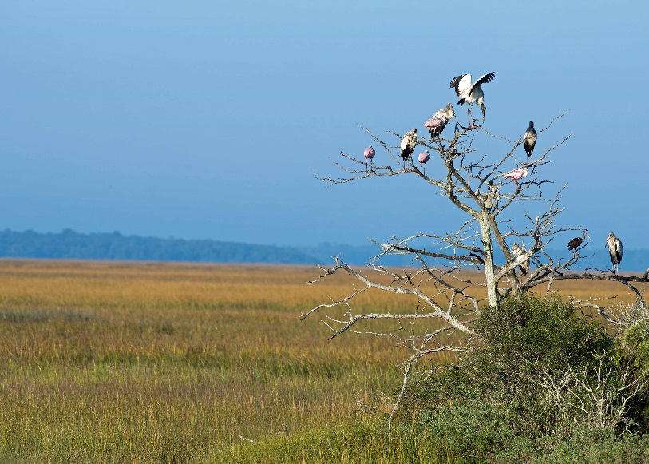
Federally Listed Designations
Species Categories
Endangered
Threatened
Proposed
Candidate

Slide 6
Critical Habitat
Critical habitat is a specific geographic area that contains essential features for the conservation of T&E species
Critical habitat may require special management and protection and requires consultation to ensure no adverse modification
Some designated critical habitat may not be occupied by the species but is needed for its recovery

Slide 7
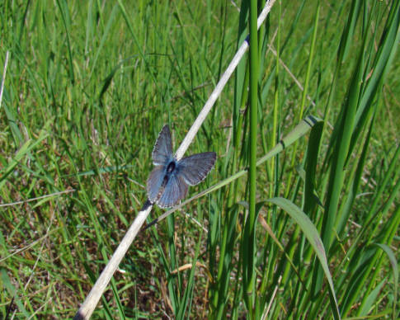
Section 7(a)(2)
Directs all Federal agencies to ensure that the actions they authorize, fund, or carry out do not jeopardize the continued existence of endangered or threatened species or destroy or adversely modify critical habitat
Fender’s blue butterfly

Slide 8
Consultation
Federal agencies must consult with FWS when any action it carries out, funds, or authorizes may affect a listed threatened or endangered species or designated critical habitat
Consultation Types
Informal
Formal
Conference
Emergency
National
Programmatic

Slide 9
No Effect
No effect means NO EFFECT!
This means generally means:
No listed species or critical habitat in the action area
No exposure
No stressors expected that could affect a listed or proposed species or critical habitat

Slide 10
May Affect, Not Likely to Adversely Affect
For listed species and designated critical habitat
The appropriate conclusion when the effects to a species or its critical habitat are likely to be:
Wholly beneficial
Discountable
Insignificant

Slide 11
May Affect, Likely to Adversely Affect
-For listed species and designated critical habitat
-Appropriate conclusion when an action is likely to directly or indirectly have an adverse effect on a listed species or its critical habitat

Slide 12
Biological Assessment
Information prepared by, or under the direction of a Federal agency to determine whether a proposed action is likely to:
Adversely affect listed species
Adversely modify or destroy critical habitat
Document used for consultation with FWS
Demonstrates consideration of effects on listed species

Slide 13
Penalties
Section 11 of ESA outlines the penalties
Civil penalties of not more than $25,000
Criminal penalties of not more than $50,000, one year of imprisonment
Citizen lawsuits may be filed

Slide 14
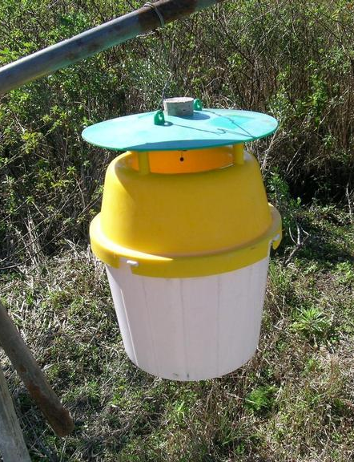
Plastic bucket trap

Slide 15
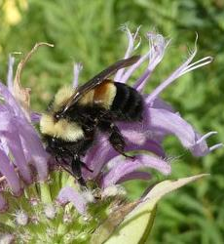
Rusty-patched bumblebee (Bombus affinis)
Listed as endangered in 2017
Occurs in MN, WI, IL, IA, IN, OH, RI, VA, WV, ME, MD

Slide 17
What has happened since then?
FWS notified APHIS of RPBB found in 2018 WI bucket bycatch in January 2020
Submitted biological assessment to FWS in February 2020
Covered 92 listed and proposed insects
Covered all U.S. states and territories
Covered all CAPS trap types

Slide 18
Where are we now?
Change in Policy Manager
Including PPA funded trapping as well as CAPS in the consultation because same methods are used
Change in consultation strategy

Slide 19
Consultation Strategy
Level 1: Avoid all trapping in the range of listed insect – no effect determination, no consultation
Level 2: Where trapping cannot be avoided, develop protection measures – not likely to adversely affect, informal consultation
Level 3: Where trapping cannot be avoided and no protection measures, likely to adversely affect, formal consultation

Slide 20
How will we do this?
States are reviewing insect range maps to determine if trapping can be avoided
Request FWS to refine range maps where too broad
Already have protection measures in place for RPBB that are nearly final
Resubmit revised BA
Building interactive map on the portal showing areas to avoid, protection measure to implement

Slide 21
Why are we doing this?
Required by law
Documented “take” of a listed species
Avoiding penalties
Avoiding litigation
Negotiating protection measures the program can live with rather than forced by the courts

