Slide 1
S&T CAPS Support
Annual NCC Meeting - Virtual
January 28, 2021
Heather Moylett

Slide 2
Review proposed Priority Pest List Changes
Prework Document:
“NCC prework CAPS Science Support” doc
Outcome:
NCC members acknowledge proposed changes to Priority Pest List.*
*Part of the “Stakeholder review and approval of Priority Pest List changes”

Slide 3
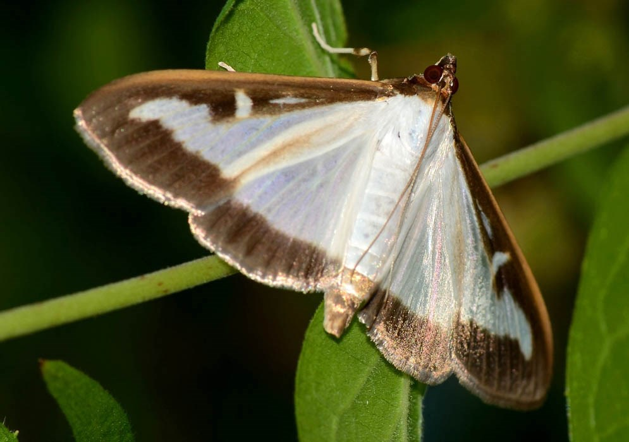
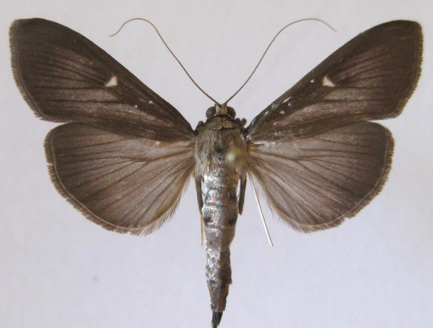
2022 Priority Pest List changes
Adding
Cydalima perspectalis (box tree moth)
Lure: Cydalima perspectalis Lure
Trap: plastic bucket trap*
*large plastic delta trap under review
Common white morph.
©Florine Leuthardt-2013
Dark morph.
Szabolcs Sáfián (CC-BY-SA-4.0)

Slide 4
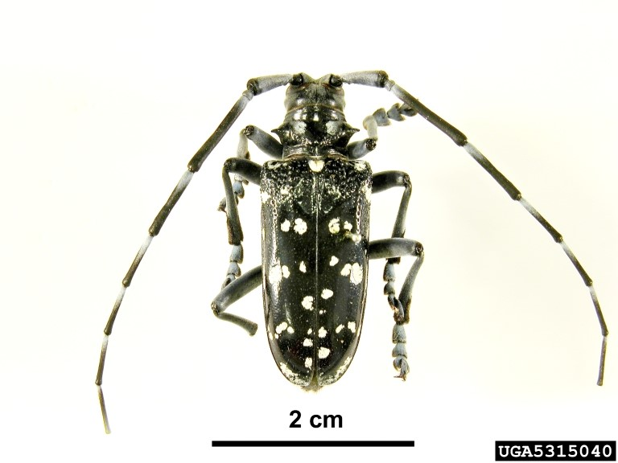
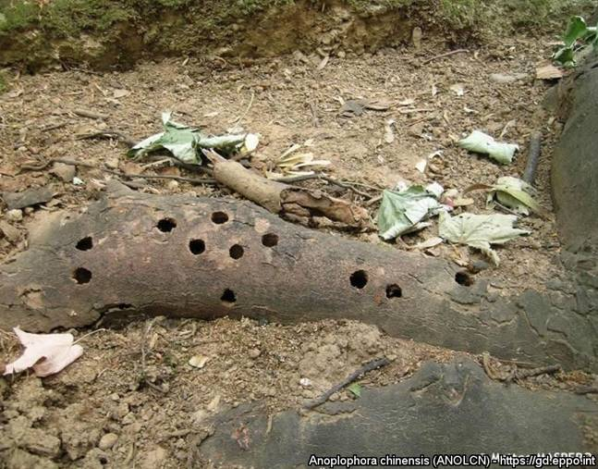
2022 Priority Pest List changes
Adding
Anaplophora chinensis (citrus longhorned beetle)
Removed in 2021 because no effective lure.
Reinstated in 2022 with expanded visual survey protocol.
Stakeholder input!
Pest and Diseases Image Library, Bugwood.org
Exit holes
https://gd.eppo.int

Slide 5
2022 Priority Pest List changes
Removing
We are still evaluating some priority pests. Any additional changes will be shared with the NCC prior to guidelines.
Target | Justification | Allow bundling?
Trichoferus campestris (velvet longhorned beetle) | Deregulated in the United States except Hawaii and U.S. Territories. | Yes

Slide 6
S&T CAPS Support Team
Contact us at
stcaps@usda.gov

Slide 7
S&T CAPS Support Team
acting Team Lead: Dan Mackesy
Feb 1 – May 8

