Slide 1
Plant Protection Act Section 7721 The Plant Pest and Disease Management and Disaster Prevention Program and The National Clean Plant Network FY 2021 PPA Update and FY 22 Plans 21 NCC Meeting Feridoon Mehdizadegan
Notes:
Most of you are familiar with the PPA funding process, but I want to give you a bit of background, and the provide some updates of program activities.

Slide 2
PPA Section 7721 APHIS Plant Protection and Quarantine
Sec. 10007 of the 2014 Farm Bill charged APHIS with allocating funds to strengthen the nation’s infrastructure for pest detection and surveillance, identification, and threat mitigation, while working to safeguard nursery production systems.
This authority was codified in Section 7721 of the Plant Protection Act (PPA 7721).
Notes:
As a reminder., Originally…

Slide 3
PPA Section 7721 APHIS Plant Protection and Quarantine
PPA Section 7721 funding supports:
Plant Pest and Disease Management and Disaster Prevention Program: strengthens APHIS’ ability to protect agriculture and natural resources from plant pest threats by funding projects that expand or enhance pest survey, identification, inspection, mitigation, risk analysis, and public education and outreach.
National Clean Plant Network: provides high quality asexually propagated plant material free of targeted plant pathogens/pests to protect the environment and ensure U.S. global competitiveness of specialty crops.
Notes:
PPA Sec. 7721 sets out the same funding schedule established by the Farm Bill Section 10007 for the PPDMDPP and NCPN; with $75 million made available in FY 2018 and beyond and a minimum of $5 million available for NCPN annually.

Slide 4
PPA Section 7721 Plant Pest and Disease Management and Disaster Prevention Program
Clear and Transparent Process
Broad Stakeholder Collaboration
Federal
State Government(s)
Tribal Nation(s)
Academia
Industry
Private Entities/Non-Profits
Notes:
The strength of PPDMDPP is its facilitation of PPQ’s collaboration with a broad range of stakeholders nationally. By working with states, other federal agencies, nongovernmental organizations, universities, non-profits and tribal organizations, APHIS can extend its ability to protect, detect, and respond to plant pests and diseases with projects identified and tailored locally.

Slide 5
PPDMDPP Goal Area Objectives
Goal 1A. Identify risk factors and high-risk pathways through analysis of available data. Develop risk-based models and decision support tools to reduce the arrival and establishment of exotic plant pest species.
Goal 1S: Target multiple, high priority pests for survey along national and local high-risk pathways. Fund high priority nationally-coordinated pest surveys in support of specialty crops, trade, and regulatory activities.
Goal 2: Target domestic inspection activities at vulnerable points in the safeguarding continuum.
Goal 3: Enhance and strengthen pest identification and technology.
Goal 4: Safeguard nursery production.
Goal 5: Conduct outreach/education to increase understanding, acceptance, and support of plant pest and disease management efforts.
Goal 6: Enhance mitigation capabilities by Improving the mechanism to assess and implement an appropriate short-term course of action for significant pest or new pest.
Notes:
Just a refresher, an abbreviated goals’ objectives

Slide 6
Evaluation Criteria Plant Pest and Disease Management and Disaster Prevention Program
Strategic Alignment – Does the suggestion align with the strategic objectives of PPA Section 7721?
Impact/Outcome – Will the project make an impact and produce results as defined by the individual goal area?
Feasibility – Can the project be accomplished based on key factors such as resources, collaborative partnerships, and clearly defined process?
Past Performance, Best Practices and Innovation – Will the project be successful based on previous experience in similar endeavors or to the extent in which the project utilizes best practices and innovation to achieving success?
Notes:
As articulated in detail in our published Implementation Plan, the evaluation criteria for all reviewers include several core themes to facilitate a consistent review process across all goal areas.

Slide 7
Overview of PPA Review Process
Suggestions submitted
SME
PPA Team
CFWG
Goal Teams
SPHD/SPRO
PPQ Deputy Administrator
APHIS Administrator
USDA Undersecretary
Funding approved
Notes:
In a nutshell, after the open period, PPA team review suggestions for duplication and incomplete suggestions, then organize and categorize, and will either send or share with goal teams, SME: experts review suggestion with specific components like Computer, citrus, tribal; CFWG are national mangers from the 3 PPQ’s core functional area (ST, FO, PM)
SME, and crossfunctional team for review, open Metastorm for SPHD and SPRO reviews; CFWG comments shared with Goal teams; Goal teams assess suggestions and recommend funding, PPA team complied goal team recommendations. PPA review and prepared a draft of spending plan for the DA review and discussion with PPA team, then forward the spending plan to the APHIS administrator; after review with send to the undersecretary for approval; spending plan will be published
PPA team discuss funding recommendation and provide background information.

Slide 8
Plant Protection Act Section 7721 FY2021 Budget
Plant Protection Act Section 7721
Appropriated | $75,000,000
Sequester % | 5.7%
Sequester Amount | $4,275,000
Net to APHIS | $70,725,000
NCPN | $7,500,000
PPDMDPP | $63,225,000
Notes:
FY2021 budget calculations for PPA 7721 include NCPN as well as reduction from sequestration. APHIS indirect costs are not included in net to program total; generally, these funds are restored to PPQ in the 3rd quarter.
The sequestration percentage has decreased slightly every year FY2021 5.7%, FY2020 5.9%, FY2019 6.20%, FY2018 6.60%

Slide 9
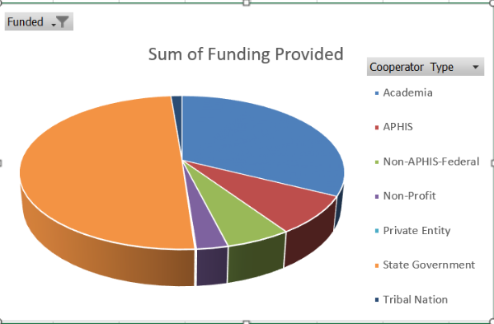
FY 21 PPA Funding
Funding Distribution Among Cooperators
Academia | $ 15,762,497
APHIS | $ 3,940,532
Non-APHIS-Federal | $ 2,708,966
Non-Profit | $ 1,312,006
Private Entity | $ 57,882
State Government | $ 24,213,265
Tribal Nation | $ 621,095
Grand Total | $ 48,616,243
Cooperators
Notes:
Just a visual Distribution of funding distribution, as you see states and academia received a significant amount of the PPA funding

Slide 10
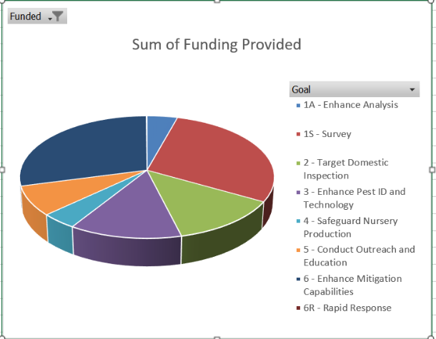
FY 21 PPA Funding
PPA Funding Distribution Among Goals
1A - Enhance Analysis | $ 2,087,871
1S - Survey | $ 14,071,495
2 - Target Domestic Inspection | $ 6,249,616
3 - Enhance Pest ID and Technology | $ 6,250,000
4 - Safeguard Nursery Production | $ 1,999,878
5 - Conduct Outreach and Education | $ 3,800,000
6 - Enhance Mitigation Capabilities | $ 14,108,444
6R - Rapid Response | $ 48,939
Grand Total | $ 48,616,243
Notes:
Fudn distribution across goals, Goal I S is always a winner.

Slide 11
FY2021 Projects Requested/Funded PPDMDPP - NCPN
FY2021 | Requested |  | Recommended |  | % of
Goal | Projects | Funding | Projects | Funding | Request
1 Analysis | 39 | $ 2,853,469 | 18 | $ 2,087,871 | 73%
1 Survey | 225 | $ 25,596,581 | 144 | $ 14,000,000 | 55%
2 Domestic Inspection | 20 | $ 8,736,442 | 9 | $ 6,249,616 | 72%
3 Pest Identification | 190 | $ 13,124,981 | 45 | $ 6,250,000 | 48%
4 Nursery Production | 25 | $ 2,971,481 | 15 | $ 1,999,878 | 67%
5 Outreach | 97 | $ 7,519,669 | 54 | $ 3,800,000 | 51%
6 Mitigation | 247 | $ 41,445,377 | 69 | $ 14,108,444 | 34%
*Direct Costs |  |  |  | $ 536,108
**Rapid Response | - |  | - | $ 14,193,083
PPDMDPP Total |  |  |  | $ 63,225,000
NCPN | 33 | $ 9,071,632 | 29 | $ 7,102,429 | 78%
*Direct Costs |  |  |  | $ 397,571
NCPN Total |  |  |  | $ 7,500,000
Total | 876 | $ 111,319,632 | 383 | $ 70,725,000
*direct costs (includes salary, supplies, travel) **RR projects will be approved via DM
Notes:
This is a snapshot of the number and amount of FY 21 requests. We were curious to see if Covid and its limitations caused a major issue for our cooperators to submit their suggestions; we received 876 suggestion which was within the range of past few years. Comparison of FY2021 # of suggestions received, and total funding requested by goal versus # of projects and total funding recommended. Note ** RR projects will be reviewed and approved via decision memo and not included in the spending plan.
Changes in funding requests from FY2020:
Goal 1A – decrease ~300K
Goal 1S – increase ~5M (CA’s exotic FF survey requested $9.5M)
Goal 2 – increase ~700K
Goal 3 – decrease ~800K
Goal 4 – increase ~100K
Goal 5 – decrease ~900K
Goal 6 – decrease ~2M

Slide 12
Moving on to FY2022: Tentative timeline
Early July: Open Period (7 weeks)
Mid August – early September: SPHD – SPRO & Key SME Review (3 weeks)
Mid September – Mid October : Goal Team Review (6 weeks) + CFWG Review
Mid-October-early November: Goal Area Spending Plan prepared
Mid-November: Spending Plan draft prepared & presented to PPQ Team
Anticipate releasing the FY2022 Spending Plan in January
Plan to use Metastorm for suggestion platform.
Notes:
Last, but not least, tentative plan for 2022 : We may change some of these dates, after consulting with the NPB

Slide 13
THANK YOU!
General Questions:
Feridoon Mehdizadegan (FO) feridoon.mehdizadegan@usda.gov
Sharla Jennings and Brooke Divver (PM)
sharla.m.jennings@usda.gov
brooke.a.divver@usda.gov
Ronald Weeks (ST) Ron.d.weeks@usda.gov
Project-Specific Questions:
PPA-projects@USDA.gov

