Slide 1


Integrated Plant Health Information System (IPHIS)
How to place survey supply orders in IPHIS
Notes:
Good Afternoon!
Welcome to Integrated Plant Health Information System - Better known as IPHIS!
This presentation will be divided into 3 Sections.
What is IPHIS
Steps and options needed prior to placing orders in IPHIS
Placing orders in IPHIS

Slide 2
Ordering Open Periods
Fall 2021
September 13 through November 19
  2022 CAPS
  PPQ supported programs (including EAB)
Winter 2021/Spring 2022
Dependent on when the PPA 7721 Spending Plan is announced.
  2022 PPA 7721
  2022 CAPS
  PPQ supported programs
Notes:
I have mention the 2 Ordering Open Periods.
The First Ordering Open Period is in the:
-Fall of 2018
-Opens -September 17th
-Closes – November 30th
The Second Ordering Open Period is in the Winter of 2018 or Spring of 2019
-It is Dependent on the Farm Bill Spending Plan
It is highly recommended to place your survey orders during these ordering open periods.
**There is a separate ordering period for EAB surveys. Usually in February.

Slide 3
What is IPHIS?
A web-based application
Supports the mission to manage plant health emergencies
Used by all levels of plant health responders
  Within the USDA
  Outside the USDA
Addresses the following plant health response processes:
  Detection
  Survey
  Diagnostic
  Regulatory control
Notes:
What is IPHIS? Integrated Plant Health Information System, a web-based application
Supports the mission to manage plant health emergencies
Used by all levels of plant health responders
within the USDA
outside the USDA
Addresses the following plant health response processes:
Detection
Survey
Diagnostic
Regulatory control

Slide 4

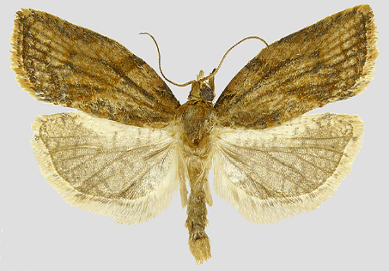
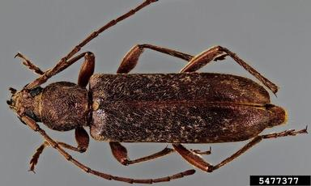
Who uses the IPHIS Survey Supply Ordering System?
Emergency Programs
PPQ Pest Programs
Cooperative Agricultural Pest Survey (CAPS)
Notes:
Emergency Programs - the “European Cherry Fruit Fly Program (Rhagoletis cerasi ).
Pest Detection Programs - the Light Brown Apple Moth Program (Epiphyas postvittana).
CAPS Program - the Velvet Long-horned Beetle (Trichoferus campestris ).

Slide 5
What are the benefits of the IPHIS Survey Supply Ordering System?
Surveyors
Web-based system
Flexibility in ordering periods
Unlimited product descriptions
Photos of products
Cooperator access
Survey Supply Program
Allows tracking products by programs
Provides an inventory management system
Provides integrated shipping communications with field
Provides a better workflow – Approval Process
Notes:
What are the benefits of the IPHIS Survey Supply Ordering System?
For the Surveyors …..
-Web-based system
-Flexibility in ordering periods - 2 per year
-Unlimited product descriptions
-Photos of products -almost
-Cooperator access – to State and Universities
For the Policy Management group …..
Facilitates in tracking products by programs.
Provides an Inventory management system.
Provides Integrated shipping communications with field
Provides a better work flow – Approval Process

Slide 6
Steps needed prior to placing orders in IPHIS
Notes:
There are steps that need to be taken prior to placing your orders in IPHIS.

Slide 7
Order the correct products
All CAPS National Priority Pests have Approved Methods for Pest Surveillance (AMPS) that must be used.
Follow official protocols and guidance for PPQ Pest Programs.
Be sure to order all products needed for the target pest (trap components, multiple lures, etc.).
Read the product descriptions in the IPHIS catalog to ensure you are ordering the correct product.
Notes:
There are several actions that you can take to ensure you order the correct products.
Be mindful of changes to the approved methods.
For 2020, refer to the slide deck of the 2020 National Pest Surveillance Guidelines webinar.
This outlines several changes to the approved methods for the 2020 survey season.
In addition, you should be familiar with all products needed for the target pest (including the trap components, multiple lures, etc.).
Read the product descriptions in the IPHIS catalog to ensure you are ordering the correct product and amount.

Slide 8
Approved Methods for Pest Surveillance (AMPS)
Important points to remember:
Confirm the correct approved traps and lures for all target pests.
Read the method and lure notes on the AMPS page.
The product names on the AMPS page will match the product names in the IPHIS catalog.
Notes:
Important points to remember:
You need to confirm the correct approved traps and lures for all target pests.
It is very important to read the method and lure notes on the AMPS page for each pest.
Be mindful of lures that require multiple products/entries.
There may be multiple options for traps or lures.
The product names on the AMPS page will match the product names in the IPHIS catalog.

Slide 9
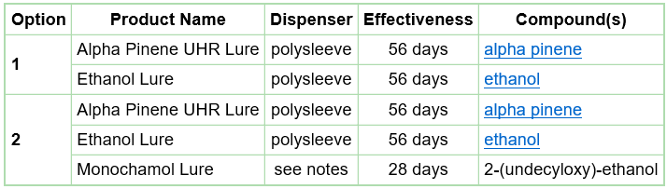
Approved Methods for Pest Surveillance (AMPS)
Example of a pest with multiple lure options:
Note, for options 1 and 2, there are multiple products that are required for survey.
Notes:
This is an example of a pest with multiple lure options:
For this target, there are two lure options.
You can see this in the Option column, where the arrow is pointing.
For Option 1, you need both the Alpha Pinene UHR and Ethanol lures.
For Option 2, you need the Alpha Pinene UHR Lure, Ethanol Lure, and the Monochamol Lure.

Slide 10
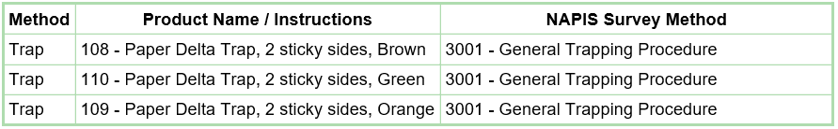
Approved Methods for Pest Surveillance
Example of a pest with multiple trap color options
In this example, there are three different color options available.
Any of the three colors may be ordered.
Read the Method Notes on the AMPS page for additional instructions.
Some approved traps may not be offered through the IPHIS catalog.
Notes:
This is an example of a pest with multiple trap color options:
In this example, there are three different color options available.
Any of the three colors may be ordered.
In some instances, you will need to read the method notes on the AMPS page.
There may be further instructions as to special cases when one trap is preferred over another.
In some instances, a trap may be an approved method for survey, but it may not be offered through the IPHIS catalog.

Slide 11
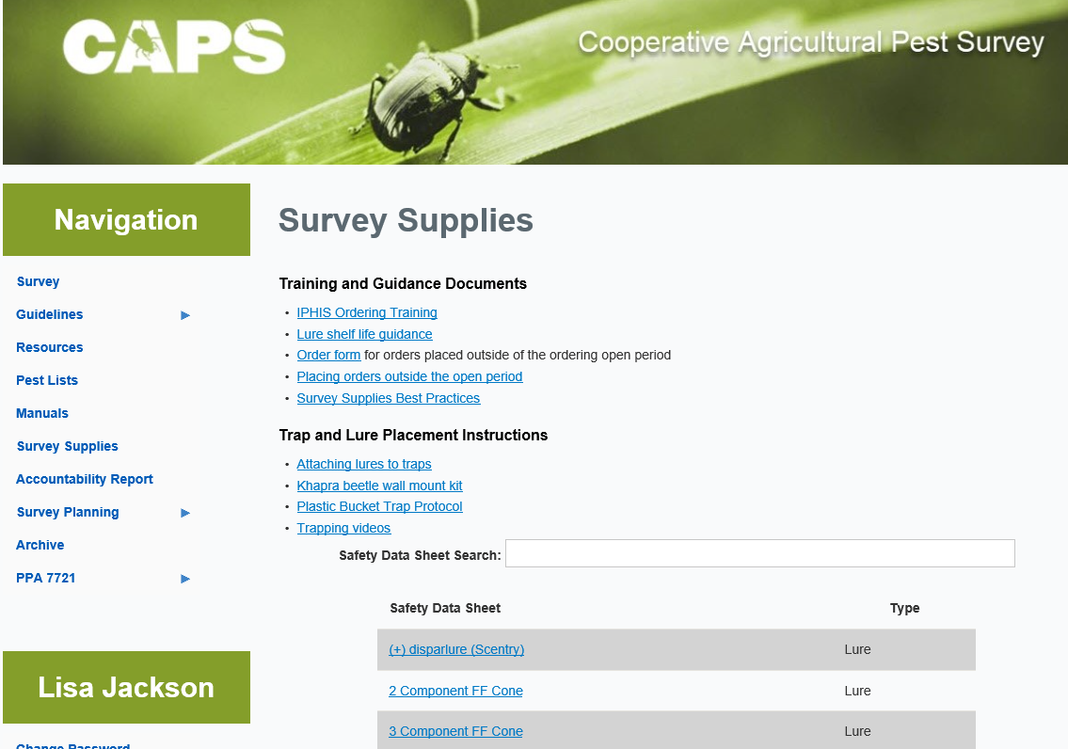
Survey Supplies Page – CAPS Website
Notes:
Next, let’s take a look at the Survey Supplies Page on the CAPS Website.
This is where Paul and I will post important training and guidance documents and other useful information.
If you are new to the program or to ordering supplies, please read through these documents.
There are 3 sections on this page.

Slide 12
Survey Supplies Page – CAPS Website
Training and Guidance Documents
IPHIS Ordering Training
Lure shelf life guidance
Order form for orders placed outside of the ordering open period
Placing orders outside the open period
Survey Supplies Best Practices
Notes:
The first section is Training and Guidance Documents
There are some very important documents in this section.
If you are new to the program, please read through these documents.
The first link, the IPHIS Ordering Training, is where you can find this presentation.

Slide 13
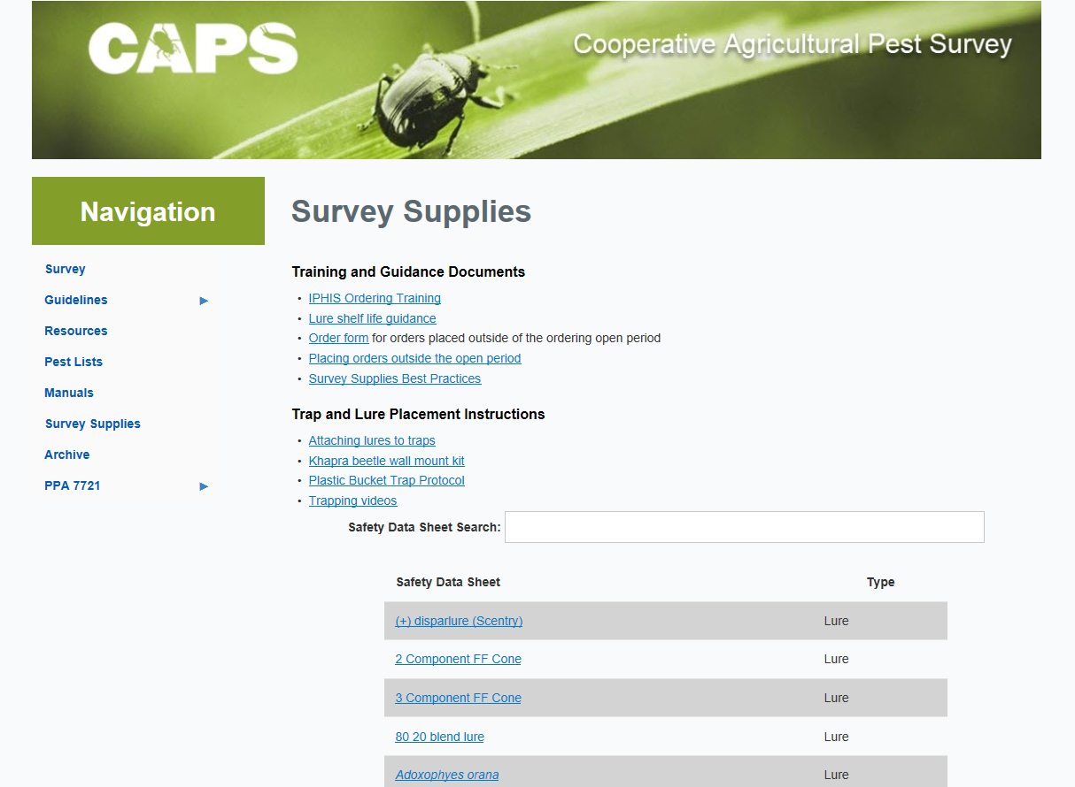
Survey Supplies Page – CAPS Website
Notes:
The third section of the page is the Safety Data Sheets.

Slide 14
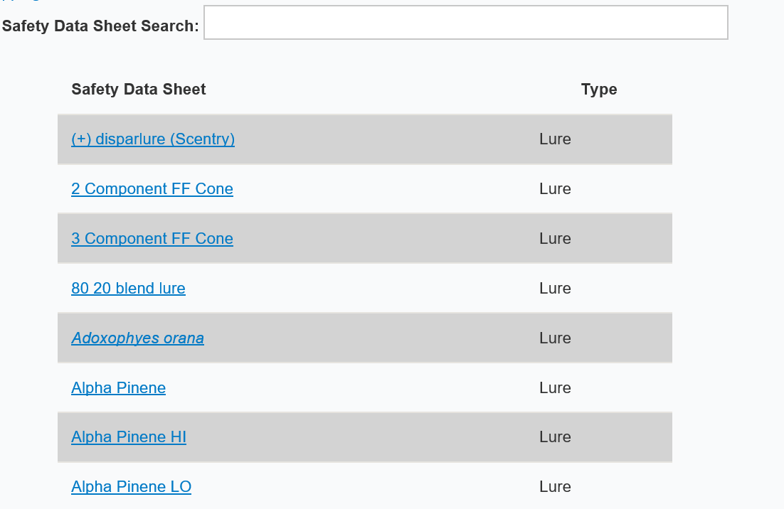
Survey Supplies Page – CAPS Website
Notes:
The third section is where you can find the Safety Data Sheet for survey supply products.

Slide 15
Survey Supplies Page – CAPS Website
Safety Data Sheet:
Safety Data Sheets are available for all survey supply products.
You may use the search field to enter the product name or chemical compound.
Or you may scroll through the dropdown list.
There may be multiple vendors for the same product.
If you do not see a sheet that you need, please contact the National Policy Manager.
Notes:
Safety Data Sheet:
Safety Data Sheets are available for all survey supply products.
You may use the search field to enter the product name or chemical compound.
Or you may scroll through the dropdown list.
There may be multiple vendors for the same product, so please check the product that you received against the safety data sheet.
If you do not see a sheet that you need, please contact the National Policy Manager for the Survey Supply Procurement Program.

Slide 16
Survey Supplies Best Practices
Read the Survey Supplies Best Practices in its entirety.
There is important information about how to fill out the fields when you are ordering products.
Filling the fields out incorrectly can greatly impact how/when you receive your products.
  DO NOT USE P.O. Boxes!!
  Provide an address where there will always be someone physically present.
  We cannot call ahead before shipments arrive.
Notes:
The next document is the Survey Supplies Best Practices.
Please read the document in its entirety.
There is important information about how to fill out the fields when you are ordering products.
Filling the fields out incorrectly can greatly impact how and when you receive your products.
Some critical points to remember:
DO NOT USE P.O. Boxes!!
Please provide an address where there will always be someone physically present.
We cannot call ahead before shipments arrive.

Slide 17
Survey Supplies Best Practices
Lure Shelf-Life Guidance:
Please read the document in its entirety. Link
Round up lure orders by 20%.
Refer to the guidance document for exceptions.
Notes:
In that first section, an important document is the Lure Shelf Life Guidance.
Please read the document in its entirety.
In general, lures are very inexpensive. Most moth lures cost less than 50 cents each.
Using lures that have lost effectiveness is a waste of all of the associated costs of the survey.
In addition, it lowers the confidence in the negative data that is collected.
General points to remember:
Round up your lure orders by 20%.
This reduces the amount of orders that need to be placed outside the open periods.
Order septa lures fresh each year (this would be most moth lures) and also:
Geranyl Acetol Lure
Khapra Beetle Lure
Platypus quercivorus Lure
Refer to the guidance document for exceptions on some moth lures that last for several years.

Slide 18
Survey Supplies Best Practices
Orders placed outside of open periods:
Outside of the open periods, states must request that the Pest Detection NOM place the orders.
The Order form must be sent to the NOM.
For these orders, the Survey Supply Program cannot guarantee that products will be in stock or able to be shipped by the requested date.
Requests for products for emergency programs will always be honored.
Notes:
The next document is for Orders placed outside of open periods:
Outside of the open periods, states must request that the Pest Detection National Operations Manager place the orders.
The IPHIS catalog is closed during these times.
The Order form for orders placed outside of the ordering open period must be sent to the National Operations Manager.
For these orders, the Survey Supply Program cannot guarantee that the products will be in stock or able to be shipped by the requested date.
Requests for products for emergency programs will always be honored.

Slide 19
Survey Supplies Best Practices
Shipping:
Except for details about freight – do not use the comments field to communicate to warehouse staff
Avoid notes such as "Call ahead before delivery“
Use UPS My Choice for specific delivery options and combinations

Slide 20
Survey Supplies Best Practices
There are steps that you can take to help us get products to you on time.
When you receive the order:
  Open the box and check all supplies against your order form.
  Check expiration dates on products.
You can check the “My Orders” page in IPHIS to view the status of your orders.
Notes:
Survey Supplies Best Practices:
There are places in the process where errors can occur.
But, there are steps that you can take to help us get the products to you on time.
By working together, we can ensure that you receive the correct products on time, and that mistakes are quickly addressed.
When you receive the order, please open the box and check all supplies against your order form.
Check expiration dates on products to ensure the products will be good for the duration of your survey season.
You can also check the “My Orders” page in IPHIS to view the status of your orders.

Slide 21
Survey Supplies Best Practices
You may contact the National Operations Manager to inquire why something is on backorder/was not shipped.
Sometimes the warehouse is waiting on items.
Other times there could be an error in shipping that we need to address.
If we catch this early, we can quickly address the issue.
Notes:
Survey Supplies Best Practices:
You may contact the National Operations Manager to inquire why something is on backorder/was not shipped.
Sometimes the warehouse is waiting on the items;
Other times there could be an error in shipping that we need to address.
If we catch this early, we can quickly address the issue.

Slide 22
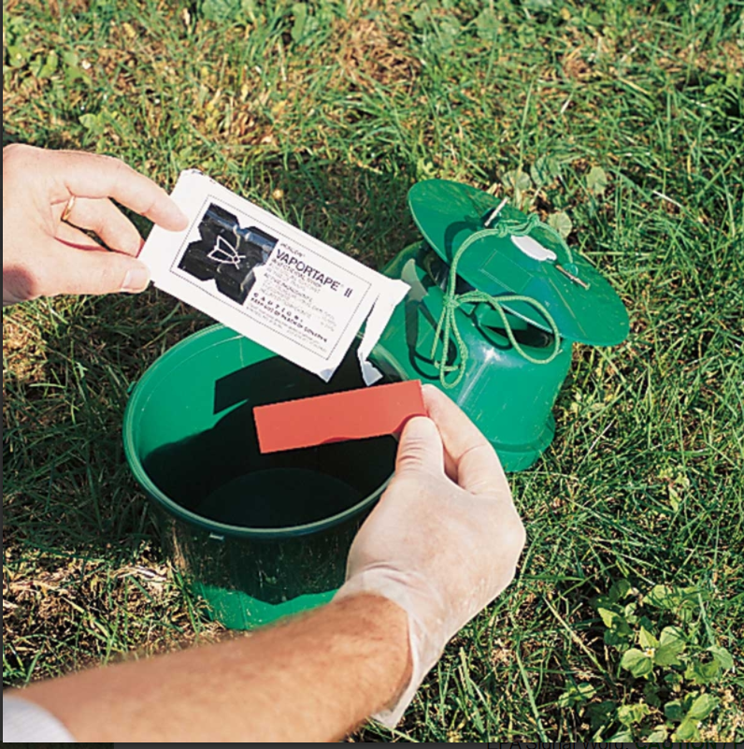
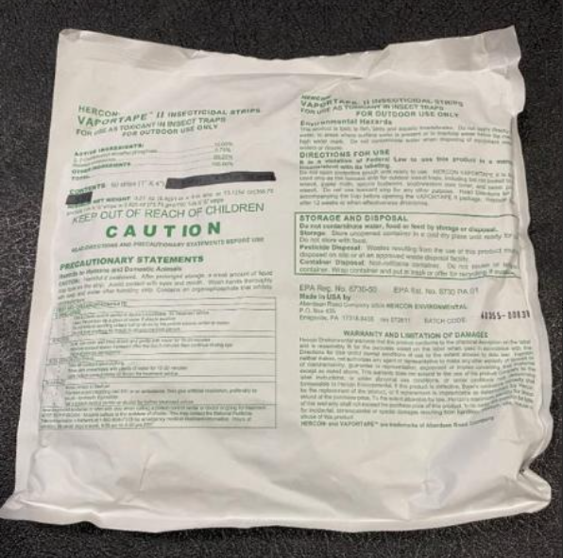
Survey Supplies Products Special Considerations
Some products have longer shelf lives when stored properly
Longer than Three Year Efficacy
  DDVP Pesticide Strips

Slide 23
Survey Supplies Products Special Considerations
Spotted Lanternfly Products
Spotted Lanternfly lures are not available for ordering for the FY22 survey season.
Only SLF PPQ Program states may order traps.
These are the only states that can order traps in FY22:
For SLF surveys outside of the SLF PPQ Program states, the approved method for survey is visual; and these states may not order SLF traps.
For any SLF programmatic questions, please reach out to Matt Travis at matthew.a.travis@usda.gov.
CT
DE
IN
MD
NJ
NY
OH
PA
VA
WV

Slide 24
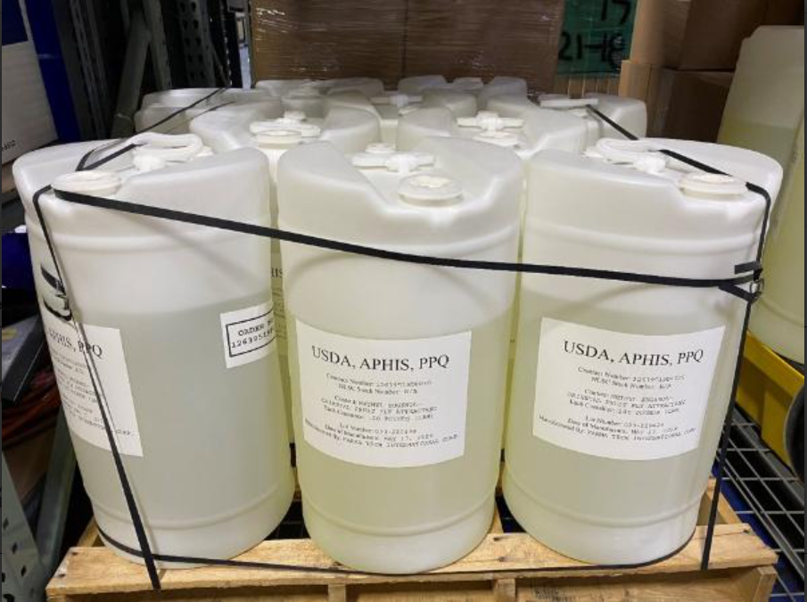
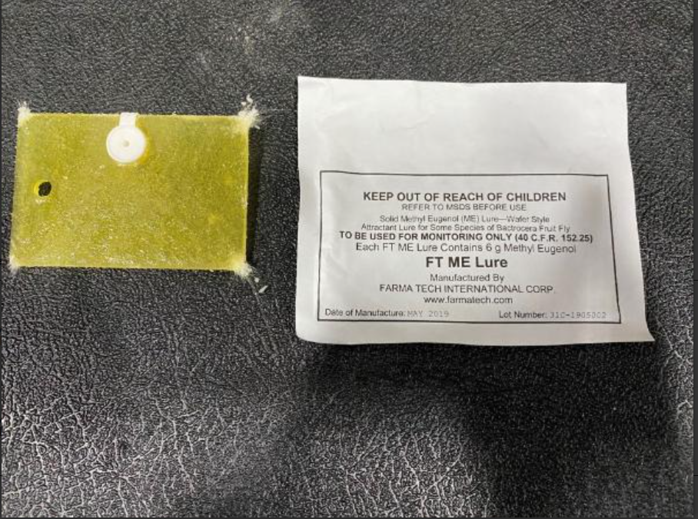
Survey Supplies Products Special Considerations
Methyl eugenol
  Solid wafers
  Liquid in drums
  Coming soon ME plugs
Be sure to order the right product!
The drums are large and costly to return to the warehouse.
Methyl Eugenol is used in fruit fly trapping. For the liquid product, it can be ordered in pounds where a 15 gallon drum is equivalent to 100 lbs. A single gallon of cue lure is about 6.5 lbs.
Methyl Eugenol is used in fruit fly trapping. Please order individual lures.

Slide 25
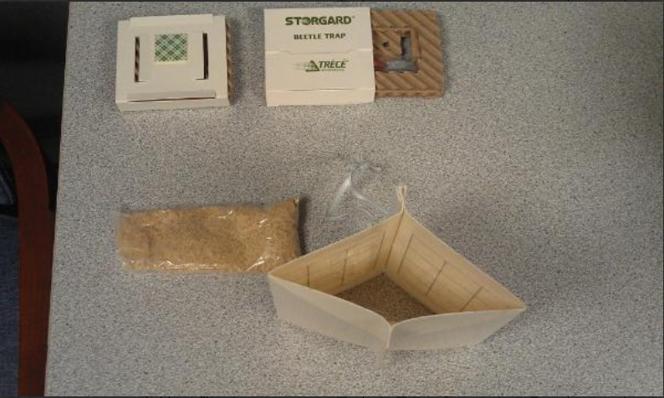
Survey Supplies Products Special Considerations
Khapra Beetle products:
  Khapra Beetle Wall Mount Trap Kit
  Khapra Beetle Lure
The Khapra Beetle Wall Mount Trap Kit includes:
  6 Wall Mounted Traps
  7 Lures
  Organic Wheat Germ
  Decoy Sticky Trap
Additional lures may be purchased by ordering the product Khapra Beetle Lure.

Slide 26

Questions?
Notes:
Are there any questions on the topics that I have covered?

Slide 27
Survey Supply Ordering System Overview
IPHIS
Notes:
This is the final section.
Survey Supply Ordering System Overview of IPHIS

Slide 28
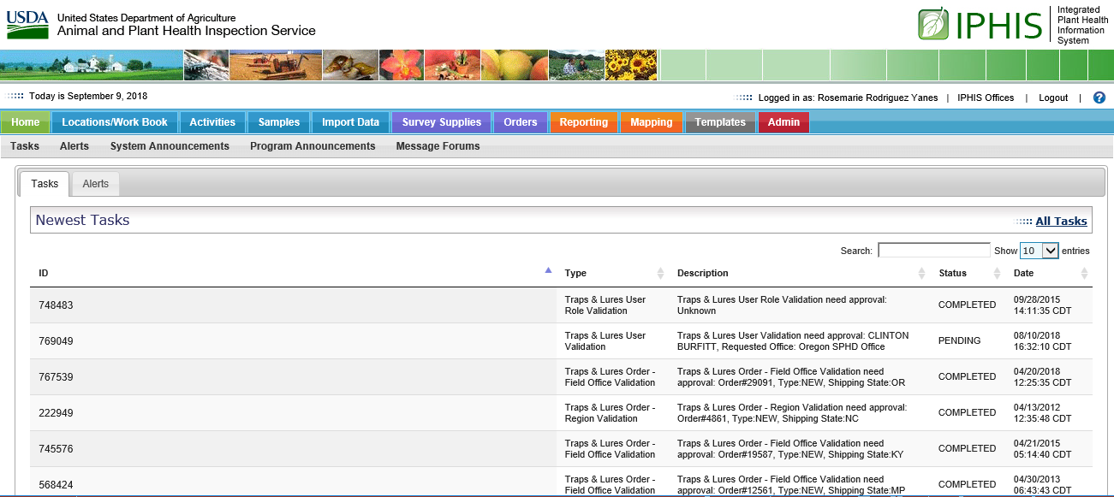
IPHIS Home Screen
Notes:
This is the IPHIS home screen.
Click on the Survey Supply - Tab.

Slide 29
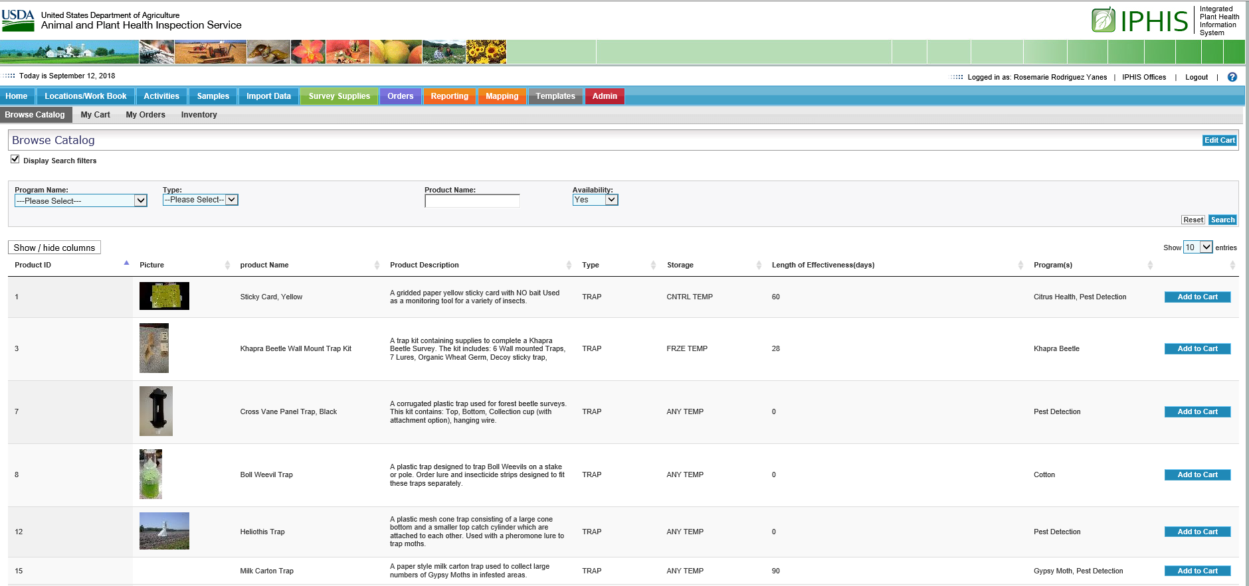
Browse Catalog
Notes:
The Following Screen will appear.
It will say Browse Catalog
Make sure that the “Availability” is set to YES

Slide 30
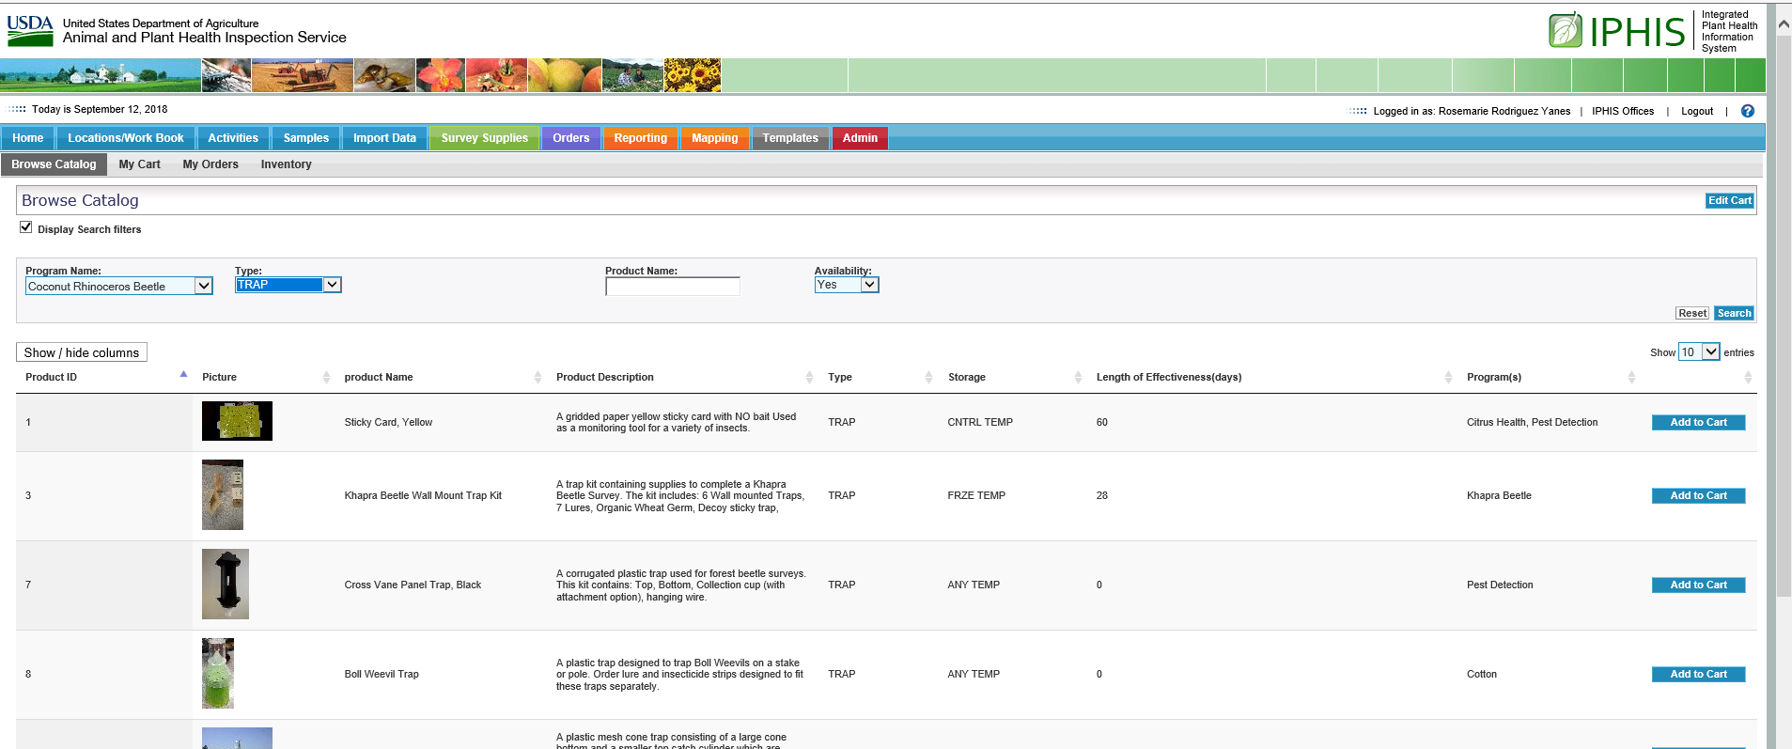
Browse Catalog
Notes:
You can search by:
-Program Name
By choosing that option – you have to choose Trap, Lures and Supplies for that Program
You can also search by Product Name,

Slide 31
Browse Catalog
Notes:
To get a better view of the Product Photo- Click on the Photo

Slide 32
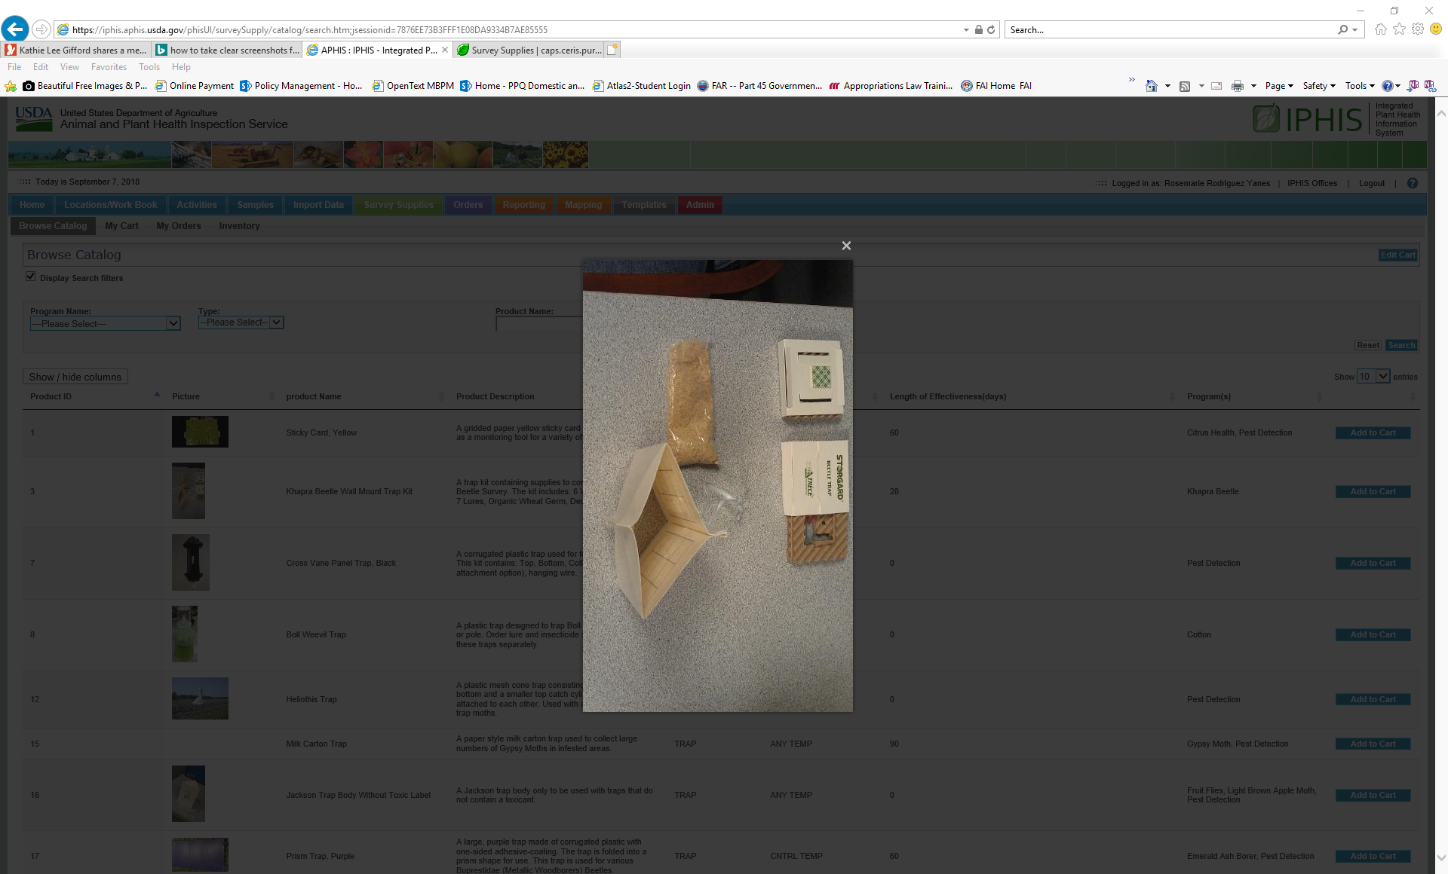
Browse Catalog- Viewing Pictures
Notes:
.

Slide 33
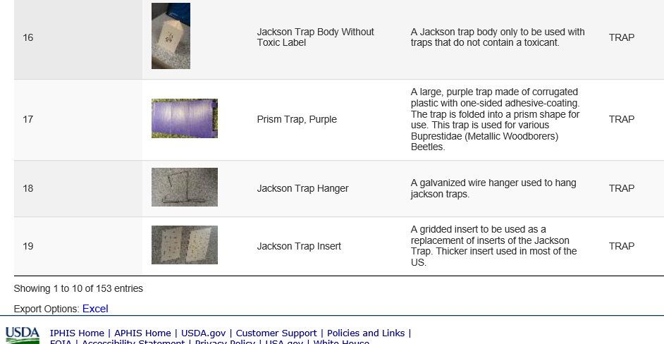
Browse Catalog
Notes:
You can get the Supply Catalog in an Excel Format by clicking on the bottom EXCEL –Tab.

Slide 34
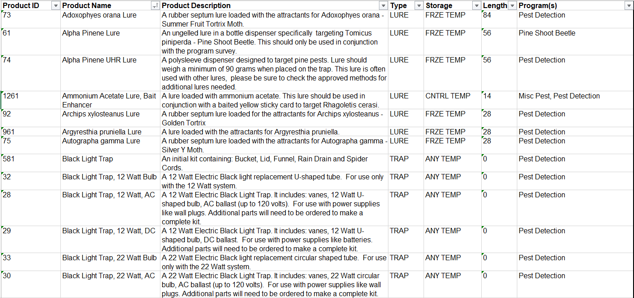
Browse Catalog in Excel
Notes:
Here is the Catalog in Excel.

Slide 35
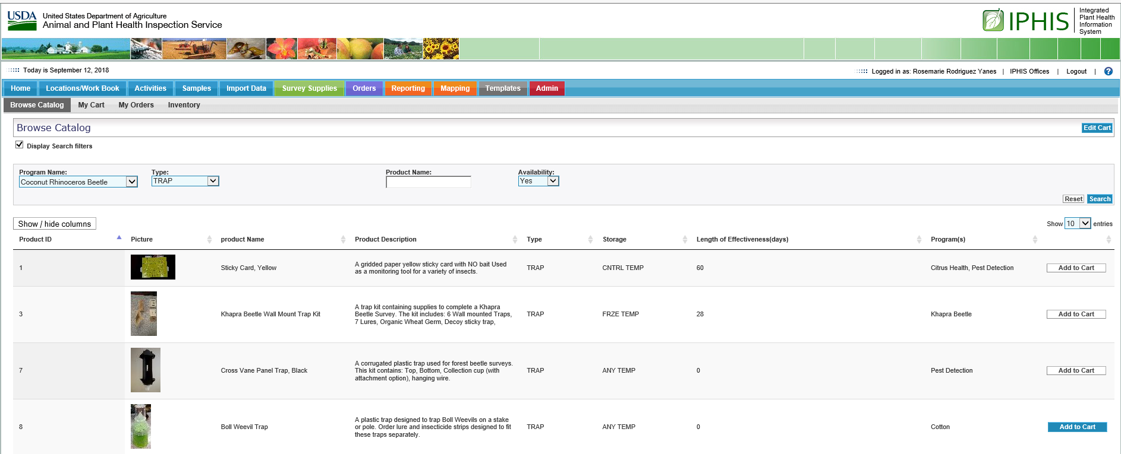
Adding to Cart
Notes:
Adding to Cart
-Select products
The Add to Cart Tab will go from blue to white color

Slide 36
Adding to Cart
Notes:
Adding to Cart
To see what is in the cart
Click on the Edit Cart Tab

Slide 37
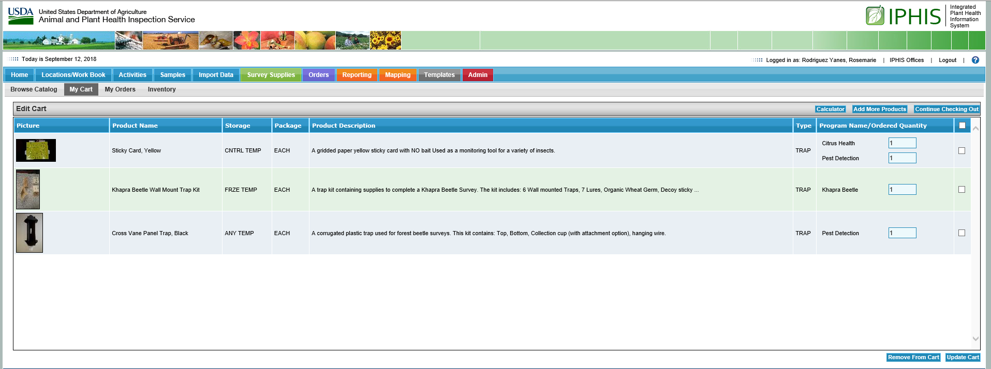
Edit Cart
Notes:
Some product have more than one funding source.
.

Slide 38
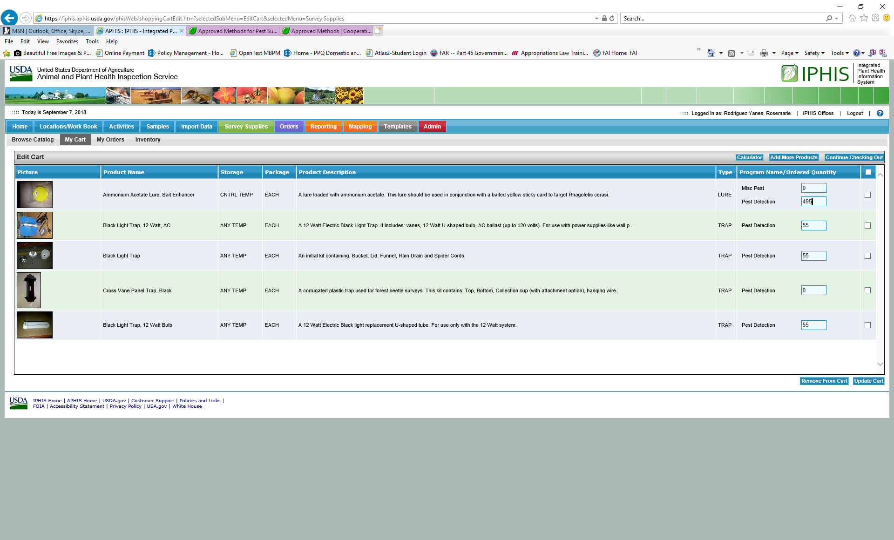
Edit Cart – Add More Products
Notes:
Products can be add at time. Just select the ADD More Product – Tab and it will take you to the Catalog.

Slide 39
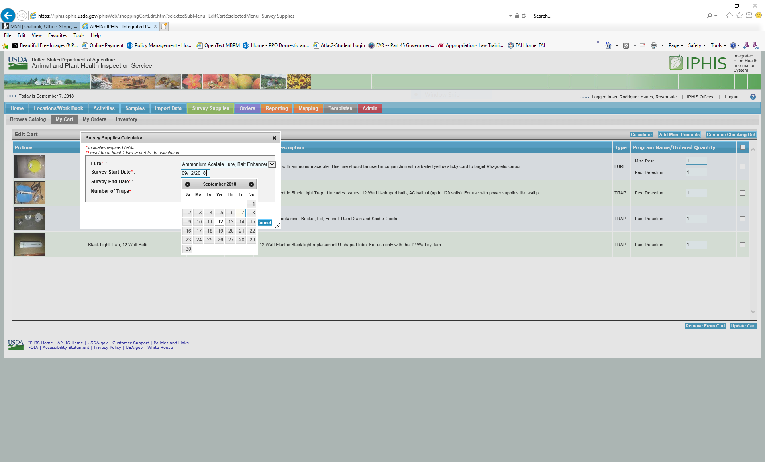
Edit Cart - Calculator (Optional)
Notes:
You will need to fill out 4 fields.
- Select the lure type
Select the start date
Select the end date
Enter number of trap locations

Slide 40
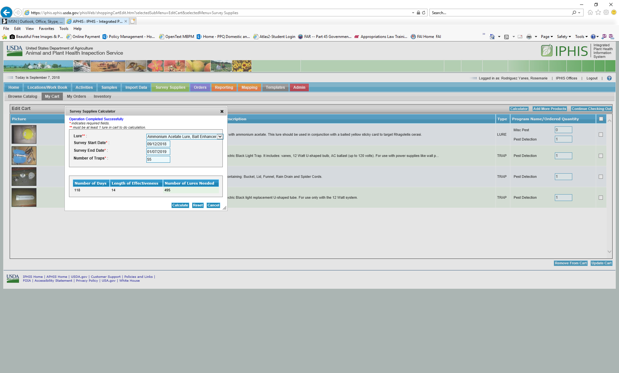

Edit Cart – Calculator (Optional)
A starting point. You will still enter the final numbers into the Edit Cart. Consider Survey Supplies Best Practices.
Notes:
IPHIS will generate the number of lures needed.
An approximation.
Remember to add to the results for loss rates and malfunctions
A starting point. You will still enter the final numbers into the Edit Cart box.

Slide 41
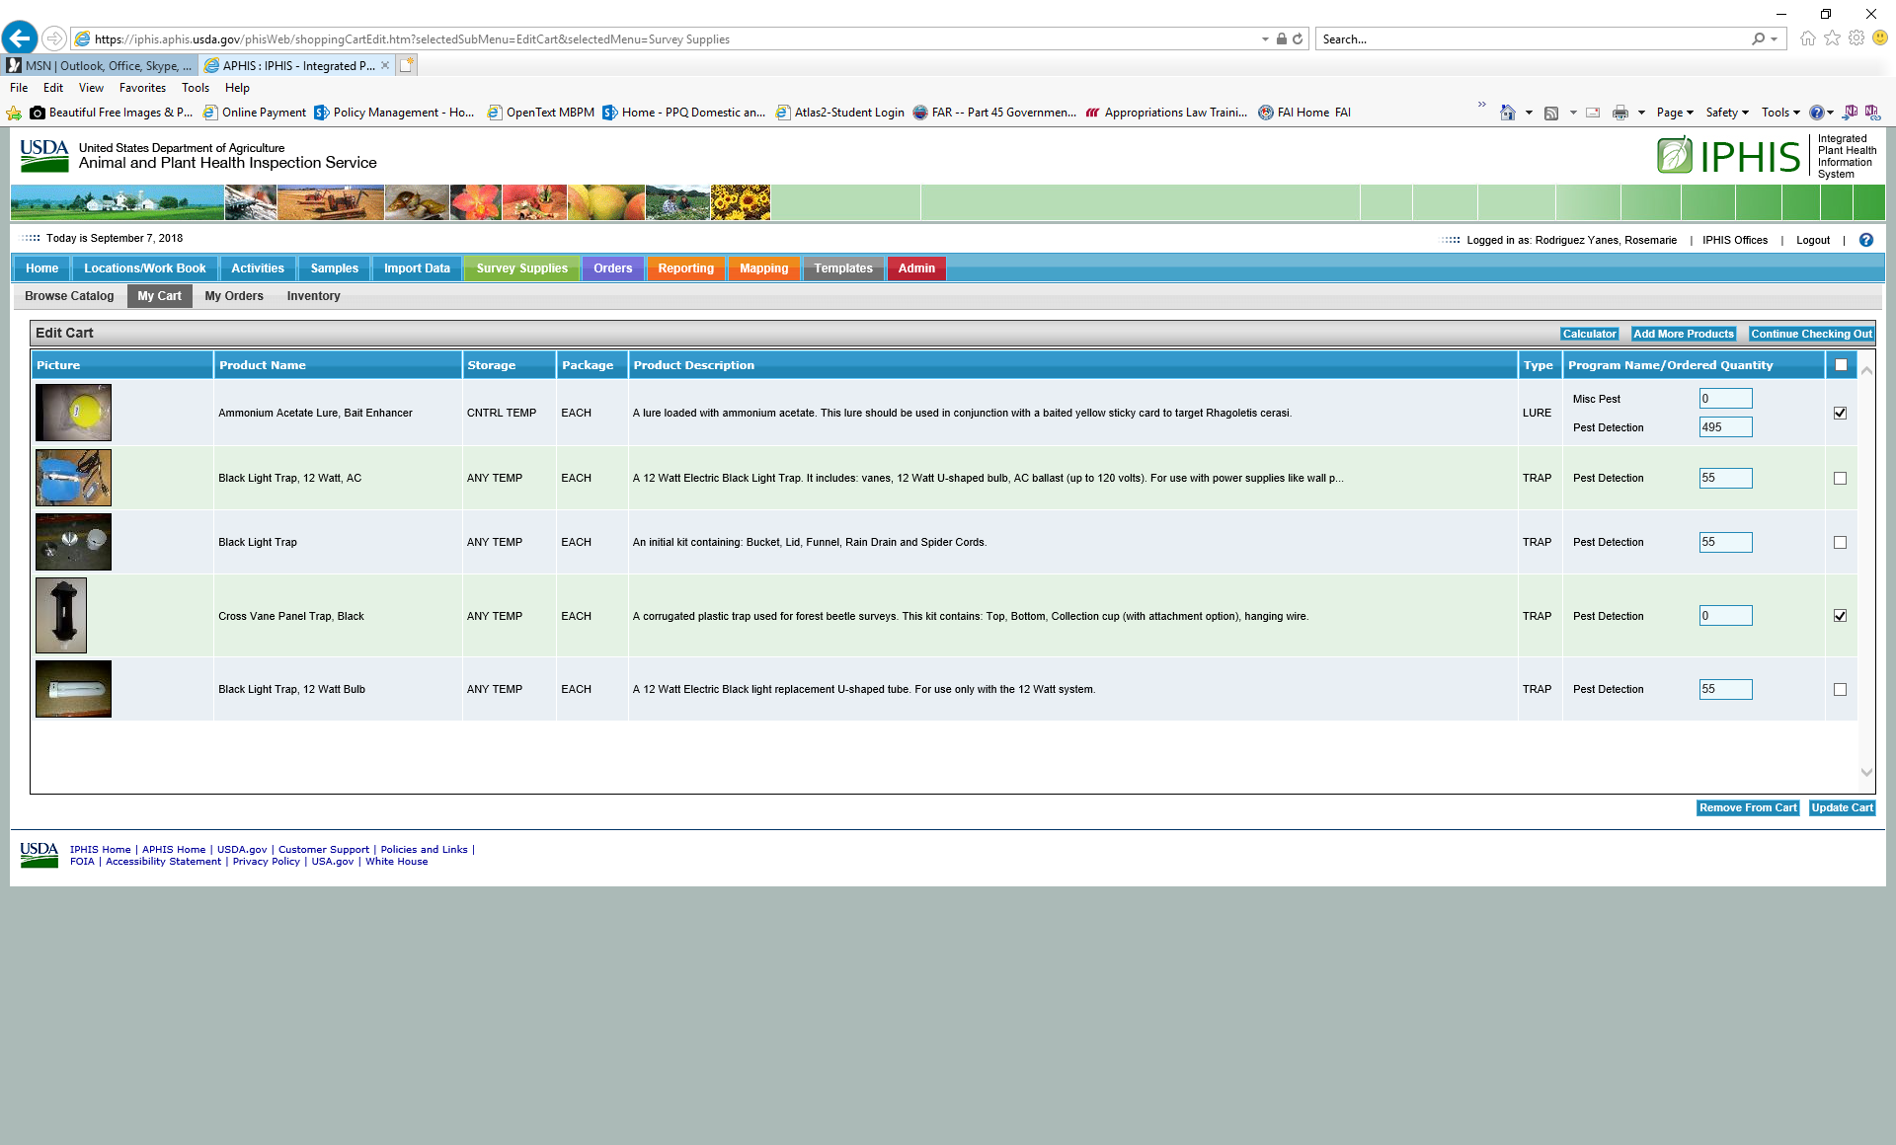
Edit Cart – Remove From Cart
Notes:
To remove from cart.
You need to select the product to be removed – by checking the corresponding box
Click the Remove From Cart Tab

Slide 42
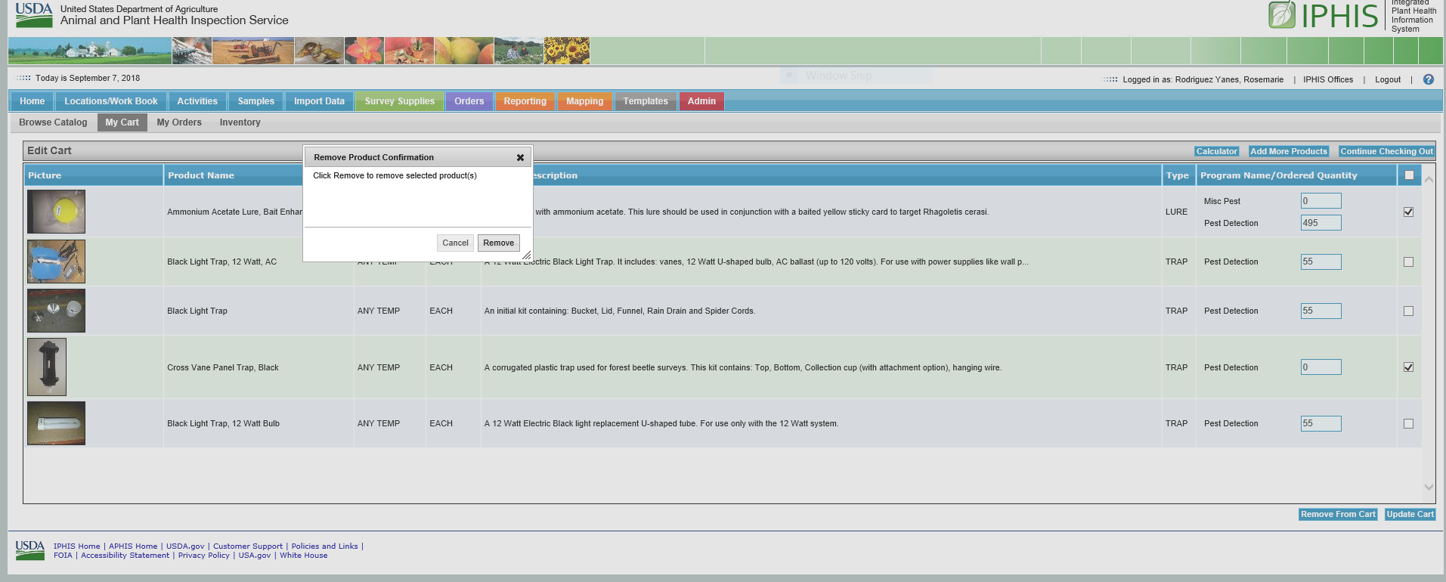
Edit Cart – Remove From Cart
Notes:
A box will appear to confirm you want to remove from cart.
Select the remove button.

Slide 43
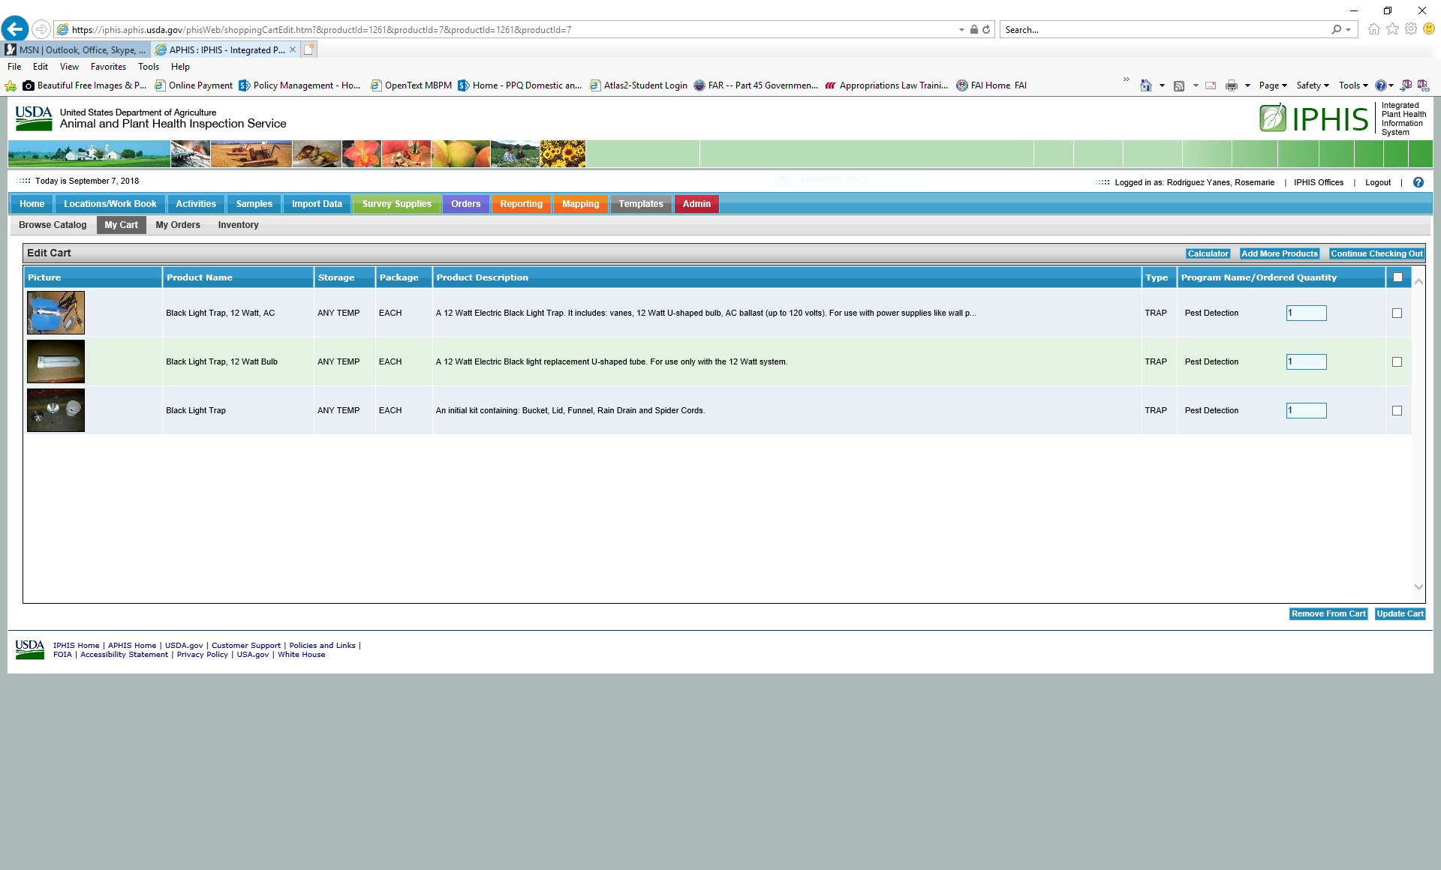
Edit Cart –Continue Checking Out
Notes:
The product was removed.
Let Continue Checking Out.
You will need to click on the “Continue Checking Out” tab.

Slide 44
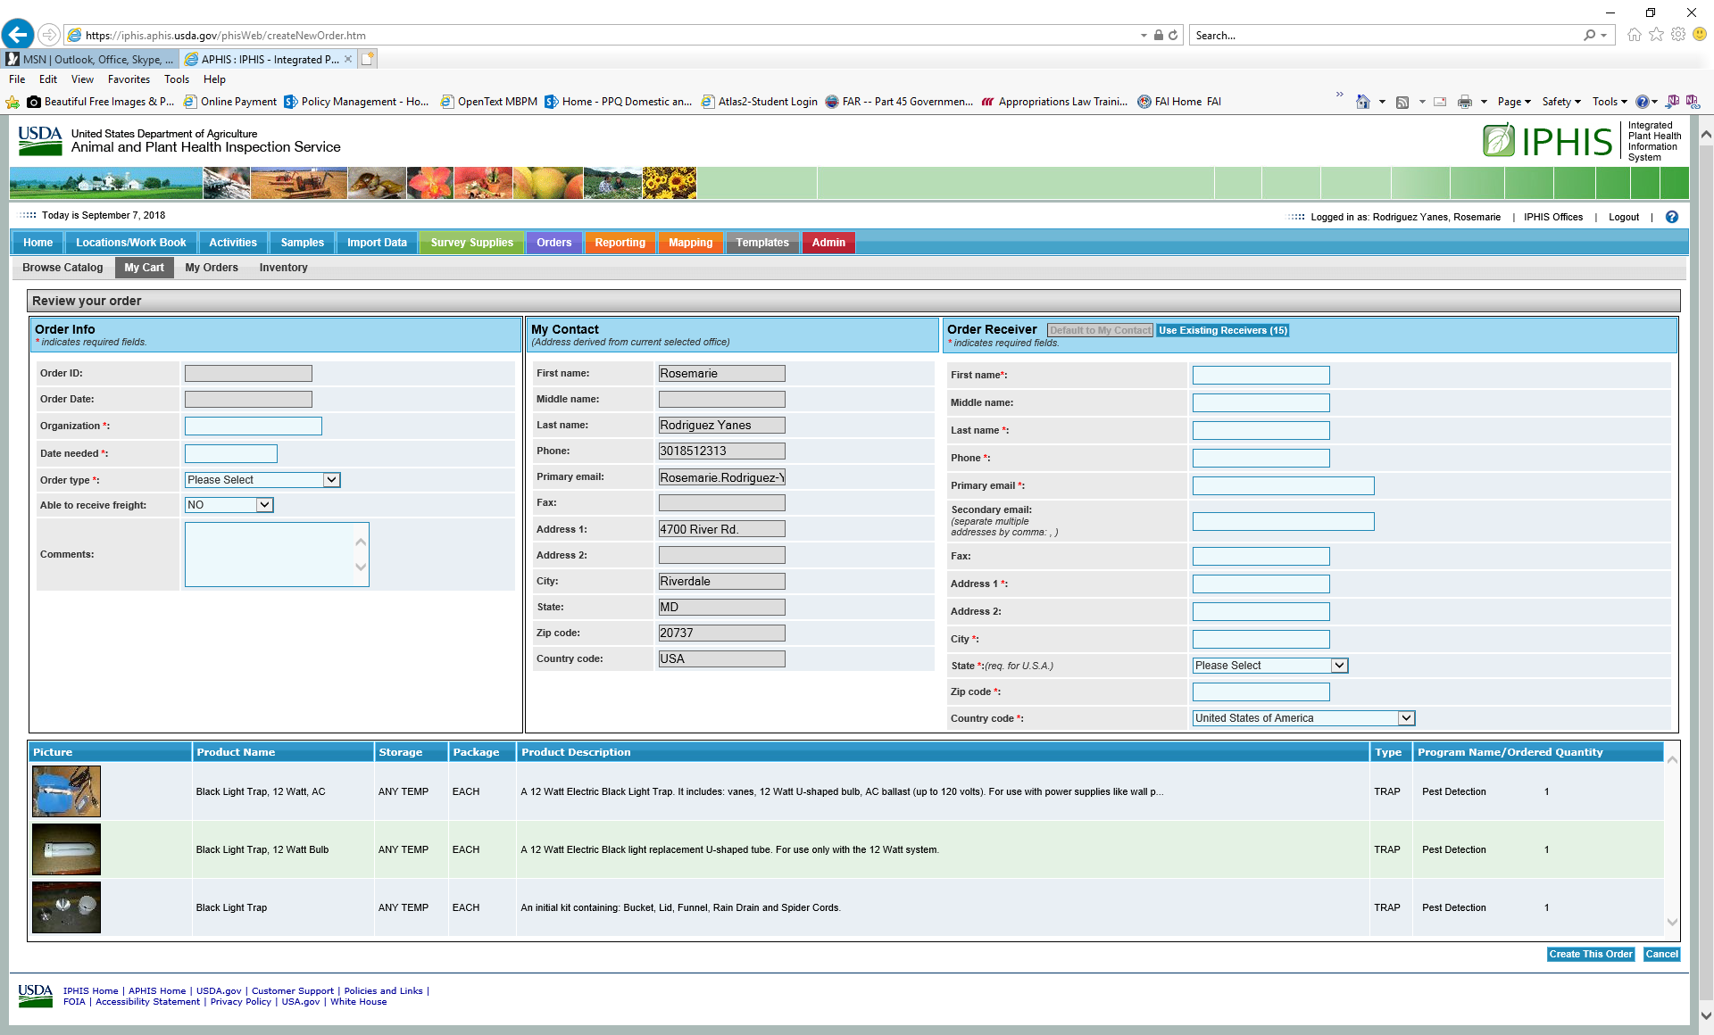
Continue Checking Out
Notes:
The first section is the “Order Information”

Slide 45
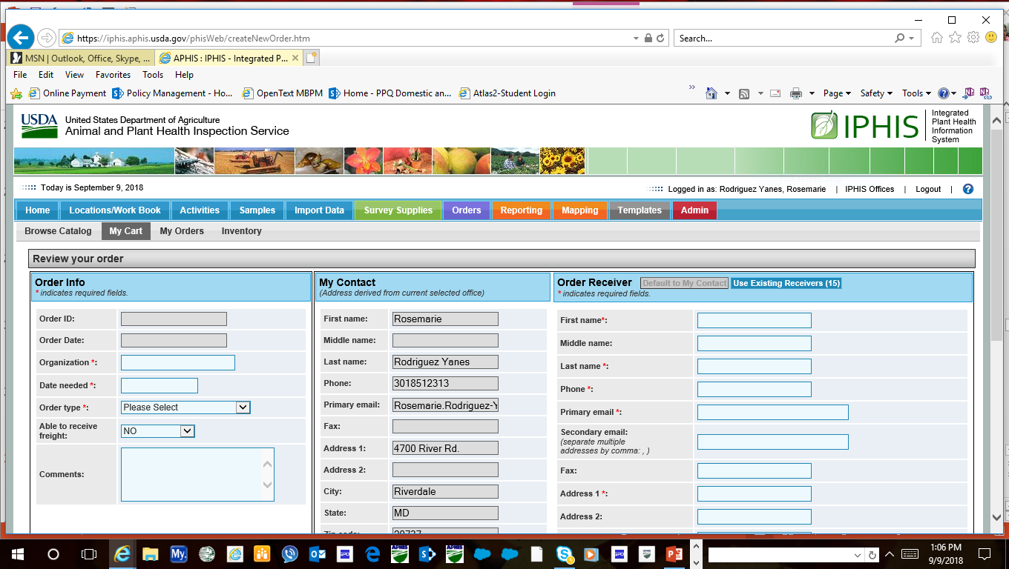
Continue Checkout – Order Info
Order ID: Auto Populated
Order Date: Auto Populated
Organization: The Receiver's organizations must be inputted-
State, or PPQ is fine.
Date needed: Only one date per order. Date entered should be 3-4 weeks before survey begins.
Order Type: Select “New” unless told otherwise.
Able to receive freight:
No - If your need UPS or FedEx delivery, Inside Delivery
Yes – If you have a loading dock and are able to receive pallets.
Comments: Enter title of Project (Optional)
Notes:
Organization: The Receiver’s organization.
• Order Type: Select “New” unless told otherwise.
• Date Needed: Select a date that is about three to four weeks before you need the supplies to start your survey (Example: Survey start date = May 21. Date Needed = May 1). This ensures that there is adequate time to ship the products to you.
• Please do not use arbitrary Date Needed dates such as January 1 for surveys that will not start until the summer. This puts undue pressure on the warehouse staff.
• Due to the holidays, January orders will likely not be shipped until the second week of January each year.
Comments: Enter title of project/survey (example: FY2018 Farm Bill: Pine and EWB/BB). Do not use the Comments field to communicate to the warehouse staff or UPS.
• Do not include notes such as “Call ahead before delivery.” Once the products are shipped, the Survey Supplies staff is not able to notify you of when items will be delivered. Please use a shipping address where someone will be available to receive orders.

Slide 46
Continue Checkout – My Contact
Notes:
The next section is ”My Contact”

Slide 47
Continue Checkout – My Contact
The person placing the order information is auto filled from IPHIS.
The order history and status will reside with this person.
Notes:
The person placing the order information is auto filled from IPHIS.
The order history and status will reside with this person

Slide 48
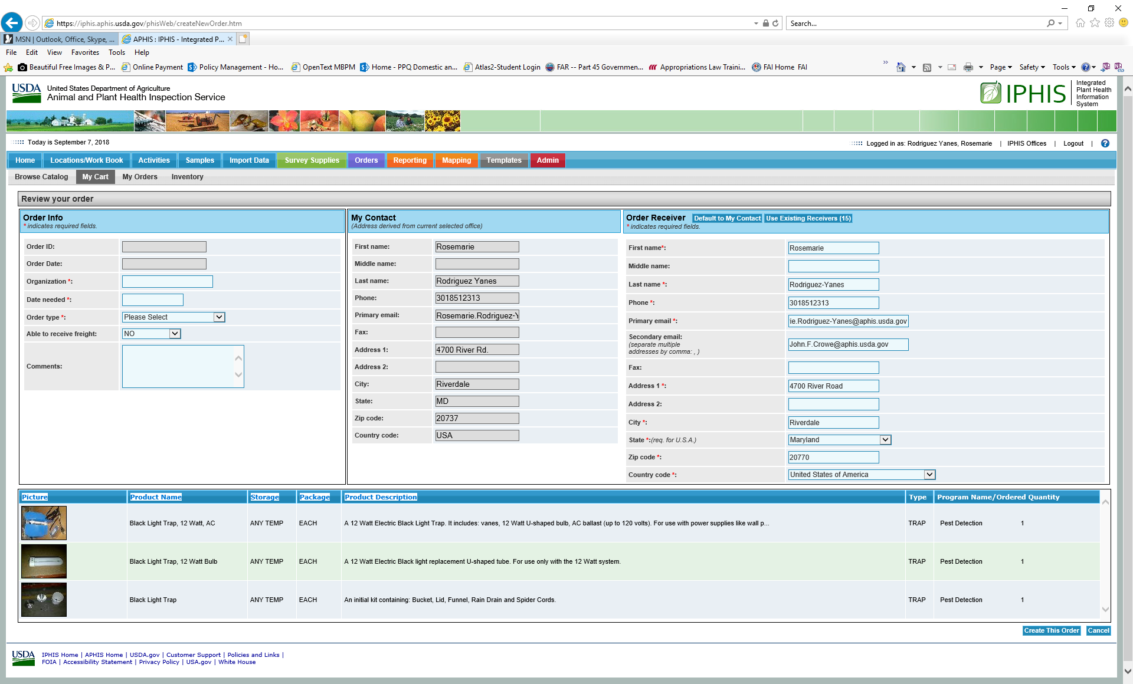
Continue Checkout – Order Receiver
Notes:
The last section is the “Order Receiver”

Slide 49
Continue Checkout – Order Receiver
All Fields can be edited
Use the Secondary email box to include many people.
Orders are not secret information.
The IPHIS System will send messages for you.
The System email notification will ONLY occur:
1) After final Approval or Decline
2) When Order is shipped
Notes:
Use the Secondary email box to include many people.
Orders are not secret information.
The IPHIS System will send messages for you.
The System email notification will ONLY occur:
1) After final Approval or Decline
2) When Order is shipped

Slide 50
Continue Checkout – Order Receiver
Notes:
Is this slide required????

Slide 51
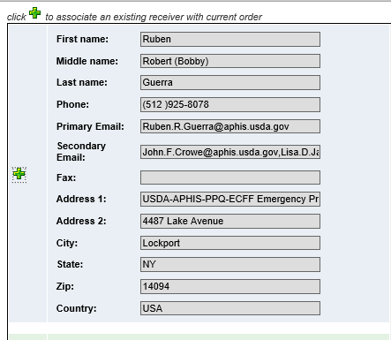
Continue Checkout – Use Existing Receivers
Tracks your previous Order Receivers.
Click plus to add to current Order Receiver information
Notes:
As mentioned before
IPHIS will
Tracks your previous Receivers.
Click plus to add to current Order Receiver information. This is auto populated feature

Slide 52
Continue Checkout- Order Receiver
Will designate the Approval Chain
Notes:
All fields can be edit.
The State field will designate the Approval Chain for this Order

Slide 53
Continue Checkout – Order Receiver
Maryland Approvers will be responsible for this order.
Notes:
Sometimes the My Contact State Field and Order Receiver Field will be the same or different.

Slide 54
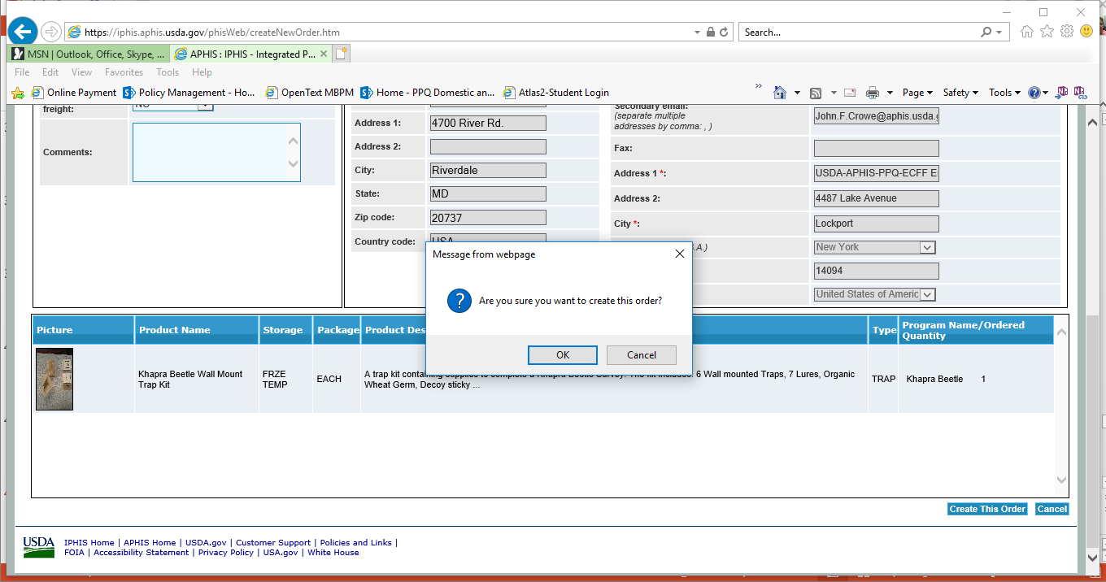
Create the Order
Notes:
Your ready to Create the Order.
Click the Create the Order Tab.
A box will appear. Click OK.
If you log out of the IPHIS system, your cart will be emptied.
You will need to start over again placing the order.

Slide 55
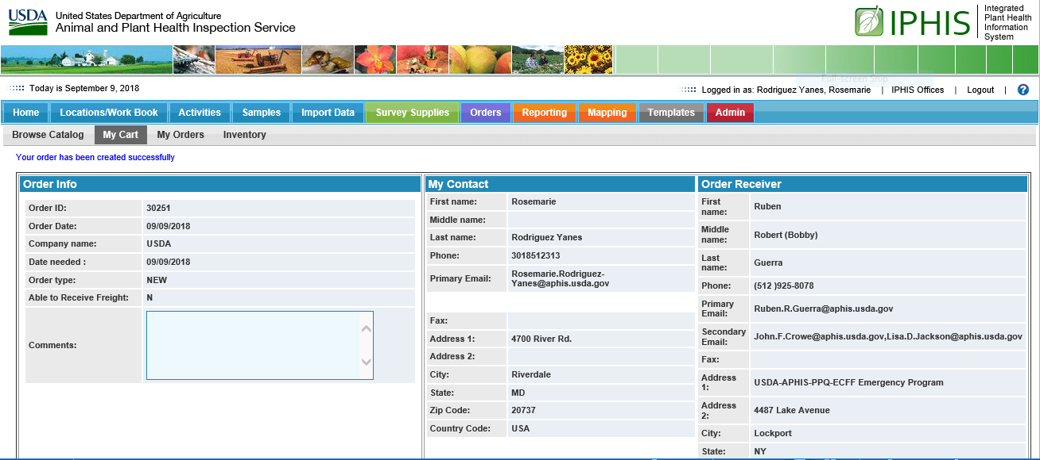
Order Created
Notes:
You will receive a message from IPHIS.
Your order has been created successfully.

Slide 56
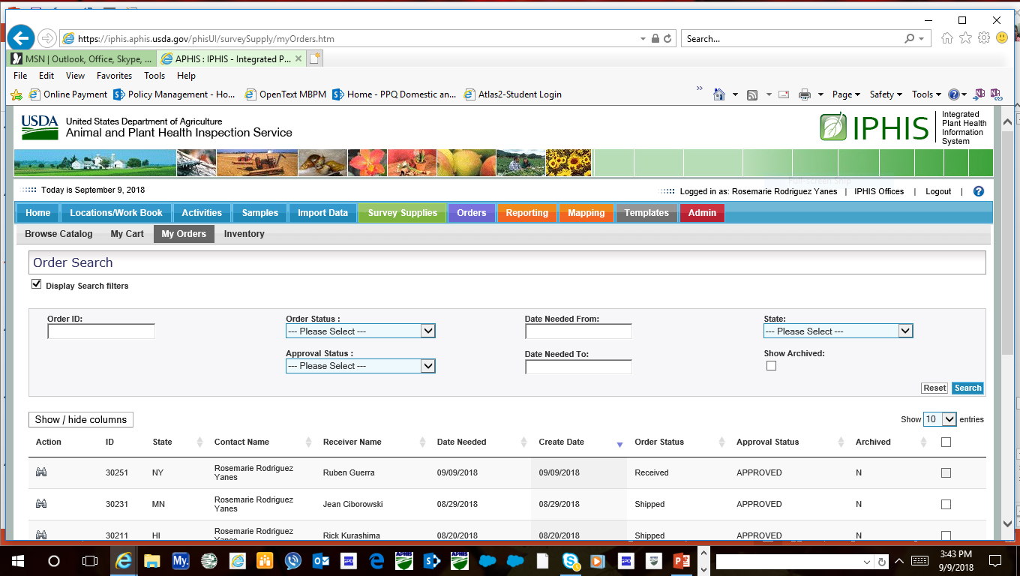
My Order
Notes:
To view your order click on the “ My Order” Tab.
Select the binocular button.

Slide 57
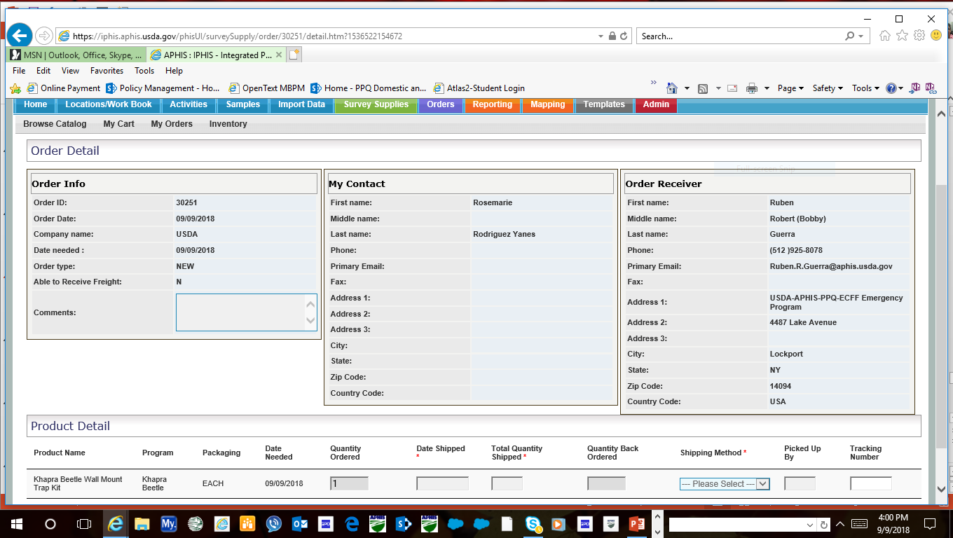
My Orders - Review
Notes:
The order will appear.

Slide 58
Ordering Open Periods
Fall 2021
September 13 through November 19
  2022 CAPS
  PPQ supported programs (including EAB)
Winter 2021/Spring 2022
Dependent on when the PPA 7721 Spending Plan is announced.
  2022 PPA 7721
  2022 CAPS
  PPQ supported programs
Notes:
I have mention the 2 Ordering Open Periods.
The First Ordering Open Period is in the:
-Fall of 2018
-Opens -September 17th
-Closes – November 30th
The Second Ordering Open Period is in the Winter of 2018 or Spring of 2019
-It is Dependent on the Farm Bill Spending Plan
It is highly recommended to place your survey orders during these ordering open periods.
**There is a separate ordering period for EAB surveys. Usually in February.

Slide 59
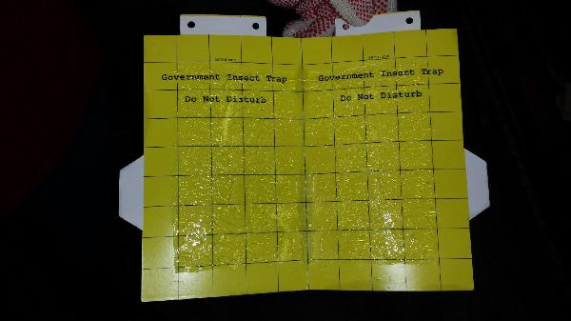
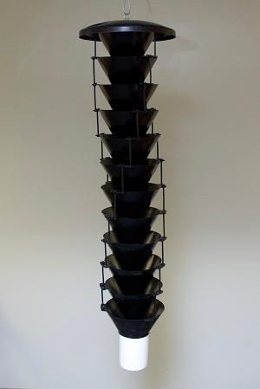
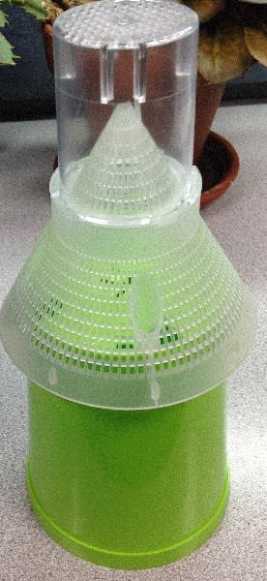
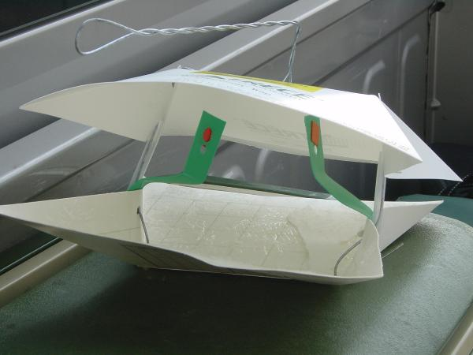
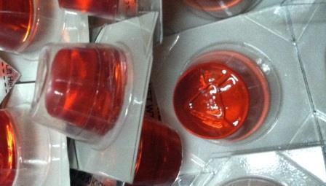
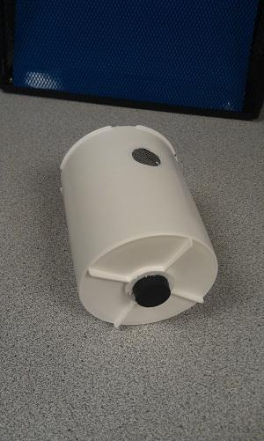
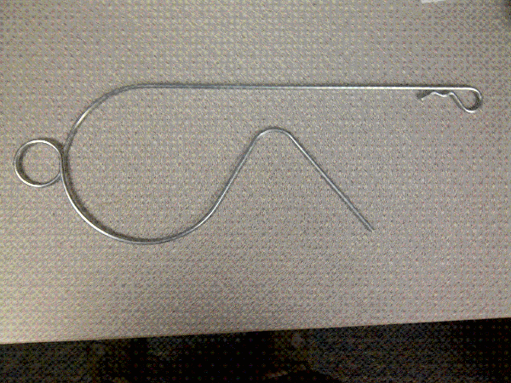
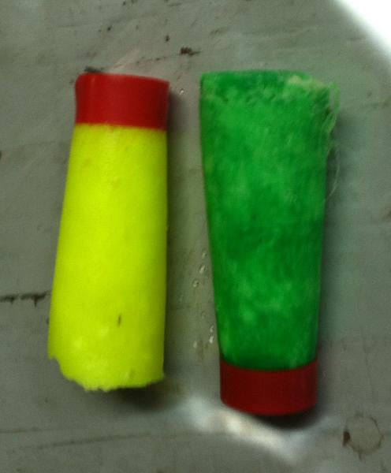
Questions?
Notes:
Do we have any questions?

Slide 60
CONTACTS:
Survey Supplies General Box – SSPP@usda.gov
Lisa Jackson – Lisa.D.Jackson@usda.gov – (919) 855-7549
- Eastern & Western Plant Board States
Darrell Bays – Darrell.a.bays@usda.gov – (919) 855-7607
- Central & Southern Plant Board States
Patrick Haslem – Patrick.Haslem@usda.gov – (301) 851-2098

Slide 61
Thank You

