Slide 1
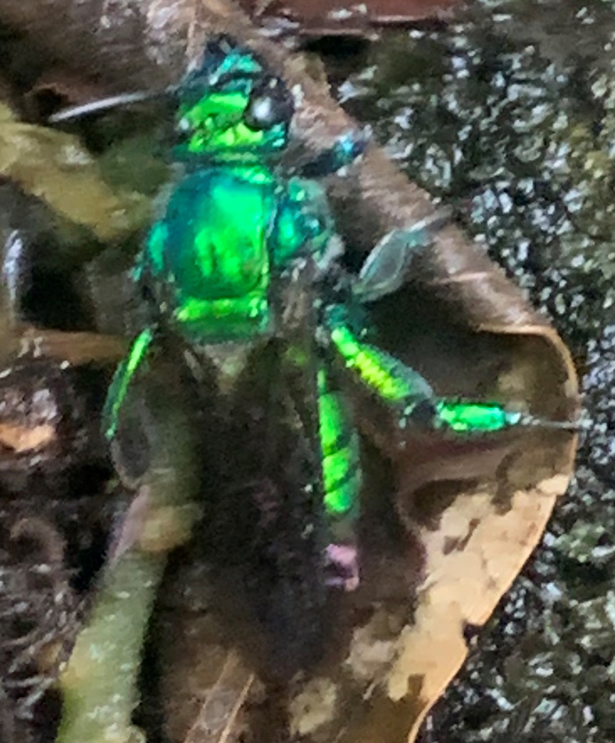
S&T CAPS Support
Annual NCC Meeting - Virtual
January 25-27, 2022
Dan Mackesy

Slide 2
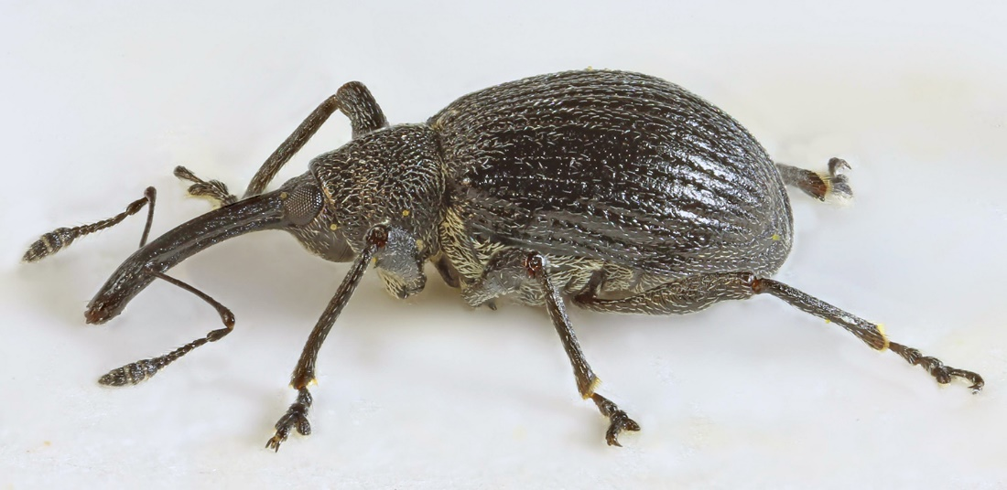
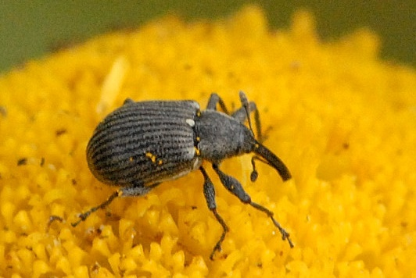
2023 Priority Pest List changes
Adding
Anthonomus rubi (strawberry blossom
weevil)
Lure: Anthonomus rubi Lure
Trap: Unitrap*
*traps under review
Photos from wikimedia commons,
(CC-BY-SA-4.0)

Slide 3
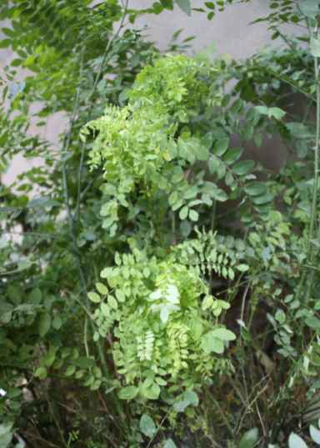
2023 Priority Pest List changes
Adding
‘Candidatus Phytoplasma ziziphi‘ (jujube witches’-broom)

Slide 4
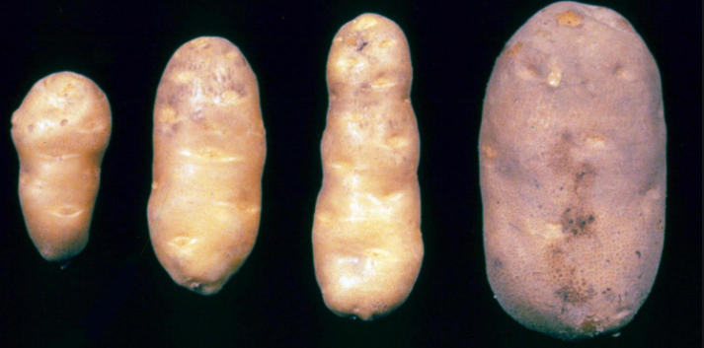
2023 Priority Pest List changes
Adding
Pospiviroid Potato spindle tuber viroid (Potato spindle tuber viroid, PSTVd)

Slide 5
2023 Priority Pest List changes
Removals
Scientific Name | Common Name | Reason
Hemileia vastatrix | Coffee leaf rust | Found in all places, detection surveys are no longer required.
Cocadviroid Coconut Cadang-Cadang Viroid | Coconut cadang -cadang (CCCVd) | Proposed survey methods require young fronds from tops of trees; this method is unsafe.
Anthonomus grandis | Boll weevil | Detection and delimit surveys are managed by cotton program.
Pectinophora gossypiella | Pink bollworm | Detection and delimit surveys are managed by cotton program.

Slide 6
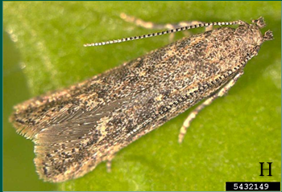
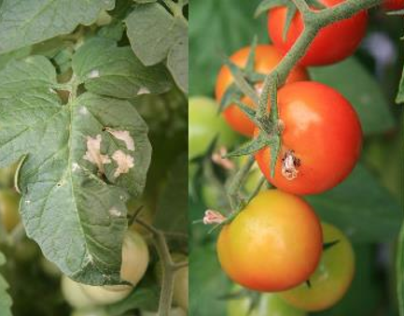
2023 Priority Pest name changes
Tuta absoluta (tomato leafminer)
New scientific name:
Phthorimaea absoluta Chang and Metz, 2021

Slide 7
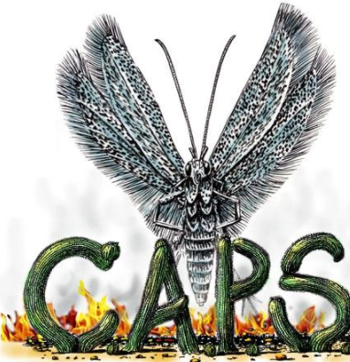
S&T CAPS Support Team
Shelley Gray, Assistant Director
Dan Mackesy, General Topics and Pathogen Lead
Colin Funaro, Arthropod Lead
Contact us at
stcaps@usda.gov

Slide 8
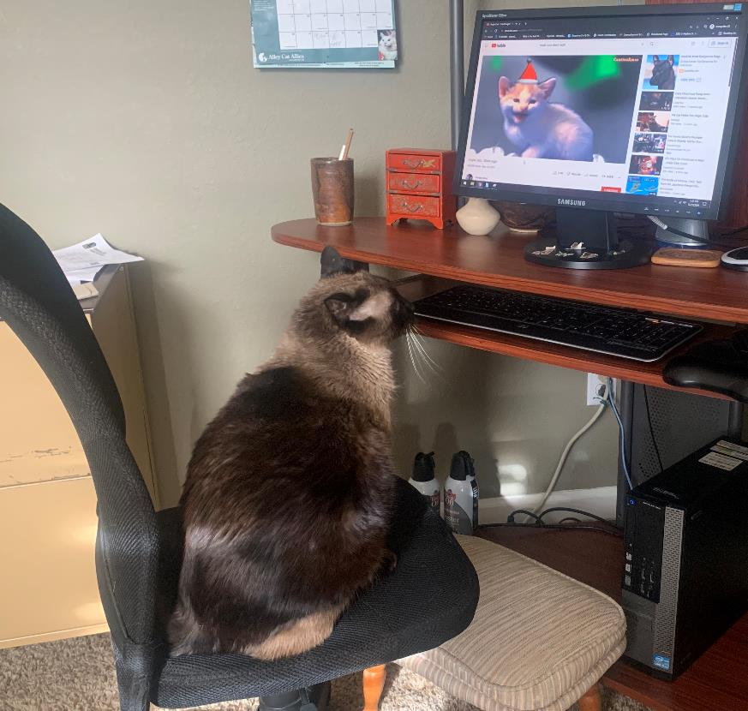
Any Questions?

