Slide 1
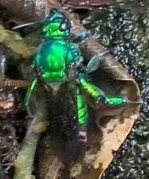
S&T CAPS Support AMPS Page discussion
Annual NCC Meeting - Virtual
January 27, 2022
Dan Mackesy

Slide 2
AMPS page updates
Proposed new format of AMPS pages
New design
Survey and diagnostic information is now only on the AMPS page
Request for feedback on AMPS page layout/content

Slide 3
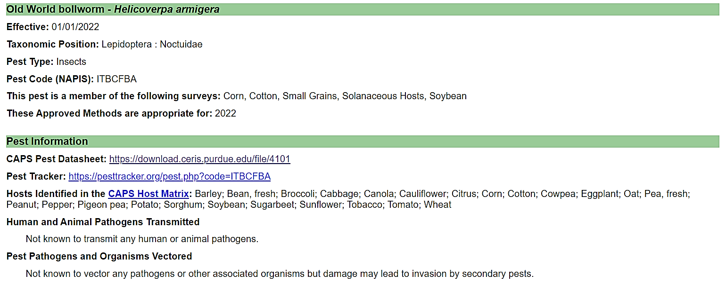
AMPS page updates
New layout – General pest information

Slide 4
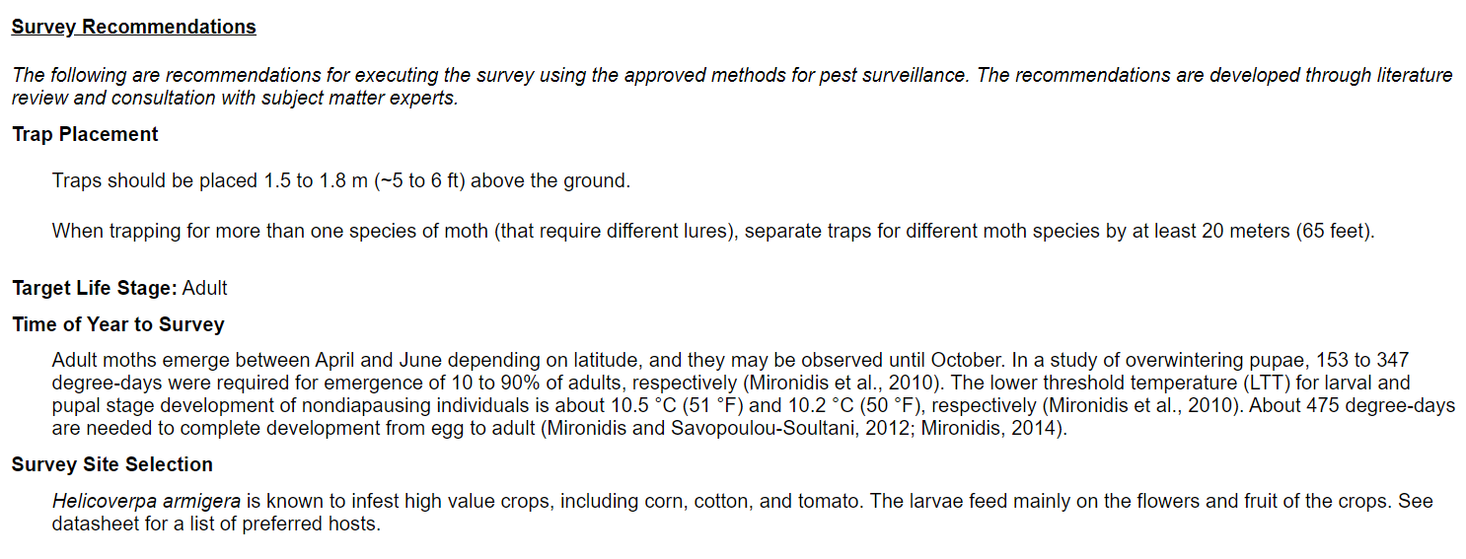
AMPS page updates
New layout – Survey recommendations

Slide 5
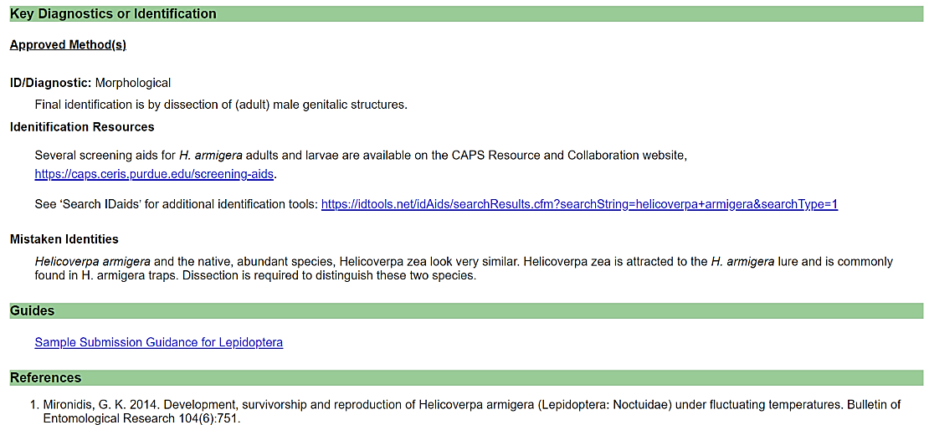
AMPS page updates
New layout – Diagnostic information and resources

Slide 6
Future AMPS page updates
Add SAFARIS maps and degree day information when they become available
Add specific lure information to AMPS pages when available
Increase visibility of safety datasheet (SDS) information

Slide 7
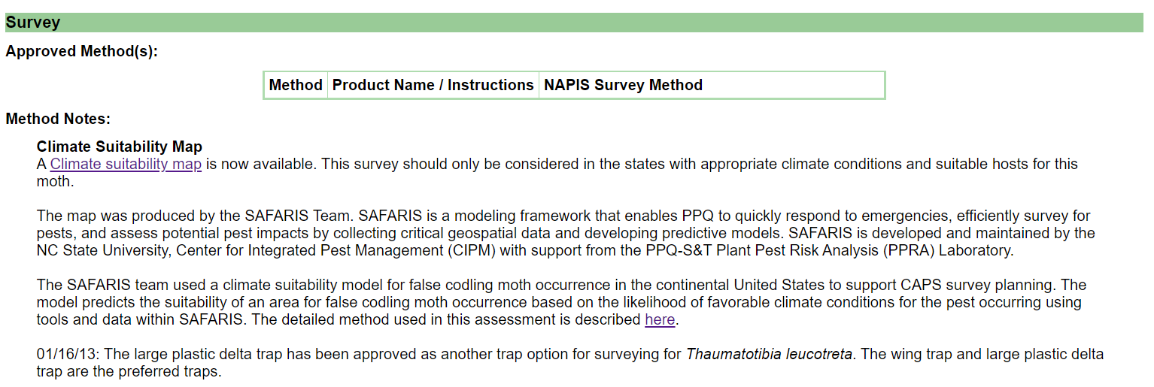
Future AMPS page updates
Add SAFARIS maps and degree day information when they become available.

Slide 8
Future AMPS page updates
Add specific lure information to AMPS page.
Lure shelf life, storage, end contamination information will be made more visible on the AMPS page. It is also available on the IPHIS page.

Slide 9
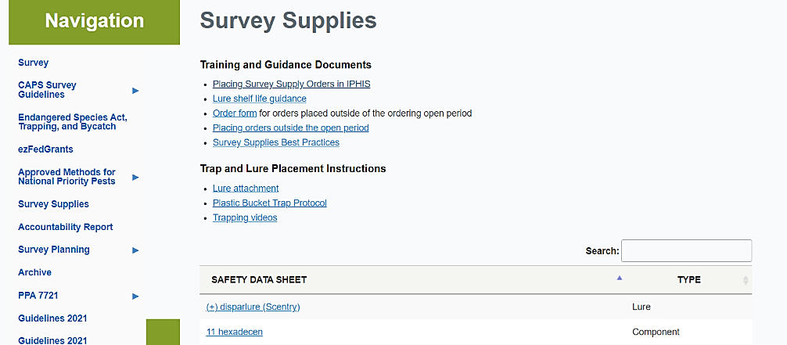
Future AMPS page updates
Increase visibility of safety datasheet (SDS) and lure shelf-life information
SDS and lure shelf-life information are currently in the ‘Survey supplies’ section of the CAPS website.

Slide 10
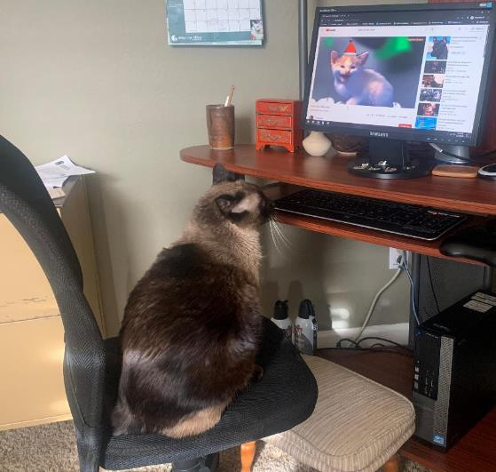
Any other ideas?
Future AMPS page updates

