Slide 1
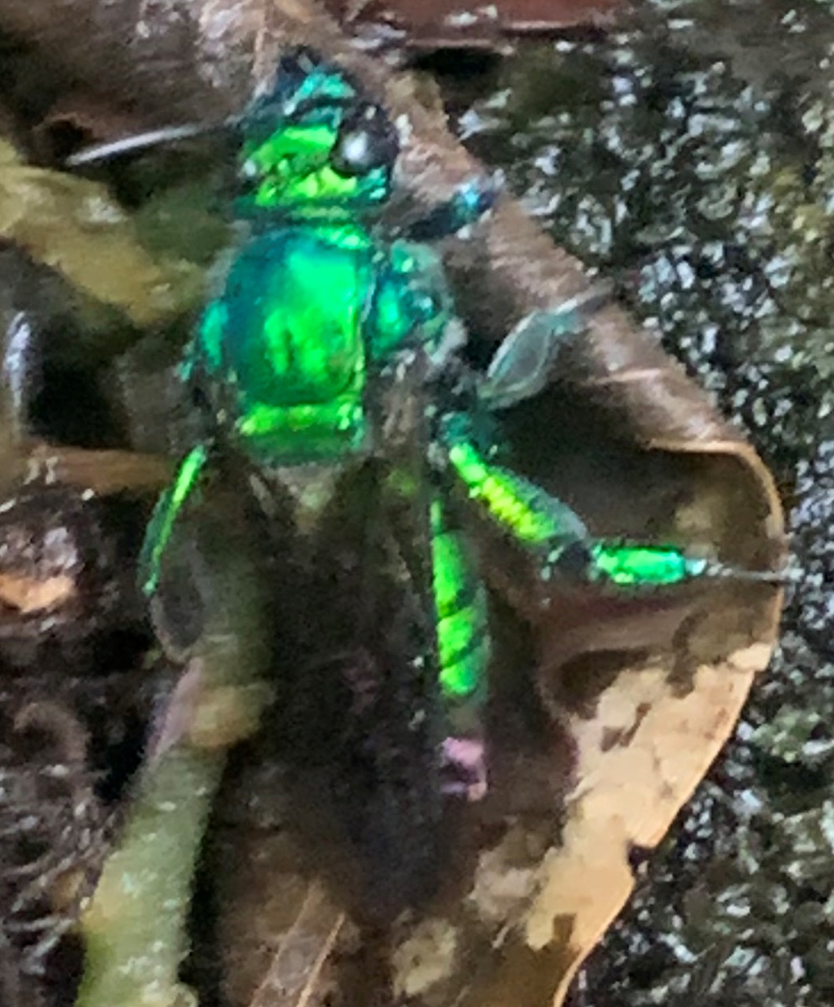
S&T CAPS Support
Annual NCC Meeting - Virtual
January 25-27, 2022
Dan Mackesy

Slide 2
AMPS change request process
Request is submitted
Request is routed
Response is announced

Slide 3
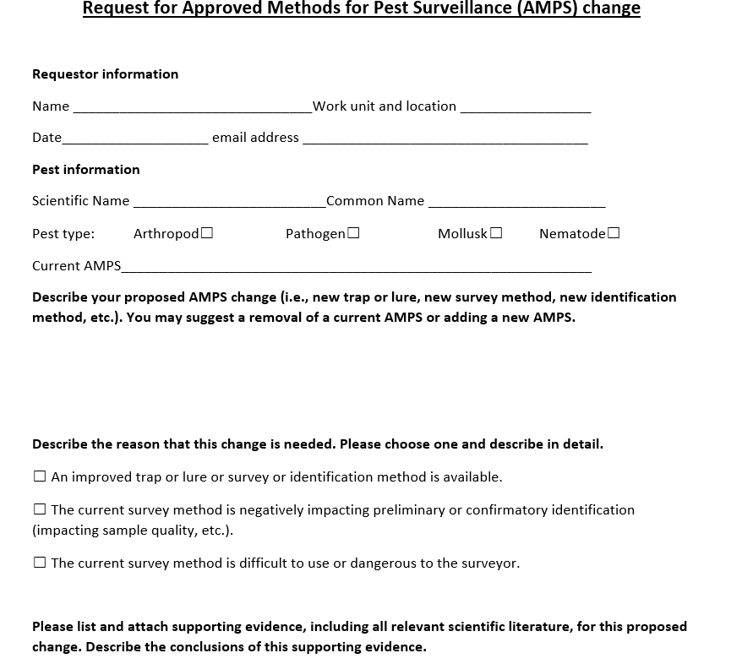
Proposed request form

Slide 4
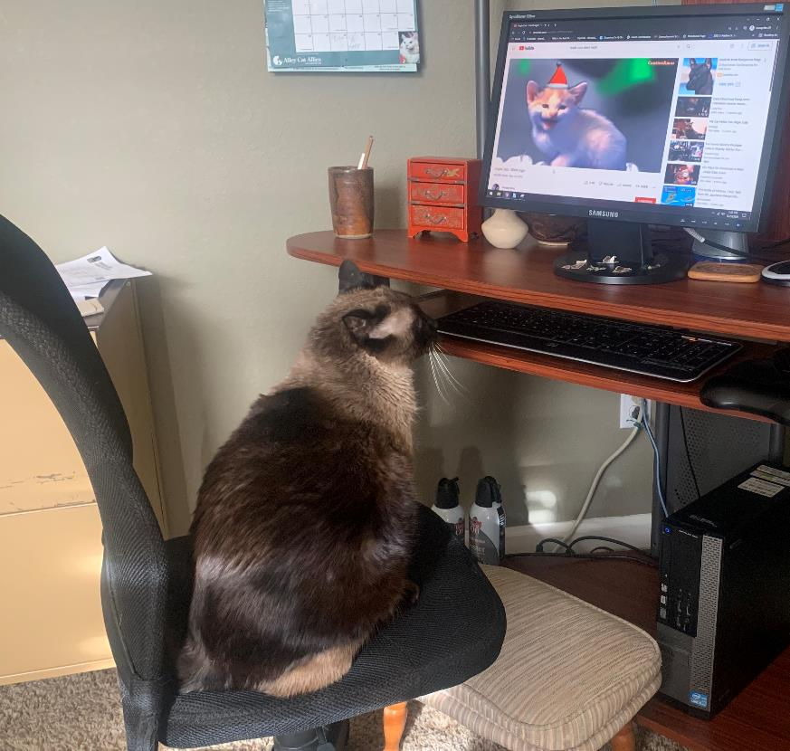
Any Questions?

