Slide 1


CAPS Information Services Update
Providing continuous maintenance, process improvements, and a high level of customer support
EPB Meeting, April 2022
James Kruse

Slide 2

Oversees Access to and the Function of:
CAPS.ceris.purdue.edu
NAPIS.ceris.purdue.edu
PESTTRACKER.org
Email:
CAPSIS@purdue.edu and NAPIS@purdue.edu

Slide 3
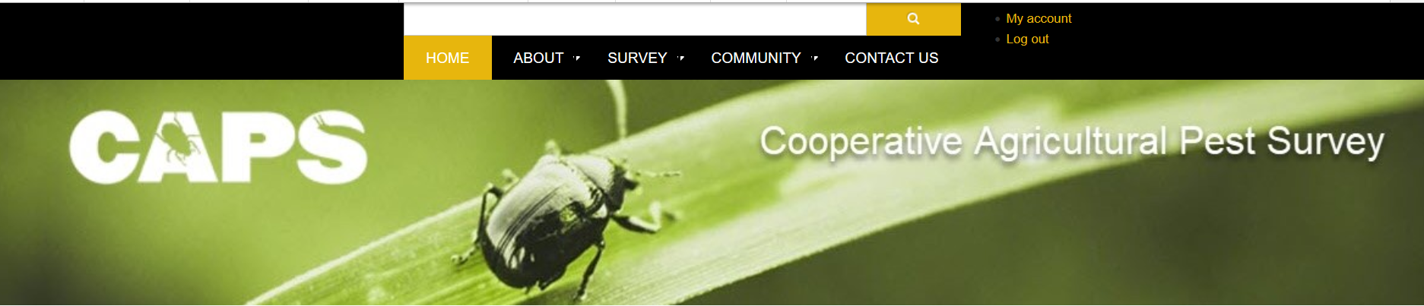
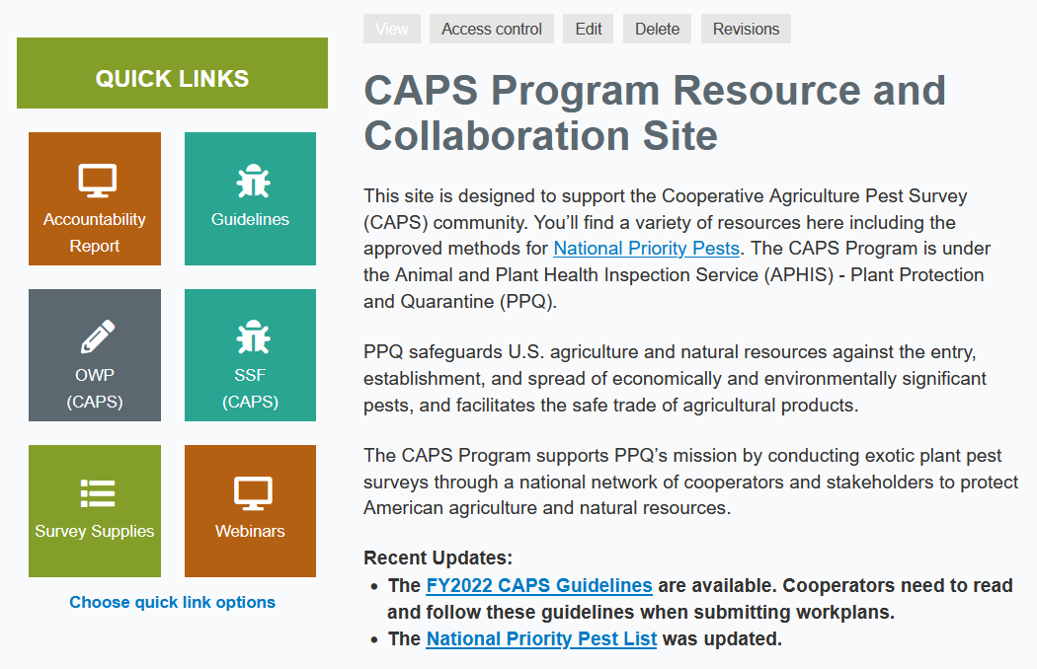
CAPS
Resource and Collaboration Site
Moved from
Drupal 8 to Drupal 9
Updated
Features
Modules
Enhanced security
Better performance

Slide 4
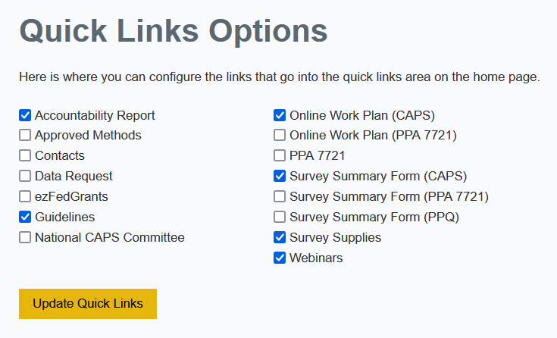
QUICK LINKS

Slide 5
QUICK LINKS
Appear on Your Home Page

Slide 6
Online Work plan
Via Quick Links

Slide 7
Online Work plan
Updates:
Auto Save
  Every minute
  When you move the cursor out of most fields

Slide 8
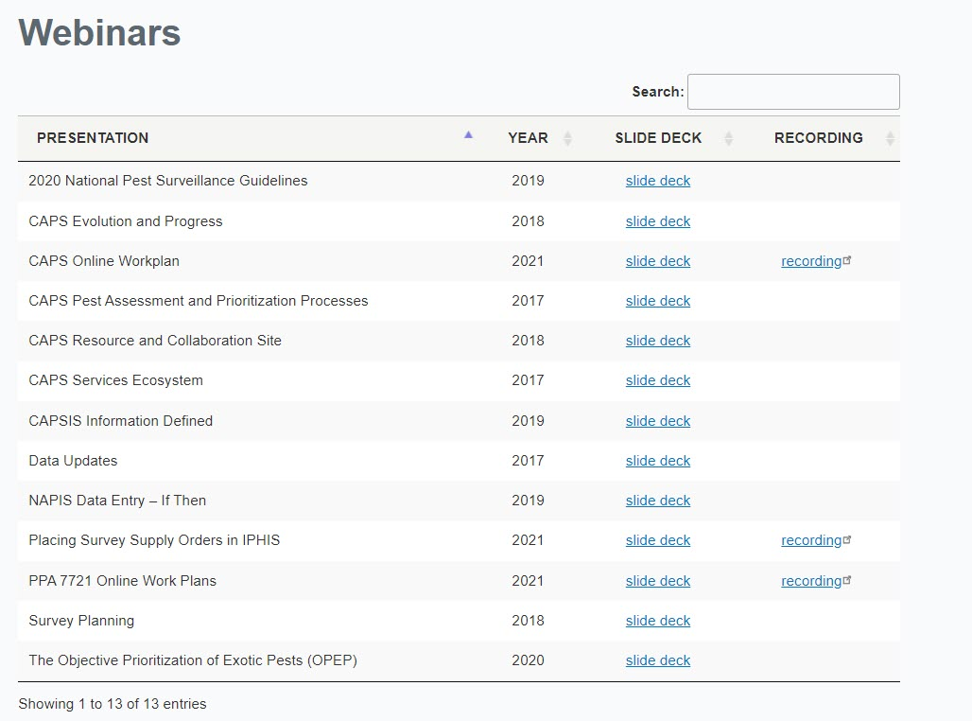
Webinars

Slide 9
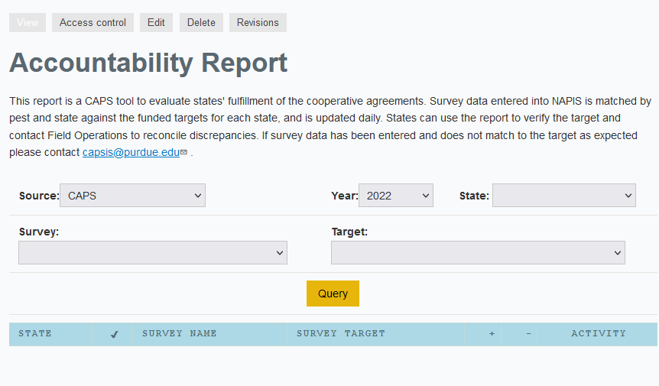
Accountability Report
Keeping Track of Your Data SSF NAPIS

Slide 10
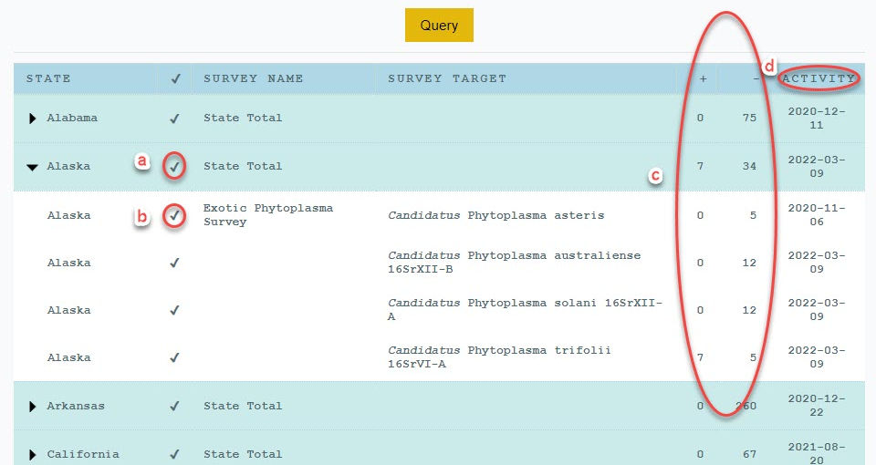
Accountability Report
a - Check mark on blue line (the state line) means everything in the plans has been entered & dash on blue line (the state line) means something has been entered
d - The date of the last date the data was entered
b - Check mark on white lines (pests) means something has been entered
c - The number of summarized units checked for the pest (positives and negatives)
If D is Blank then No Data Has been Entered

Slide 11
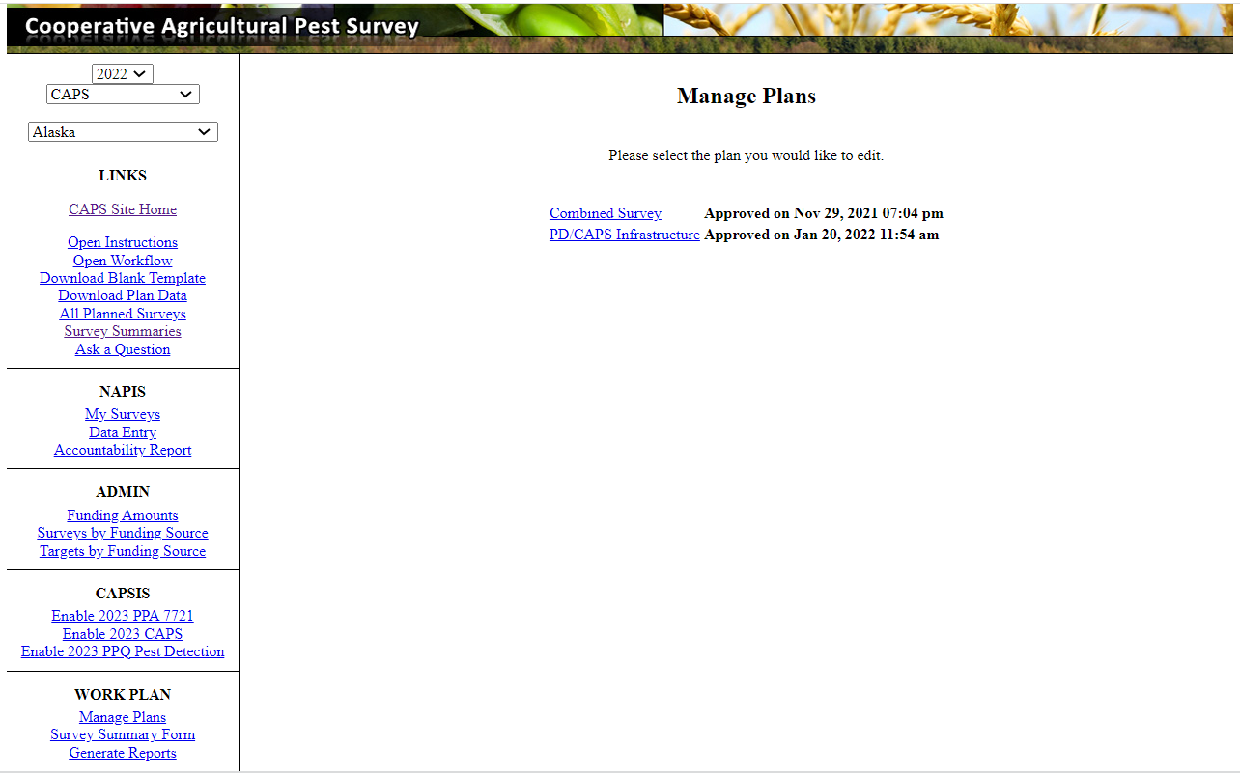
Survey Summary Form
Manage Plans Via Quick Links

Slide 12
Survey Summary Form
Change Requests
Usually made to:
Update a survey method for a pest
Add / Remove a pest from the Survey Summary Form

Slide 13
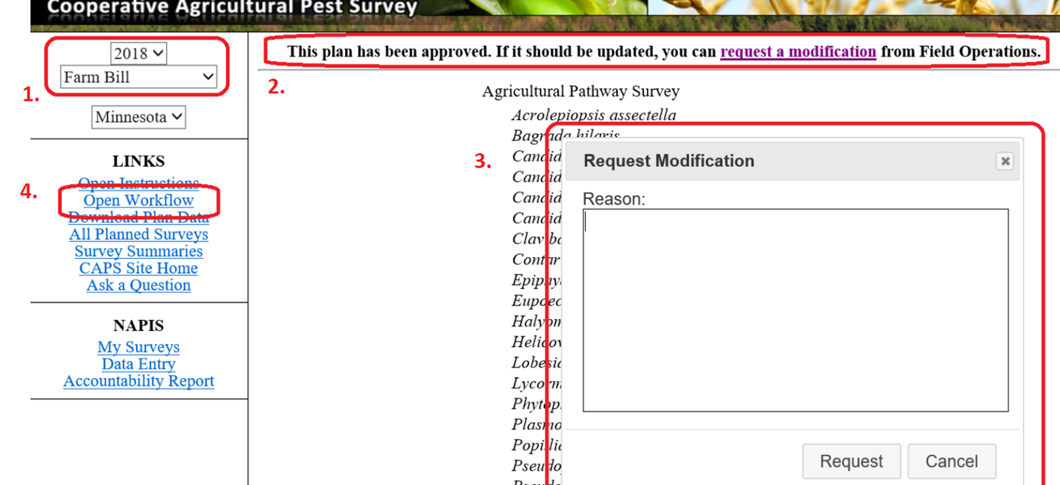
Survey Summary Form
To Make Change Requests:
  Describe the reason for the request, click request
  Check status in Open Workflow
      You should also look for status emails
      And, when approval is given, make edits and save
  Set appropriate funding year, source
  Click on request modification link
Notes:
How to submit a modification request and reason(s) for submitting it.
Usually to update a survey method for a pest or add/remove a pest from the SSF

Slide 14
Open Workflow
An approved change request can take a SSF from “Approved” to “Being Entered”

Slide 15
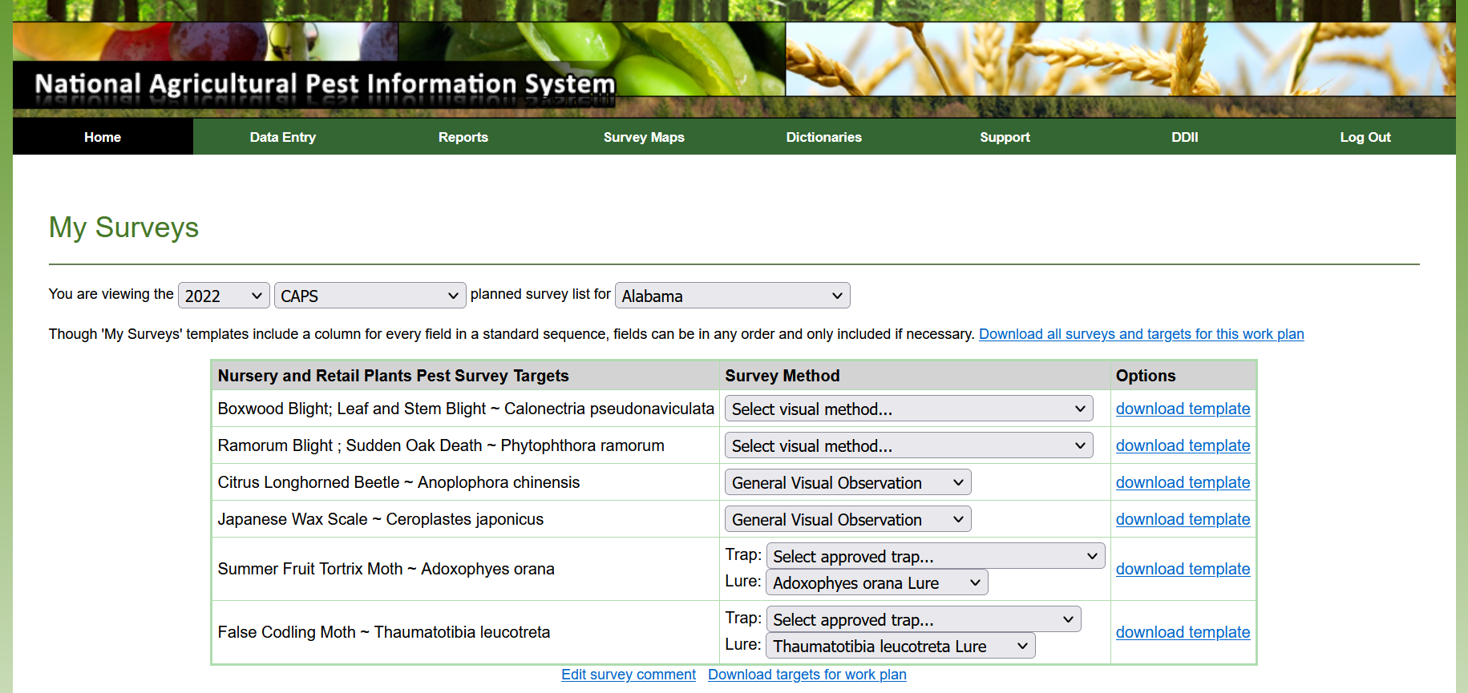
Survey Templates
Templates are Available in NAPIS: My Surveys

Slide 16
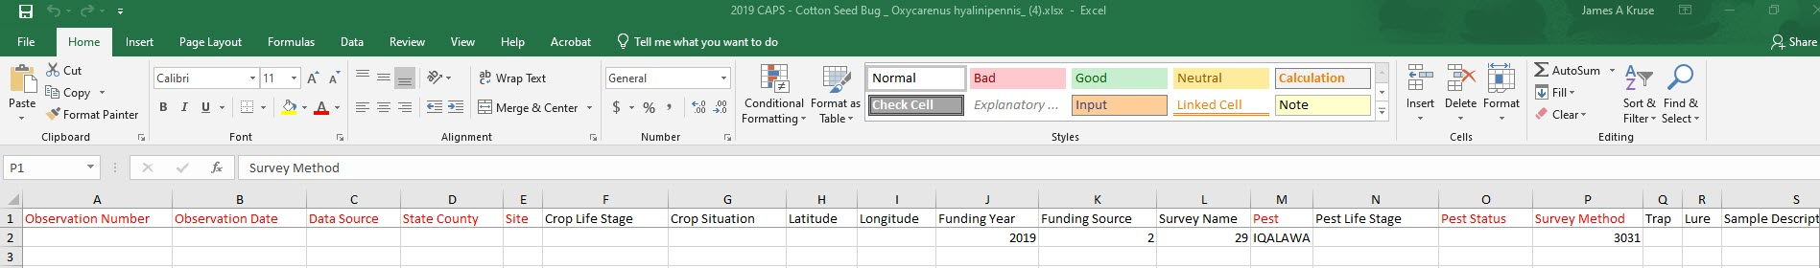
Survey Templates
Templates are Available in NAPIS: My Surveys

Slide 17
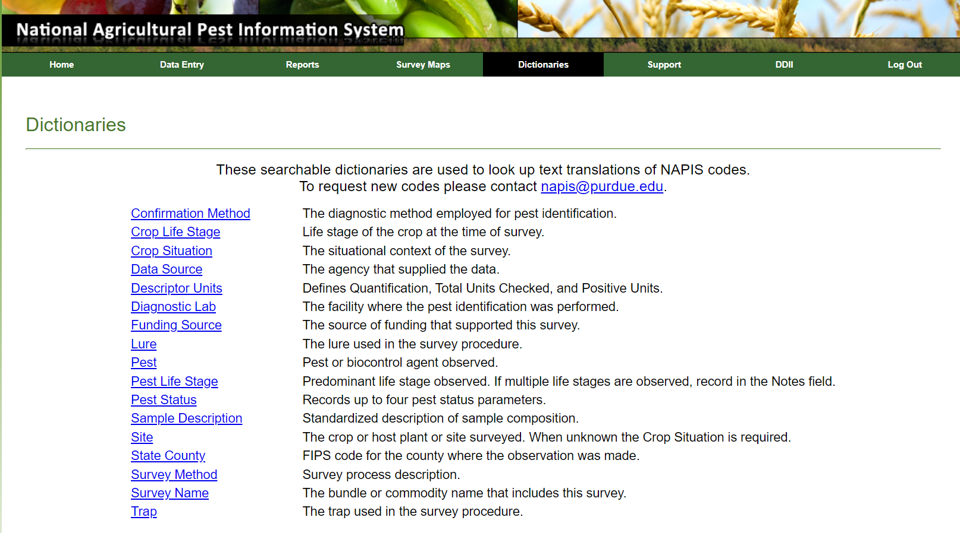
Requesting New Codes
Email is Available in NAPIS: Dictionaries
NAPIS@purdue.edu
Notes:
It is helpful if you include the scientific name, common name, order and family, but we can also research that for you.

Slide 18
Requesting New Codes
Email is Available in NAPIS: Dictionaries
When you email NAPIS@purdue.edu
Please Include:
Order
Family
Scientific name
Common name
Notes:
It is helpful if you include the scientific name, common name, order and family, but we can also research that for you. The database requires these entries.

Slide 19
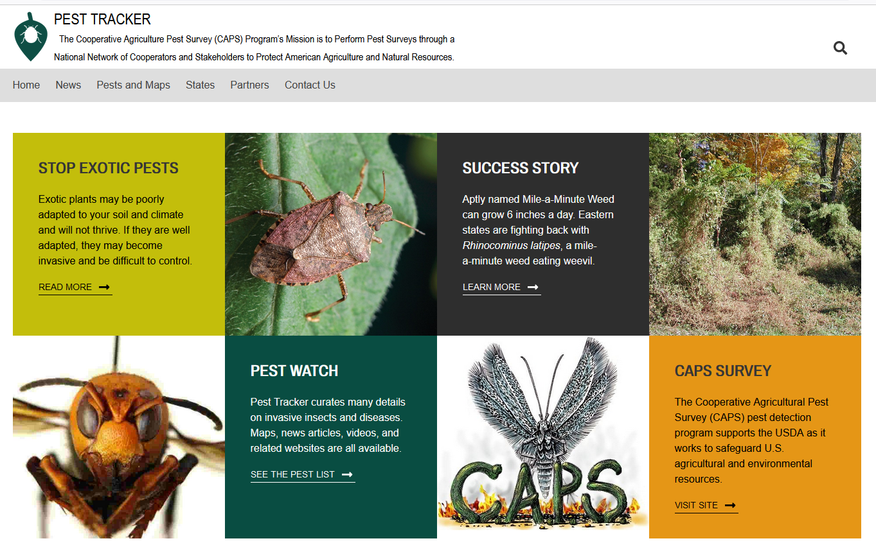
Pest Tracker
Public showcase for CAPS activities
Notes:
New look

Slide 20
PEST TRACKER
Topics Include:
News
Maps
State Info
Partners
Exotic Pest Info
Success Stories
Pest Watch
CAPS

Slide 21
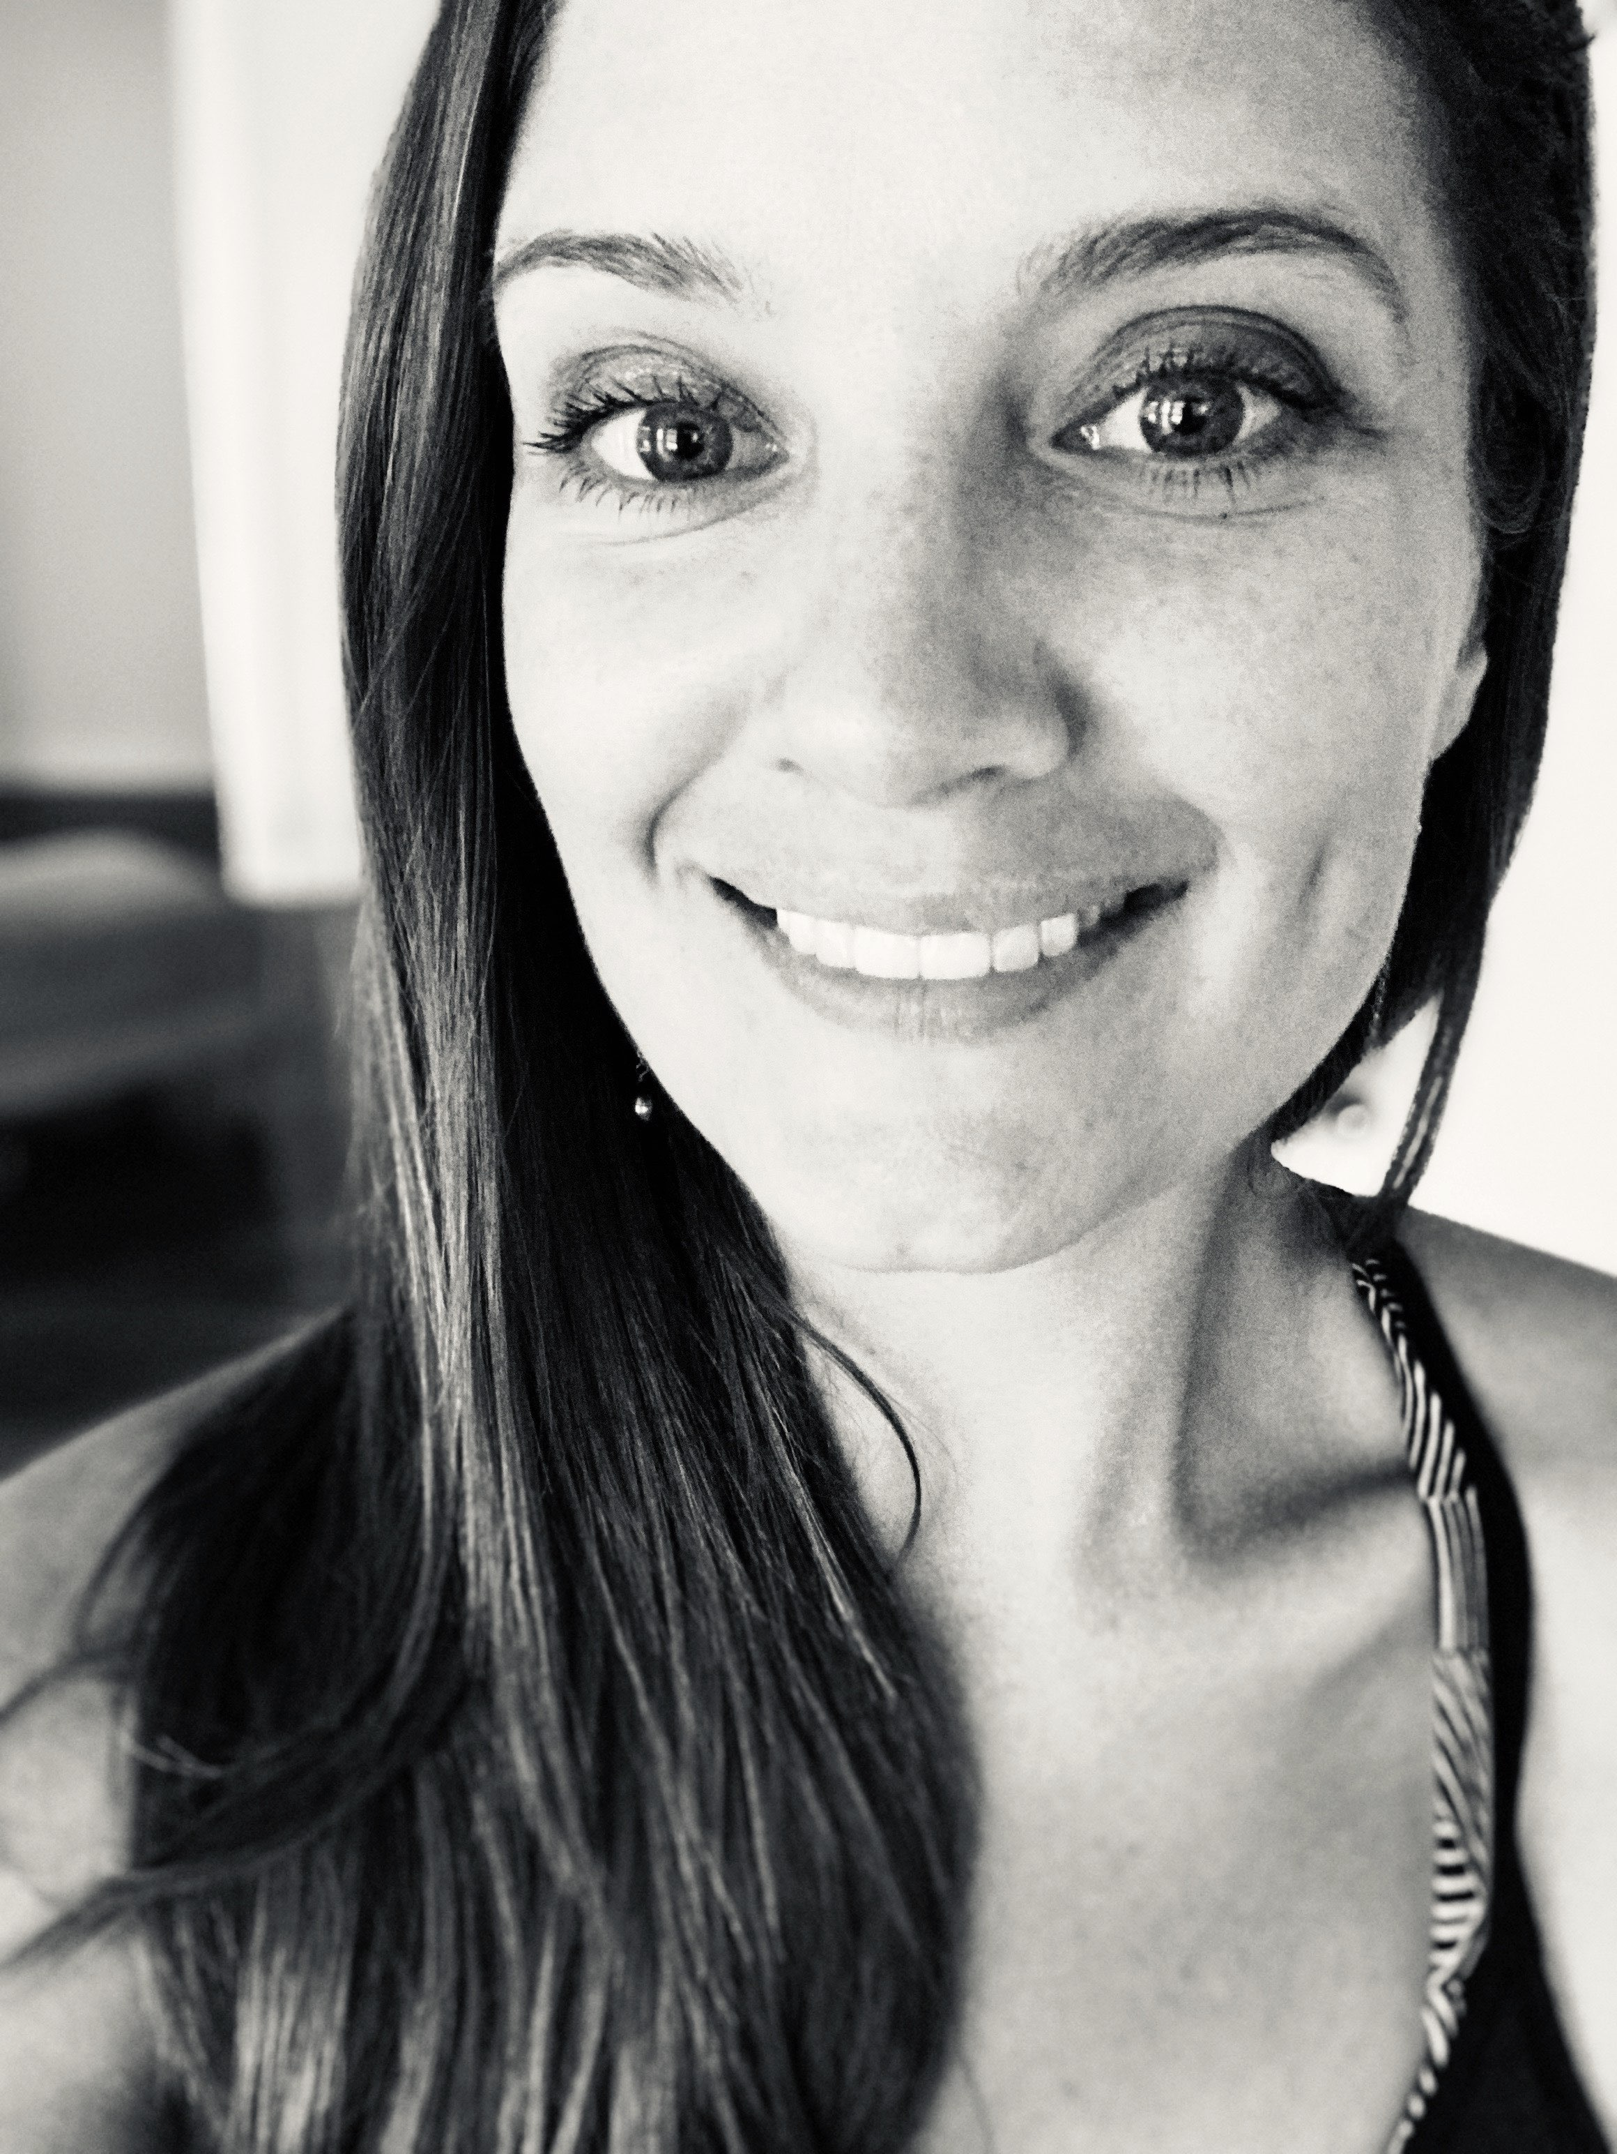
New Coordinator
Bonnie Dietrich
M.S. Entomology UHM
Worked for the Hawaii Department of Agriculture
Previous CAPS Experience: Red Imported Fire Ant
Notes:
Worked at the Hawaii Department of Agriculture and Tress Solutions and Environmental Consulting Services.

Slide 22
Thank You
Email us for training or if you have any questions.
CAPSIS Coordinator: Bonnie Dietrich
CAPSIS@Purdue.edu
(808) 349-7732 after noon EST
Notes:
We do online training at your convenience. We want to hear from you.

