Slide 1

CAPS Resource and Collaboration
An overview
CAPS Information Services Coordinator
Bonnie Dietrich
Center for Environmental and Regulatory Information Systems
Purdue University
Notes:
CAPS Resource and Collaboration Site – An Overview
By the CAPS Information Service Coordinator / Bonnie Dietrich
At the Center for Environmental and Regulatory Information Systems / Purdue University

Slide 2
Welcome
The Presentations Goals
Clear
Concise
Informative
Notes:
WELCOME. The goals of this webinar are to be Clear, Concise, and Informative.

Slide 3
Index
Tabs Slides
Log In 5-6
Home 7-8
About 9-16
Survey 17-26
Community 27-32
Contact Us 35-37
The bulk of information is found in About, Survey, & Community
Notes:
To that end, I’ve made an Index for the Presentation.
First, I will talk about logging in. Then I will discuss the 5 tabs at the top of the web page.
The bulk of information is found in About, Survey, & Community

Slide 4

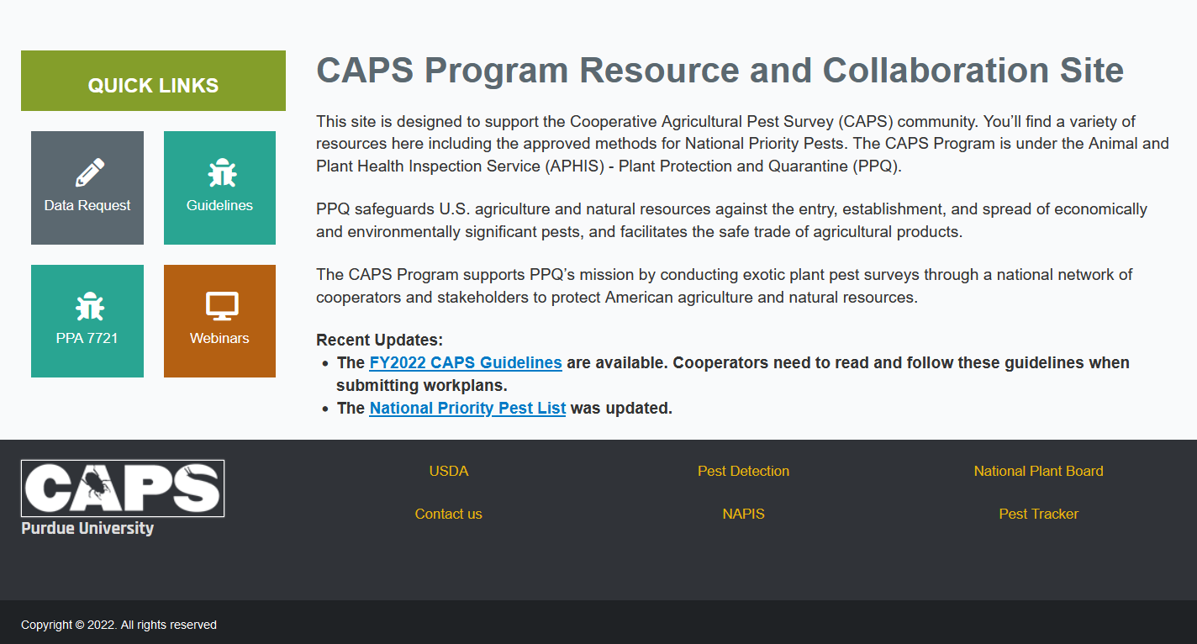
CAPS
Address:
caps.ceris.purdue.edu/
Log In
Home
About
Survey
Community
Contact Us
Notes:
The address for the CAPS R&C site is caps.ceris.purdue.edu/
The Log In link is here, and at the top of the page, along with the tabs of CAPS content.

Slide 5
Log In
This site requires a username and password
Notes:
Some Content of the site requires a user name and password, but the majority is viewable publicly.
You will need to Log In to View the CAPS Directories and the Accountability Report.

Slide 6
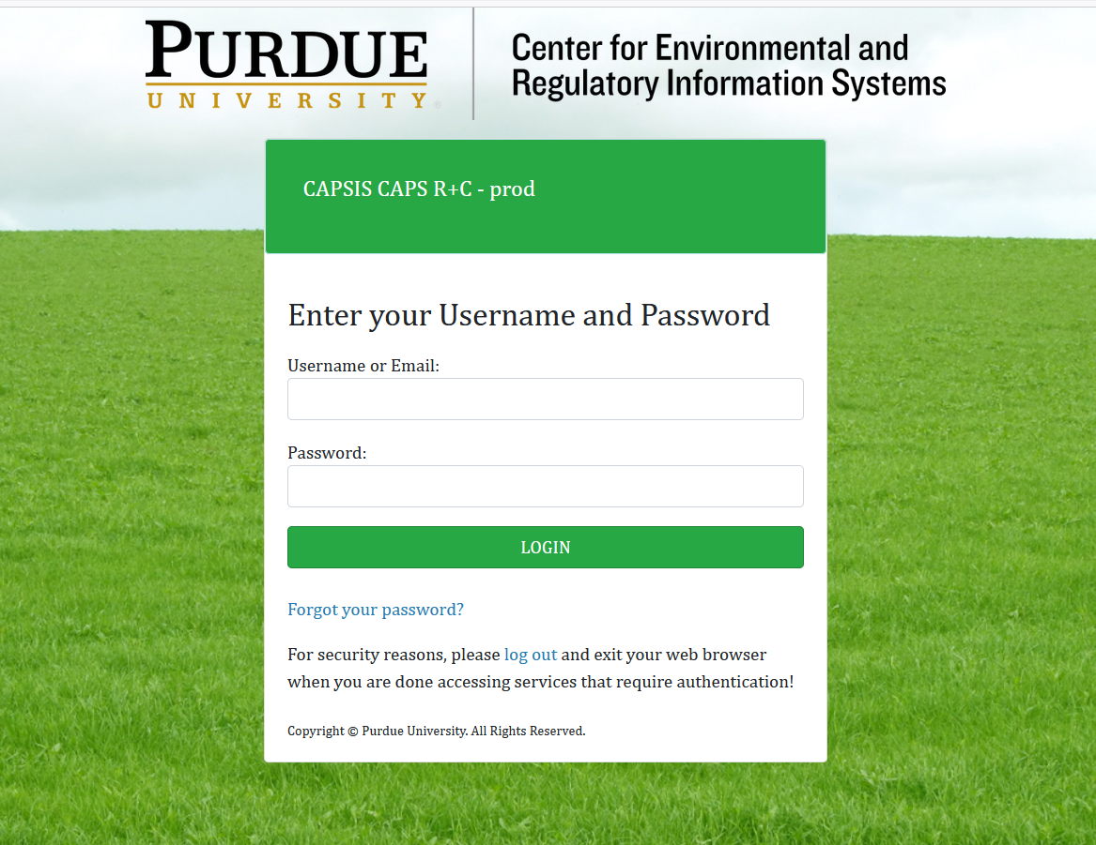
Log In
To set up an account Contact CAPSIS
Email:
CAPSIS@purdue.edu
Or Call:
(765) 496-2381
Notes:
To set up an account contact CAPSIS at CAPSIS@purdue.edu or call (765) 496-2381

Slide 7
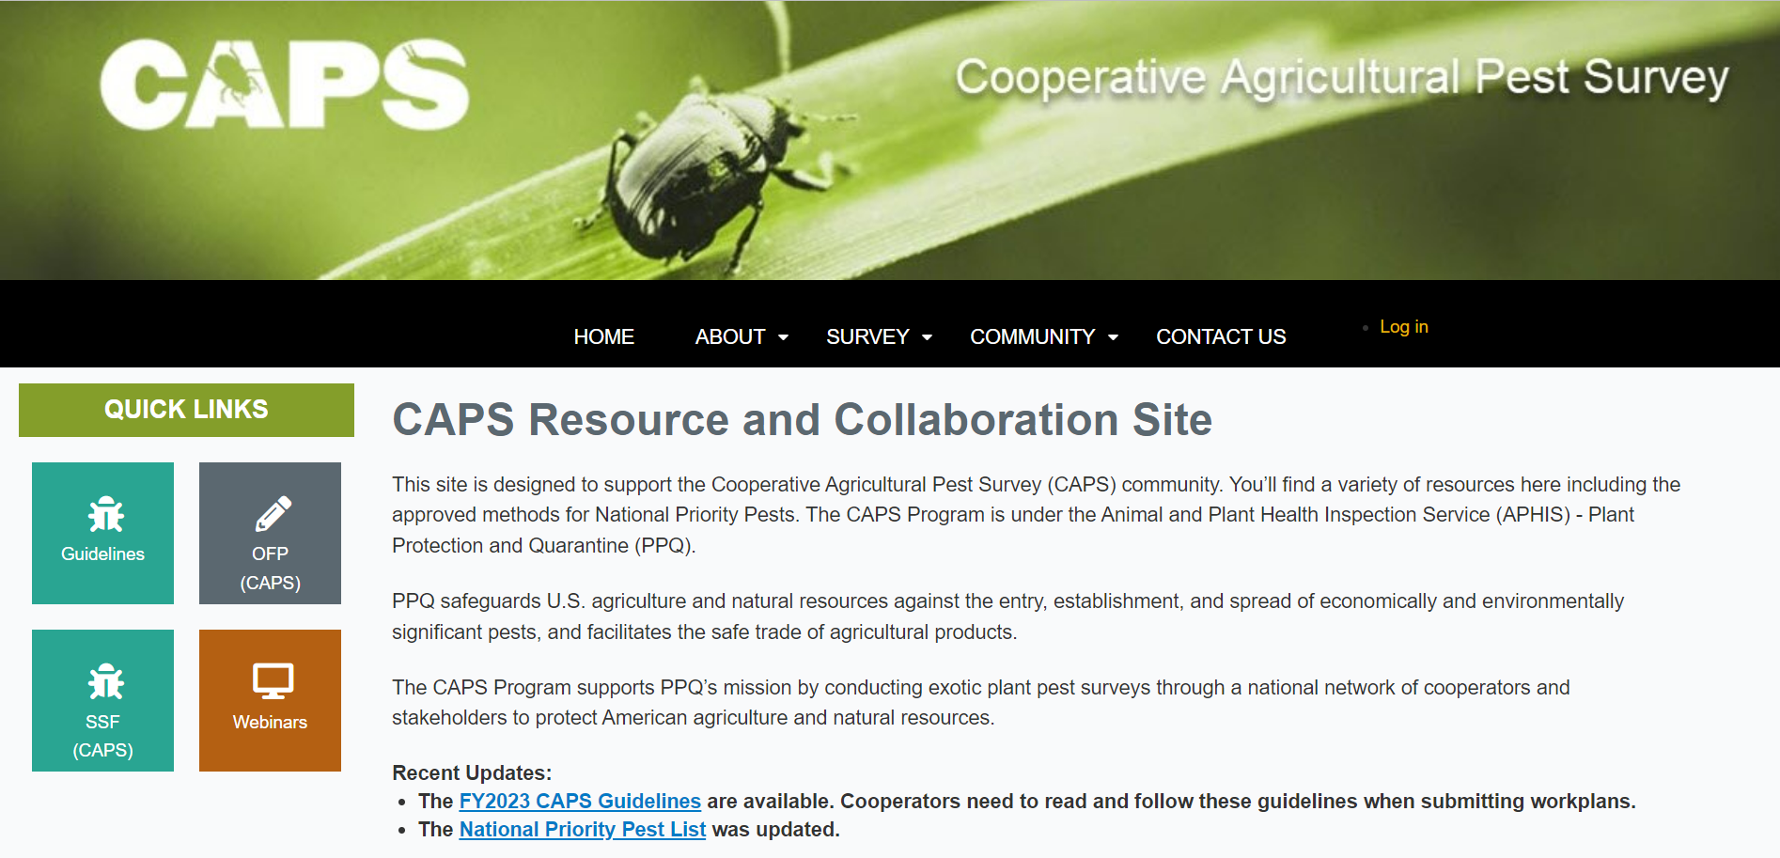
Home
The First Tab
Notes:
HOME: the first tab

Slide 8
Home
CAPS Program Resource and Collaboration Site
This site is designed to support the Cooperative Agricultural Pest Survey (CAPS) community. You’ll find a variety of resources here including the approved methods for National Priority Pests. The CAPS Program is under the Animal and Plant Health Inspection Service (APHIS) - Plant Protection and Quarantine (PPQ).
PPQ safeguards U.S. agriculture and natural resources against the entry, establishment, and spread of economically and environmentally significant pests, and facilitates the safe trade of agricultural products.
The CAPS Program supports PPQ’s mission by conducting exotic plant pest surveys through a national network of cooperators and stakeholders to protect American agriculture and natural resources.
Recent Updates:
The FY2022 CAPS Guidelines are available. Cooperators need to read and follow these guidelines when submitting workplans.
The National Priority Pest List was updated.
Notes:
HOME Provides a summary of the website and recent updates.
It also introduces the user to the federal team behind CAPS (USDA- APHIS- PPQ), a bit about their work, as well as the CAPS program’s mission.

Slide 9
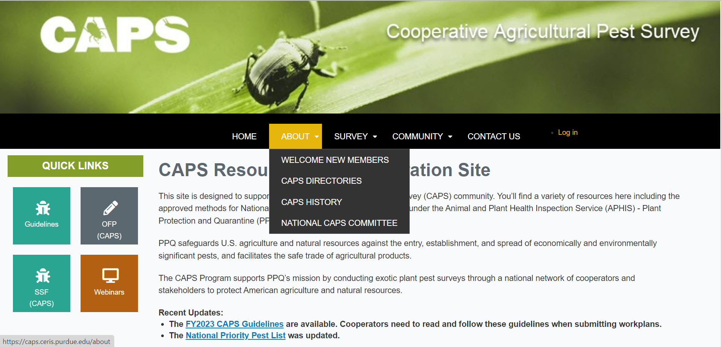
About
The Second Tab
Notes:
ABOUT: the second tab

Slide 10
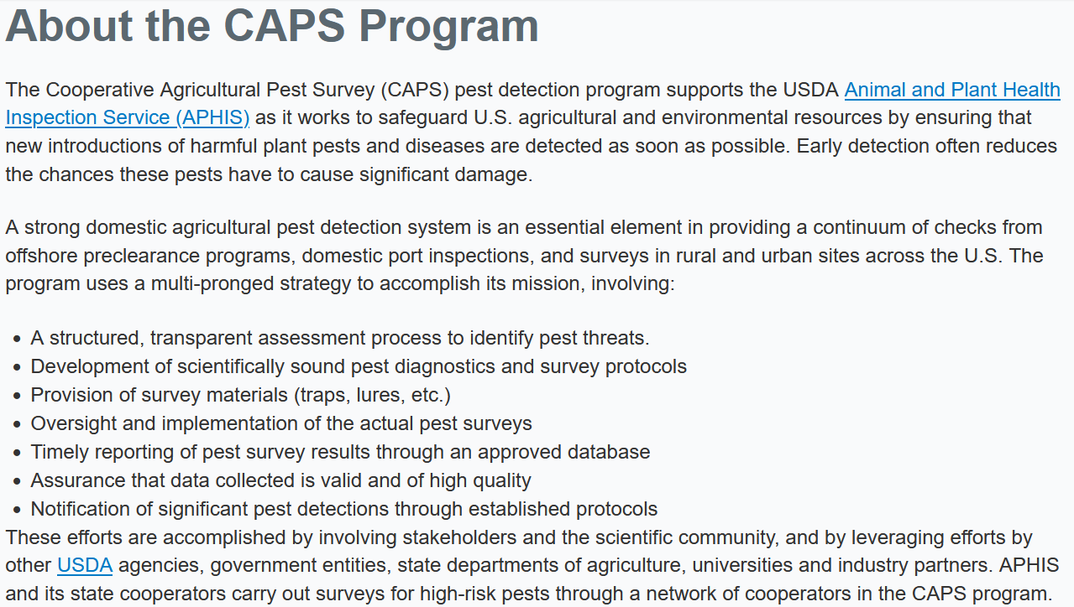
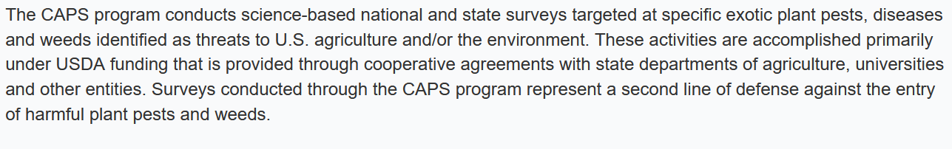
About
Notes:
ABOUT Explains how the CAPS program supports APHIS’s role in protecting U.S. Agriculture from harmful pests and plant diseases, through pest detection programs offshore, at ports of entry, and across the U.S., in rural and urban settings.
ABOUT ALSO Describes how stakeholders, the scientific community, federal & state government, as well as universities and private industry partner up to accomplish this goal.

Slide 11
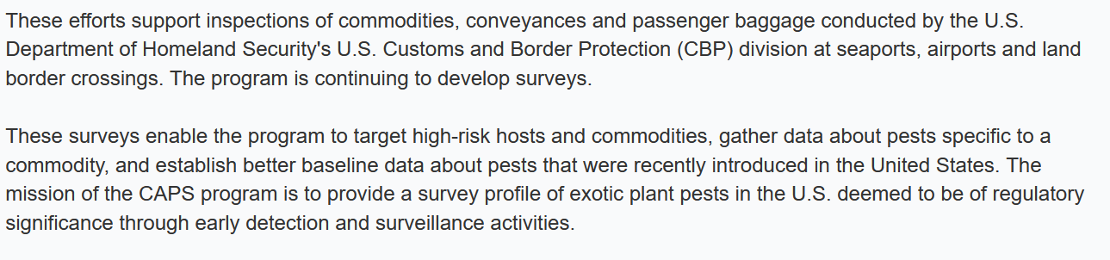
About Continued…
Notes:
ABOUT Expands on how the program uses USDA funding to target high risk exotic pests, plant pathogens, and weeds to create a national survey profile for regulation.

Slide 12
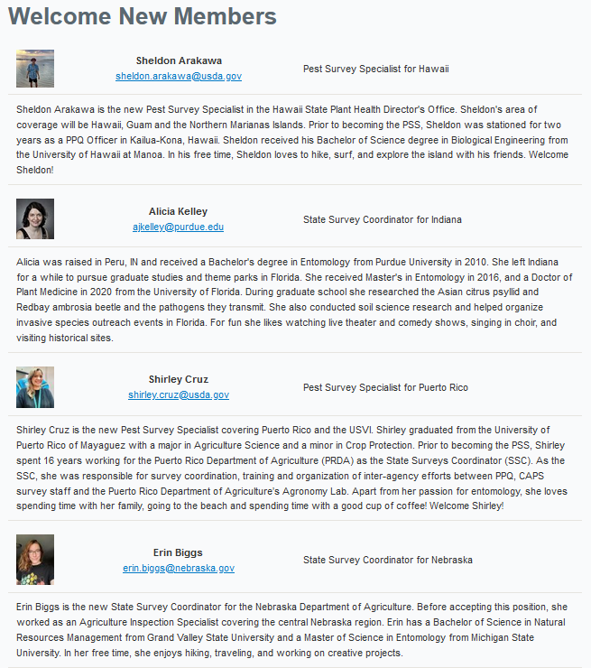
Welcome New Members
Notes:
WELCOME NEW MEMBERS This is a place to learn about new CAPS community members.
The photos and biographies rotate out as new members arrive.
Their role and email can be found here, if you’d like to introduce yourself and welcome them.

Slide 13
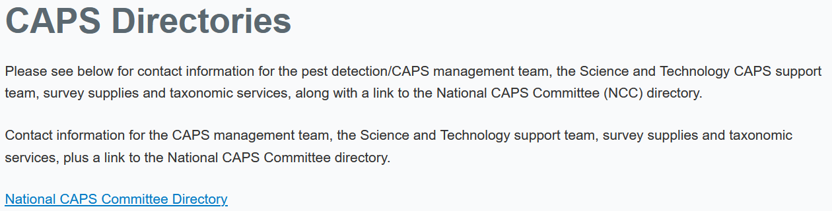
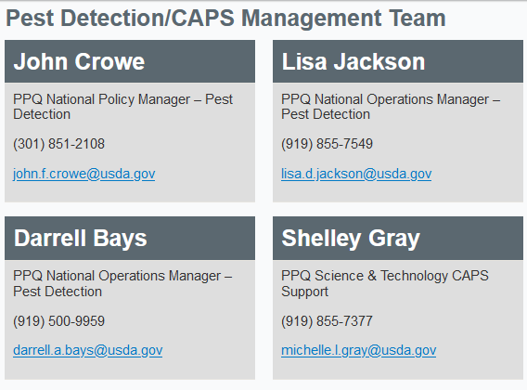
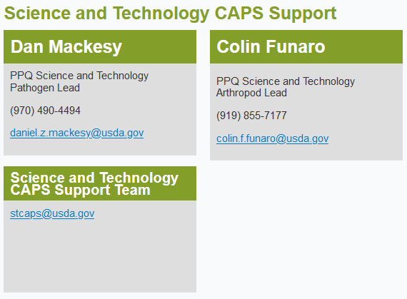
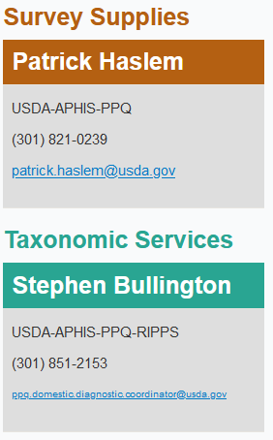
CAPS Directories
Notes:
CAPS DIRECTORIES This directory is where you can find contact information for members of the entire CAPS community.
The top of the page lists:
The Pest Detection/CAPS Management Team
Science & Technology CAPS Support
Survey Supplies
And Taxonomic Services

Slide 14
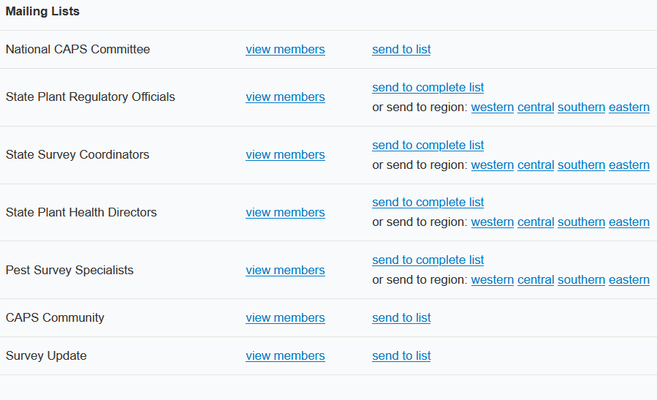
CAPS Directories
Notes:
The bottom of the page lists:
The National CAPS Committee
State Plant Regulatory Officials
State Survey Coordinators
State Plant Health Directors
Pest Survey Specialists
And the entire CAPS community, in alphabetical order

Slide 15
CAPS History
Summary of the progression from USDA-APHIS-PPQ to CAPS.
 |  | Year
USDA-APHIS-PPQ |  | 1972
ICPP | Intersociety Consortium for Plant Protection | 1980
CNPPSDP | Cooperative National Plant Pest Survey & Detection Program | 1982
NAPIS | National Agricultural Pest Information System | 1983
CAPS | Cooperative Agricultural Pest Survey | 1987
Summary of the implementation and evolution of various components in CAPS Information Services.
 | Implementation | Updated | Current Version
NAPIS | Mid-1980s | 1992, 2004 | 2014-2015 | NAPIS 3.0
NAPIS Maps | 2000 | 2017 | 2017
CAPS Restricted site | 1995 | 2010 | 2019 | CAPS R & C
Pest Tracker | 2008 | 2017 | 2017 | 2020 – undergoing update
Accountability Report | 2008 | 2016 | 2018 | CAPS and Farm Bill Reports
CAPS Approved Methods | 2011 | Annually | 2019 | Approved Methods for Pest Surveillance
Survey Summary Form | 2012 | 2018 | 2018 | Survey Planning
Notes:
CAPS HISTORY This is a downloadable file with detailed information about the origins and history of CAPS from as early as 1917.
I’ve pulled out some interesting highlights about the timeline, and included them in table form here.

Slide 16
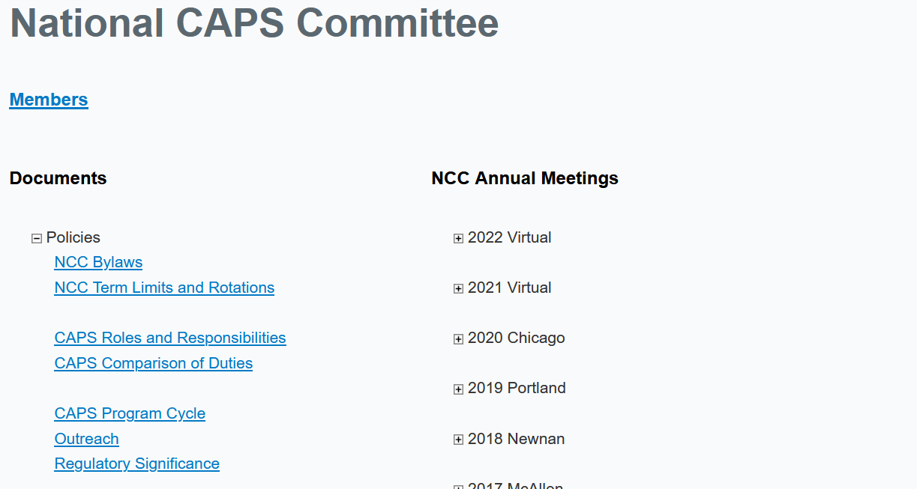
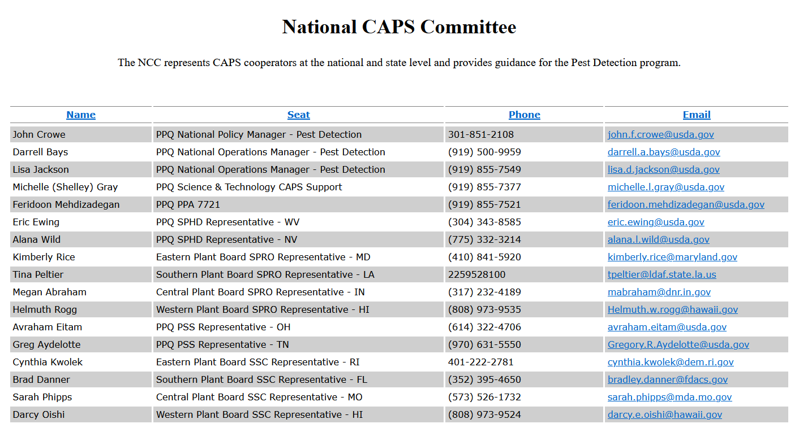
National CAPS Committee
Notes:
NATIONAL CAPS COMMITTEE The NCC represents CAPS cooperators at the national and state levels.
These cooperators support the pest detection program by tracking CAPS initiatives….ADD HERE

Slide 17
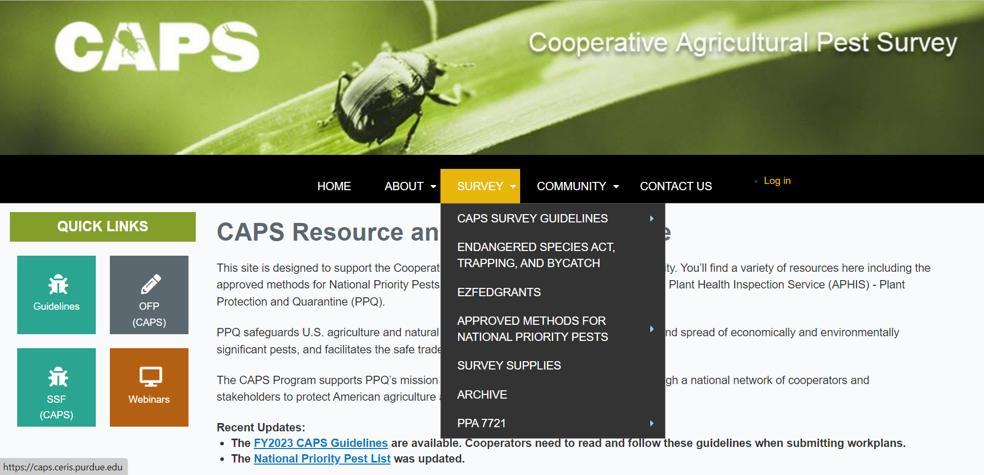
Survey
The Third Tab
Notes:
SURVEY: the third tab

Slide 18
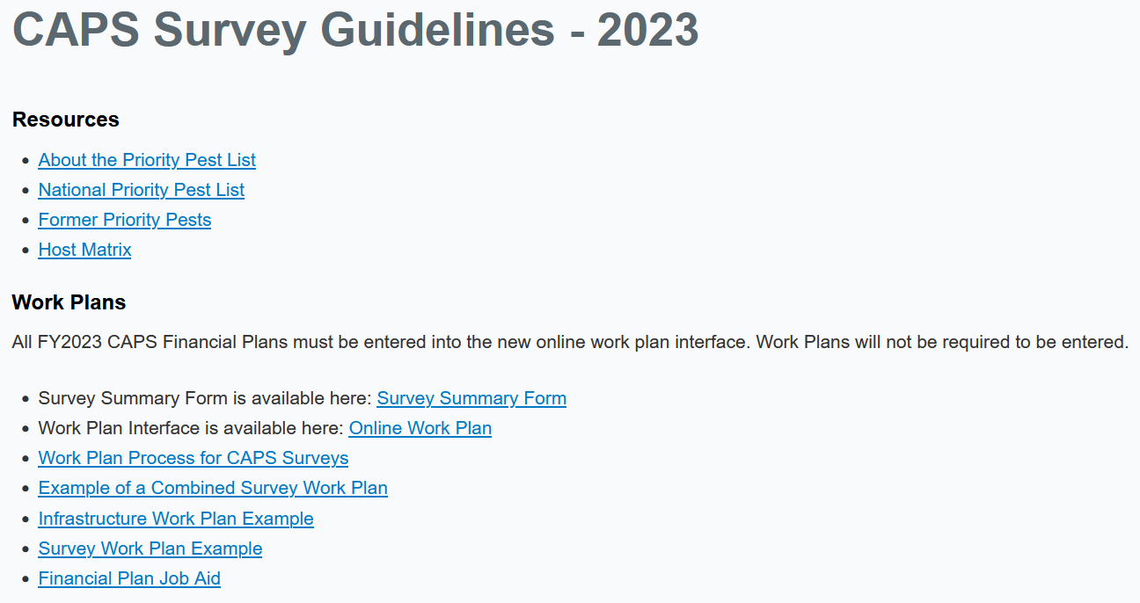
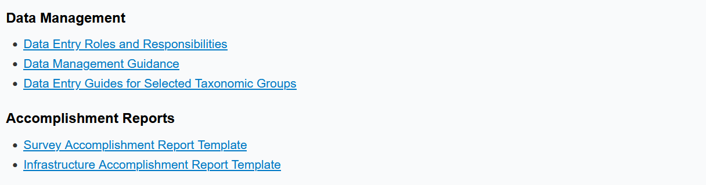
CAPS Survey Guidelines
2023

Slide 19
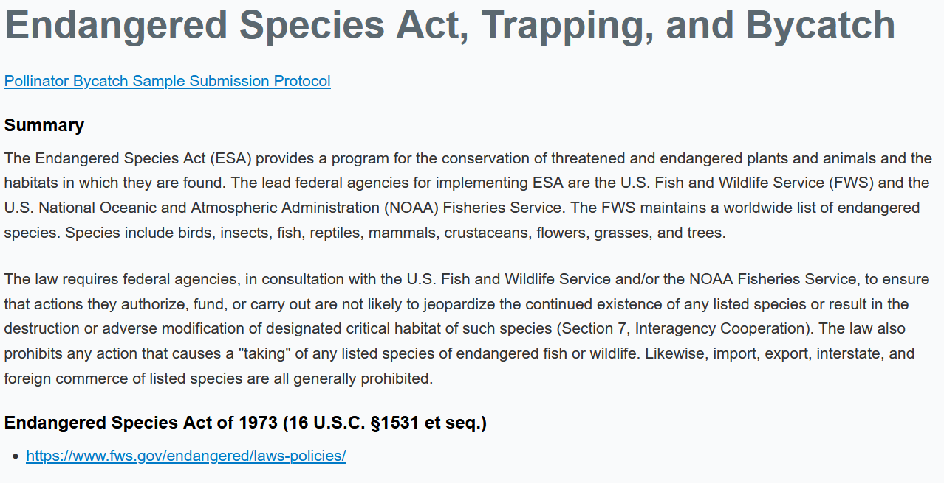
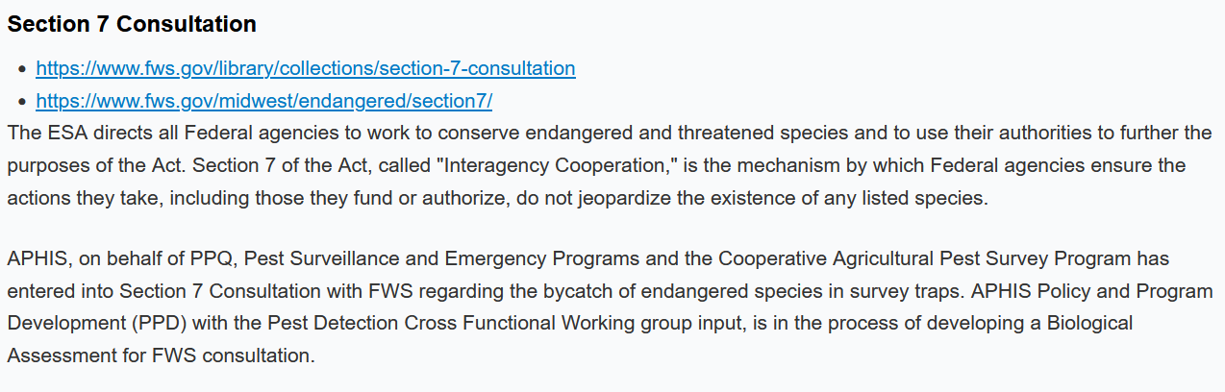
Endangered Species Act, Trapping, and Bycatch

Slide 20
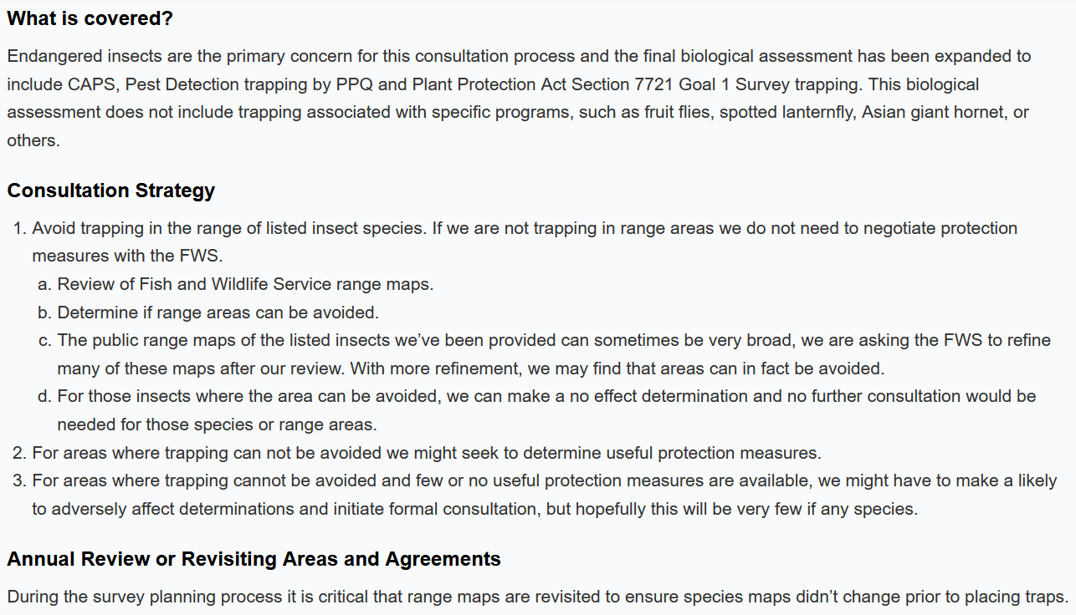
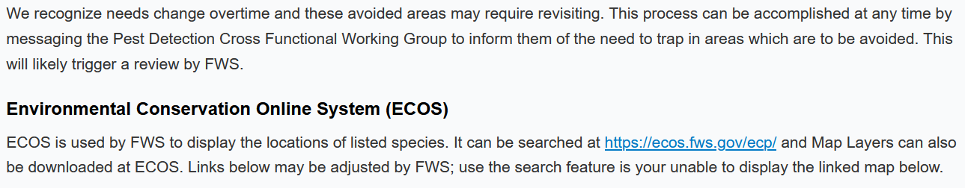
Endangered Species Act, Trapping, and Bycatch

Slide 21
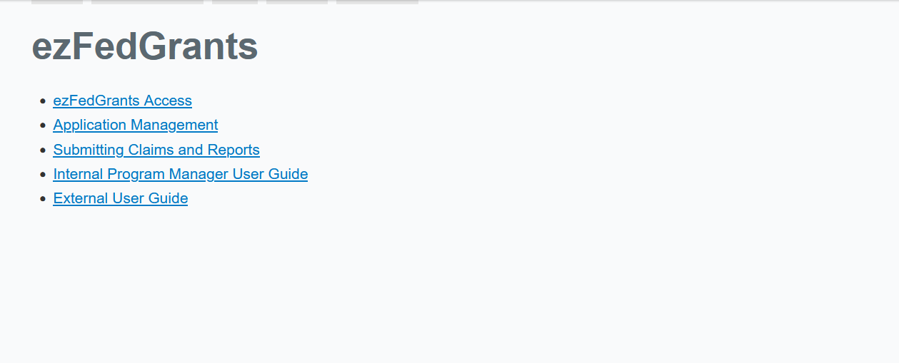
ezfedgrants

Slide 22
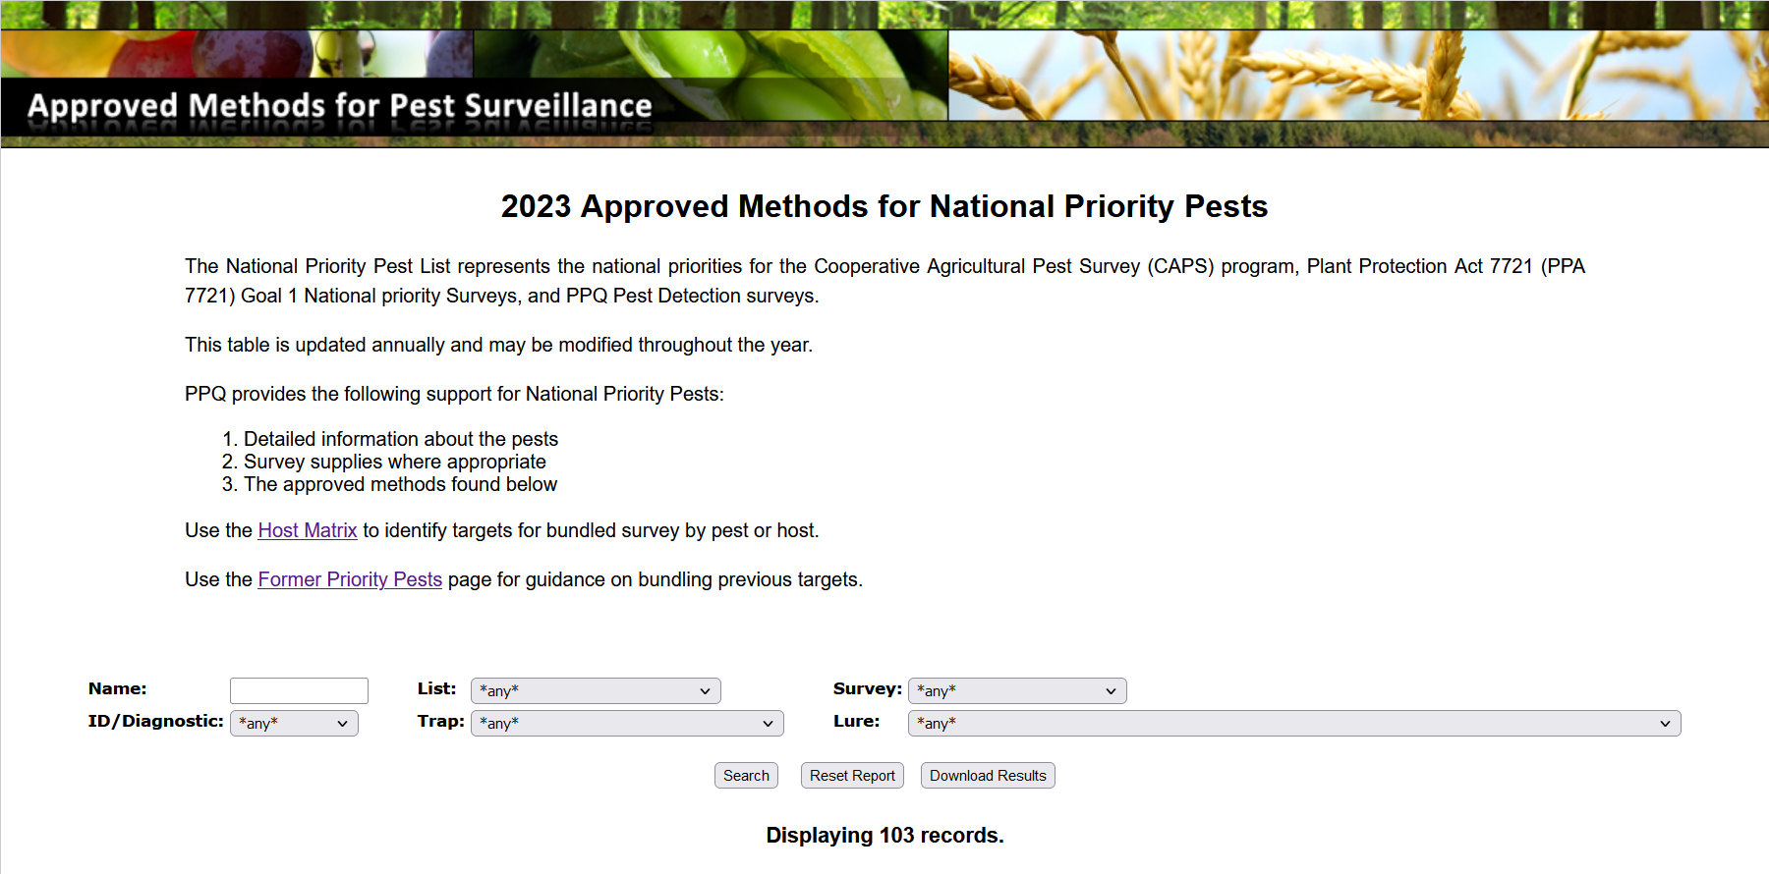
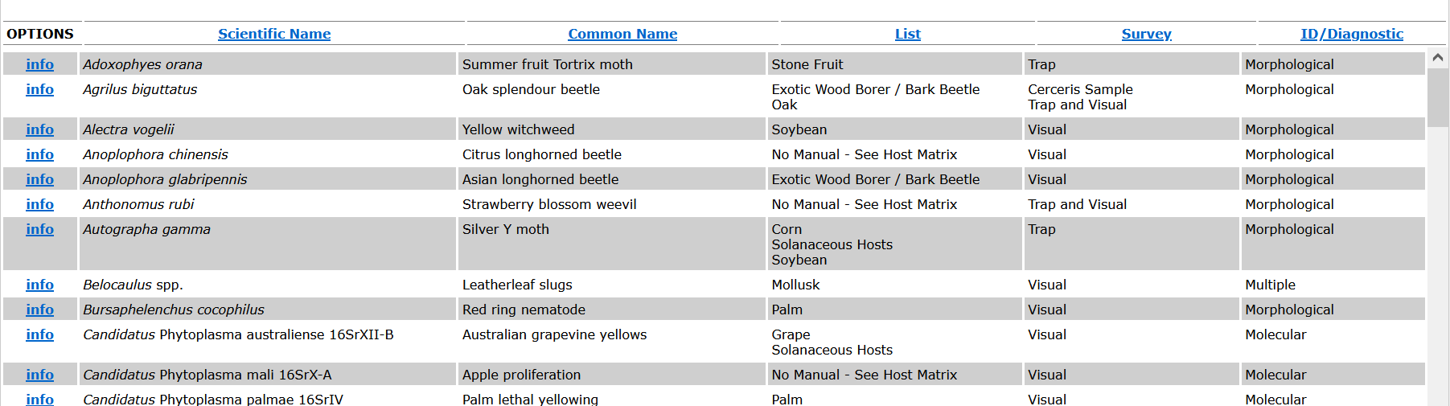
Approved methods for national priority pests

Slide 23
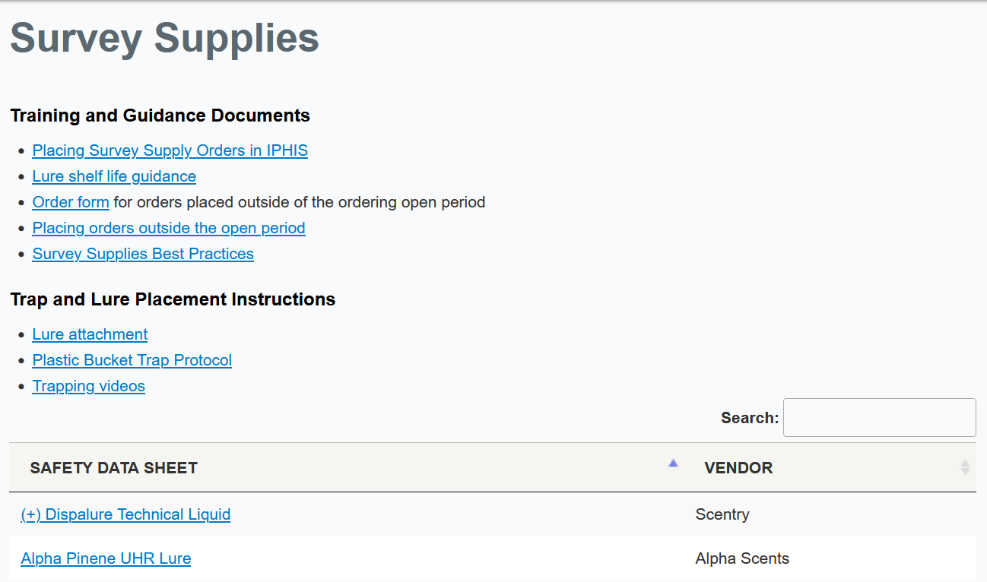
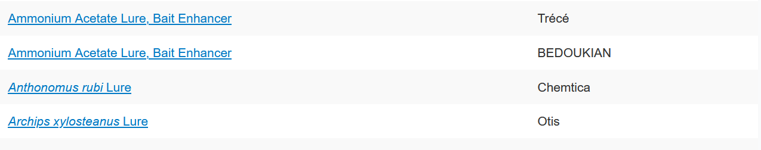
Survey supplies

Slide 24
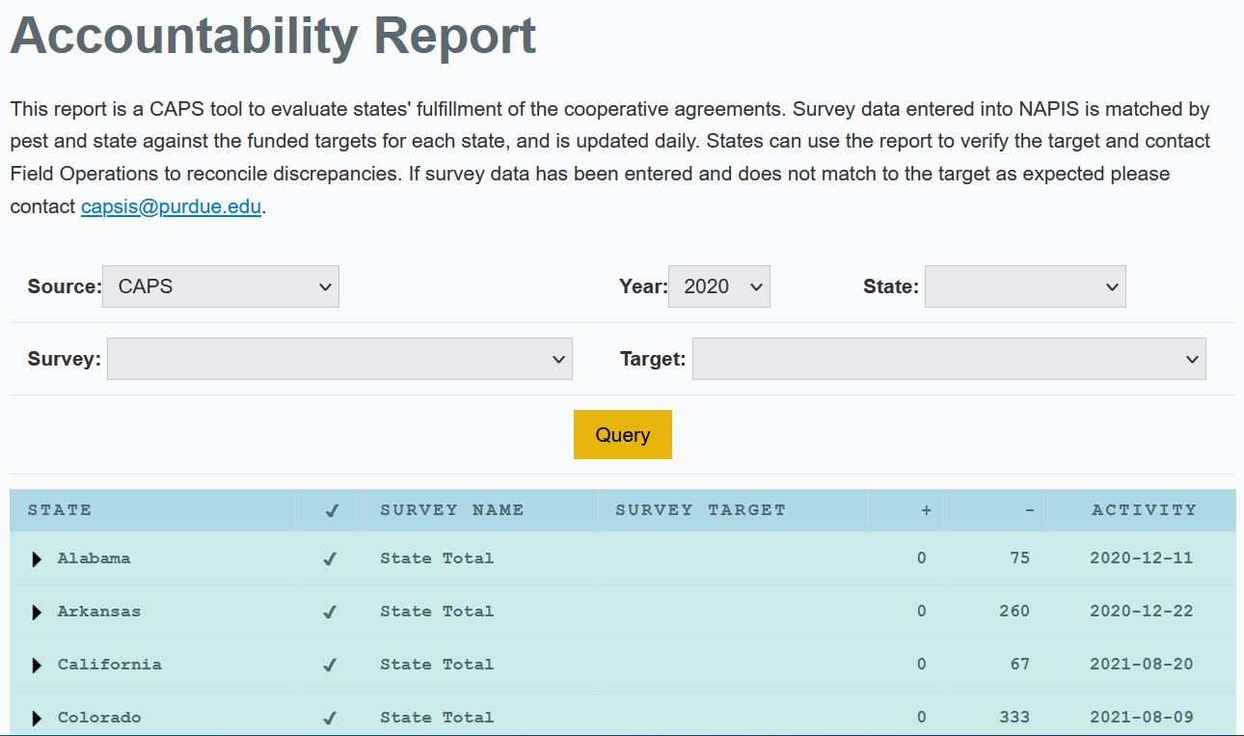
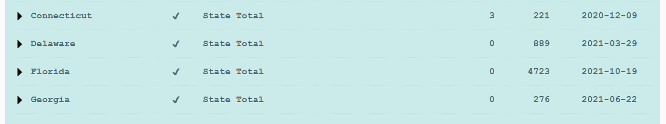
Accountability report

Slide 25
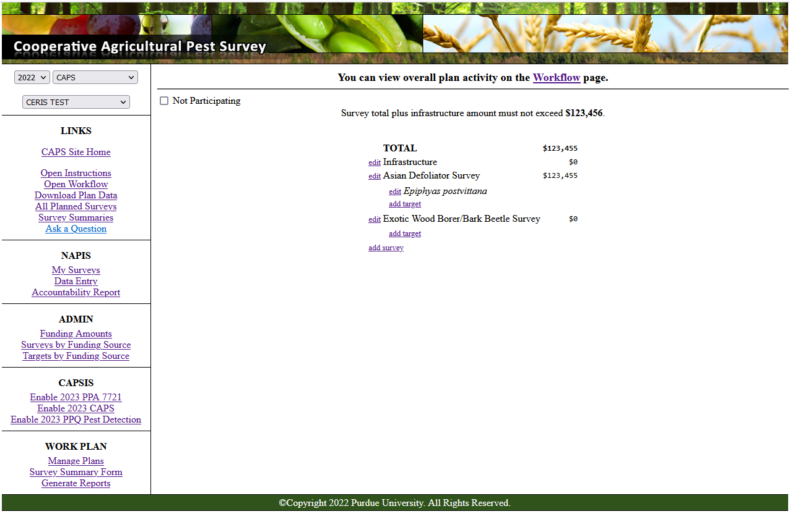
Survey planning
Notes:
SURVEY PLANNING This will bring you to the Survey Summary Form.
Select the year, survey name (either CAPS, PPQ Pest Detection, or PPA 7721), and your state.
You will either check the not participating box (in the top left corner) or create your survey summary here by adding surveys for specific pests.

Slide 26
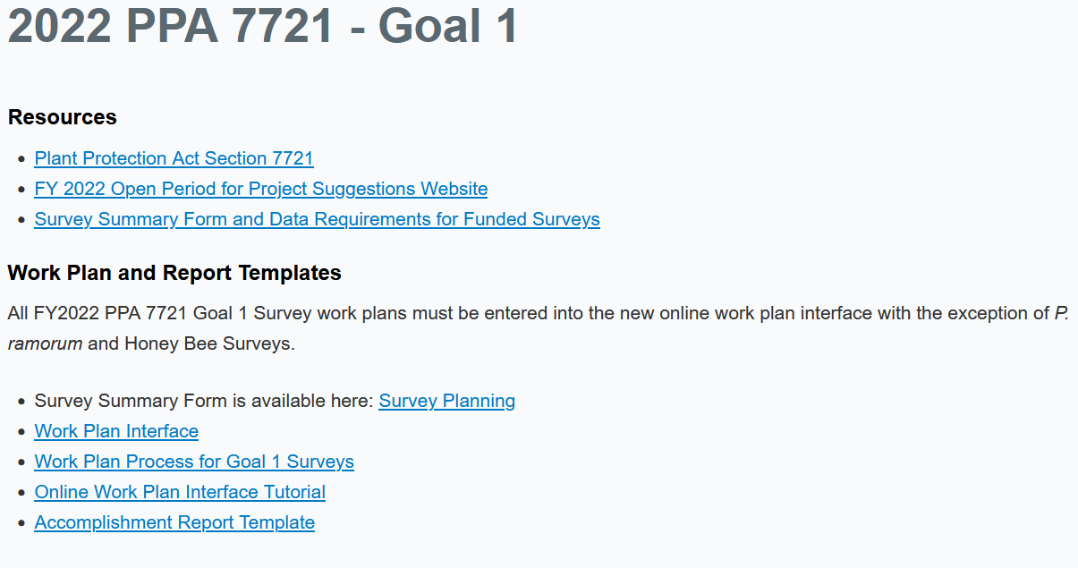
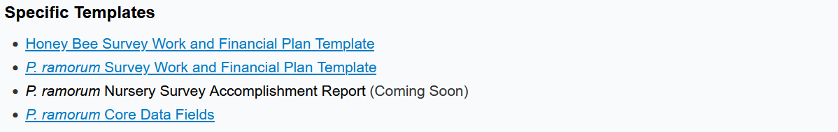
PPA 7721 – Goal 1

Slide 27
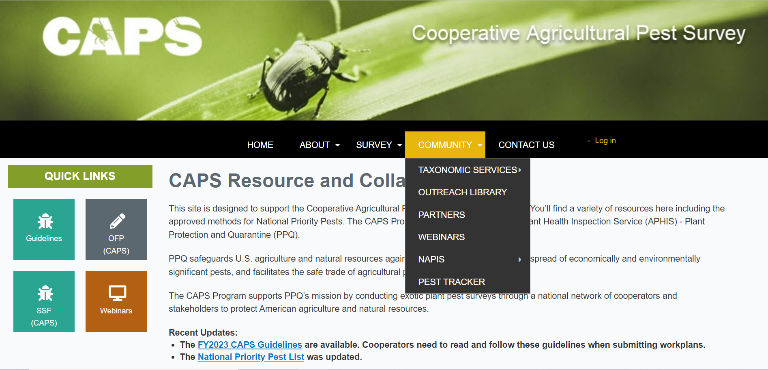
Community
The Fourth Tab
Notes:
COMMUNITY: the fourth tab

Slide 28
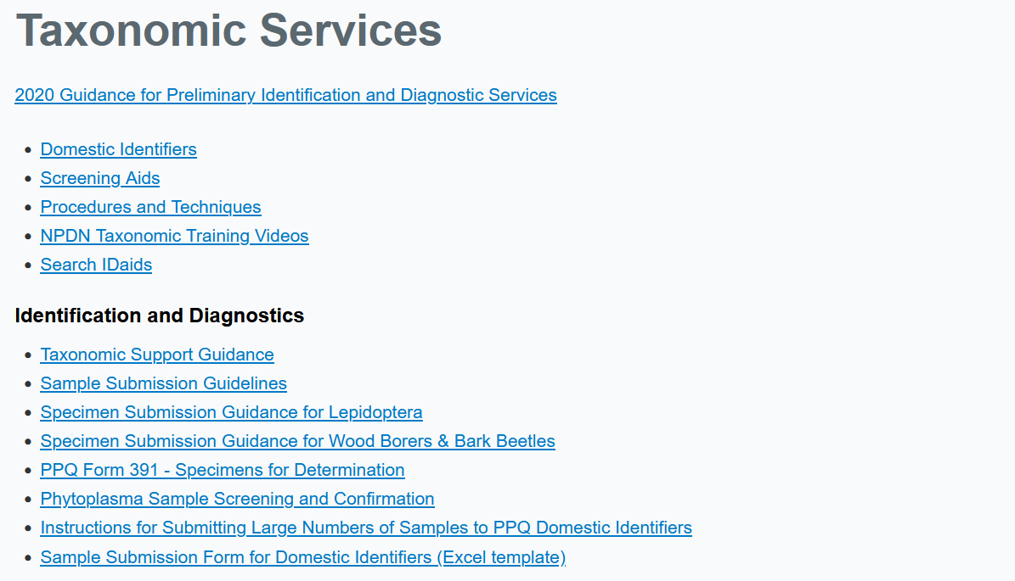
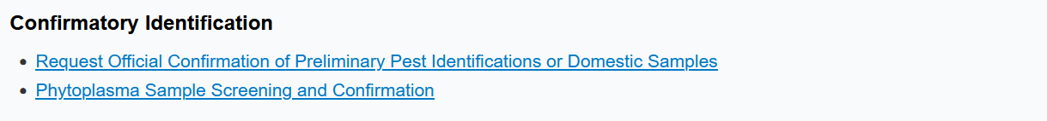
Taxonomic Services
Notes:
TAXONOMIC SERVICES The CAPS program uses the National Identification Service (NIS) for taxonomic services.
This includes information about domestic identifiers, procedures, and screening aids.

Slide 29
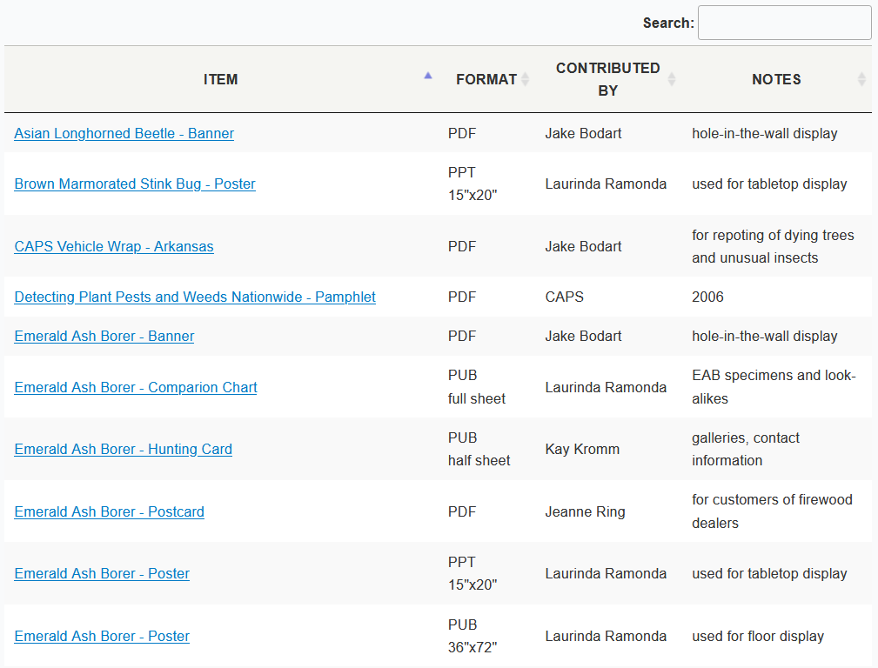
Outreach Library
Notes:
OUTREACH LIBRARY A searchable database of downloadable and printable materials that can be helpful for CAPS outreach programs.

Slide 30
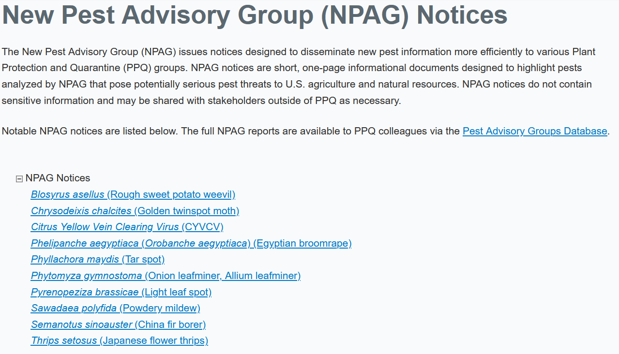
New Pest Advisory Group
Notes:
NEW PEST ADVISORY GROUPS NPAG issues notices designed to disseminate new pest information more efficiently to various PPQ groups.

Slide 31
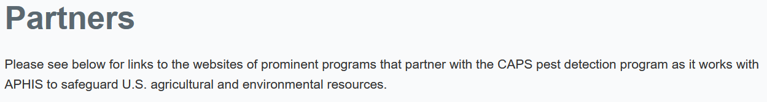
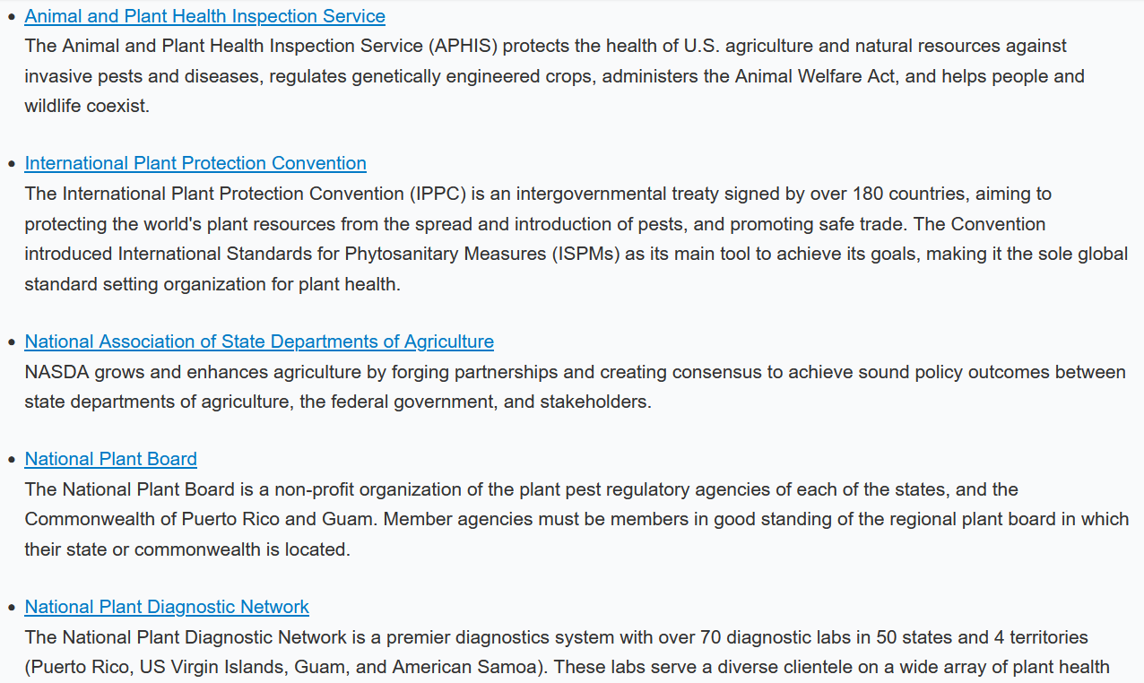
Partners
Notes:
PARTNERS Find links to partner pages here.

Slide 32
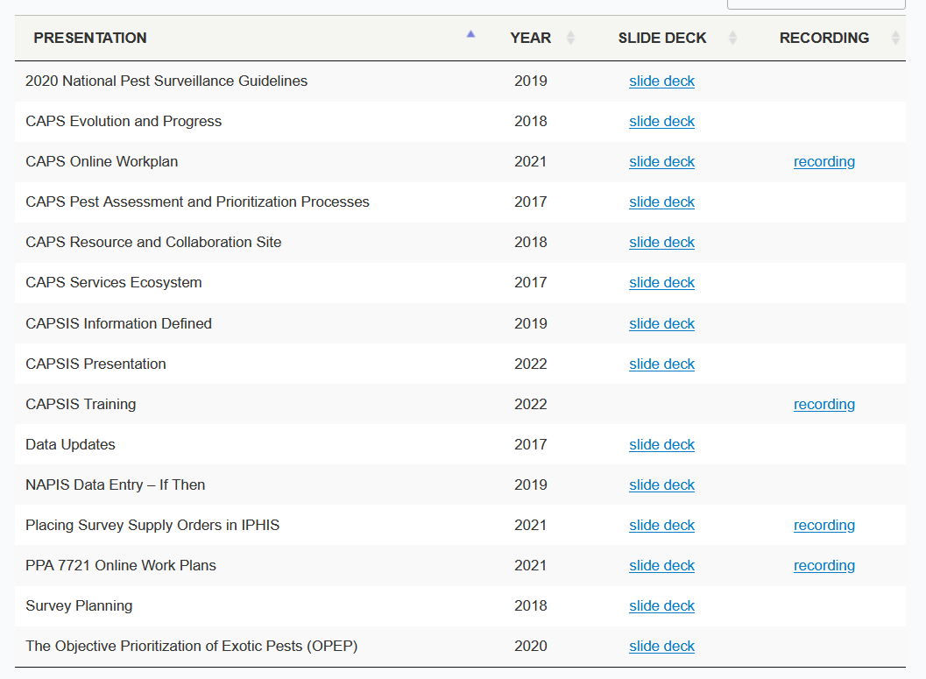
WEBINARS
Notes:
WEBINARS Instructional online seminars on topics related to the CAPS program.

Slide 33
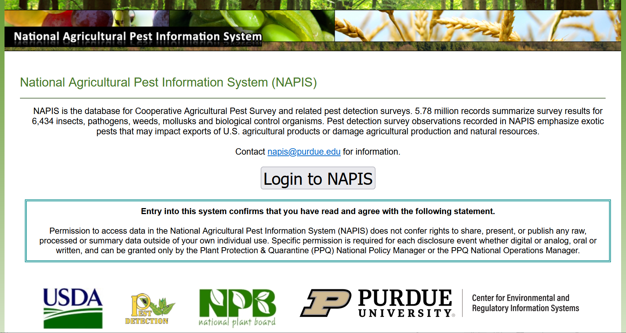
NAPIS
Both CAPSIS@purdue.edu and NAPIS@purdue.edu go to the CAPSIS Coordinator.
This is where all data from CAPS surveys is uploaded to the national database.
Please reach out to us with any questions. We are always available to help.
Notes:
NAPIS This is where all data from CAPS surveys is uploaded to the national database.
Please reach out to us with any questions. We are always available to help. Both CAPSIS@purdue.edu and NAPIS@purdue.edu go to the CAPSIS Coordinator.

Slide 34
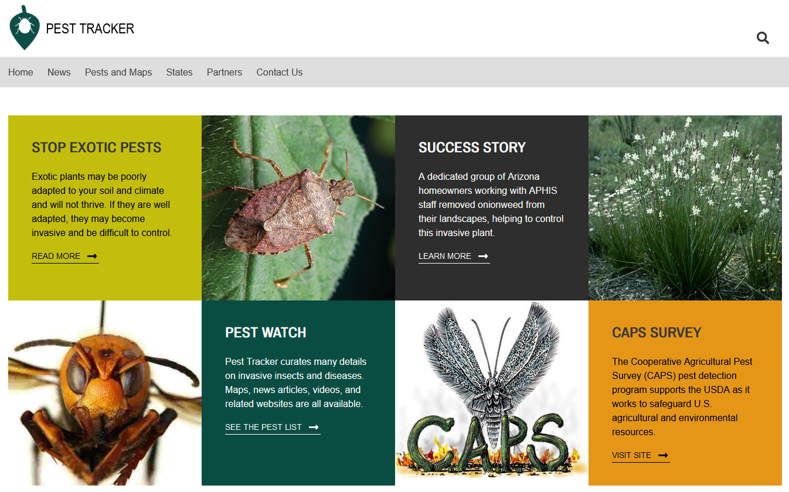
Pest Tracker
This is the public site for CAPS activities.
People often look at pest maps and write in with questions.
Notes:
PEST TRACKER This is the public site for CAPS activities. People often look at pest maps and write in with questions.

Slide 35
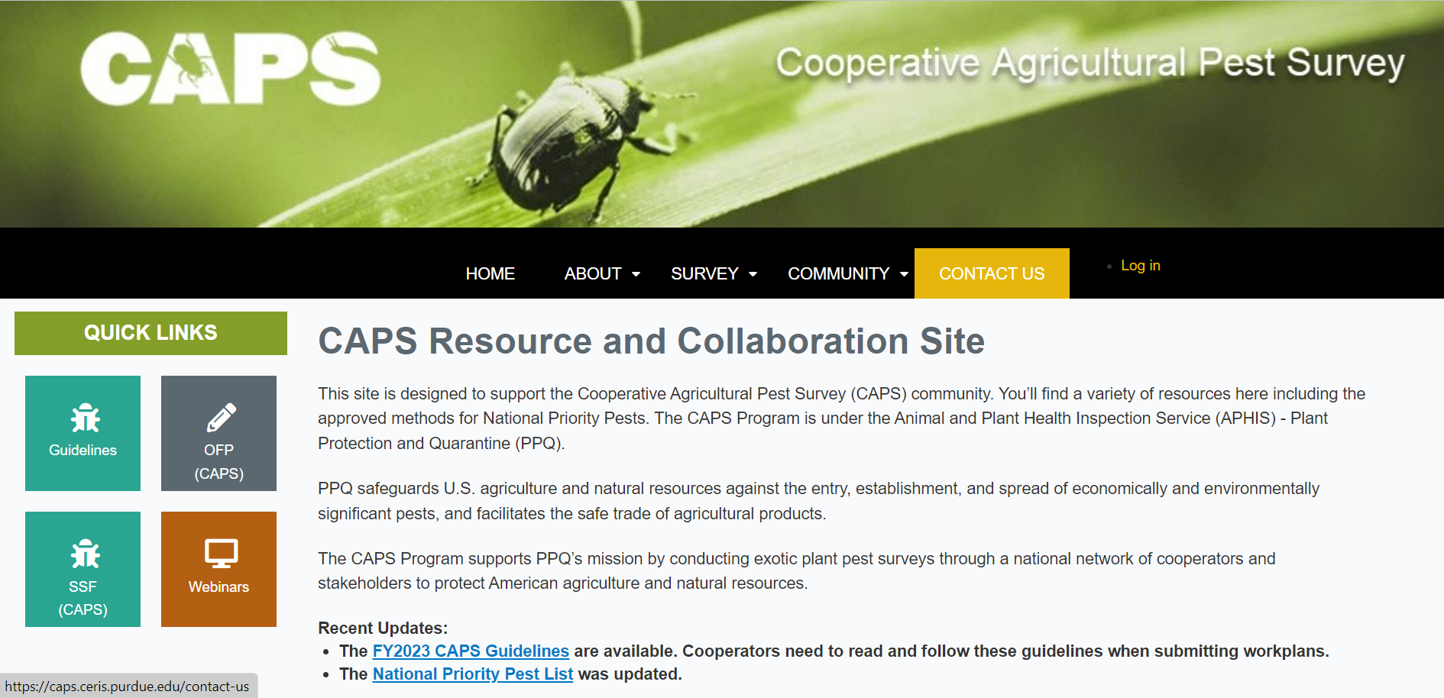
Contact Us
The Fifth Tab
Notes:
CONTACT US: the fifth tab

Slide 36
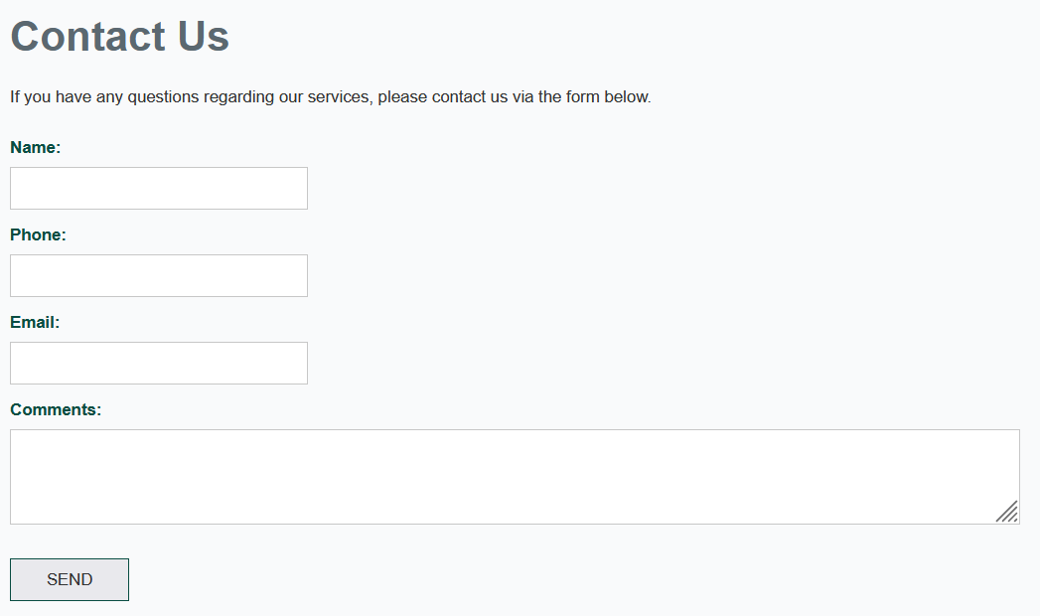
Contact Us
Use this page to contact us about anything.
Your message will be sent to: CAPSIS@purdue.edu
The CAPSIS Coordinator will get in touch with you.
You can also call us at:
(765) 496-2381
Notes:
CONTACT US Use this page to contact us about anything. Your message will be sent to: CAPSIS@purdue.edu
The CAPSIS Coordinator will get in touch with you.
You can also call us at:
(765) 496-2381

Slide 37



Thank You
Questions?
Contact:
Bonnie Dietrich
CAPSIS Coordinator
CAPSIS@purdue.edu
(765) 496-2381
Notes:
THANK YOU

