Slide 1
CAPS/PPA/PD Preliminary Identification
February 1st, 2023
USDA Forest Pest Laboratory
Otis Air National Guard Base
1398 W. Truck Rd.
Buzzards Bay, MA 02542
United States

Slide 2
Overview
Key Partners
Review Roles and Responsibilities
Discuss Goals and Achievements
Discuss Future Planning

Slide 3
Preliminary ID CFWG*
Patrick Haslem – EDP* Preliminary ID National Coordinator
Steven Bullington – NIS* Domestic Diagnostics Coordinator
Darrell Bays – Field Operations Preliminary ID Coordinator
Soo-Hoon (Sam) Kim – Acting S&T* Assistant Director - Plant Pest Risk Analysis
Colin Funaro – S&T Risk Analyst – CAPS Support – Entomology
Vacant – S&T Risk Analyst – CAPS Support – Plant Pathology
Notes:
***Cross Functional Working Groups
***Emergency and Domestic Programs
** National Identification Services
***Science and Technology

Slide 4
Preliminary ID CFWG – Key Task/Future Planning
Review Survey & Diagnostic Request
Revise and strengthen CFA’s roles and responsibility lanes
Increase efficiency and support across all pest programs (CAPS and Farm Bill surveys are critical).
Work with CFMG leadership to determine how to support new surveys/expand existing surveys.
Which surveys are not able to be performed because states and PPQ do not have identification/diagnostic resources available?
Develop priority list of projects/capacity for Farm Bill Implementation Plan, annually.

Slide 5
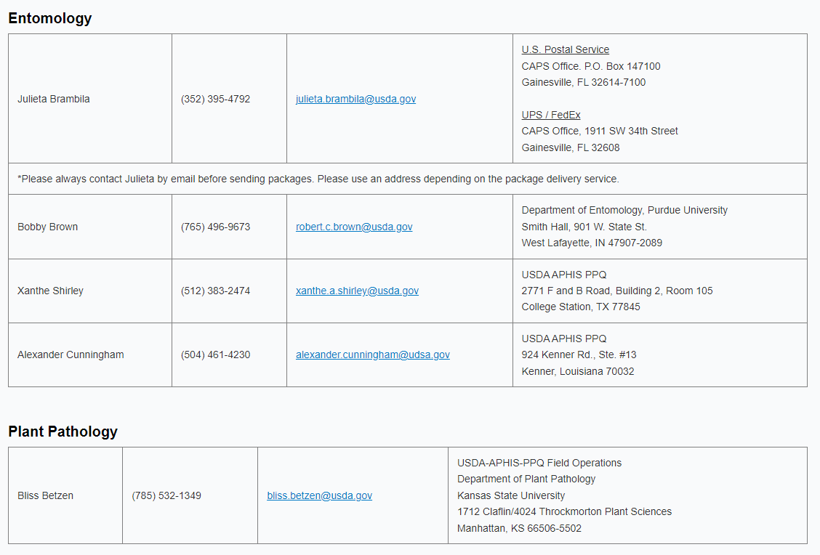
PPQ Domestic Identifiers

Slide 6
Taxonomic Institutions
Carnegie Institute
  5 Year Contract - Annual performance review/renewal
Mississippi State Screening Center
  PPA and Pest Detection – Annual Cooperative Agreement (CA)
Oregon Dept. of Agriculture
  PPA – Annual Cooperative Agreement (CA)
Washington State Department of Agriculture
  PPA – Annual Cooperative Agreement (CA)
  PPA Goal 3 CA’s are governed by Goal 3 Implementation, Work, Financial Plans and Accomplishment Reports.

Slide 7
Preliminary ID Coordinator Key Tasks –
ADODR for Institutions
Liaison with NIS
Supports field sample coordination
Manage capacity overflows
Evaluate and manage capacity for Institutions

Slide 8
Field Operations – Key Tasks
Identify and manage the assigned financial resources
Coordinate PPQ PSS sample submission annually (EWB/BB)
Manage Contracts/Agreements that are funded through FO Pest Detection
Look for identification gaps
Work closely with the National Coordinator to account for identification costs in agreements and look for areas to improve service cost savings.

Slide 9
Goals Achieved and Future Planning
Discuss sample submission/preservation challenges
Support pilot trap/lure preliminary ID impact evaluations
    Examples - Gauge by-catch of 6 Component Cerambycid lure
Support on-boarding of new Domestic PPQ Identifiers
  Supervised by FO SPHD
Facilitate workload coordination with PPQ Domestic Identifiers
Assess current resources available to assist w/ID (training, voucher specimens, screening aids, job aids)
Exploring molecular options due to;
  By-catch capacity (OWB)
  Endangered Species compliance (RPB)
  Pesticide compliance

Slide 10
National Identification Service NIS – Tasks/Protocols
Verify appropriate identification protocols and tools
Maintain Pest Confirmation (Guidance, S&D Reviews, ARM Pest Status)
Initiate new screening aids and protocols
Manage the suite of screening aids
Resolve identification issues for pests on the Priority Pest list or pests under consideration for inclusion on the list.
Serves as an advocate for the identifiers, but also holds them accountable for following protocols and processing samples timely

Slide 11
CAPSIS Support
Michael Hill – Director - Center for Environmental and Regulatory Information Systems
Bonnie Dietrich – Project Coordinator - Center for Environmental and Regulatory Information Systems
Key Task
  Survey Summary Form – Diagnostic Summary
  Sample Submission Guidance
  Screening Aids
  Training Resources
Goals Achieved and Future Planning
  Review/Update Screening Aids
  SSF Definitions
    Identifier / Diagnostician
    Diagnostic Details
  AMPS Page - Key Diagnostic or Identification

Slide 12
ARM Domestic Module
Tina Gresham – EDP National Policy Manager
Darrell Bays – FO CFWG Representative
Key Task
  supports ARM users from domestic programs and activities
    Diagnostic Requests – (DR)
    Emergency Action Notifications – (EAN)
    DR Notification Routing
    Testing
Goals Achieved and Future Planning
  Established ARM Communication workflow
  Established a budget
  Identified and ranked needed enhancements
  Plan for Field level training

Slide 13
Thank you! For more information please contact;
Patrick Haslem – National Coordinator
Darrell Bays – Field Operations Coordinator
Darrell.a.bays@usda.gov
Patrick.haslem@usda.gov

