Slide 1
S&D Assessment and AMPS Website Updates
Colin Funaro
CAPS Scientific Support Team Lead, PPRA

Slide 2
Brief Introduction
Our team guides new exotic pests on their path to the National Priority Pest List
PPRA
Who should we be worried about?
OPEP assessment provides an impact rating
High impact pests are considered further
Low/moderate impact pests are not considered
Can we FIND and then IDENTIFY these pests?
Survey and Diagnostic Assessment
PPRA uses a literature review to evaluate the ease of survey and ID
Expert reviewers add their support and comments to the final decisions
Should we add these pests to the Priority Pest List?
With the information from PPRA and other criteria, Pest Detection CFWG makes the decision
What do surveyors need to know about these pests?
CAPS Pest datasheets and Approved Methods for Survey and ID
Incorporates info from OPEP and S&D assessments

Slide 3
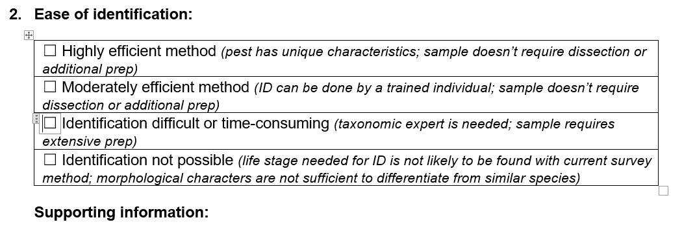
The S&D Assessment
Streamlining the process
More clear and accountable decision making
Clear record of reasons and timing for passing/failing of the pest at any stage in the process
*Special cases: Confirming that pests already on the NPP have effective survey and diagnostic methods (e.g. palm weevils)
Supported with info obtained from the literature by PPRA analysts
Notes:
These are our goals for updating the S&D assessment
Special Case: Palm weevils were assessed despite being already on the NPP.
They were assessed to evaluate the Picusan traps (or palm weevil cone traps) and improve the AMPS
Many pests still do not have S&D assessments, so continued assessments to ensure the approved methods are functional and up to date may be in the works.

Slide 4
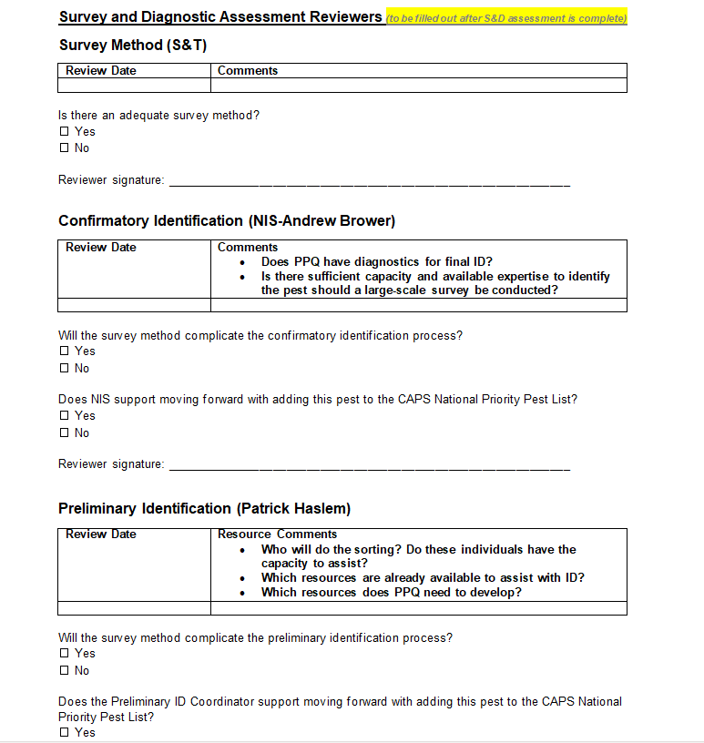
The S&D Assessment - Reviews
Streamlining the process
More clear and accountable decision making
Clear record of reasons and timing for passing/failing of the pest at any stage in the process
Survey Methods Review by S&T CAPS Scientific advisors
ID Methods Review by National Identification Services (NIS)
Preliminary ID Methods Review by Prelim ID Group

Slide 5
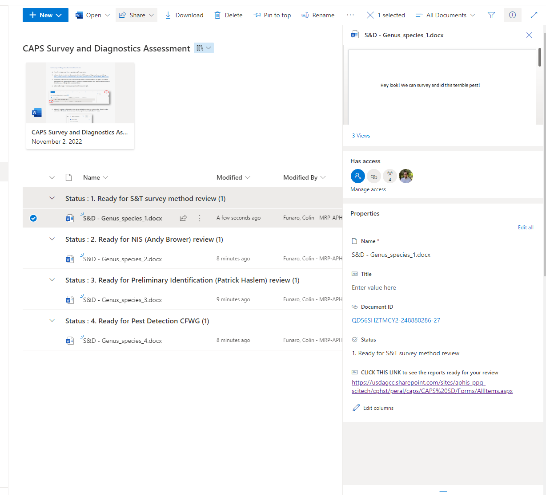
The Sharepoint Process
Streamlining the process
More clear and accountable decision making
Clear record of reasons and timing for passing/failing of the pest at any stage in the process
Link to Site
Notes:
The Share point site also provides additional streamlining, along with version history and a history of who is making changes when.
It will also act as a repository for all S&D assessments, in case they are needed in the future.
We can look at the site to see the different features
Show sections for different reviews
Show latest updates on far right side
Show version history

Slide 6
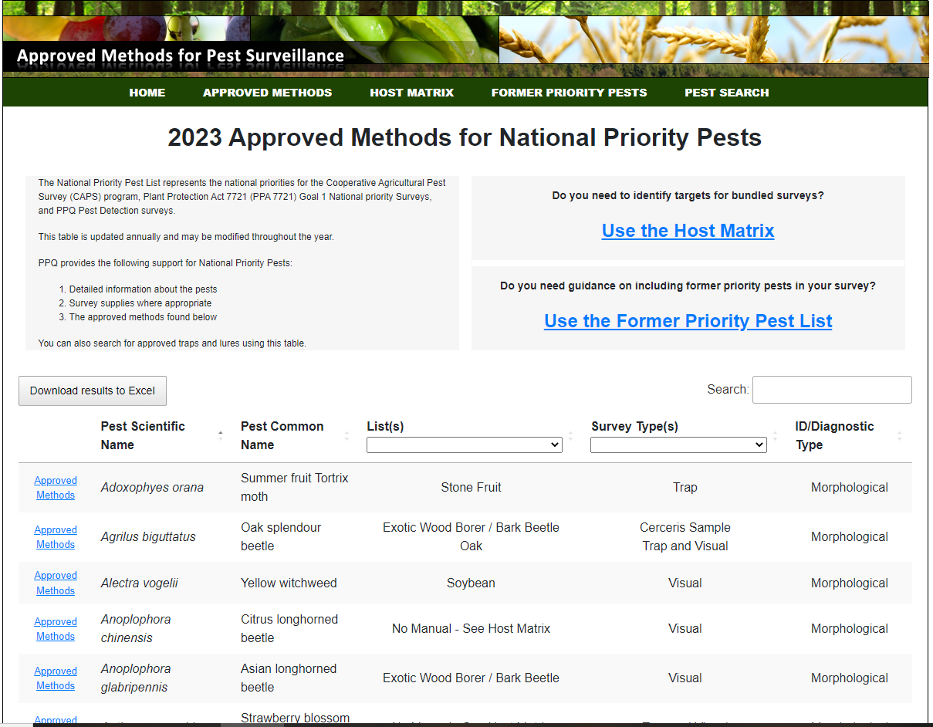
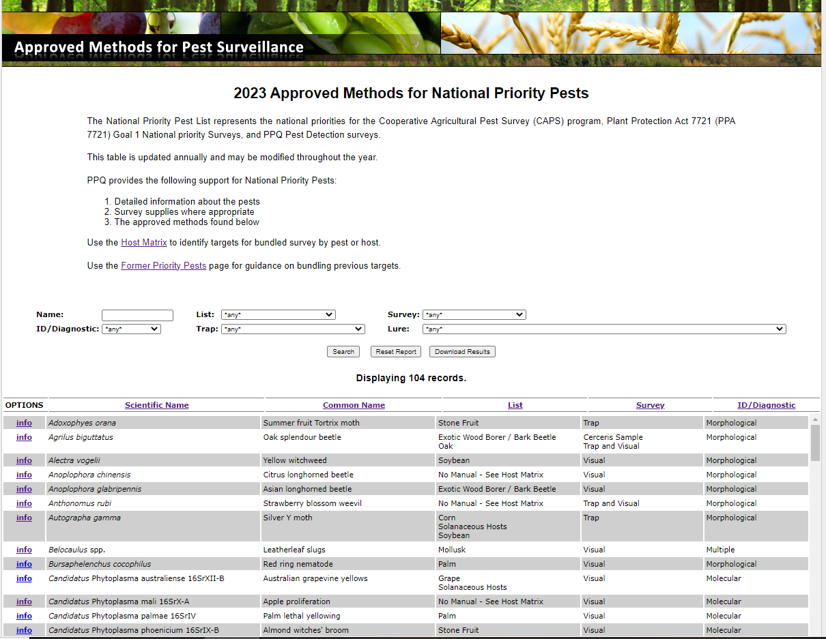
AMPS Site Updates
Navigation Bar
Search
Host Matrix
Old
New
Former Pests
Pest Search
Link to Site
Link to OLD Site
Notes:
Comparison of the sites
Navigation bar for ease of movement between sites
More intuitive guidance for the Host Matrix and Former Priority Pest List
Search for any term, can be useful for grouping pests or searching for what you know about a pest if you aren’t sure
Drop down menus for the lists and surveys and you can sort by any column
The host matrix, former pests, and search all have the same updates and are very similar.
For NOW best viewed on a computer or a large tablet – mobile accessibility is on the way, at some point.
The site WORKS on mobile, just not optimized

Slide 7
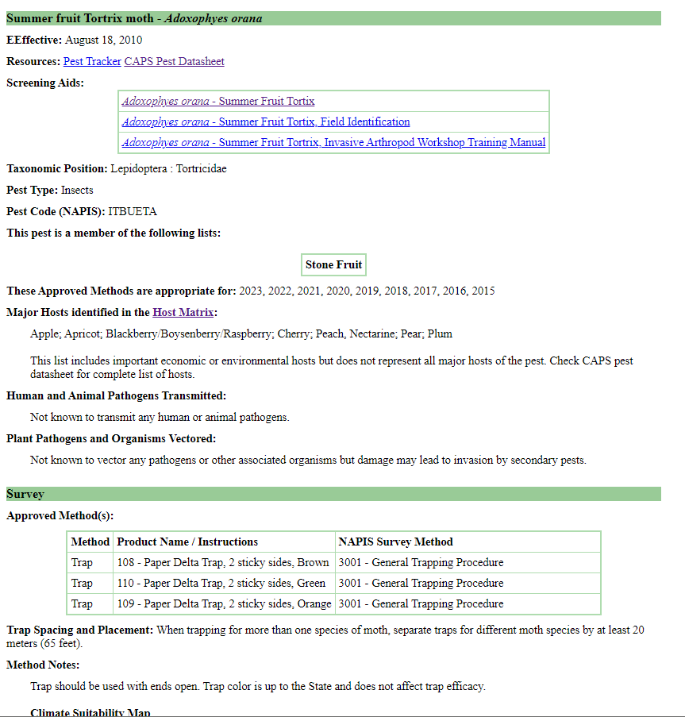
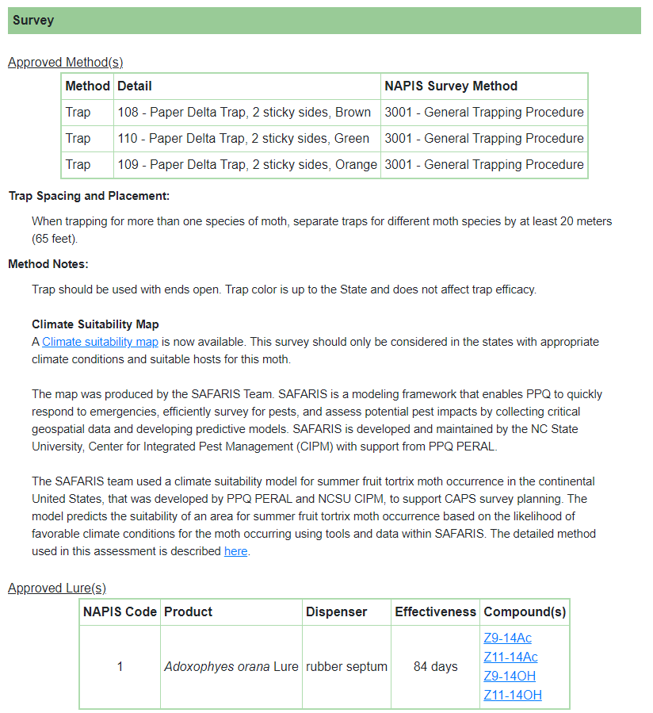
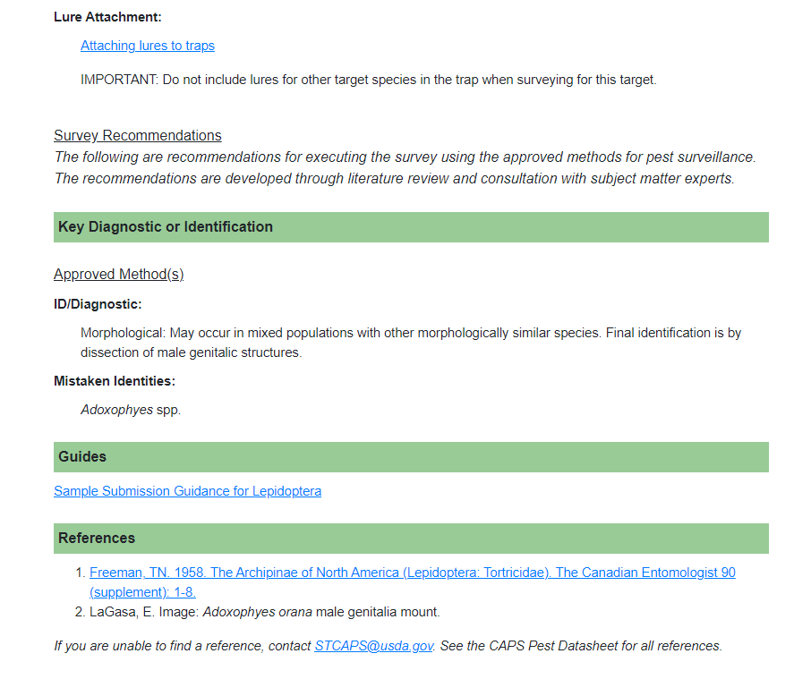
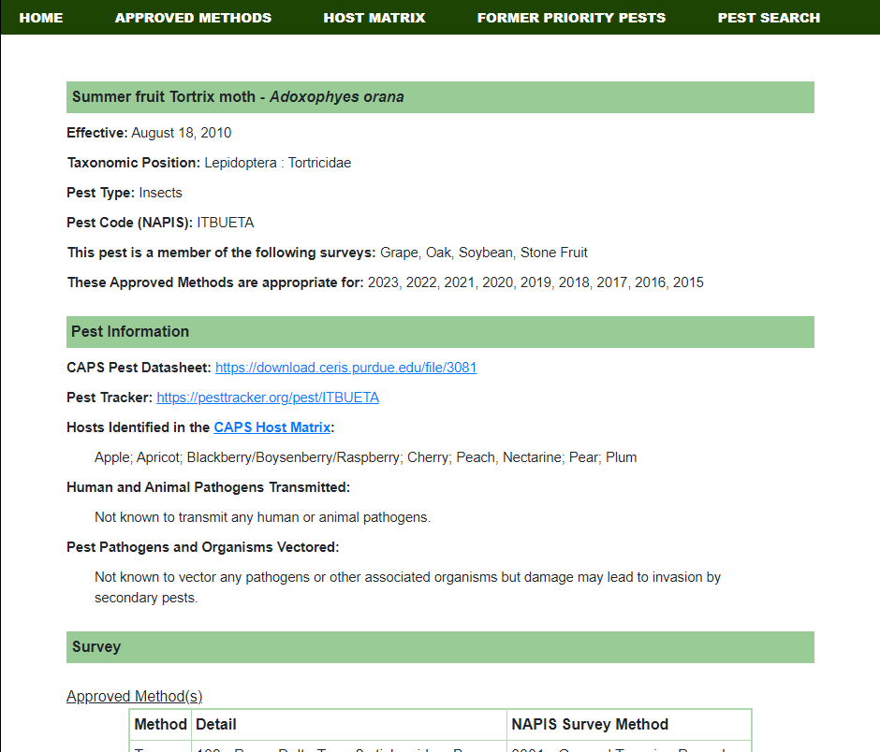
AMPS Site Updates
Link to Site
Notes:
Key Differences: Easier to read formatting, clearer directions to find CAPS products
FOR NOW: Screening aids removed. Still available on the screening aids site (within CAPS Main site), but they need review
This is partly a work in progress – There are more diverse sections to fill in survey and ID info, including:
Lure Notes, Signs, Symptoms, Special Notes, Target Life Stage, Time of year to survey, Survey Design, Survey Site Selection, Site Inspection, Sample Collection
Identification Resources, Mistaken Identities, and Diagnostic Notes
We also added language for the Climate Suitability Maps that are available to improve survey design.

Slide 8
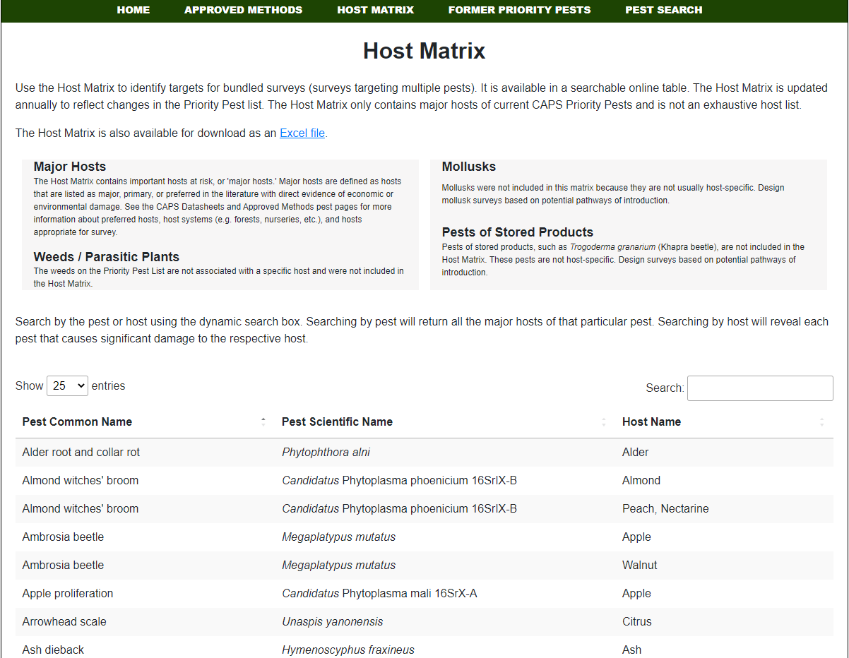
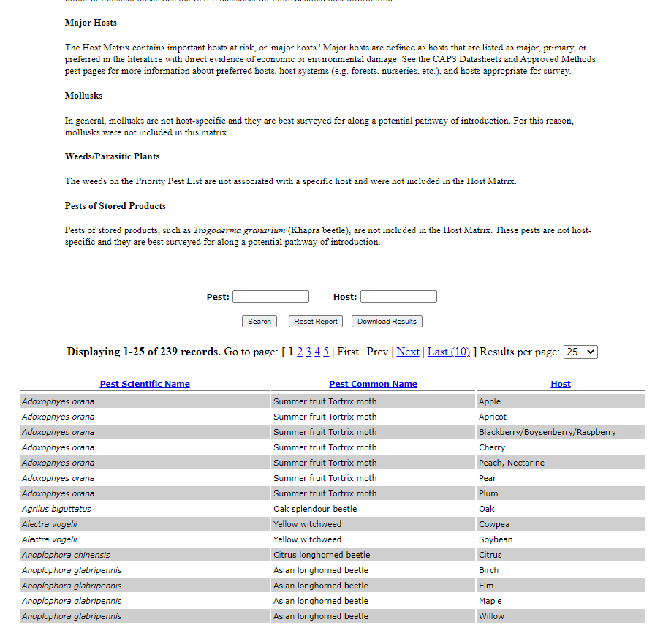
Notes:
*IF AMPS SITE IS UNAVAILABLE, SHOW THESE SLIDES*

Slide 9
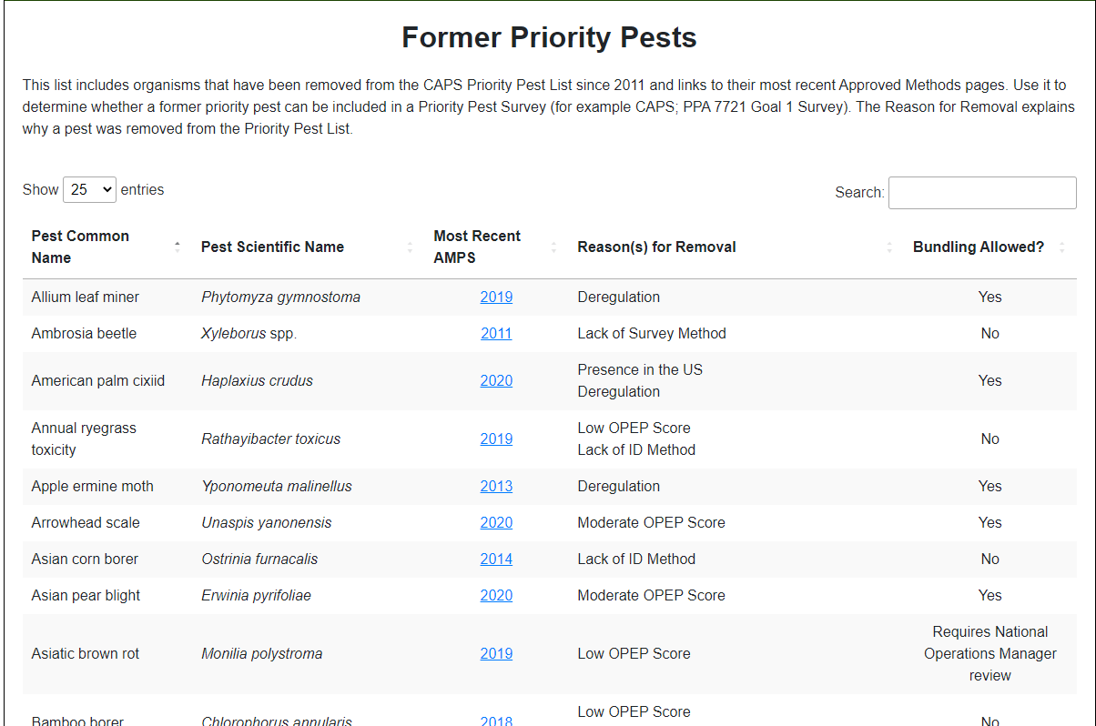
Notes:
*IF AMPS SITE IS UNAVAILABLE, SHOW THESE SLIDES*

Slide 10
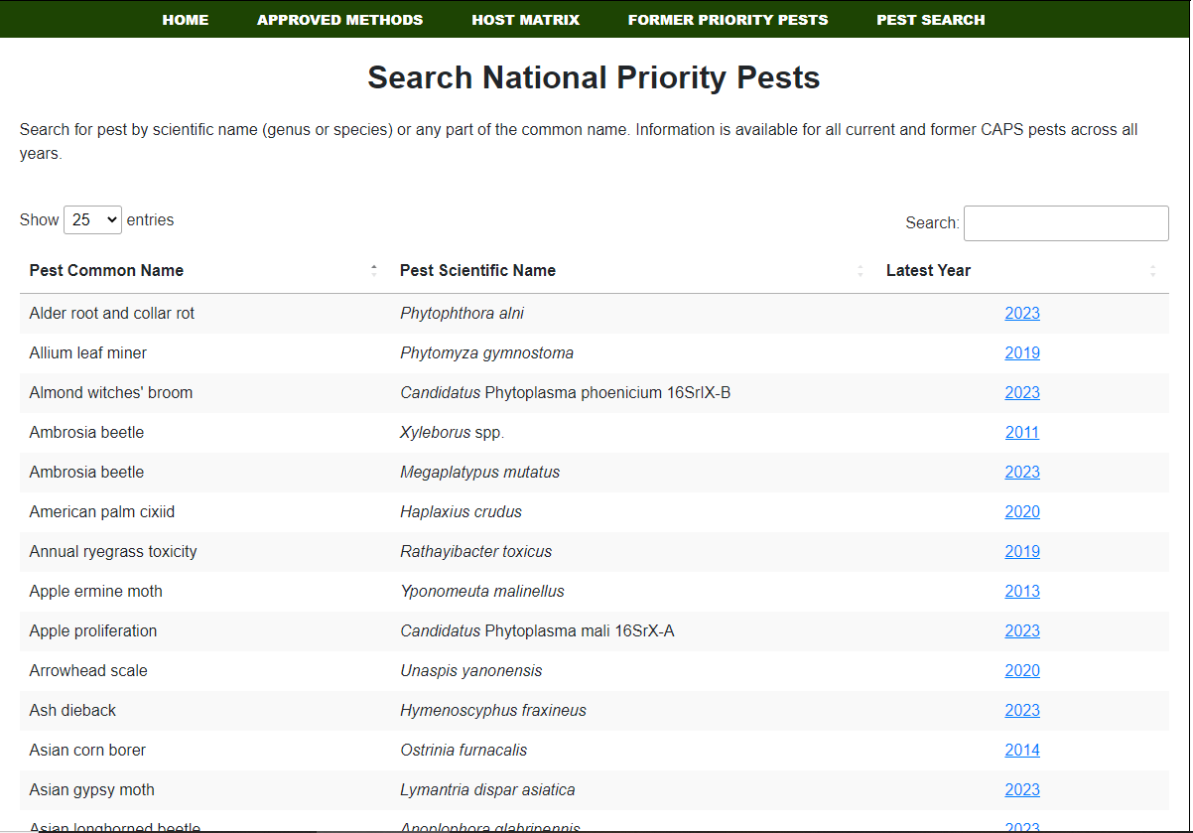
Notes:
*IF AMPS SITE IS UNAVAILABLE, SHOW THESE SLIDES*

