Slide 1
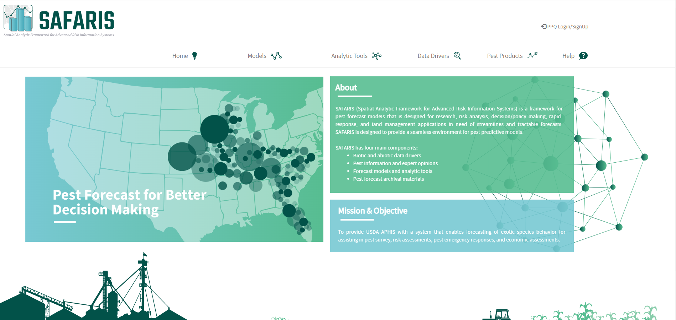
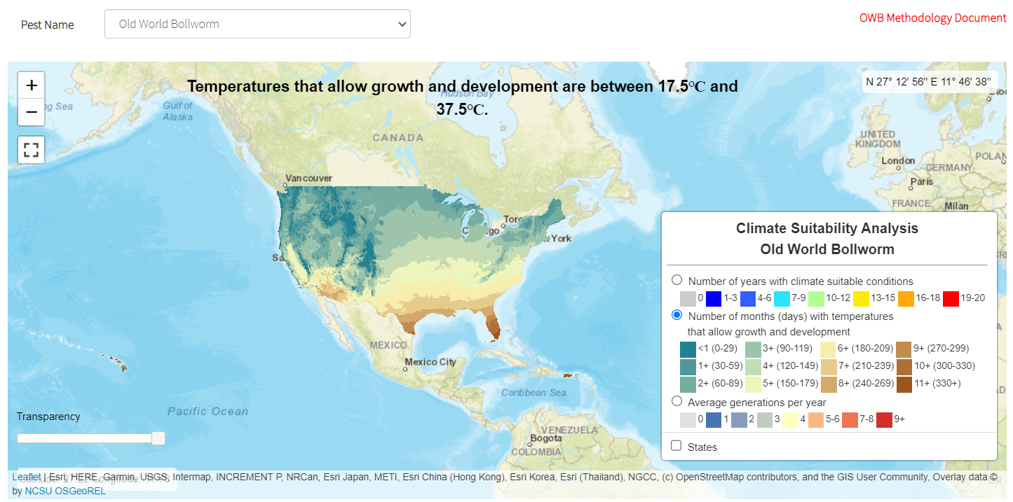
An Intro to the SAFARIS Toolbox:
A collection of spatial tools to help survey planning
Amber Tripodi, USDA-APHIS-PPQ-S&T-PPRA amber.tripodi@usda.gov
The SAFARIS Home Page has links to all of the available tools
https://safaris.cipm.info
Models for specific pests are all listed by pest on the Pest Products Page. Here you can find prediction maps for weekly and monthly life stage and the CAPS Climate Suitability Maps for Pest Surveillance.
Climate Suitability models are specific for each pest based on what we know about their biology. For some pests, more than one model may be available to help survey planning.

Slide 2
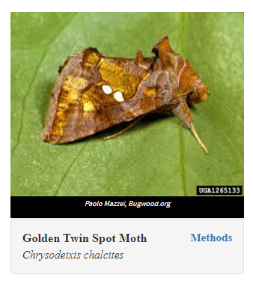
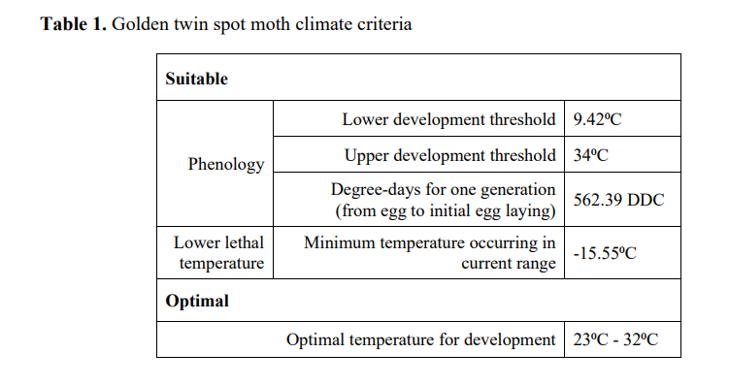
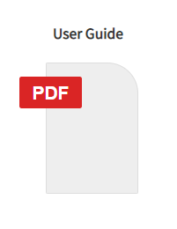
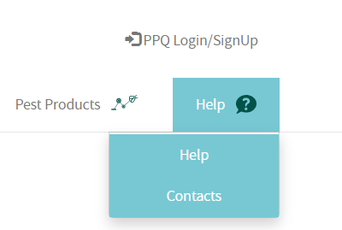
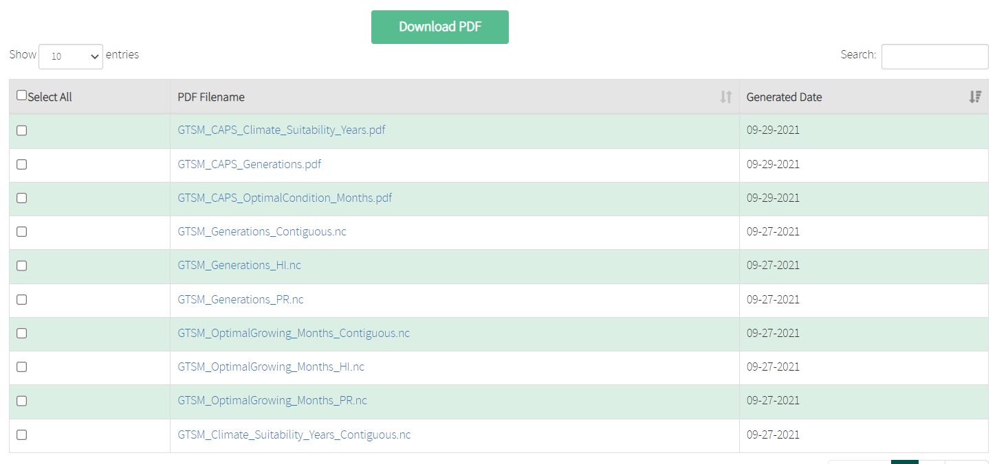
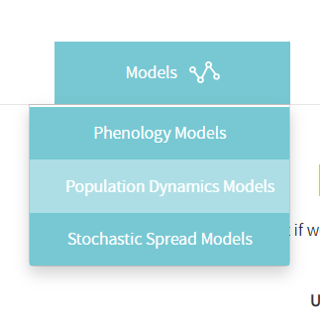
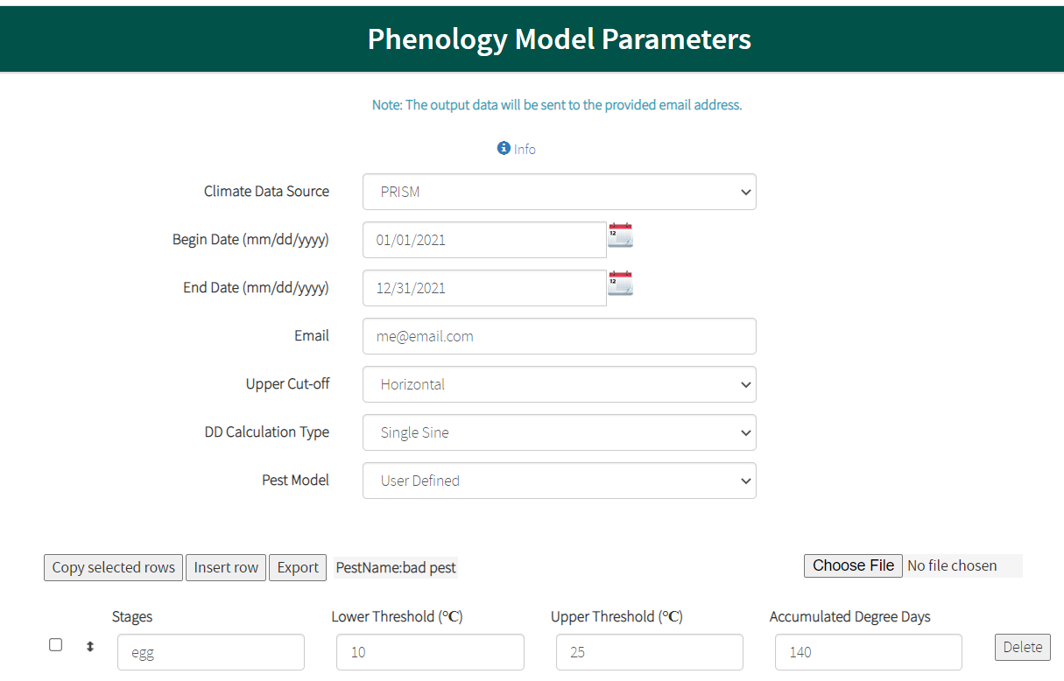
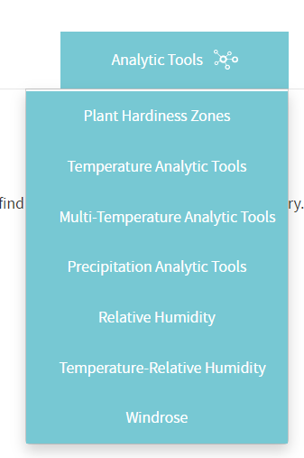
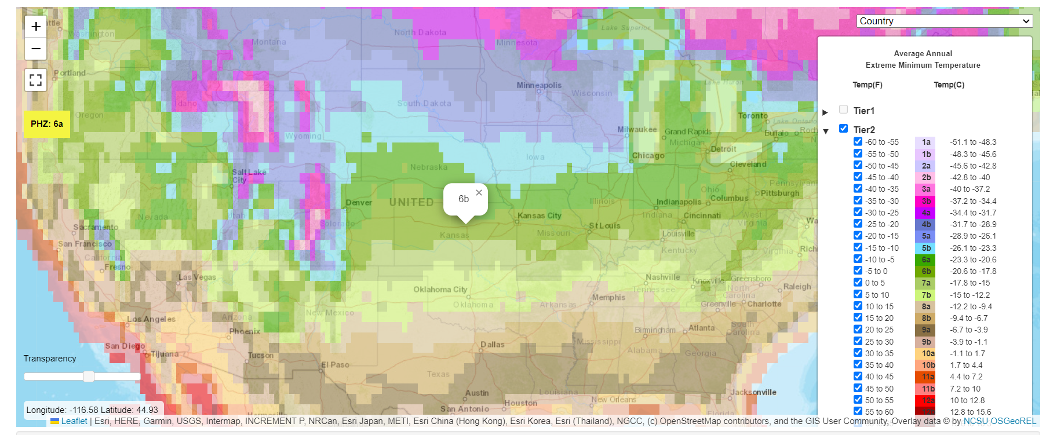
Each pest has a methodology document that describes how we defined suitability and where we got the data to parameterize the model.
Maps can be downloaded in pdf form for paper copies or sharing or in netcdf form for using in your own spatial software. Instructions for using netcdf files in ArcGIS are in the User Guide document under Help.
There are many other spatial tools available in SAFARIS, such as an interactive Plant Hardiness Zone Map and the Phenology Model, a customizable degree day calculator, that provide maps that you can download and use. Check the User Guide for step-by-step instructions.

Slide 3
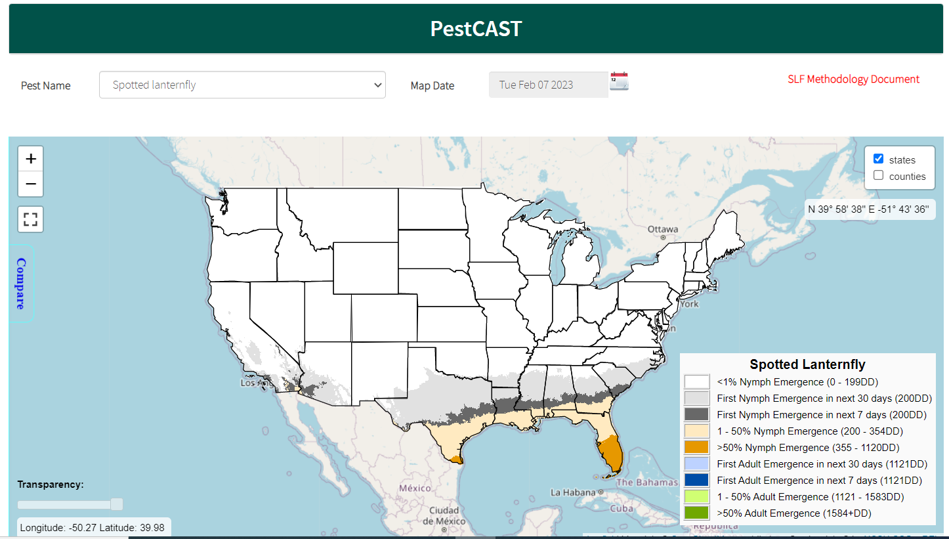
The tools are customizable and interactive. Best of all, the models are dynamic and can be updated as new data are available. This has worked well for the SLF PestCAST model, which has been updated as we gather new observations. The life-stage predictions from PestCAST for SLF are very accurate.
Because this is a dynamic system, we can build new tools to model the diverse climate suitability needs of 100+ CAPS Priority Pests. Pathogens, weeds, mollusks, and long-lived insects likely require a different perspective than most of the insects we’ve addressed so far, so some models may take longer than others.
We are working on improvements to the user interface and improving map communication, and we hope to have a model interpretation guide available soon. Your feedback is a crucial part of this. Please reach out if you have ideas!
SAFARIS is a collaboration between USDA-APHIS-PPQ-S&T and Yu Takeuchi with the North Carolina State University Center for Integrated Pest Management.

