Slide 1
S&T CAPS Support
Annual NCC Meeting
Jan 31- Feb 1, 2023
Sam Kim
Notes:
[Don’t forget to ask the moderator to hold any questions until the end]

Slide 2
About the Priority Pest List https://caps.ceris.purdue.edu/pest-surveillance-guidelines/about-priority-pest-list
Pests are removed if:
they have been federally deregulated or
have become established in multiple states.
Pests are added if:
they are predicted to have a high impact in the United States in OPEP assessment and
effective methods and resources are available to support detection surveys.

Slide 3
Objective Prioritization of Exotic Pests (OPEP)
Assessment looking into
evaluating the likelihood that an exotic pest will cause significant impacts if introduced into the United State
Low, moderate, high impact

Slide 4
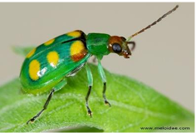
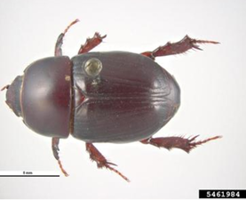
Removal From Priority Pest List
Diabrotica speciosa – Cucurbit beetle
Reason – moderate value in OPEP assessment
Heteronychus arator – Black maize beetle
Reason – moderate value in OPEP assessment

Slide 5
S&T CAPS Support Team
Shelley Gray, AD, Lead
Sam Kim, Acting AD
Colin Funaro, Team lead
Contact us at
stcaps@usda.gov

