Slide 1
Rusty Patched Bumble Bee &
PPQ Pest Surveillance
John Crowe
National Policy Manager
John.F.Crowe@usda.gov

Slide 2
CAPS Mission Statement
The Cooperative Agriculture Pest Survey (CAPS) program’s mission is to conduct exotic plant pest surveys through a national network of cooperators and stakeholders to safeguard American agriculture and natural resources.

Slide 3
Endangered Species Act
The Endangered Species Act (ESA) provides a program for the conservation of threatened and endangered plants and animals and the habitats in which they are found.
The lead federal agencies for implementing ESA are the U.S. Fish and Wildlife Service (FWS) and the U.S. National Oceanic and Atmospheric Administration (NOAA) Fisheries Service.
The FWS maintains a worldwide list of endangered species. Species include birds, insects, fish, reptiles, mammals, crustaceans, flowers, grasses, and trees.
https://www.fws.gov/endangered/laws-policies/

Slide 4
Endangered Species Act
The law requires federal agencies, in consultation with the U.S. Fish and Wildlife Service, to ensure that actions they authorize, fund, or carry out are not likely to jeopardize the continued existence of any listed species or result in the destruction or adverse modification of designated critical habitat of such species (Section 7, Interagency Cooperation).
The law also prohibits any action that causes a "taking" of any listed species of endangered fish or wildlife. Likewise, import, export, interstate, and foreign commerce of listed species are all generally prohibited.

Slide 5
Endangered Species Act
2017 - Rusty Patched Bumble Bee (RPBB) Listed by FWS
2018 – First capture of RPBB in a plastic bucket trap
2018 – PPQ initiates FWS Consultation for RPBB
2023 – FWS issues Biological Opinion with incidental take

Slide 6





Pest Surveillance
CAPS
PPQ Pest Detection
AQI Port Environs
PPA Survey
Technical Information & Authority

Slide 7
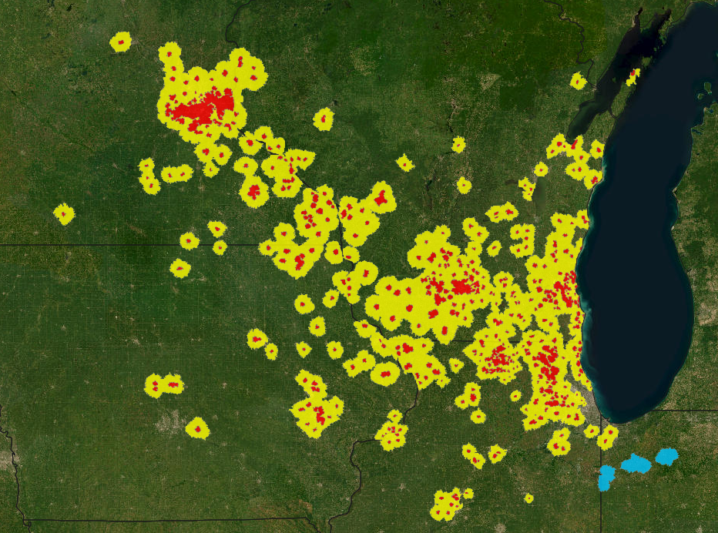
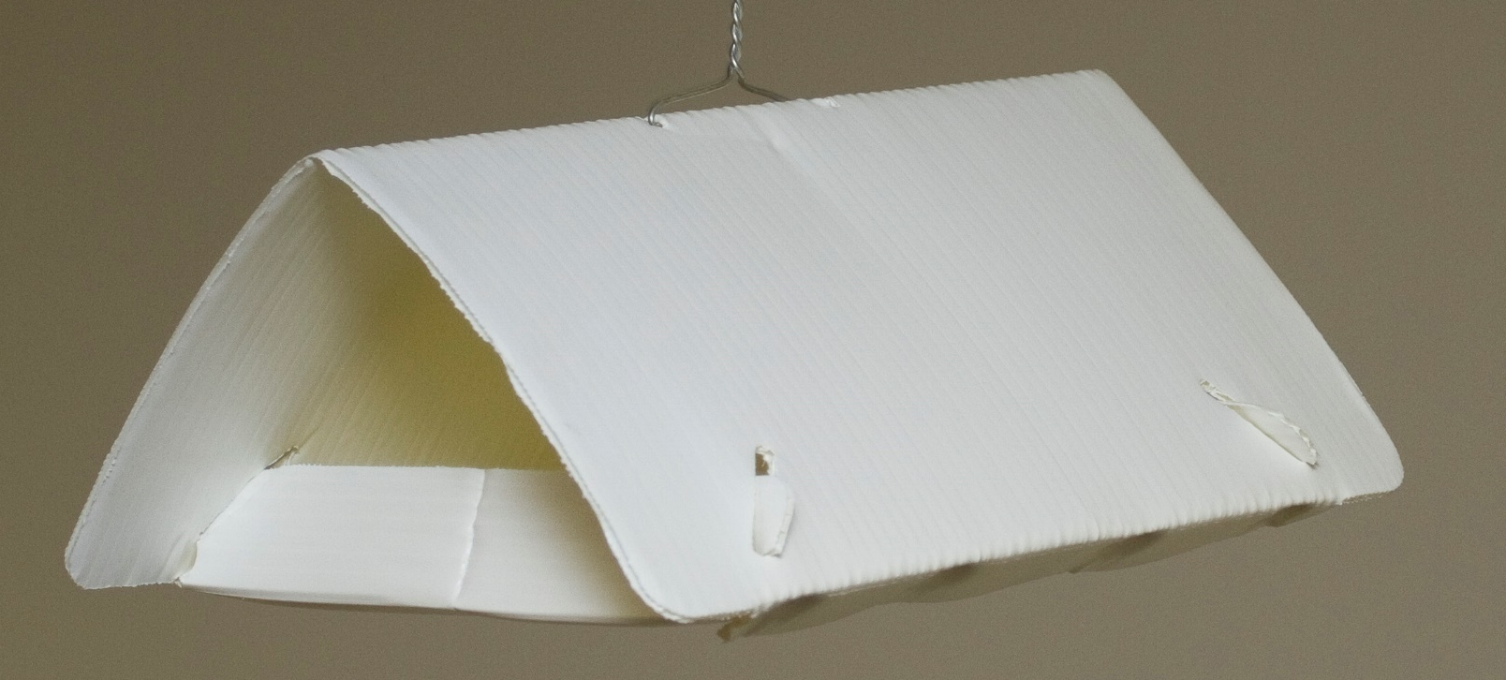
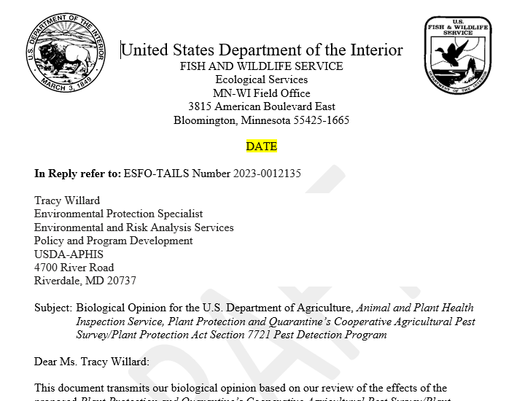
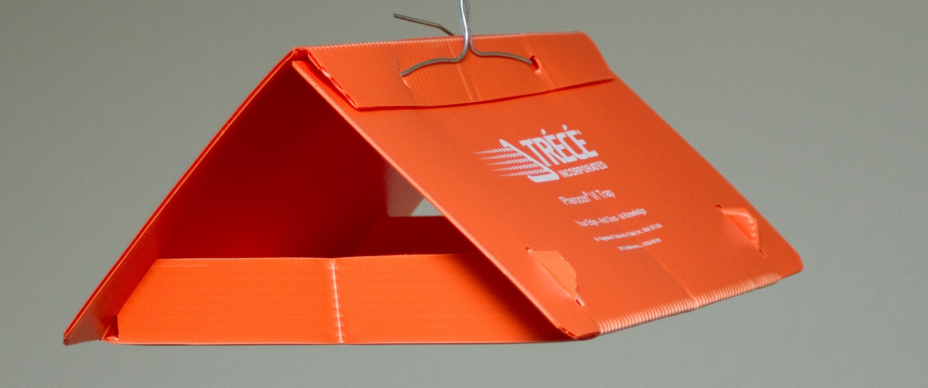
Consultation Strategy
Avoid trapping in the range of listed insect species.
Apply acceptable mitigations.
Start formal consultation.

Slide 8
Consultation Strategy – Primary
Avoid trapping in the range of listed insect species.
Review of Fish and Wildlife Service range maps.
Determine if range areas can be avoided.
If in proximity, ask NPM for map clarification.
For those insects where the area can be avoided, we can make a no effect determination and no further consultation would be needed for those species or range areas.

Slide 9
Consultation Strategy – Primary
Example:
State | Listed Species | Common Name | Description
Texas | Batrisodes texanus | Coffin cave mold beetle | Underground. Would not be captured in traps.
New Hampshire | Lycaeides melissa samuelis | Karner blue butterfly | Agreed on January 14, 2021, to avoid listed areas.
After agreement, a draft listing on the CAPS Collaboration Site is needed.

Slide 10
Consultation Strategy – Secondary
For areas where trapping must happen, we may seek alternative trapping protocols or additional steps.
Example:
State | Listed Species | Common Name | Description
Florida | Anaea troglodyta floridalis | Florida leafwing butterfly | Pineland croton, Croton cascarilla will be identified by survey staff and avoided, and traps known to capture butterflies will not be used in proximity to pineland croton or Croton coscarilla.
Oklahoma | Nicrophorus americanus | American burying beetle | Trapping in OK will be at breast height or above, and captured material will be replaced at least every two weeks in all traps. These mitigating factors will prevent the entry of American burying beetle in any traps.
When agreed to, a draft listing on the CAPS Collaboration Site is needed.

Slide 11
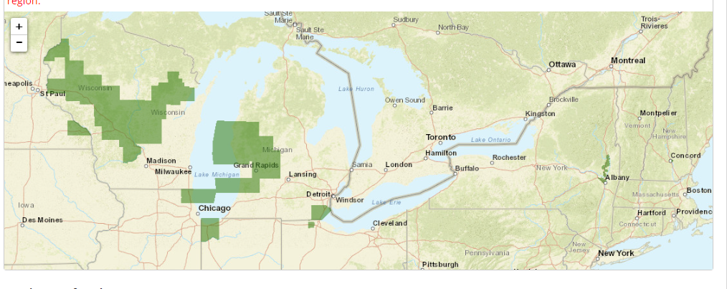
Consultation Strategy - Hybrid
Examples - Karner blue butterfly
New Hampshire - can avoid
Wisconsin - Likely require a different approach.
New Hampshire
Wisconsin

Slide 12
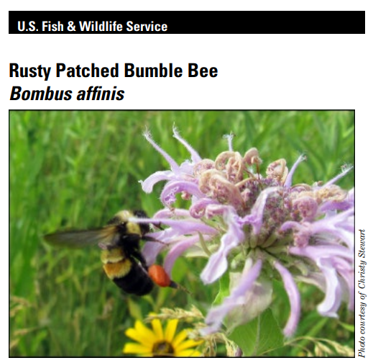
Consultation Strategy – Formal
For areas where trapping cannot be avoided and few or no useful protection measures are available, we might have to make a likely to adversely affect determination(s) and initiate formal consultation.

Slide 13
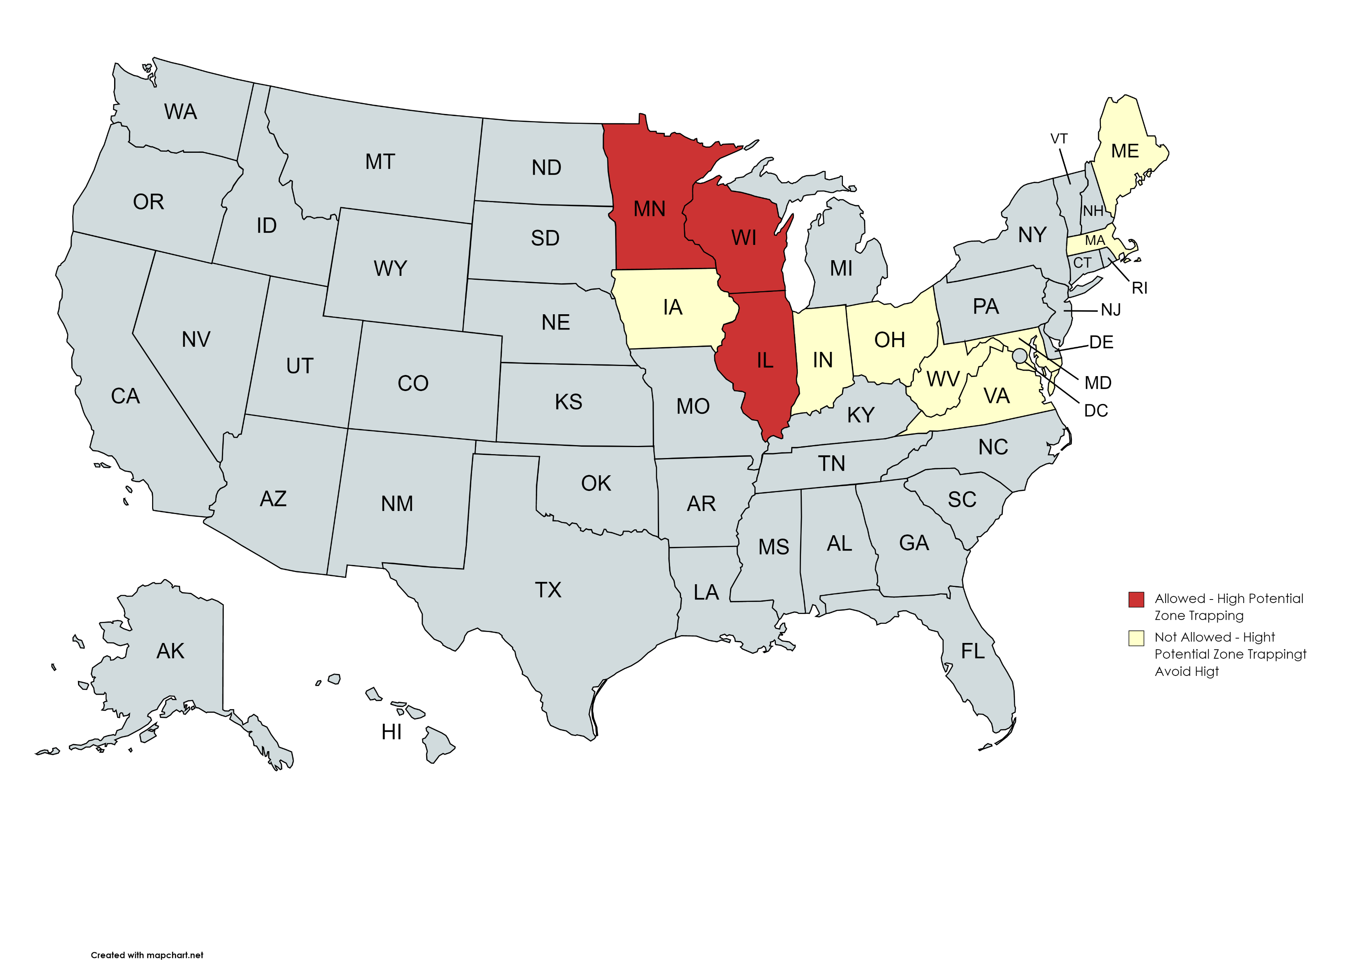
Consultation Strategy - RPBB
11 States with RPBB Populations
3 State could not avoid trapping
  Illinois
  Minnesota
  Wisconsin

Slide 14
Formal Consultation - RPBB
For rusty patched bumble bee:
Populations in large areas of Illinois, Minnesota, and Wisconsin.

Slide 15
Consultation Strategy – Formal
Prior to placing traps:
Check the rusty patched bumble bee map for changes.
Confirm GPS coordinators of trapping locations.
Compare trapping coordinates and High and Low Potential Zones.
Follow policy guidance when overlapped.

Slide 16
Traps of Concern
Prism Traps (Purple)
Large Plastic Delta Traps (White)
Plastic Bucket Trap – Multi-Colored (White, Yellow, and Green)
Jackson Traps
Wing Traps (White)
Large Plastic Delta Traps (Orange and Red)

Slide 17
Traps of Concern – Plastic Bucket Trap
  All States:
  Low Potential Zones (yellow zones):
  Require identification of bumble bee bycatch.
  Follow Annex 1
  No notice is required
Plastic Bucket Trap – Multi-Colored (White, Yellow, and Green)

Slide 18
Traps of Concern – Plastic Bucket Trap
  Illinois, Minnesota, and Wisconsin:
  High Potential Zones (red zones):
  Notice and Approval Required
  SPHD assembles trap location list
  Require identification of bumble bee bycatch (follow Annex)
  FWS will approve final locations
Plastic Bucket Trap – Multi-Colored (White, Yellow, and Green)

Slide 19
Traps of Concern – Plastic Bucket Trap
  States other than, Illinois, Minnesota, and Wisconsin:
  High Potential Zones (red zones):
    Must be avoided
Plastic Bucket Trap – Multi-Colored (White, Yellow, and Green)

Slide 20
Traps of Concern – Prism Traps
All States:
High Potential Zones (red zones on the map)
  May not be used.
Low Potential Zones (yellow zones on the map)
  Limit use as much as possible.
Historical Areas (blue/gray zones on the map)
  No restrictions.
Prism Traps (Purple)

Slide 21
Traps of Concern – Large Plastic Delta Traps
All States:
Large Plastic Delta Traps (White)
High Potential Zones (red zones)
  May not be used. (Alternative colors are acceptable.)
Low Potential Zones (yellow zones)
  Limit use as much as possible.
Historical Areas (blue/gray zones)
  No restrictions.
Large Plastic Delta Traps (White)

Slide 22
Traps of Concern – Large Plastic Delta Traps
All States:
High Potential Zones (red zones)
Limit use as much as possible.
Low Potential Zones (yellow zones)
Limit use as much as possible.
Historical Areas (blue/gray zone)
No restrictions.
Large Plastic Delta Traps (Orange and Red)

Slide 23
Traps of Concern – Jackson Traps
All States:
High Potential Zones (red zones):
  May not be used until after fruit tree bloom.
  Bumble Bee bycatch must be identified using Annex 1.
Low Potential Zones (yellow zones)
  Limit use as much as possible.
  Bumble Bee bycatch must be identified using Annex 1.
Historical Areas (blue/gray zones on the map)
  No restrictions.
Jackson Traps

Slide 24
Traps of Concern – Wing Traps
  All States:
  High Potential Zones (red zones)
    May not be used.
  Low Potential Zones (yellow zones)
    Limit use as much as possible.
  Historical Areas (blue/gray zones)
    No restrictions.
Wing Traps (White)

Slide 25
Annex 1: Bumble Bee Bycatch Submission
Local Sorting Practices
  No sorting in the field.
  Dry samples are preferred.
Local Screening
  Screener qualified to identify bumble bees.
Questions to: allan.h.smith-pardo@usda.gov

Slide 26
Annex 1: Bumble Bee Bycatch Submission
Sample Submission:
Bumble bee specimens absent - locally recorded:
  Date of when the sample was collected
  Date of when the sample was screened for bumble bees
  Who processed the samples
  Note of negative determination for bumble bees, i.e., no bumble bees were found
Bumble bee specimens present – before shipping:
  Complete - 391 or IBP for each sample
  Message: allan.h.smith-pardo@usda.gov
    Subject, “bee bycatch samples”
    Number of specimens
    Package tracking number
    Completed 391 or IBP number

Slide 27
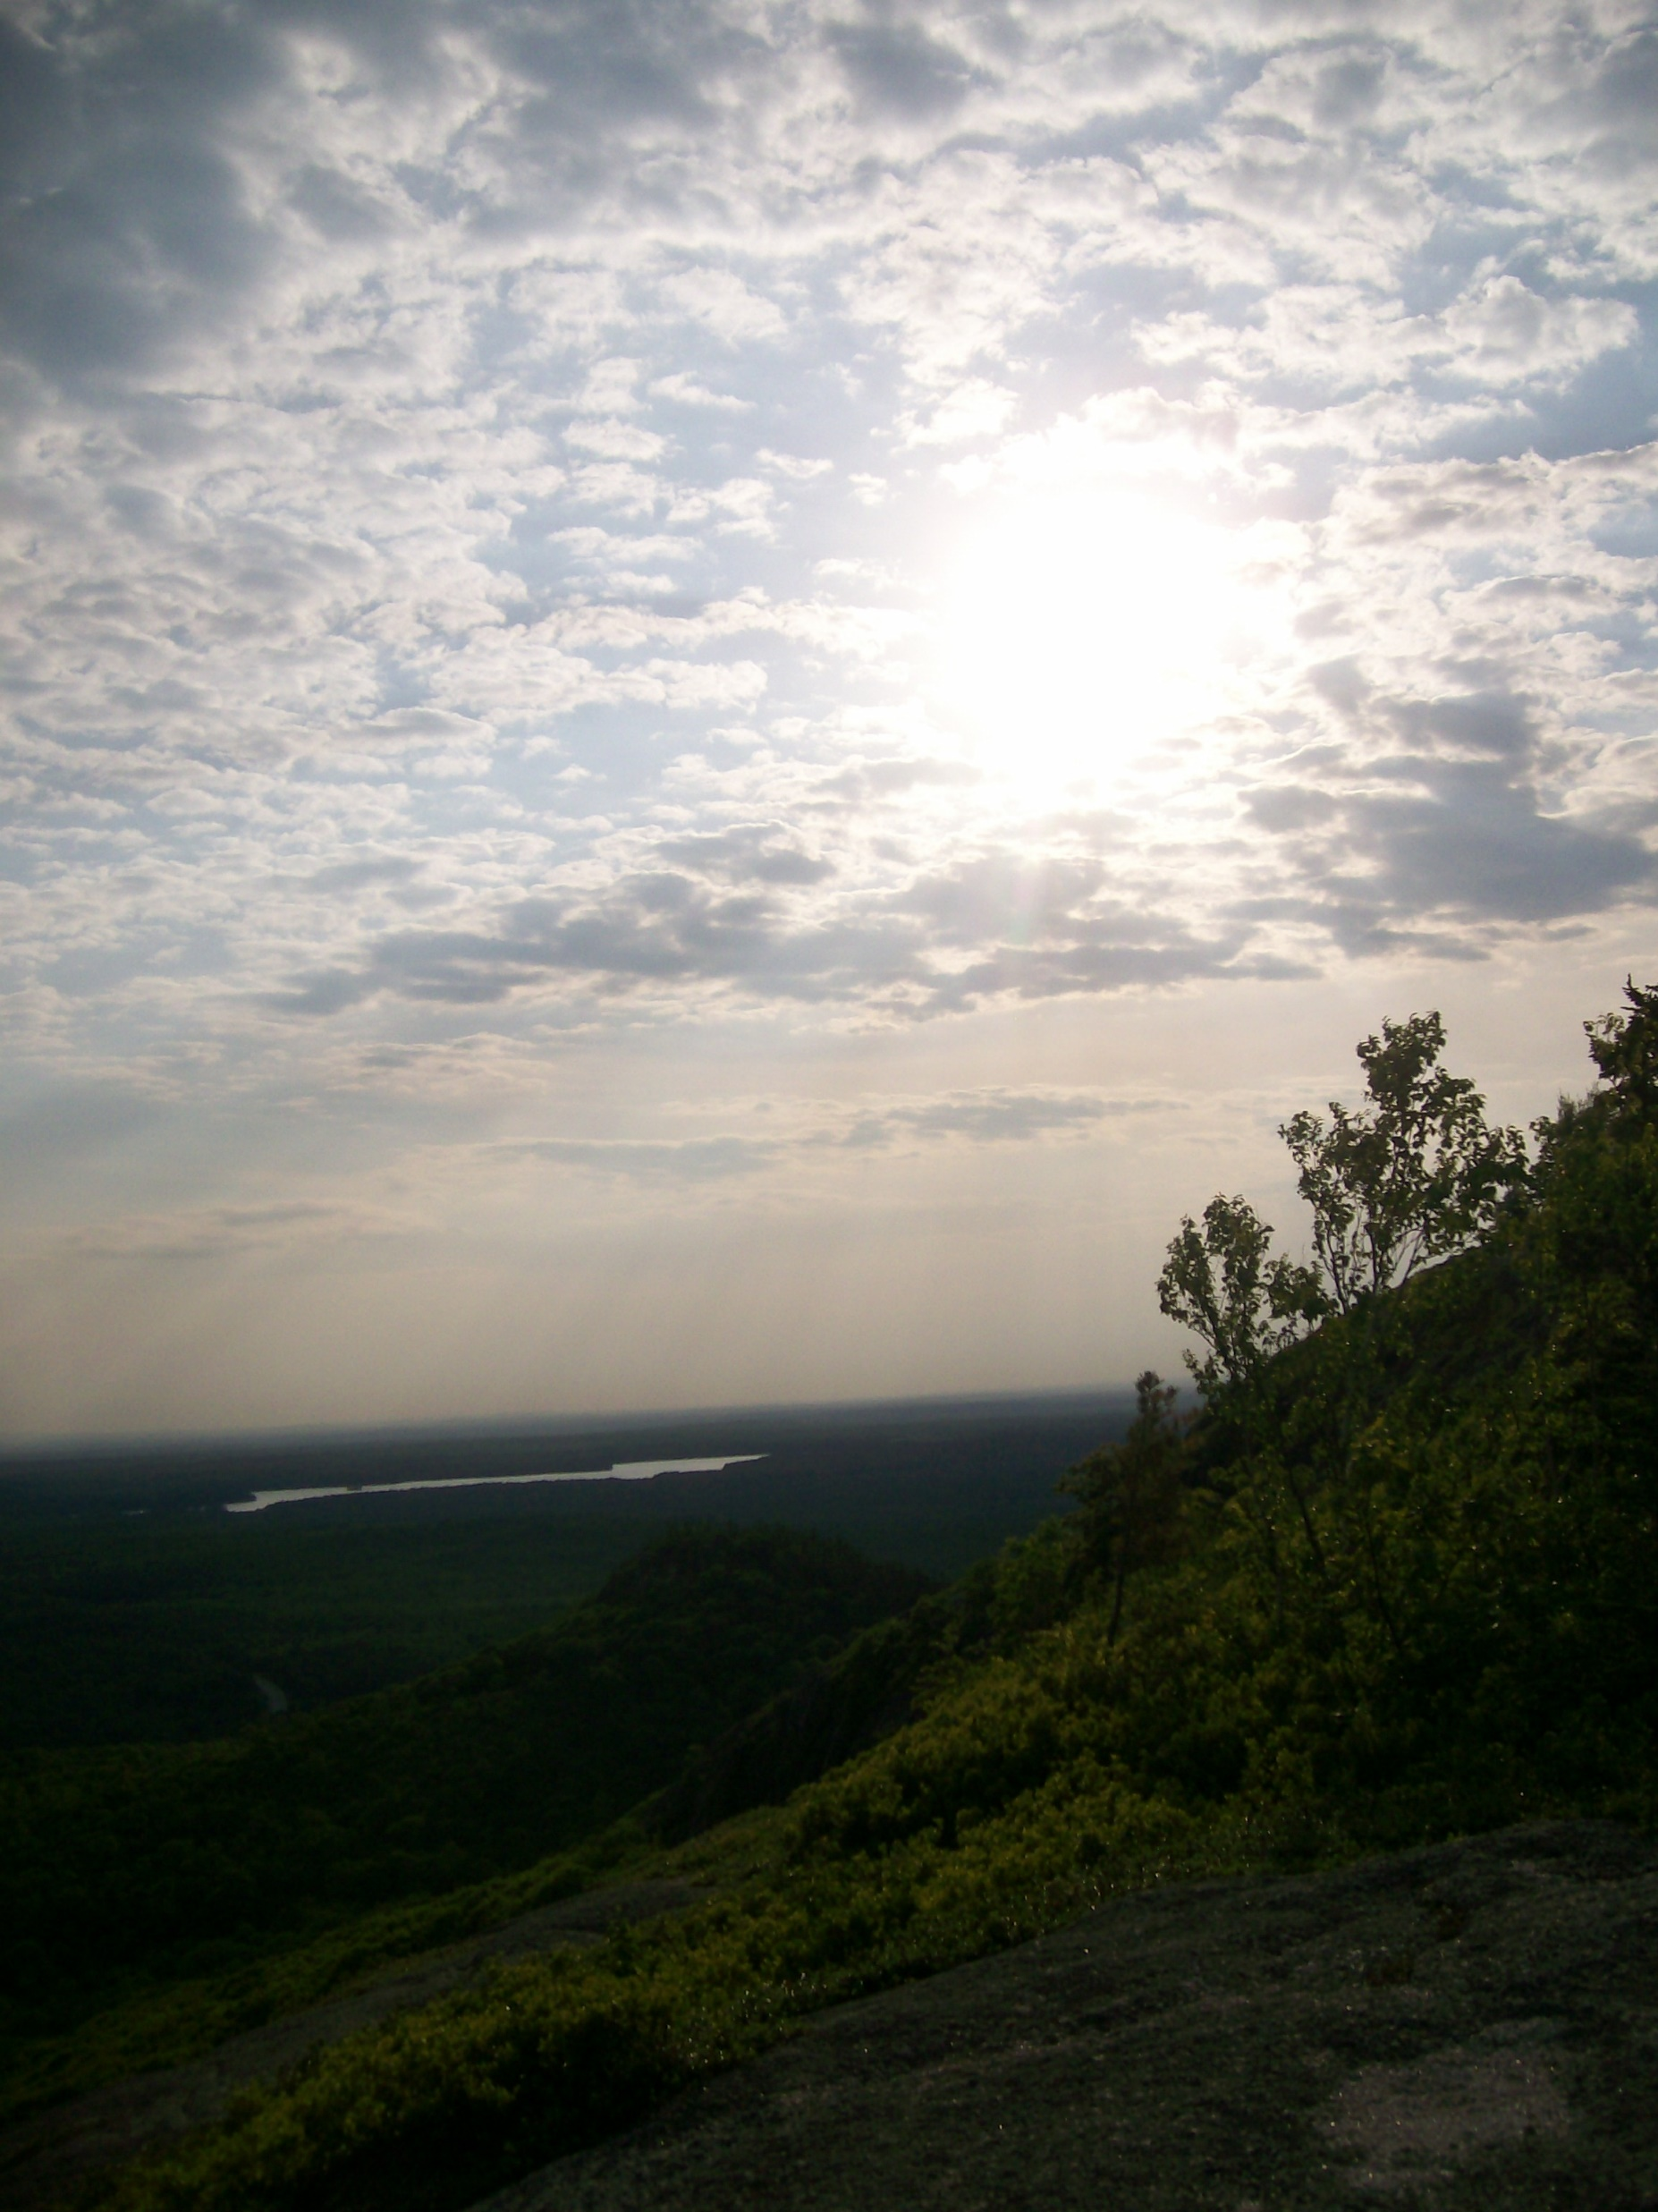
Thank you!
  Questions to:
John Crowe - john.f.crowe@usda.gov

