Slide 1
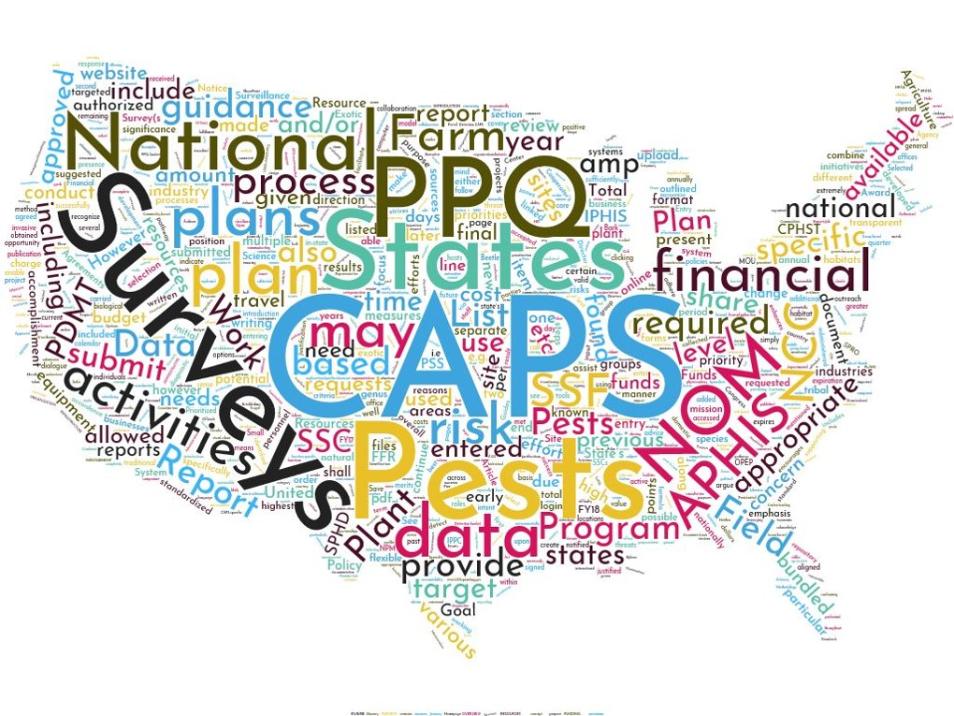
National Priority Pest List

Slide 2
Evaluating Potential Pests
Pests are added to the National Priority Pest List if:
  They are predicted to have a high impact in the United States, and
  Effective methods and resources are available to support detection surveys.

Slide 3
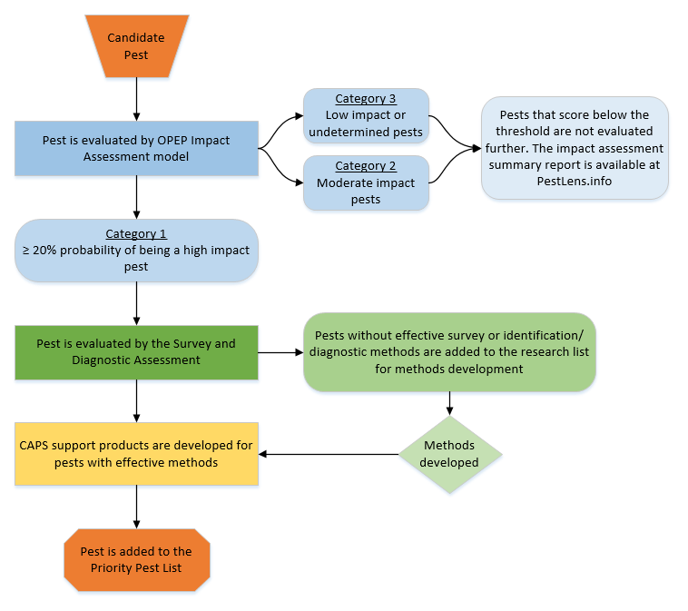
Notes:
Pest is submitted for evaluation.
Pest is run through OPEP model.
If high impact – goes through Survey and Diagnostic Assessment.
If methods available, gets added to Pest List.

Slide 4
Evaluating Potential Pests
We hear about potential pests from:
    PPQ scientists
    Colleagues overseas
    Scanning the literature
    Scanning online information: PestLens
    YOU!!!
This is a very important part of the process. We can only assess pests that we hear about.
We have an open door policy to submit pest suggestions.

Slide 5
Evaluating Potential Pests
The PPQ S&T Plant Pest Risk Analysis Lab developed a model to predict pest impact:
The Objective Prioritization of Exotic Pests (OPEP) Impact Assessment model
The model evaluates the predicted impact of a species in the United States
The CAPS Program leadership uses results from the model to develop the national pest list
Notes:
We’ve had a few changes to the Survey Summary Form for 2023 that we would like to walk through with you.

Slide 6
Evaluating Potential Pests
Pests that are predicted to cause high impact are run through the Survey and Diagnostic Assessment:
1. Are effective detection methods available for survey?
2. Are effective diagnostic methods available?
3. Is there capacity and available expertise to identify the species if a large-scale survey is conducted?
Notes:
Pests that are run through the model and predicted to cause high impact are run through another assessment to determine if the pest is “survey ready”.
We address these questions:
1. Are effective detection methods available for survey?
2. Are effective diagnostic methods available?
3. Is there capacity and available expertise to identify the species if a large-scale survey is conducted?

Slide 7

Evaluating Potential Pests
If the pest does not pass the Survey and Diagnostic assessment, it is not added to the list.
The S&T CAPS Support Team will determine what is lacking for the pest.
We will look for experts and additional funding sources to address these research needs.
We add the pests and research needs to the PPA 7721 Implementation Plan to solicit research project suggestions.

Slide 8
Evaluating Potential Pests
Pests that are predicted to be high impact and pass the Survey and Diagnostic Assessment are added to the National Priority Pest List.
For pests that are added to the List:
  S&T develops CAPS Pest datasheets and Approved Methods for Survey and ID.
  Traps and lures are provided by PPQ.
  Identification and diagnostic support is available from PPQ.

Slide 9
Feedback on the List
New pests to be evaluated:
Email STCAPS@usda.gov with any supporting information, literature, etc.
Can be sent any time throughout the year
Feedback on existing pests:
If you have input on survey or ID methods, email STCAPS@usda.gov with any supporting information, literature, etc.
This could include additional methods
Concerns about the methods (ease of use, efficacy, etc.)

Slide 10
Feedback on the List
Removal of a pest:
S&T CAPS informs NCC of any removals with justification at the annual meeting (January)
NCC reps send out to constituents for comment
Pests are removed from the next year’s pest list in the Guidelines

Slide 11
Bundling Former Priority Pests
In general, pests are usually still able to be bundled into surveys.
However, if the pest falls off the list:
It will no longer count towards the 60% Priority Pests threshold in surveys.
Survey supplies will only be supplied until remaining stock runs out.
Former Priority Pests may not be bundled if the pest lacks an effective survey or identification method.
You must get NOM approval if the pest had a low OPEP score.
This information can be found here: Former Priority Pests (purdue.edu) – available as a link from the AMPS page

Slide 12
National Priority Pest List
Important Links
On each year’s Guidelines page:
Resources
  About the Priority Pest List
  National Priority Pest List
  Former Priority Pests

