Slide 1

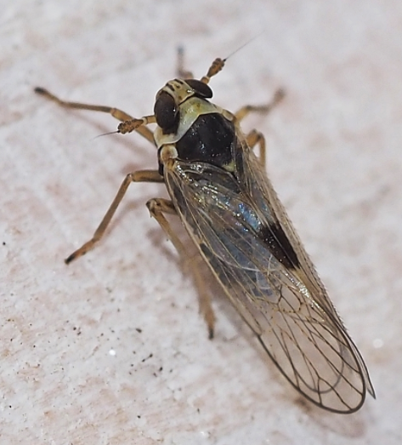
How to submit samples from the surveys for Laodelphax striatellus, the small brown planthopper (Delphacidae)
Julieta Brambila
Domestic Identifier (Retired)
Image used with permission
Laodelphax striatellus – Grain crochet | Insectarium (insektarium.net)

Slide 2
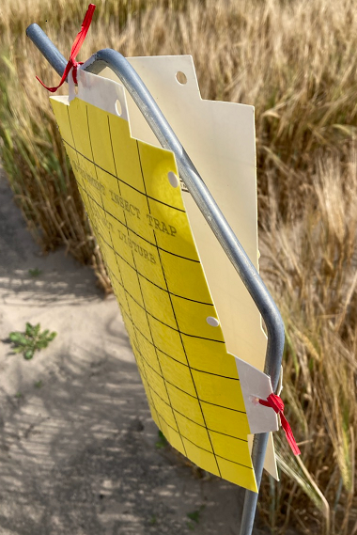
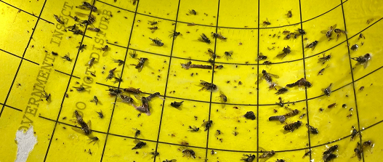
Sticky traps
Yellow cards are used for surveying for the delphacid planthopper Laodelphax striatellus. These cards are covered with glue.
Hoppers are caught on the sticky cards.
NOTE: Other arthropods, including spiders and insects, as well as seeds and soil are often found on these traps too.

Slide 3
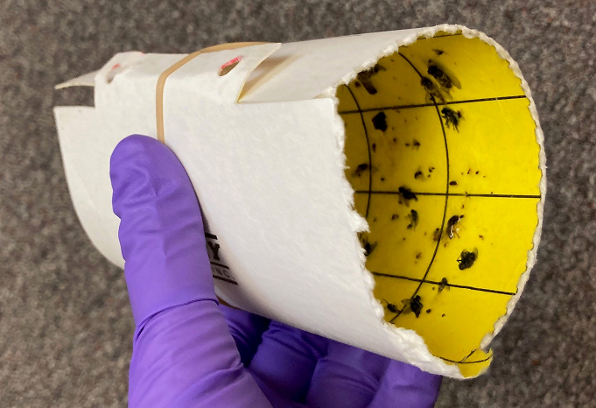
Sticky traps
Retrieve the cards from the field wearing disposable gloves.
Roll the sticky cards gently and hold the roll with a rubber band or tape and place each card in a plastic bag.
Freeze the labeled and bagged glue cards for at least two days to ensure all insects and spiders are dead.
NOTE: Keep the cards in the freezer, not the refrigerator, if storing them for a longer time; otherwise, mold keeps growing.

Slide 4
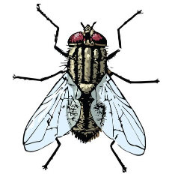
Screening the samples
Using a microscope or a magnifying lens and good lighting, search for insects that are most likely planthoppers.
When examining insects caught on the glue cards avoid manipulating them because they are easily damaged.
The target, the small brown planthopper, is in the Delphacidae family of planthoppers. Leafhoppers (Cicadellidae) and planthoppers (which include several insect families) are similar in general appearance. Consider all of them ‘suspects’. Any hopper is considered a suspect in this survey, and screening can stop at this point.
Submit samples (whole sticky yellow cards) soon after retrieving them from the field, but after freezing, when they include suspects.
NOTE: If only seeds, wasps, flies, beetles, or moths, etc., are found on the glue cards, don’t submit the samples.

Slide 5
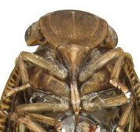
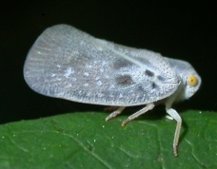
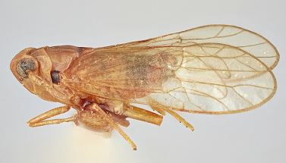
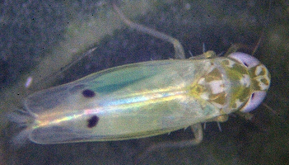
Screening the samples
Hoppers are small insects that, when alive and disturbed, tend to escape by a jump or a jump/fly combination, and that’s why they are called hoppers.
In the adult stage, hoppers have scale-less veined wings which are usually held like a roof over their body. The wings may be transparent, may have color patterns, may overlap, or may be very short.
Hoppers have sucking mouthparts instead of chewing mouthparts.

Slide 6
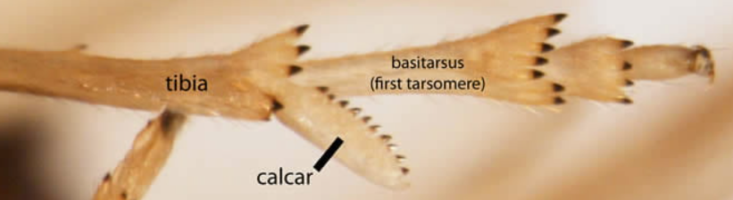
Screening the samples
The specimens may be in any position on the sticky cards making the diagnostic family characters hard to see, but sometimes the body parts are in good positions for microscope examination.
To distinguish planthoppers in the family Delphacidae, search for hoppers 2 to 4 mm in length (although the world range is 1.5 to 10 mm) and that have a moveable large spur at the apex of the hind tibiae:
  This diagnostic structure is called a “calcar”
  This spur is usually leaf-like in shape (flattened), but in some species it is spine-like, long and narrow
  Most calcars have a row of black teeth
Image used with permission
Basic delphacid features and biology | Planthoppers of North America (udel.edu)

Slide 7
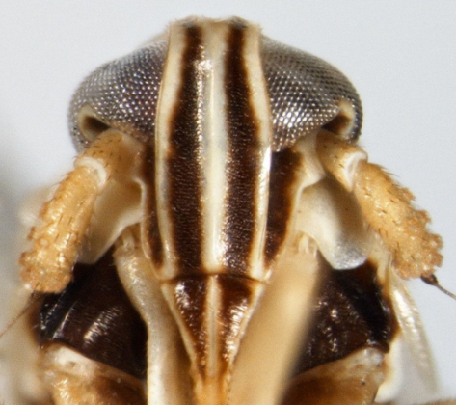
Identification of the target
To approximate identifying the target, Laodelphax striatellus, search for these external characters. However, many species share these characters and are not unique to the small brown hopper.
  Mesonotum black or brown and shiny
  Wings usually long and transparent (wings can be short)
  Forewings with a black or dark brown pterostigma (spot) on the inner margin
  Frons (front part of head) black on the areas between the white carinae (vertical ridges, or keels) – this is the most diagnostic external character
  Calcar leaf-shaped and densely dentate
  Genitalic dissection is required for actual species identification
Image used with permission
Genus Laodelphax Fennah, 1963 | Planthoppers of North America (udel.edu)

Slide 8
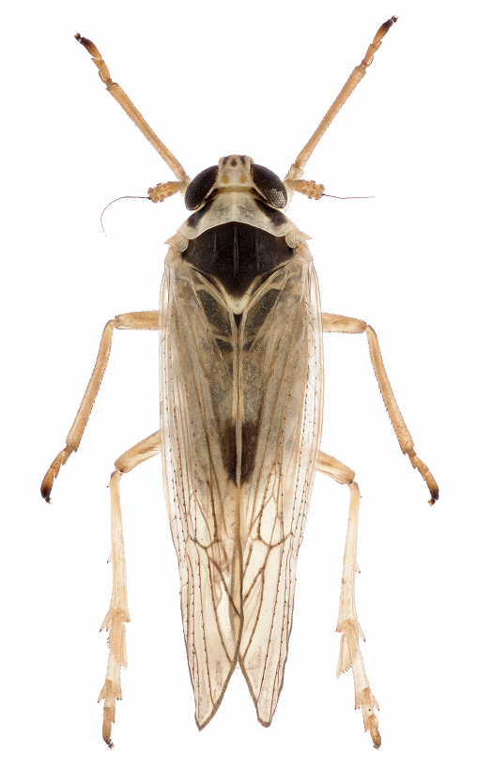
Identification of the target
  Mesonotum shiny and black or dark brown
  Pterostigma black or dark brown
  Calcar flattened and with a row spines
  Length 1.7 to 4.0 mm
Image of Laodelphax striatellus used with permission from the photographer Theodoor Heijerman, Netherlands

Slide 9
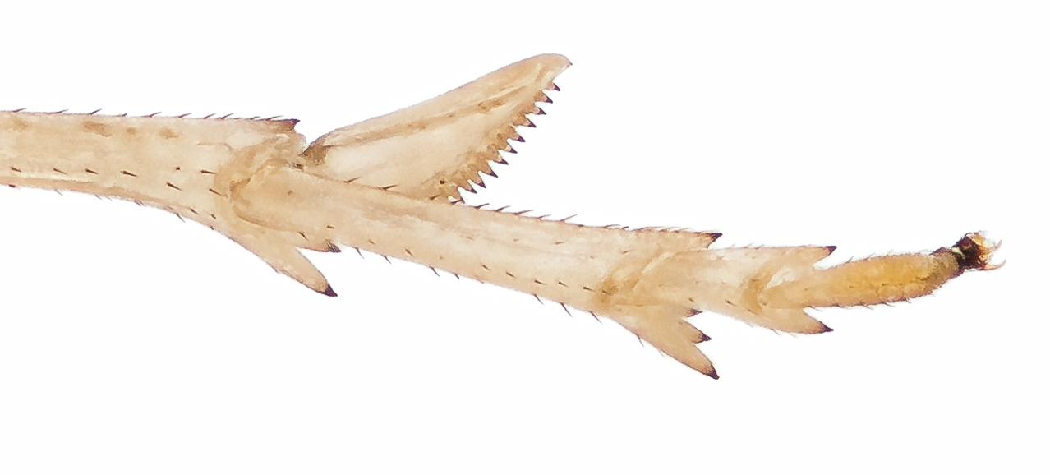
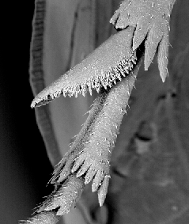
Identification of the target
Calcar
  leaf-shaped, flattened
  posterior margin with 20 to 24 small black-tipped teeth
Image used with permission from the photographer Theodoor Heijerman, Wageningen, Netherlands
Scanning electron micrograph of the calcar of Laodelphax striatellus used with permission from Jolanta Brożek, University of Silesia in Katowice, Poland

Slide 10
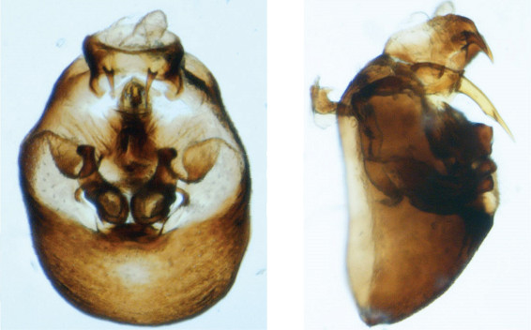
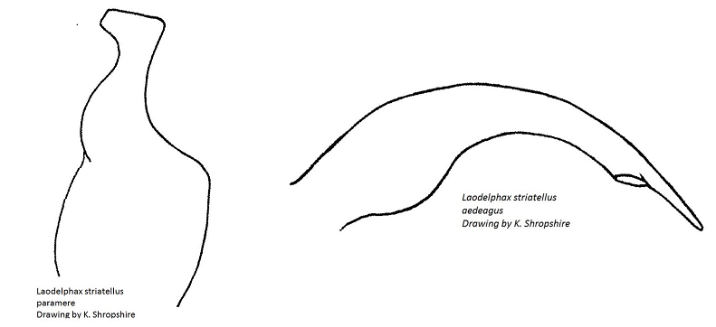
Identification of the target
For final identification of Laodelphax striatellus, genitalic dissection is necessary. The abdomens of male specimens are chemically treated and then carefully dissected to examine the shapes of the genital capsule, parameres, and aedeagus.
  Capsule
  Aedeagus
  Paramere
Images used with permission from Charles Bartlett, University of Delaware, located at this address:
Genus Laodelphax Fennah, 1963 | Planthoppers of North America (udel.edu)

Slide 11
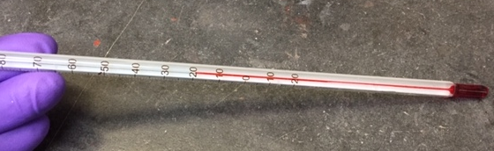
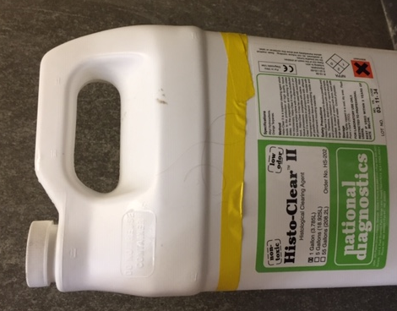
How to remove specimens from glue cards
To see some morphological structures to sort at the family level (Delphacidae), sometimes specimens caught in the yellow sticky traps need to be detached and cleaned. However, any hopper is a target suspect and the entire sticky card should be submitted to an Area Identifier. No one is encouraged to detach specimens.
Synthetic citrus oils are recommended to remove the glue because they are safe and because they leave specimens very clean (but brittle). Other alternatives are “Goo Gone” and Hemo-D.
Histo-Clear II can be used cold or hot (usually ~65°C), but for keeping DNA integrity viable for study the temperature should not go above 40°C.

Slide 12
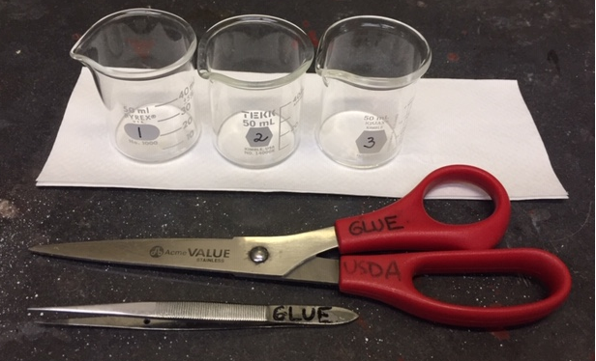
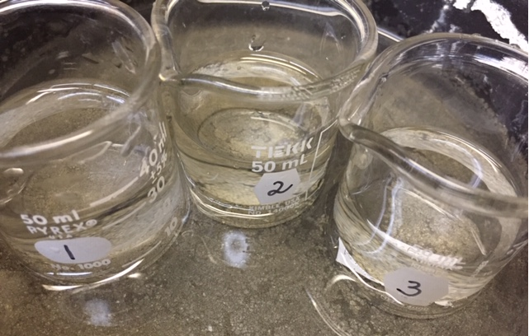
How to remove specimens from glue cards
Label three glass containers (1, 2, 3, or dirty, medium and clean).
Add some Histo-Clear-II, the glue solvent, to the three glasses.
Place all three glasses in a water bath at a steady temperature.

Slide 13
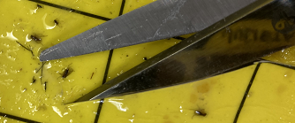
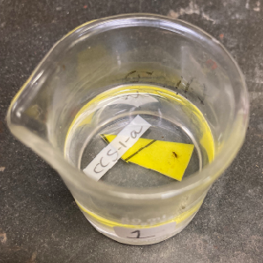
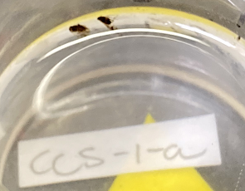
How to remove specimens from glue cards
Cut around the selected individual specimens with scissors dedicated to working only with glue.
Drop the cuttings into the first glass container, along with a paper label and wait until the specimens detach and float up, but they may be gently encouraged to detach after five minutes with forceps or a small brush.

Slide 14
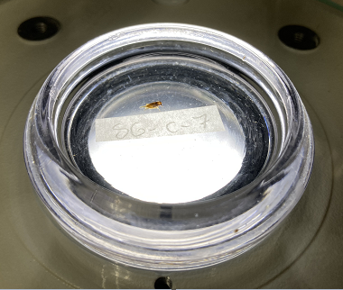
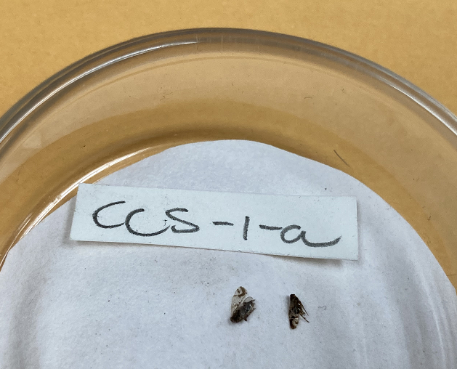
How to remove specimens from glue cards
Lift very carefully every specimen and transfer them to the second glass container and leave them for a few minutes before transferring them to the third container.
Remove the hoppers and label from the last glass container carefully and lay them on a glass dish with absorbent paper (filter paper or a piece of paper towel) to air dry. The specimens will be clean but crisp and dehydrated.
Transfer specimens and label to a dish with alcohol for examination by microscope.

Slide 15
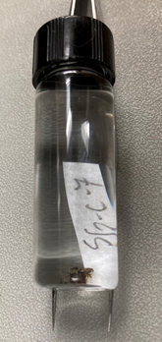
How to remove specimens from glue cards
Transfer specimens and label to a completely filled vial with ethanol for storage. If shipping, the small vial should be completely filled with ethanol to prevent breakage of the brittle specimens.
NOTES:
This cleaning technique cannot remove mold (hyphae) from specimens; it only removes the glue.
Presence of mold (hyphae) delays the cleaning of specimens because it attaches them to the cardboard.
Internally rotten specimens fall apart during the cleaning.
The third soaking can be skipped if the first two soaking fluids are very clean. It can be replaced by soaking specimens instead in 100% isopropyl or 100% ethanol.

Slide 16
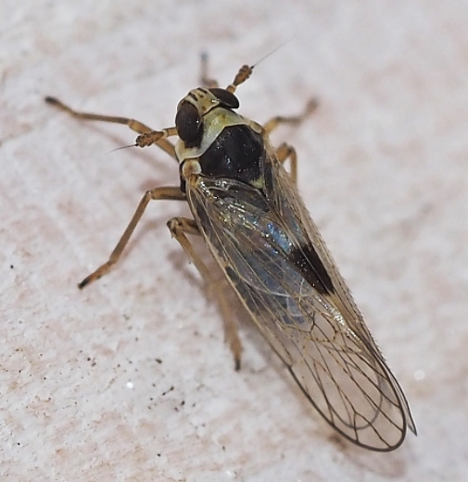
Final identification and verification
After cleaning and dissection by an Area Identifier, positive or likely positive specimens are submitted to the National Identifiers for verification, or for possible final identification if not the target species.
Some of the specimens may then be transferred to a DNA lab for confirmation and to obtain additional data from the extracted DNA.
Sticky cards should never be shipped to National Identifiers; they are sent to Area Identifiers for processing and screening.
Date of latest edition: July 30, 2025

