Slide 1

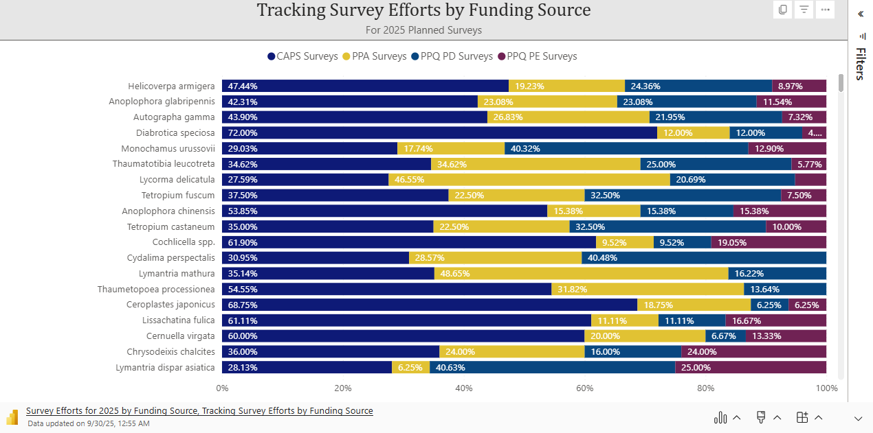
Microsoft Power BI
Notes:
Return to your internet browser or copy this link into your browser:
https://pages.store.office.com/addinsinstallpage.aspx?rs=en-US&assetid=WA200003233&isWac=True&ui=en-US&ad=US

